Slide 1
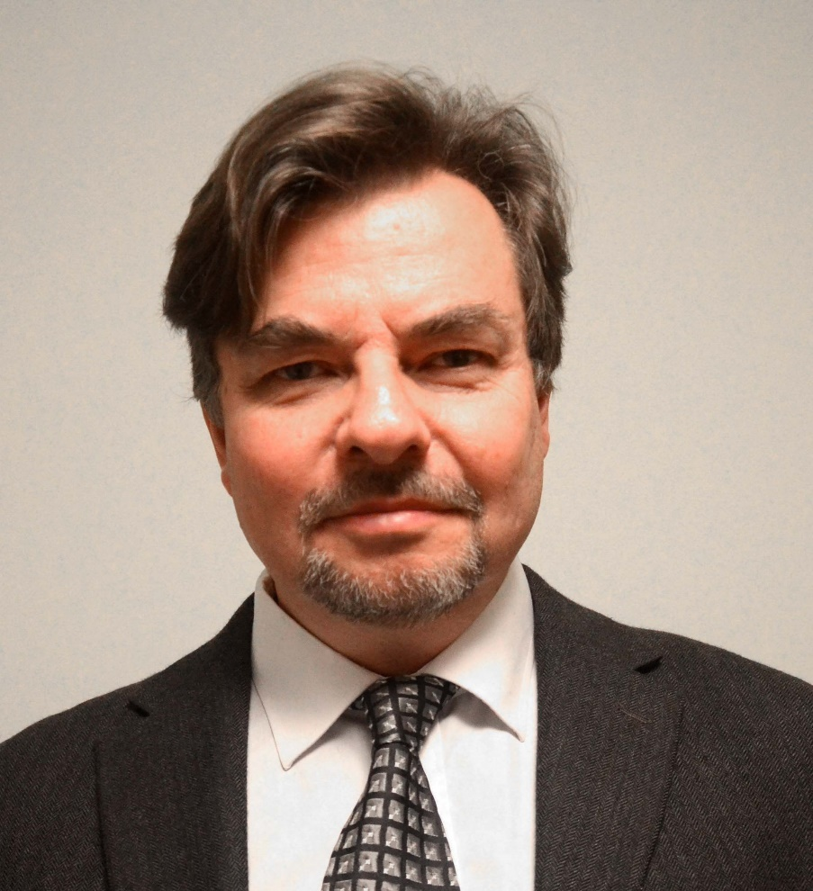
Derivation of the principles of optimal expansion of bioenergy based on forest resources in combination with fossil fuels, CCS and combined heat and power production with consideration of economics and global warming
Lecture by Professor Dr. Peter Lohmander, Swedish University of Agricultural Sciences, SLU, Sweden, http://www.Lohmander.com
Peter@Lohmander.com
Operations Research for the Future Forest Management,
University of Guilan, Iran, March 8-12, 2014
Saturday March 8, 10.00-12.00

Slide 2
Derivation of the principles of optimal expansion of bioenergy based on forest resources in combination with fossil fuels, CCS and combined heat and power production with consideration of economics and global warming
In the production of district heating, electricity and many other energy outputs, we may use fossil fuels and renewable inputs, in different combinations. The optimal input mix is a function of technological options, prices of different inputs and costs of alternative levels of environmental consequences. Even with presently existing technology in combined heat and power plants, it is usually possible to reduce the amount of fossil fuels such as coal and strongly increase the level of forest based energy inputs. In large parts of the world, such as Russian Federation, forest stocks are close to dynamic equilibria, in the sense that the net growth (and net carbon uptake) is close to zero. If these forests will be partly harvested, the net growth can increase and a larger part of the CO2 emitted from the CHP plants will be captured by the forests. Furthermore, with CCS, Carbon Capture and Storage, the rest of the emitted CO2 can be permanently stored. The lecture incudes the definition of a general optimization model that can handle these problems in a consistent way. The model is used to derive general principles of optimal decisions in this problem area via comparative statics analysis with general functions.
The lecture also includes case studies from different parts of the world. In several countries, it is presently profitable to replace coal by forest inputs in CHP plants. In Norway and UK, CCS has been applied and a commercially attractive option during many years and the physical potential is large. Carbon taxes on fossil fuels explain this development. With increasing carbon taxes in all parts of the world, such developments could be expected everywhere. With increasing levels of forest inputs in combination with CCS, it is possible to reduce the CO2 in the atmosphere and the global warming problem can be managed. Furthermore, international trade in forest based energy can improve international relations, regional development and environmental conditions.
Professor Dr. Peter Lohmander, Swedish University of Agricultural Sciences, SLU, Sweden, http://www.Lohmander.com Peter@Lohmander.com

Slide 3
The Lohmander Energy, Forest, Fossil Fuels, CCS and Climate System Optimization Model

Slide 4
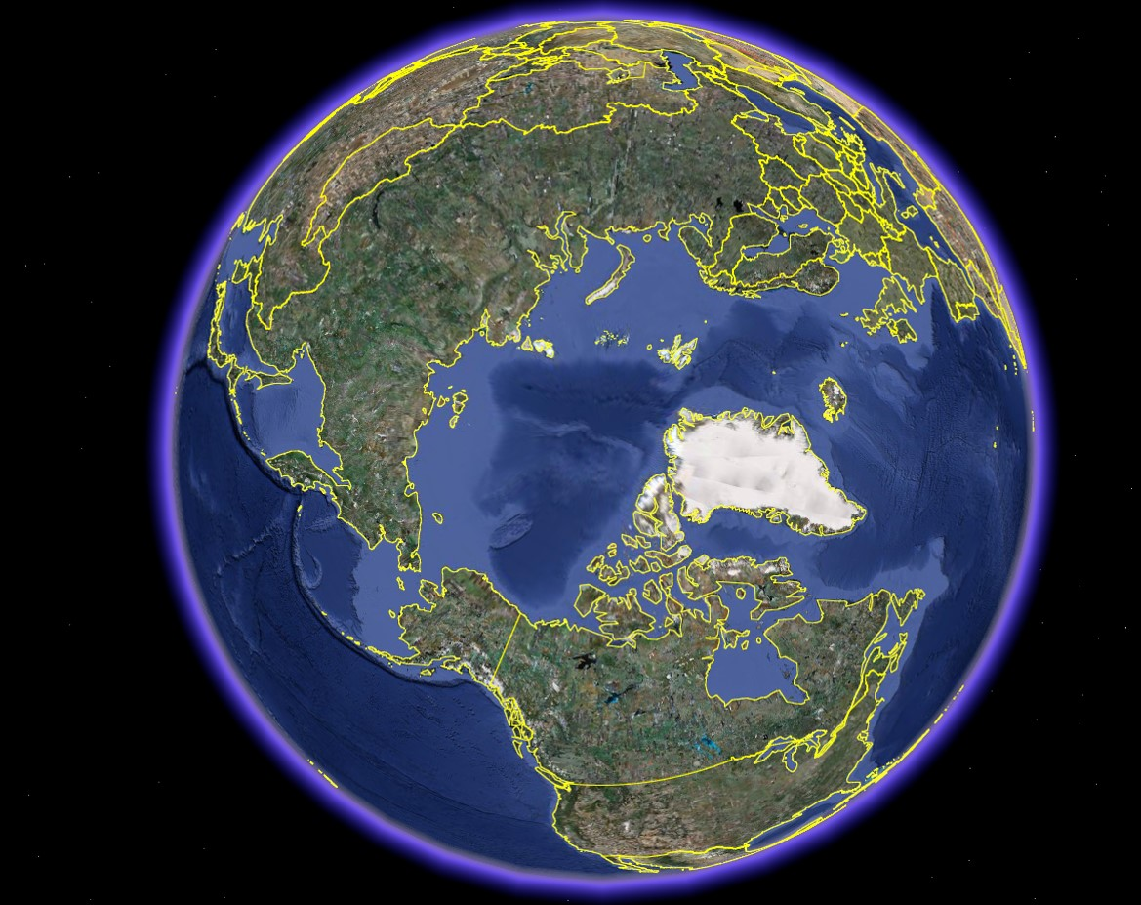

Slide 6
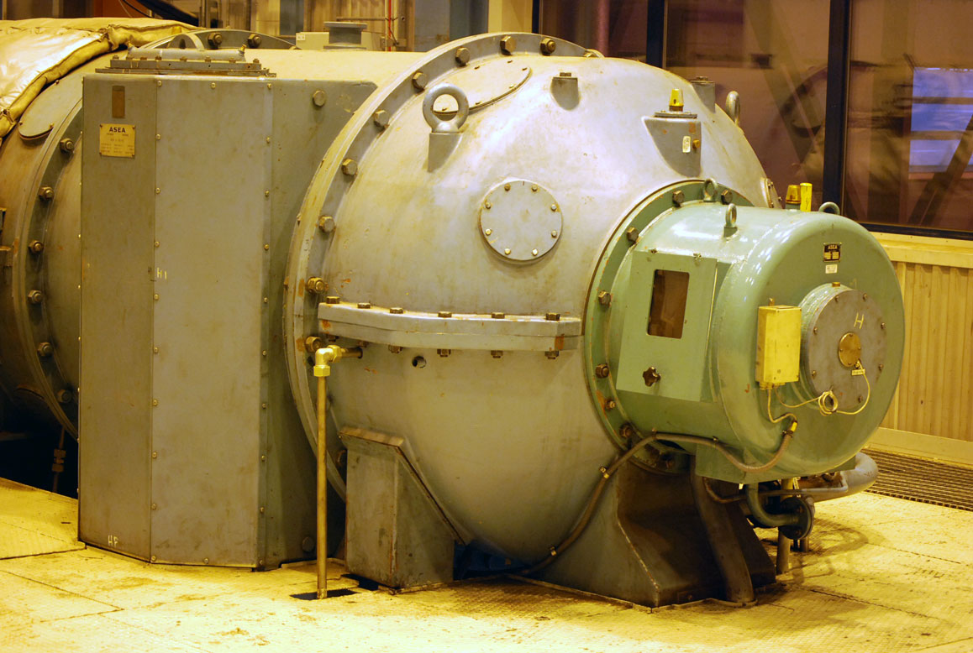

Slide 7
The Lohmander Energy, Forest, Fossil Fuels, CCS and Climate System Optimization Model

Slide 8
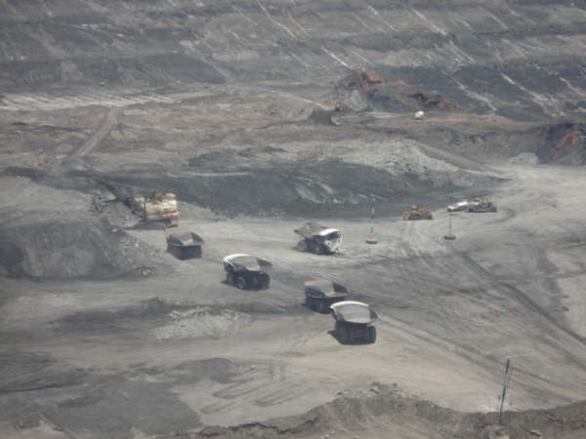

Slide 9
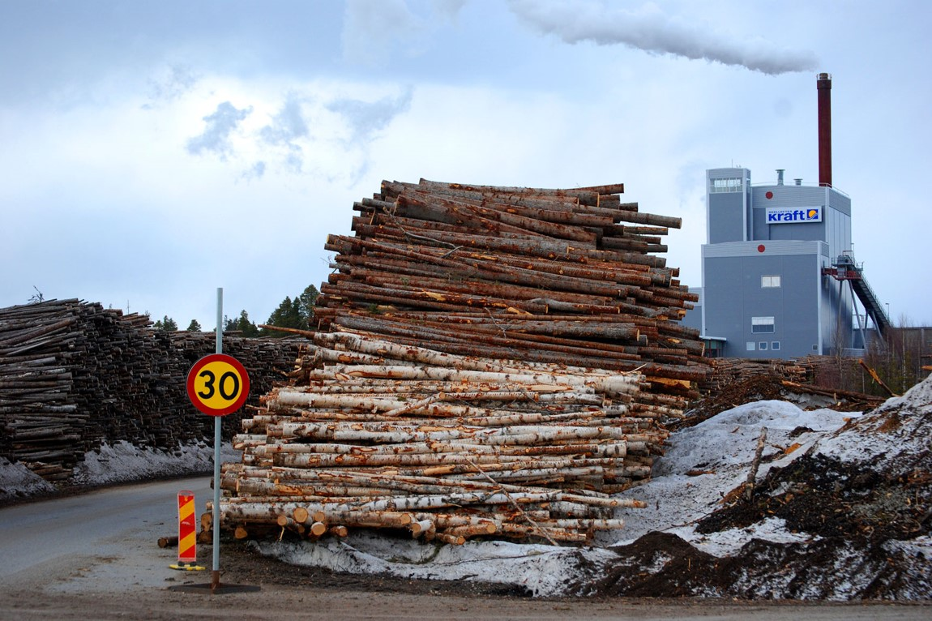

Slide 10
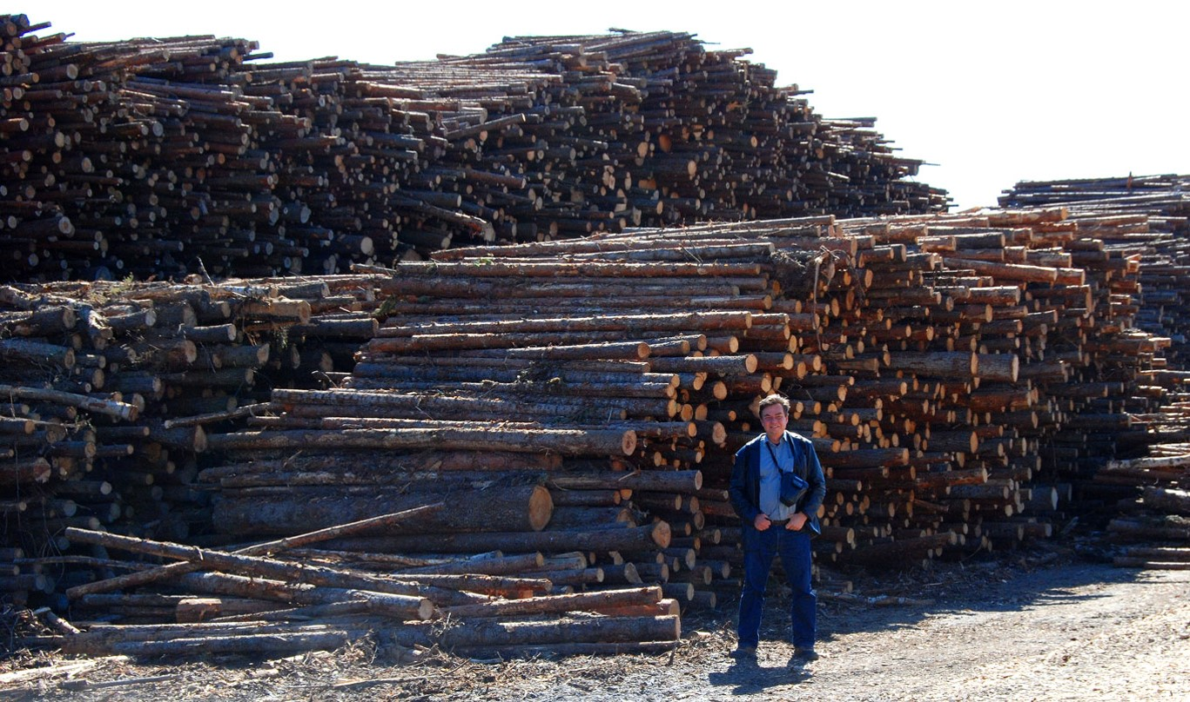

Slide 11
Fuel mix 1991 - 2006
Oil (BLACK)
Coal (DARK GREY)
Ruber (LIGHT GREY)
Forest chips
(ORANGE)
Waste wood
(PINK)
Waste (RED)

Slide 12
The Lohmander Energy, Forest, Fossil Fuels, CCS and Climate System Optimization Model

Slide 13
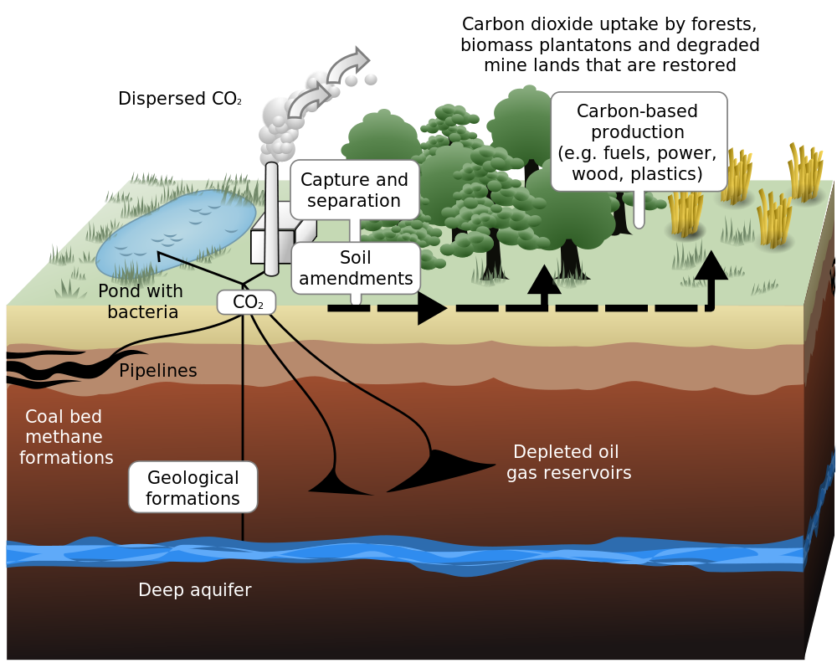

Slide 14
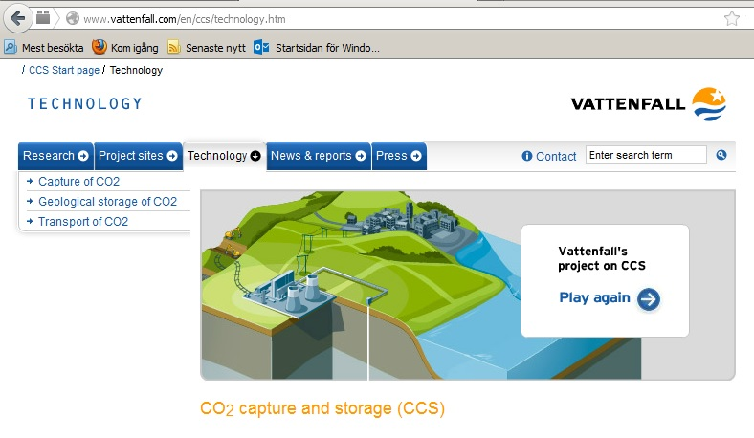

Slide 15
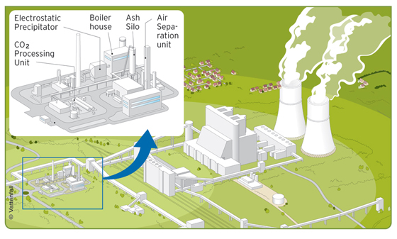

Slide 16
$$Max Z = −k_{π}\left(C_{F}\left(F\right)+ C_{h}\left(h\right)+ C_{S}\left(S\right)\right)−k_{G}\left(\left(1+α_{F}\right)F+ α_{h}h− α_{S}S\right)$$ s.t. $F+h ≥M$

Slide 17
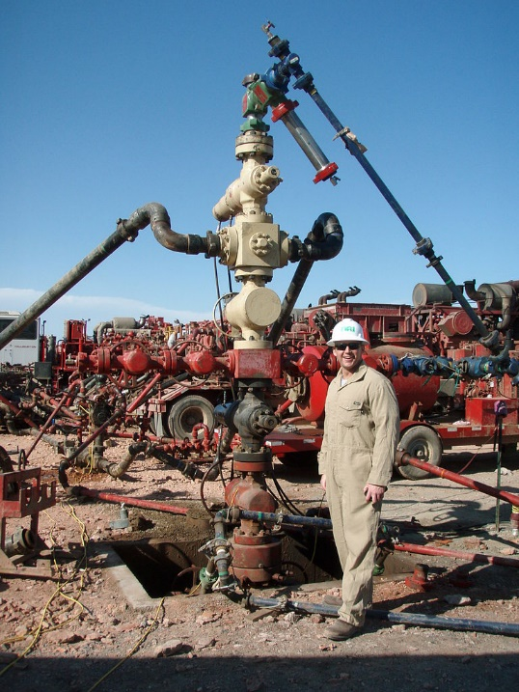
The model does not include absolute constraints
on the availability of fossil fuels.
Motive:
Such constraints are assumed not to be binding
in the optimal total solution.
Hydraulic fracturing also called fracturing
and fracking has recently shown that
there are very large quantitites of fossil
fuels available in the world.

Slide 18
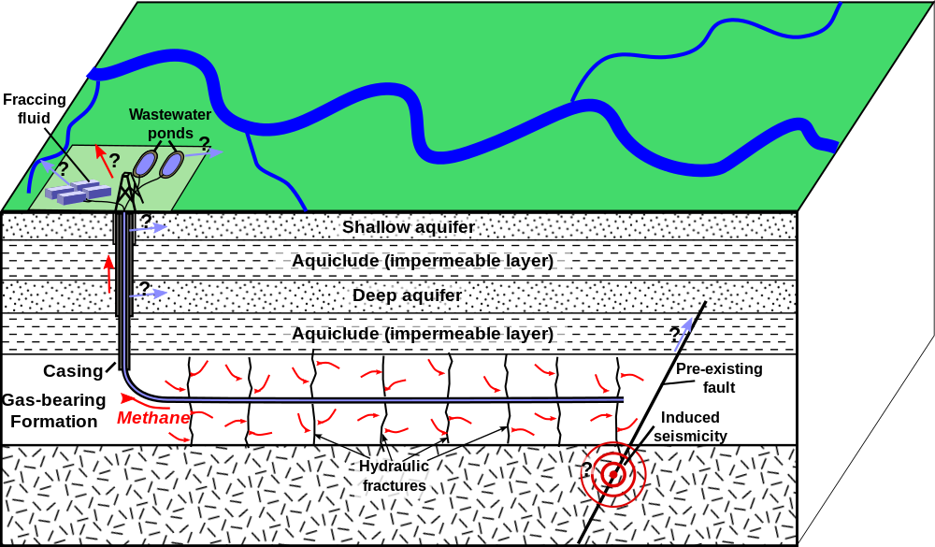

Slide 19
Analysis:
$$Max Z= −k_{π}\left(C_{F}\left(F\right)+ C_{h}\left(h\right)+ C_{S}\left(S\right)\right)−k_{G}\left(\left(1+α_{F}\right)F+ α_{h}h− α_{S}S\right)$$
s.t.
$$F+h ≥M$$

Slide 20
Parameter assumptions:
$$k_{π}>0$$
$$k_{G}>0$$
$$α_{F}>0$$
$$α_{h}>0$$
$${0<α}_{S}<1$$
$$α_{h}<1+α_{F}$$

Slide 21
This constraint is not binding:
$$S<F+h$$

Slide 22
Cost function assumptions:
$$C_{F}^{′}>0$$
$$C_{F}^{′′}>0$$
$$C_{h}^{′}>0$$
$$C_{h}^{′′}>0$$
$$C_{S}^{′}>0$$
$$C_{S}^{′′}>0$$

Slide 24
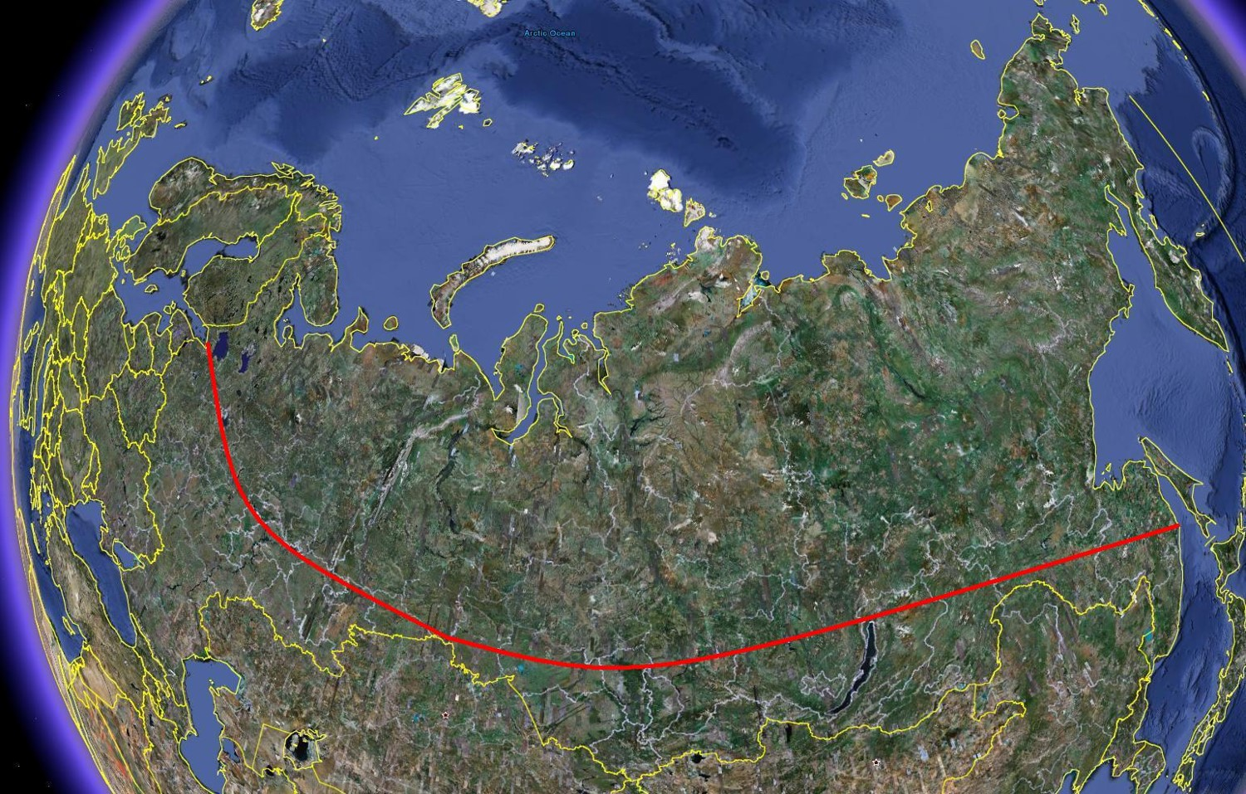

Slide 25
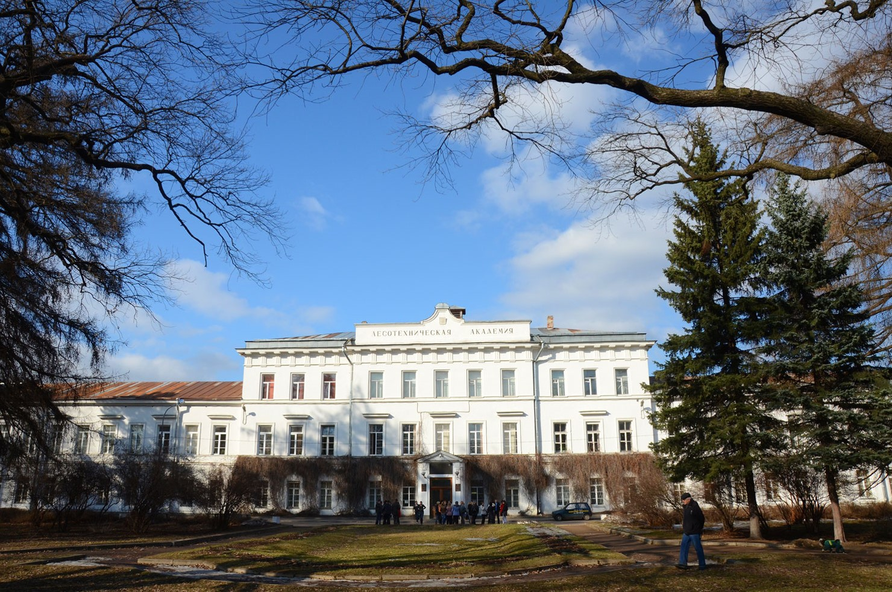

Slide 26
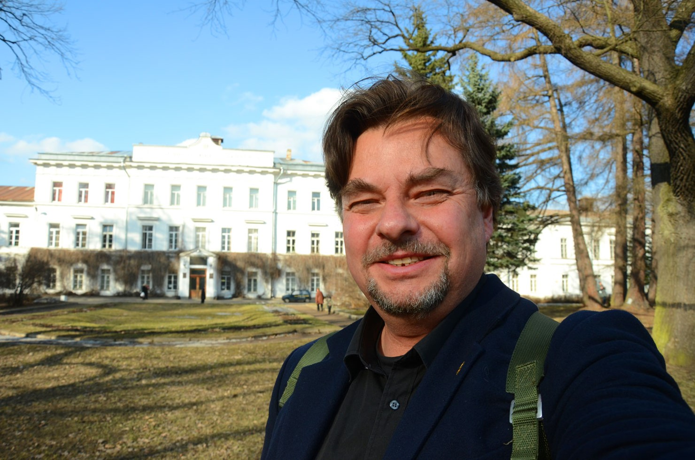

Slide 28
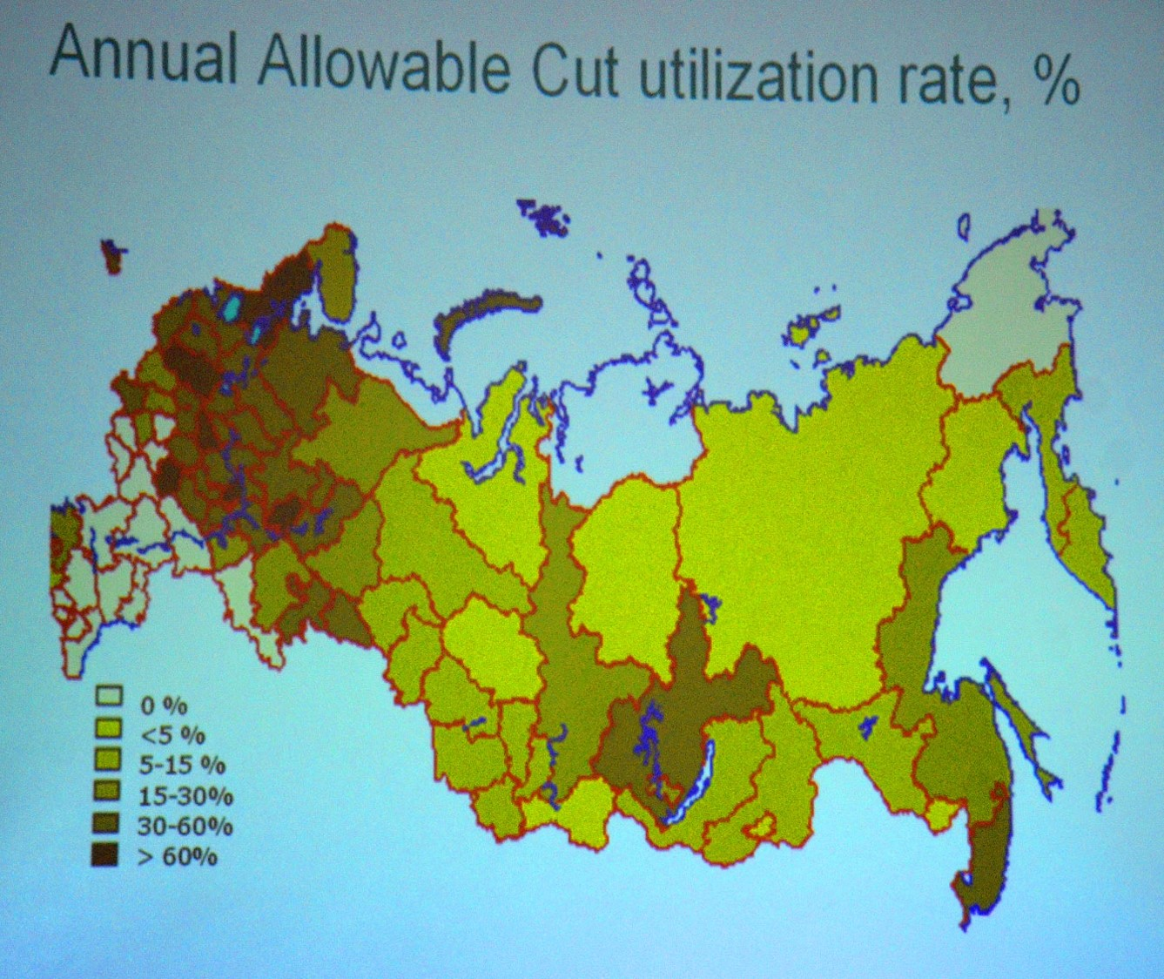

Slide 29
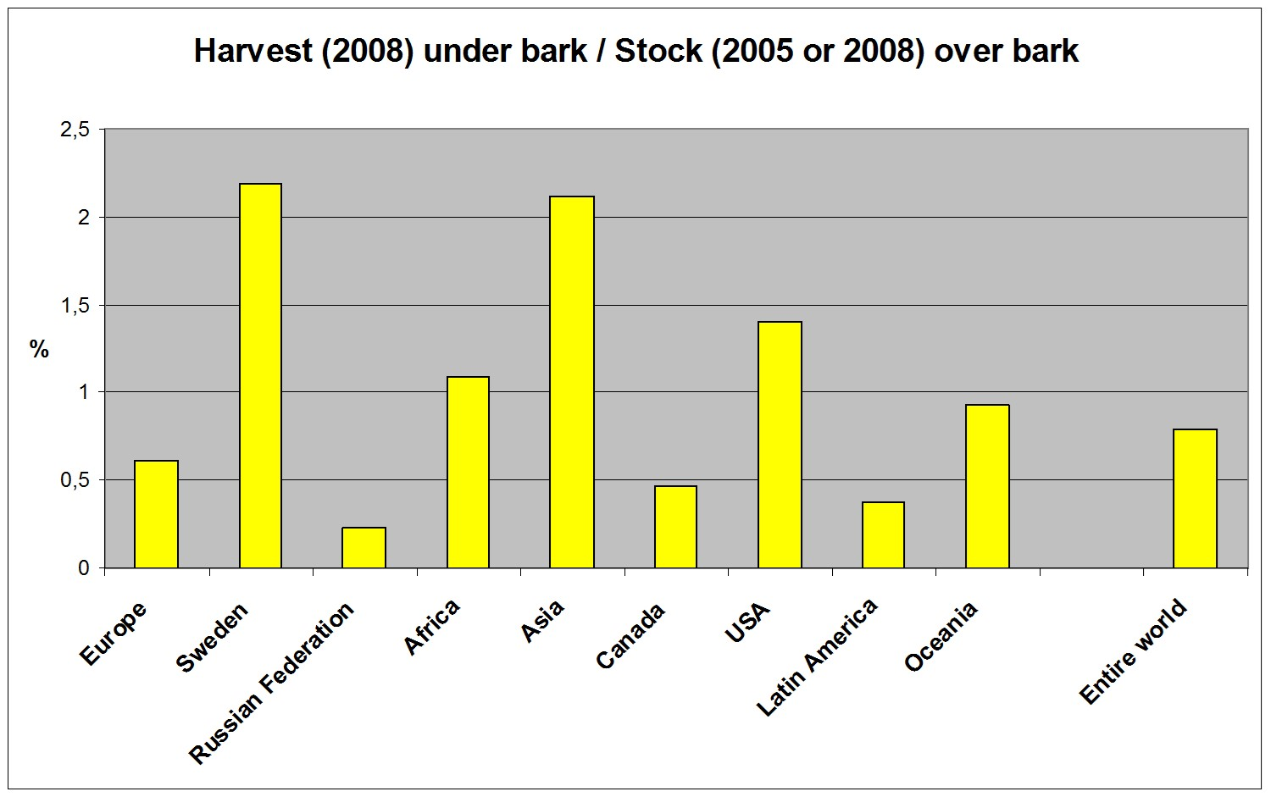

Slide 30
The classical dynamic natural resource model:
$$\frac{dx}{dt}=sx\left(1−\frac{x}{K}\right)$$
$$x(t)=\frac{K}{1+Ce^{−st}}$$
$$\lim_{\begin{aligned}t→∞ \\ (s>0)\end{aligned}}{x(t)}=K$$

Slide 31
$$\frac{dx}{dt}=\frac{KsCe^{−st}}{{\left(1+Ce^{−st}\right)}^{2}}$$
$$\lim_{\begin{aligned}t→∞ \\ (s>0)\end{aligned}}\left(\frac{dx}{dt}\right)=0$$
Such forests do not change the carbon levels of the atmosphere.

Slide 32
The Lagrange function, L, $is:$
$$= −k_{π}\left(C_{F}\left(F\right)+ C_{h}\left(h\right)+ C_{S}\left(S\right)\right) −k_{G}\left(\left(1+α_{F}\right)F+ α_{h}h−α_{S}S\right)$$
$$+λ\left(F+h−M\right)$$

Slide 33
The Kuhn Tucker conditions are:
$$F≥0;h≥0;S≥0$$
$$\frac{dL}{dF}≤0; \frac{dL}{dh}≤0;\frac{dL}{dS}≤0$$
$$F\frac{dL}{dF}=0;h\frac{dL}{dh}=0;S\frac{dL}{dS}=0$$
$$λ≥0$$
$$\frac{dL}{dλ}≥0$$
$$λ\frac{dL}{dλ}=0$$

Slide 34
Here, we have four of the constraints:
$$\begin{matrix}\frac{dL}{dλ}=F+h−M ≥0 \\ \frac{dL}{dF}= −k_{π}C_{F}^{′}\left(F\right)−k_{G}\left(1+α_{F}\right)+λ ≤0 \\ \begin{matrix}\frac{dL}{dh}=−k_{π}C_{h}^{′}\left(h\right)−k_{G}α_{h}+λ ≤0 \\ \frac{dL}{dS}= −k_{π}C_{S}^{′}\left(S\right)+k_{G}α_{S} ≤0 \end{matrix}\end{matrix}$$

Slide 35
Assumption:
The optimal solution is an interior solution.
$$F>0;h>0;S>0;λ>0$$
As a consequence, we know that:
$$\frac{dL}{dλ}=0; \frac{dL}{dF}=0; \frac{dL}{dh}=0;\frac{dL}{dS}=0$$

Slide 36
This means that the following equation system should be solved:
$$\begin{matrix}\frac{dL}{dλ}=F+h−M =0 \\ \frac{dL}{dF}= −k_{π}C_{F}^{′}\left(F\right)−k_{G}\left(1+α_{F}\right)+λ =0 \\ \begin{matrix}\frac{dL}{dh}=−k_{π}C_{h}^{′}\left(h\right)−k_{G}α_{h}+λ =0 \\ \frac{dL}{dS}= −k_{π}C_{S}^{′}\left(S\right)+k_{G}α_{S} =0 \end{matrix}\end{matrix}$$

Slide 37
The system with four equations and four endogenous variables is partly separable.
It may be split into one system with tree equations and three endogenous variables $(F, h and λ)$ and a separate equation with only one endogenous variable, $S$ .
Stars denote optimal values.

Slide 38
First, we investigate $S^{∗}$ .
$$\frac{dL}{dS}= −k_{π}C_{S}^{′}\left(S\right)+k_{G}α_{S} ≤0$$
$$\left(\frac{dL}{dS}=0 \right)⇒\left(C_{S}^{′}\left(S\right)=\frac{k_{G}α_{S}}{k_{π}}\right)$$

Slide 39
We differentiate the first order optimum condition:
$${{−k}_{π}C}_{S}^{′′}\left(S\right)dS^{∗}−C_{S}^{′}\left(S\right)dk_{π}+α_{S}dk_{G}+k_{G}dα_{S}=0$$
$$dS^{∗}=\frac{1}{{k_{π}C}_{S}^{′′}\left(S\right)}\left(−C_{S}^{′}\left(S\right)dk_{π}+α_{S}dk_{G}+k_{G}dα_{S}\right)$$

Slide 40
The derivatives of $S^{∗}$ with respect to the parameters are the following:
$$\frac{dS^{∗}}{dk_{π}}=\frac{−C_{S}^{′}\left(S\right)}{{k_{π}C}_{S}^{′′}\left(S\right)}<0$$
$$\frac{dS^{∗}}{dk_{G}}=\frac{α_{S}}{k_{π}C_{S}^{′′}\left(S\right)}>0$$
$$\frac{dS^{∗}}{dα_{S}}=\frac{k_{G}}{k_{π}C_{S}^{′′}\left(S\right)}>0$$

Slide 41
$$Max Z = −k_{π}\left(C_{F}\left(F\right)+ C_{h}\left(h\right)+ C_{S}\left(S\right)\right)−k_{G}\left(\left(1+α_{F}\right)F+ α_{h}h− α_{S}S\right)$$ s.t. $F+h ≥M$
$$\frac{dS^{∗}}{dk_{π}}=\frac{−C_{S}^{′}\left(S\right)}{{k_{π}C}_{S}^{′′}\left(S\right)}<0$$
$$\frac{dS^{∗}}{dk_{G}}=\frac{α_{S}}{k_{π}C_{S}^{′′}\left(S\right)}>0$$
$$\frac{dS^{∗}}{dα_{S}}=\frac{k_{G}}{k_{π}C_{S}^{′′}\left(S\right)}>0$$

Slide 42
Next, we investigate $F^{∗}, h^{∗}and λ^{∗}$ .
The first order optimum conditions are found from this three dimensional equation system:
$$\begin{matrix}\frac{dL}{dλ}= F+h−M =0 \\ \frac{dL}{dF}= −k_{π}C_{F}^{′}\left(F\right)−k_{G}\left(1+α_{F}\right)+λ =0 \\ \begin{matrix}\frac{dL}{dh}=−k_{π}C_{h}^{′}\left(h\right)−k_{G}α_{h}+λ =0 \end{matrix}\end{matrix}$$

Slide 43
We differentiate the equations:
$$\left[\begin{matrix}\begin{matrix}1 & 1 \\ −k_{π}C_{F}^{′′} & 0\end{matrix} & \begin{matrix}0 \\ 1\end{matrix} \\ \begin{matrix} 0 & −k_{π}C_{h}^{′′}\end{matrix} & \begin{matrix}1\end{matrix}\end{matrix}\right]\left[\begin{matrix}dF^{∗} \\ dh^{∗} \\ \begin{matrix}dλ^{∗}\end{matrix}\end{matrix}\right]=\left[\begin{matrix}dM \\ C_{F}^{′}dk_{π}+\left(1+α_{F}\right)dk_{G}+k_{G}dα_{F} \\ \begin{matrix}C_{h}^{′}dk_{π}+α_{h}dk_{G}+k_{G}dα_{h}\end{matrix}\end{matrix}\right]$$

Slide 44
When we apply Cramer’s rule, we need to know $\left|\begin{matrix}D\end{matrix}\right|$.
$$\left|\begin{matrix}D\end{matrix}\right|=\left|\begin{matrix}\begin{matrix}\begin{matrix}1 & 1 \\ −k_{π}C_{F}^{′′} & 0\end{matrix} & \begin{matrix}0 \\ 1\end{matrix} \\ \begin{matrix} 0 & −k_{π}C_{h}^{′′}\end{matrix} & \begin{matrix}1\end{matrix}\end{matrix}\end{matrix}\right|$$
$$\left|\begin{matrix}D\end{matrix}\right|=k_{π}\left(C_{h}^{′′}+C_{F}^{′′}\right)>0$$

Slide 45
The derivatives of $F^{∗}, h^{∗}and λ^{∗}$ with respect to M are determined via Cramer’s rule:
$$\frac{dF^{∗}}{dM}=\frac{\left|\begin{matrix}\begin{matrix}\begin{matrix}1 & 1 \\ 0 & 0\end{matrix} & \begin{matrix}0 \\ 1\end{matrix} \\ \begin{matrix} 0 & −k_{π}C_{h}^{′′}\end{matrix} & \begin{matrix}1\end{matrix}\end{matrix}\end{matrix}\right|}{\left|\begin{matrix}D\end{matrix}\right|}$$
$$\frac{dF^{∗}}{dM}=\frac{C_{h}^{′′}}{C_{h}^{′′}+C_{F}^{′′}}>0$$

Slide 46
$$\frac{dh^{∗}}{dM}=\frac{\left|\begin{matrix}\begin{matrix}\begin{matrix}1 & 1 \\ −k_{π}C_{F}^{′′} & 0\end{matrix} & \begin{matrix}0 \\ 1\end{matrix} \\ \begin{matrix} 0 & 0\end{matrix} & \begin{matrix}1\end{matrix}\end{matrix}\end{matrix}\right|}{\left|\begin{matrix}D\end{matrix}\right|}$$
$$\frac{dh^{∗}}{dM}=\frac{C_{F}^{′′}}{C_{h}^{′′}+C_{F}^{′′}}>0$$

Slide 47
$$\frac{dλ^{∗}}{dM}=\frac{\left|\begin{matrix}\begin{matrix}\begin{matrix}1 & 1 \\ −k_{π}C_{F}^{′′} & 0\end{matrix} & \begin{matrix}1 \\ 0\end{matrix} \\ \begin{matrix} 0 & −k_{π}C_{h}^{′′}\end{matrix} & \begin{matrix}0\end{matrix}\end{matrix}\end{matrix}\right|}{\left|\begin{matrix}D\end{matrix}\right|}$$
$$\frac{dλ^{∗}}{dM}=\frac{k_{π}C_{F}^{′′}C_{h}^{′′}}{C_{h}^{′′}+C_{F}^{′′}}>0$$

Slide 48
$$Max Z = −k_{π}\left(C_{F}\left(F\right)+ C_{h}\left(h\right)+ C_{S}\left(S\right)\right)−k_{G}\left(\left(1+α_{F}\right)F+ α_{h}h− α_{S}S\right)$$ s.t. $F+h ≥M$
$$\frac{dF^{∗}}{dM}=\frac{C_{h}^{′′}}{C_{h}^{′′}+C_{F}^{′′}}>0$$
$$\frac{dh^{∗}}{dM}=\frac{C_{F}^{′′}}{C_{h}^{′′}+C_{F}^{′′}}>0$$
$$\frac{dλ^{∗}}{dM}=\frac{k_{π}C_{F}^{′′}C_{h}^{′′}}{C_{h}^{′′}+C_{F}^{′′}}>0$$

Slide 49
The derivatives of $F^{∗}, h^{∗}and λ^{∗}$ with respect to $k_{G}$ are:
$$\frac{dF^{∗}}{dk_{G}}=\frac{\left|\begin{matrix}\begin{matrix}\begin{matrix}0 & 1 \\ (1+α_{F}) & 0\end{matrix} & \begin{matrix}0 \\ 1\end{matrix} \\ \begin{matrix} α_{h} & −k_{π}C_{h}^{′′}\end{matrix} & \begin{matrix}1\end{matrix}\end{matrix}\end{matrix}\right|}{\left|\begin{matrix}D\end{matrix}\right|}$$
$$\frac{dF^{∗}}{dk_{G}}=\frac{α_{h}−(1+α_{F})}{k_{π}(C_{h}^{′′}+C_{F}^{′′})}<0$$

Slide 50
$$\frac{dh^{∗}}{dk_{G}}=\frac{\left|\begin{matrix}\begin{matrix}\begin{matrix}1 & 0 \\ −k_{π}C_{F}^{′′} & (1+α_{F})\end{matrix} & \begin{matrix}0 \\ 1\end{matrix} \\ \begin{matrix} 0 & α_{h}\end{matrix} & \begin{matrix}1\end{matrix}\end{matrix}\end{matrix}\right|}{\left|\begin{matrix}D\end{matrix}\right|}$$
$$\frac{dh^{∗}}{dk_{G}}=\frac{\left(1+α_{F}\right)−α_{h} }{k_{π}(C_{h}^{′′}+C_{F}^{′′})}>0$$

Slide 51
$$\frac{dλ^{∗}}{dk_{G}}=\frac{\left|\begin{matrix}\begin{matrix}\begin{matrix}1 & 1 \\ −k_{π}C_{F}^{′′} & 0\end{matrix} & \begin{matrix}0 \\ \left(1+α_{F}\right)\end{matrix} \\ \begin{matrix} 0 & −k_{π}C_{h}^{′′}\end{matrix} & \begin{matrix}α_{h}\end{matrix}\end{matrix}\end{matrix}\right|}{\left|\begin{matrix}D\end{matrix}\right|}$$
$$\frac{dλ^{∗}}{dk_{G}}=\frac{C_{h}^{′′}{\left(1+α_{F}\right)+C}_{F}^{′′}\begin{matrix}α_{h}\end{matrix}}{C_{h}^{′′}+C_{F}^{′′}}>0$$

Slide 52
$$Max Z = −k_{π}\left(C_{F}\left(F\right)+ C_{h}\left(h\right)+ C_{S}\left(S\right)\right)−k_{G}\left(\left(1+α_{F}\right)F+ α_{h}h− α_{S}S\right)$$ s.t. $F+h ≥M$
$$\frac{dF^{∗}}{dk_{G}}=\frac{α_{h}−(1+α_{F})}{k_{π}(C_{h}^{′′}+C_{F}^{′′})}<0$$
$$\frac{dh^{∗}}{dk_{G}}=\frac{\left(1+α_{F}\right)−α_{h} }{k_{π}(C_{h}^{′′}+C_{F}^{′′})}>0$$
$$\frac{dλ^{∗}}{dk_{G}}=\frac{C_{h}^{′′}{\left(1+α_{F}\right)+C}_{F}^{′′}\begin{matrix}α_{h}\end{matrix}}{C_{h}^{′′}+C_{F}^{′′}}>0$$

Slide 53
The derivatives of $F^{∗}, h^{∗}and λ^{∗}$ with respect to $k_{π}$ :
$$\frac{dF^{∗}}{dk_{π}}=\frac{\left|\begin{matrix}\begin{matrix}\begin{matrix}0 & 1 \\ C_{F}^{′} & 0\end{matrix} & \begin{matrix}0 \\ 1\end{matrix} \\ \begin{matrix} C_{h}^{′} & −k_{π}C_{h}^{′′}\end{matrix} & \begin{matrix}1\end{matrix}\end{matrix}\end{matrix}\right|}{\left|\begin{matrix}D\end{matrix}\right|}$$
$$\frac{dF^{∗}}{dk_{π}}=\frac{C_{h}^{′}−C_{F}^{′}}{k_{π}(C_{h}^{′′}+C_{F}^{′′})}\left\{\begin{matrix}> \\ = \\ <\end{matrix}\right\}0$$

Slide 54
Observation:
The sign of $\frac{dF^{∗}}{dk_{π}}$ is expected to change over time, since fossil fuels in the long run become more scarce and more costly to extract.
In most cases, it is assumed that $\frac{dF^{∗}}{dk_{π}}>0$ in the year 2014. At some future point in time, $\frac{dF^{∗}}{dk_{π}}=0$ and at later points in time $\frac{dF^{∗}}{dk_{π}}<0$ .

Slide 55
$$\frac{dh^{∗}}{dk_{π}}=\frac{\left|\begin{matrix}\begin{matrix}\begin{matrix}1 & 0 \\ −k_{π}C_{F}^{′′} & C_{F}^{′}\end{matrix} & \begin{matrix}0 \\ 1\end{matrix} \\ \begin{matrix} 0 & \end{matrix}C_{h}^{′} & \begin{matrix}1\end{matrix}\end{matrix}\end{matrix}\right|}{\left|\begin{matrix}D\end{matrix}\right|}$$
$$\frac{dh^{∗}}{dk_{π}}=\frac{ C_{F}^{′}−C_{h}^{′} }{k_{π}(C_{h}^{′′}+C_{F}^{′′})}\left\{\begin{matrix}> \\ = \\ <\end{matrix}\right\}0$$

Slide 56
Observation:
The sign of $\frac{dh^{∗}}{dk_{π}}$ is expected to change over time, since fossil fuels in the long run become more scarce and more costly to extract.
In most cases, it is assumed that $\frac{dh^{∗}}{dk_{π}}<0$ in the year 2014. At some future point in time, $\frac{dh^{∗}}{dk_{π}}=0$ and at later points in time $\frac{dh^{∗}}{dk_{π}}>0$ .

Slide 57
$$\frac{dλ^{∗}}{dk_{π}}=\frac{\left|\begin{matrix}\begin{matrix}\begin{matrix}1 & 1 \\ −k_{π}C_{F}^{′′} & 0\end{matrix} & \begin{matrix}0 \\ C_{F}^{′}\end{matrix} \\ \begin{matrix} 0 & −k_{π}C_{h}^{′′}\end{matrix} & \begin{matrix}C_{h}^{′}\end{matrix}\end{matrix}\end{matrix}\right|}{\left|\begin{matrix}D\end{matrix}\right|}$$
$$\frac{dλ^{∗}}{dk_{π}}=\frac{C_{h}^{′′}{C_{F}^{′}+C}_{F}^{′′}\begin{matrix}\begin{matrix}C_{h}^{′}\end{matrix}\end{matrix}}{C_{h}^{′′}+C_{F}^{′′}}>0$$

Slide 58
$$Max Z = −k_{π}\left(C_{F}\left(F\right)+ C_{h}\left(h\right)+ C_{S}\left(S\right)\right)−k_{G}\left(\left(1+α_{F}\right)F+ α_{h}h− α_{S}S\right)$$ s.t. $F+h ≥M$
$$\frac{dF^{∗}}{dk_{π}}=\frac{C_{h}^{′}−C_{F}^{′}}{k_{π}(C_{h}^{′′}+C_{F}^{′′})}\left\{\begin{matrix}> \\ = \\ <\end{matrix}\right\}0$$
$$\frac{dh^{∗}}{dk_{π}}=\frac{ C_{F}^{′}−C_{h}^{′} }{k_{π}(C_{h}^{′′}+C_{F}^{′′})}\left\{\begin{matrix}> \\ = \\ <\end{matrix}\right\}0$$
$$\frac{dλ^{∗}}{dk_{π}}=\frac{C_{h}^{′′}{C_{F}^{′}+C}_{F}^{′′}\begin{matrix}\begin{matrix}C_{h}^{′}\end{matrix}\end{matrix}}{C_{h}^{′′}+C_{F}^{′′}}>0$$

Slide 59
The derivatives of $F^{∗}, h^{∗}and λ^{∗}$ with respect to $α_{F}$ are:
$$\frac{dF^{∗}}{dα_{F}}=\frac{\left|\begin{matrix}\begin{matrix}\begin{matrix}0 & 1 \\ k_{G} & 0\end{matrix} & \begin{matrix}0 \\ 1\end{matrix} \\ \begin{matrix} 0 & −k_{π}C_{h}^{′′}\end{matrix} & \begin{matrix}1\end{matrix}\end{matrix}\end{matrix}\right|}{\left|\begin{matrix}D\end{matrix}\right|}$$
$$\frac{dF^{∗}}{dα_{F}}=\frac{−k_{G}}{k_{π}(C_{h}^{′′}+C_{F}^{′′})}<0$$

Slide 60
$$\frac{dh^{∗}}{dα_{F}}=\frac{\left|\begin{matrix}\begin{matrix}\begin{matrix}1 & 0 \\ −k_{π}C_{F}^{′′} & k_{G}\end{matrix} & \begin{matrix}0 \\ 1\end{matrix} \\ \begin{matrix} 0 & \end{matrix}0 & \begin{matrix}1\end{matrix}\end{matrix}\end{matrix}\right|}{\left|\begin{matrix}D\end{matrix}\right|}$$
$$\frac{dh^{∗}}{dα_{F}}=\frac{ k_{G} }{k_{π}(C_{h}^{′′}+C_{F}^{′′})}>0$$

Slide 61
$$\frac{dλ^{∗}}{dα_{F}}=\frac{\left|\begin{matrix}\begin{matrix}\begin{matrix}1 & 1 \\ −k_{π}C_{F}^{′′} & 0\end{matrix} & \begin{matrix}0 \\ k_{G}\end{matrix} \\ \begin{matrix} 0 & −k_{π}C_{h}^{′′}\end{matrix} & \begin{matrix}0\end{matrix}\end{matrix}\end{matrix}\right|}{\left|\begin{matrix}D\end{matrix}\right|}$$
$$\frac{dλ^{∗}}{dα_{F}}=\frac{C_{h}^{′′}k_{G}}{C_{h}^{′′}+C_{F}^{′′}}>0$$

Slide 62
$$Max Z = −k_{π}\left(C_{F}\left(F\right)+ C_{h}\left(h\right)+ C_{S}\left(S\right)\right)−k_{G}\left(\left(1+α_{F}\right)F+ α_{h}h− α_{S}S\right)$$ s.t. $F+h ≥M$
$$\frac{dF^{∗}}{dα_{F}}=\frac{−k_{G}}{k_{π}(C_{h}^{′′}+C_{F}^{′′})}<0$$
$$\frac{dh^{∗}}{dα_{F}}=\frac{ k_{G} }{k_{π}(C_{h}^{′′}+C_{F}^{′′})}>0$$
$$\frac{dλ^{∗}}{dα_{F}}=\frac{C_{h}^{′′}k_{G}}{C_{h}^{′′}+C_{F}^{′′}}>0$$

Slide 63
The derivatives of $F^{∗}, h^{∗}and λ^{∗}$ with respect to $α_{h}$ are:
$$\frac{dF^{∗}}{dα_{h}}=\frac{\left|\begin{matrix}\begin{matrix}\begin{matrix}0 & 1 \\ 0 & 0\end{matrix} & \begin{matrix}0 \\ 1\end{matrix} \\ \begin{matrix} k_{G} & −k_{π}C_{h}^{′′}\end{matrix} & \begin{matrix}1\end{matrix}\end{matrix}\end{matrix}\right|}{\left|\begin{matrix}D\end{matrix}\right|}$$
$$\frac{dF^{∗}}{dα_{h}}=\frac{k_{G}}{k_{π}(C_{h}^{′′}+C_{F}^{′′})}>0$$

Slide 64
$$\frac{dh^{∗}}{dα_{h}}=\frac{\left|\begin{matrix}\begin{matrix}\begin{matrix}1 & 0 \\ −k_{π}C_{F}^{′′} & 0\end{matrix} & \begin{matrix}0 \\ 1\end{matrix} \\ \begin{matrix} 0 & \end{matrix}k_{G} & \begin{matrix}1\end{matrix}\end{matrix}\end{matrix}\right|}{\left|\begin{matrix}D\end{matrix}\right|}$$
$$\frac{dh^{∗}}{dα_{h}}=\frac{ {−k}_{G} }{k_{π}(C_{h}^{′′}+C_{F}^{′′})}<0$$

Slide 65
$$\frac{dλ^{∗}}{dα_{h}}=\frac{\left|\begin{matrix}\begin{matrix}\begin{matrix}1 & 1 \\ −k_{π}C_{F}^{′′} & 0\end{matrix} & \begin{matrix}0 \\ 0\end{matrix} \\ \begin{matrix} 0 & −k_{π}C_{h}^{′′}\end{matrix} & \begin{matrix}k_{G}\end{matrix}\end{matrix}\end{matrix}\right|}{\left|\begin{matrix}D\end{matrix}\right|}$$
$$\frac{dλ^{∗}}{dα_{h}}=\frac{C_{F}^{′′}k_{G}}{C_{h}^{′′}+C_{F}^{′′}}>0$$

Slide 66
$$Max Z = −k_{π}\left(C_{F}\left(F\right)+ C_{h}\left(h\right)+ C_{S}\left(S\right)\right)−k_{G}\left(\left(1+α_{F}\right)F+ α_{h}h− α_{S}S\right)$$ s.t. $F+h ≥M$
$$\frac{dF^{∗}}{dα_{h}}=\frac{k_{G}}{k_{π}(C_{h}^{′′}+C_{F}^{′′})}>0$$
$$\frac{dh^{∗}}{dα_{h}}=\frac{ {−k}_{G} }{k_{π}(C_{h}^{′′}+C_{F}^{′′})}<0$$
$$\frac{dλ^{∗}}{dα_{h}}=\frac{C_{F}^{′′}k_{G}}{C_{h}^{′′}+C_{F}^{′′}}>0$$

Slide 68
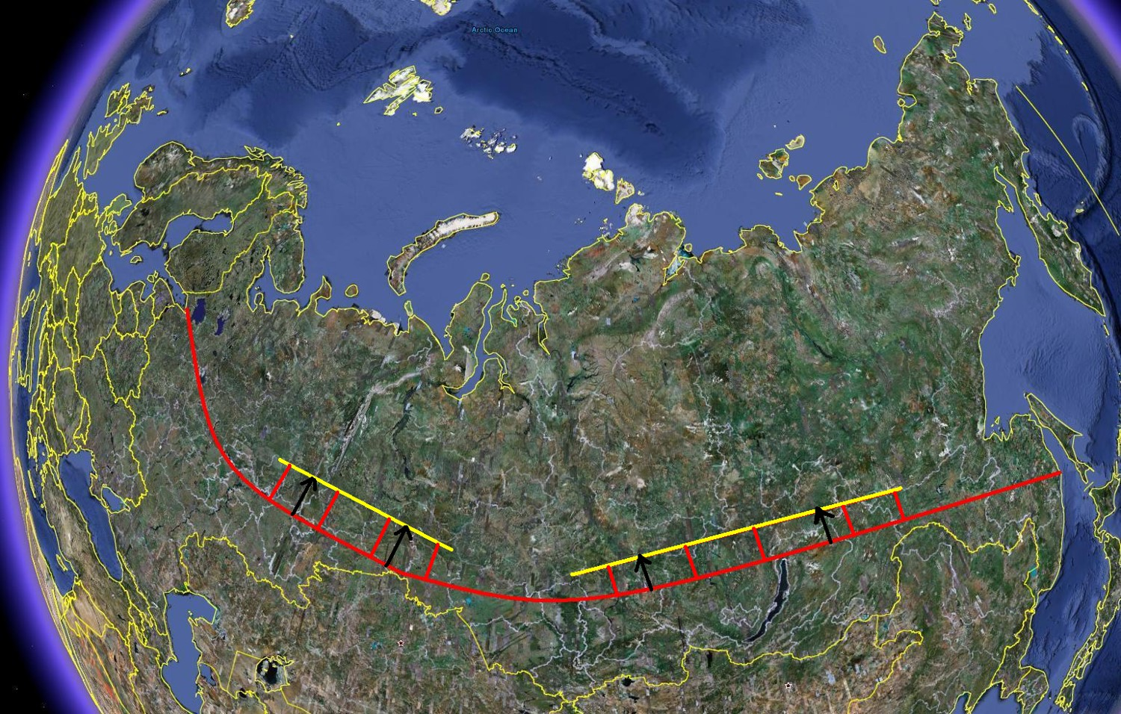

Slide 69
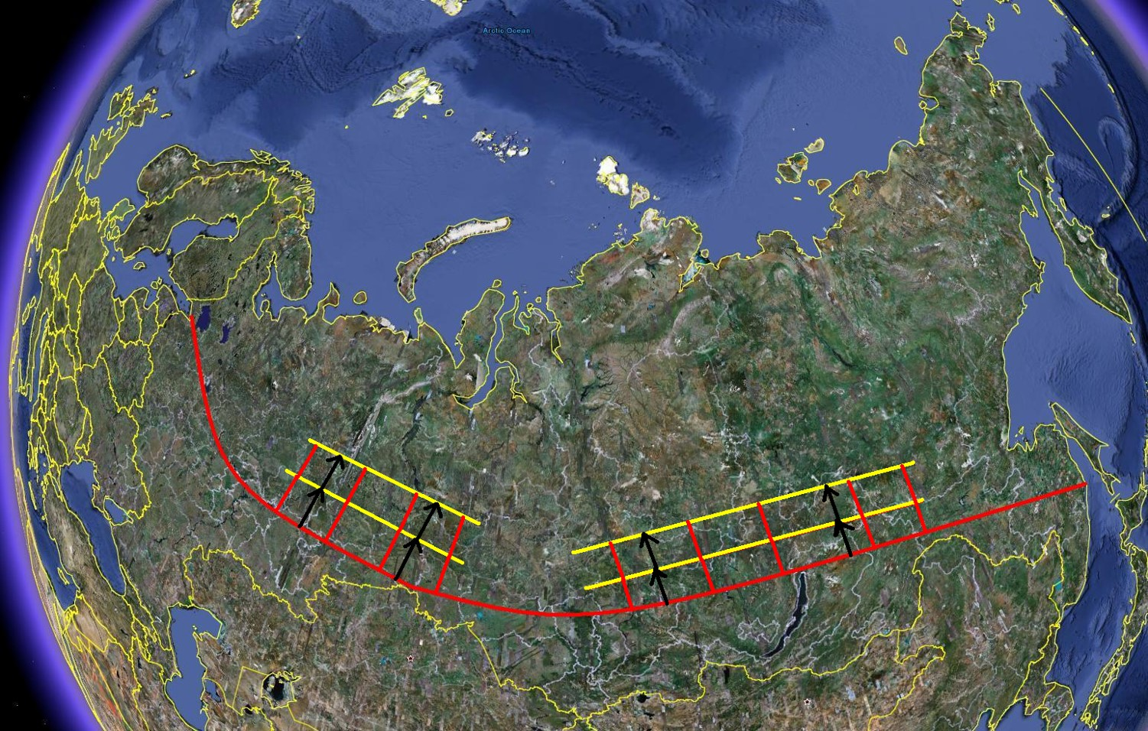

Slide 70
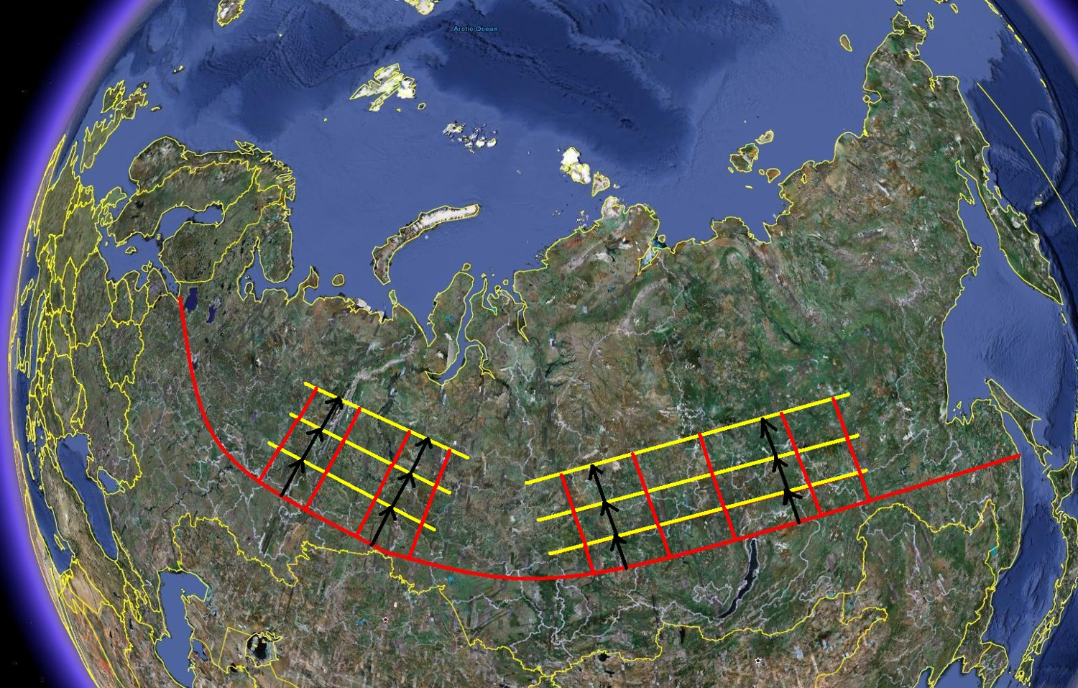

Slide 71
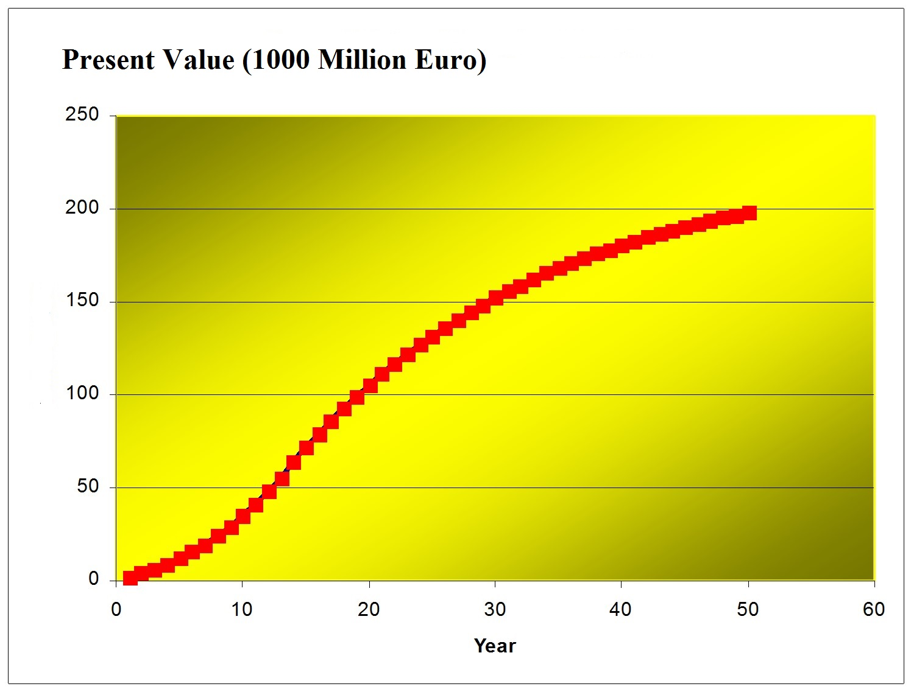

Slide 72
References
http://www.lohmander.com/Information/Ref.htm
Lohmander, P. (Chair) TRACK 1: Global Bioenergy, Economy and Policy, BIT’s 2nd World Congress on Bioenergy, Xi'an, China, April 25-28, 2012 http://www.Lohmander.com/Schedule_China_2012.pdf http://www.Lohmander.com/PLWCBE12intro.ppt Lohmander, P., Economic optimization of sustainable energy systems based on forest resources with consideration of the global warming problem: International perspectives, BIT’s 2nd World Congress on Bioenergy, Xi'an, China, April 25-28, 2012 http://www.Lohmander.com/WorldCongress12_PL.pdf http://www.Lohmander.com/WorldCongress12_PL.doc http://www.Lohmander.com/PLWCBE12.ppt

Slide 73
Lohmander, P., Lectures at Shandong Agricultural University, April 29 - May 1, 2012, Jinan, China, http://www.Lohmander.com/PLJinan12.ppt
Lohmander, P. (Chair) TRACK: Finance, Strategic Planning, Industrialization and Commercialization, BIT’s 1st World Congress on Bioenergy, Dalian World Expo Center, Dalian, China, April 25-30, 2011 http://www.bitlifesciences.com/wcbe2011/fullprogram_track5.asp http://www.lohmander.com/PRChina11/Track_WorldCongress11_PL.pdf http://www.lohmander.com/ChinaPic11/Track5.ppt Lohmander, P., Economic forest management with consideration of the forest and energy industries, BIT’s 1st World Congress on Bioenergy, Dalian World Expo Center, Dalian, China, April 25-30, 2011 http://www.lohmander.com/PRChina11/WorldCongress11_PL.pdf http://www.lohmander.com/ChinaPic11/LohmanderTalk.ppt

Slide 74
CONCLUSIONS:
With increasing levels of forest inputs in combination with CCS, it is possible to reduce the CO2 in the atmosphere and the global warming problem can be managed.
Furthermore, international trade in forest based energy can improve international relations, regional development and environmental conditions.
All suggestions concerning future cooperation projects are welcome!
Thank you!
Peter Lohmander

Slide 75
APPENDIX
The classical dynamic natural resource model:
$$\frac{dx}{dt}=sx\left(1−\frac{x}{K}\right)$$
$$\frac{dx}{dt}=sx−\frac{s}{K}x^{2}$$
$$\frac{dx}{dt}=sx\left(1+γx\right), γ=−K^{−1}$$
$$\frac{1}{x\left(1+γx\right)}dx=sdt$$
$$\frac{1}{x\left(1+γx\right)}=\frac{m}{x}+\frac{n}{1+γx}$$
$$\frac{m}{x}+\frac{n}{1+γx}=\frac{\left(1+γx\right)m+nx}{x\left(1+γx\right)}$$
$$\frac{\left(1+γx\right)m+nx}{x\left(1+γx\right)}=\frac{1}{x\left(1+γx\right)}$$
$$\left(1+γx\right)m+nx=1$$
$$m+mγx+nx=1$$
$$m+\left(mγ+n\right)x=1$$
Observation:
$$m+\left(mγ+n\right)x=1∀x$$
$$\left\{\begin{matrix} m=1 \\ mγ+n=0\end{matrix}\right.$$
Solution:
$\left(m,n\right)=(1,−γ)$
$$\frac{1}{x\left(1+γx\right)}dx=sdt$$
$$\left(\frac{m}{x}+\frac{n}{1+γx}\right)dx=sdt$$
$$\left(\frac{1}{x}−\frac{γ}{1+γx}\right)dx=sdt$$
$$\frac{dLN(1+γx)}{dx}=\frac{γ}{1+γx}$$

Slide 76
$$\frac{1}{x}dx−\frac{γ}{1+γx}dx=sdt$$
$$\int{\frac{1}{x}dx}−\int{\frac{γ}{1+γx}dx}=\int{sdt}$$
$$LN\left(x\right)−LN\left(1+γx\right)=st+C_{1}$$
$$LN\left(\frac{x}{1+γx}\right)=st+C_{1}$$
$$e^{LN\left(\frac{x}{1+γx}\right)}=e^{st+C_{1}}$$
$$\frac{x}{1+γx}={C_{2}e}^{st}$$
$$x={{\left(1+γx\right)C}_{2}e}^{st}$$
$$x\left(1−{C_{2}γe}^{st}\right)={C_{2}e}^{st}$$
$$x=\frac{{C_{2}e}^{st}}{1−{C_{2}γe}^{st}}$$
$$x=\frac{1}{\frac{1}{C_{2}}e^{−st}−γ}$$
$$γ={−K}^{−1}$$
$$x=\frac{1}{\frac{1}{C_{2}}e^{−st}+\frac{1}{K}}$$
$$x(t)=\frac{K}{1+Ce^{−st}}$$
$$\lim_{\begin{aligned}t→∞ \\ (s>0)\end{aligned}}{x(t)}=K$$
$$\frac{dx}{dt}=\frac{KsCe^{−st}}{{\left(1+Ce^{−st}\right)}^{2}}$$
$$\lim_{\begin{aligned}t→∞ \\ (s>0)\end{aligned}}\left(\frac{dx}{dt}\right)=0$$

