Slide 1
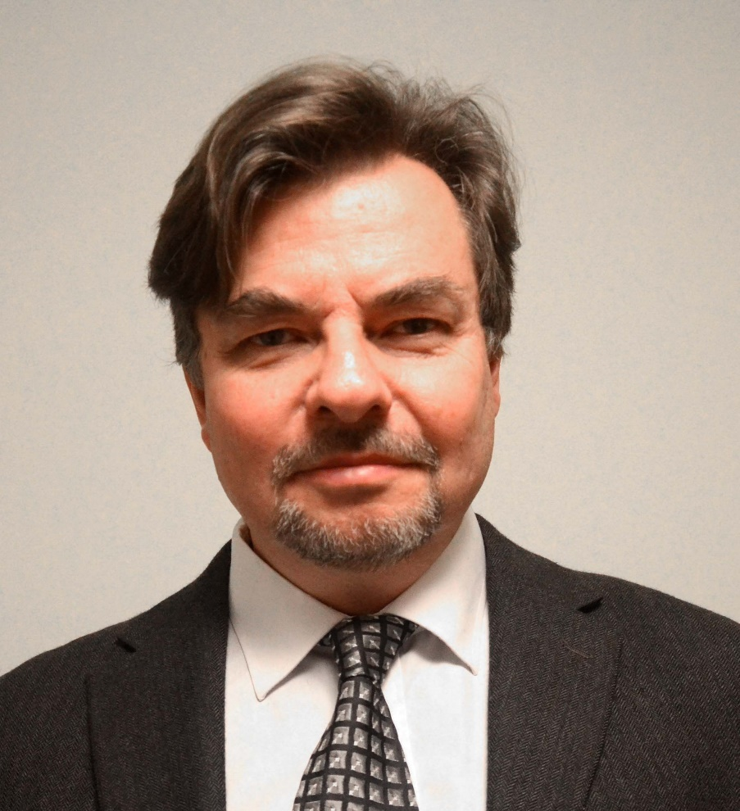
Rational Research in Forest Production and Forest Management with Consideration of Mixed Species Forest Management and Risk
Lecture by Professor Dr. Peter Lohmander, Swedish University of Agricultural Sciences, SLU, Sweden, http://www.Lohmander.com
Peter@Lohmander.com
Operations Research for the Future Forest Management,
University of Guilan, Iran, March 8-12, 2014
Saturday March 8, 13.30-15.00

Slide 2
Rational Research in Forest Production and Forest Management with Consideration of Mixed Species Forest Management and Risk
In order to solve the forest management optimization problems, it is necessary that the most relevant and important management options are well investigated and formulated. Models of biological growth should be developed that describe the production options available over time and space. The latest decades clearly show that detailed deterministic long term planning is irrelevant. Energy prices, prices of industrial products and environmental problems rapidly change in ways that cannot be perfectly predicted. Research in forest production planning should focus on the development of growth models that are useful when stochastic optimal control theory is applied. Since biological production takes considerable time, it is very important to create options to sequentially adjust the production to new relative prices, growth conditions, ecological problems and possible damages caused by parasites, fire or storms. In particular, valuable options can be obtained via mixed species stands. When several species are available in the young stands, the species mix can sequentially be adapted to changing product prices, costs and growth conditions. The analysis concerns the structure of relevant stochastic optimal control problems and consistent development of research in forest production. General mathematical models are analyzed. Comparative statics analysis and numerical methods are used to derive optimal results.
Professor Dr. Peter Lohmander, Swedish University of Agricultural Sciences, SLU, Sweden, http://www.Lohmander.com Peter@Lohmander.com

Slide 3
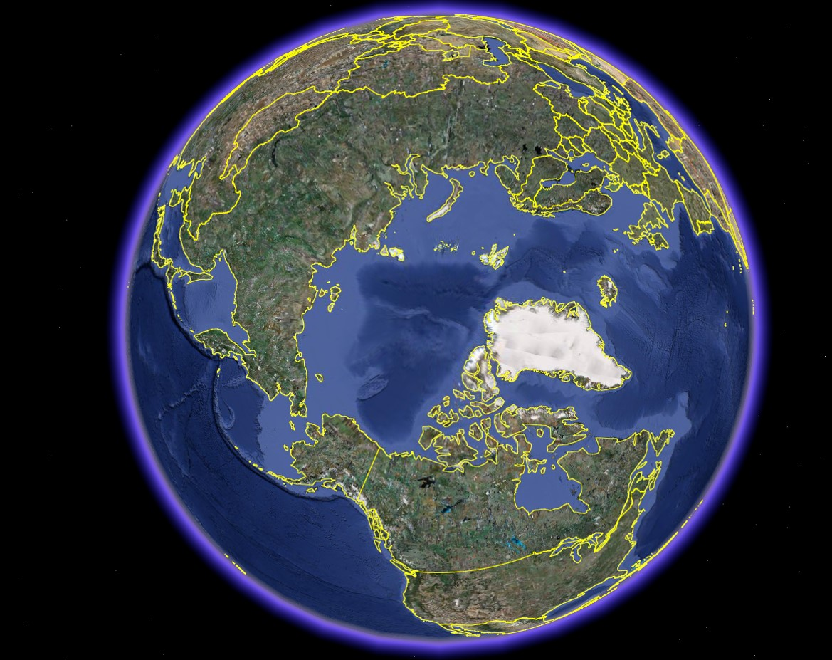

Slide 4
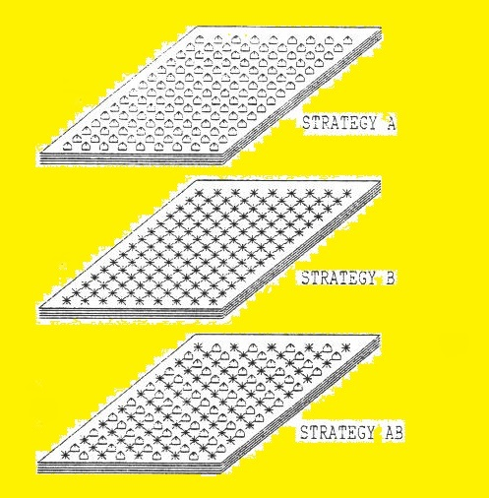
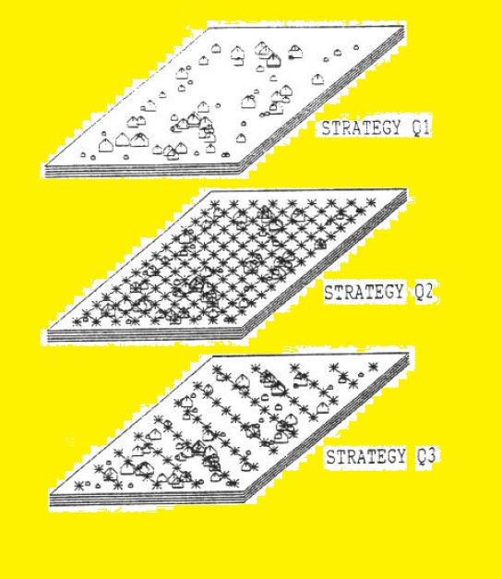

Slide 5
Lohmander, P., The multi species forest stand, stochastic prices and adaptive selective thinning, SYSTEMS ANALYSIS - MODELLING - SIMULATION, Vol. 9, 229-250, 1992 http://www.Lohmander.com/PL_SAMS_9_1992.pdf
Lohmander, P., Economic two stage multi period species management in a stochastic environment: The value of selective thinning options and stochastic growth parameters,SYSTEMS ANALYSIS - MODELLING -SIMULATION, Vol. 11, 287-302, 1993 http://www.Lohmander.com/PL_SAMS_11_1993.pdf
Lohmander, P., Optimal sequential forestry decisions under risk, ANNALS OF OPERATIONS RESEARCH, Vol. 95, pp. 217-228, 2000 http://www.Lohmander.com/PL_AOR_95_2000.pdf
Lohmander, P., Optimala beslut inför osäker framtid, FAKTA SKOG, SUAS, Nr 10, 2001 http://www.Lohmander.com/FS01-10.pdf

Slide 6
Lu, F., Lohmander, P., Optimal mixed stand management under risk, in Lu, F., Optimization of forest management decision making under conditions of risk, Doctoral Thesis, Acta Universitatis Agriculturae Sueciae, Swedish University of Agricultural Sciences, No. 333, 2004
Lohmander, P., Adaptive Optimization of Forest Management in a Stochastic World, in Weintraub A. et al (Editors), Handbook of Operations Research in Natural Resources, Springer, Springer Science, International Series in Operations Research and Management Science, New York, USA, pp 525-544, 2007 http://www.amazon.ca/gp/reader/0387718141/ref=sib_dp_pt/701-0734992-1741115#reader-link http://www.Lohmander.com/PL_Handbook2007.pdf
Lu, F., Lohmander, P., Optimal Decisions for Mixed Forests under Risk, Scientia Silvae Sinicae, Vol. 45, No. 11, Nov. 2009 http://www.Lohmander.com/Lu_Lohmander_2009.pdf

Slide 7
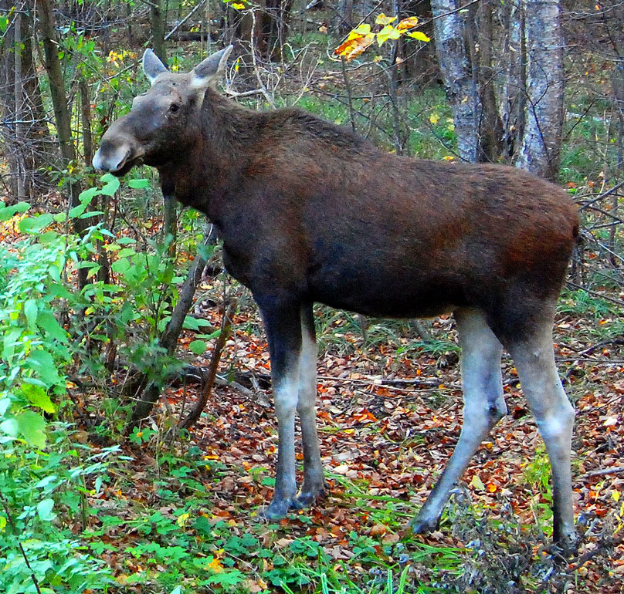

Slide 8
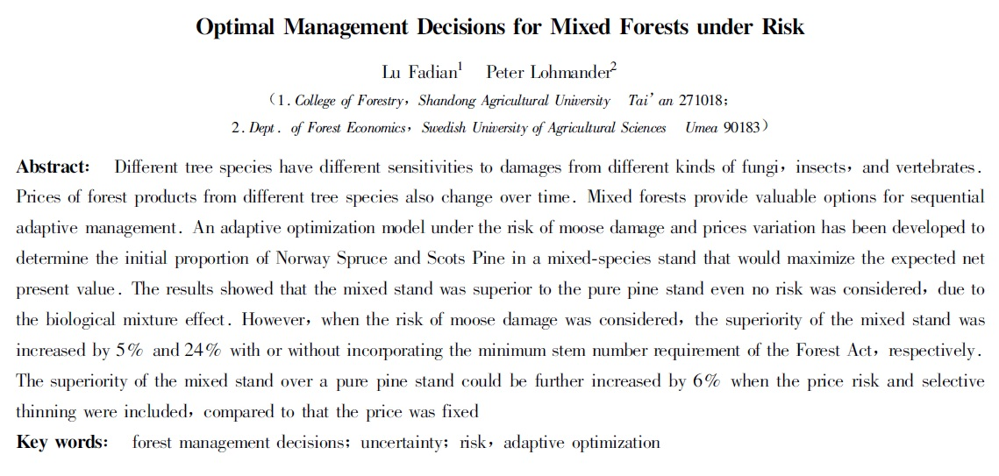
Lu, F., Lohmander, P., Optimal Decisions for Mixed Forests under Risk, Scientia Silvae Sinicae, Vol. 45, No. 11, Nov. 2009 http://www.Lohmander.com/Lu_Lohmander_2009.pdf

Slide 9
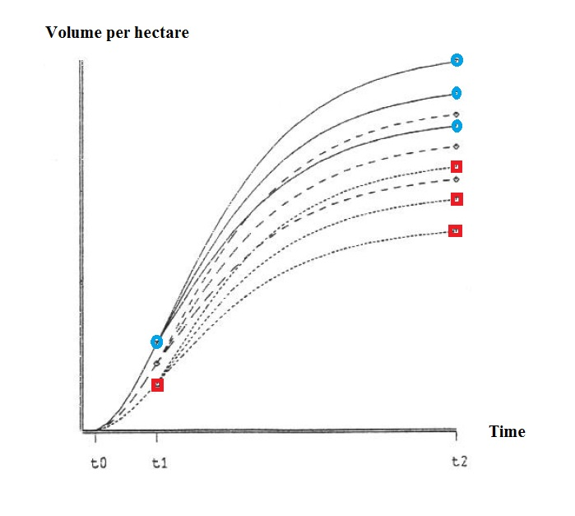

Slide 10
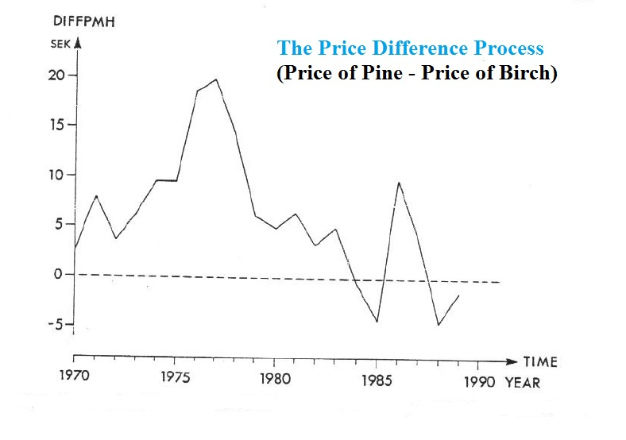

Slide 11
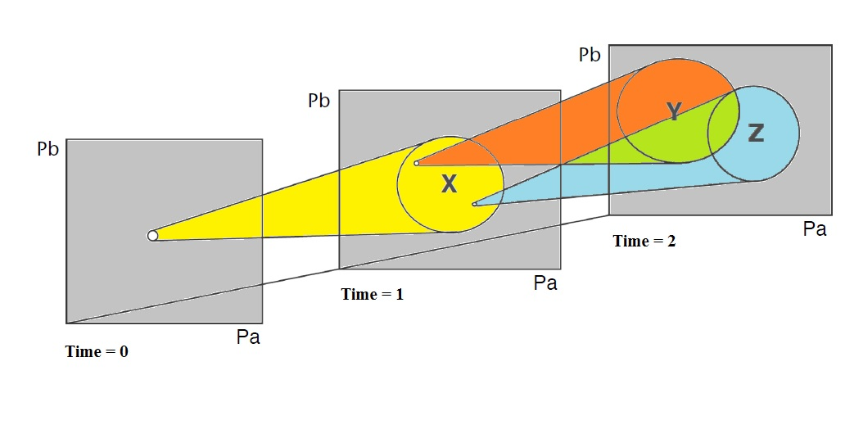

Slide 12
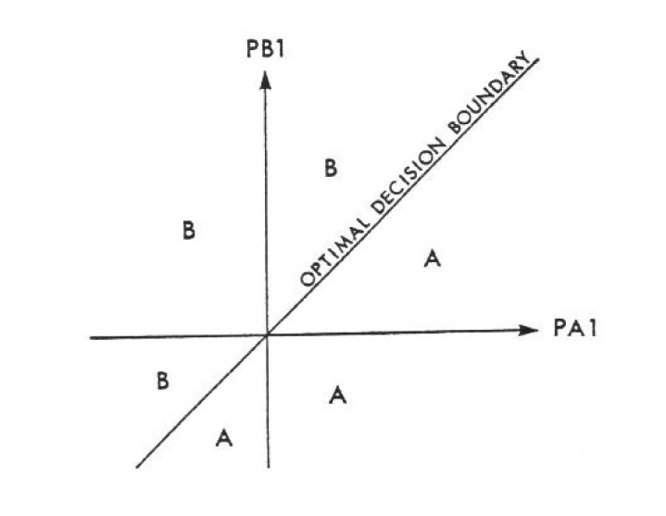

Slide 13
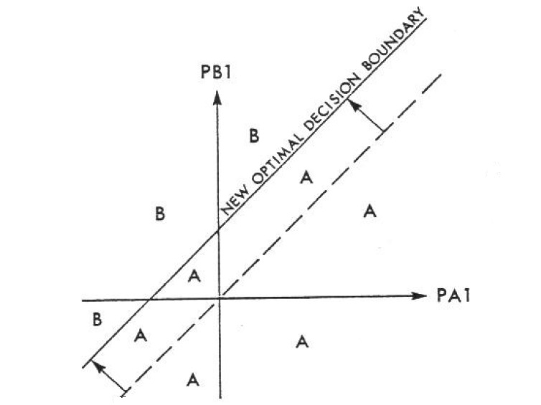

Slide 14
The stochastic prices and mixed species problem
A new explorative investigation of the fundamental problem

Slide 15
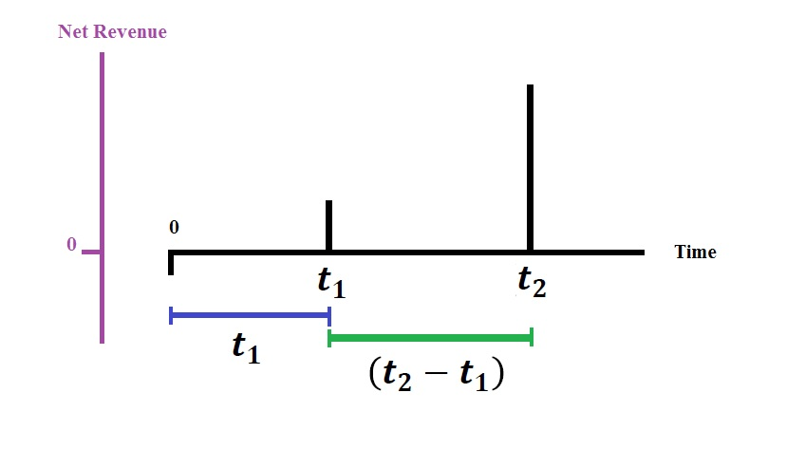

Slide 16
Initial price process assumptions:
Prices are real Martingale processes. $σ_{AB}=0$.
$$P_{A_{1}}=P_{A_{0}}+∆P_{A_{1}}$$
$$∆P_{A_{1}}∈N\left(0,t_{1}σ_{A}^{2}\right)$$
$$\left.E(P_{A_{1}}\right|P_{A_{0}})=P_{A_{0}}$$

Slide 17
$$∆P_{A_{1}}=∆_{1}+∆_{2}+…+∆_{t_{1}−1}+∆_{t_{1}}$$
$$∆_{i}∈N\left(0,σ_{A}^{2}\right) ∀i$$
$$∆P_{A_{1}}∈N\left(0,{t_{1}σ}_{A}^{2}\right)$$

Slide 18
$$P_{A_{2}}=P_{A_{1}}+∆P_{A_{2}}$$
$$∆P_{A_{2}}∈N\left(0,\left(t_{2}−t_{1}\right)σ_{A}^{2}\right)$$
$$\left.E(P_{A_{2}}\right|P_{A_{1}})=P_{A_{1}}$$
$$\left.E(P_{A_{2}}\right|P_{A_{0}})=P_{A_{0}}$$

Slide 19
In most cases, $P_{A_{1}}≠P_{A_{0}}$
Observation:
$$\left.E(P_{A_{2}}\right|P_{A_{1}})−\left.E(P_{A_{2}}\right|P_{A_{0}})\left\{\begin{matrix}>0 if (P_{A_{1}}>P_{A_{0}}) \\ =0 if (P_{A_{1}}=P_{A_{0}}) \\ <0 if (P_{A_{1}}<P_{A_{0}})\end{matrix}\right.$$

Slide 20
$$P_{B_{1}}=P_{B_{0}}+∆P_{B_{1}}$$
$$∆P_{B_{1}}∈N\left(0,t_{1}σ_{B}^{2}\right)$$
$$\left.E(P_{B_{1}}\right|P_{B_{0}})=P_{B_{0}}$$
$$P_{B_{2}}=P_{B_{1}}+∆P_{B_{2}}$$
$$∆P_{B_{2}}∈N\left(0,{\left(t_{2}−t_{1}\right)σ}_{B}^{2}\right)$$
$$\left.E(P_{B_{2}}\right|P_{B_{1}})=P_{B_{1}}$$
$$\left.E(P_{B_{2}}\right|P_{B_{0}})=P_{B_{0}}$$

Slide 21
In most cases, $P_{B_{1}}≠P_{B_{0}}$
Observation:
$$\left.E(P_{B_{2}}\right|P_{B_{1}})−\left.E(P_{B_{2}}\right|P_{B_{0}})\left\{\begin{matrix}>0 if (P_{B_{1}}>P_{B_{0}}) \\ =0 if (P_{B_{1}}=P_{B_{0}}) \\ <0 if (P_{B_{1}}<P_{B_{0}})\end{matrix}\right.$$

Slide 22
$d_{1}=e^{−rt_{1}}$, $d_{2}=e^{−rt_{2}}$
Expected present value of management system A without adaptive decisions:
$$π_{A}=E\left(\left.(−c_{A}+d_{1}P_{A_{1}}h_{A_{1}}+{d_{2}P}_{A_{2}}h_{A_{2}})\right|P_{A_{0}}\right)$$
$$π_{A}=−c_{A}+d_{1}E(\left.P_{A_{1}}\right|{P_{A_{0}})h}_{A_{1}}+d_{2}E(\left.P_{A_{2}}\right|{P_{A_{0}})h}_{A_{2}}$$

Slide 23
$$\left.E(P_{A_{1}}\right|P_{A_{0}})=P_{A_{0}}$$
$$\left.E(P_{A_{2}}\right|P_{A_{1}})=P_{A_{1}}$$
$$π_{A}=−c_{A}+{{d_{1}P}_{A_{0}}h}_{A_{1}}+{d_{2}P}_{A_{0}}h_{A_{2}}$$

Slide 24
Expected present value of management system B without adaptive decisions:
$$π_{B}=E\left(\left.(−c_{B}+{d_{1}P}_{B_{1}}h_{B_{1}}+{d_{2}P}_{B_{2}}h_{B_{2}})\right|P_{B_{0}}\right)$$
$$π_{B}=−c_{B}+d_{1}E(\left.P_{B_{1}}\right|{P_{B_{0}})h}_{B_{1}}+d_{2}E(\left.P_{B_{2}}\right|{P_{B_{0}})h}_{B_{2}}$$
$$\left.E(P_{B_{1}}\right|P_{B_{0}})=P_{B_{0}}$$
$$\left.E(P_{B_{2}}\right|P_{B_{1}})=P_{B_{1}}$$
$$π_{B}=−c_{B}+{{d_{1}P}_{B_{0}}h}_{B_{1}}+d_{2}{P_{B_{0}}h}_{B_{2}}$$

Slide 25
Expected present value of a management system AB with adaptive decisions. (50% of the stems are removed at $t_{1}$.)
$$π_{AB}=\left(\begin{aligned}−\frac{\left(c_{A}+c_{B}\right)}{2}−k \\ + \\ φ\left(\left(d_{1}{\left.{{P_{B_{1}}h}_{B_{1}}+\left.d_{2}E(P_{A_{2}}\right|P_{A_{1}})h_{A_{2}}≥d_{1}P}_{A_{1}}h_{A_{1}}+\left.d_{2}E(P_{B_{2}}\right|P_{B_{1}})h_{B_{2}})\right|(P_{A_{0}},P}_{B_{0}}\right)\right)Z_{1} \\ + \\ φ\left(\left({\left.{{{d_{1}P}_{B_{1}}h}_{B_{1}}+\left.d_{2}E(P_{A_{2}}\right|P_{A_{1}})h_{A_{2}}<d_{1}P}_{A_{1}}h_{A_{1}}+\left.d_{2}E(P_{B_{2}}\right|P_{B_{1}})h_{B_{2}})\right|(P_{A_{0}},P}_{B_{0}}\right)\right)Z_{2}\end{aligned}\right)$$

Slide 26
$$Z_{1}=E\left(d_{1}P_{B_{1}}h_{B_{1}}+{d_{2}P}_{A_{2}}h_{A_{2}} | \left(P_{A_{0}},P_{B_{0}}, \left({{{d_{1}P}_{B_{1}}h}_{B_{1}}+\left.d_{2}E(P_{A_{2}}\right|P_{A_{1}})h_{A_{2}}≥d_{1}P}_{A_{1}}h_{A_{1}}+\left.d_{2}E(P_{B_{2}}\right|P_{B_{1}})h_{B_{2}}\right)\right)\right)$$
$$Z_{2}=E\left(d_{1}P_{A_{1}}h_{A_{1}}+{d_{2}P}_{B_{2}}h_{B_{2}} | \left(P_{A_{0}},P_{B_{0}},\left(d_{1}{{P_{B_{1}}h}_{B_{1}}+\left.d_{2}E(P_{A_{2}}\right|P_{A_{1}})h_{A_{2}}<d_{1}P}_{A_{1}}h_{A_{1}}+\left.d_{2}E(P_{B_{2}}\right|P_{B_{1}})h_{B_{2}}\right)\right)\right)$$

Slide 27
$$π_{AB}=−\frac{\left(c_{A}+c_{B}\right)}{2}−k+φZ_{1}+(1−φ)Z_{2}$$

Slide 28
$$π_{AB}=−\frac{\left(c_{A}+c_{B}\right)}{2}−k+φZ_{1}+(1−φ)Z_{2}$$
$$φ= φ\left(\left(d_{1}{\left.{{P_{B_{1}}h}_{B_{1}}+d_{2}\left.E(P_{A_{2}}\right|P_{A_{1}})h_{A_{2}}≥d_{1}P}_{A_{1}}h_{A_{1}}+d_{2}\left.E(P_{B_{2}}\right|P_{B_{1}})h_{B_{2}})\right|(P_{A_{0}},P}_{B_{0}}\right)\right)$$
$$Z_{1}=E\left(d_{1}P_{B_{1}}h_{B_{1}}+{d_{2}P}_{A_{2}}h_{A_{2}} | \left(P_{A_{0}},P_{B_{0}}, \left({{{d_{1}P}_{B_{1}}h}_{B_{1}}+\left.d_{2}E(P_{A_{2}}\right|P_{A_{1}})h_{A_{2}}≥d_{1}P}_{A_{1}}h_{A_{1}}+\left.d_{2}E(P_{B_{2}}\right|P_{B_{1}})h_{B_{2}}\right)\right)\right)$$
$$Z_{2}=E\left(d_{1}P_{A_{1}}h_{A_{1}}+{d_{2}P}_{B_{2}}h_{B_{2}} | \left(P_{A_{0}},P_{B_{0}},\left(d_{1}{{P_{B_{1}}h}_{B_{1}}+\left.d_{2}E(P_{A_{2}}\right|P_{A_{1}})h_{A_{2}}<d_{1}P}_{A_{1}}h_{A_{1}}+\left.d_{2}E(P_{B_{2}}\right|P_{B_{1}})h_{B_{2}}\right)\right)\right)$$

Slide 29
Case 1:
Harvests at $t_{1}$ are not affected by the timber prices $P_{A_{1}}$and $P_{B_{1}}$ (since harvests at $t_{1}$ do not give timber but other assortments, such as energy assortments and pulp wood.)
We assume that all management alternatives lead to the same net present values of harvests at $t_{1}$.
In order to make the following derivations easier to follow, we exclude the present values of harvests at $t_{1}$ from $π_{A}$, $π_{B}$ and $π_{AB}$.
We also assume that the timber harvest volumes are the same, h, for both species.

Slide 30
$$π_{A}=−c_{A}+d_{2}E(\left.P_{A_{2}}\right|{P_{A_{0}})h}_{A_{2}}$$
$$π_{A}=−c_{A}+{d_{2}P}_{A_{0}}h$$
$$π_{B}=−c_{B}+d_{2}E(\left.P_{B_{2}}\right|{P_{B_{0}})h}_{B_{2}}$$
$$π_{B}=−c_{B}+d_{2}P_{B_{0}}h$$

Slide 31
$$π_{AB}=−\frac{\left(c_{A}+c_{B}\right)}{2}−k+φZ_{1}+\left(1−φ\right)Z_{2}$$
$$φ= φ\left(\left({\left.\left.d_{2}E(P_{A_{2}}\right|P_{A_{1}})h_{A_{2}}≥\left.d_{2}E(P_{B_{2}}\right|P_{B_{1}})h_{B_{2}})\right|(P_{A_{0}},P}_{B_{0}}\right)\right)$$
$$φ= φ\left(\left(d_{2}{\left.{P_{A_{1}}h}_{A_{2}}≥d_{2}P_{B_{1}}h_{B_{2}})\right|(P_{A_{0}},P}_{B_{0}}\right)\right)$$
$$φ= φ\left(\left({\left.P_{A_{1}}≥P_{B_{1}})\right|(P_{A_{0}},P}_{B_{0}}\right)\right)$$

Slide 32
$$Z_{1}=E\left(d_{2}P_{A_{2}}h_{A_{2}} | \left(P_{A_{0}},P_{B_{0}}, \left({\left.E(P_{A_{2}}\right|P_{A_{1}})h}_{A_{2}}≥\left.E(P_{B_{2}}\right|P_{B_{1}})h_{B_{2}}\right)\right)\right)$$
$$Z_{1}=d_{2}E\left(P_{A_{2}} | \left(P_{A_{0}},P_{B_{0}}, \left(P_{A_{1}}≥P_{B_{1}}\right)\right)\right)h$$

Slide 33
$$Z_{2}=E\left({d_{2}P}_{B_{2}}h_{B_{2}} | \left(P_{A_{0}},P_{B_{0}},\left({\left.E(P_{A_{2}}\right|P_{A_{1}})h}_{A_{2}}<\left.E(P_{B_{2}}\right|P_{B_{1}})h_{B_{2}}\right)\right)\right)$$
$$Z_{2}=d_{2}E\left(P_{B_{2}} | \left(P_{A_{0}},P_{B_{0}}, \left(P_{A_{1}}<P_{B_{1}}\right)\right)\right)h$$

Slide 34
Summary of Case 1:
$$π_{A}=−c_{A}+{d_{2}P}_{A_{0}}h$$
$$π_{B}=−c_{B}+{d_{2}P}_{B_{0}}h$$
$$π_{AB}=−\frac{\left(c_{A}+c_{B}\right)}{2}−k+φZ_{1}+(1−φ)Z_{2}$$

Slide 35
$$π_{AB}=−\frac{\left(c_{A}+c_{B}\right)}{2}−k+φZ_{1}+(1−φ)Z_{2}$$
$$φ= φ\left(\left({\left.P_{A_{1}}≥P_{B_{1}})\right|(P_{A_{0}},P}_{B_{0}}\right)\right)$$
$$Z_{1}=d_{2}E\left(P_{A_{2}} | \left(P_{A_{0}},P_{B_{0}}, \left(P_{A_{1}}≥P_{B_{1}}\right)\right)\right)h$$
$$Z_{2}=d_{2}E\left(P_{B_{2}} | \left(P_{A_{0}},P_{B_{0}}, \left(P_{A_{1}}<P_{B_{1}}\right)\right)\right)h$$

Slide 36
Case 2:
As Case 1 with the following constraints:
$$σ_{B}=0$$
$$\left(σ_{B}=0\right)⟹\left(∆P_{B_{1}}=0 ; ∆P_{B_{2}}=0\right)$$
$${P_{A_{0}}=P}_{B_{0}}$$

Slide 37
$$p= {P_{A_{1}}−P}_{B_{1}}$$
$$f(p)= \left\{\begin{matrix}0 , p≤−g \\ g^{−1}+g^{−2}p , −g<p<0 \\ g^{−1 } , p=0 \\ g^{−1}−g^{−2}p , 0<p<g \\ 0 , p≥g\end{matrix}\right.$$

Slide 38
$$π_{AB}=−\frac{\left(c_{A}+c_{B}\right)}{2}−k+φZ_{1}+(1−φ)Z_{2}$$
$$φ= \frac{1}{2}$$
$$Z_{1}=\left(2d_{2}\int_{0}^{g}{\left(α+βp\right)f\left(p\right)dp}\right)h$$

Slide 39
$$Z_{1}=\left(2d_{2}\int_{0}^{g}{\left(α+βp\right)f\left(p\right)dp}\right)h$$
$Z_{3}=\frac{Z_{1}}{2d_{2}h}$
$$Z_{3}=\int_{0}^{g}{\left(α+βp\right)f\left(p\right)dp}$$

Slide 40
$$Z_{3}=\int_{0}^{g}{\left(α+βp\right)f\left(p\right)dp}$$
$$Z_{3}=\int_{0}^{g}{\left(α+βp\right)\left(g^{−1}−g^{−2}p\right)dp}$$
$$Z_{3}=\int_{0}^{g}{\left(αg^{−1}−αg^{−2}p+βg^{−1}p−{βg}^{−2}p^{2}\right)dp}$$

Slide 41
$$Z_{3}=\int_{0}^{g}{\left(αg^{−1}−αg^{−2}p+βg^{−1}p−{βg}^{−2}p^{2}\right)dp}$$
$$Z_{3}={\left[αg^{−1}p−\frac{αg^{−2}p^{2}}{2}+\frac{βg^{−1}p^{2}}{2}−\frac{{βg}^{−2}p^{3}}{3}\right]}_{0}^{g}$$
$$Z_{3}=αg^{−1}g−\frac{αg^{−2}g^{2}}{2}+\frac{βg^{−1}g^{2}}{2}−\frac{{βg}^{−2}g^{3}}{3}$$

Slide 42
$$Z_{3}=αg^{−1}g−\frac{αg^{−2}g^{2}}{2}+\frac{βg^{−1}g^{2}}{2}−\frac{{βg}^{−2}g^{3}}{3}$$
$$Z_{3}=α−\frac{α}{2}+\frac{βg}{2}−\frac{βg}{3}$$
$$Z_{3}=\frac{α}{2}+\left(\frac{1}{2}−\frac{1}{3}\right)βg$$

Slide 43
$$Z_{3}=\frac{α}{2}+\left(\frac{1}{2}−\frac{1}{3}\right)βg$$
$$Z_{3}=\frac{α}{2}+\left(\frac{3}{6}−\frac{2}{6}\right)βg$$
$$Z_{3}=\frac{α}{2}+\frac{β}{6}g$$
$$Z_{1}=2d_{2}h\left(\frac{α}{2}+\frac{β}{6}g\right)$$
$$Z_{1}=d_{2}h\left(α+\frac{β}{3}g\right)$$

Slide 44
$$Z_{2}=d_{2}E\left(P_{B_{2}} | \left(P_{A_{0}},P_{B_{0}}, \left(P_{A_{1}}<P_{B_{1}}\right)\right)\right)h$$
$$Z_{2}=d_{2}P_{B_{0}}h$$

Slide 45
Observation: $Z_{1}=d_{2}h\left(α+\frac{β}{3}g\right)$
For g=0:
$$Z_{1}=d_{2}hα$$
$$Z_{2}=d_{2}P_{B_{0}}h$$
$$d_{2}hα=d_{2}P_{B_{0}}h$$
$$α=P_{B_{0}}$$

Slide 46
Comparison of investments for g=0:
$$π_{A}=−c_{A}+{d_{2}P}_{A_{0}}h$$
$$π_{B}=−c_{B}+{d_{2}P}_{B_{0}}h$$
$$π_{AB}=−\frac{\left(c_{A}+c_{B}\right)}{2}−k+φZ_{1}+(1−φ)Z_{2}$$

Slide 47
$$π_{AB}=−\frac{\left(c_{A}+c_{B}\right)}{2}−k+φZ_{1}+\left(1−φ\right)Z_{2}$$
$$π_{AB}=−\frac{\left(c_{A}+c_{B}\right)}{2}−k+\frac{1}{2}d_{2}h\left(α+\frac{β}{3}g\right)+\frac{1}{2}d_{2}P_{B_{0}}h$$
$$π_{AB}=−\frac{\left(c_{A}+c_{B}\right)}{2}−k+\frac{1}{2}d_{2}h\left(α+\frac{β}{3}0\right)+\frac{1}{2}d_{2}P_{B_{0}}h$$

Slide 48
$$π_{AB}=−\frac{\left(c_{A}+c_{B}\right)}{2}−k+\frac{1}{2}d_{2}hα+\frac{1}{2}d_{2}P_{B_{0}}h$$
$$α=P_{B_{0}}$$
$$π_{AB}=−\frac{\left(c_{A}+c_{B}\right)}{2}−k+\frac{1}{2}d_{2}hP_{B_{0}}+\frac{1}{2}d_{2}P_{B_{0}}h$$
$$π_{AB}=−\frac{\left(c_{A}+c_{B}\right)}{2}−k+d_{2}P_{B_{0}}h$$

Slide 49
$${P_{A_{0}}=P}_{B_{0}}=P_{0}$$
Let $c_{A}=c_{B}=c$
$$π_{A}=−c_{A}+{d_{2}P}_{A_{0}}h$$
$$π_{A}=−c+{d_{2}P}_{0}h$$
$$π_{B}=−c_{B}+{d_{2}P}_{B_{0}}h$$
$$π_{B}=−c+{d_{2}P}_{0}h$$

Slide 50
$$π_{AB}=−\frac{\left(c_{A}+c_{B}\right)}{2}−k+d_{2}P_{B_{0}}h$$
$$π_{AB}=−c−k+d_{2}P_{0}h$$

Slide 51
Then,
$$π_{A}=π_{B}=π_{1}$$
Standard assumption: $k>0.$
$$\left(g=0∧k>0\right)⇒\left(π_{AB}<π_{A}=π_{B}\right)$$

Slide 52
Comparative statics for g > 0:
$$π_{AB}=−\frac{\left(c_{A}+c_{B}\right)}{2}−k+φZ_{1}+(1−φ)Z_{2}$$
$$π_{AB}=−\frac{\left(c_{A}+c_{B}\right)}{2}−k+\frac{1}{2}d_{2}h\left(α+\frac{β}{3}g\right)+\frac{1}{2}d_{2}P_{B_{0}}h$$
$$\frac{dπ_{AB}}{dg}=\frac{d_{2}hβ}{6}>0$$

Slide 53
Observation:
$${∆π=π}_{AB}−π_{1}=−k+\frac{d_{2}hβ}{6}g$$
$${∆π=π}_{AB}−π_{1} \left\{\begin{matrix}<0 , k>\frac{d_{2}hβ}{6}g \\ =0 , k=\frac{d_{2}hβ}{6}g \\ >0 , k<\frac{d_{2}hβ}{6}g \end{matrix}\right.$$

Slide 54
General comparative statics analysis:
$$π_{AB}=−\frac{\left(c_{A}+c_{B}\right)}{2}−k+φZ_{1}+(1−φ)Z_{2}$$
$$φ=φ(σ_{A},…)$$
$${Z_{1}=Z}_{1}(σ_{A},…)$$
$${Z_{2}=Z}_{2}(σ_{A},…)$$

Slide 55
$$π_{AB}=−\frac{\left(c_{A}+c_{B}\right)}{2}−k+φ(σ_{A})Z_{1}(σ_{A})+(1−φ(σ_{A}))Z_{2}(σ_{A})$$

Slide 56
$$π_{AB}=−\frac{\left(c_{A}+c_{B}\right)}{2}−k+φ(σ_{A})Z_{1}(σ_{A})+(1−φ(σ_{A}))Z_{2}(σ_{A})$$
$$\frac{dπ_{AB}}{dσ_{A}}=\frac{dφ\left(σ_{A}\right)}{dσ_{A}}Z_{1}\left(σ_{A}\right)+φ\left(σ_{A}\right)\frac{dZ_{1}\left(σ_{A}\right)}{dσ_{A}}−\frac{dφ\left(σ_{A}\right)}{dσ_{A}}Z_{2}\left(σ_{A}\right)+(1−φ(σ_{A}))\frac{dZ_{2}\left(σ_{A}\right)}{dσ_{A}}$$
$$\frac{dπ_{AB}}{dσ_{A}}=\frac{dφ\left(σ_{A}\right)}{dσ_{A}}\left(Z_{1}−Z_{2}\right)+φ\left(σ_{A}\right)\frac{dZ_{1}\left(σ_{A}\right)}{dσ_{A}}+(1−φ(σ_{A}))\frac{dZ_{2}\left(σ_{A}\right)}{dσ_{A}}$$

Slide 57
Observation:
On the decision boundary, the expected present values of A and B are the same,
$Z_{1}−Z_{2}=0$
Usually,
$\left|\frac{dZ_{2}\left(σ_{A},.\right)}{dσ_{A}}\right|≪\left|\frac{dZ_{1}\left(σ_{A},.\right)}{dσ_{A}}\right|$ and $\frac{dZ_{1}\left(σ_{A}\right)}{dσ_{A}} >0$
$φ\left(σ_{A},.\right)$ and $\left(1−φ\left(σ_{A},.\right)\right)$ are strictly positive and of the same order of magnitude. Then:
$$\frac{dπ_{AB}}{dσ_{A}}≈φ\left(σ_{A}\right)\frac{dZ_{1}\left(σ_{A}\right)}{dσ_{A}}>0$$

Slide 58
Observation:
$${∆π=π}_{AB}−π_{1}=−k+w(σ_{A})$$
$$\frac{dw(σ_{A})}{dσ_{A}}>0$$
$${∆π=π}_{AB}−π_{1} \left\{\begin{matrix}<0 , k>w(σ_{A}) \\ =0 , k=w(σ_{A}) \\ >0 , k<w(σ_{A})\end{matrix}\right.$$

Slide 59
CONCLUSIONS:
In typical cases:
If $σ_{A}=0$ , a one species plantation gives the highest expected present value.
At some strictly positive and unique value of $σ_{A}$ , investments in one or two species give the same expected present value.
At higher values of $σ_{A}$ , a two species investment gives a strictly higher expected present value than a one species investment.

Slide 60
Rational Research in Forest Production and Forest Management with Consideration of Mixed Species Forest Management and Risk
The latest decades clearly show that detailed deterministic long term planning is irrelevant.
Energy prices, prices of industrial products and environmental problems rapidly change in ways that cannot be perfectly predicted.
Research in forest production planning should focus on the development of growth models that are useful when stochastic optimal control theory is applied.
Since biological production takes considerable time, it is very important to create options to sequentially adjust the production to new relative prices, growth conditions, ecological problems and possible damages caused by parasites, fire or storms.
In particular, valuable options can be obtained via mixed species stands. When several species are available in the young stands, the species mix can sequentially be adapted to changing product prices, costs and growth conditions.
Professor Dr. Peter Lohmander, Swedish University of Agricultural Sciences, SLU, Sweden, http://www.Lohmander.com
Peter@Lohmander.com

