Slide 1

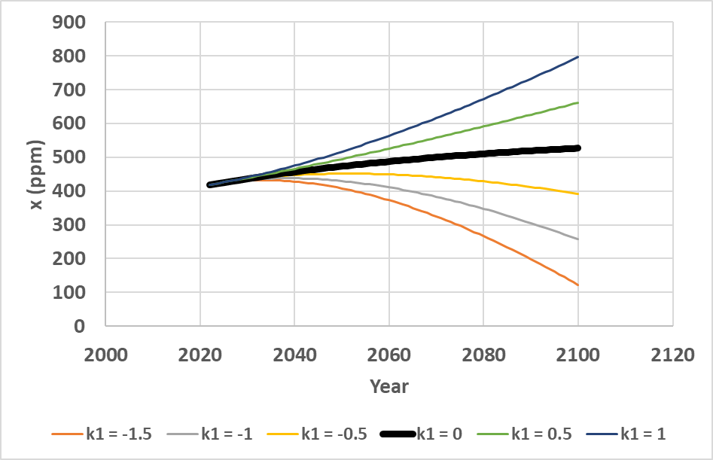
Rational Control of Global Warming
Dynamics via the CO₂ level, Emission
Reductions and Forestry Expansion by
Peter Lohmander
Professor
Peter Lohmander
Optimal Solutions
Sweden
Options:
Eighth International Conference on
Statistics for Twenty-first
Century-2022 (ICSTC 2022)
16-19 December 2022
Organized by:
International Statistics Fraternity (ISF), Department of Statistics, University of Kerala, School of Physical & Mathematical Sciences, University of Kerala
http://www.lohmander.com/Lohmander_Peter_ICSTC_2022.pdf
Presentation Version 221213_1651

Slide 2
This presentation is based on the original version of the contents presented in the following open access article:
Lohmander., P., Rational Control of Global Warming Dynamics Via the CO2 Level, Emission Reductions and Forestry Expansion. Biomed J Sci & Tech Res 47(3)-2022. BJSTR. MS.ID.007501.
https://biomedres.us/pdfs/BJSTR.MS.ID.007501.pdf
Observation: When this presentation was written, the open access article found above still contained
some misprints. Hopefully, these errors have been corrected before you study that article.
However, it is also possible to read the original version of the paper via this link:
http://www.lohmander.com/PL_EnvSci_Original_221209.pdf

Slide 3
Abstract
First, the observed CO2 level in the atmosphere, recorded by NOAA (2022) at the Mauna Loa observatory, and the global industrial CO2 emissions, reported by EDGAR (2021), European Commission, are investigated, from 1990 until 2021. Then, a differential equation model is developed, based on two hypotheses, that explains how these time series interact. The hypotheses of the explaining model are tested with regression analysis, and it is demonstrated that no hypothesis can be rejected on statistical grounds. The parameters of the CO2 concentration model are determined with high t-values and low p-values. The model is used to determine the time path of the CO2 concentration of the natural system without industrial emissions, for arbitrary initial conditions. This system has a unique and stable equilibrium at 262 ppm. With constant industrial emissions, the equilibrium is found at a higher level, which is shown with an explicit equation. Comparative statics analysis shows how the equilibrium is affected by alternative parameter adjustments. An extended version of the natural differential equation, with a forcing function, representing the time paths of industrial emissions, is developed. The industrial emissions are modeled as a quadratic function of time. The general function of the time path of the CO2 concentration of the natural system under the influence of industrial emissions, is determined for arbitrary initial conditions and parameters of the industrial emission function. The CO2 time path function is analytically verified. Then, it is also empirically tested and found to be able to reproduce the historical CO2 observations with high precision. Then, the time paths of the future CO2 concentrations are calculated, for six alternative levels of change of the industrial emissions, from -1.5 Gt/year to +1.0 Gt/year, from the year 2022 until 2100. These results are presented as a function and as graphs. The net CO2 emissions can also be reduced over time, if forestry is gradually intensified. The rational intensity of this investment process is determined, taking the time path of the CO2 level into consideration, during an arbitrary time interval. An explicit function for the optimal forestry intensification level, based on all CO2 time path function parameters, the marginal cost of the CO2 concentration, time interval parameters, rate of interest and different cost function parameters, is derived and presented.

Slide 4
Contents:
The differential equation of the CO₂ concentration in the atmosphere:
Fundamental theory, mathematics and statistical estimation.
Time path of the CO₂ concentration:
Determined without and with arbitrary industrial emissions.
Historical CO₂ observations:
Reproduced by the model.
The CO₂ concentration equilibrium:
Exists, is unique and stable.
Intensified sustainable forestry:
Reduces the future CO₂ concentration.
The optimal forestry intensification level:
Is determined as an explicit function of all parameters.

Slide 5
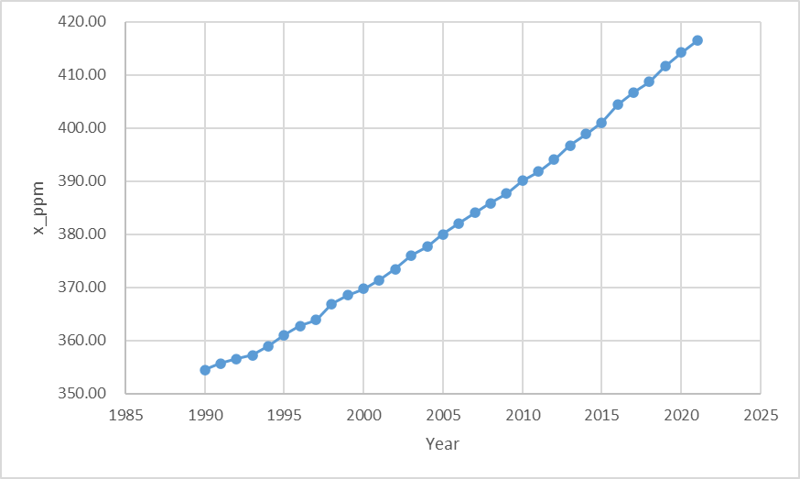
Figure 1.
The CO₂ concentration in the atmosphere, in the unit ppm, according to the observations from the Mauna Loa observatory. Source: NOAA (2022).

Slide 6
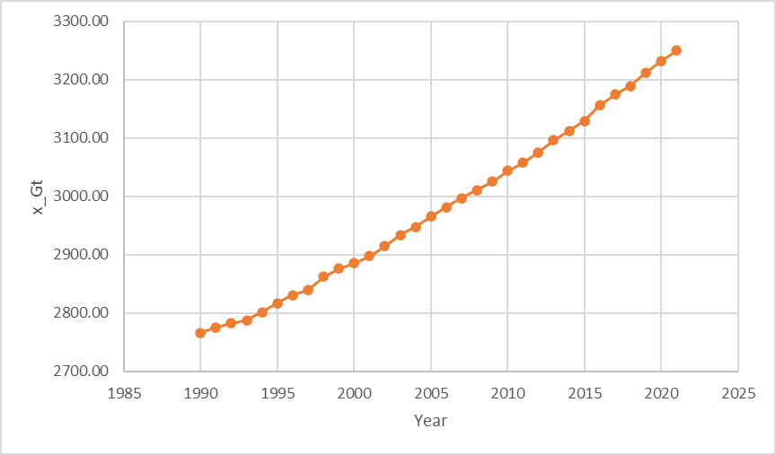
Figure 2.
The CO₂ level in the atmosphere, in the unit Gt, according to the observations from the Mauna Loa observatory and variable transformations. Sources: NOAA (2022) and O’Hara (1990).

Slide 7
The natural system:
CO₂ concentration
in the atmosphere
The natural system + industrial net emissions:

Slide 8
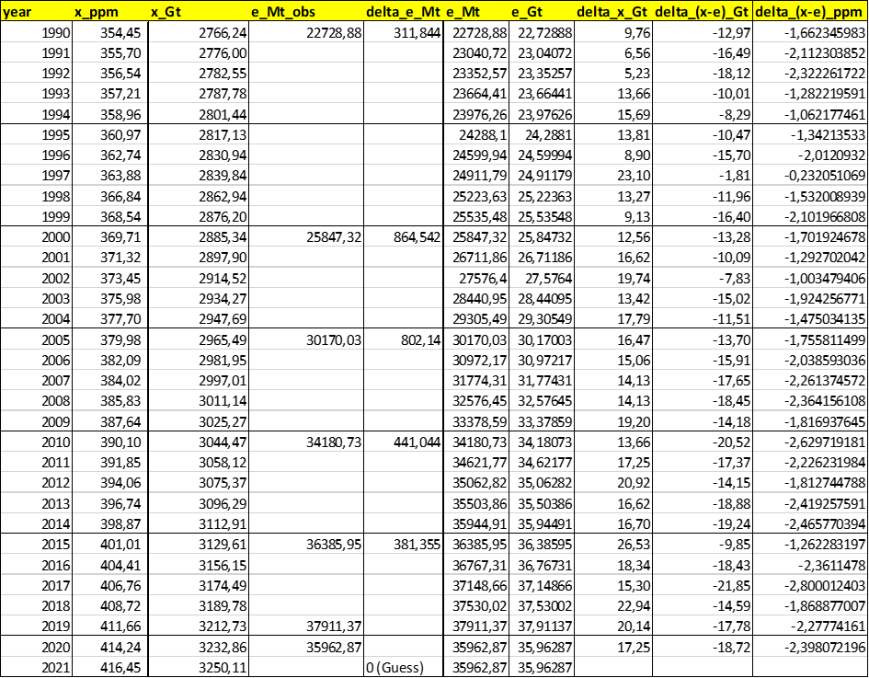
Empirical data and transformations

Slide 9
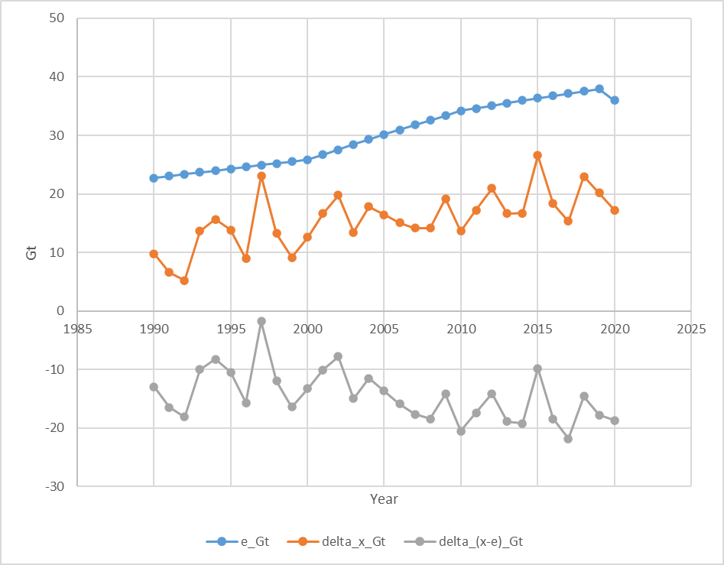
The industrial net CO₂ emissions to the atmosphere per year.
Change during one year of the CO₂ level in the atmosphere.
Change during one year of the CO₂ level in the atmosphere reduced by the industrial net emissions.
(These negative values also have a negative time trend. More CO₂ is absorbed now than earlier, most likely because of the increasing CO₂ level.)
Figure 3.
The CO₂ emissions to the atmosphere, e_Gt, in the unit Gt, the change during one year of the CO₂ level in the atmosphere, delta_x_Gt, and the yearly change of the CO₂ level in the atmosphere reduced by the emissions, delta_(x-e)_Gt, in the unit Gt. Sources: NOAA (2022), EDGAR (2021) and O’Hara (1990).

Slide 11
Table A2.
Regression in Gt.

Slide 14
Table A3.
Regression in ppm.

Slide 19
Pre industrial equilibrium

Slide 22
The equilibrium CO₂ level in the atmosphere is a strictly increasing function of the level of the natural emissions.
The CO₂ equilibrium level in the atmosphere is a strictly increasing function of b, which means that it is a strictly decreasing function of the natural absorption level.
The equilibrium CO₂ level in the atmosphere is a strictly increasing function of the exogenous industrial emission level.

Slide 28
The natural system converges to the ”Pre industrial equilibrium”.

Slide 42
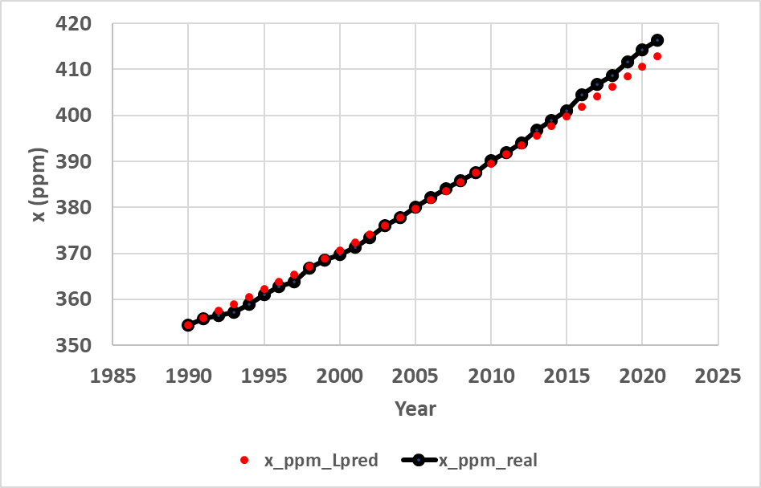
Figure 4.
The time path of the CO₂ level in the atmosphere, x, from year 1990 until 2021, in the empirical data, x_ppm_real, and the prediction, x_ppm_Lpred, via the solution to the differential equation (80), based on the assumptions that the initial CO2 level in year 1990 and all other parameters are known. In year 1990, t = 0. Parameter k₀ is the emission level in 1990, namely 22.729 (Gt) and k₁ = (the emissions in 2021 – the emissions in 1990) / (31 years). This calculation gives a k₁ value of approximately 0.4269 (Gt per year). Tables 1 and 2 contain the other parameters. The differential equation prediction follows the true development rather well, but underestimates the latest CO₂ levels slightly. One reason may be variations in the industrial emission increments. Still, the prediction model results replicate the true history rather well and we may believe in equation (80).

Slide 44
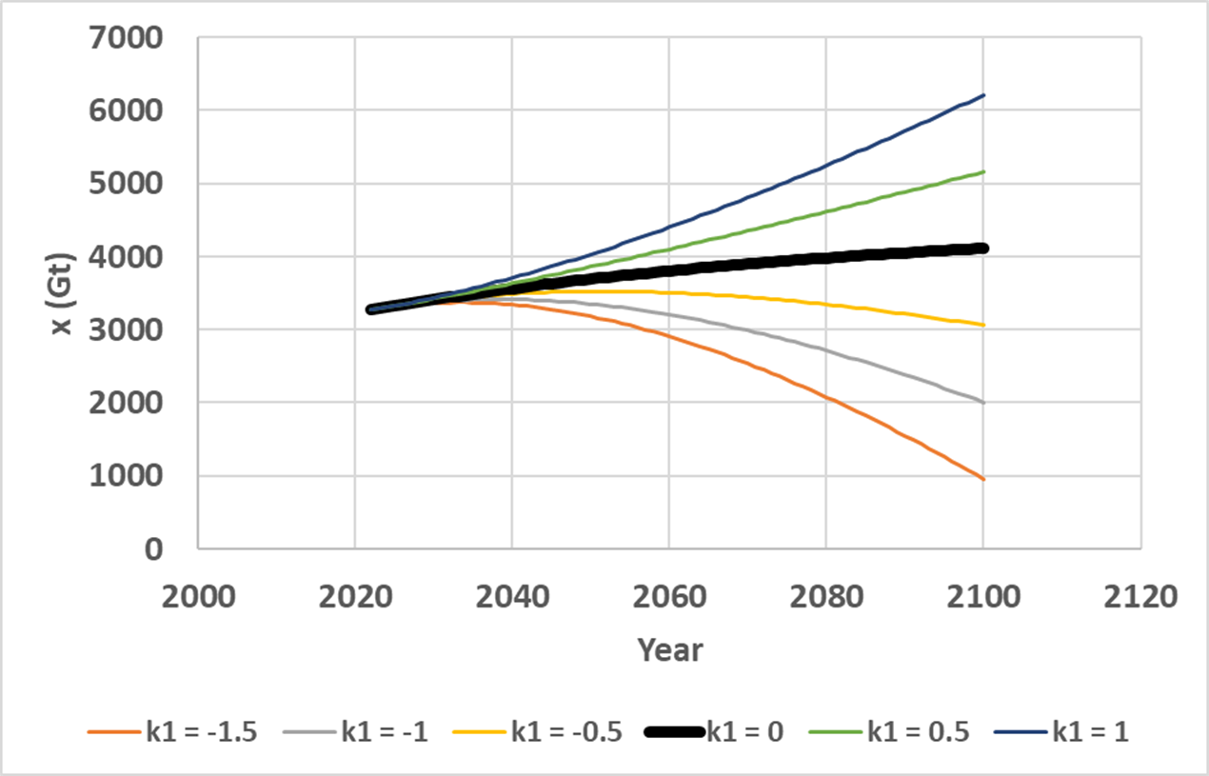
Figure 5.
Emission strategy conditional predictions of the CO₂ level in the atmosphere, x (Gt), from year 2022 until 2100, via equation (80), based on the assumptions that the initial CO₂ level in year 2022 and all other parameters are known. In year 2022, t = 0, and the initial value x₀ is estimated from the values in 2020 and 2021. (3250.11-3232.86) + 3250.11 = 3267.36 (Gt). Parameter k₀ is the estimated emission level in 2022, assumed to be identical to the level in 2019, directly before the Corona pandemic, namely 37.911 (Gt). The time derivative of the emissions, k₁, takes alternative values, from -1.5 to + 1.0 (Gt per year). Tables 1 and 2 contain the other parameters.

Slide 45
Figure 6.
Emission strategy conditional predictions of the CO2 concentration in the atmosphere, x (ppm), from year 2022 until 2100, via equation (80), based on the assumptions that the initial CO2 level in year 2022 and the parameters were known. In year 2022, t = 0, and the initial value x₀ is estimated from the values in 2020 and 2021. (3250.11-3232.86) + 3250.11 = 3267.36 (Gt). Parameter k₀ is the estimated emission level in 2022, assumed to be identical to the level in 2019, directly before the Corona pandemic, namely 37.911 (Gt). The time derivative of the emissions, k₁, takes alternative values, from -1.5 to + 1.0 (Gt per year). Tables 1 and 2 contain the other parameters.

Slide 46
The decision k₁ and effects on the climate:

Slide 60
OBSERVATIONS 1.
1.a. It is possible to model the dynamics of the CO₂ level in the atmosphere via a differential equation. The formulated hypotheses, of how the CO₂ level is affected by natural emissions and concentration dependent absorption, could not be rejected.
1.b. The parameters were empirically estimated, with high precision, from the latest available empirical time series of observations of CO₂ concentration in the atmosphere, and industrial emissions.
1.c. It is possible to determine the time path of the CO₂ concentration of the natural system without industrial emissions, for arbitrary initial conditions.
1.d. This system has a unique and stable equilibrium, with an expected estimated value of 262 ppm. With constant industrial emissions, the equilibrium would be found at a higher level, according to an explicit equation.

Slide 61
OBSERVATIONS 2.
2.a. Comparative statics analysis shows how the equilibrium is affected by alternative parameter adjustments.
2.b. An extended version of the natural differential equation, with a forcing function, a quadratic function of time, representing the time paths of industrial emissions, has been developed.
2.c. The general function of the time path of the CO₂ concentration of the natural system under the influence of industrial emissions, has been determined for arbitrary initial conditions and parameters of the industrial emission function.

Slide 62
OBSERVATIONS 3.
3.a. The CO₂ time path function has been analytically verified and empirically tested and found to be able to reproduce the historical CO₂ observations with high precision.
3.b. The time paths of the future CO₂ concentrations have also been calculated, for six alternative levels of change of the industrial emissions, from -1.5 Gt/year to +1.0 Gt/year, from the year 2022 until 2100.
3.c. The net CO₂ emissions can be reduced over time, if sustainable forestry is gradually intensified. The rational intensity of this investment process has been determined.
3.d. An explicit function for the optimal forestry intensification level, based on all CO₂ time path function parameters, the marginal cost of the CO₂ concentration, time interval parameters, rate of interest and cost function parameters, has been derived.

Slide 63
Optimal management of the climate: FIRST STEP:
As a first step, we have to know, and agree about, the economic value of decreasing the CO₂ concentration by 1 ppm.
(If we can not agree about that, we will not agree about rational investment levels in emission reductions and/or optimal areas of intensified forestry.)
For these reasons, the author hopes and suggests that United Nations initiates an international research and negotiation process where the fundamental principles and facts of relevance to managing the CO₂ concentration problem are in focus. In this work, the analyses and results presented in this paper can hopefully be useful as a starting point.

Slide 64
Conclusions:
The differential equation of the CO₂ concentration in the atmosphere:
Fundamental theory, mathematics and statistical estimation.
Time path of the CO₂ concentration:
Determined without and with arbitrary industrial emissions.
Historical CO₂ observations:
Reproduced by the model.
The CO₂ concentration equilibrium:
Exists, is unique and stable.
Intensified sustainable forestry:
Reduces the future CO₂ concentration.
The optimal forestry intensification level:
Is determined as an explicit function of all parameters.

Slide 65
References
Braun M. (1986). Differential Equations and Their Applications. Applied Mathematics Sciences, Springer. 1986;15:546, https://www.springer.com/gp/book/9781468493603
Brown, S., Sathaye, J., Cannell, M., & Kauppi, P. E. (1996). Mitigation of carbon emissions to the atmosphere by forest management. The Commonwealth Forestry Review, 75(1), 80–91. http://www.jstor.org/stable/42607279
EDGAR (2021). Crippa, M., Guizzardi, D., Solazzo, E., Muntean, M., Schaaf, E., Monforti-Ferrario, F., Banja, M., Olivier, J.G.J., Grassi, G., Rossi, S., Vignati, E.,GHG emissions of all world countries - 2021 Report, EUR 30831 EN, Publications Office of the European Union, Luxembourg, 2021, ISBN 978-92-76-41547-3, doi:10.2760/173513, JRC126363
Fagerberg, N., Lohmander, P., Eriksson, O., Olsson, J-O., Poudel, B.C., Bergh, J. (2022),
Evaluation of individual-tree growth models for Picea abies based on a case study of an uneven-sized stand in southern Sweden, Scandinavian Journal of Forest Research, 37:1, 45-58, https://www.tandfonline.com/doi/pdf/10.1080/02827581.2022.2037700
Favero, A., Daigneault, A., Sohngen, B. (2020). Forests: Carbon sequestration, biomass energy, or both? Science Advances. 6, eaay6792, https://www.science.org/doi/10.1126/sciadv.aay6792
Forster, E.J., Healey, J.R., Dymond, C. et al. (2021). Commercial afforestation can deliver effective climate change mitigation under multiple decarbonisation pathways. Nature Communications 12, 3831 (2021). https://doi.org/10.1038/s41467-021-24084-x

Slide 66
Hatami, N., Lohmander, P., Moayeri, M.H. et al. (2020). A basal area increment model for individual trees in mixed continuous cover forests in Iranian Caspian forests. J. For. Res. 31, 99–106 (2020). https://doi.org/10.1007/s11676-018-0862-8
Holmgren, P. (2021). The forest carbon debt illusion, Future Vistas AB, 2021-05-06, https://www.forestindustries.se/siteassets/dokument/rapporter/report-the-forest-carbon-debt-illusion2.pdf
Lohmander P. (2020a). Dynamics and control of the CO2 level via a differential equation and alternative global emission strategies. Int Rob Auto J. 2020;6(1):7‒15. DOI: 10.15406/iratj.2020.06.0019, https://medcraveonline.com/IRATJ/IRATJ-06-00197.pdf
Lohmander, P. (2020b)., Optimization of continuous cover forestry expansion under the influence of global warming, International Robotics & Automation Journal, Volume 6, Issue 3, 2020, 127-132. https://medcraveonline.com/IRATJ/IRATJ-06-00211.pdf ,
https://medcraveonline.com/IRATJ/IRATJ-06-00211A.pdf
Lohmander, P. (2020c). Fundamental principles of optimal utilization of forests with consideration of global warming, Central Asian Journal of Environmental Science and Technology Innovation, Volume 1, Issue 3, May and June 2020, 134-142. doi: 10.22034/CAJESTI.2020.03.02
http://www.cas-press.com/article_111213.html
http://www.cas-press.com/article_111213_5ab21574a30f6f2c7bdc0a0733234181.pdf
Lohmander P. (2020d). Adaptive mobile firefighting resources: stochastic dynamic optimization of international cooperation. Int Rob Auto J. 2020;6(4):150‒155. DOI: 10.15406/iratj.2020.06.00213
https://medcraveonline.com/IRATJ/IRATJ-06-00213.pdf

Slide 67
Lohmander, P. (2020e). Forest fire expansion under global warming conditions: -Multivariate estimation, function properties and predictions for 29 countries. Cent. Asian J. Environ. Sci. Technol. Innov., 5, 262-276
https://www.cas-press.com/article_122566_c3544cd0c21d5c077f72e985a77d30e9.pdf
Lohmander, P. (2021a). Optimization of Forestry, Infrastructure and Fire Management. Caspian Journal of Environmental Sciences, 19: 287-316
https://cjes.guilan.ac.ir/article_4746_197fe867639c4cc5e317b63f9f9d370b.pdf
Lohmander P. (2021b). Optimization of distance between fire stations: effects of fire ignition probabilities, fire engine speed and road limitations, property values and weather conditions. Int Rob Auto J. 2021;7(4):112‒120. DOI: 10.15406/iratj.2021.07.0023
https://medcraveonline.com/IRATJ/IRATJ-07-00235.pdf
Lohmander, P. (2021c). Global Stability via the Forced Global Warming Equation, Fire Control with Joint Fire Fighting Resources, and Optimal Forestry, KEYNOTE at ICASE 2021: International Conference on Applied Science & Engineering, March 31, 2021.
http://www.Lohmander.com/PL_ICASE_2021_Abstract.pdf
http://www.Lohmander.com/PL_ICASE_2021_KEYNOTE.pdf
Mohammadi, Z., Lohmander, P., Kašpar, J. et al. (2021). The effect of climate factors on the size of forest wildfires (case study: Prague-East district, Czech Republic). J. For. Res. (2021). https://doi.org/10.1007/s11676-021-01413-w

Slide 68
NOAA (2022). Global Monitoring Laboratory, Earth System Research Laboratories, Trends in Atmospheric Carbon Dioxide, Mauna Loa CO2 records. https://gml.noaa.gov/webdata/ccgg/trends/co2/co2_annmean_mlo.txt ,
https://gml.noaa.gov/obop/mlo/
O’Hara F. Jr. (1990). Carbon Dioxide and Climate, 3rd edition. Tennessee, Oak Ridge. https://www.osti.gov/servlets/purl/5067232
Solomon S, Qin D, Manning M, et al. (2007). Climate Change 2007-The Physical Science Basis. Contribution of Working Group I to the Fourth Assessment Report of the Intergovernmental Panel on Climate Change. bridge University Press. https://www.ipcc.ch/site/assets/uploads/2018/02/ar4-wg1-ts-1.pdf

Slide 69
Thank you very much for your time and a most interesting conference!
Professor Dr Peter Lohmander
Peter@Lohmander.com
http://www.lohmander.com/Information/Ref.htm

