Slide 1
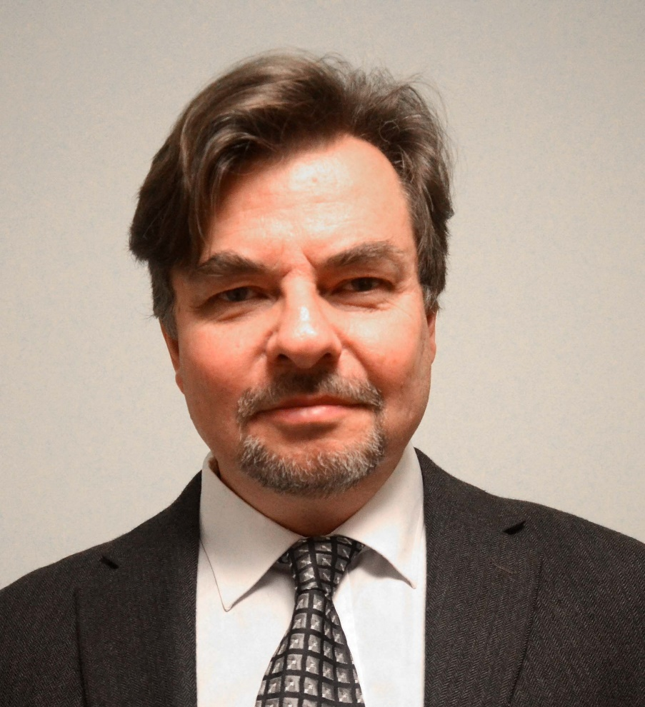
Rational Research in Environmental Ecology with Consideration of a Sustainable World Economy under Risk
Professor Dr Peter Lohmander
SLU, Sweden, http://www.Lohmander.com
Peter@Lohmander.com
BIT's 4th Annual International Congress of Environment-2014 (ICE-2014)
Theme: "Clean World, Happy Society"
September 21-23
Qingdao International Convention Center, Qingdao, China

Slide 2
Rational Research in Environmental Ecology with Consideration of a Sustainable World Economy under Risk
Dr. Peter Lohmander, Professor of Forest Management and Economic Optimization, SLU, Sweden, http://www.Lohmander.com Peter@Lohmander.com
In order to solve the global warming problem and other environmental and economic problems with global implications, it is necessary that the most relevant and important sustainable management options are well investigated and formulated. Models of biological growth should be developed that describe the production options available over time and space. These models should have relevant scales and be possible to integrate in general optimization models with spatial and dynamic dimensions, where not only the ecological problems are in focus but all relevant economical and technical problems are included. The forests are of particular importance, since they store large amounts of carbon and can produce a sustainable flow of biomass. The latest decades clearly show that detailed deterministic long term planning is irrelevant.
Energy prices, prices of industrial products and environmental problems rapidly change in ways that cannot be perfectly predicted. Research in environmental ecology with consideration of a sustainable world economy should focus on the development of growth models that are useful when stochastic optimal control theory is applied. Since biological production takes considerable time, it is very important to create options to sequentially adjust the production to new relative prices, growth conditions, ecological problems and possible damages caused by parasites, fire or storms. The analysis includes the structure of relevant stochastic optimal control problems and consistent development of research in environmental ecology.

Slide 3
In order to solve the global warming problem and other environmental and economic problems with global implications,
it is necessary that the most relevant and important sustainable management options are well investigated and formulated.

Slide 4
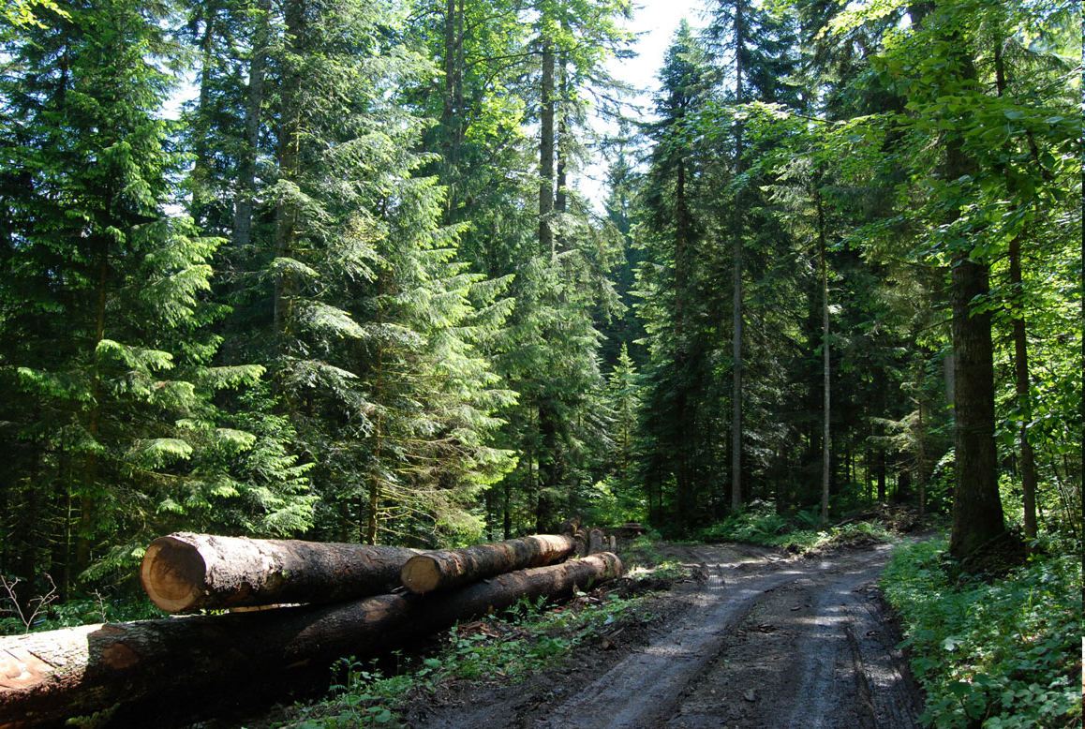
The forests are of particular importance, since they store large amounts of carbon and can produce a sustainable flow of biomass.

Slide 5
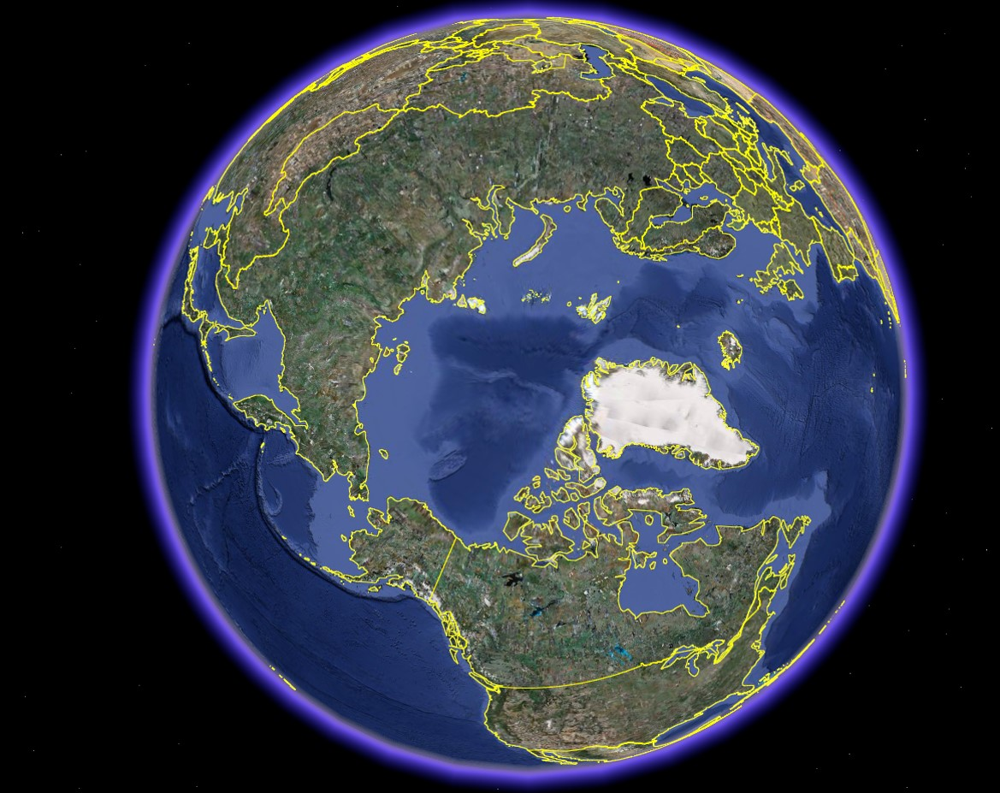
The most relevant
and important
new sustainable
management
options are found
where we presently
have very large
forest resources
with low degrees
of utilization.

Slide 6
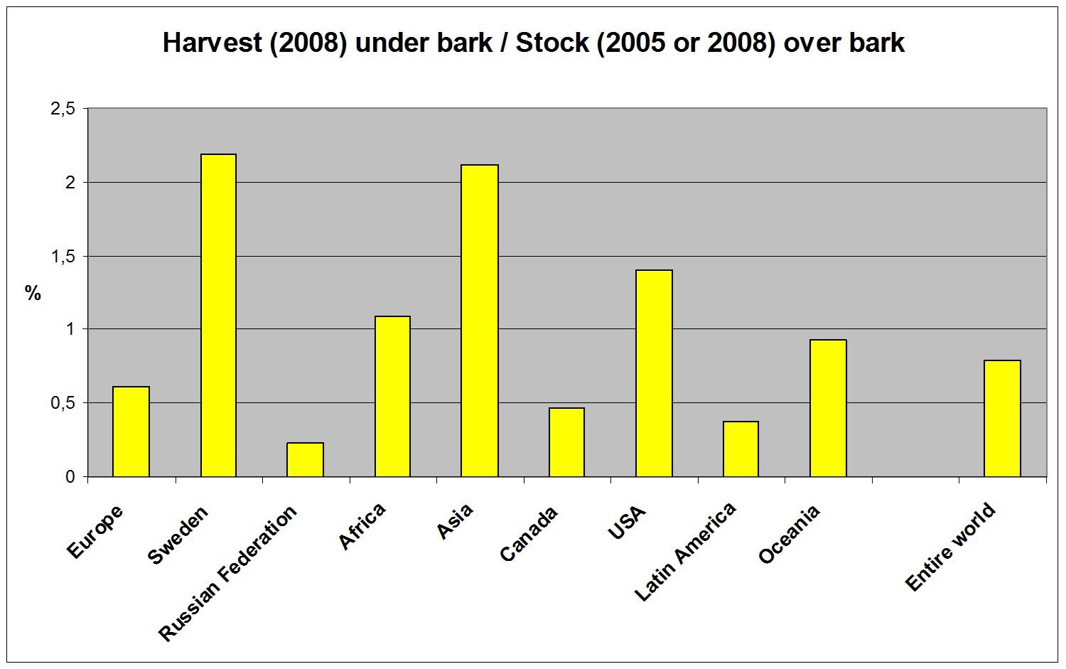

Slide 7
Very large forest areas in the north,
in particular in
Russian Federation
and Canada,
are covered by
more or less natural forests, where trees
of different sizes, ages and species, grow together.

Slide 8

181
69
156
Harvest Mm3 ub, 2008M (ubm3

Slide 9
A simple calculation based on official statistics shows that the sustainable forest production potential in Russian Federation is more than 2900 million cubic metres (over bark) per year.
The harvest (year 2008) was only
181 million cubic metres (under bark).
http://www.lohmander.com/RuMa09/Lohmander_Presentation.ppt
http://www.iiasa.ac.at/Research/FOR/forest_cdrom/english/for_fund_en.html

Slide 10
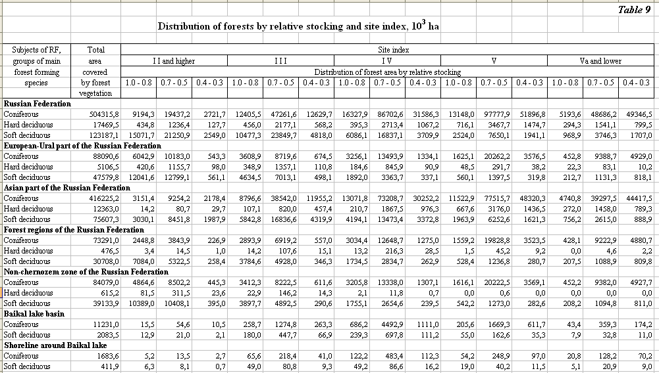
Source:
http://www.iiasa.ac.at/Research/FOR/forest_cdrom/english/for_fund_en.html
(From Roslesinforg, 2003, VNIILM, 2003)

Slide 11
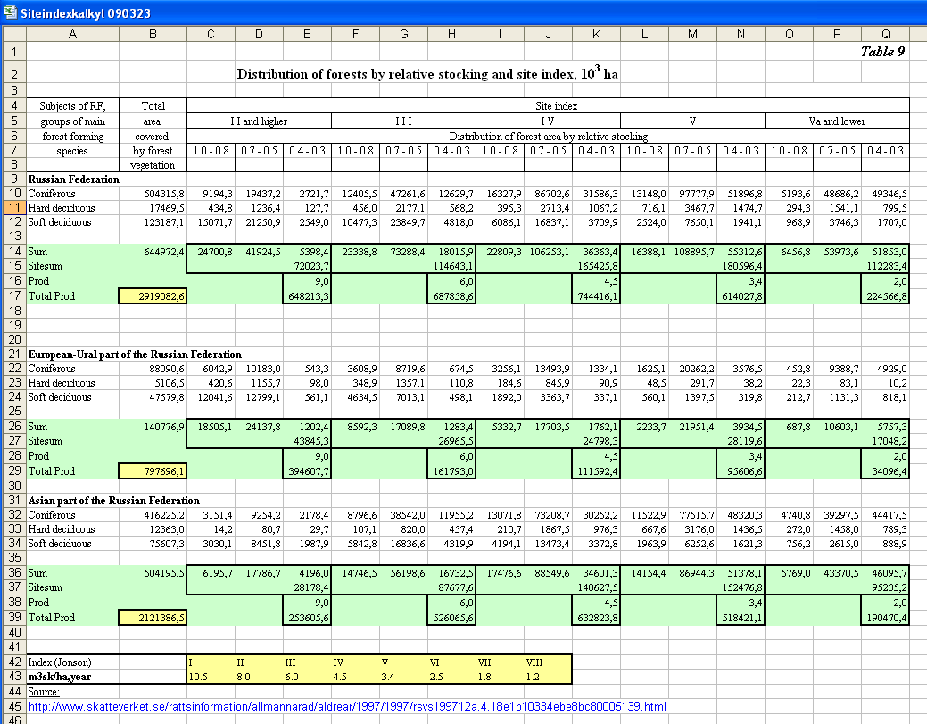
Calculation of the long run sustainable production level

Slide 12
Rough example and approximation:
All of the sustainable forest production potential in Russian Federation
(2900 million cubic metres, over bark, per year) is transformed to energy.
(In reality, some fraction will probably be used for other purposes.)
With 2 TWh/Mm3, we get:
5 800 TWh/year.

Slide 13
China is the world's largest power generator, surpassing the United States in 2011.
Net power generation was an estimated 4,476 TWh in 2011.

Slide 14
Modern research, based on typical conditions in the north, has shown that:
The economic value (present value) of forestry, starting with forests where trees of different sizes and ages grow together, is usually higher if we use optimal continuous cover forestry than if we instantly harvest all trees and periodically start new forest generations with plantations.
Furthermore,
The forest biomass production (and net CO2 uptake) can be higher if we never harvest all trees, but always keep growing trees on the land.
Many kinds of environmental values are higher if we use continuous cover forestry than if we periodically harvest all trees.

Slide 15
Why focus on mixed species forests?
The presently existing forests are to a large extent mixed species forests.
Mixed species forests give more options to sequentially adapt the forests to unexpected events such as market changes, changing environmental conditions, forest fires, parasites, etc.. In several cases they can be shown to give higher expected present values than single species forests.
Mixed species forests are less sensitive to species specific parasites and diseases
Mixed species forests have environmental advantages and make it possible for more animal species to exist.

Slide 16
Models of biological growth should be developed that describe the
production options available over time and space.

Slide 17
Forest growth model development should focus on growth in forests, where trees of different sizes, ages and species, grow together.
The models should be flexible and make it possible to investigate the effects of alternative dynamic controls (harvest volumes over time) and alternative selection principles (species and dimensions).

Slide 18
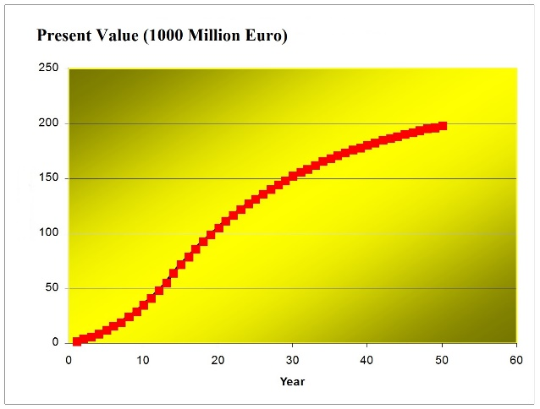
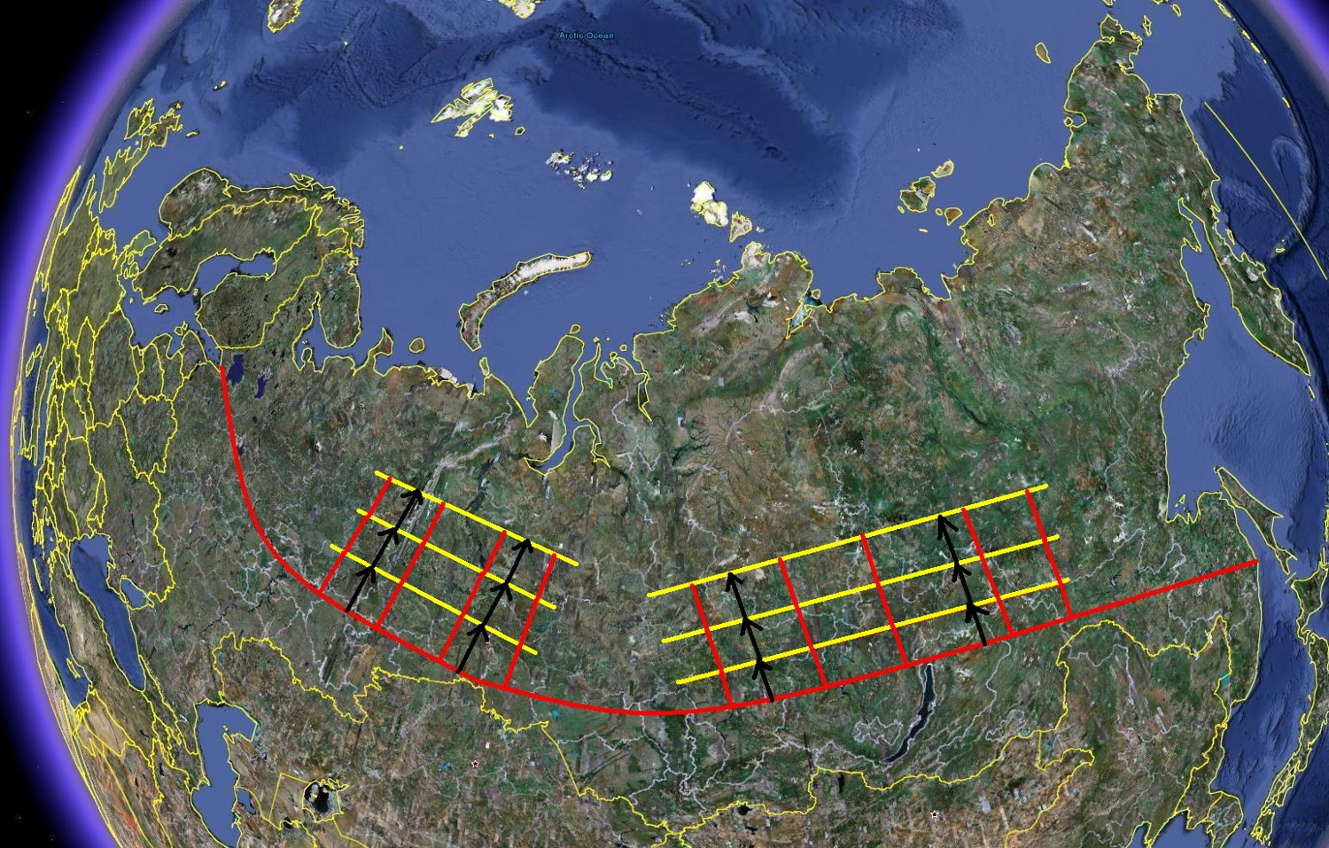
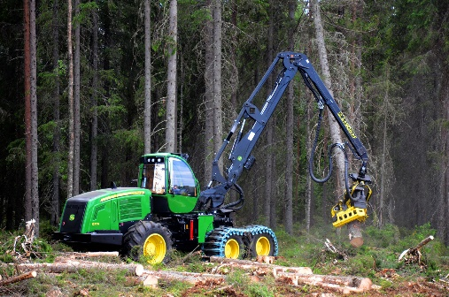
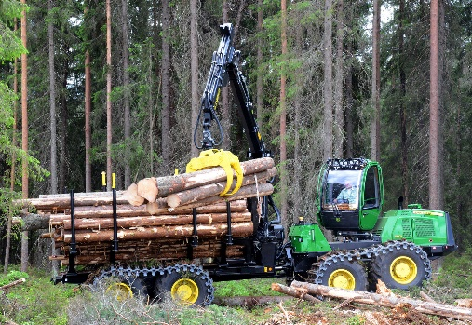
These models should have relevant scales and be possible to integrate in general optimization models with spatial and dynamic dimensions, where not only the ecological problems are in focus but all relevant economical and technical problems are included.

Slide 19
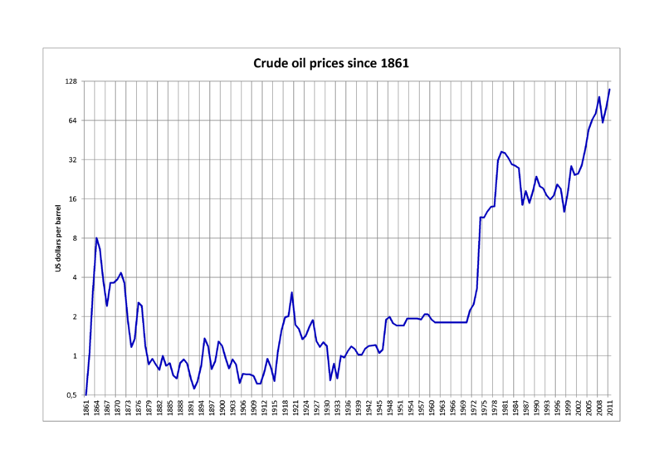
The latest decades clearly show that detailed deterministic long term planning is irrelevant.
Energy prices, prices of industrial products and environmental problems rapidly change in ways that cannot be perfectly predicted.
Source: http://en.wikipedia.org/wiki/Price_of_petroleum

Slide 20
Research in environmental ecology with consideration of a sustainable world economy should focus on the
development of growth models that are useful when stochastic optimal control theory is applied.

Slide 21
Since biological production takes considerable time, it is very important to
create options to sequentially adjust the production
to new relative prices, growth conditions, ecological problems and possible damages caused by parasites, fire or storms.

Slide 22
The analysis includes
the structure of relevant stochastic optimal control problems
and consistent development of research in environmental ecology.

Slide 23
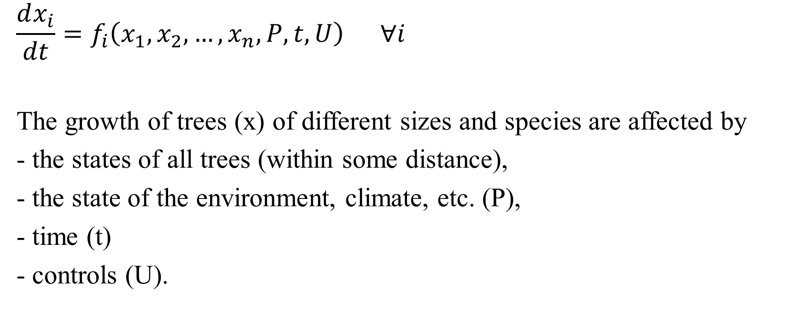
General growth functions are needed
$$\frac{dx_{i}}{dt}=f_{i}\left(x_{1},x_{2},…,x_{n},P,t,U\right) ∀i$$
The growth of trees (x) of different sizes and species are affected by
- the states of all trees (within some distance),
- the state of the environment, climate, etc. (P),
- time (t)
- controls (U).

Slide 24
Next, special cases illustrate the most central concepts and principles

Slide 25
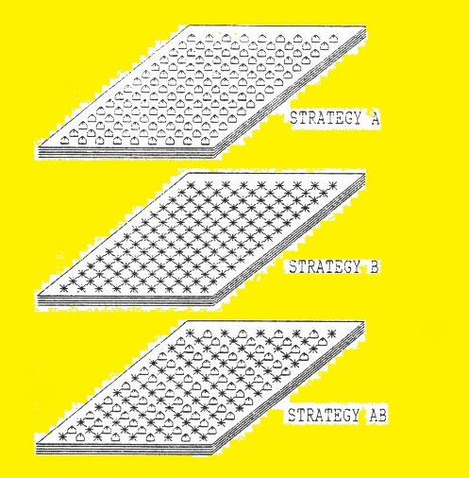
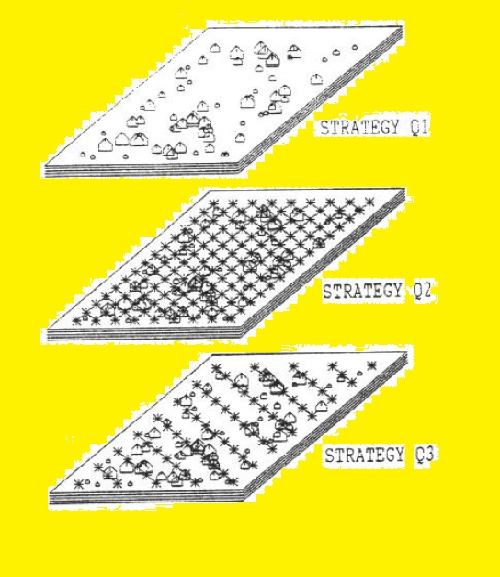

Slide 26
Lohmander, P., The multi species forest stand, stochastic prices and adaptive selective thinning, SYSTEMS ANALYSIS - MODELLING - SIMULATION, Vol. 9, 229-250, 1992
http://www.Lohmander.com/PL_SAMS_9_1992.pdf
Lohmander, P., Economic two stage multi period species management in a stochastic environment: The value of selective thinning options and stochastic growth parameters, SYSTEMS ANALYSIS - MODELLING -SIMULATION, Vol. 11, 287-302, 1993
http://www.Lohmander.com/PL_SAMS_11_1993.pdf
Lohmander, P., Optimal sequential forestry decisions under risk, ANNALS OF OPERATIONS RESEARCH, Vol. 95, pp. 217-228, 2000
http://www.Lohmander.com/PL_AOR_95_2000.pdf
Lohmander, P., Optimala beslut inför osäker framtid, FAKTA SKOG, SUAS, Nr 10, 2001
http://www.Lohmander.com/FS01-10.pdf

Slide 27
Lu, F., Lohmander, P., Optimal mixed stand management under risk, in Lu, F., Optimization of forest management decision making under conditions of risk, Doctoral Thesis, Acta Universitatis Agriculturae Sueciae, Swedish University of Agricultural Sciences, No. 333, 2004
Lohmander, P., Adaptive Optimization of Forest Management in a Stochastic World, in Weintraub A. et al (Editors), Handbook of Operations Research in Natural Resources, Springer, Springer Science, International Series in Operations Research and Management Science, New York, USA, pp 525-544, 2007
http://www.amazon.ca/gp/reader/0387718141/ref=sib_dp_pt/701-0734992-1741115#reader-link
http://www.Lohmander.com/PL_Handbook2007.pdf
Lu, F., Lohmander, P., Optimal Decisions for Mixed Forests under Risk,
Scientia Silvae Sinicae, Vol. 45, No. 11, Nov. 2009
http://www.Lohmander.com/Lu_Lohmander_2009.pdf

Slide 28
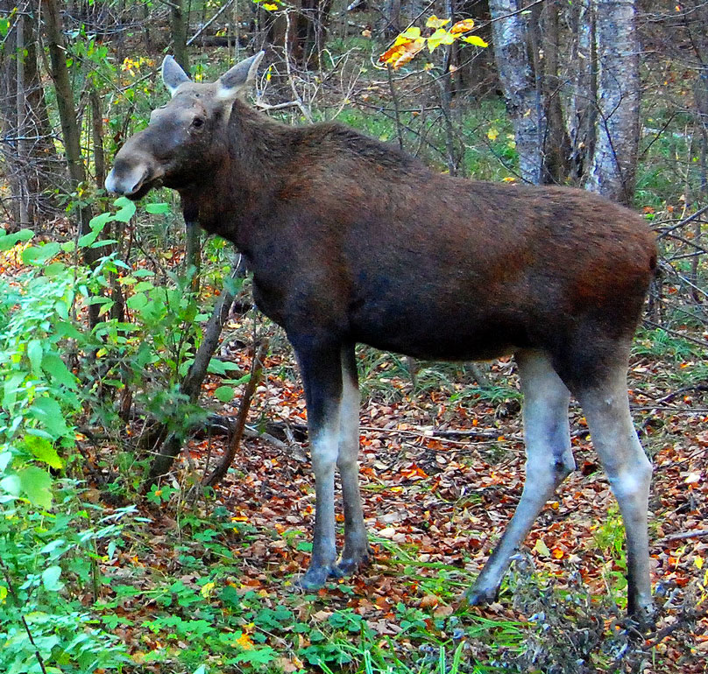
Will the moose eat
the pine trees?
This is not known when
the plantation is created.
If the forest contains several
tree species, the forest
production can continue
even if the moose will
eat the pine trees.

Slide 29
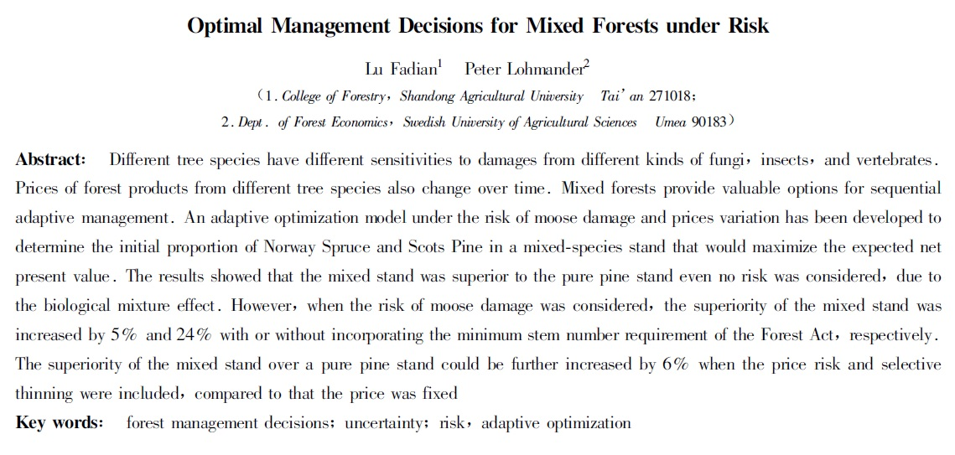
Lu, F., Lohmander, P., Optimal Decisions for Mixed Forests under Risk,
Scientia Silvae Sinicae, Vol. 45, No. 11, Nov. 2009
http://www.Lohmander.com/Lu_Lohmander_2009.pdf

Slide 30
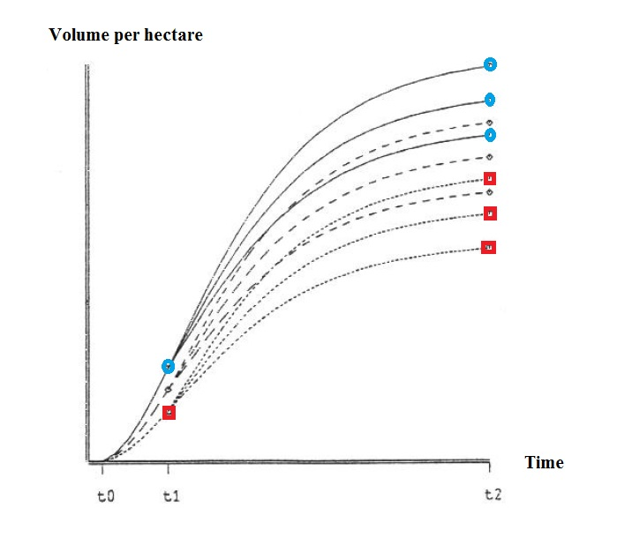
How will the climate and the
acidity of soils change during
the next 30 years?
How will this affect the
growth of different species?
That is not yet known.
If we have several species
in the forest, we can change
the species mix
when we know more,
at a later point in time.

Slide 31
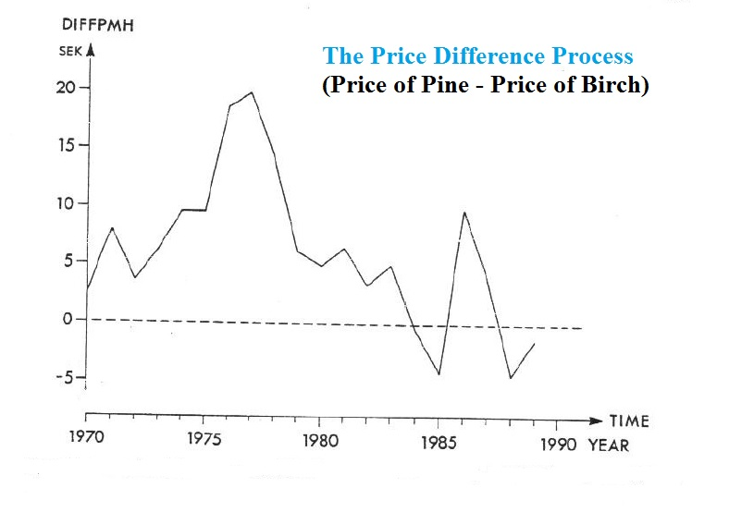
Which species will be
the most valuable to industry?
That is not yet known.
Relative prices change
as a function of technical
development in the
process industries.
If we start with a mixed forest,
we can rapidly adapt forest
production and harvesting
to changing prices.

Slide 32
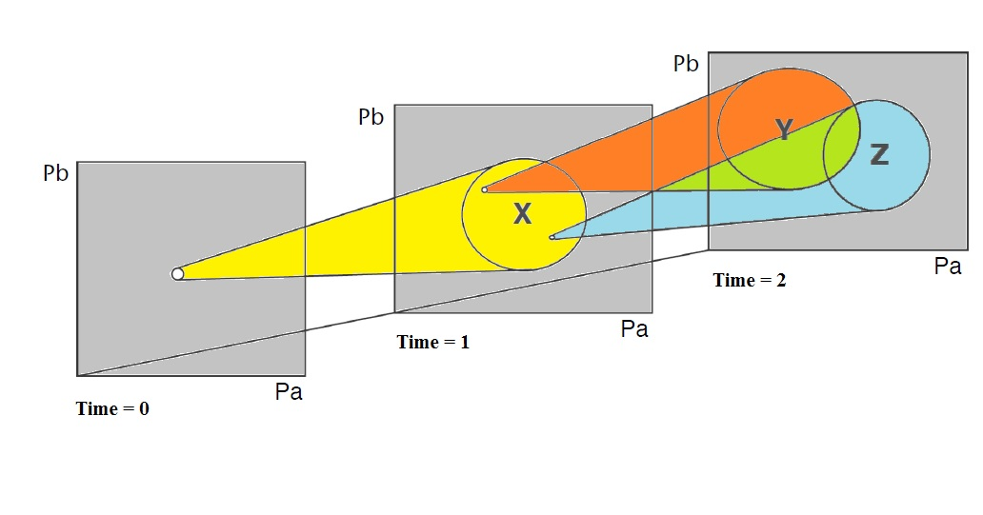
With a mixed species plantation at Time 0, we can select species for continued production at Time 1.
At Time 1, we know more (than what we knew at Time 0)
and we can make a better prediction of the conditions at Time 2.

Slide 33
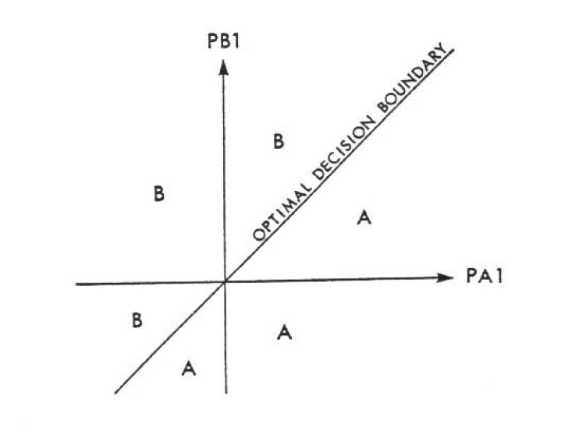
PA1 and PB1 are the prices
of species A and B at Time 1.
These prices are not known
at Time 0.
The
”OPTIMAL DECISION BOUNDARY”
is one example of a
stochastic optimal control rule.
At Time 1, you should continue
production of the
species A or B depending on
the state (PA1, PB1).

Slide 34
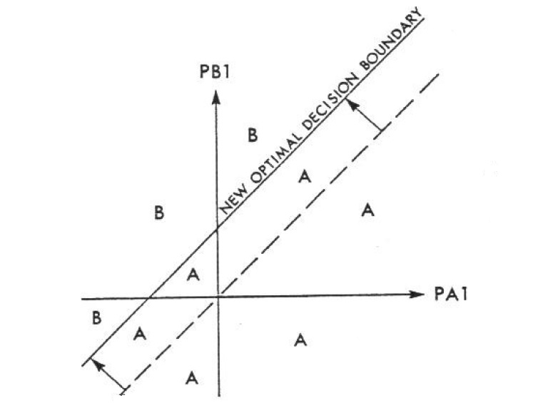
With other parameters,
growth conditions,
damage probabilities
etc.,
the
OPTIMAL DECISION BOUNDARY”
changes.
The graph shows what happens
if the expected growth of species A
increases in relation to the
expected growh of species B.

Slide 35
The stochastic prices and mixed species problem
An explorative investigation of the fundamental problem

Slide 36
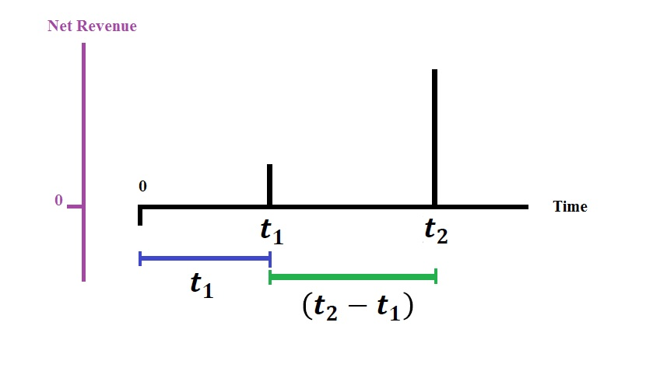

Slide 37
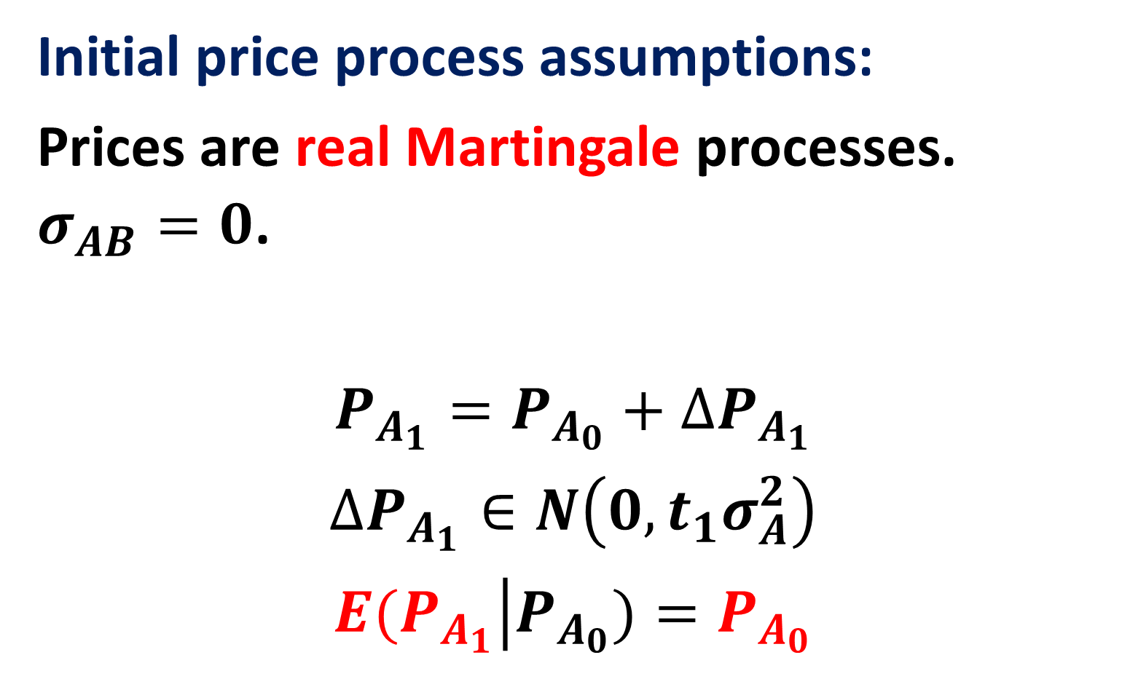
Initial price process assumptions:
Prices are real Martingale processes. $σ_{AB}=0$.
$$P_{A_{1}}=P_{A_{0}}+∆P_{A_{1}}$$
$$∆P_{A_{1}}∈N\left(0,t_{1}σ_{A}^{2}\right)$$
$$\left.E(P_{A_{1}}\right|P_{A_{0}})=P_{A_{0}}$$

Slide 38
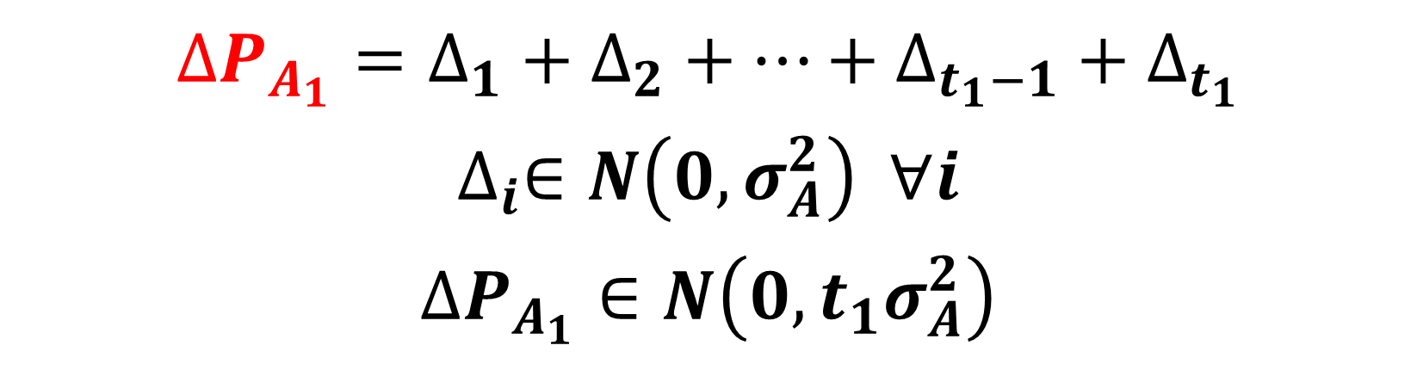
$$∆P_{A_{1}}=∆_{1}+∆_{2}+…+∆_{t_{1}−1}+∆_{t_{1}}$$
$$∆_{i}∈N\left(0,σ_{A}^{2}\right) ∀i$$
$$∆P_{A_{1}}∈N\left(0,{t_{1}σ}_{A}^{2}\right)$$

Slide 39
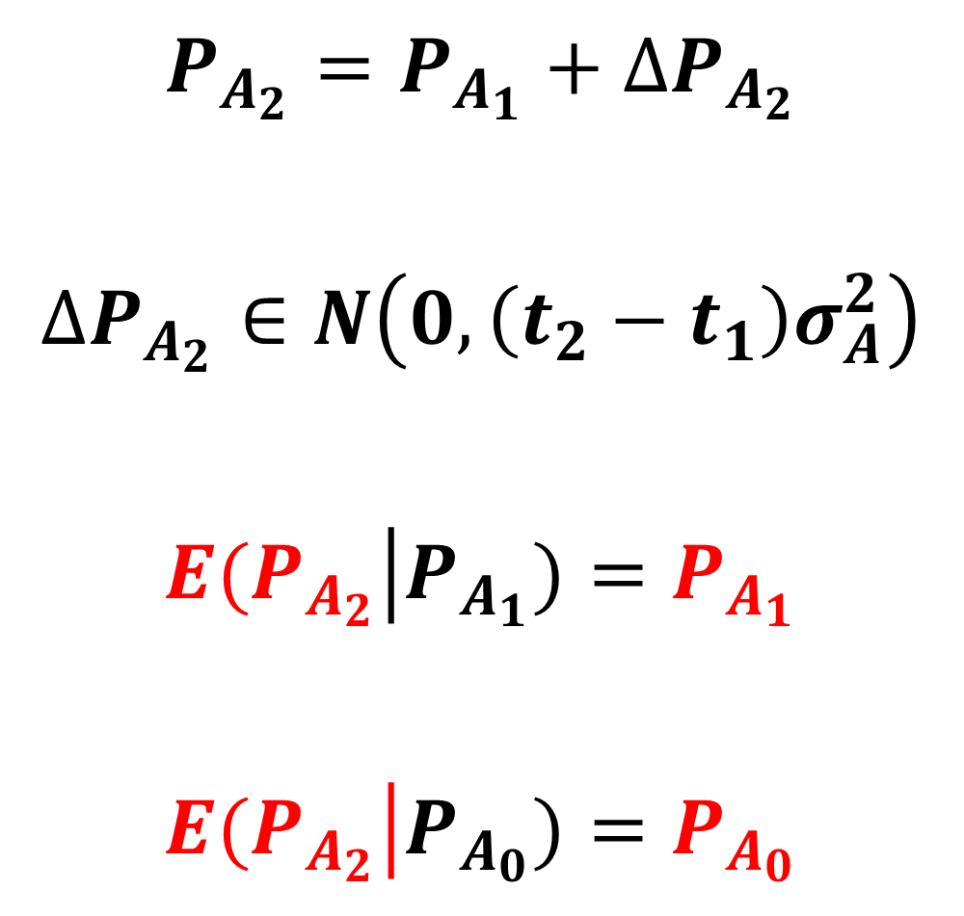
$$P_{A_{2}}=P_{A_{1}}+∆P_{A_{2}}$$
$$∆P_{A_{2}}∈N\left(0,\left(t_{2}−t_{1}\right)σ_{A}^{2}\right)$$
$$\left.E(P_{A_{2}}\right|P_{A_{1}})=P_{A_{1}}$$
$$\left.E(P_{A_{2}}\right|P_{A_{0}})=P_{A_{0}}$$

Slide 40
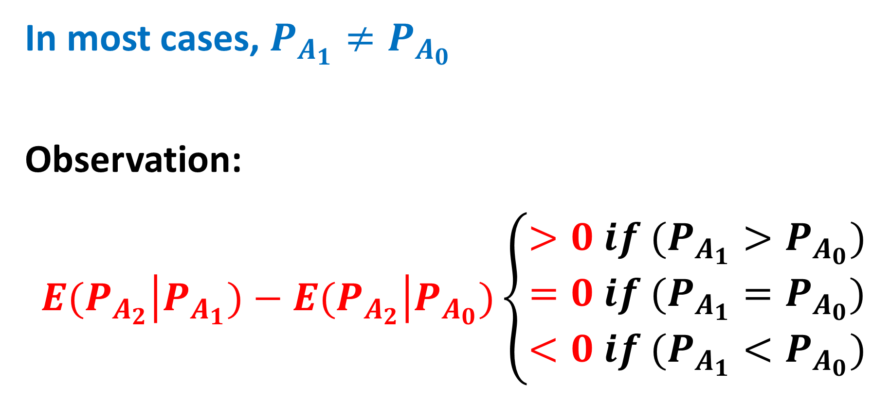
In most cases, $P_{A_{1}}≠P_{A_{0}}$
Observation:
$$\left.E(P_{A_{2}}\right|P_{A_{1}})−\left.E(P_{A_{2}}\right|P_{A_{0}})\left\{\begin{matrix}>0 if (P_{A_{1}}>P_{A_{0}}) \\ =0 if (P_{A_{1}}=P_{A_{0}}) \\ <0 if (P_{A_{1}}<P_{A_{0}})\end{matrix}\right.$$

Slide 41
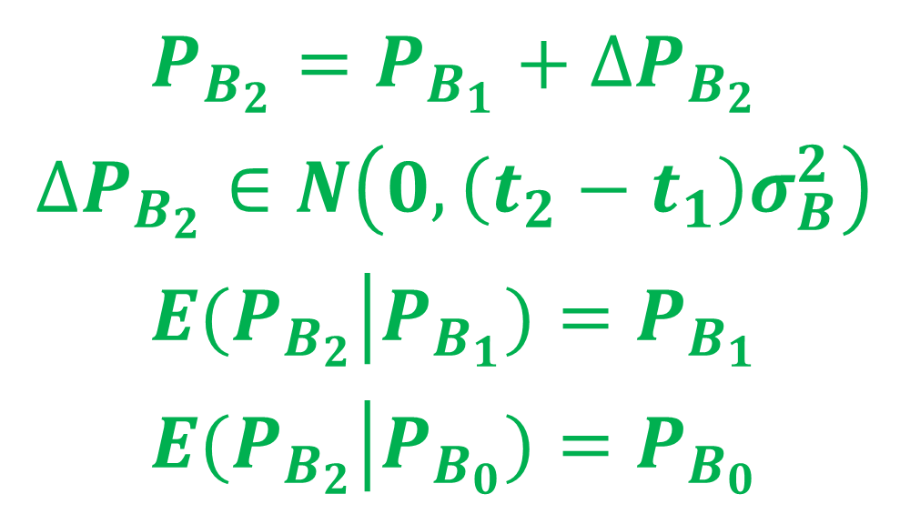
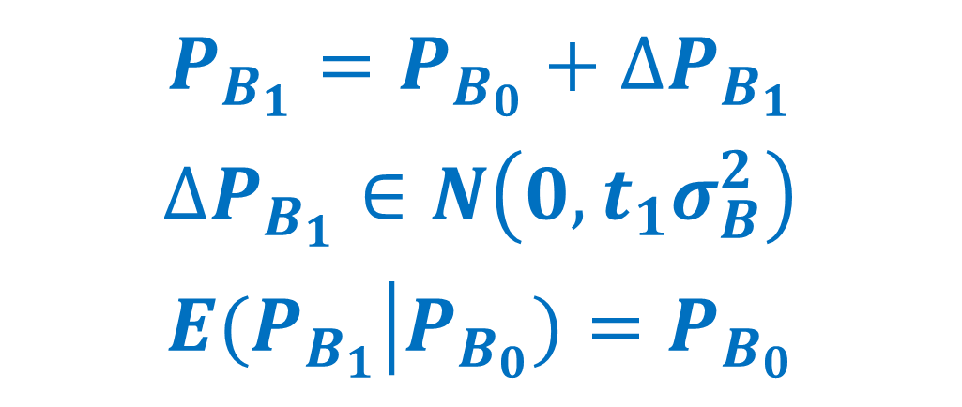
$$P_{B_{1}}=P_{B_{0}}+∆P_{B_{1}}$$
$$∆P_{B_{1}}∈N\left(0,t_{1}σ_{B}^{2}\right)$$
$$\left.E(P_{B_{1}}\right|P_{B_{0}})=P_{B_{0}}$$
$$P_{B_{2}}=P_{B_{1}}+∆P_{B_{2}}$$
$$∆P_{B_{2}}∈N\left(0,{\left(t_{2}−t_{1}\right)σ}_{B}^{2}\right)$$
$$\left.E(P_{B_{2}}\right|P_{B_{1}})=P_{B_{1}}$$
$$\left.E(P_{B_{2}}\right|P_{B_{0}})=P_{B_{0}}$$

Slide 42

In most cases, $P_{B_{1}}≠P_{B_{0}}$
Observation:
$$\left.E(P_{B_{2}}\right|P_{B_{1}})−\left.E(P_{B_{2}}\right|P_{B_{0}})\left\{\begin{matrix}>0 if (P_{B_{1}}>P_{B_{0}}) \\ =0 if (P_{B_{1}}=P_{B_{0}}) \\ <0 if (P_{B_{1}}<P_{B_{0}})\end{matrix}\right.$$

Slide 43
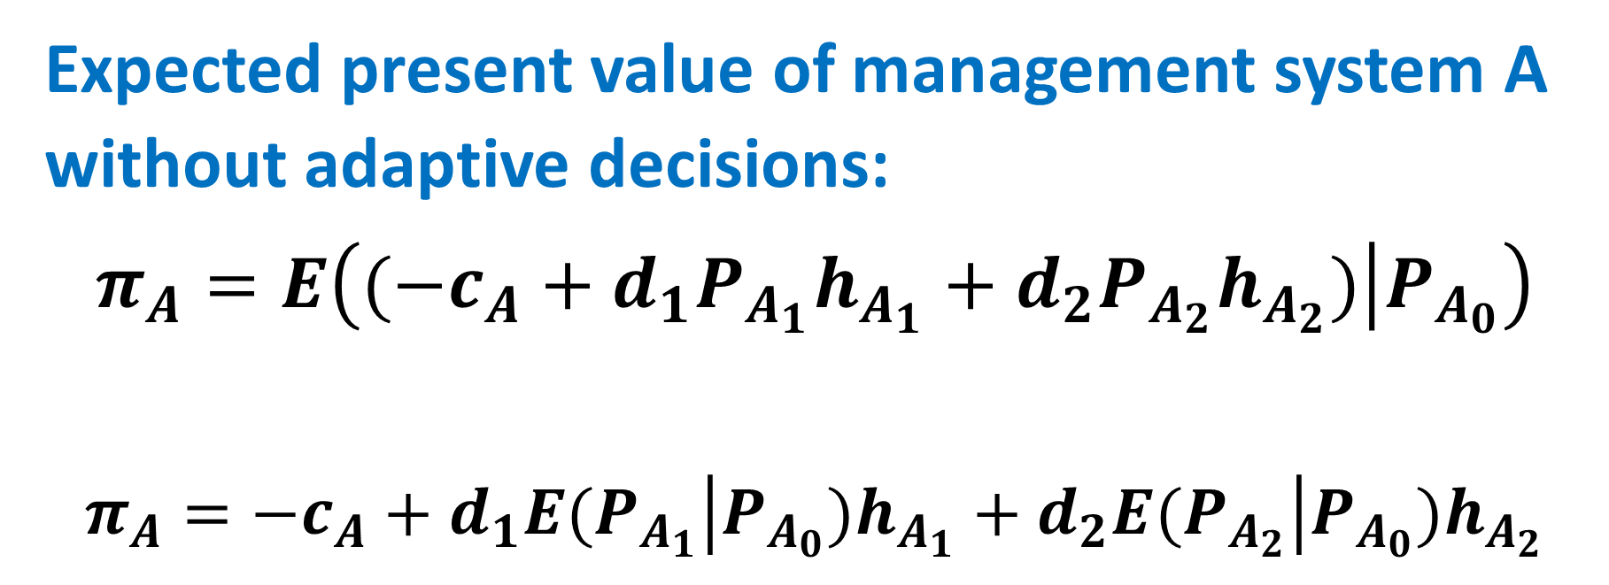
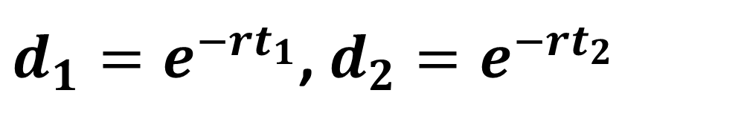
$d_{1}=e^{−rt_{1}}$, $d_{2}=e^{−rt_{2}}$
Expected present value of management system A without adaptive decisions:
$$π_{A}=E\left(\left.(−c_{A}+d_{1}P_{A_{1}}h_{A_{1}}+{d_{2}P}_{A_{2}}h_{A_{2}})\right|P_{A_{0}}\right)$$
$$π_{A}=−c_{A}+d_{1}E(\left.P_{A_{1}}\right|{P_{A_{0}})h}_{A_{1}}+d_{2}E(\left.P_{A_{2}}\right|{P_{A_{0}})h}_{A_{2}}$$

Slide 44
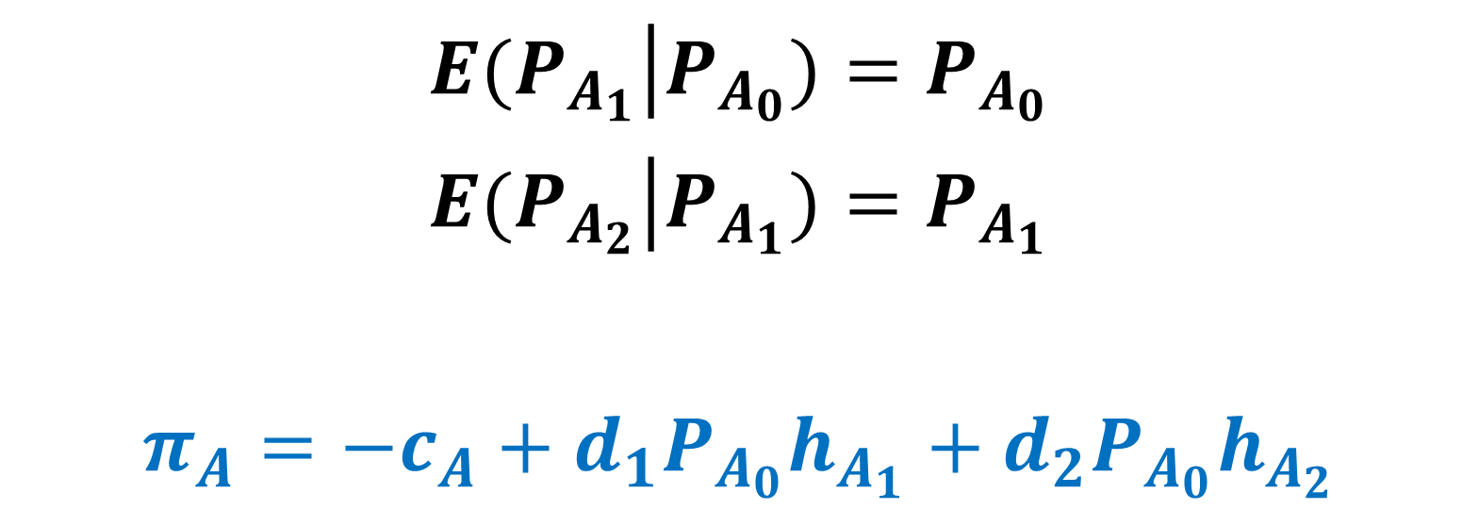
$$\left.E(P_{A_{1}}\right|P_{A_{0}})=P_{A_{0}}$$
$$\left.E(P_{A_{2}}\right|P_{A_{1}})=P_{A_{1}}$$
$$π_{A}=−c_{A}+{{d_{1}P}_{A_{0}}h}_{A_{1}}+{d_{2}P}_{A_{0}}h_{A_{2}}$$

Slide 45
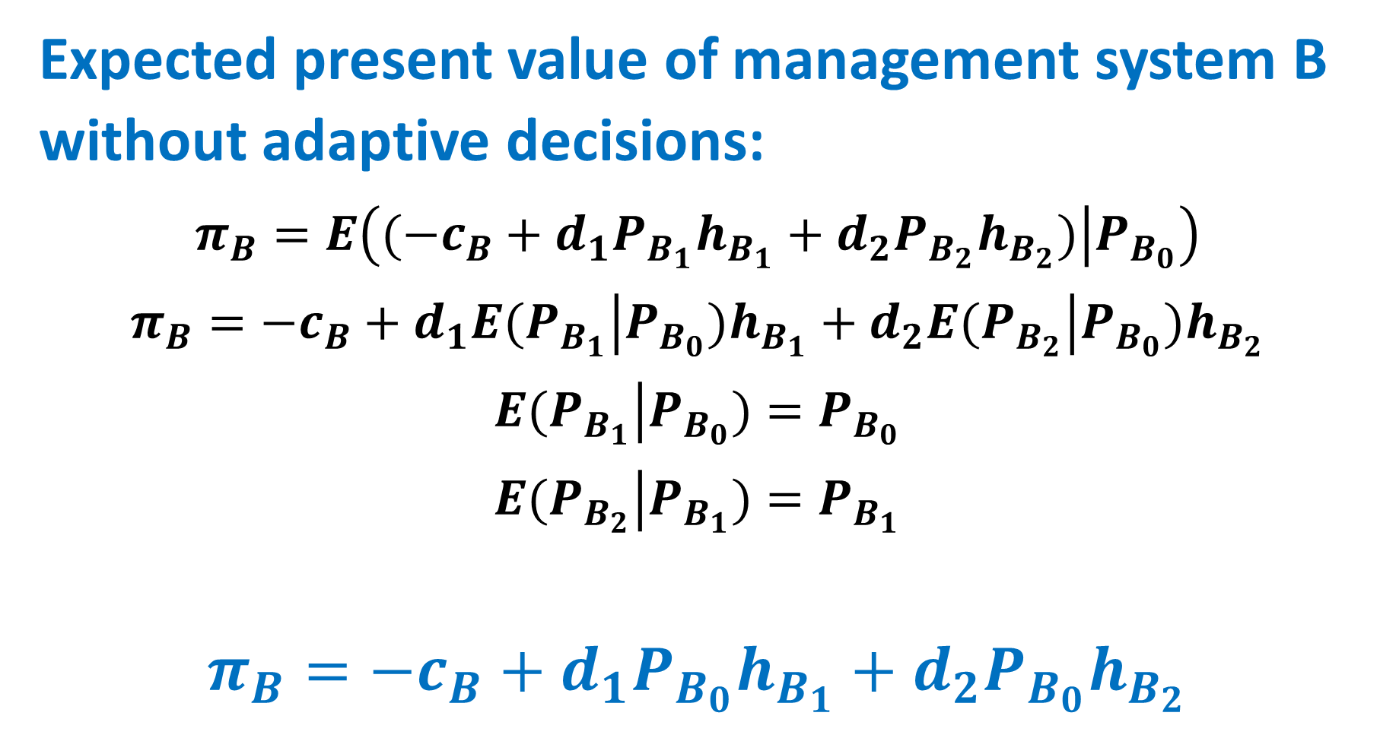
Expected present value of management system B without adaptive decisions:
$$π_{B}=E\left(\left.(−c_{B}+{d_{1}P}_{B_{1}}h_{B_{1}}+{d_{2}P}_{B_{2}}h_{B_{2}})\right|P_{B_{0}}\right)$$
$$π_{B}=−c_{B}+d_{1}E(\left.P_{B_{1}}\right|{P_{B_{0}})h}_{B_{1}}+d_{2}E(\left.P_{B_{2}}\right|{P_{B_{0}})h}_{B_{2}}$$
$$\left.E(P_{B_{1}}\right|P_{B_{0}})=P_{B_{0}}$$
$$\left.E(P_{B_{2}}\right|P_{B_{1}})=P_{B_{1}}$$
$$π_{B}=−c_{B}+{{d_{1}P}_{B_{0}}h}_{B_{1}}+d_{2}{P_{B_{0}}h}_{B_{2}}$$

Slide 46
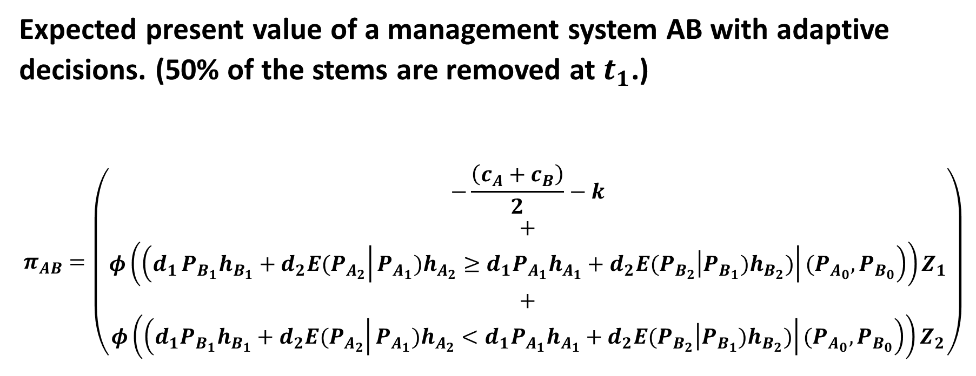
Expected present value of a management system AB with adaptive decisions. (50% of the stems are removed at $t_{1}$.)
$$π_{AB}=\left(\begin{aligned}−\frac{\left(c_{A}+c_{B}\right)}{2}−k \\ + \\ φ\left(\left(d_{1}{\left.{{P_{B_{1}}h}_{B_{1}}+\left.d_{2}E(P_{A_{2}}\right|P_{A_{1}})h_{A_{2}}≥d_{1}P}_{A_{1}}h_{A_{1}}+\left.d_{2}E(P_{B_{2}}\right|P_{B_{1}})h_{B_{2}})\right|(P_{A_{0}},P}_{B_{0}}\right)\right)Z_{1} \\ + \\ φ\left(\left({\left.{{{d_{1}P}_{B_{1}}h}_{B_{1}}+\left.d_{2}E(P_{A_{2}}\right|P_{A_{1}})h_{A_{2}}<d_{1}P}_{A_{1}}h_{A_{1}}+\left.d_{2}E(P_{B_{2}}\right|P_{B_{1}})h_{B_{2}})\right|(P_{A_{0}},P}_{B_{0}}\right)\right)Z_{2}\end{aligned}\right)$$

Slide 47
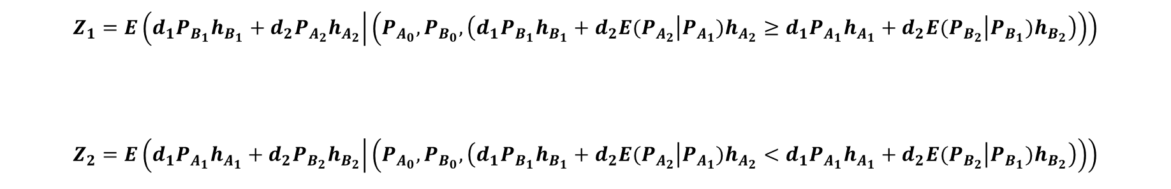
$$Z_{1}=E\left(d_{1}P_{B_{1}}h_{B_{1}}+{d_{2}P}_{A_{2}}h_{A_{2}} | \left(P_{A_{0}},P_{B_{0}}, \left({{{d_{1}P}_{B_{1}}h}_{B_{1}}+\left.d_{2}E(P_{A_{2}}\right|P_{A_{1}})h_{A_{2}}≥d_{1}P}_{A_{1}}h_{A_{1}}+\left.d_{2}E(P_{B_{2}}\right|P_{B_{1}})h_{B_{2}}\right)\right)\right)$$
$$Z_{2}=E\left(d_{1}P_{A_{1}}h_{A_{1}}+{d_{2}P}_{B_{2}}h_{B_{2}} | \left(P_{A_{0}},P_{B_{0}},\left(d_{1}{{P_{B_{1}}h}_{B_{1}}+\left.d_{2}E(P_{A_{2}}\right|P_{A_{1}})h_{A_{2}}<d_{1}P}_{A_{1}}h_{A_{1}}+\left.d_{2}E(P_{B_{2}}\right|P_{B_{1}})h_{B_{2}}\right)\right)\right)$$

Slide 48
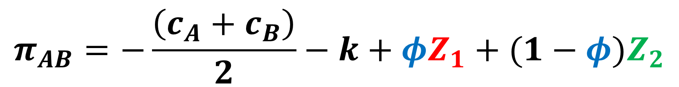
$$π_{AB}=−\frac{\left(c_{A}+c_{B}\right)}{2}−k+φZ_{1}+(1−φ)Z_{2}$$

Slide 49
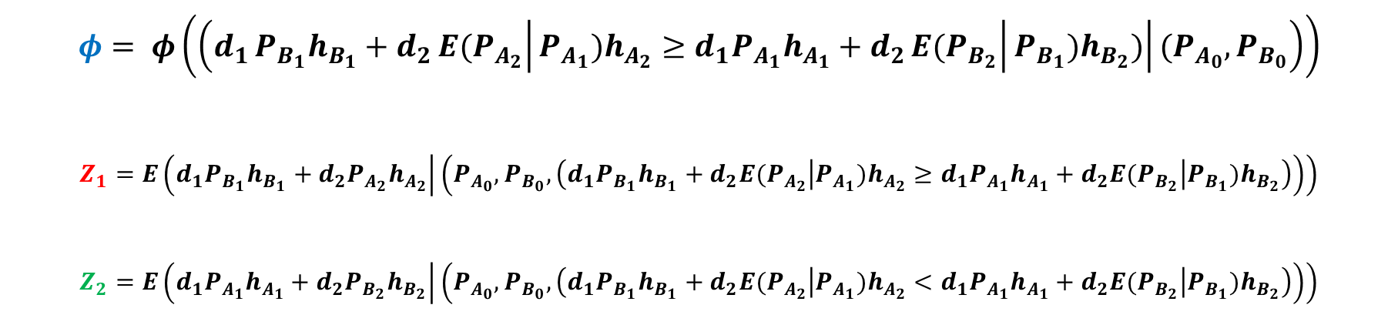

$$π_{AB}=−\frac{\left(c_{A}+c_{B}\right)}{2}−k+φZ_{1}+(1−φ)Z_{2}$$
$$φ= φ\left(\left(d_{1}{\left.{{P_{B_{1}}h}_{B_{1}}+d_{2}\left.E(P_{A_{2}}\right|P_{A_{1}})h_{A_{2}}≥d_{1}P}_{A_{1}}h_{A_{1}}+d_{2}\left.E(P_{B_{2}}\right|P_{B_{1}})h_{B_{2}})\right|(P_{A_{0}},P}_{B_{0}}\right)\right)$$
$$Z_{1}=E\left(d_{1}P_{B_{1}}h_{B_{1}}+{d_{2}P}_{A_{2}}h_{A_{2}} | \left(P_{A_{0}},P_{B_{0}}, \left({{{d_{1}P}_{B_{1}}h}_{B_{1}}+\left.d_{2}E(P_{A_{2}}\right|P_{A_{1}})h_{A_{2}}≥d_{1}P}_{A_{1}}h_{A_{1}}+\left.d_{2}E(P_{B_{2}}\right|P_{B_{1}})h_{B_{2}}\right)\right)\right)$$
$$Z_{2}=E\left(d_{1}P_{A_{1}}h_{A_{1}}+{d_{2}P}_{B_{2}}h_{B_{2}} | \left(P_{A_{0}},P_{B_{0}},\left(d_{1}{{P_{B_{1}}h}_{B_{1}}+\left.d_{2}E(P_{A_{2}}\right|P_{A_{1}})h_{A_{2}}<d_{1}P}_{A_{1}}h_{A_{1}}+\left.d_{2}E(P_{B_{2}}\right|P_{B_{1}})h_{B_{2}}\right)\right)\right)$$

Slide 50
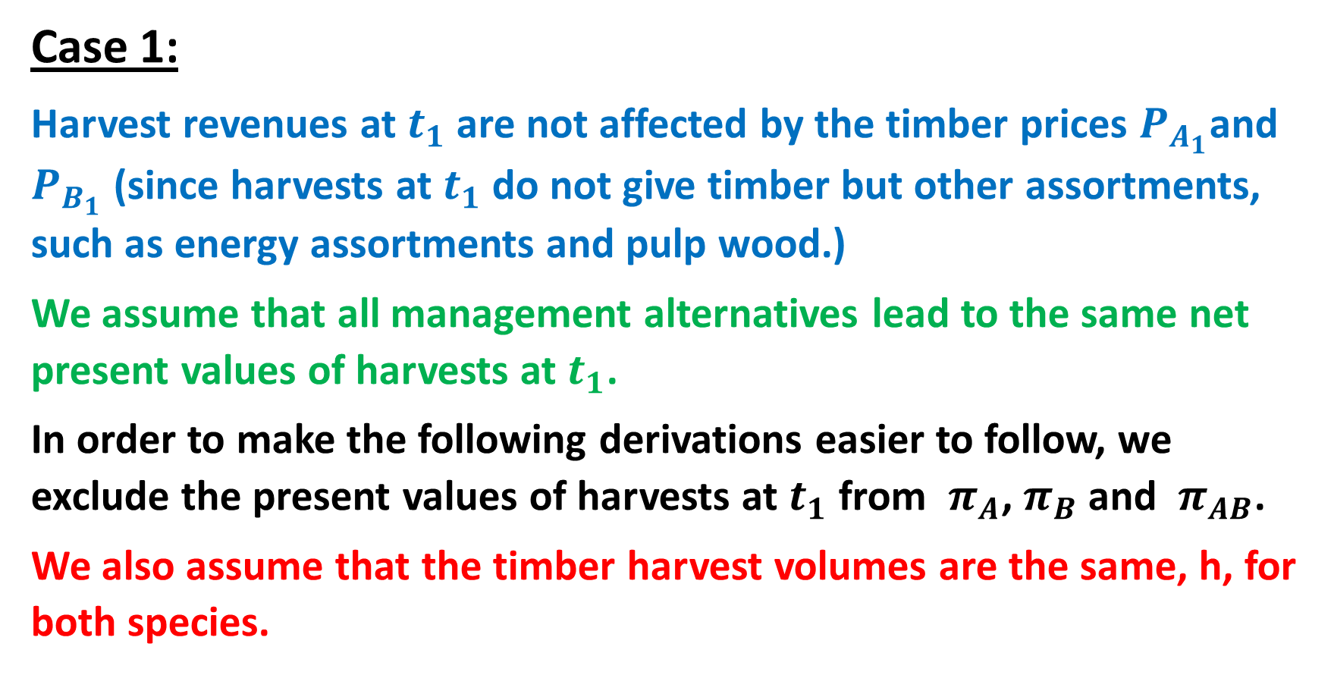
Case 1:
Harvest revenues at $t_{1}$ are not affected by the timber prices $P_{A_{1}}$and $P_{B_{1}}$ (since harvests at $t_{1}$ do not give timber but other assortments, such as energy assortments and pulp wood.)
We assume that all management alternatives lead to the same net present values of harvests at $t_{1}$.
In order to make the following derivations easier to follow, we exclude the present values of harvests at $t_{1}$ from $π_{A}$, $π_{B}$ and $π_{AB}$.
We also assume that the timber harvest volumes are the same, h, for both species.

Slide 51
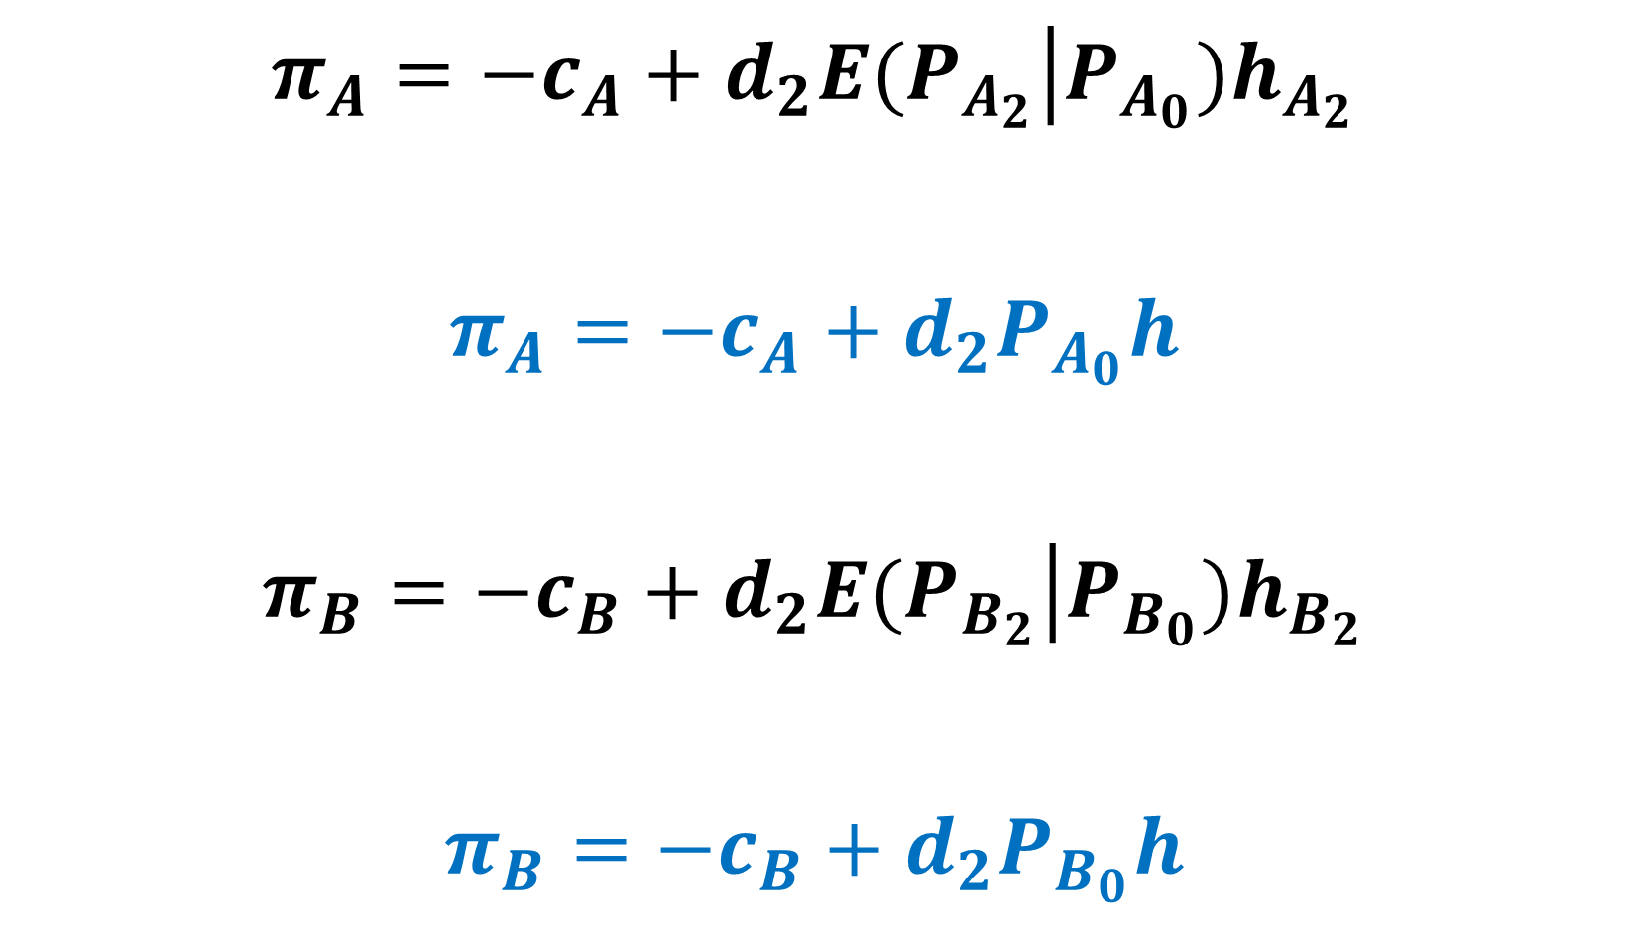
$$π_{A}=−c_{A}+d_{2}E(\left.P_{A_{2}}\right|{P_{A_{0}})h}_{A_{2}}$$
$$π_{A}=−c_{A}+{d_{2}P}_{A_{0}}h$$
$$π_{B}=−c_{B}+d_{2}E(\left.P_{B_{2}}\right|{P_{B_{0}})h}_{B_{2}}$$
$$π_{B}=−c_{B}+d_{2}P_{B_{0}}h$$

Slide 52
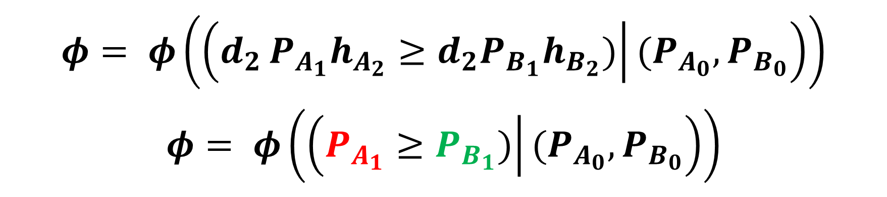
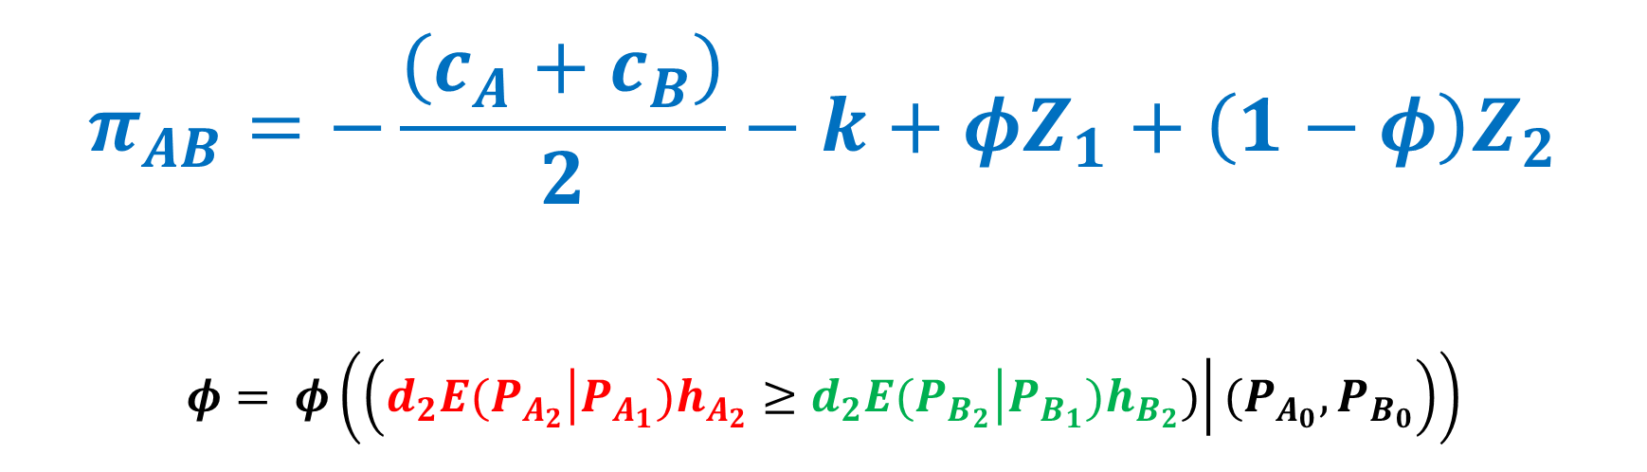
$$π_{AB}=−\frac{\left(c_{A}+c_{B}\right)}{2}−k+φZ_{1}+\left(1−φ\right)Z_{2}$$
$$φ= φ\left(\left({\left.\left.d_{2}E(P_{A_{2}}\right|P_{A_{1}})h_{A_{2}}≥\left.d_{2}E(P_{B_{2}}\right|P_{B_{1}})h_{B_{2}})\right|(P_{A_{0}},P}_{B_{0}}\right)\right)$$
$$φ= φ\left(\left(d_{2}{\left.{P_{A_{1}}h}_{A_{2}}≥d_{2}P_{B_{1}}h_{B_{2}})\right|(P_{A_{0}},P}_{B_{0}}\right)\right)$$
$$φ= φ\left(\left({\left.P_{A_{1}}≥P_{B_{1}})\right|(P_{A_{0}},P}_{B_{0}}\right)\right)$$

Slide 53
PA1 and PB1 are the prices
of species A and B at Time 1.
These prices are not known
at Time 0.
The
”OPTIMAL DECISION BOUNDARY”
is one example of a
stochastic optimal control rule.
At Time 1, you should continue
production of the
species A or B depending on
the state (PA1, PB1).

Slide 54
With other parameters,
growth conditions,
damage probabilities
etc.,
the
OPTIMAL DECISION BOUNDARY”
changes.
The graph shows what happens
if the expected growth of species A
increases in relation to the
expected growh of species B.

Slide 55
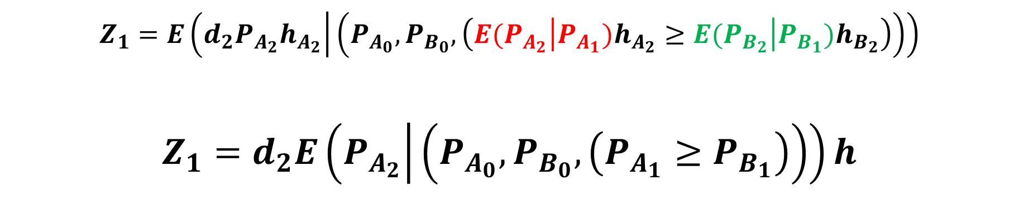
$$Z_{1}=E\left(d_{2}P_{A_{2}}h_{A_{2}} | \left(P_{A_{0}},P_{B_{0}}, \left({\left.E(P_{A_{2}}\right|P_{A_{1}})h}_{A_{2}}≥\left.E(P_{B_{2}}\right|P_{B_{1}})h_{B_{2}}\right)\right)\right)$$
$$Z_{1}=d_{2}E\left(P_{A_{2}} | \left(P_{A_{0}},P_{B_{0}}, \left(P_{A_{1}}≥P_{B_{1}}\right)\right)\right)h$$

Slide 56
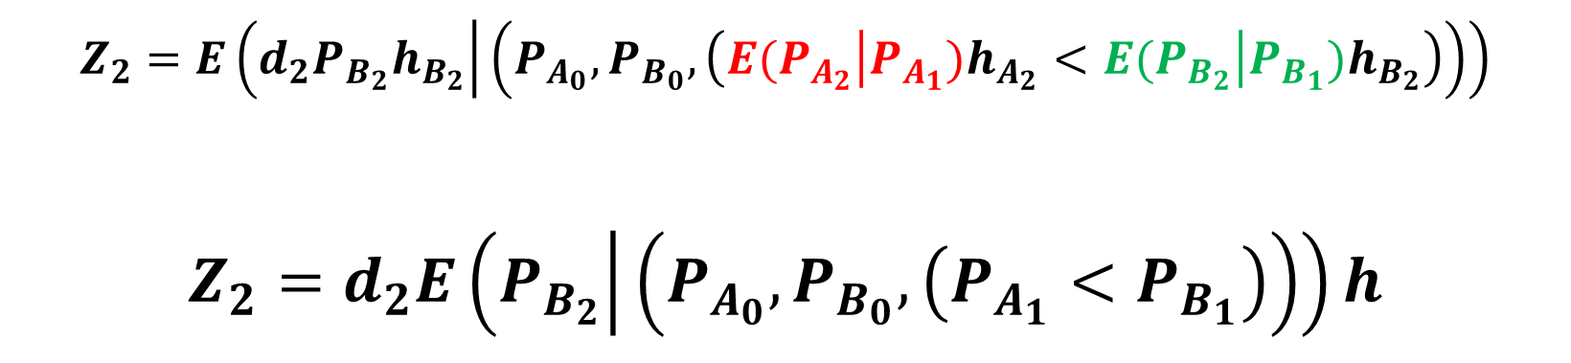
$$Z_{2}=E\left({d_{2}P}_{B_{2}}h_{B_{2}} | \left(P_{A_{0}},P_{B_{0}},\left({\left.E(P_{A_{2}}\right|P_{A_{1}})h}_{A_{2}}<\left.E(P_{B_{2}}\right|P_{B_{1}})h_{B_{2}}\right)\right)\right)$$
$$Z_{2}=d_{2}E\left(P_{B_{2}} | \left(P_{A_{0}},P_{B_{0}}, \left(P_{A_{1}}<P_{B_{1}}\right)\right)\right)h$$

Slide 57
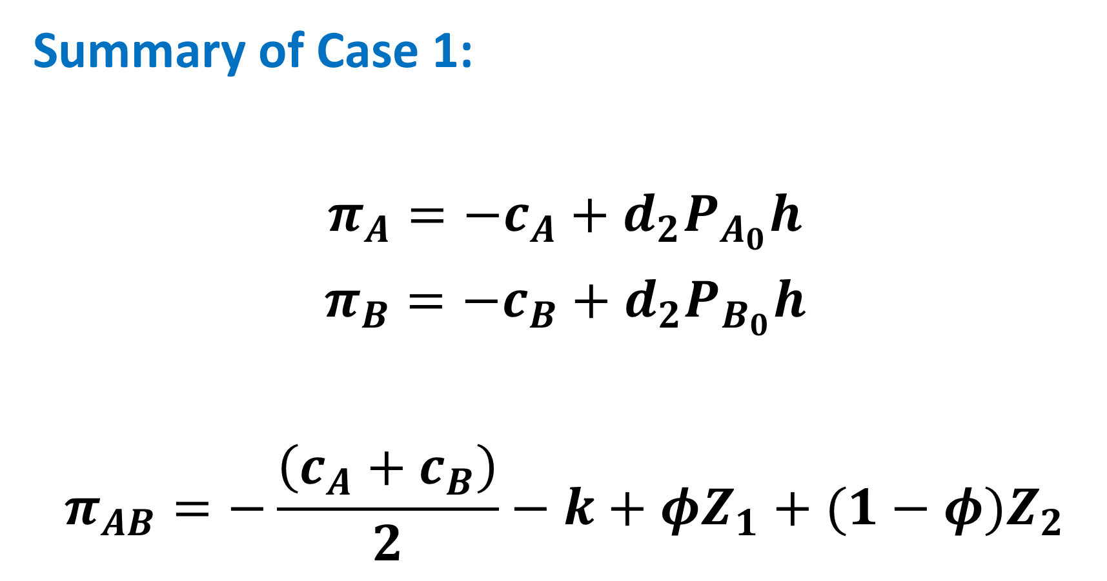
Summary of Case 1:
$$π_{A}=−c_{A}+{d_{2}P}_{A_{0}}h$$
$$π_{B}=−c_{B}+{d_{2}P}_{B_{0}}h$$
$$π_{AB}=−\frac{\left(c_{A}+c_{B}\right)}{2}−k+φZ_{1}+(1−φ)Z_{2}$$

Slide 58
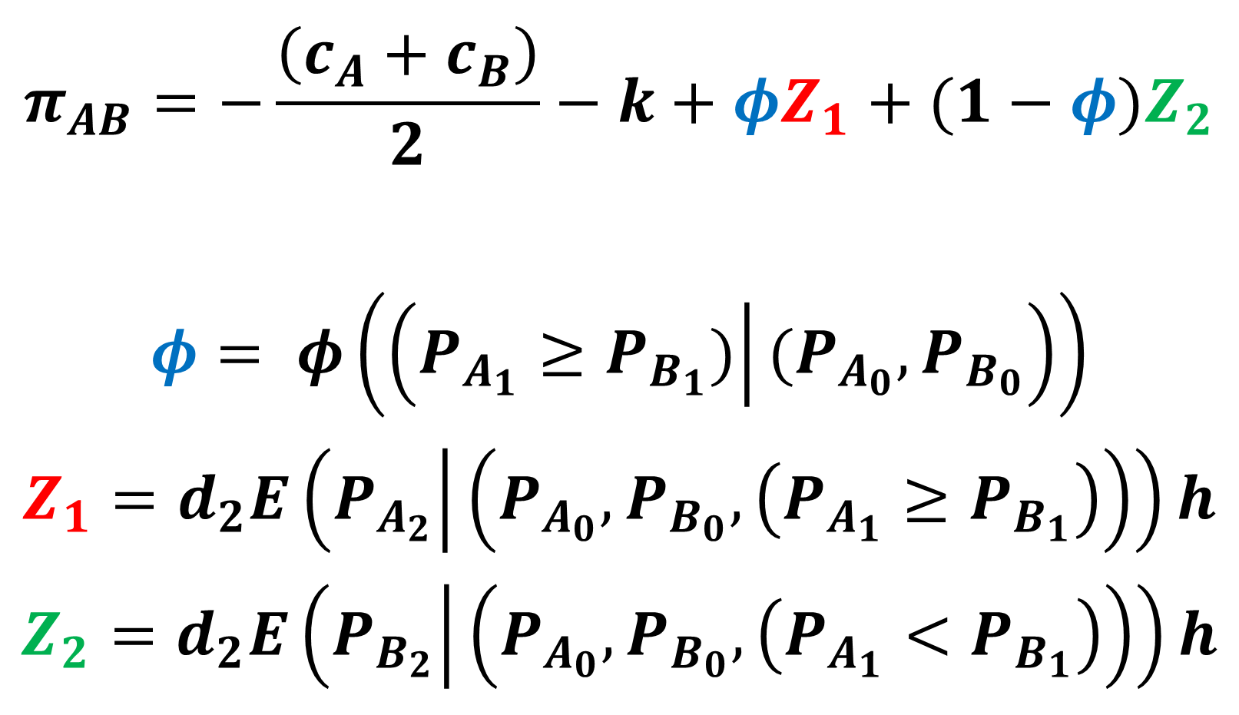
$$π_{AB}=−\frac{\left(c_{A}+c_{B}\right)}{2}−k+φZ_{1}+(1−φ)Z_{2}$$
$$φ= φ\left(\left({\left.P_{A_{1}}≥P_{B_{1}})\right|(P_{A_{0}},P}_{B_{0}}\right)\right)$$
$$Z_{1}=d_{2}E\left(P_{A_{2}} | \left(P_{A_{0}},P_{B_{0}}, \left(P_{A_{1}}≥P_{B_{1}}\right)\right)\right)h$$
$$Z_{2}=d_{2}E\left(P_{B_{2}} | \left(P_{A_{0}},P_{B_{0}}, \left(P_{A_{1}}<P_{B_{1}}\right)\right)\right)h$$

Slide 59
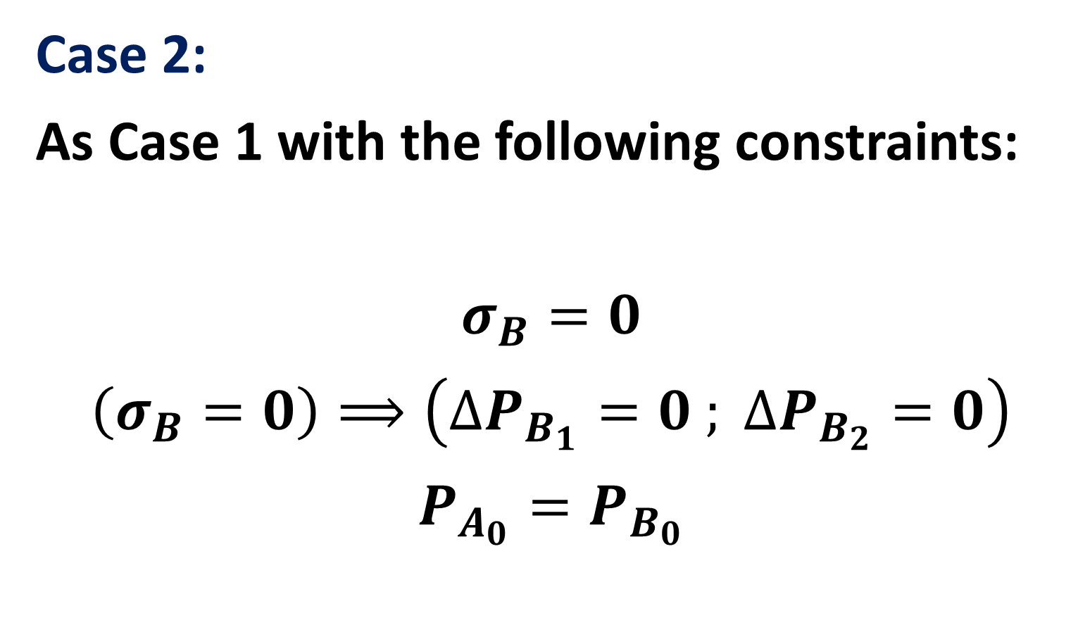
Case 2:
As Case 1 with the following constraints:
$$σ_{B}=0$$
$$\left(σ_{B}=0\right)⟹\left(∆P_{B_{1}}=0 ; ∆P_{B_{2}}=0\right)$$
$${P_{A_{0}}=P}_{B_{0}}$$

Slide 60
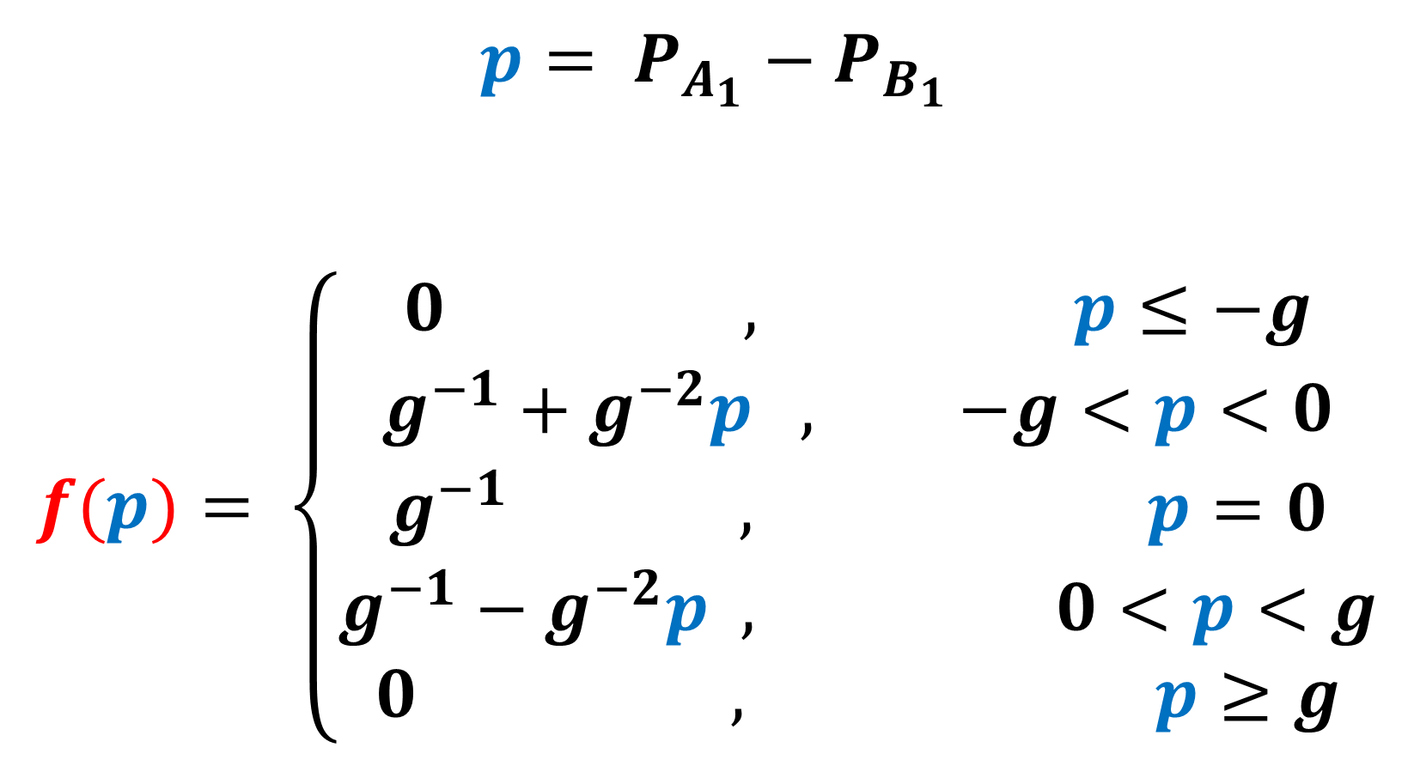
$$p= {P_{A_{1}}−P}_{B_{1}}$$
$$f(p)= \left\{\begin{matrix}0 , p≤−g \\ g^{−1}+g^{−2}p , −g<p<0 \\ g^{−1 } , p=0 \\ g^{−1}−g^{−2}p , 0<p<g \\ 0 , p≥g\end{matrix}\right.$$

Slide 61
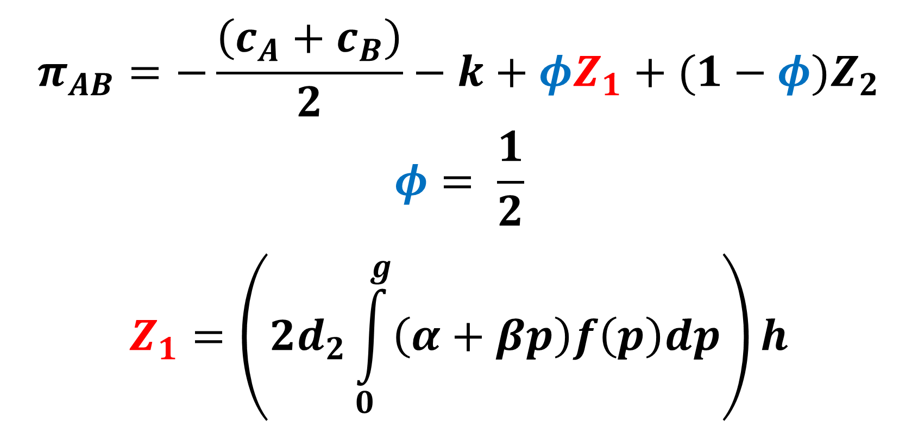
$$π_{AB}=−\frac{\left(c_{A}+c_{B}\right)}{2}−k+φZ_{1}+(1−φ)Z_{2}$$
$$φ= \frac{1}{2}$$
$$Z_{1}=\left(2d_{2}\int_{0}^{g}{\left(α+βp\right)f\left(p\right)dp}\right)h$$

Slide 62
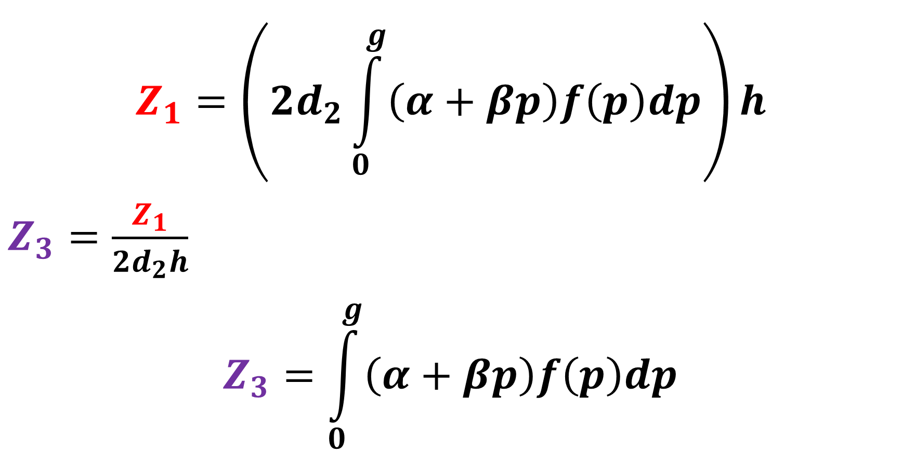
$$Z_{1}=\left(2d_{2}\int_{0}^{g}{\left(α+βp\right)f\left(p\right)dp}\right)h$$
$Z_{3}=\frac{Z_{1}}{2d_{2}h}$
$$Z_{3}=\int_{0}^{g}{\left(α+βp\right)f\left(p\right)dp}$$

Slide 63
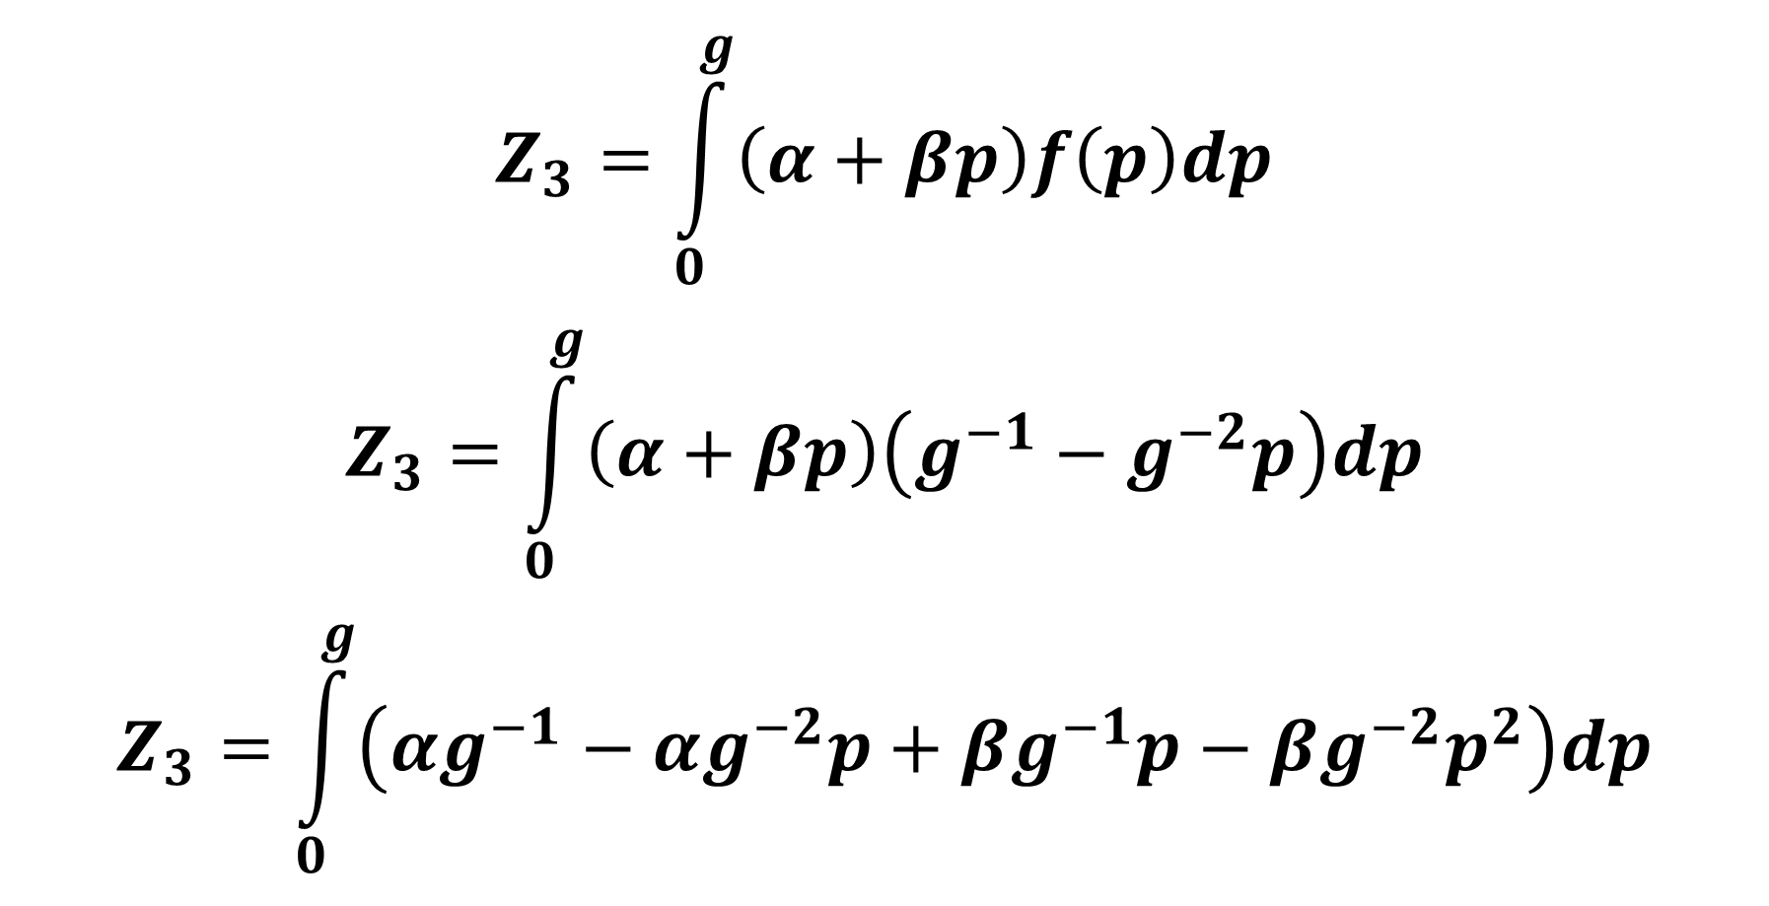
$$Z_{3}=\int_{0}^{g}{\left(α+βp\right)f\left(p\right)dp}$$
$$Z_{3}=\int_{0}^{g}{\left(α+βp\right)\left(g^{−1}−g^{−2}p\right)dp}$$
$$Z_{3}=\int_{0}^{g}{\left(αg^{−1}−αg^{−2}p+βg^{−1}p−{βg}^{−2}p^{2}\right)dp}$$

Slide 64
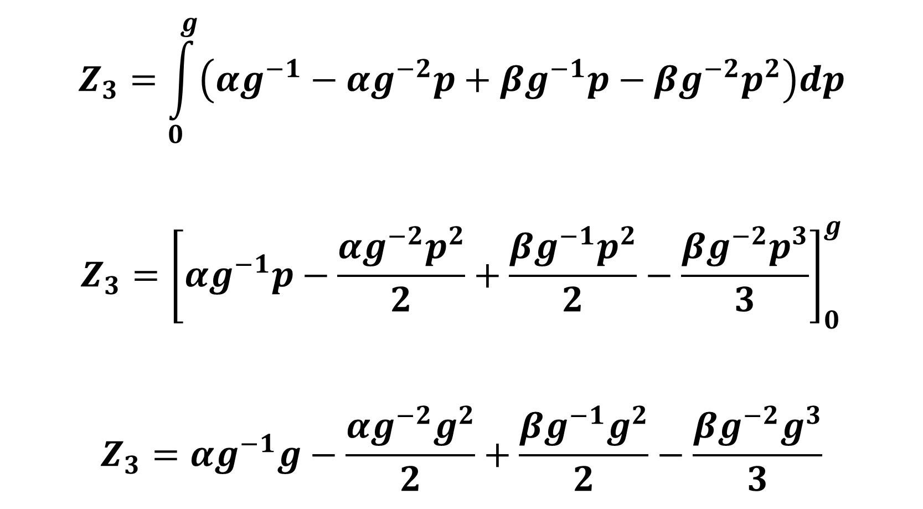
$$Z_{3}=\int_{0}^{g}{\left(αg^{−1}−αg^{−2}p+βg^{−1}p−{βg}^{−2}p^{2}\right)dp}$$
$$Z_{3}={\left[αg^{−1}p−\frac{αg^{−2}p^{2}}{2}+\frac{βg^{−1}p^{2}}{2}−\frac{{βg}^{−2}p^{3}}{3}\right]}_{0}^{g}$$
$$Z_{3}=αg^{−1}g−\frac{αg^{−2}g^{2}}{2}+\frac{βg^{−1}g^{2}}{2}−\frac{{βg}^{−2}g^{3}}{3}$$

Slide 65

$$Z_{3}=αg^{−1}g−\frac{αg^{−2}g^{2}}{2}+\frac{βg^{−1}g^{2}}{2}−\frac{{βg}^{−2}g^{3}}{3}$$
$$Z_{3}=α−\frac{α}{2}+\frac{βg}{2}−\frac{βg}{3}$$
$$Z_{3}=\frac{α}{2}+\left(\frac{1}{2}−\frac{1}{3}\right)βg$$

Slide 66

$$Z_{3}=\frac{α}{2}+\left(\frac{1}{2}−\frac{1}{3}\right)βg$$
$$Z_{3}=\frac{α}{2}+\left(\frac{3}{6}−\frac{2}{6}\right)βg$$
$$Z_{3}=\frac{α}{2}+\frac{β}{6}g$$
$$Z_{1}=2d_{2}h\left(\frac{α}{2}+\frac{β}{6}g\right)$$
$$Z_{1}=d_{2}h\left(α+\frac{β}{3}g\right)$$

Slide 67

$$Z_{2}=d_{2}E\left(P_{B_{2}} | \left(P_{A_{0}},P_{B_{0}}, \left(P_{A_{1}}<P_{B_{1}}\right)\right)\right)h$$
$$Z_{2}=d_{2}P_{B_{0}}h$$

Slide 68

Observation: $Z_{1}=d_{2}h\left(α+\frac{β}{3}g\right)$
For g=0:
$$Z_{1}=d_{2}hα$$
$$Z_{2}=d_{2}P_{B_{0}}h$$
$$d_{2}hα=d_{2}P_{B_{0}}h$$
$$α=P_{B_{0}}$$

Slide 69

Comparison of investments for g=0:
$$π_{A}=−c_{A}+{d_{2}P}_{A_{0}}h$$
$$π_{B}=−c_{B}+{d_{2}P}_{B_{0}}h$$
$$π_{AB}=−\frac{\left(c_{A}+c_{B}\right)}{2}−k+φZ_{1}+(1−φ)Z_{2}$$

Slide 70

$$π_{AB}=−\frac{\left(c_{A}+c_{B}\right)}{2}−k+φZ_{1}+\left(1−φ\right)Z_{2}$$
$$π_{AB}=−\frac{\left(c_{A}+c_{B}\right)}{2}−k+\frac{1}{2}d_{2}h\left(α+\frac{β}{3}g\right)+\frac{1}{2}d_{2}P_{B_{0}}h$$
$$π_{AB}=−\frac{\left(c_{A}+c_{B}\right)}{2}−k+\frac{1}{2}d_{2}h\left(α+\frac{β}{3}0\right)+\frac{1}{2}d_{2}P_{B_{0}}h$$

Slide 71

$$π_{AB}=−\frac{\left(c_{A}+c_{B}\right)}{2}−k+\frac{1}{2}d_{2}hα+\frac{1}{2}d_{2}P_{B_{0}}h$$
$$α=P_{B_{0}}$$
$$π_{AB}=−\frac{\left(c_{A}+c_{B}\right)}{2}−k+\frac{1}{2}d_{2}hP_{B_{0}}+\frac{1}{2}d_{2}P_{B_{0}}h$$
$$π_{AB}=−\frac{\left(c_{A}+c_{B}\right)}{2}−k+d_{2}P_{B_{0}}h$$

Slide 72

$${P_{A_{0}}=P}_{B_{0}}=P_{0}$$
Let $c_{A}=c_{B}=c$
$$π_{A}=−c_{A}+{d_{2}P}_{A_{0}}h$$
$$π_{A}=−c+{d_{2}P}_{0}h$$
$$π_{B}=−c_{B}+{d_{2}P}_{B_{0}}h$$
$$π_{B}=−c+{d_{2}P}_{0}h$$

Slide 73

$$π_{AB}=−\frac{\left(c_{A}+c_{B}\right)}{2}−k+d_{2}P_{B_{0}}h$$
$$π_{AB}=−c−k+d_{2}P_{0}h$$

Slide 74

Then,
$$π_{A}=π_{B}=π_{1}$$
Standard assumption: $k>0.$
$$\left(g=0∧k>0\right)⇒\left(π_{AB}<π_{A}=π_{B}\right)$$

Slide 75

Comparative statics for g > 0:
$$π_{AB}=−\frac{\left(c_{A}+c_{B}\right)}{2}−k+φZ_{1}+(1−φ)Z_{2}$$
$$π_{AB}=−\frac{\left(c_{A}+c_{B}\right)}{2}−k+\frac{1}{2}d_{2}h\left(α+\frac{β}{3}g\right)+\frac{1}{2}d_{2}P_{B_{0}}h$$
$$\frac{dπ_{AB}}{dg}=\frac{d_{2}hβ}{6}>0$$

Slide 76

Observation:
$${∆π=π}_{AB}−π_{1}=−k+\frac{d_{2}hβ}{6}g$$
$${∆π=π}_{AB}−π_{1} \left\{\begin{matrix}<0 , k>\frac{d_{2}hβ}{6}g \\ =0 , k=\frac{d_{2}hβ}{6}g \\ >0 , k<\frac{d_{2}hβ}{6}g \end{matrix}\right.$$

Slide 77

General comparative statics analysis:
$$π_{AB}=−\frac{\left(c_{A}+c_{B}\right)}{2}−k+φZ_{1}+(1−φ)Z_{2}$$
$$φ=φ(σ_{A},…)$$
$${Z_{1}=Z}_{1}(σ_{A},…)$$
$${Z_{2}=Z}_{2}(σ_{A},…)$$

Slide 78
$$π_{AB}=−\frac{\left(c_{A}+c_{B}\right)}{2}−k+φ(σ_{A})Z_{1}(σ_{A})+(1−φ(σ_{A}))Z_{2}(σ_{A})$$

Slide 79

$$π_{AB}=−\frac{\left(c_{A}+c_{B}\right)}{2}−k+φ(σ_{A})Z_{1}(σ_{A})+(1−φ(σ_{A}))Z_{2}(σ_{A})$$
$$\frac{dπ_{AB}}{dσ_{A}}=\frac{dφ\left(σ_{A}\right)}{dσ_{A}}Z_{1}\left(σ_{A}\right)+φ\left(σ_{A}\right)\frac{dZ_{1}\left(σ_{A}\right)}{dσ_{A}}−\frac{dφ\left(σ_{A}\right)}{dσ_{A}}Z_{2}\left(σ_{A}\right)+(1−φ(σ_{A}))\frac{dZ_{2}\left(σ_{A}\right)}{dσ_{A}}$$
$$\frac{dπ_{AB}}{dσ_{A}}=\frac{dφ\left(σ_{A}\right)}{dσ_{A}}\left(Z_{1}−Z_{2}\right)+φ\left(σ_{A}\right)\frac{dZ_{1}\left(σ_{A}\right)}{dσ_{A}}+(1−φ(σ_{A}))\frac{dZ_{2}\left(σ_{A}\right)}{dσ_{A}}$$

Slide 80

Observation:
On the decision boundary, the expected present values of A and B are the same,
$Z_{1}−Z_{2}=0$
Usually,
$\left|\frac{dZ_{2}\left(σ_{A},.\right)}{dσ_{A}}\right|≪\left|\frac{dZ_{1}\left(σ_{A},.\right)}{dσ_{A}}\right|$ and $\frac{dZ_{1}\left(σ_{A}\right)}{dσ_{A}} >0$
$φ\left(σ_{A},.\right)$ and $\left(1−φ\left(σ_{A},.\right)\right)$ are strictly positive and of the same order of magnitude. Then:
$$\frac{dπ_{AB}}{dσ_{A}}≈φ\left(σ_{A}\right)\frac{dZ_{1}\left(σ_{A}\right)}{dσ_{A}}>0$$

Slide 81

Observation:
$${∆π=π}_{AB}−π_{1}=−k+w(σ_{A})$$
$$\frac{dw(σ_{A})}{dσ_{A}}>0$$
$${∆π=π}_{AB}−π_{1} \left\{\begin{matrix}<0 , k>w(σ_{A}) \\ =0 , k=w(σ_{A}) \\ >0 , k<w(σ_{A})\end{matrix}\right.$$

Slide 82

CONCLUSIONS:
In typical cases:
If $σ_{A}=0$ , a one species plantation gives the highest expected present value.
At some strictly positive and unique value of $σ_{A}$ , investments in one or two species give the same expected present value.
At higher values of $σ_{A}$ , a two species investment gives a strictly higher expected present value than a one species investment.

Slide 83
Conclusions:
The latest decades clearly show that detailed deterministic long term planning is irrelevant.
Energy prices, prices of industrial products and environmental problems rapidly change in ways that cannot be perfectly predicted.
Research in forest production planning should focus on the development of growth models that are useful when stochastic optimal control theory is applied.
Since biological production takes considerable time, it is very important to create options to sequentially adjust the production to new relative prices, growth conditions, ecological problems and possible damages caused by parasites, fire or storms.
In particular, valuable options can be obtained via mixed species stands. When several species are available in the young stands, the species mix can sequentially be adapted to changing product prices, costs and growth conditions.
Professor Dr. Peter Lohmander, Swedish University of Agricultural Sciences, SLU, Sweden, http://www.Lohmander.com
Peter@Lohmander.com

Slide 84
References
http://www.lohmander.com/Information/Ref.htm
Lohmander, P. (Chair) TRACK 1: Global Bioenergy, Economy and Policy, BIT’s 2nd World Congress on Bioenergy,
Xi'an, China, April 25-28, 2012
http://www.Lohmander.com/Schedule_China_2012.pdf
http://www.Lohmander.com/PLWCBE12intro.ppt
Lohmander, P., Economic optimization of sustainable energy systems based on forest resources with consideration of the global warming problem: International perspectives,
BIT’s 2nd World Congress on Bioenergy,
Xi'an, China, April 25-28, 2012
http://www.Lohmander.com/WorldCongress12_PL.pdf
http://www.Lohmander.com/WorldCongress12_PL.doc
http://www.Lohmander.com/PLWCBE12.ppt

Slide 85
Lohmander, P., Lectures at Shandong Agricultural University,
April 29 - May 1, 2012, Jinan, China,
http://www.Lohmander.com/PLJinan12.ppt
Lohmander, P. (Chair) TRACK: Finance, Strategic Planning,
Industrialization and Commercialization, BIT’s 1st World Congress on Bioenergy, Dalian World Expo Center,
Dalian, China, April 25-30, 2011
http://www.bitlifesciences.com/wcbe2011/fullprogram_track5.asp
http://www.lohmander.com/PRChina11/Track_WorldCongress11_PL.pdf
http://www.lohmander.com/ChinaPic11/Track5.ppt
Lohmander, P., Economic forest management with consideration
of the forest and energy industries, BIT’s 1st World Congress on Bioenergy, Dalian World Expo Center, Dalian, China, April 25-30, 2011
http://www.lohmander.com/PRChina11/WorldCongress11_PL.pdf
http://www.lohmander.com/ChinaPic11/LohmanderTalk.ppt

Slide 86
Rational Research in Environmental Ecology with Consideration of a Sustainable World Economy under Risk
Professor Dr Peter Lohmander
SLU, Sweden, http://www.Lohmander.com
Peter@Lohmander.com
BIT's 4th Annual International Congress of Environment-2014 (ICE-2014)
Theme: "Clean World, Happy Society"
September 21-23
Qingdao International Convention Center, Qingdao, China

