Slide 1
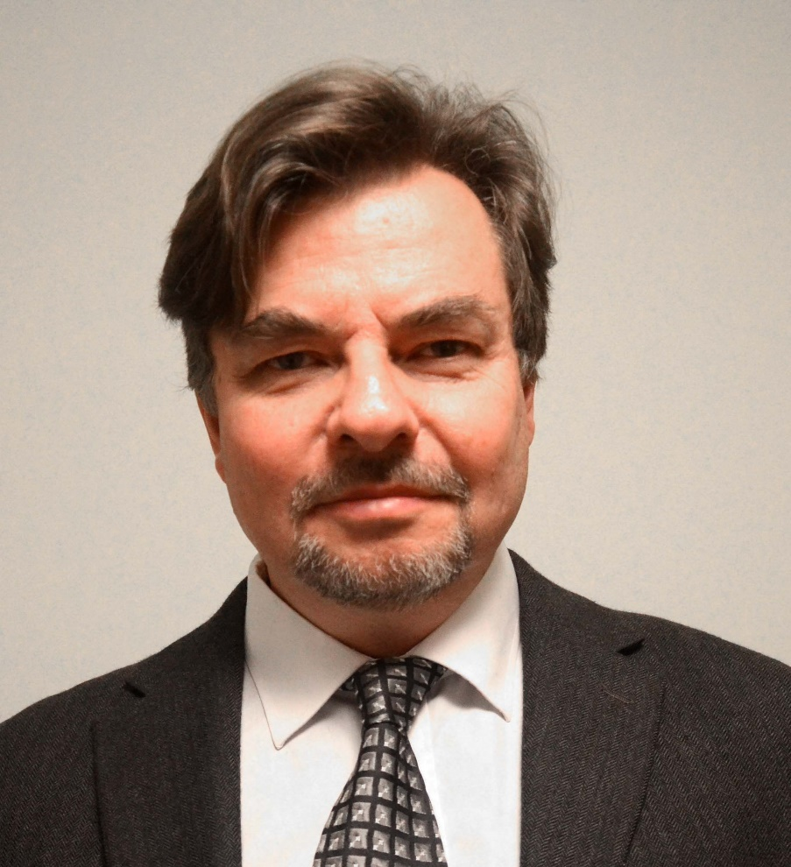
With expanded bioenergy based on forest resources, we may simultaneously and sustainably reduce global warming, improve economic results, international relations and environmental conditions
Professor Dr Peter Lohmander
SLU, Sweden, http://www.Lohmander.com
Peter@Lohmander.com
BIT’s 4th Annual World Congress of Bioenergy
Theme: Roadmap Toward 2020
September 21-23
Qingdao International Convention Center, Qingdao, China

Slide 2
With expanded bioenergy based on forest resources, we may simultaneously and sustainably reduce global warming, improve economic results, international relations and environmental conditions Professor Dr. Peter Lohmander, SLU, Sweden, http://www.Lohmander.com Peter@Lohmander.com
In the production of district heating, electricity and many other energy outputs, we may use fossil fuels and renewable inputs, in different combinations. The optimal input mix is a function of technological options, prices of different inputs and costs of alternative levels of environmental consequences.
Even with presently existing technology in combined heat and power plants, it is usually possible to reduce the amount of fossil fuels such as coal and strongly increase the level of forest based energy inputs.
In large parts of the world, such as Russian Federation, forest stocks are close to dynamic equilibria, in the sense that the net growth (and net carbon uptake) is close to zero. If these forests will be partly harvested, the net growth and CO2 uptake can increase.
In Norway and UK, CCS has been applied and a commercially attractive option during many years and the physical potential is large. With increasing carbon taxes in all parts of the world, such developments could be expected everywhere.
With increasing levels of forest inputs in combination with CCS, it is possible to reduce the CO2 in the atmosphere and the global warming problem can be managed. Furthermore, international trade in forest based energy can improve international relations, regional development and environmental conditions.

Slide 3
In the production of district heating, electricity and many other energy outputs, we may use fossil fuels and renewable inputs, in different combinations.
The optimal input mix is a function of technological options, prices of different inputs and costs of alternative levels of environmental consequences.

Slide 4
Let us define a model that includes the most important parts of the global problem!
Include alternative energy sources and CO2 effects.
Include relevant production options.
Make it possible to derive policy conclusions in a transparent way.
OBSERVATION:
More details can easily be included in the model. Then, however,
a transparent analysis and presentation are no longer possible.

Slide 5
The Lohmander Energy, Forest, Fossil Fuels, CCS and Climate System Optimization Model

Slide 6
$$Max Z =$$
$$−k_{π}\left(C_{F}\left(F\right)+ C_{h}\left(h\right)+ C_{S}\left(S\right)\right)$$
$$−k_{G}\left(\left(1+α_{F}\right)F+ α_{h}h− α_{S}S\right)$$
s.t. $F+h ≥M$
Objective function
Costs of operations
Costs of CO2 in atmosphere
Energy input constraint

Slide 7
This presentation focuses on problem definition and a transparent derivation and summary of central results.
A complete mathematical analysis with a more detailed model is of course also possible but would take much more time.

Slide 8
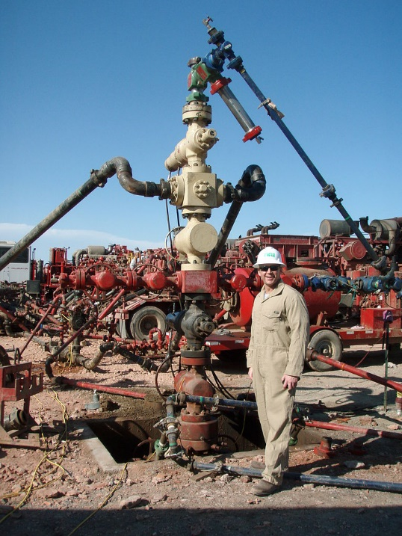
The model does not include constraints
on the total availability of fossil fuels.
Motive:
Such constraints are assumed not to be binding
in the optimal total solution.
Hydraulic fracturing also called fracturing
and fracking has recently shown that
there are very large quantitites of fossil
fuels available in the world.

Slide 9
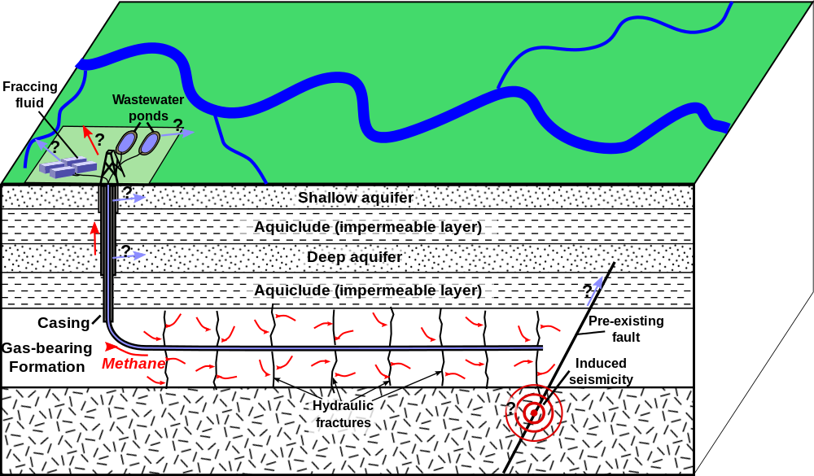

Slide 10
$$Max Z = −k_{π}\left(C_{F}\left(F\right)+ C_{h}\left(h\right)+ C_{S}\left(S\right)\right)−k_{G}\left(\left(1+α_{F}\right)F+ α_{h}h− α_{S}S\right)$$ s.t. $F+h ≥M$

Slide 11
Mathematical Analysis:
$$Max Z= −k_{π}\left(C_{F}\left(F\right)+ C_{h}\left(h\right)+ C_{S}\left(S\right)\right)−k_{G}\left(\left(1+α_{F}\right)F+ α_{h}h− α_{S}S\right)$$
s.t.
$$F+h ≥M$$

Slide 12
Parameter assumptions:
$$k_{π}>0$$
$$k_{G}>0$$
$$α_{F}>0$$
$$α_{h}>0$$
$${0<α}_{S}<1$$
$$α_{h}<1+α_{F}$$

Slide 13
This constraint is not binding:
$$S<F+h$$

Slide 14
Cost function assumptions:
$$C_{F}^{′}>0$$
$$C_{F}^{′′}>0$$
$$C_{h}^{′}>0$$
$$C_{h}^{′′}>0$$
$$C_{S}^{′}>0$$
$$C_{S}^{′′}>0$$

Slide 15
The Lagrange function, L, $is:$
$$= −k_{π}\left(C_{F}\left(F\right)+ C_{h}\left(h\right)+ C_{S}\left(S\right)\right) −k_{G}\left(\left(1+α_{F}\right)F+ α_{h}h−α_{S}S\right)$$
$$+λ\left(F+h−M\right)$$

Slide 16
The Kuhn Tucker conditions are:
$$F≥0;h≥0;S≥0$$
$$\frac{dL}{dF}≤0; \frac{dL}{dh}≤0;\frac{dL}{dS}≤0$$
$$F\frac{dL}{dF}=0;h\frac{dL}{dh}=0;S\frac{dL}{dS}=0$$
$$λ≥0$$
$$\frac{dL}{dλ}≥0$$
$$λ\frac{dL}{dλ}=0$$

Slide 17
Here, we have four of the constraints:
$$\begin{matrix}\frac{dL}{dλ}=F+h−M ≥0 \\ \frac{dL}{dF}= −k_{π}C_{F}^{′}\left(F\right)−k_{G}\left(1+α_{F}\right)+λ ≤0 \\ \begin{matrix}\frac{dL}{dh}=−k_{π}C_{h}^{′}\left(h\right)−k_{G}α_{h}+λ ≤0 \\ \frac{dL}{dS}= −k_{π}C_{S}^{′}\left(S\right)+k_{G}α_{S} ≤0 \end{matrix}\end{matrix}$$

Slide 18
Assumption:
The optimal solution is an interior solution.
$$F>0;h>0;S>0;λ>0$$
As a consequence, we know that:
$$\frac{dL}{dλ}=0; \frac{dL}{dF}=0; \frac{dL}{dh}=0;\frac{dL}{dS}=0$$

Slide 19
This means that the following equation system should be solved:
$$\begin{matrix}\frac{dL}{dλ}=F+h−M =0 \\ \frac{dL}{dF}= −k_{π}C_{F}^{′}\left(F\right)−k_{G}\left(1+α_{F}\right)+λ =0 \\ \begin{matrix}\frac{dL}{dh}=−k_{π}C_{h}^{′}\left(h\right)−k_{G}α_{h}+λ =0 \\ \frac{dL}{dS}= −k_{π}C_{S}^{′}\left(S\right)+k_{G}α_{S} =0 \end{matrix}\end{matrix}$$

Slide 20
The system with four equations and four endogenous variables is partly separable.
It may be split into one system with tree equations and three endogenous variables $(F, h and λ)$ and a separate equation with only one endogenous variable, $S$ .
Stars denote optimal values.

Slide 21
First, we investigate $S^{∗}$ .
$$\frac{dL}{dS}= −k_{π}C_{S}^{′}\left(S\right)+k_{G}α_{S} ≤0$$
$$\left(\frac{dL}{dS}=0 \right)⇒\left(C_{S}^{′}\left(S\right)=\frac{k_{G}α_{S}}{k_{π}}\right)$$

Slide 22
We differentiate the first order optimum condition:
$${{−k}_{π}C}_{S}^{′′}\left(S\right)dS^{∗}−C_{S}^{′}\left(S\right)dk_{π}+α_{S}dk_{G}+k_{G}dα_{S}=0$$
$$dS^{∗}=\frac{1}{{k_{π}C}_{S}^{′′}\left(S\right)}\left(−C_{S}^{′}\left(S\right)dk_{π}+α_{S}dk_{G}+k_{G}dα_{S}\right)$$

Slide 23
The optimal level of CCS
decreases if we put more weight on the costs of operations.
increases if the marginal cost of global warming increases.
increases if the technical efficiency of CCS increases.
The derivatives of $S^{∗}$ with respect to the parameters are the following:
$$\frac{dS^{∗}}{dk_{π}}=\frac{−C_{S}^{′}\left(S\right)}{{k_{π}C}_{S}^{′′}\left(S\right)}<0$$
$$\frac{dS^{∗}}{dk_{G}}=\frac{α_{S}}{k_{π}C_{S}^{′′}\left(S\right)}>0$$
$$\frac{dS^{∗}}{dα_{S}}=\frac{k_{G}}{k_{π}C_{S}^{′′}\left(S\right)}>0$$

Slide 24
Next, we investigate $F^{∗}, h^{∗}and λ^{∗}$ .
The first order optimum conditions are found from this three dimensional equation system:
$$\begin{matrix}\frac{dL}{dλ}= F+h−M =0 \\ \frac{dL}{dF}= −k_{π}C_{F}^{′}\left(F\right)−k_{G}\left(1+α_{F}\right)+λ =0 \\ \begin{matrix}\frac{dL}{dh}=−k_{π}C_{h}^{′}\left(h\right)−k_{G}α_{h}+λ =0 \end{matrix}\end{matrix}$$

Slide 25
We differentiate the equations:
$$\left[\begin{matrix}\begin{matrix}1 & 1 \\ −k_{π}C_{F}^{′′} & 0\end{matrix} & \begin{matrix}0 \\ 1\end{matrix} \\ \begin{matrix} 0 & −k_{π}C_{h}^{′′}\end{matrix} & \begin{matrix}1\end{matrix}\end{matrix}\right]\left[\begin{matrix}dF^{∗} \\ dh^{∗} \\ \begin{matrix}dλ^{∗}\end{matrix}\end{matrix}\right]=\left[\begin{matrix}dM \\ C_{F}^{′}dk_{π}+\left(1+α_{F}\right)dk_{G}+k_{G}dα_{F} \\ \begin{matrix}C_{h}^{′}dk_{π}+α_{h}dk_{G}+k_{G}dα_{h}\end{matrix}\end{matrix}\right]$$

Slide 26
When we apply Cramer’s rule, we need to know $\left|\begin{matrix}D\end{matrix}\right|$.
$$\left|\begin{matrix}D\end{matrix}\right|=\left|\begin{matrix}\begin{matrix}\begin{matrix}1 & 1 \\ −k_{π}C_{F}^{′′} & 0\end{matrix} & \begin{matrix}0 \\ 1\end{matrix} \\ \begin{matrix} 0 & −k_{π}C_{h}^{′′}\end{matrix} & \begin{matrix}1\end{matrix}\end{matrix}\end{matrix}\right|$$
$$\left|\begin{matrix}D\end{matrix}\right|=k_{π}\left(C_{h}^{′′}+C_{F}^{′′}\right)>0$$

Slide 27
The derivatives of $F^{∗}, h^{∗}and λ^{∗}$ with respect to M are determined via Cramer’s rule:
$$\frac{dF^{∗}}{dM}=\frac{\left|\begin{matrix}\begin{matrix}\begin{matrix}1 & 1 \\ 0 & 0\end{matrix} & \begin{matrix}0 \\ 1\end{matrix} \\ \begin{matrix} 0 & −k_{π}C_{h}^{′′}\end{matrix} & \begin{matrix}1\end{matrix}\end{matrix}\end{matrix}\right|}{\left|\begin{matrix}D\end{matrix}\right|}$$
$$\frac{dF^{∗}}{dM}=\frac{C_{h}^{′′}}{C_{h}^{′′}+C_{F}^{′′}}>0$$

Slide 28
$$\frac{dh^{∗}}{dM}=\frac{\left|\begin{matrix}\begin{matrix}\begin{matrix}1 & 1 \\ −k_{π}C_{F}^{′′} & 0\end{matrix} & \begin{matrix}0 \\ 1\end{matrix} \\ \begin{matrix} 0 & 0\end{matrix} & \begin{matrix}1\end{matrix}\end{matrix}\end{matrix}\right|}{\left|\begin{matrix}D\end{matrix}\right|}$$
$$\frac{dh^{∗}}{dM}=\frac{C_{F}^{′′}}{C_{h}^{′′}+C_{F}^{′′}}>0$$

Slide 29
$$\frac{dλ^{∗}}{dM}=\frac{\left|\begin{matrix}\begin{matrix}\begin{matrix}1 & 1 \\ −k_{π}C_{F}^{′′} & 0\end{matrix} & \begin{matrix}1 \\ 0\end{matrix} \\ \begin{matrix} 0 & −k_{π}C_{h}^{′′}\end{matrix} & \begin{matrix}0\end{matrix}\end{matrix}\end{matrix}\right|}{\left|\begin{matrix}D\end{matrix}\right|}$$
$$\frac{dλ^{∗}}{dM}=\frac{k_{π}C_{F}^{′′}C_{h}^{′′}}{C_{h}^{′′}+C_{F}^{′′}}>0$$

Slide 30
If the total energy consumption increases
the optimal level of fossil energy input increases.
the optimal level of forest energy input increases.
the marginal cost of energy input increases.
$$\frac{dF^{∗}}{dM}=\frac{C_{h}^{′′}}{C_{h}^{′′}+C_{F}^{′′}}>0$$
$$\frac{dh^{∗}}{dM}=\frac{C_{F}^{′′}}{C_{h}^{′′}+C_{F}^{′′}}>0$$
$$\frac{dλ^{∗}}{dM}=\frac{k_{π}C_{F}^{′′}C_{h}^{′′}}{C_{h}^{′′}+C_{F}^{′′}}>0$$

Slide 31
The derivatives of $F^{∗}, h^{∗}and λ^{∗}$ with respect to $k_{G}$ are:
$$\frac{dF^{∗}}{dk_{G}}=\frac{\left|\begin{matrix}\begin{matrix}\begin{matrix}0 & 1 \\ (1+α_{F}) & 0\end{matrix} & \begin{matrix}0 \\ 1\end{matrix} \\ \begin{matrix} α_{h} & −k_{π}C_{h}^{′′}\end{matrix} & \begin{matrix}1\end{matrix}\end{matrix}\end{matrix}\right|}{\left|\begin{matrix}D\end{matrix}\right|}$$
$$\frac{dF^{∗}}{dk_{G}}=\frac{α_{h}−(1+α_{F})}{k_{π}(C_{h}^{′′}+C_{F}^{′′})}<0$$

Slide 32
$$\frac{dh^{∗}}{dk_{G}}=\frac{\left|\begin{matrix}\begin{matrix}\begin{matrix}1 & 0 \\ −k_{π}C_{F}^{′′} & (1+α_{F})\end{matrix} & \begin{matrix}0 \\ 1\end{matrix} \\ \begin{matrix} 0 & α_{h}\end{matrix} & \begin{matrix}1\end{matrix}\end{matrix}\end{matrix}\right|}{\left|\begin{matrix}D\end{matrix}\right|}$$
$$\frac{dh^{∗}}{dk_{G}}=\frac{\left(1+α_{F}\right)−α_{h} }{k_{π}(C_{h}^{′′}+C_{F}^{′′})}>0$$

Slide 33
$$\frac{dλ^{∗}}{dk_{G}}=\frac{\left|\begin{matrix}\begin{matrix}\begin{matrix}1 & 1 \\ −k_{π}C_{F}^{′′} & 0\end{matrix} & \begin{matrix}0 \\ \left(1+α_{F}\right)\end{matrix} \\ \begin{matrix} 0 & −k_{π}C_{h}^{′′}\end{matrix} & \begin{matrix}α_{h}\end{matrix}\end{matrix}\end{matrix}\right|}{\left|\begin{matrix}D\end{matrix}\right|}$$
$$\frac{dλ^{∗}}{dk_{G}}=\frac{C_{h}^{′′}{\left(1+α_{F}\right)+C}_{F}^{′′}\begin{matrix}α_{h}\end{matrix}}{C_{h}^{′′}+C_{F}^{′′}}>0$$

Slide 34
If the marginal cost of global warming increases the optimal level of fossil energy input decreases. the optimal level of forest energy input increases. the marginal cost of energy input increases.
$$\frac{dF^{∗}}{dk_{G}}=\frac{α_{h}−(1+α_{F})}{k_{π}(C_{h}^{′′}+C_{F}^{′′})}<0$$
$$\frac{dh^{∗}}{dk_{G}}=\frac{\left(1+α_{F}\right)−α_{h} }{k_{π}(C_{h}^{′′}+C_{F}^{′′})}>0$$
$$\frac{dλ^{∗}}{dk_{G}}=\frac{C_{h}^{′′}{\left(1+α_{F}\right)+C}_{F}^{′′}\begin{matrix}α_{h}\end{matrix}}{C_{h}^{′′}+C_{F}^{′′}}>0$$

Slide 35
The derivatives of $F^{∗}, h^{∗}and λ^{∗}$ with respect to $k_{π}$ :
$$\frac{dF^{∗}}{dk_{π}}=\frac{\left|\begin{matrix}\begin{matrix}\begin{matrix}0 & 1 \\ C_{F}^{′} & 0\end{matrix} & \begin{matrix}0 \\ 1\end{matrix} \\ \begin{matrix} C_{h}^{′} & −k_{π}C_{h}^{′′}\end{matrix} & \begin{matrix}1\end{matrix}\end{matrix}\end{matrix}\right|}{\left|\begin{matrix}D\end{matrix}\right|}$$
$$\frac{dF^{∗}}{dk_{π}}=\frac{C_{h}^{′}−C_{F}^{′}}{k_{π}(C_{h}^{′′}+C_{F}^{′′})}\left\{\begin{matrix}> \\ = \\ <\end{matrix}\right\}0$$

Slide 36
Observation:
The sign of $\frac{dF^{∗}}{dk_{π}}$ is expected to change over time, since fossil fuels in the long run become more scarce and more costly to extract.
In most cases, it is assumed that $\frac{dF^{∗}}{dk_{π}}>0$ in the year 2014. At some future point in time, $\frac{dF^{∗}}{dk_{π}}=0$ and at later points in time $\frac{dF^{∗}}{dk_{π}}<0$ .

Slide 37
$$\frac{dh^{∗}}{dk_{π}}=\frac{\left|\begin{matrix}\begin{matrix}\begin{matrix}1 & 0 \\ −k_{π}C_{F}^{′′} & C_{F}^{′}\end{matrix} & \begin{matrix}0 \\ 1\end{matrix} \\ \begin{matrix} 0 & \end{matrix}C_{h}^{′} & \begin{matrix}1\end{matrix}\end{matrix}\end{matrix}\right|}{\left|\begin{matrix}D\end{matrix}\right|}$$
$$\frac{dh^{∗}}{dk_{π}}=\frac{ C_{F}^{′}−C_{h}^{′} }{k_{π}(C_{h}^{′′}+C_{F}^{′′})}\left\{\begin{matrix}> \\ = \\ <\end{matrix}\right\}0$$

Slide 38
Observation:
The sign of $\frac{dh^{∗}}{dk_{π}}$ is expected to change over time, since fossil fuels in the long run become more scarce and more costly to extract.
In most cases, it is assumed that $\frac{dh^{∗}}{dk_{π}}<0$ in the year 2014. At some future point in time, $\frac{dh^{∗}}{dk_{π}}=0$ and at later points in time $\frac{dh^{∗}}{dk_{π}}>0$ .

Slide 39
$$\frac{dλ^{∗}}{dk_{π}}=\frac{\left|\begin{matrix}\begin{matrix}\begin{matrix}1 & 1 \\ −k_{π}C_{F}^{′′} & 0\end{matrix} & \begin{matrix}0 \\ C_{F}^{′}\end{matrix} \\ \begin{matrix} 0 & −k_{π}C_{h}^{′′}\end{matrix} & \begin{matrix}C_{h}^{′}\end{matrix}\end{matrix}\end{matrix}\right|}{\left|\begin{matrix}D\end{matrix}\right|}$$
$$\frac{dλ^{∗}}{dk_{π}}=\frac{C_{h}^{′′}{C_{F}^{′}+C}_{F}^{′′}\begin{matrix}\begin{matrix}C_{h}^{′}\end{matrix}\end{matrix}}{C_{h}^{′′}+C_{F}^{′′}}>0$$

Slide 40
If the costs of operations are considered more important the optimal level of fossil energy input increases (now) and decreases (later). the optimal level of forest energy input decreases (now) and increases (later). the marginal cost of energy input increases.
$$\frac{dF^{∗}}{dk_{π}}=\frac{C_{h}^{′}−C_{F}^{′}}{k_{π}(C_{h}^{′′}+C_{F}^{′′})}\left\{\begin{matrix}> \\ = \\ <\end{matrix}\right\}0$$
$$\frac{dh^{∗}}{dk_{π}}=\frac{ C_{F}^{′}−C_{h}^{′} }{k_{π}(C_{h}^{′′}+C_{F}^{′′})}\left\{\begin{matrix}> \\ = \\ <\end{matrix}\right\}0$$
$$\frac{dλ^{∗}}{dk_{π}}=\frac{C_{h}^{′′}{C_{F}^{′}+C}_{F}^{′′}\begin{matrix}\begin{matrix}C_{h}^{′}\end{matrix}\end{matrix}}{C_{h}^{′′}+C_{F}^{′′}}>0$$

Slide 41
The derivatives of $F^{∗}, h^{∗}and λ^{∗}$ with respect to $α_{F}$ are:
$$\frac{dF^{∗}}{dα_{F}}=\frac{\left|\begin{matrix}\begin{matrix}\begin{matrix}0 & 1 \\ k_{G} & 0\end{matrix} & \begin{matrix}0 \\ 1\end{matrix} \\ \begin{matrix} 0 & −k_{π}C_{h}^{′′}\end{matrix} & \begin{matrix}1\end{matrix}\end{matrix}\end{matrix}\right|}{\left|\begin{matrix}D\end{matrix}\right|}$$
$$\frac{dF^{∗}}{dα_{F}}=\frac{−k_{G}}{k_{π}(C_{h}^{′′}+C_{F}^{′′})}<0$$

Slide 42
$$\frac{dh^{∗}}{dα_{F}}=\frac{\left|\begin{matrix}\begin{matrix}\begin{matrix}1 & 0 \\ −k_{π}C_{F}^{′′} & k_{G}\end{matrix} & \begin{matrix}0 \\ 1\end{matrix} \\ \begin{matrix} 0 & \end{matrix}0 & \begin{matrix}1\end{matrix}\end{matrix}\end{matrix}\right|}{\left|\begin{matrix}D\end{matrix}\right|}$$
$$\frac{dh^{∗}}{dα_{F}}=\frac{ k_{G} }{k_{π}(C_{h}^{′′}+C_{F}^{′′})}>0$$

Slide 43
$$\frac{dλ^{∗}}{dα_{F}}=\frac{\left|\begin{matrix}\begin{matrix}\begin{matrix}1 & 1 \\ −k_{π}C_{F}^{′′} & 0\end{matrix} & \begin{matrix}0 \\ k_{G}\end{matrix} \\ \begin{matrix} 0 & −k_{π}C_{h}^{′′}\end{matrix} & \begin{matrix}0\end{matrix}\end{matrix}\end{matrix}\right|}{\left|\begin{matrix}D\end{matrix}\right|}$$
$$\frac{dλ^{∗}}{dα_{F}}=\frac{C_{h}^{′′}k_{G}}{C_{h}^{′′}+C_{F}^{′′}}>0$$

Slide 44
If the CO2 emissions from fossil energy operations (per unit) increases, ($α_{F}$ increases over time since you have to extract from deeper levels and in more remote places.)
the optimal level of fossil energy input decreases. the optimal level of forest energy input increases. the marginal cost of energy input increases.
$$\frac{dF^{∗}}{dα_{F}}=\frac{−k_{G}}{k_{π}(C_{h}^{′′}+C_{F}^{′′})}<0$$
$$\frac{dh^{∗}}{dα_{F}}=\frac{ k_{G} }{k_{π}(C_{h}^{′′}+C_{F}^{′′})}>0$$
$$\frac{dλ^{∗}}{dα_{F}}=\frac{C_{h}^{′′}k_{G}}{C_{h}^{′′}+C_{F}^{′′}}>0$$

Slide 45
The derivatives of $F^{∗}, h^{∗}and λ^{∗}$ with respect to $α_{h}$ are:
$$\frac{dF^{∗}}{dα_{h}}=\frac{\left|\begin{matrix}\begin{matrix}\begin{matrix}0 & 1 \\ 0 & 0\end{matrix} & \begin{matrix}0 \\ 1\end{matrix} \\ \begin{matrix} k_{G} & −k_{π}C_{h}^{′′}\end{matrix} & \begin{matrix}1\end{matrix}\end{matrix}\end{matrix}\right|}{\left|\begin{matrix}D\end{matrix}\right|}$$
$$\frac{dF^{∗}}{dα_{h}}=\frac{k_{G}}{k_{π}(C_{h}^{′′}+C_{F}^{′′})}>0$$

Slide 46
$$\frac{dh^{∗}}{dα_{h}}=\frac{\left|\begin{matrix}\begin{matrix}\begin{matrix}1 & 0 \\ −k_{π}C_{F}^{′′} & 0\end{matrix} & \begin{matrix}0 \\ 1\end{matrix} \\ \begin{matrix} 0 & \end{matrix}k_{G} & \begin{matrix}1\end{matrix}\end{matrix}\end{matrix}\right|}{\left|\begin{matrix}D\end{matrix}\right|}$$
$$\frac{dh^{∗}}{dα_{h}}=\frac{ {−k}_{G} }{k_{π}(C_{h}^{′′}+C_{F}^{′′})}<0$$

Slide 47
$$\frac{dλ^{∗}}{dα_{h}}=\frac{\left|\begin{matrix}\begin{matrix}\begin{matrix}1 & 1 \\ −k_{π}C_{F}^{′′} & 0\end{matrix} & \begin{matrix}0 \\ 0\end{matrix} \\ \begin{matrix} 0 & −k_{π}C_{h}^{′′}\end{matrix} & \begin{matrix}k_{G}\end{matrix}\end{matrix}\end{matrix}\right|}{\left|\begin{matrix}D\end{matrix}\right|}$$
$$\frac{dλ^{∗}}{dα_{h}}=\frac{C_{F}^{′′}k_{G}}{C_{h}^{′′}+C_{F}^{′′}}>0$$

Slide 48
If the CO2 emissions from forest operations (per unit) decrease, ($α_{h}$ may decrease thanks to more railways in remote areas etc.)
the optimal level of fossil energy input decreases.
the optimal level of forest energy input increases.
the marginal cost of energy input decreases.
$$\frac{dF^{∗}}{dα_{h}}=\frac{k_{G}}{k_{π}(C_{h}^{′′}+C_{F}^{′′})}>0$$
$$\frac{dh^{∗}}{dα_{h}}=\frac{ {−k}_{G} }{k_{π}(C_{h}^{′′}+C_{F}^{′′})}<0$$
$$\frac{dλ^{∗}}{dα_{h}}=\frac{C_{F}^{′′}k_{G}}{C_{h}^{′′}+C_{F}^{′′}}>0$$

Slide 49
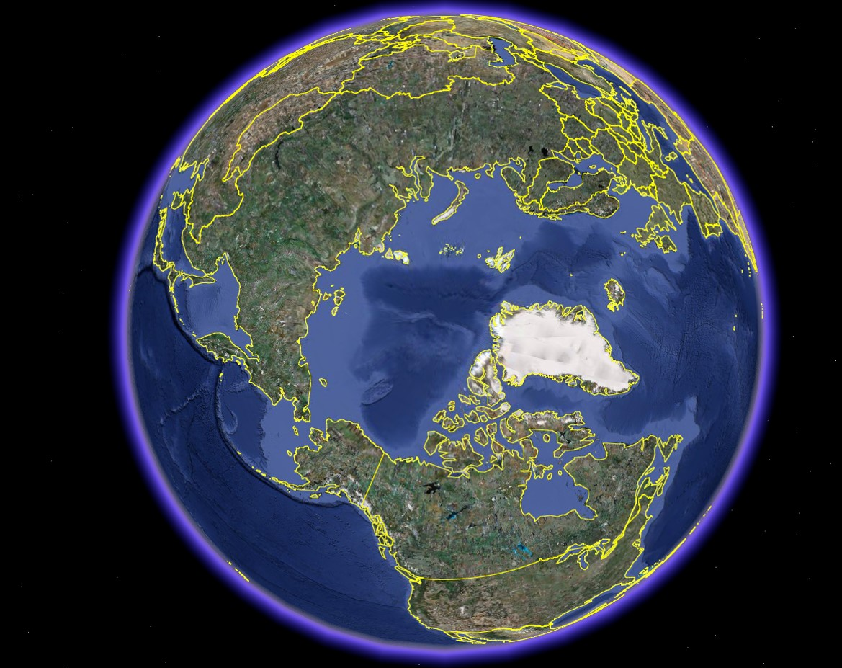
Now, we investigate
the real world!

Slide 50
First, let us look at the ”total energy supply” in a small country, Sweden:

Slide 54
Now, let us look at the ”total energy supply” in combined heat and power plants in Sweden:

Slide 56
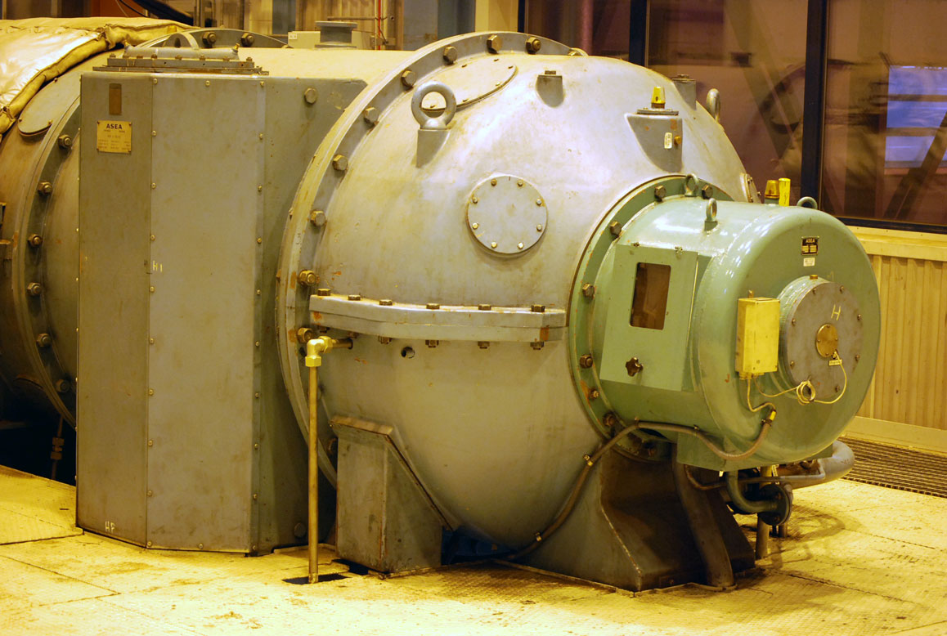

Slide 57
The Lohmander Energy, Forest, Fossil Fuels, CCS and Climate System Optimization Model

Slide 58
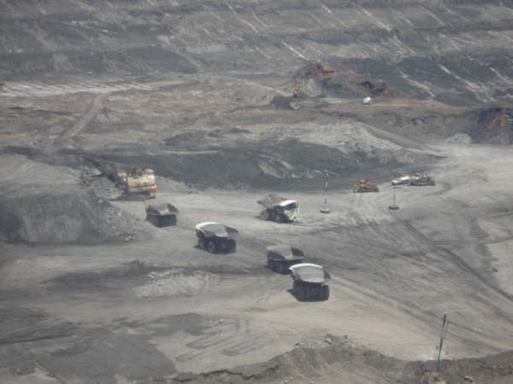

Slide 59
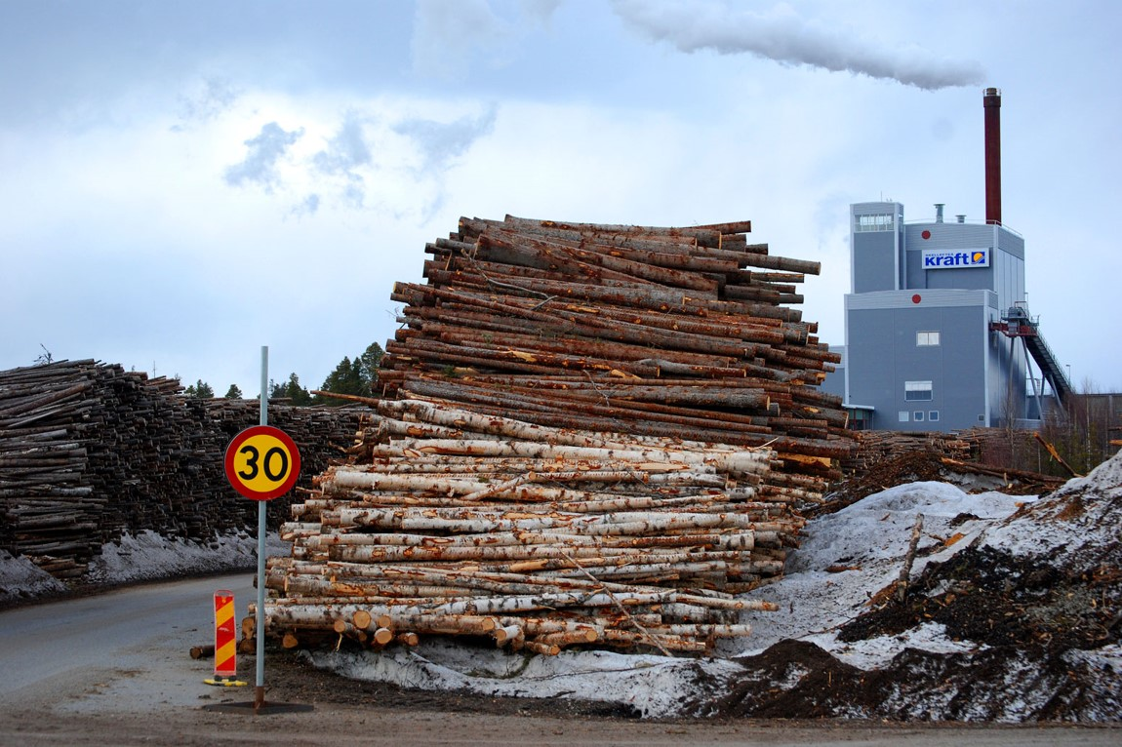

Slide 60
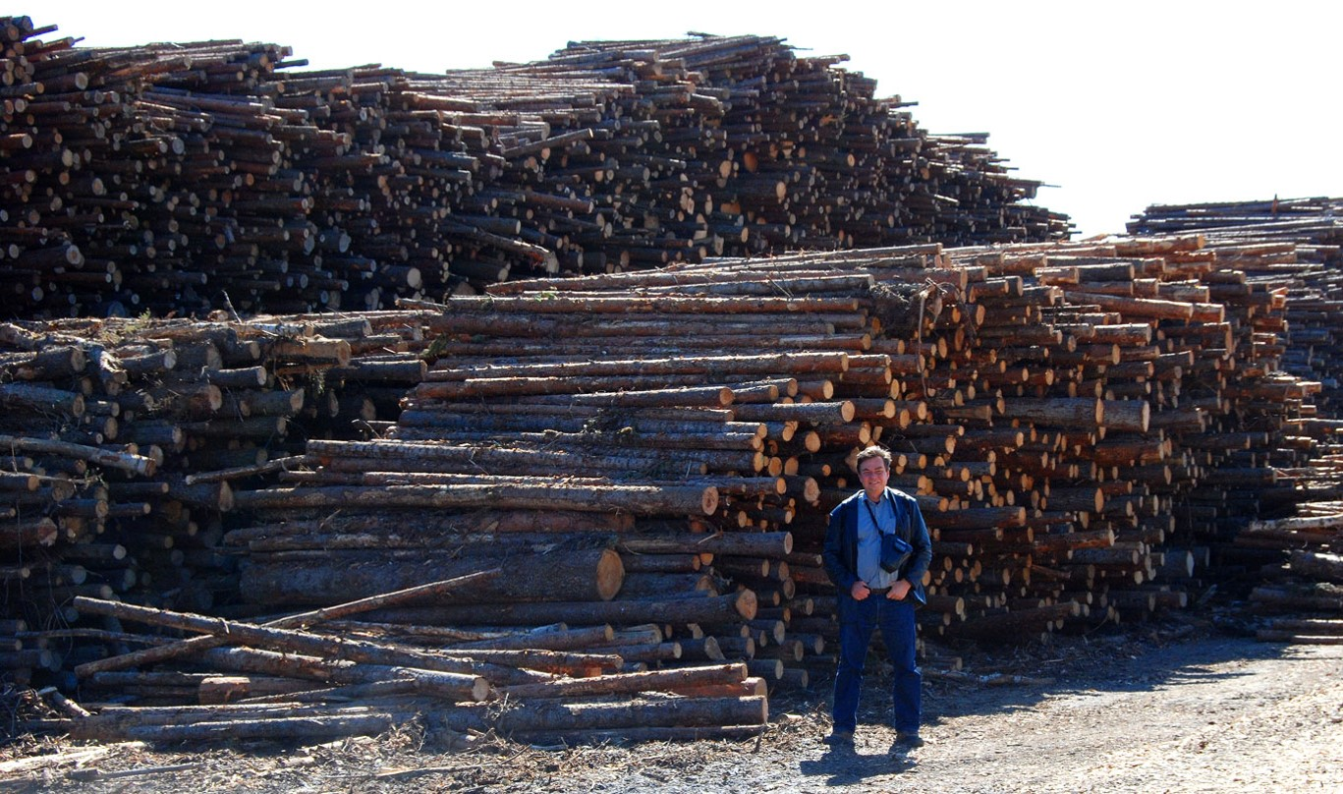

Slide 61
Fuel mix 1991 – 2006
E.On, Händelö CHP
Oil (BLACK)
Coal (DARK GREY)
Rubber (LIGHT GREY)
Forest chips
(ORANGE)
Waste wood
(PINK)
Waste from
households
and industries
(RED)

Slide 62
The increasing use of bioenergy and decreasing use of coal and oil can be explained by the increasing tax on fossil fuels (”CO2 taxation”).

Slide 63
Summary of the CO2 tax policy in Sweden from the International Institute for Sustainable Development http://www.iisd.org/greenbud/sweden.htm
The Policy in Brief
Economic Instrument: Carbon dioxide tax.
Problem: Emissions of greenhouse gases which may induce global warming.
Goal: Reduce or stabilize CO2 emissions, generate revenue for the national budget and serve as a model for applications internationally.
Description: A tax on CO2, levied primarily on fossil fuels including oil, coal, natural gas, LPG and gasoline. Part of the wider energy taxation system, the tax is generally higher for the household sector than for the industrial one so as not to hamper competitiveness on international markets.
Administering Institution: National Tax Board (Sweden).

Slide 64
Can we increase the bioenergy supply from forests
without negative effects on the CO2 net uptake?
In large parts of the world, such as Russian Federation, forest stocks are close to dynamic equilibria, in the sense that the net growth (and net carbon uptake) is close to zero.
If these forests will be partly harvested, the net growth and CO2 uptake can increase.

Slide 66
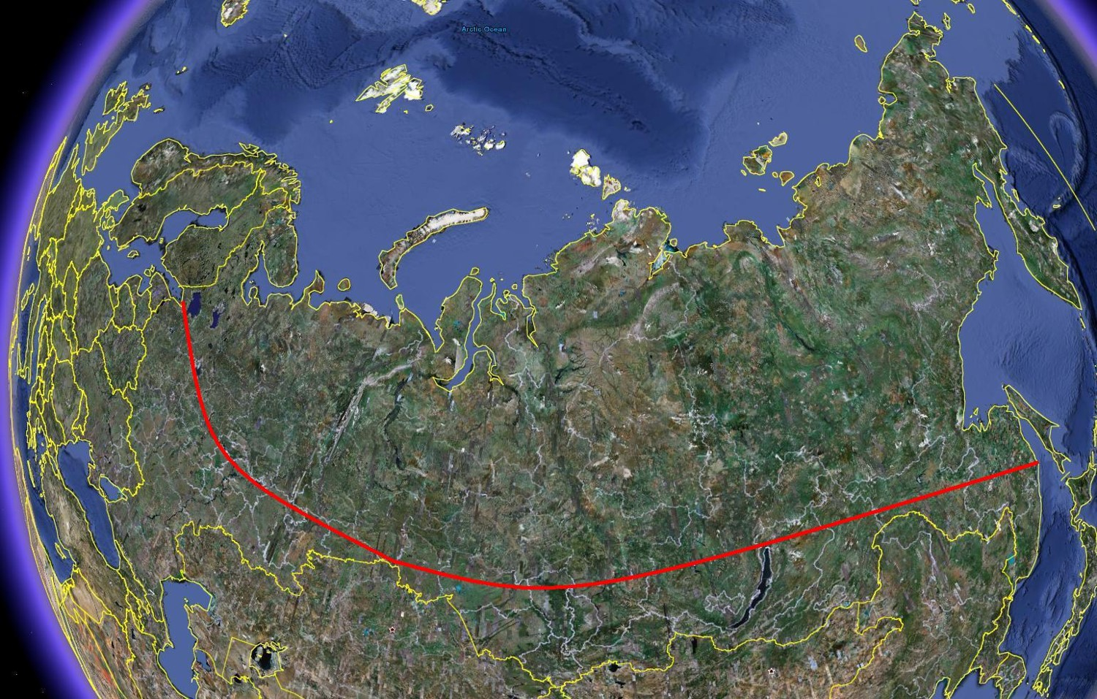

Slide 67
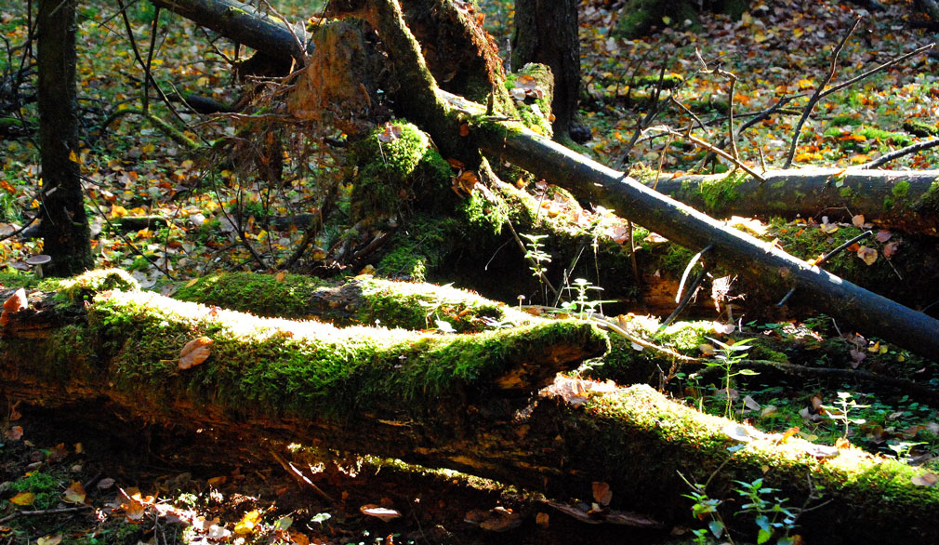

Slide 68
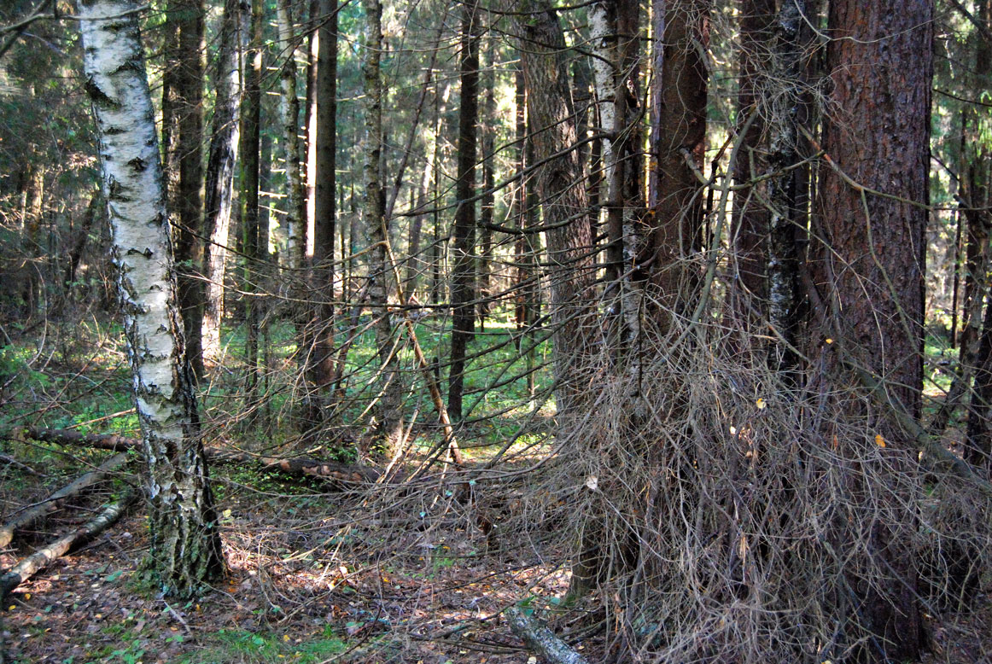

Slide 69
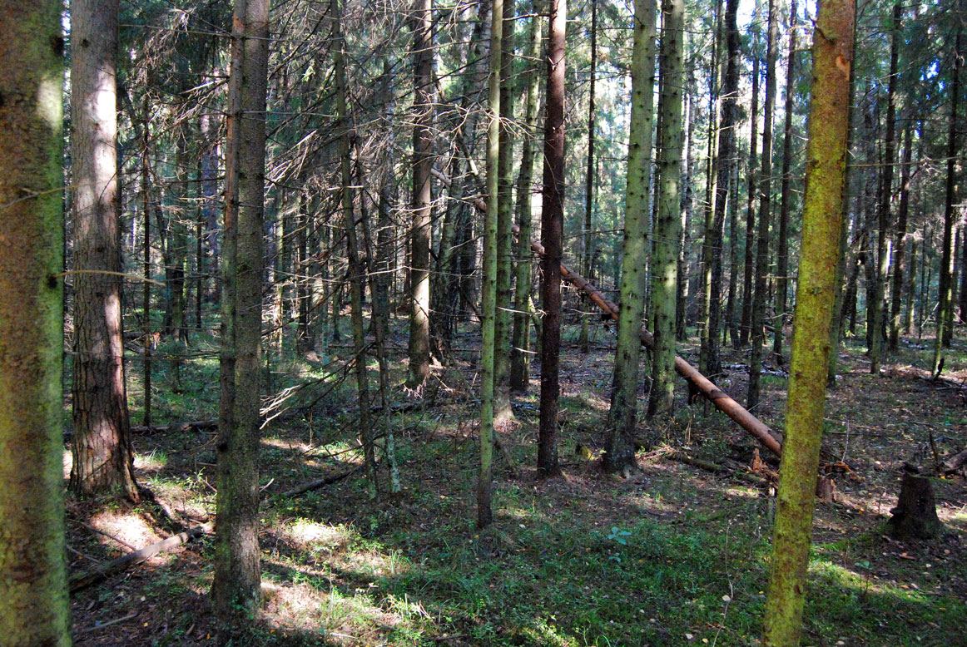

Slide 70
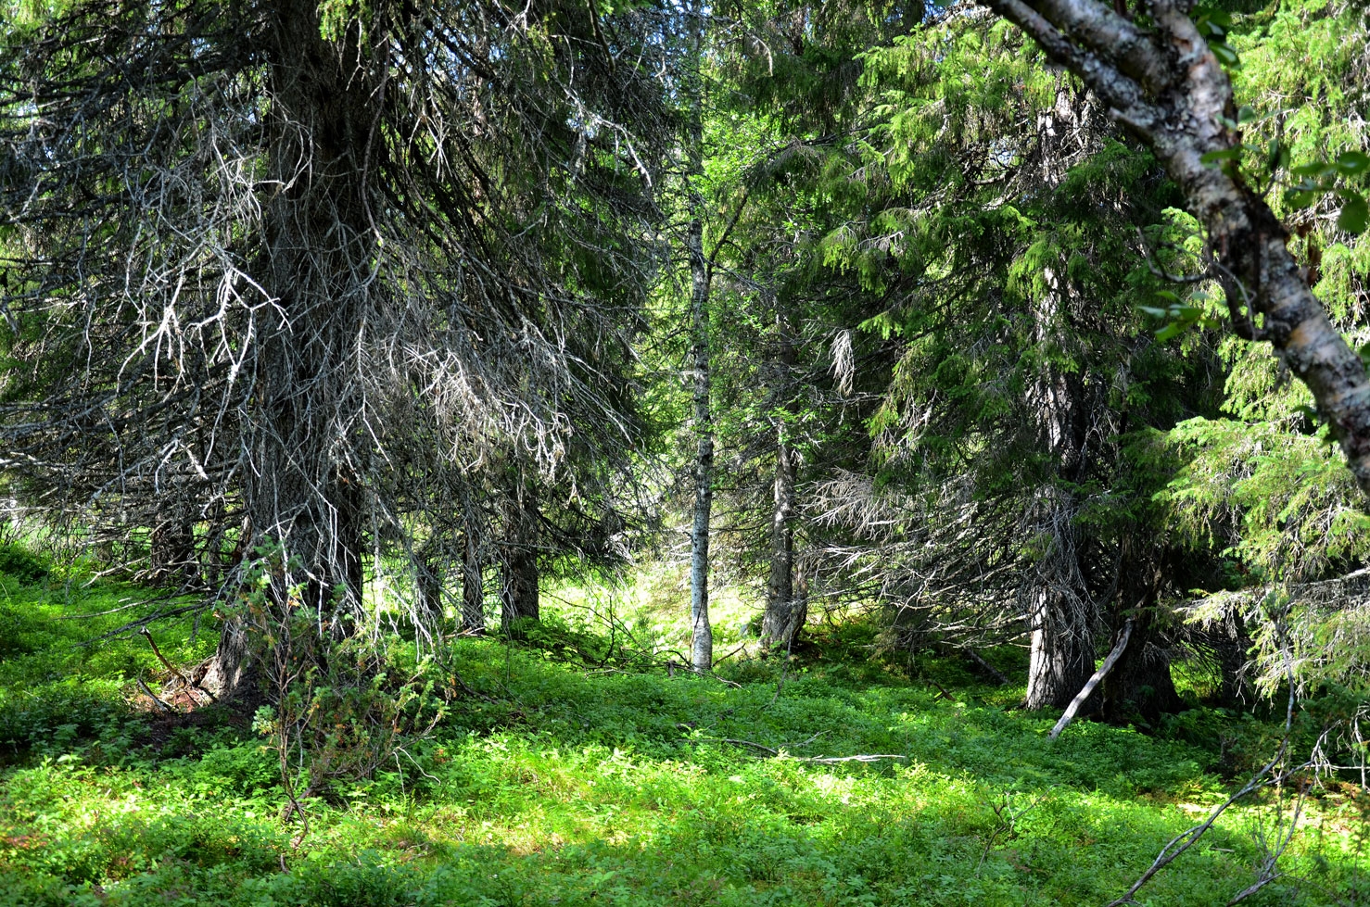

Slide 71
The classical dynamic natural resource model (Verhulst 1837):
$$\frac{dx}{dt}=sx\left(1−\frac{x}{K}\right)$$
$$x(t)=\frac{K}{1+Ce^{−st}}$$
$$\lim_{\begin{aligned}t→∞ \\ (s>0)\end{aligned}}{x(t)}=K$$

Slide 72
$$\lim_{\begin{aligned}t→∞ \\ (s>0)\end{aligned}}\left(\frac{dx}{dt}\right)=0$$
Such forests do not change the carbon level of the atmosphere.

Slide 73
Conclusion:
Yes, we can increase the bioenergy supply
from the forests very much without negative
effects on the CO2 net uptake!

Slide 74
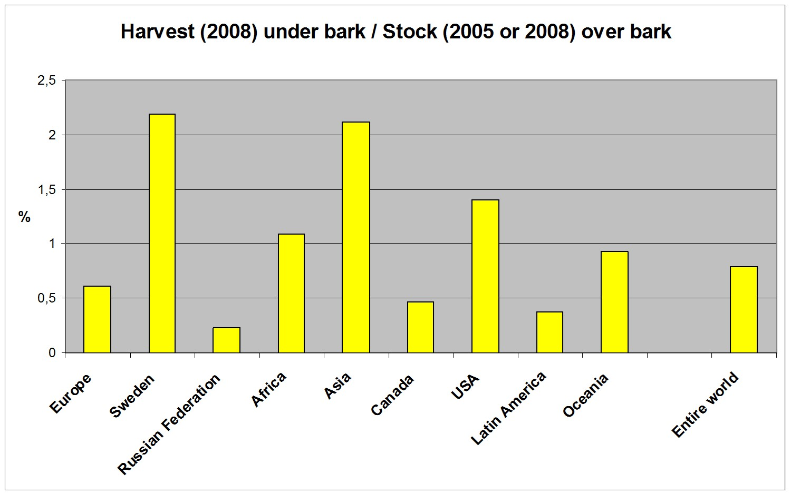

Slide 75
809
23
261
(NR)
Forest area
(Million hectares)

Slide 76
3.2
80.5
29.4 or 33
Stock
(Billion m3)

Slide 77
236
93
224
Harvest Mm3Mm3

Slide 78
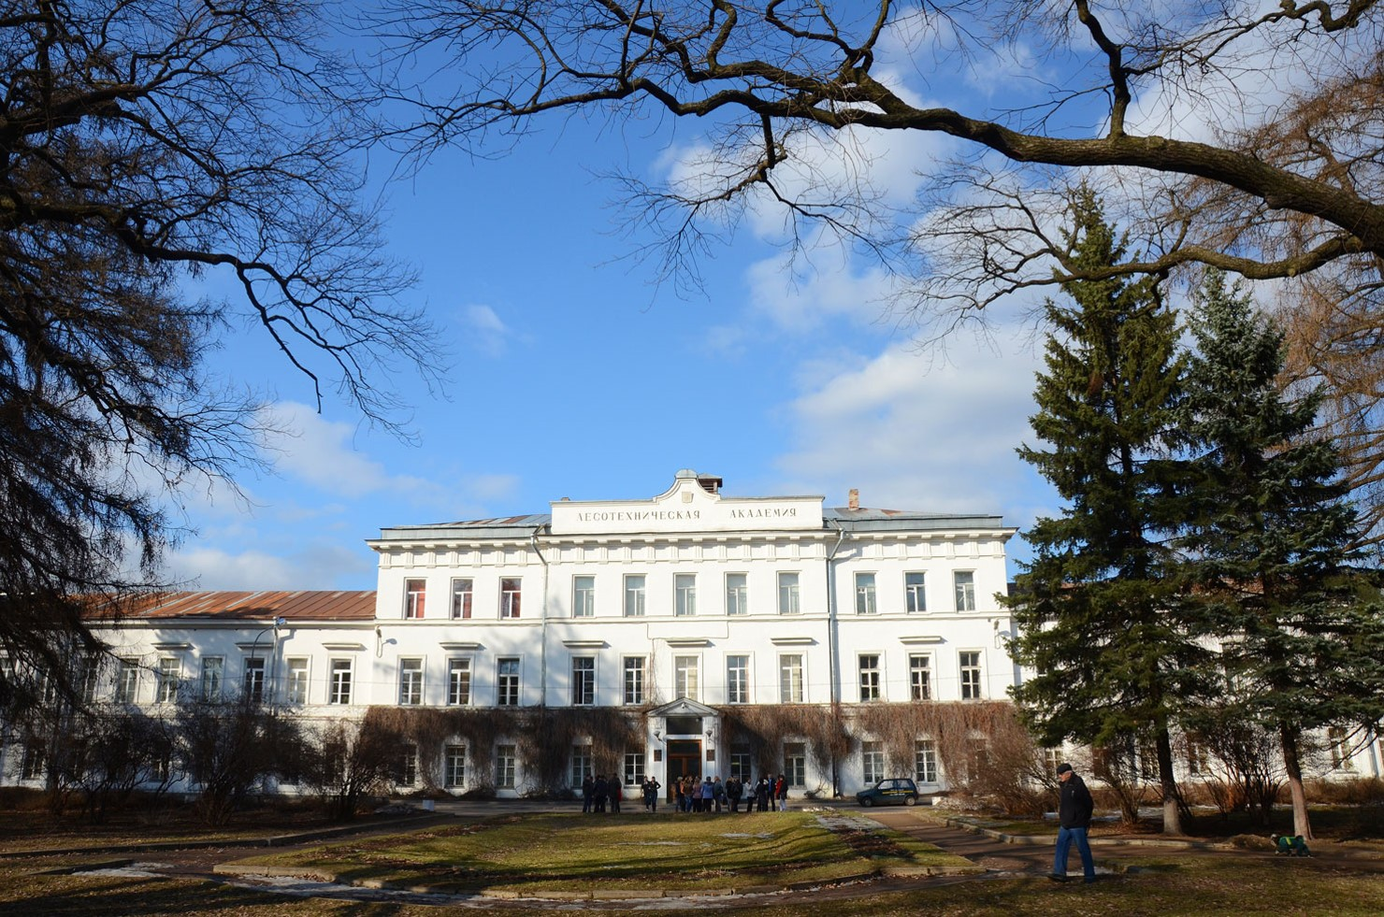

Slide 79
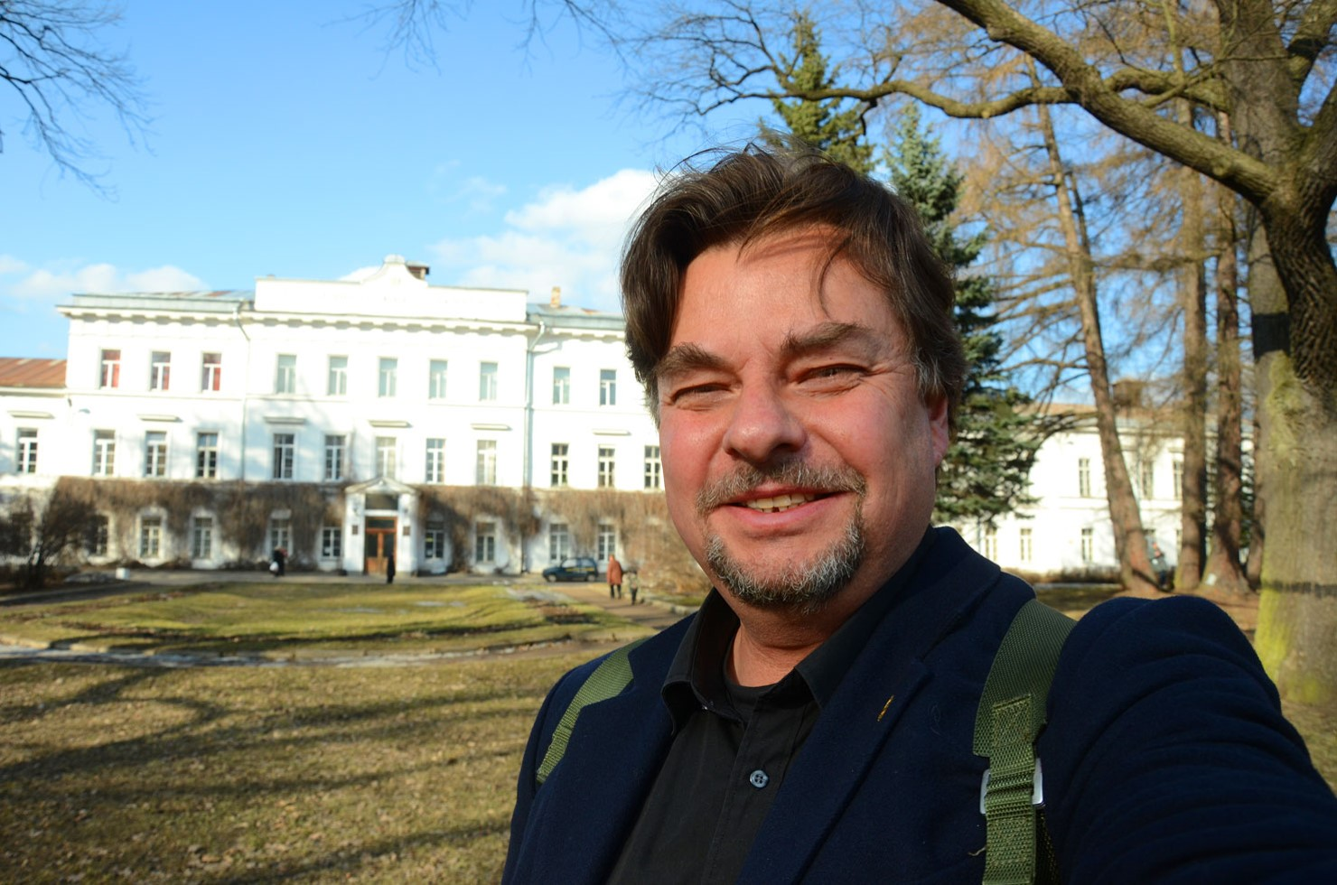

Slide 81
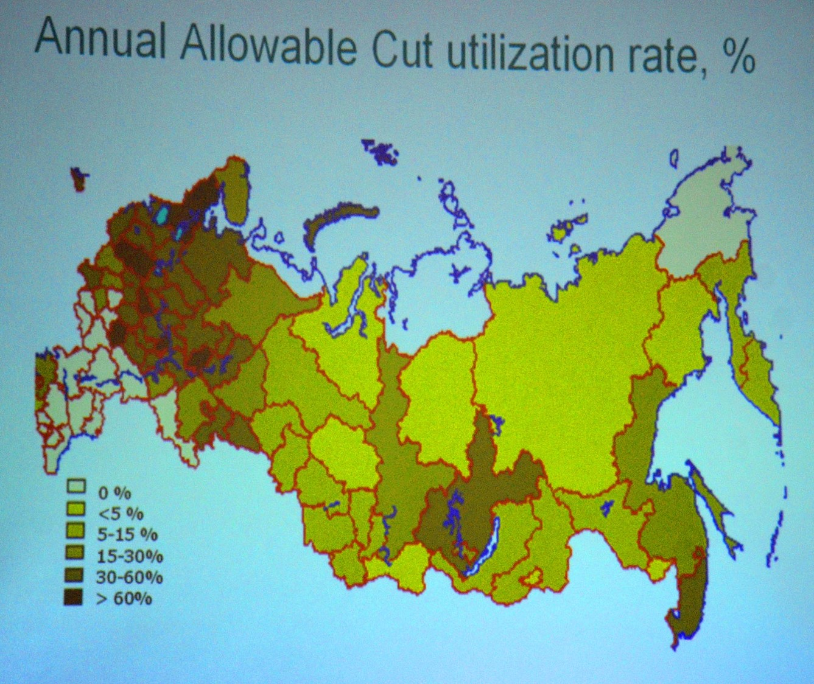

Slide 82
Conclusion: The sustainable bioenergy supply from the forests of Russian Federation can increase very much.

Slide 83
Focus on Canada

Slide 84
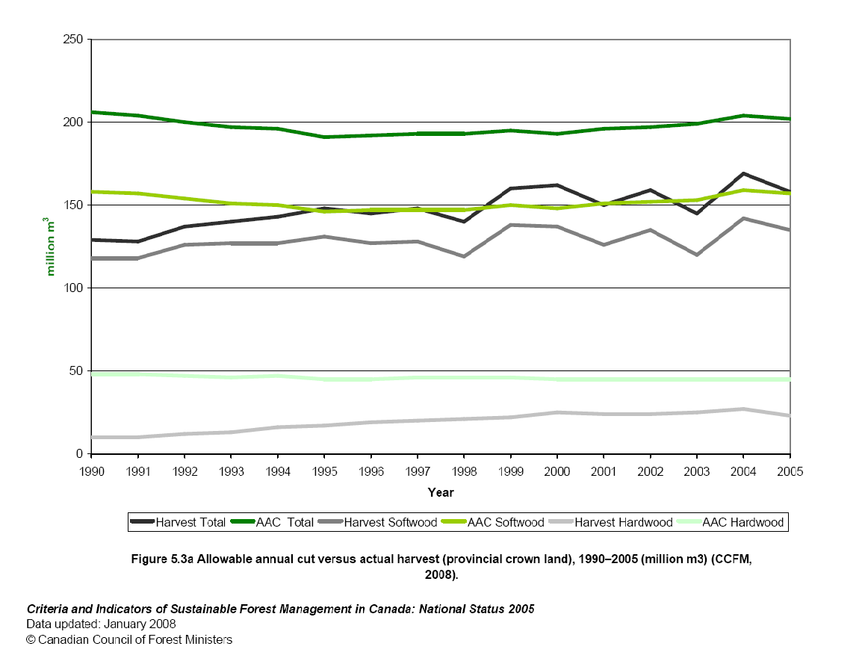
http://www.ccfm.org/ci/rprt2005/English/pdf/5.3a.pdf

Slide 85
http://www.canadaforests.nrcan.gc.ca/articletopic/14
A global endowment
Article Date: 2005-09-01
About 750 000 hectares—or 0.2 percent of the total boreal forest
—are harvested each year.
The part not managed for timber production is either
unavailable because it has been designated as
protected areas and reserves,
or currently considered inaccessible.
Unlike the forests of the United States, Scandinavia and the
majority of other nations,
most of Canada's forests (93 percent) are publicly owned.
The remaining 7 percent are held by private owners.

Slide 86
Conclusion: The sustainable bioenergy supply from the forests of Canada can increase very much.

Slide 87
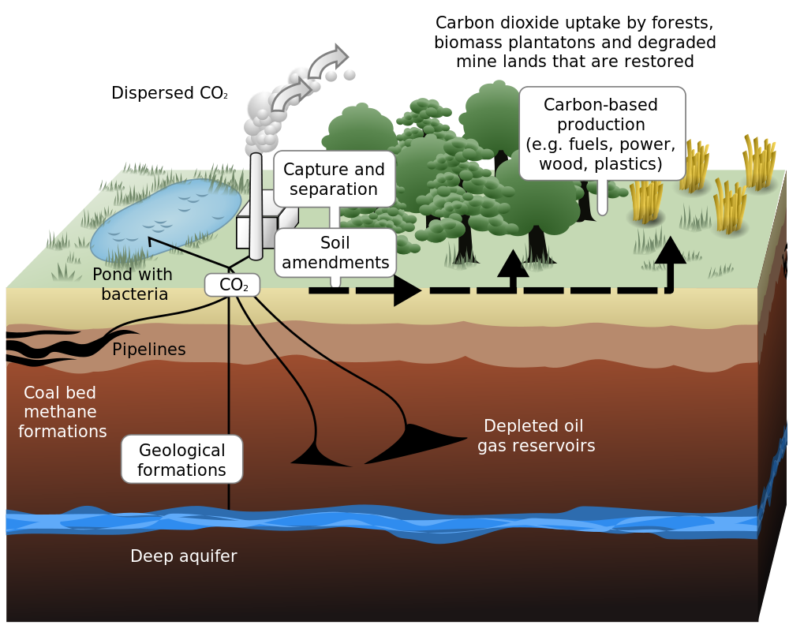
Maybe CCS (Carbon Capture and Storage) is also a useful component in our problem?

Slide 88
In Norway (Statoil) and UK (British Petroleum) , CCS (Carbon Capture and Storage) has been applied and a commercially attractive option during many years and the physical potential is large.
Carbon Capture & Storage - BP Technology - YouTube
With increasing carbon taxes in all parts of the world, such developments could be expected everywhere.

Slide 89
Vattenfall, a Swedish
energy company, is also
active in Germany and in CCS research.

Slide 90
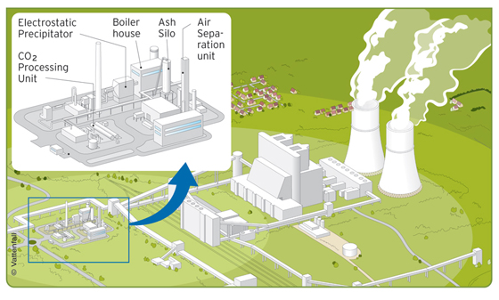

Slide 91
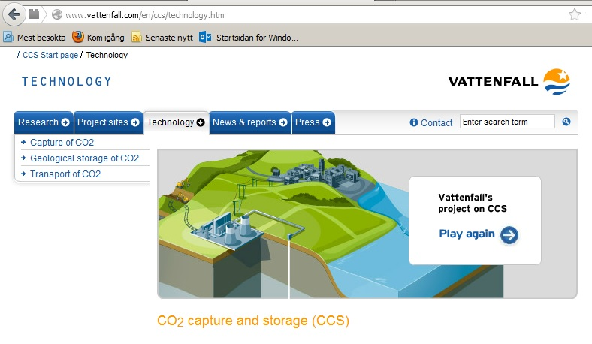

Slide 92
With increasing levels of forest inputs in combination with CCS, it is possible to reduce the CO2 in the atmosphere and the global warming problem can be managed.
Lohmander, P., Economic forest production with consideration of the forest and energy industries, E.ON International Bioenergy Conference, Malmo, Sweden, 2008-10-30 http://www.lohmander.com/eon081030/eon081030.ppt
Lohmander, P., Optimal dynamic control of the forest resource with changing energy demand functions and valuation of CO2 storage, UE2008.fr, The European Forest-based Sector: Bio-Responses to Address New Climate and Energy Challenges? Nancy, France, November 6-8, 2008 http://www.lohmander.com/Nancy08/Nancy08.ppt
Lohmander, P., The Economics of Forest Biomass and a Rational European Carbon Policy, NCSU, North Carolina State University, Pulp and Paper Laboratory, March 22, 2012 http://www.lohmander.com/PLNCSU120322.ppt http://www.lohmander.com/PLNCSU120322.pdf http://www.lohmander.com/PLNCSU2012.pdf http://www.lohmander.com/PLNCSU2012.doc

Slide 93
International trade in forest based energy can improve international relations, regional development and environmental conditions.
The “2020” targets of EU with respect to renewable energy, can be met, in an economically favorable way, with bioenergy from the forests of Russian Federation.
Lohmander, P., Methodology for optimization of coordinated forestry, bioenergy and infrastructure investments with focus on Russian Federation, Moscow State Forestry University Forest Bulletin, ISSN 1727-3749, No 84, Issue 1, 2012 http://www.lohmander.com/PLMosc12.pdf http://www.lohmander.com/PLRU201202.doc http://www.Lohmander.com/PLRU2010.pdf http://www.lesaevrasii.ru/wp-content/uploads/oficialnye-dokumenty/sbornik_le_2010.pdf
Lohmander, P., Economic optimization of sustainable energy systems based on forest resources with consideration of the global warming problem: International perspectives, BIT’s 2nd World Congress on Bioenergy, Xi'an, China, April 25-28, 2012 http://www.Lohmander.com/WorldCongress12_PL.pdf http://www.Lohmander.com/WorldCongress12_PL.doc http://www.Lohmander.com/PLWCBE12.ppt

Slide 94
Lohmander, P., Methodology for optimization of coordinated
forestry, bioenergy and infrastructure investments with focus
on Russian Federation,
Moscow State Forestry University Forest Bulletin,
ISSN 1727-3749, No 84, Issue 1, 2012

Slide 95
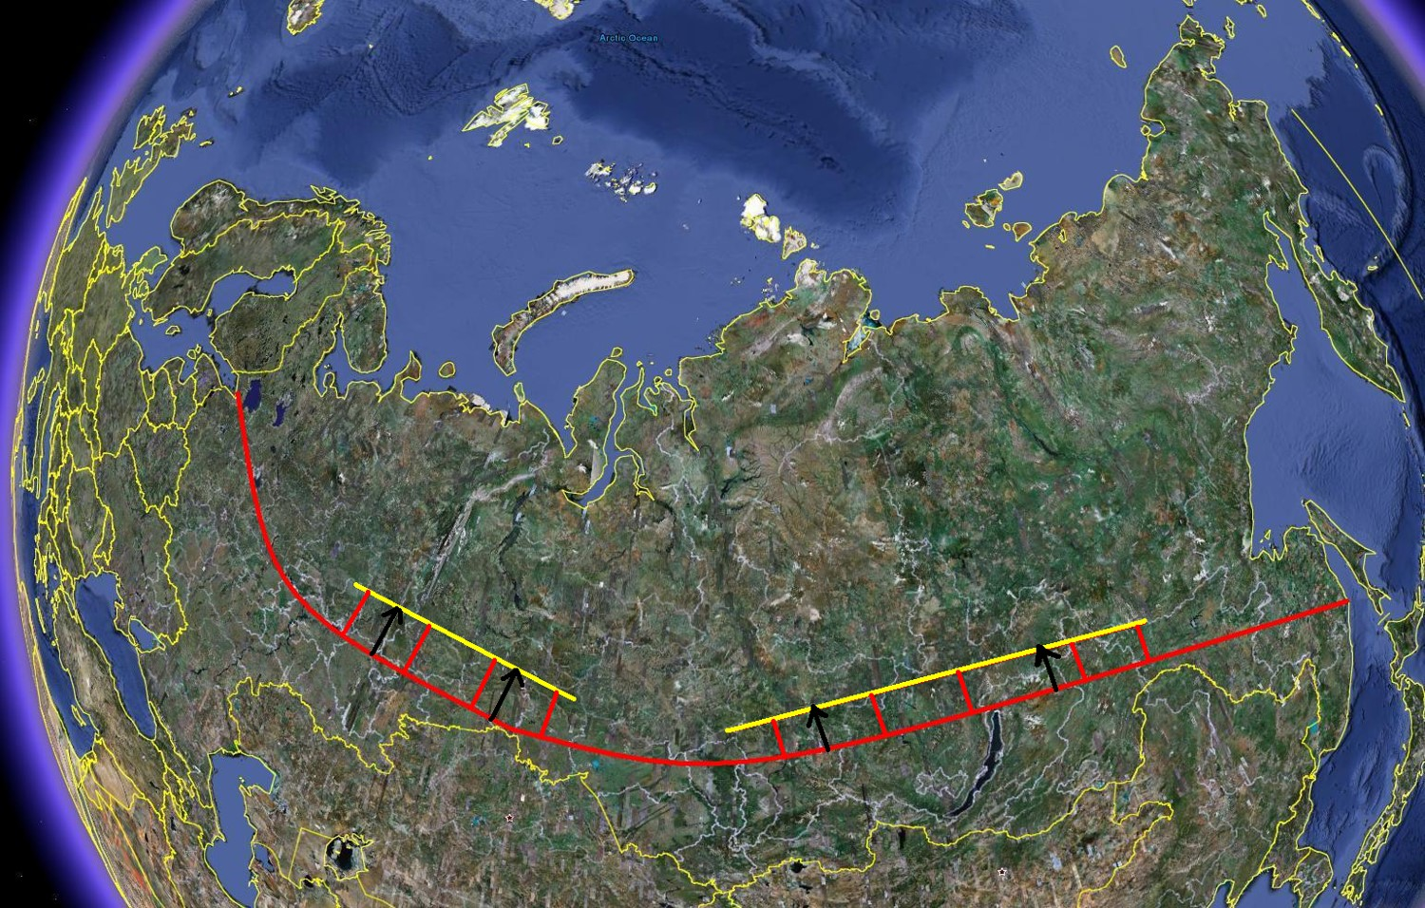

Slide 96
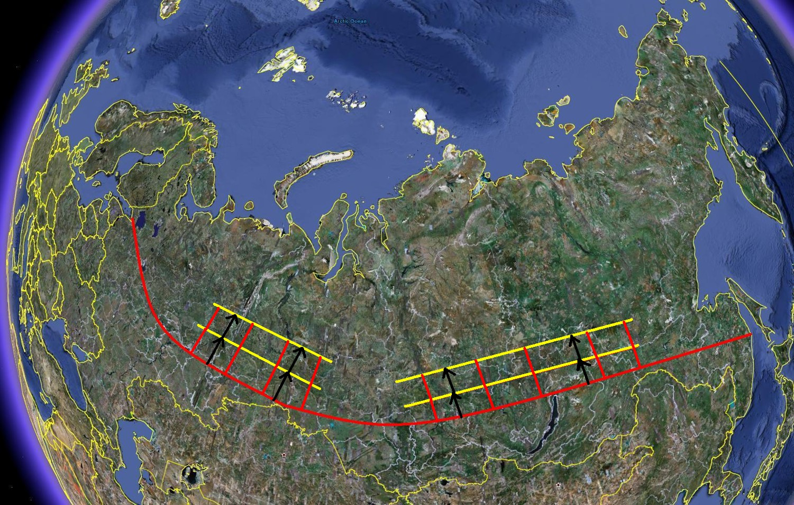

Slide 97
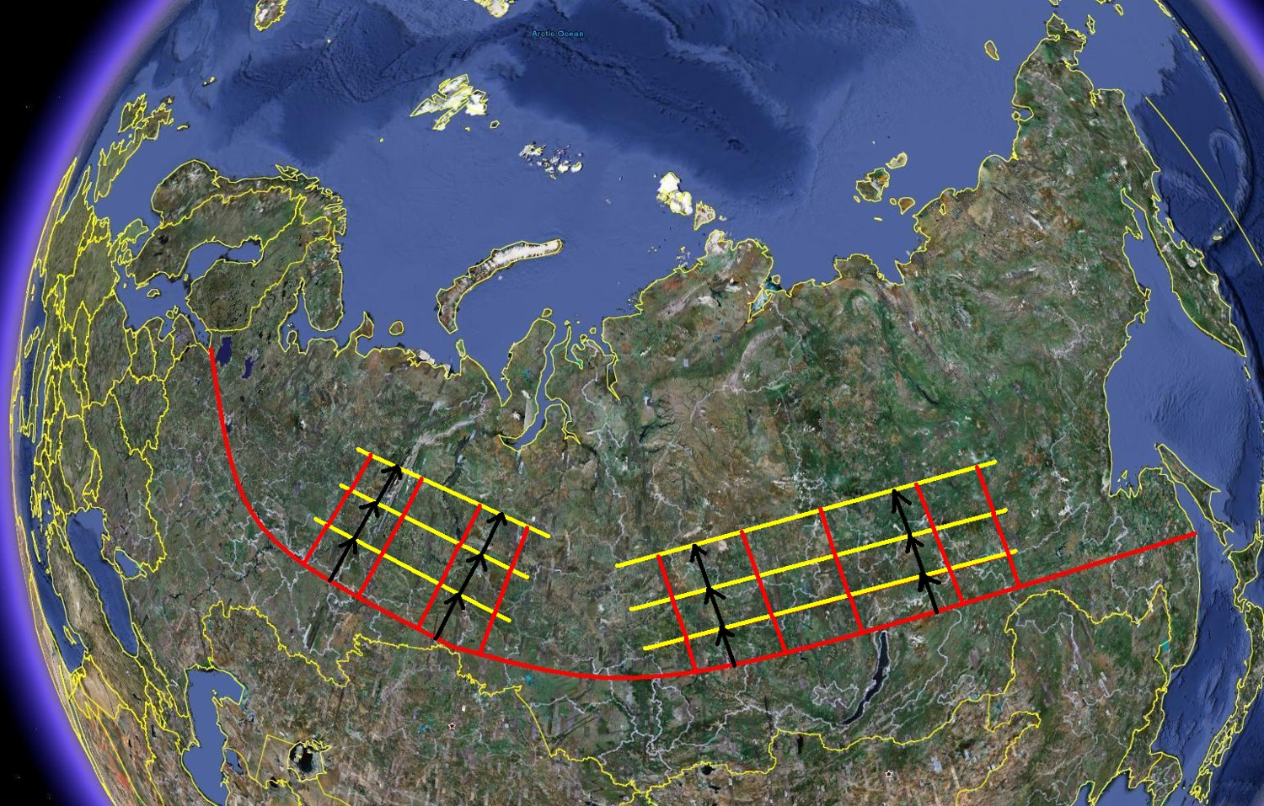

Slide 98
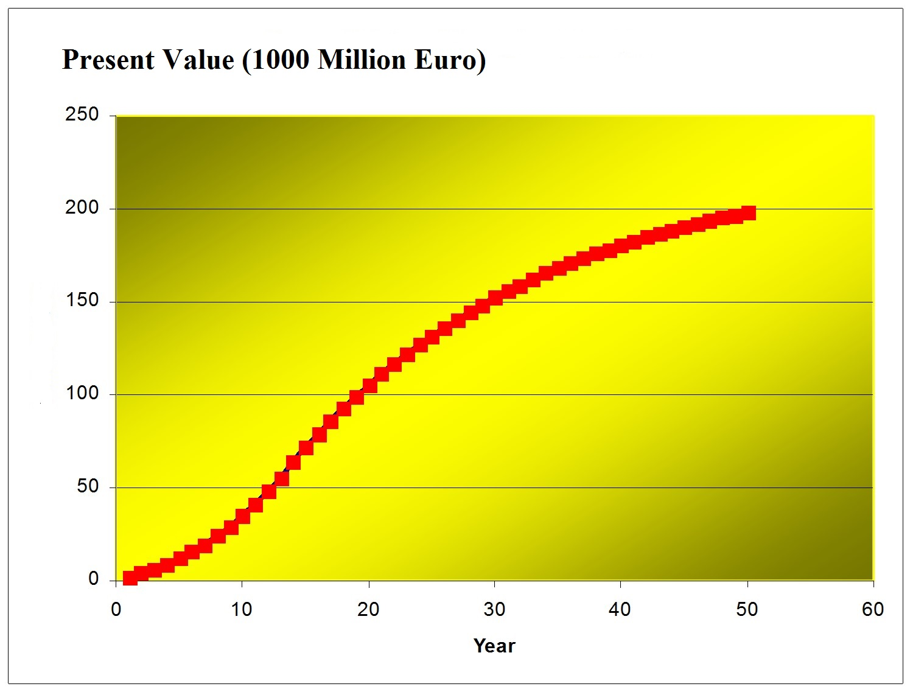

Slide 99
CONCLUSIONS:
With increasing levels of forest inputs in combination with CCS, it is possible to reduce the CO2 in the atmosphere and the global warming problem can be managed.
Furthermore, international trade in forest based energy can improve international relations, regional development and environmental conditions.
All suggestions concerning future cooperation projects are welcome!
Thank you!
Peter Lohmander

Slide 100
With expanded bioenergy based on forest resources, we may simultaneously and sustainably reduce global warming, improve economic results, international relations and environmental conditions
Professor Dr Peter Lohmander
SLU, Sweden, http://www.Lohmander.com
Peter@Lohmander.com
BIT’s 4th Annual World Congress of Bioenergy
Theme: Roadmap Toward 2020
September 21-23
Qingdao International Convention Center, Qingdao, China

Slide 101
With expanded bioenergy based on forest resources, we may simultaneously and sustainably reduce global warming, improve economic results, international relations and environmental conditions Professor Dr. Peter Lohmander, SLU, Sweden, http://www.Lohmander.com Peter@Lohmander.com
In the production of district heating, electricity and many other energy outputs, we may use fossil fuels and renewable inputs, in different combinations. The optimal input mix is a function of technological options, prices of different inputs and costs of alternative levels of environmental consequences.
Even with presently existing technology in combined heat and power plants, it is usually possible to reduce the amount of fossil fuels such as coal and strongly increase the level of forest based energy inputs.
In large parts of the world, such as Russian Federation, forest stocks are close to dynamic equilibria, in the sense that the net growth (and net carbon uptake) is close to zero. If these forests will be partly harvested, the net growth and CO2 uptake can increase.
In Norway and UK, CCS has been applied and a commercially attractive option during many years and the physical potential is large. With increasing carbon taxes in all parts of the world, such developments could be expected everywhere.
With increasing levels of forest inputs in combination with CCS, it is possible to reduce the CO2 in the atmosphere and the global warming problem can be managed. Furthermore, international trade in forest based energy can improve international relations, regional development and environmental conditions.

Slide 102
References
http://www.lohmander.com/Information/Ref.htm
Lohmander, P. (Chair) TRACK 1: Global Bioenergy, Economy and Policy, BIT’s 2nd World Congress on Bioenergy, Xi'an, China, April 25-28, 2012 http://www.Lohmander.com/Schedule_China_2012.pdf http://www.Lohmander.com/PLWCBE12intro.ppt Lohmander, P., Economic optimization of sustainable energy systems based on forest resources with consideration of the global warming problem: International perspectives, BIT’s 2nd World Congress on Bioenergy, Xi'an, China, April 25-28, 2012 http://www.Lohmander.com/WorldCongress12_PL.pdf http://www.Lohmander.com/WorldCongress12_PL.doc http://www.Lohmander.com/PLWCBE12.ppt

Slide 103
Lohmander, P., Lectures at Shandong Agricultural University, April 29 - May 1, 2012, Jinan, China, http://www.Lohmander.com/PLJinan12.ppt
Lohmander, P. (Chair) TRACK: Finance, Strategic Planning, Industrialization and Commercialization, BIT’s 1st World Congress on Bioenergy, Dalian World Expo Center, Dalian, China, April 25-30, 2011 http://www.bitlifesciences.com/wcbe2011/fullprogram_track5.asp http://www.lohmander.com/PRChina11/Track_WorldCongress11_PL.pdf http://www.lohmander.com/ChinaPic11/Track5.ppt Lohmander, P., Economic forest management with consideration of the forest and energy industries, BIT’s 1st World Congress on Bioenergy, Dalian World Expo Center, Dalian, China, April 25-30, 2011 http://www.lohmander.com/PRChina11/WorldCongress11_PL.pdf http://www.lohmander.com/ChinaPic11/LohmanderTalk.ppt

Slide 104
APPENDIX
The classical dynamic natural resource model:
$$\frac{dx}{dt}=sx\left(1−\frac{x}{K}\right)$$
$$\frac{dx}{dt}=sx−\frac{s}{K}x^{2}$$
$$\frac{dx}{dt}=sx\left(1+γx\right), γ=−K^{−1}$$
$$\frac{1}{x\left(1+γx\right)}dx=sdt$$
$$\frac{1}{x\left(1+γx\right)}=\frac{m}{x}+\frac{n}{1+γx}$$
$$\frac{m}{x}+\frac{n}{1+γx}=\frac{\left(1+γx\right)m+nx}{x\left(1+γx\right)}$$
$$\frac{\left(1+γx\right)m+nx}{x\left(1+γx\right)}=\frac{1}{x\left(1+γx\right)}$$
$$\left(1+γx\right)m+nx=1$$
$$m+mγx+nx=1$$
$$m+\left(mγ+n\right)x=1$$
Observation:
$$m+\left(mγ+n\right)x=1∀x$$
$$\left\{\begin{matrix} m=1 \\ mγ+n=0\end{matrix}\right.$$
Solution:
$\left(m,n\right)=(1,−γ)$
$$\frac{1}{x\left(1+γx\right)}dx=sdt$$
$$\left(\frac{m}{x}+\frac{n}{1+γx}\right)dx=sdt$$
$$\left(\frac{1}{x}−\frac{γ}{1+γx}\right)dx=sdt$$
$$\frac{dLN(1+γx)}{dx}=\frac{γ}{1+γx}$$

Slide 105
$$\frac{1}{x}dx−\frac{γ}{1+γx}dx=sdt$$
$$\int{\frac{1}{x}dx}−\int{\frac{γ}{1+γx}dx}=\int{sdt}$$
$$LN\left(x\right)−LN\left(1+γx\right)=st+C_{1}$$
$$LN\left(\frac{x}{1+γx}\right)=st+C_{1}$$
$$e^{LN\left(\frac{x}{1+γx}\right)}=e^{st+C_{1}}$$
$$\frac{x}{1+γx}={C_{2}e}^{st}$$
$$x={{\left(1+γx\right)C}_{2}e}^{st}$$
$$x\left(1−{C_{2}γe}^{st}\right)={C_{2}e}^{st}$$
$$x=\frac{{C_{2}e}^{st}}{1−{C_{2}γe}^{st}}$$
$$x=\frac{1}{\frac{1}{C_{2}}e^{−st}−γ}$$
$$γ={−K}^{−1}$$
$$x=\frac{1}{\frac{1}{C_{2}}e^{−st}+\frac{1}{K}}$$
$$x(t)=\frac{K}{1+Ce^{−st}}$$
$$\lim_{\begin{aligned}t→∞ \\ (s>0)\end{aligned}}{x(t)}=K$$
$$\frac{dx}{dt}=\frac{KsCe^{−st}}{{\left(1+Ce^{−st}\right)}^{2}}$$
$$\lim_{\begin{aligned}t→∞ \\ (s>0)\end{aligned}}\left(\frac{dx}{dt}\right)=0$$

