Slide 1
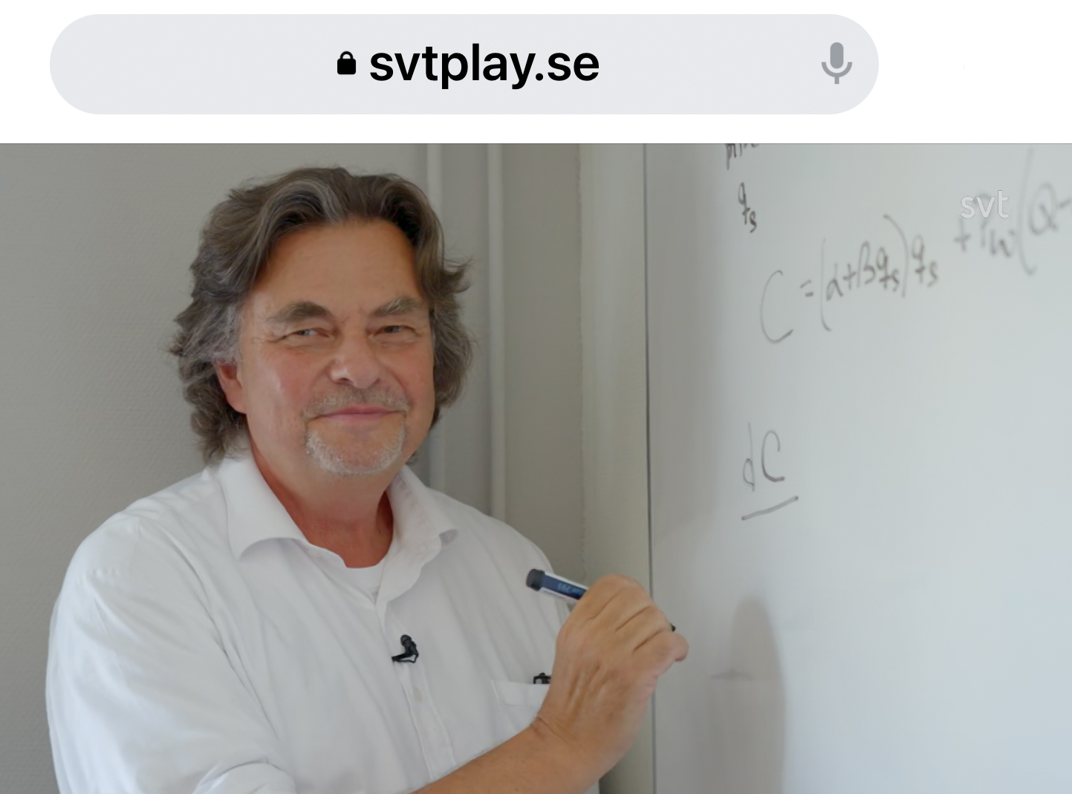
Mathematical Methods for Optimization of Adaptive Control Decisions under Risk with CCF and other Applications by Prof Dr Peter Lohmander
Peter@Lohmander.com

Slide 2
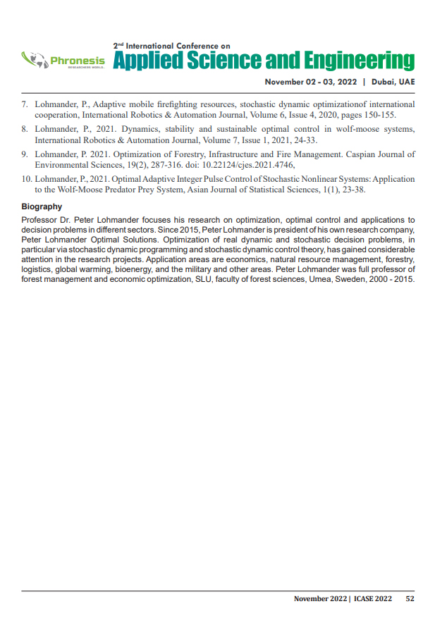
Updated references with links,
next page.

Slide 3
Updated references with links:
[1] Lohmander, P., Optimal Stochastic Control in Continuous Time with Wiener Processes: General Results and Applications to Optimal Wildlife Management, Iranian Journal of Operations Research, Vol. 8, No. 2, 2017, pp. 58-67 http://iors.ir/journal/article-1-541-en.pdf http://www.Lohmander.com/PL_IJOR_2017.pdf
[2] Lohmander, P., Control function optimization for stochastic continuous cover forest management, International Robotics and Automation Journal, 2019;5(2), pages 85-89. https://medcraveonline.com/IRATJ/IRATJ-05-00178.pdf
[3] Lohmander, P., Market Adaptive Control Function Optimization in Continuous Cover Forest Management, Iranian Journal of Management Studies, Article 1, Volume 12, Issue 3, Summer 2019, Page 335-361. DOI: 10.22059/IJMS.2019.267204.673348 https://ijms.ut.ac.ir/article_71443.html

Slide 4
[4] Lohmander, P., Adaptive mobile firefighting resources, stochastic dynamic optimization of international cooperation, International Robotics & Automation Journal, Volume 6, Issue 4, 2020, pages 150-155. https://medcraveonline.com/IRATJ/IRATJ-06-00213.pdf
[5] Lohmander, P., Dynamics, stability and sustainable optimal control in wolf-moose systems, International Robotics & Automation Journal, Volume 7, Issue 1, 2021, pages 24-33. https://medcraveonline.com/IRATJ/IRATJ-07-00223.pdf
[6] Lohmander, P., Optimization of forestry, infrastructure and fire management, Caspian Journal of Environmental Sciences, Vol. 19 No. 2 pp. 287-316, 2021. https://cjes.guilan.ac.ir/article_4746_197fe867639c4cc5e317b63f9f9d370b.pdf

Slide 5
[7] Lohmander, P., Optimal Adaptive Integer Pulse Control of Stochastic Nonlinear Systems: Application to the Wolf-Moose Predator Prey System, Asian Journal of Statistical Sciences,
1(1), 2021, pages 23-38.
https://www.arfjournals.com/ajss/issue/105
[8] Lohmander, P., Fagerberg, N., Statistics and Mathematics of General Control Function Optimization for Continuous Cover Forestry, with a Swedish Case Study based on Picea abies, Asian Journal of Statistical Sciences, Vol. 2, No-1, (2022), pp. 01-35.
https://www.arfjournals.com/ajss/issue/169

Slide 6
Our World develops rapidly, and unpredictably, in many ways.
This is true in large and small scales.
In order to decide what to do in order to manage some system or organization in the best way, it is necessary to apply some method that can optimize decisions that are rational under such conditions.

Slide 7
This field is denoted adaptive optimization.
Adaptive control decisions can be determined via different methods.
Most methods are more useful in some situation(s) and less useful, or more difficult to apply, in other cases.

Slide 8
This keynote presentation will present a number of real world problems and investigate how rational adaptive decisions can be obtained via alternative optimization methods.
These adaptive decision problems have recently been optimized with alternative mathematical methods and published in eight open access articles in different international journals.
These articles are available via the included links and serve as a more detailed background to the presentation.

Slide 9
The approaches include analytical and numerical methods, such as
Discrete stochastic dynamic programming.
Continuous stochastic optimal control theory.
Optimization of continuous control functions in combination with
stochastic system simulation.
Integer pulse control of stochastic nonlinear systems.

Slide 10
The illustrations include:
Continuous cover forestry.
Infrastructure optimization.
Fire risk management.
Wildlife management.
The methods can be applied in all industrial sectors

Slide 11
Analytical optimization of general function model | Analytical optimization of dynamic system equilibrium
Stochastic dynamic programming | Stochastic optimal control theory, Stochastic differential equation etc.
Stochastic simulation + Optimization of discrete control function parameters via enumeration | Stochastic simulation + Nonlinear approximation of objective function + Analytical optimization of control function parameters

Slide 12
Lohmander, P., Optimization of forestry, infrastructure and fire management, Caspian Journal of Environmental Sciences, Vol. 19 No. 2 pp. 287-316, 2021. https://cjes.guilan.ac.ir/article_4746_197fe867639c4cc5e317b63f9f9d370b.pdf | Lohmander, P., Dynamics, stability and sustainable optimal control in wolf-moose systems, International Robotics & Automation Journal, Volume 7, Issue 1, 2021, pages 24-33. https://medcraveonline.com/IRATJ/IRATJ-07-00223.pdf
Lohmander, P., Adaptive mobile firefighting resources, stochastic dynamic optimization of international cooperation, International Robotics & Automation Journal, Volume 6, Issue 4, 2020, pages 150-155. https://medcraveonline.com/IRATJ/IRATJ-06-00213.pdf | Lohmander, P., Optimal Stochastic Control in Continuous Time with Wiener Processes: General Results and Applications to Optimal Wildlife Management, Iranian Journal of Operations Research, Vol. 8, No. 2, 2017, pp. 58-67 http://iors.ir/journal/article-1-541-en.pdf
Lohmander, P., Optimal Adaptive Integer Pulse Control of Stochastic Nonlinear Systems: Application to the Wolf-Moose Predator Prey System, Asian Journal of Statistical Sciences, 1(1), 2021, pages 23-38. https://www.arfjournals.com/ajss/issue/105 | Lohmander, P., Control function optimization for stochastic continuous cover forest management, International Robotics and Automation Journal, 2019;5(2), pages 85-89. https://medcraveonline.com/IRATJ/IRATJ-05-00178.pdf Lohmander, P., Market Adaptive Control Function Optimization in Continuous Cover Forest Management, Iranian Journal of Management Studies, Article 1, Volume 12, Issue 3, Summer 2019, Page 335-361. DOI: 10.22059/IJMS.2019.267204.673348 https://ijms.ut.ac.ir/article_71443.html Lohmander, P., Fagerberg, N., Statistics and Mathematics of General Control Function Optimization for Continuous Cover Forestry, with a Swedish Case Study based on Picea abies, Asian Journal of Statistical Sciences, Vol. 2, No-1, (2022), pp. 01-35. https://www.arfjournals.com/ajss/issue/169

Slide 13
Analytical optimization of general function model
Lohmander, P., Optimization of forestry, infrastructure and fire management, Caspian Journal of Environmental Sciences, Vol. 19 No. 2 pp. 287-316, 2021. https://cjes.guilan.ac.ir/article_4746_197fe867639c4cc5e317b63f9f9d370b.pdf

Slide 14
Illustration of some sequences of equations:
Expected total
present value
Profit from forestry in forests
that have not yet burned.

Slide 15
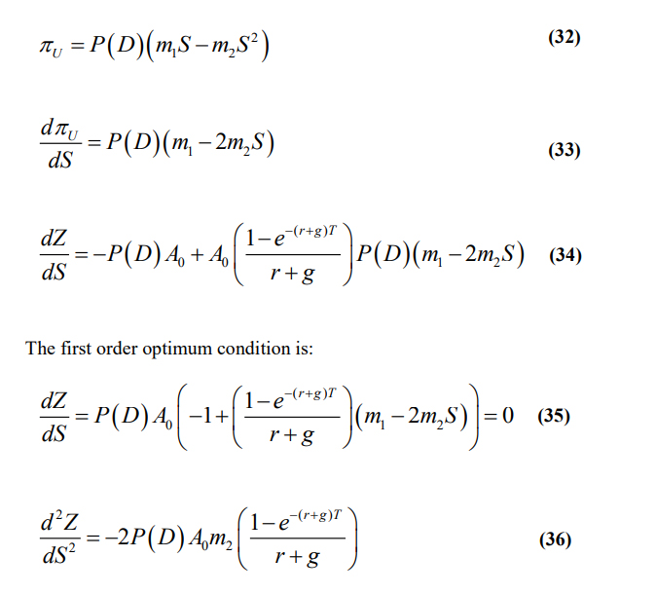
Stock
level
in the
forests
We want to select the stock level that maximizes the expected total present value.
< 0
(Second order
maximum condition)

Slide 16
In the same way, many other continuous decision variables can be optimized.
(With several simultaneous decisions, the second order maximum conditions
become more complicated.)

Slide 17
Analytical optimization of dynamic system equilibrium
Lohmander, P., Dynamics, stability and sustainable optimal control in wolf-moose systems, International Robotics & Automation Journal, Volume 7, Issue 1, 2021, pages 24-33.
https://medcraveonline.com/IRATJ/IRATJ-07-00223.pdf

Slide 18
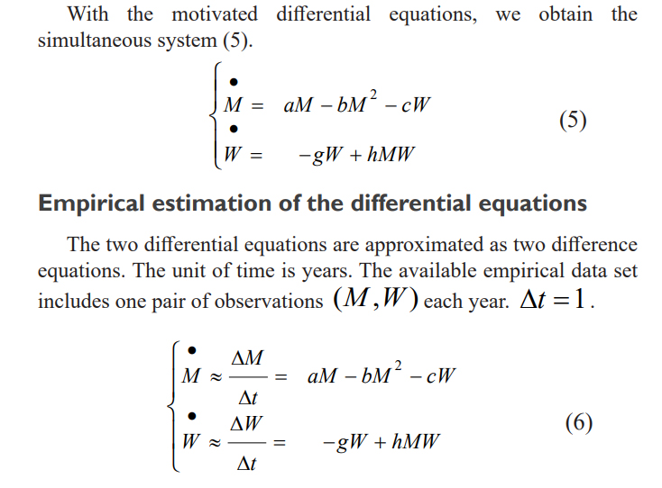
Moose
Wolf

Slide 19
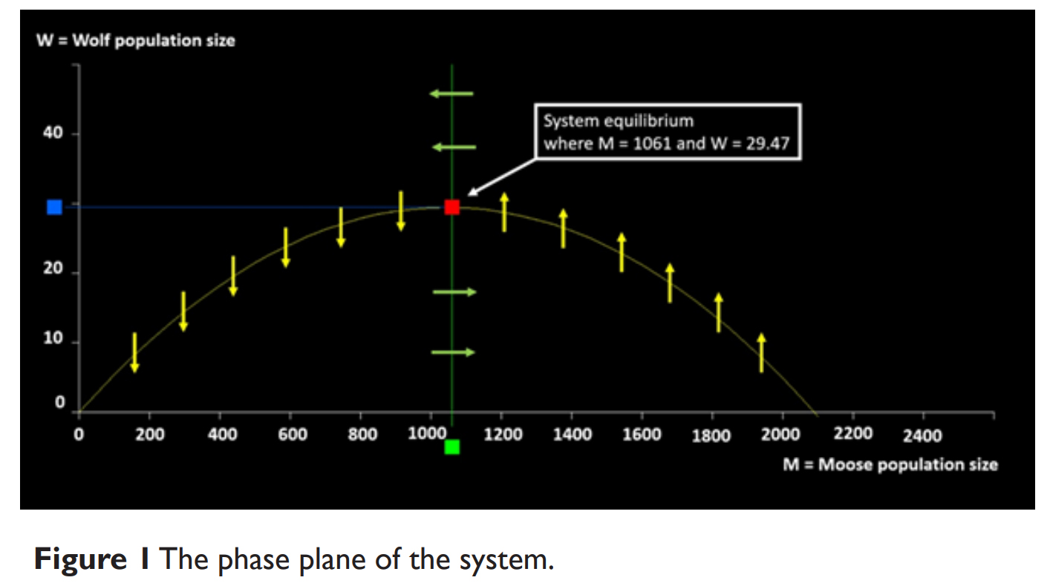

Slide 20
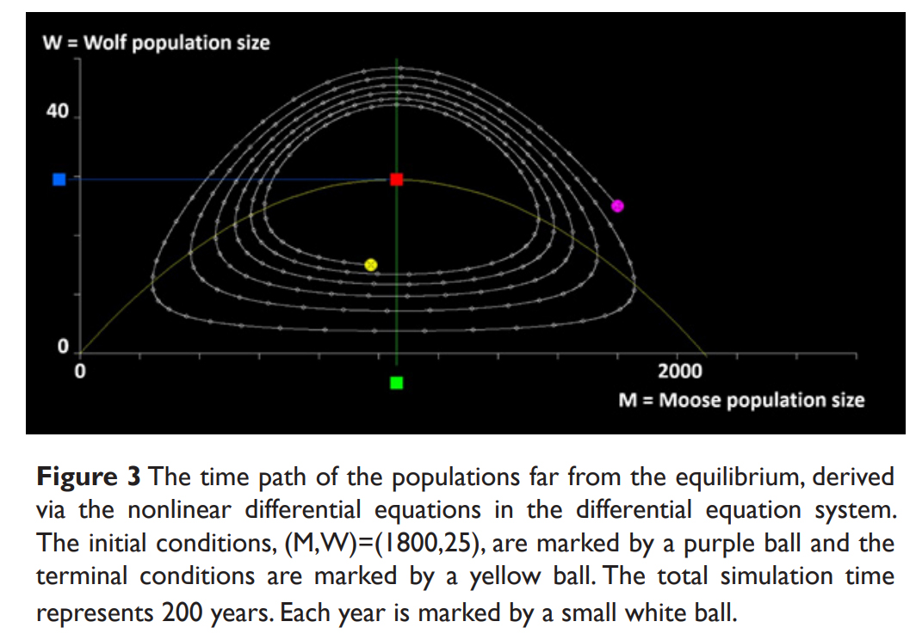

Slide 21
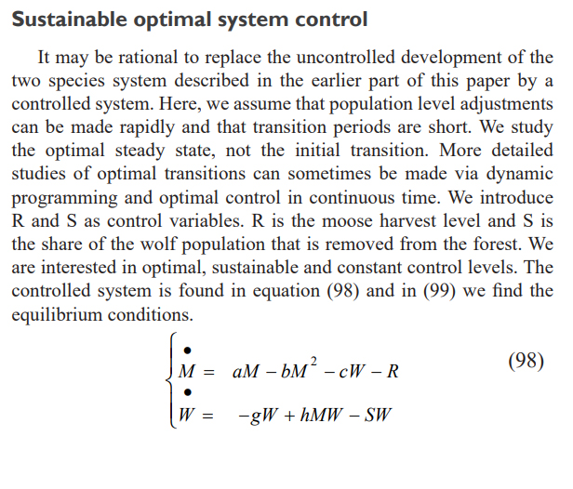
Optimal hunting
level of moose
hunting level (share of population) of wolf

Slide 22
Optimal hunting level of moose
Functions of several
parameters
Optimal hunting level (share of population) of wolf

Slide 23
Stochastic dynamic programming
Lohmander, P., Adaptive mobile firefighting resources, stochastic dynamic optimization of international cooperation, International Robotics & Automation Journal, Volume 6, Issue 4, 2020, pages 150-155. https://medcraveonline.com/IRATJ/IRATJ-06-00213.pdf

Slide 24
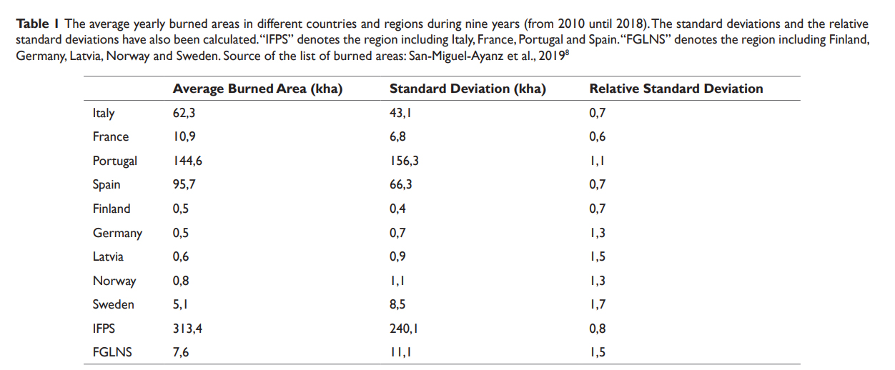
Average burned areas per year, in different countries

Slide 25
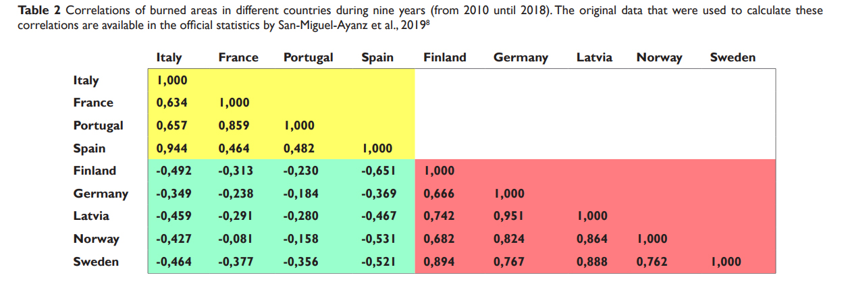
Correlations of burned areas per year, between different countries

Slide 26
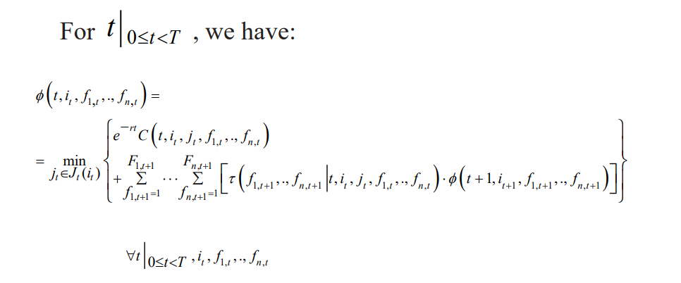
Stochastic dynamic programming determines how to optimally distribute water bombing air planes between countries

Slide 27
Stochastic optimal control theory, Stochastic differential equation etc.
Lohmander, P., Optimal Stochastic Control in Continuous Time with Wiener Processes: General Results and Applications to Optimal Wildlife Management, Iranian Journal of Operations Research, Vol. 8, No. 2, 2017, pp. 58-67 http://iors.ir/journal/article-1-541-en.pdf

Slide 29
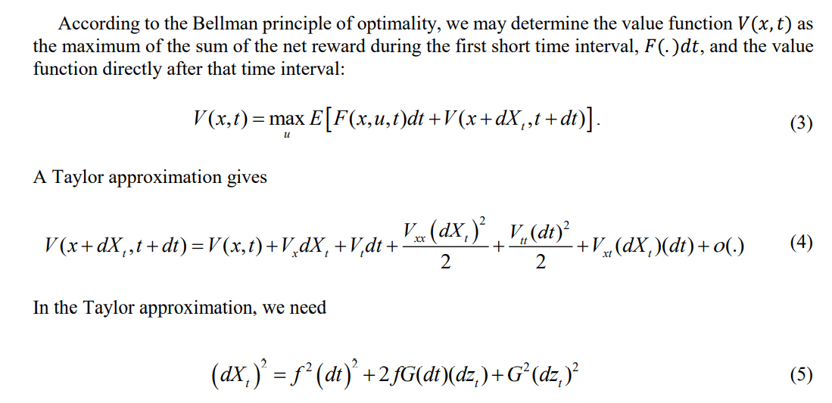

Slide 32
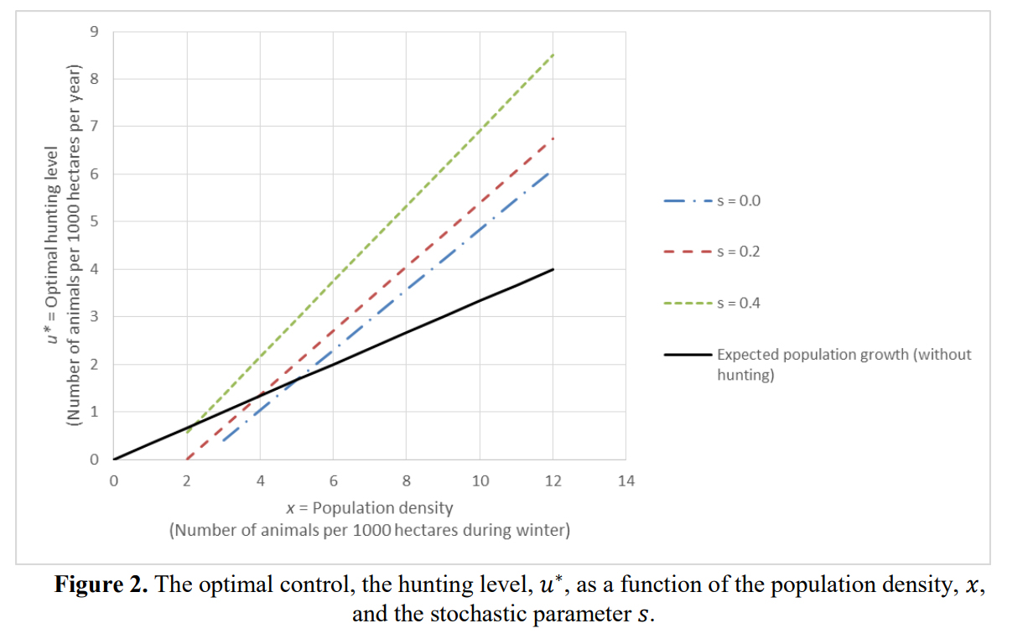

Slide 33
Stochastic simulation + Optimization of discrete control function parameters via enumeration
Lohmander, P., Optimal Adaptive Integer Pulse Control of Stochastic Nonlinear Systems: Application to the Wolf-Moose Predator Prey System, Asian Journal of Statistical Sciences, 1(1), 2021, pages 23-38.
https://www.arfjournals.com/ajss/issue/105

Slide 34
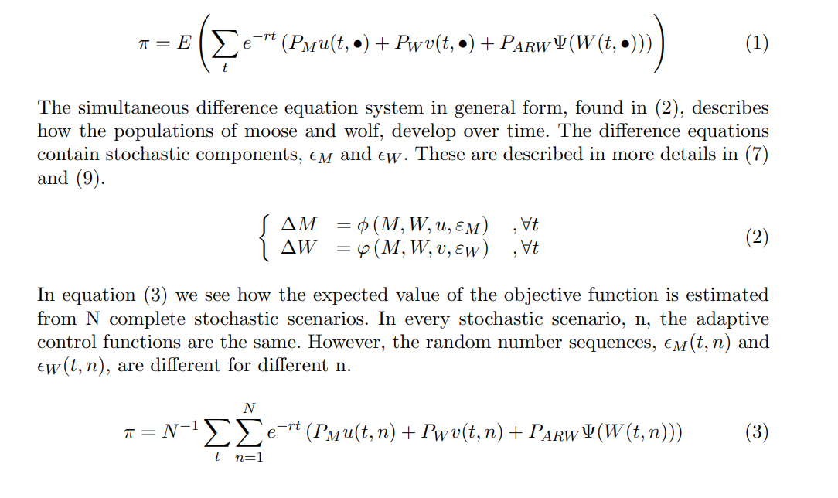

Slide 35
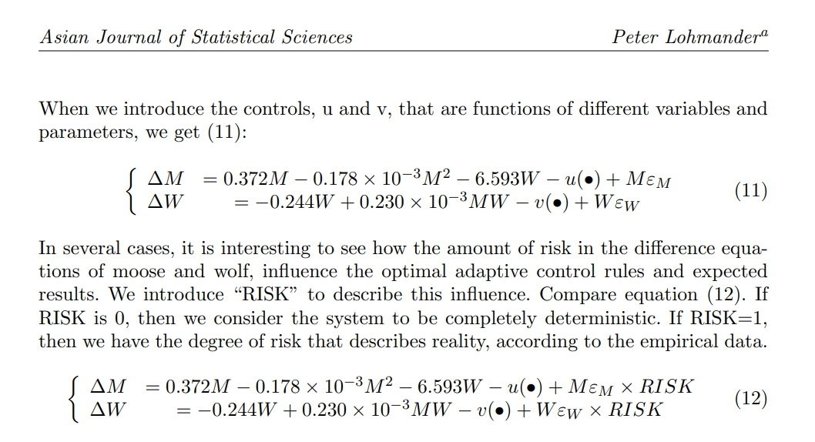

Slide 36
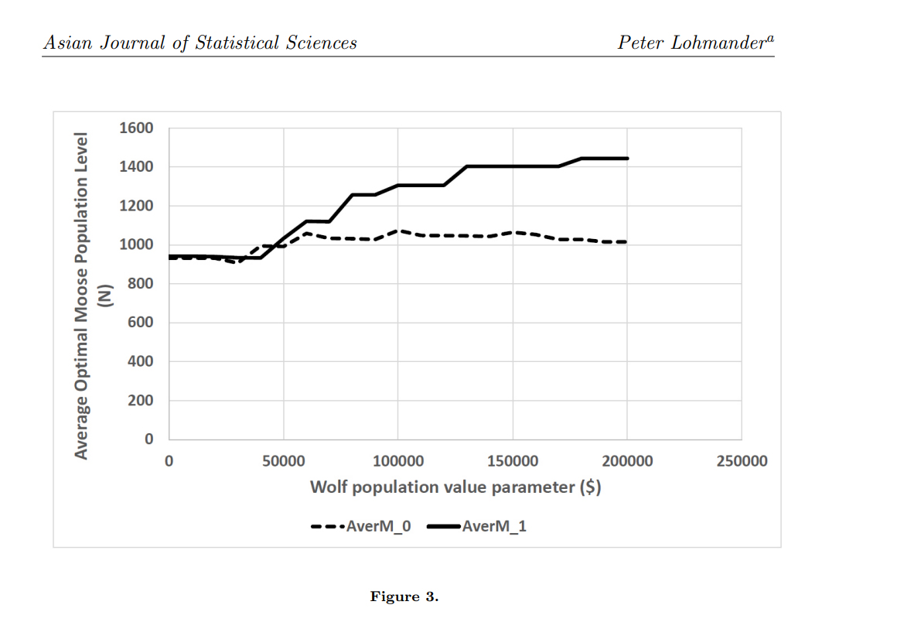
With risk
Without risk

Slide 37
Stochastic simulation + Nonlinear approximation of objective function + Analytical optimization of control function parameters
Lohmander, P., Control function optimization for stochastic continuous cover forest management, International Robotics and Automation Journal, 2019;5(2), pages 85-89. https://medcraveonline.com/IRATJ/IRATJ-05-00178.pdf
Lohmander, P., Market Adaptive Control Function Optimization in Continuous Cover Forest Management, Iranian Journal of Management Studies, Article 1, Volume 12, Issue 3, Summer 2019, Page 335-361. DOI: 10.22059/IJMS.2019.267204.673348 https://ijms.ut.ac.ir/article_71443.html
Lohmander, P., Fagerberg, N., Statistics and Mathematics of General Control Function Optimization for Continuous Cover Forestry, with a Swedish Case Study based on Picea abies, Asian Journal of Statistical Sciences, Vol. 2, No-1, (2022), pp. 01-35.
https://www.arfjournals.com/ajss/issue/169

Slide 38
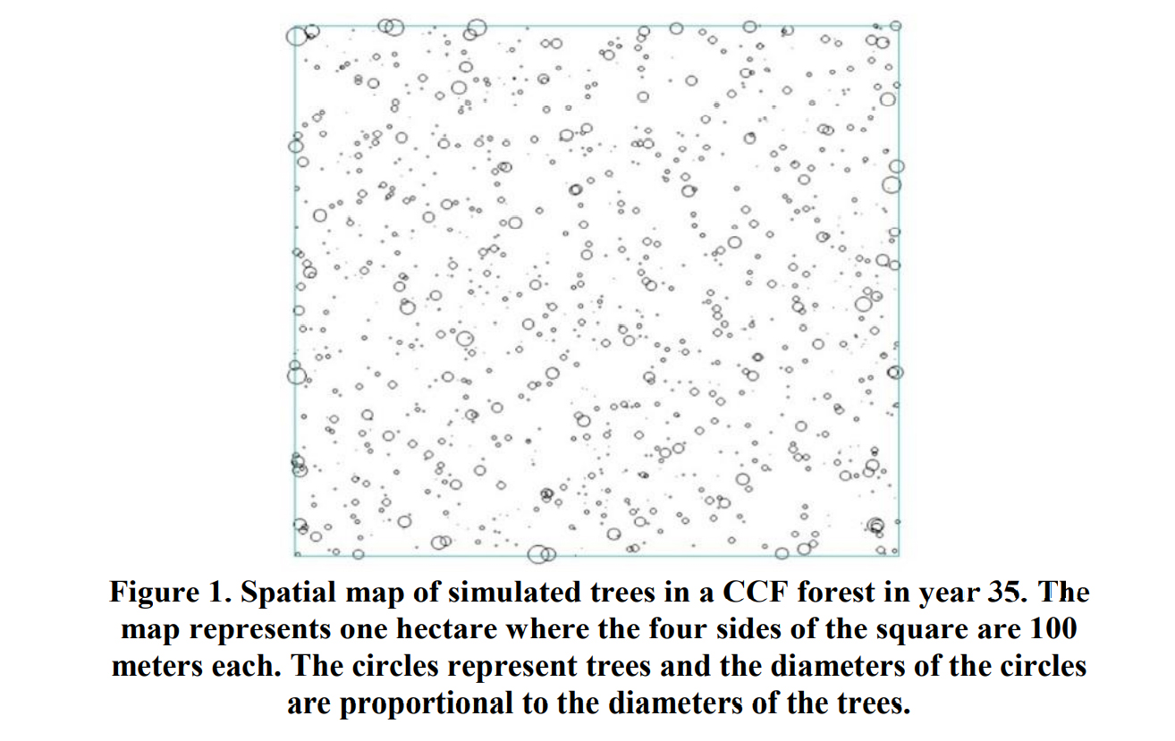

Slide 39
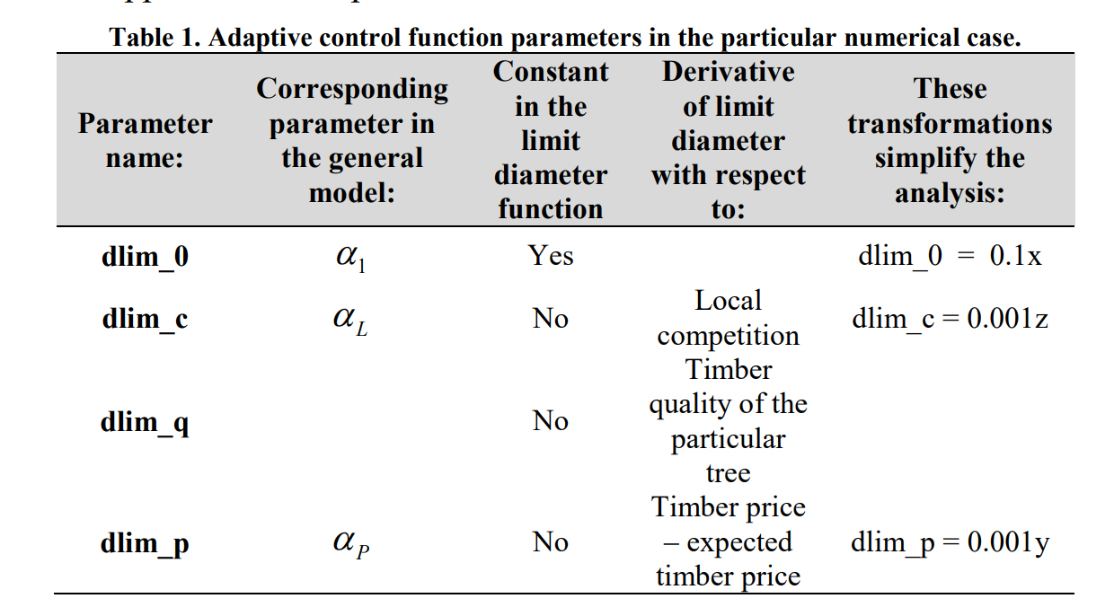

Slide 40
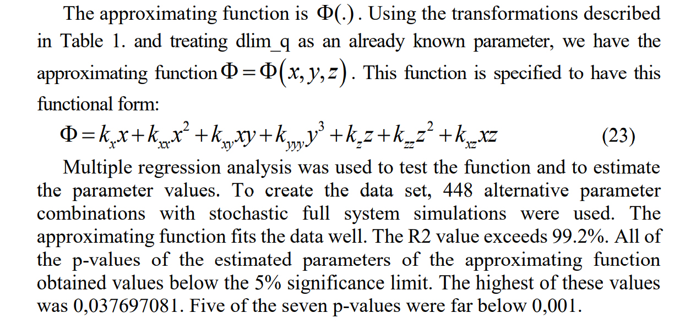

Slide 41
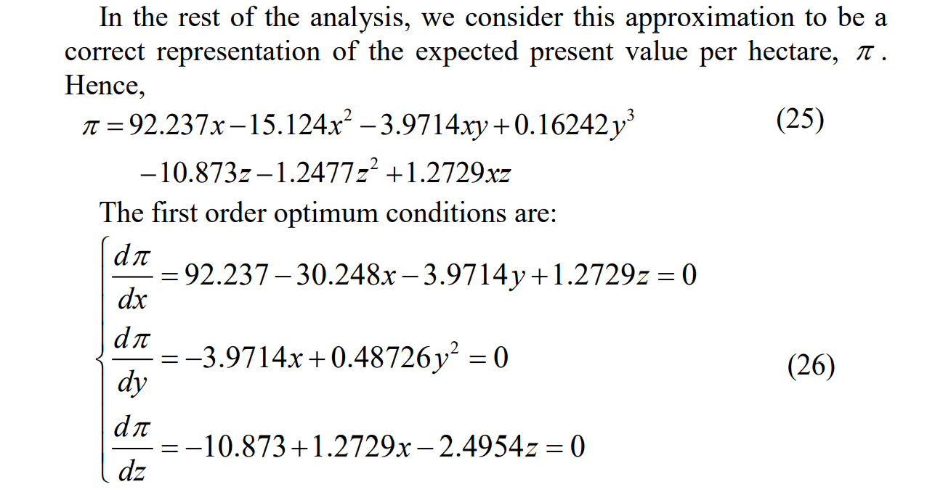

Slide 42
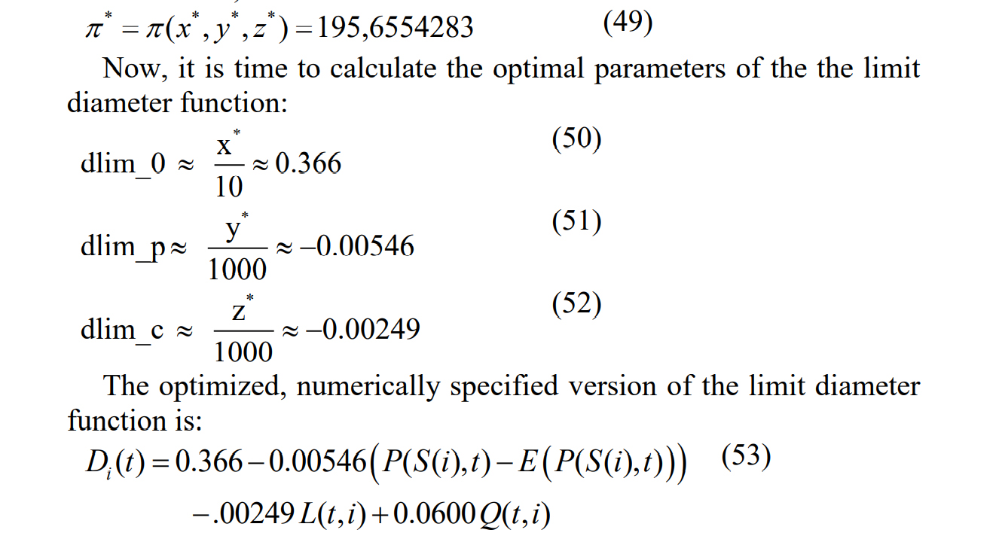

Slide 43
CONCLUSIONS
Our World develops rapidly, and unpredictably, in many ways.
This is true in large and small scales.
In order to decide what to do in order to manage some system or organization in the best way, it is necessary to apply some method that can optimize decisions that are rational under such conditions.

Slide 44
This field is denoted adaptive optimization.
Adaptive control decisions can be determined via different methods.
Most methods are more useful in some situation(s) and less useful, or more difficult to apply, in other cases.

Slide 45
Now, we have seen a number of real world problems and investigated how rational adaptive decisions could be obtained via alternative optimization methods.
These adaptive decision problems have recently been optimized with alternative mathematical methods and published in eight open access articles in different international journals.
These articles are available via the included links.
THANK YOU FOR YOUR TIME!

Slide 46
Mathematical Methods for Optimization of Adaptive Control Decisions under Risk with CCF and other Applications by Prof Dr Peter Lohmander
Peter@Lohmander.com

