Slide 1
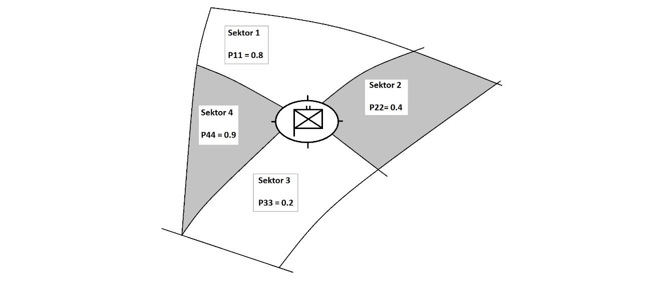
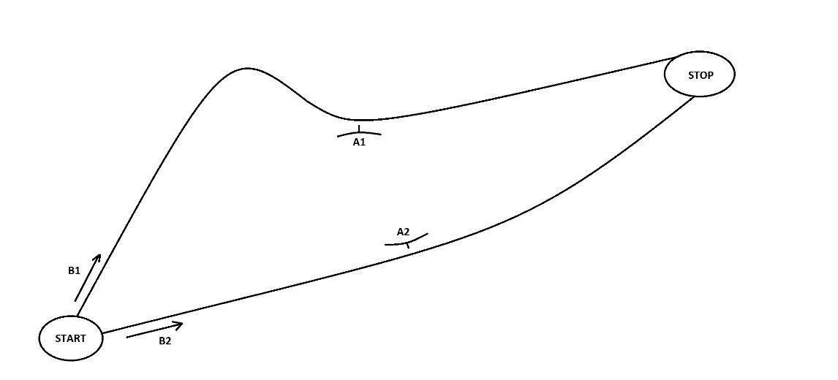
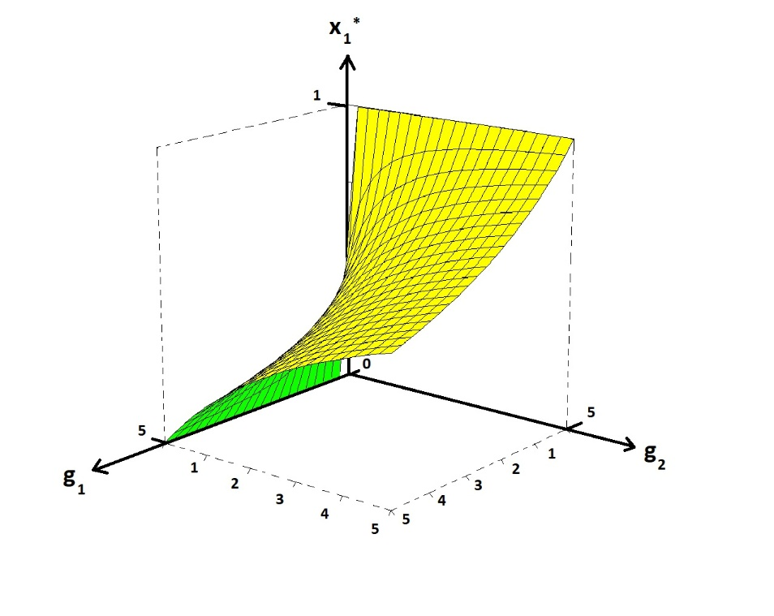

RECENT ADVANCES IN GENERAL GAME THEORY
AND APPLICATIONS
Peter Lohmander Lecture at Mid Sweden University
Prof.Dr. Optimal Solutions Department of Economics, Geography, Law
and Tourism (EJT), Sundsvall
www.Lohmander.com 2020-01-16 13.00 – 14.30
Peter@Lohmander.com

Slide 2
RECENT ADVANCES IN GENERAL GAME THEORY AND APPLICATIONS
By Peter Lohmander
In part 1 of this presentation, the two player zero sum games with diagonal game matrixes, TPZSGD, are analyzed.
Many important applications of this particular class of games are found in military decision problems, in customs and immigration strategies and police work.
Explicit functions are derived that give the optimal frequences of different decisions and the expected results of relevance to the different decision makers.

Slide 3
RECENT ADVANCES IN GENERAL GAME THEORY AND APPLICATIONS
By Peter Lohmander
Arbitrary numbers of decision alternatives are covered.
It is proved that the derived optimal decision frequency formulas correspond to the unique optimization results of the two players.
It is proved that the optimal solutions, for both players, always lead to a unique completely mixed strategy Nash equilibrium.
For each player, the optimal frequency of a particular decision is strictly greater than 0 and strictly less than 1.

Slide 4
RECENT ADVANCES IN GENERAL GAME THEORY AND APPLICATIONS
By Peter Lohmander
With comparative statics analyses, the directions of the changes of optimal decision frequences and expected game values as functions of changes in different parameter values, are determined.
The signs of the optimal changes of the decision frequences, of the different players, are also determined as functions of risk in different parameter values.

Slide 5
RECENT ADVANCES IN GENERAL GAME THEORY AND APPLICATIONS
By Peter Lohmander
Furthermore, the directions of changes of the expected optimal value of the game, are determined as functions of risk in the different parameter values.
Finally, some of the derived formulas are used to confirm earlier game theory results presented in the literature. It is demonstrated that the new functions can be applied to solve common military problems.

Slide 6
RECENT ADVANCES IN GENERAL GAME THEORY AND APPLICATIONS
By Peter Lohmander
In part 2 of this presentation, four military decision problems, common and relevant to typical army and ranger units, at platoon, company and battalion levels, are described and analysed.
It is found that fundamental game theory and methods can be used to determine optimal decisions.
The optimal decisions are derived as mixed strategy Nash equilibria, via manual methods.

Slide 7
RECENT ADVANCES IN GENERAL GAME THEORY AND APPLICATIONS
By Peter Lohmander
It is found that considerable improvements of the expected outcomes of typical decisions can be obtained in a way that does not require high investment costs.
It is argued that the methodology to some degree should be included in the education of all Swedish military officers, in particular in the army and ranger units intended for special operations.
In part 3, stochastic dynamic extensions of part 1 will be defined.

Slide 8
References to this presentation:
Lohmander, P., Optimal decisions and expected values in two player zero sum games with diagonal game matrixes, - Explicit functions, general proofs and effects of parameter estimation errors, International Robotics & Automation Journal, Volume 5, Issue 5, 2019, pages 186-198.
https://medcraveonline.com/IRATJ/IRATJ-05-00193.pdf
http://www.Lohmander.com/PL_files_191114.zip
Lohmander, P., Four central military decision problems, General methods and solutions, The Royal Swedish Academy of War Sciences, Proceedings and Journal, No. 2/2019, pages 119-134.
http://www.Lohmander.com/PLRSAWS_19_sum.pdf
http://www.Lohmander.com/PLRSAWS_19_jpg.zip
Lohmander, P., Applications and Mathematical Modeling in Operations Research, In: Cao BY. (ed) Fuzzy Information and Engineering and Decision. IWDS 2016. Advances in Intelligent Systems and Computing, vol 646. Springer, Cham, 2018 Print ISBN 978-3-319-66513-9, Online ISBN 978-3-319-66514-6, eBook Package: Engineering

Slide 9
References to this presentation (continued):
Lohmander, P., Applications and mathematical modeling in operations research, KEYNOTE, International Conference on Mathematics and Decision Science, International Center of Optimization and Decision Making & Guangzhou University, Guangzhou, China, September 12-15, 2016 http://www.Lohmander.com/PL_KEYNOTE_MATH_2016.jpg http://www.Lohmander.com/PL_ICODM_2016_KEY.pptx http://www.Lohmander.com/PL_ICODM_2016_KEY.pdf http://www.Lohmander.com/PL_ICODM_2016_KEY_PAPER.pdf http://www.Lohmander.com/PL_ICODM_2016_KEY_PAPER.docx http://icodm2020.com/en/
Presentation of Peter Lohmander
Bauer, M., Peter Lohmander, IIASA,
International Institute for Applied Systems Analysis,
http://www.iiasa.ac.at/web/home/about/alumni/News/20181204_lohmander.html
http://www.Lohmander.com/PL_IIASA_18.pdf
References on related topics
http://www.lohmander.com/Information/Ref.htm

Slide 10
First, we start with some very concrete decision problems, with only 2 and 4 dimensions.
Later, we will generalize the findings to arbitrary numbers of dimensions.

Slide 11


Slide 12
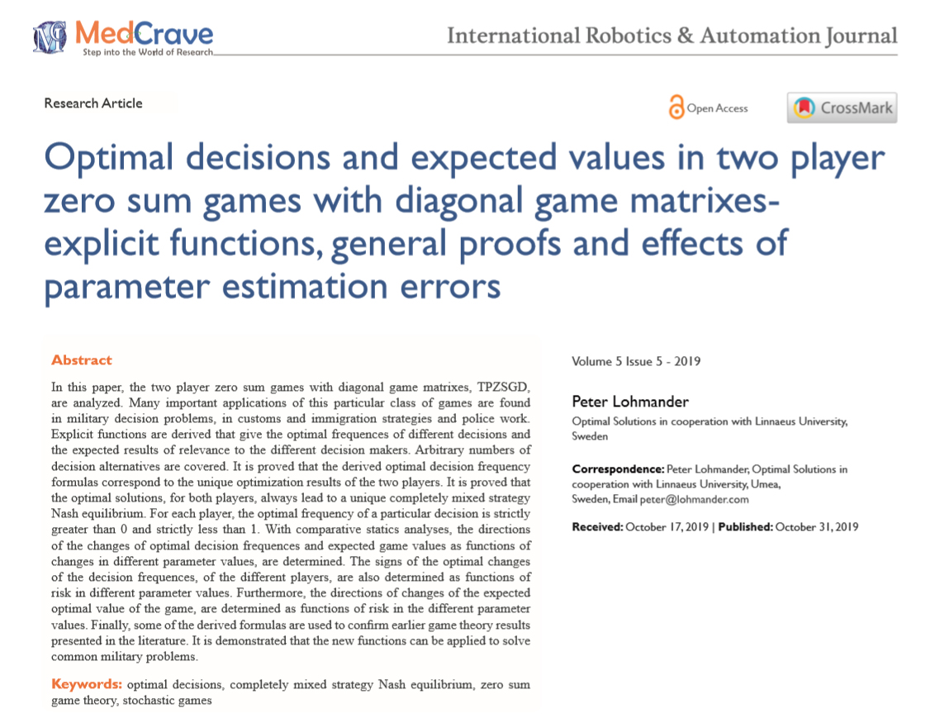

Slide 13
Beslutsproblem Decision Problems
Vägval vid uppmarsch och underhållstransporter
Val av plats för eldöverfall vid fördröjningsstrid
Positionering av bevaknings- och stridspatruller vid stabsplats
Val av utgångsgruppering för spaning mot, och störande av, fientlig stabsplats
The selection of roads for transport when enemy forces may prepare attacks along different roads with different expected outcomes,
The selection of roads where attacks on enemy transports should be prepared,
The positioning of guard squads and
The positioning of intelligence, reconaissance and sabotage groups.

Slide 14
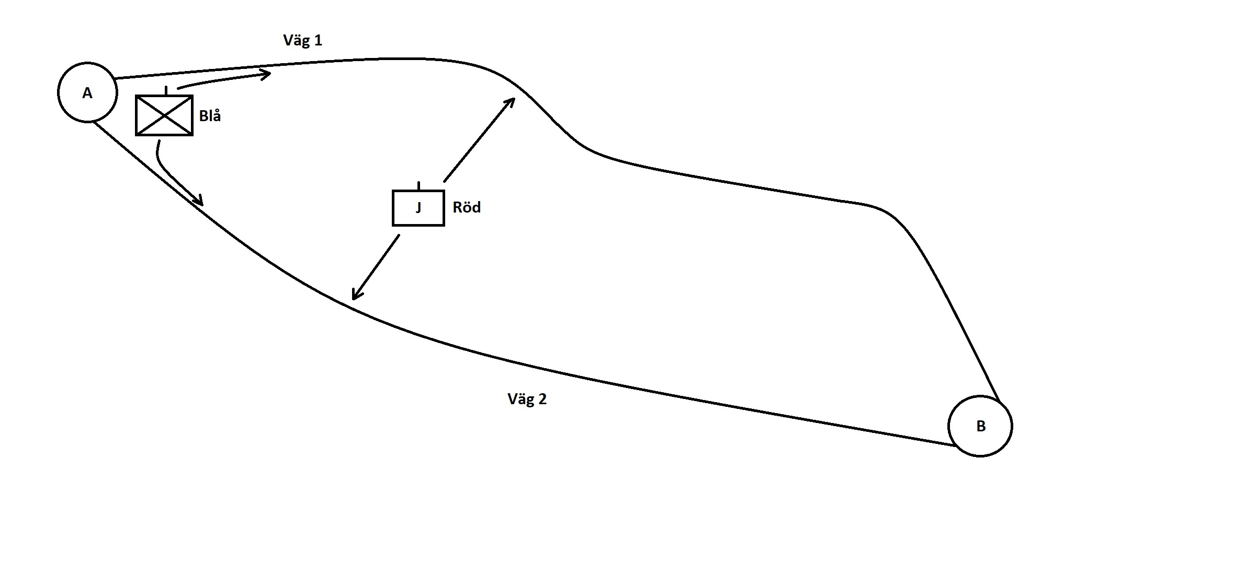

Slide 15
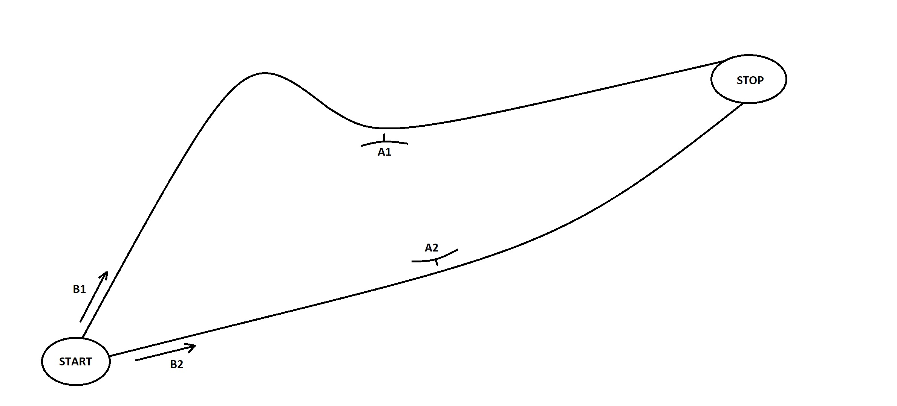

Slide 20
Special case:

Slide 22
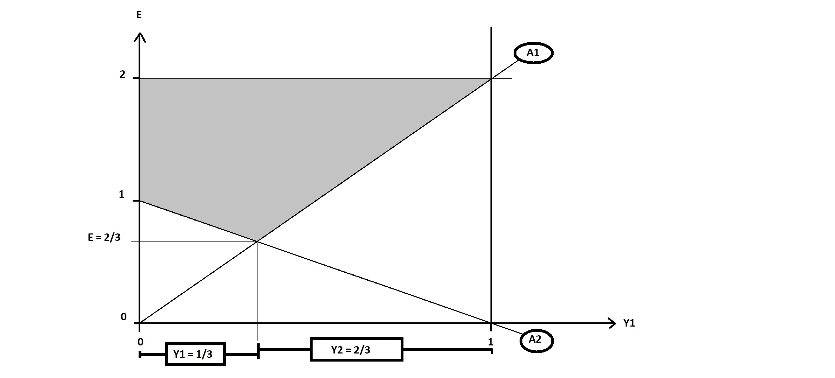

Slide 27
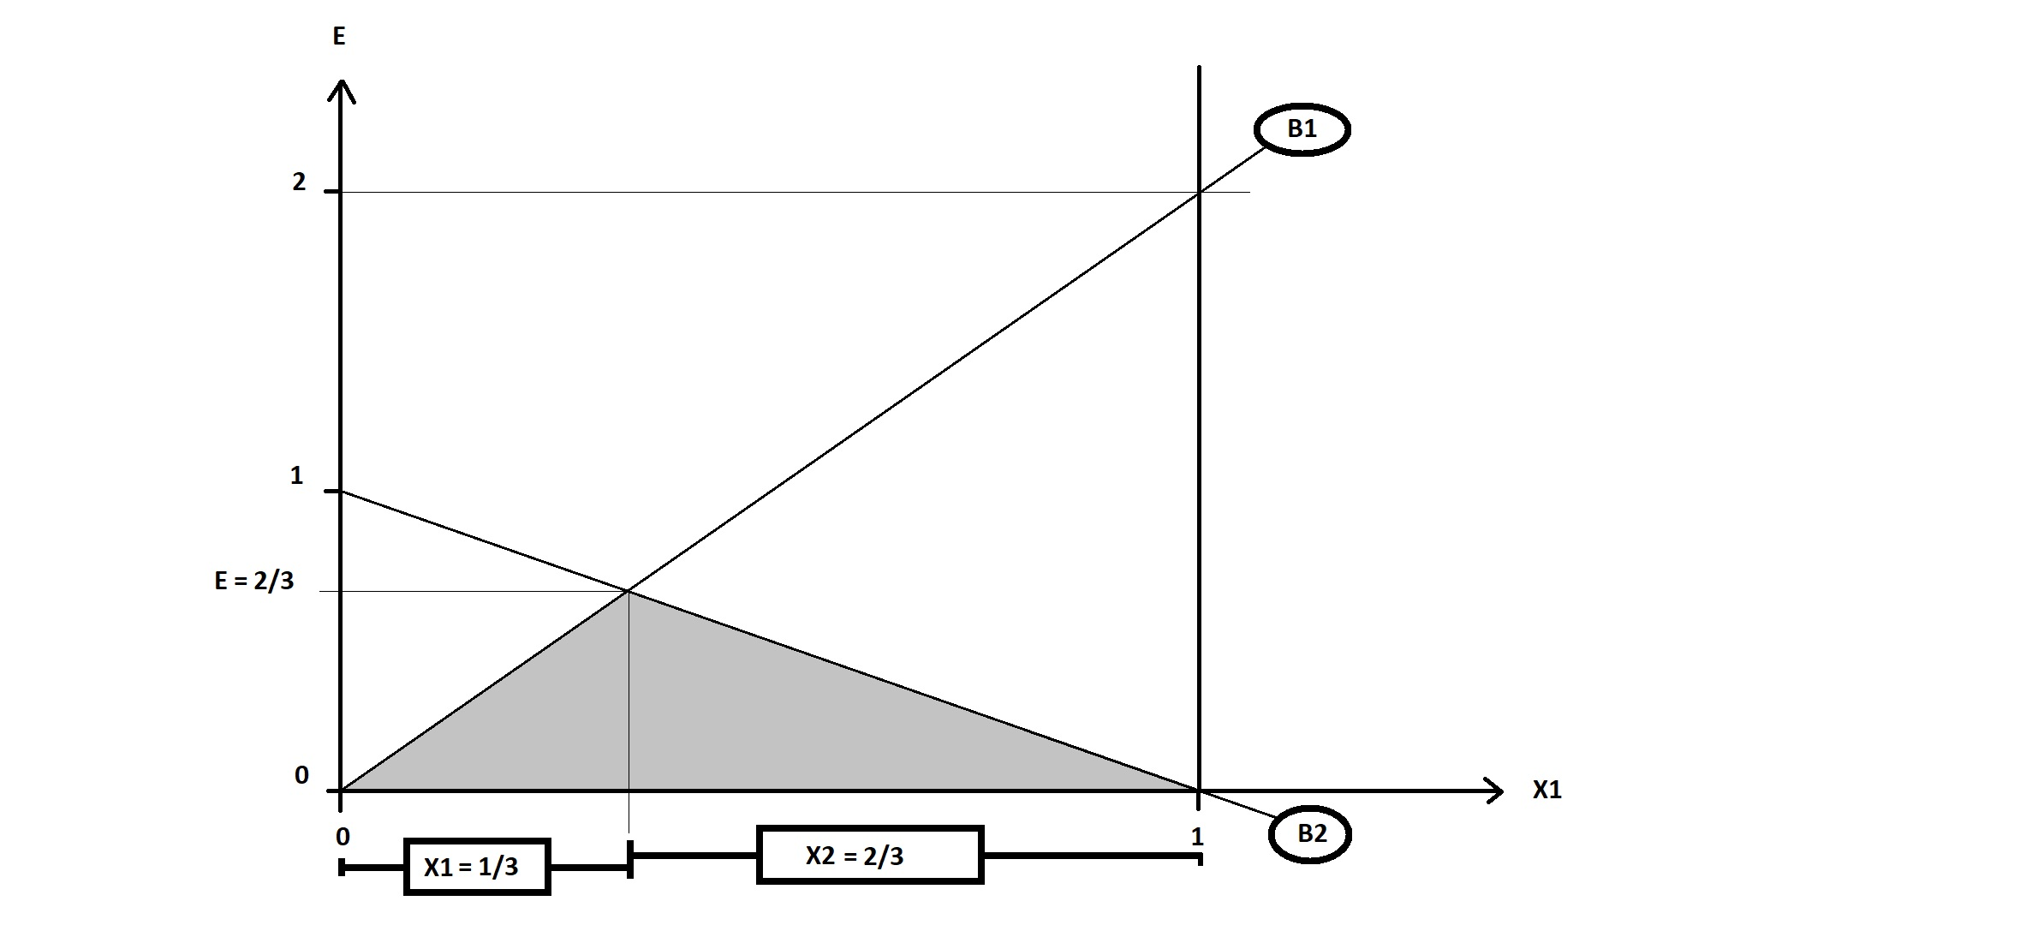

Slide 28

New Results

Slide 29
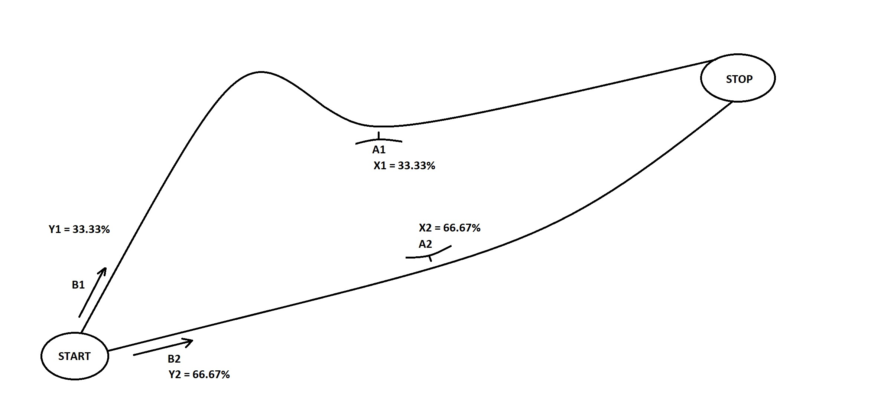

Slide 30
Observation:
If we can be sure that, in optimum, all decisions have stricly positive probabilities, then we know that:
Then, if the number of possible decisions is 2, we have:
Particular
decision
rules

Slide 31
Observation:
When there are exactly two possible decisions, and the optimal probabities are strictly positive,
we may calculate the expected value of the game in two ways. The results are identical.

Slide 32


Slide 34
If we know
that the
optimal
frequences
of all decision
are strictly
positive,
then:

Slide 43
New Results

Slide 44
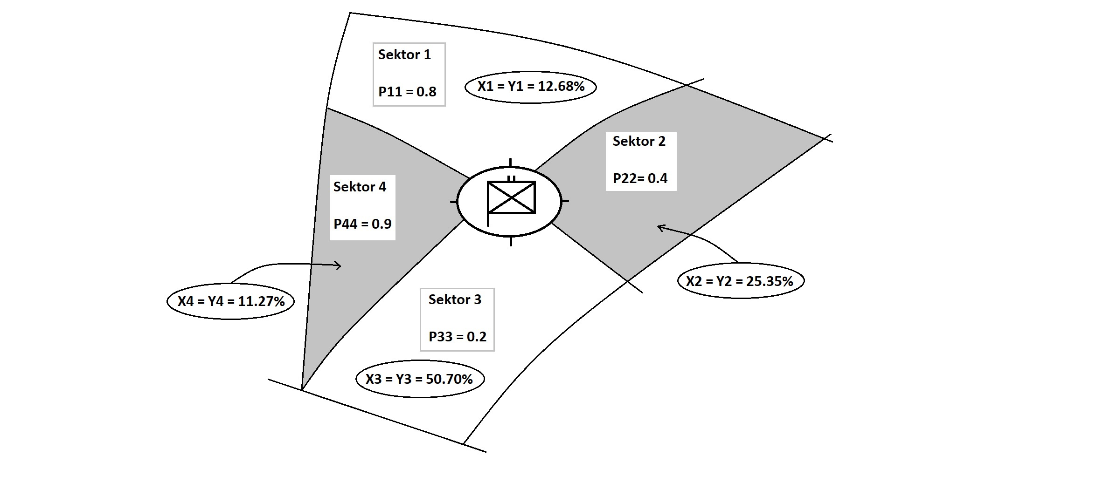

Slide 46
If we know
that the
optimal
frequences
of all decision
are strictly
positive,
then:

Slide 56
New Results

Slide 58
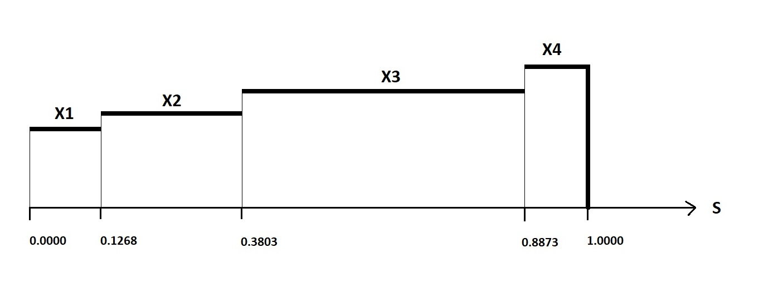

Slide 59
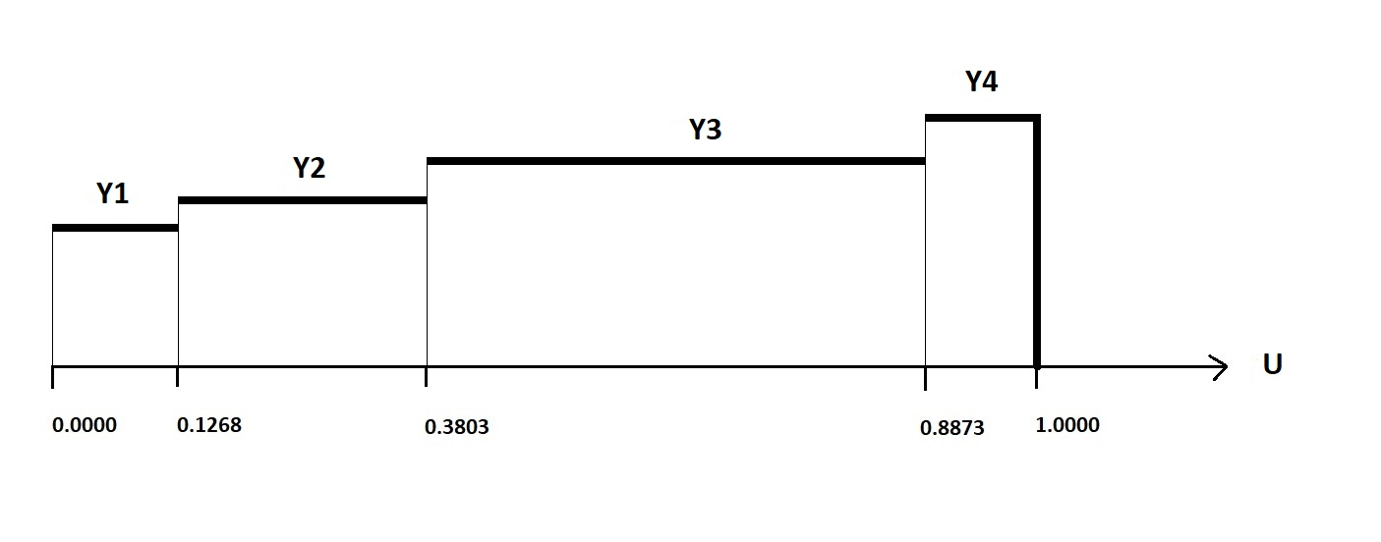

Slide 60
Test

Slide 61
Is this correct?
YES!

Slide 62
New General Theory

Slide 67
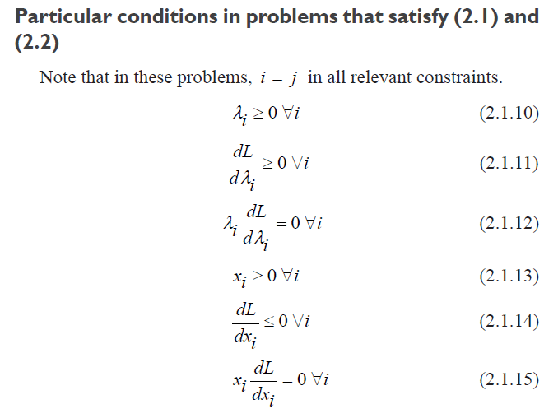

Slide 70
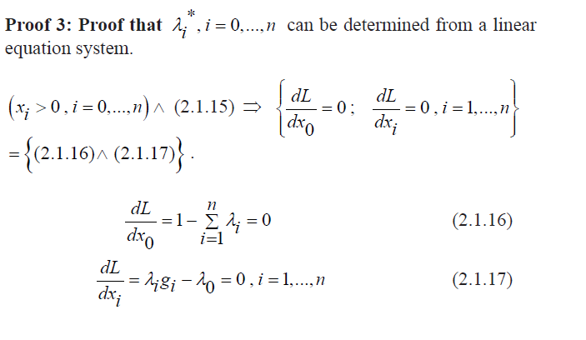

Slide 77
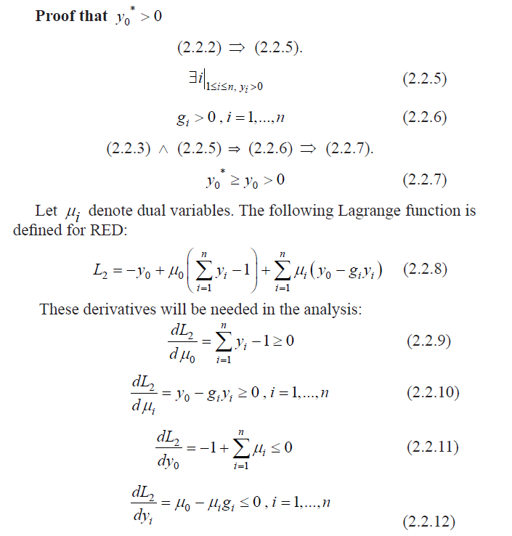

Slide 81
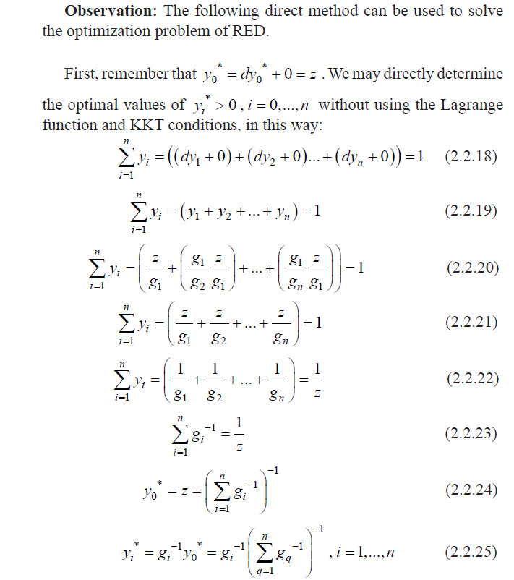

Slide 89
New General Results

Slide 93
New General Results

Slide 96
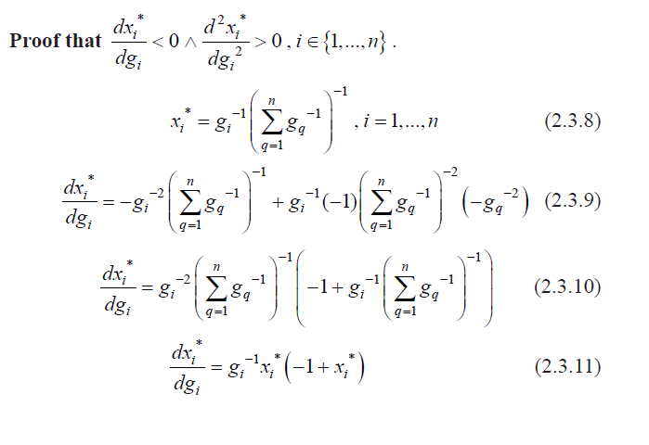

Slide 97
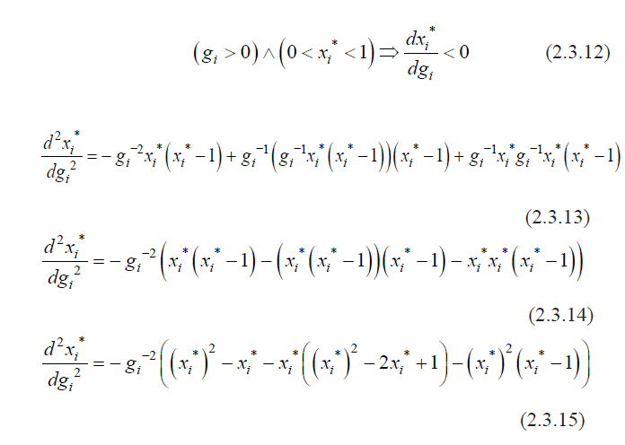

Slide 99
New General Results

Slide 102
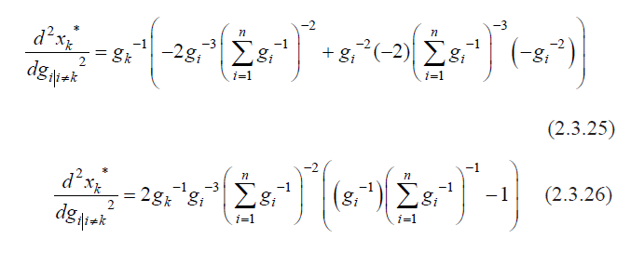

Slide 103
New General Results

Slide 104
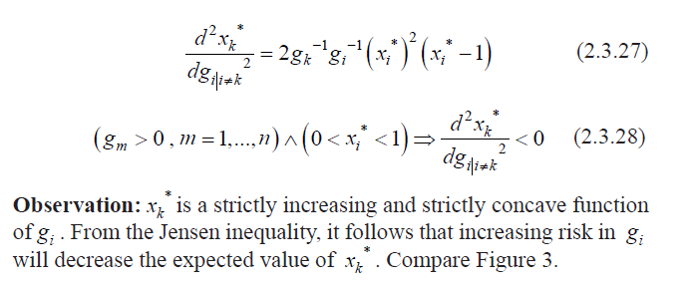

Slide 105
Numerical Example

Slide 108
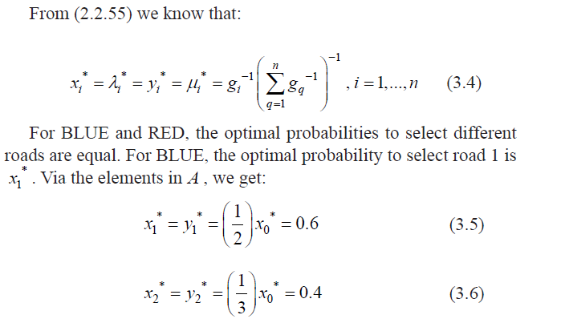

Slide 109
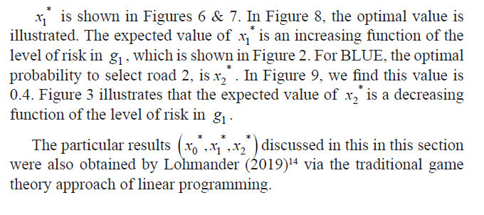

Slide 110
Graphical illustrations of optimal results

Slide 111
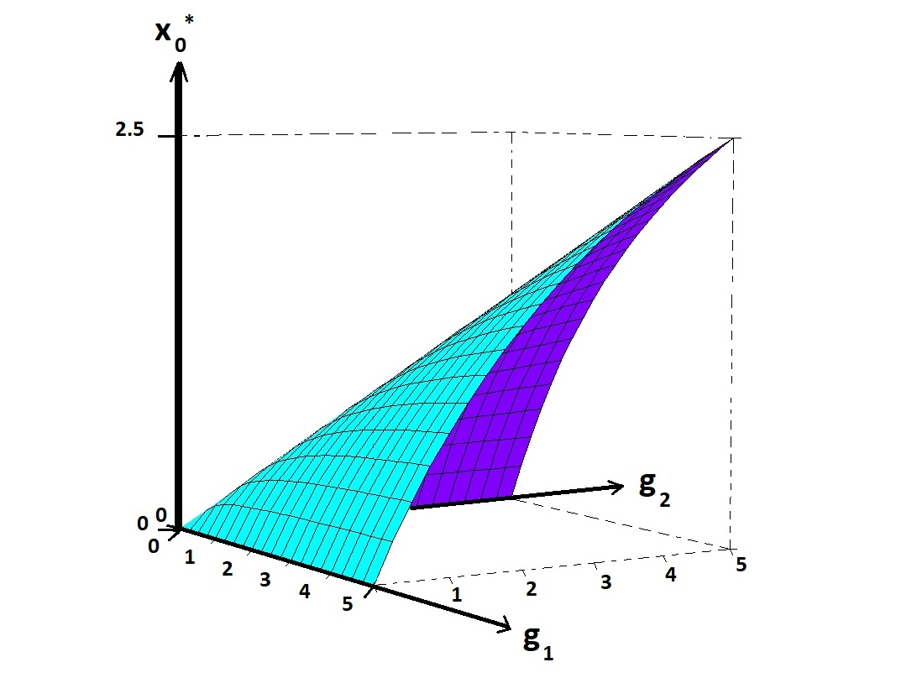

Slide 112
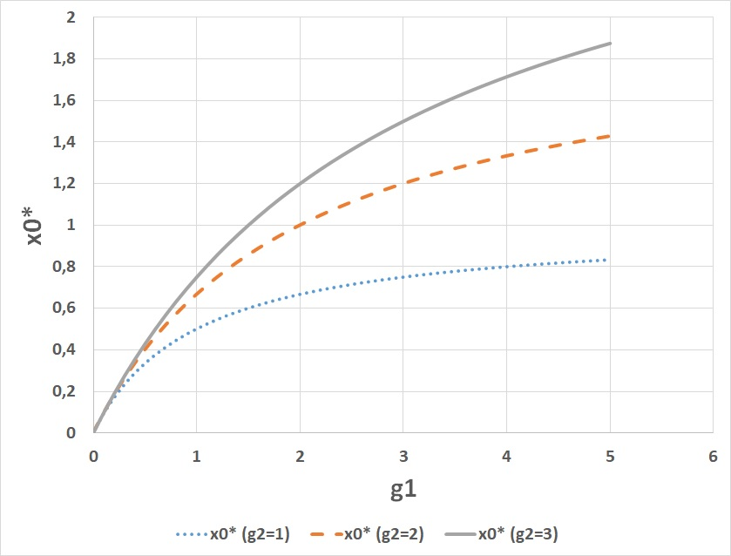

Slide 113
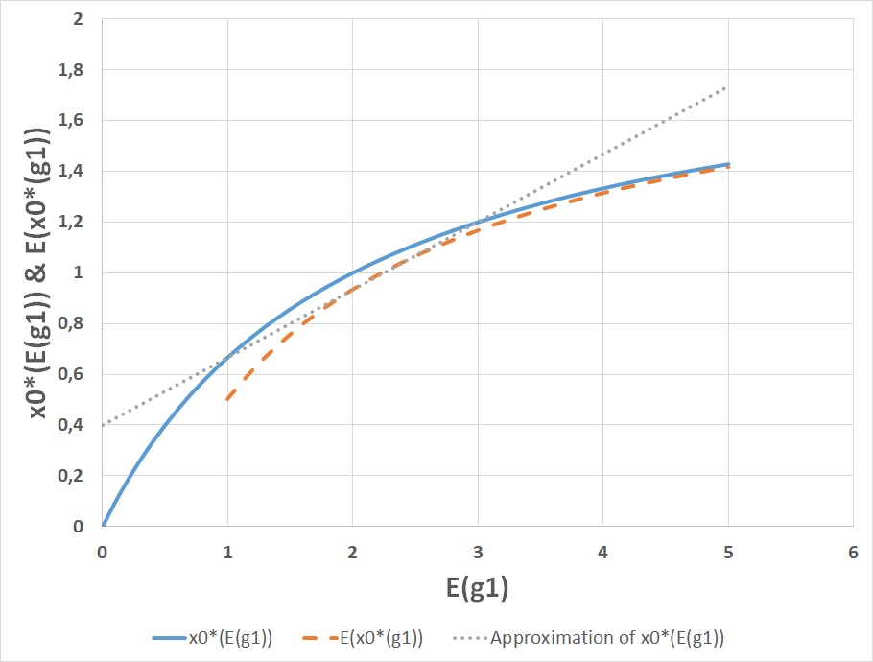

Slide 114
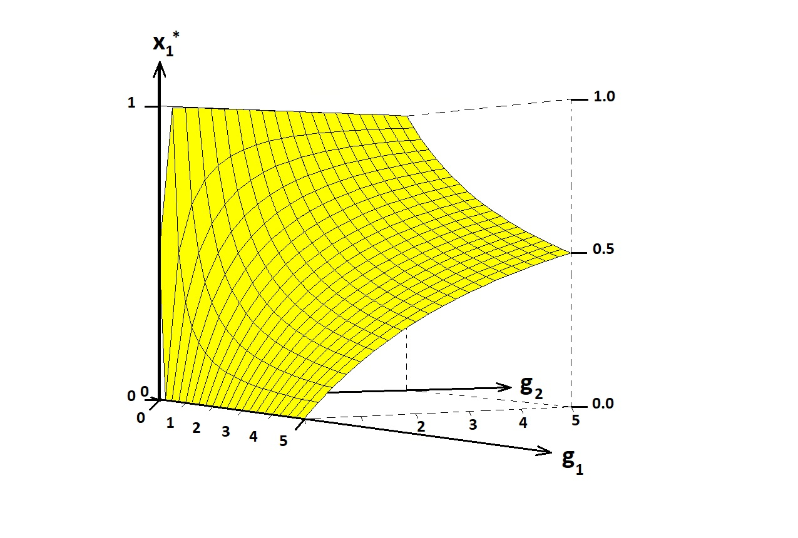

Slide 115


Slide 116
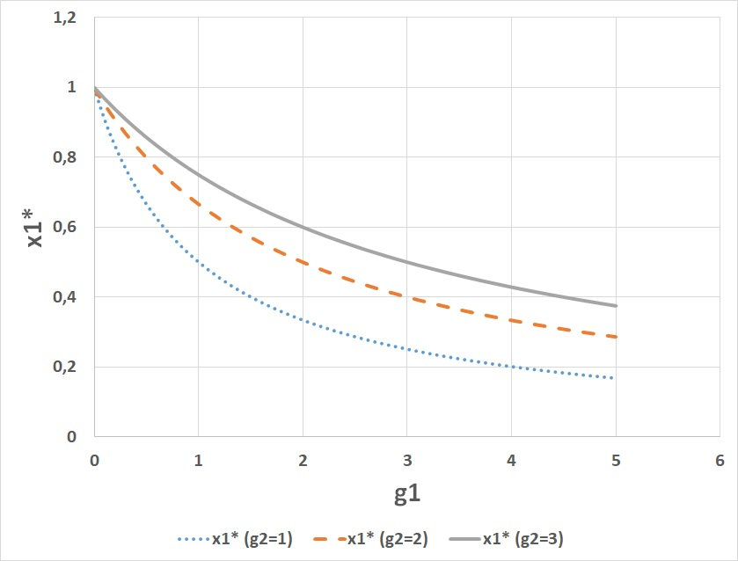

Slide 117
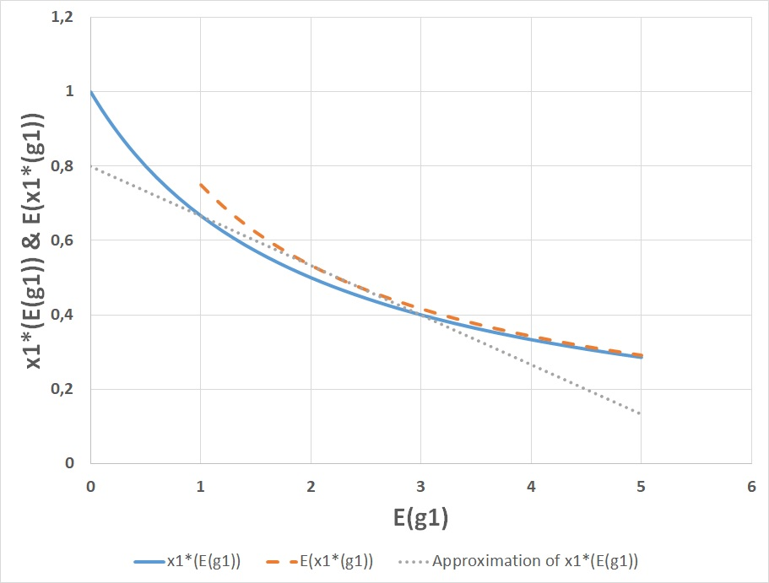

Slide 118
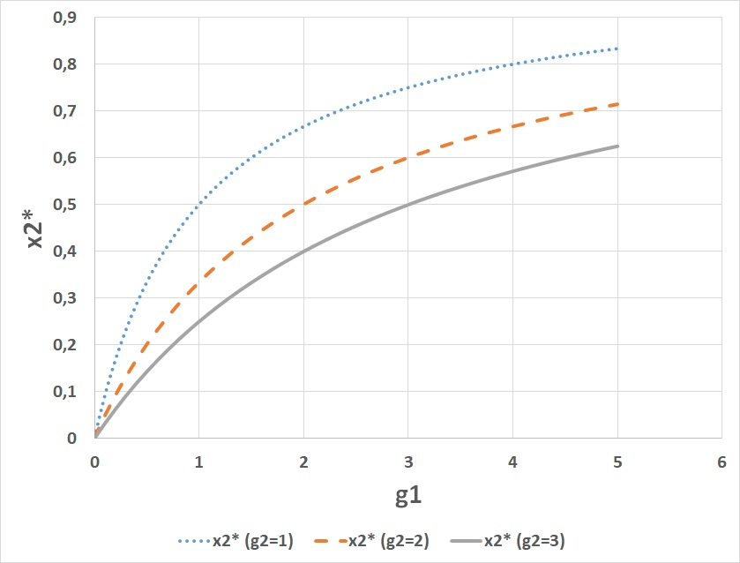

Slide 119
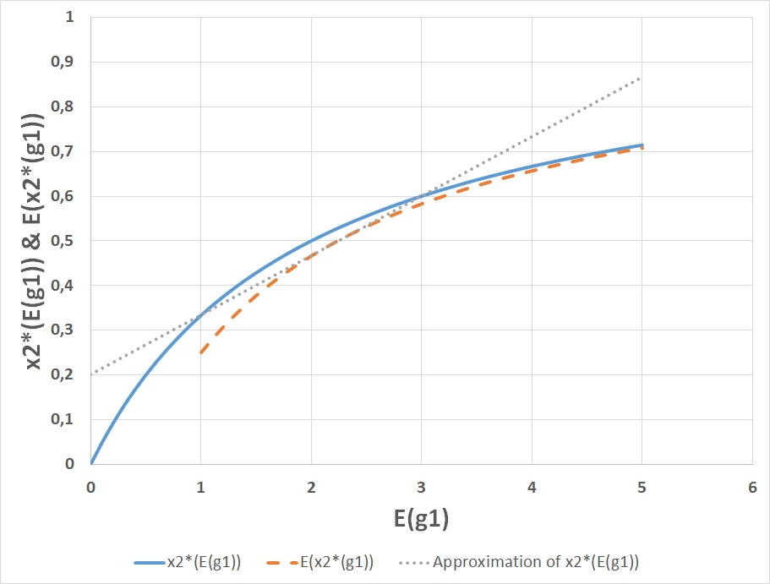

Slide 120
On Stochastic
Dynamic Games

Slide 121
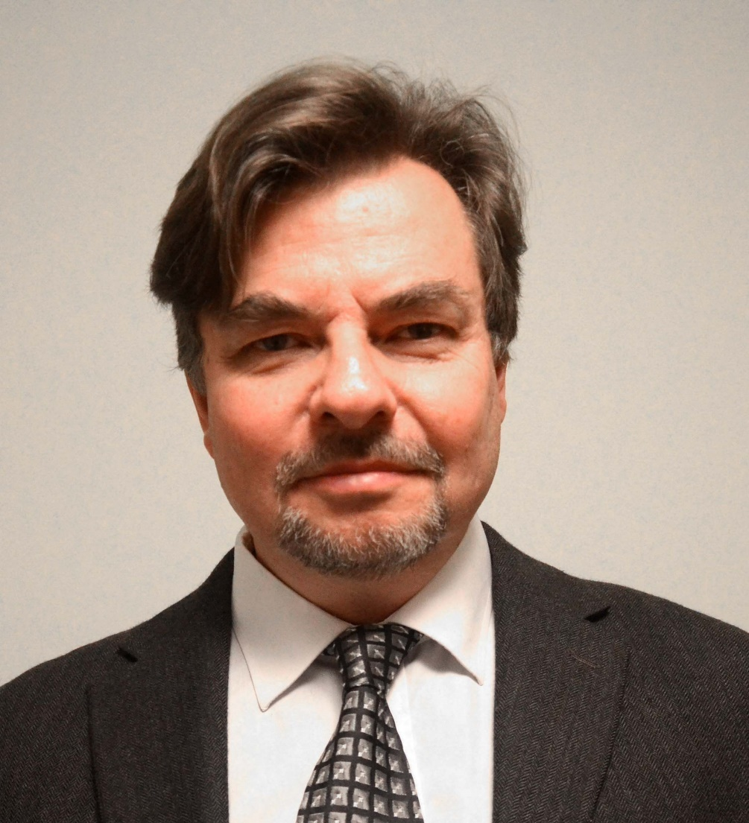
APPLICATIONS AND MATHEMATICAL MODELING IN OPERATIONS RESEARCH
Version 160828
Peter Lohmander
Professor Dr., Optimal Solutions & Linnaeus University, Sweden www.Lohmander.com & Peter@Lohmander.com
Keynote presentation at:

Slide 122
Lohmander, P., Applications and Mathematical Modeling in Operations Research, In: Cao BY. (ed) Fuzzy Information and Engineering and Decision. IWDS 2016. Advances in Intelligent Systems and Computing, vol 646. Springer, Cham, 2018 Print ISBN 978-3-319-66513-9, Online ISBN 978-3-319-66514-6, eBook Package: Engineering

Slide 124
Stochastic dynamic games with arbitrary functions, with and without mixed strategies
Lohmander, P., A Stochastic Differential (Difference) Game Model With an LP Subroutine for Mixed and Pure Strategy Optimization, INFORMS International Meeting 2007, Puerto Rico, 2007 http://www.Lohmander.com/SDG.ppt

Slide 125
General Conclusions

Slide 126
General Conclusions:
Game theory is necessary in order to understand and handle
relevant decision problems.
Game theory contains an enormous number of
alternative specifications.
It is essential that the most relevant approach
is defined, analyzed and used.
I hope that we can cooperate in this field in the future.
Peter Lohmander

Slide 127
RECENT ADVANCES IN GENERAL GAME THEORY
AND APPLICATIONS
Peter Lohmander Lecture at Mid Sweden University
Prof.Dr. Optimal Solutions Department of Economics, Geography, Law
and Tourism (EJT), Sundsvall
www.Lohmander.com 2020-01-16 13.00 – 14.30
Peter@Lohmander.com

