Slide 1
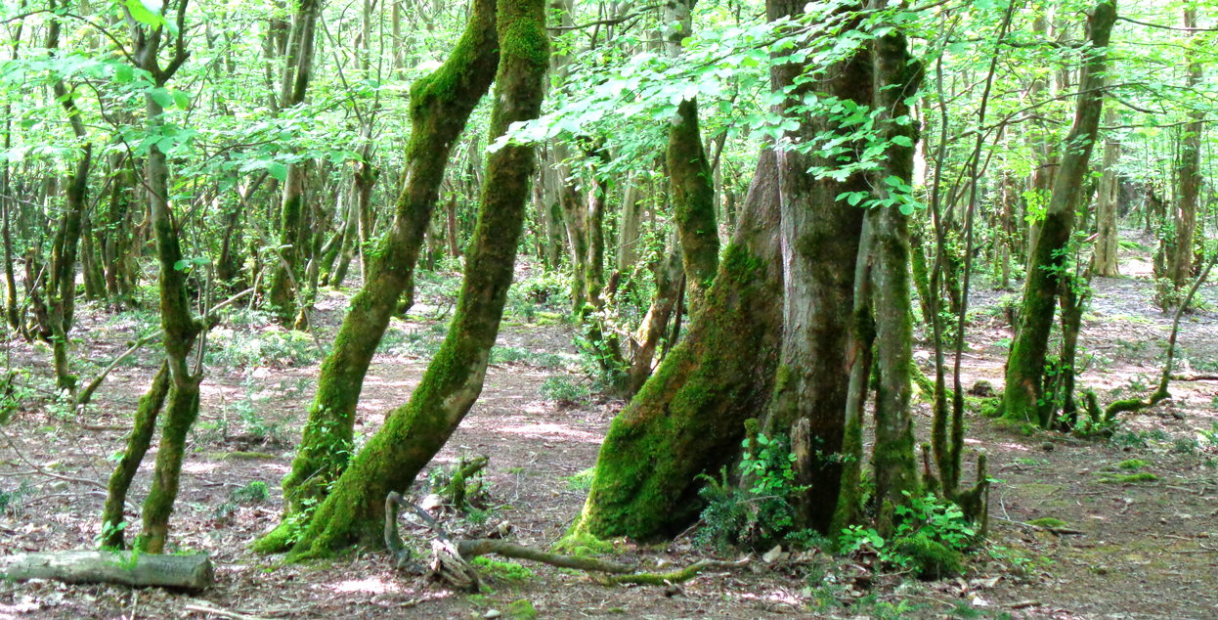

Should a forest be optimally managed or develop without control?
- Dynamic consequences for biodiversity, global warming and economics.
Gorgan University of Agricultural Sciences and Natural Resources (GUASNR), November 2017
Panel presentation Version 17-11-06
Peter Lohmander
Professor Dr., Optimal Solutions, www.Lohmander.com & Peter@Lohmander.com

Slide 2
Should a forest be optimally managed or develop without control?
- Dynamic consequences for biodiversity, global warming and economics.
Workshop at: Gorgan University of Agricultural Sciences and Natural Resources (GUASNR), November 2017
Panel presentation Version 17-11-06
Peter Lohmander
Abstract part 1
With active forestry, with sequential thinnings, biodiversity may be higher than without harvesting. In three of the four cases studied in the analysis, without control, the forests with two competing tree species develop into forests with only one tree species. In case we are interested to keep several tree species in the forest, this can be obtained if we control the forest and sequentally make species selective thinnings. If we control the forest and have several tree species in the forest stand, we may sequentially adapt the species selective harvest decisions to unpredictable changes in prices, environmental changes, species specific damages etc. With optimal control, the expected economic result is improved in relation to if we only have one tree species in the forest. We can also avoid natural disasters where all trees die.

Slide 3
Should a forest be optimally managed or develop without control?
- Dynamic consequences for biodiversity, global warming and economics.
Workshop at: Gorgan University of Agricultural Sciences and Natural Resources (GUASNR), November 2017
Panel presentation Version 17-11-06
Peter Lohmander
Abstract part 2
The most efficient way to use the forest in several regions of the world with low degree of forest harvesting, is to increase harvesting. Forest resources can replace some fossil fuels such as coal and oil in the production of energy, in particular in combined heat and power stations. Before some of the forest resources, such as timber and pulpwood, are used for energy production, they can be used for wood and paper products. When these products are wasted, the waste wood and waste paper can also be used in energy production. It may seem to be a good idea to stop harvesting the forest and to increase the standing volume in the forest in order to store more carbon there. Then, however, we forget that if we increase harvesting, we can store more carbon below ground, in the coal and oil reserves. Furthermore, forests, where the harvest level is lower than the growth, will sooner or later reach a state of dynamic equilibrium, where the standing volume does not increase anymore. Such forests, in dynamic equilibrium, do not contribute to solving the global warming problem any more.

Slide 4
Should a forest be optimally managed or develop without control?
- Dynamic consequences for biodiversity, global warming and economics.
Workshop at: Gorgan University of Agricultural Sciences and Natural Resources (GUASNR), November 2017
Panel presentation Version 17-11-06
Peter Lohmander
Abstract part 3
It is important to utilize the environmentally and recreationally valuable forest areas in the best possible way. In order to utilize these areas in the optimal way, it is necessary to optimize and control the number of visitors to the sensitive areas. Free access may seem to be the best alternative. Then, however, it has been proved that the total value of recreation and tourism is lower than if the optimal number of visitors is determined and applied. Free access leads to environmental degradation and reduced total utility.

Slide 5
Should a forest be optimally managed or develop without control?
- Dynamic consequences for biodiversity, global warming and economics.
Workshop at: Gorgan University of Agricultural Sciences and Natural Resources (GUASNR), November 2017
Panel presentation Version 17-11-06
Peter Lohmander
Abstract part 4
With adaptive optimization of forest management, it is possible to obtain the very best production economic result. A typical objective function is the expected present value. Many other types of objective functions can however also be used. Optimal forest management normally means that you should periodically harvest the largest trees, also taking the stochastic price variations and other stochastic events into account. Of course, the objective function may also include the value of tourism, recreation etc.. In case the forest is not managed at all, the result can not be better than the optimal result obtained with optimized management. Economic results normally decrease if management stops completely. There may be severe and costly damages and CO2 emissions by wild forest fires, windthrows and so on. Employment in the forest sector is reduced.

Slide 6
ON BIODIVERSITY:
How does a forest with two competing tree species develop over time, without control?
This problem has been studied via systems of differential equations, during many years and by many authors.
The ”principle of competitive exclusion” is often mentioned in this context.
Here, the main ideas and some new observations will be shown.

Slide 7
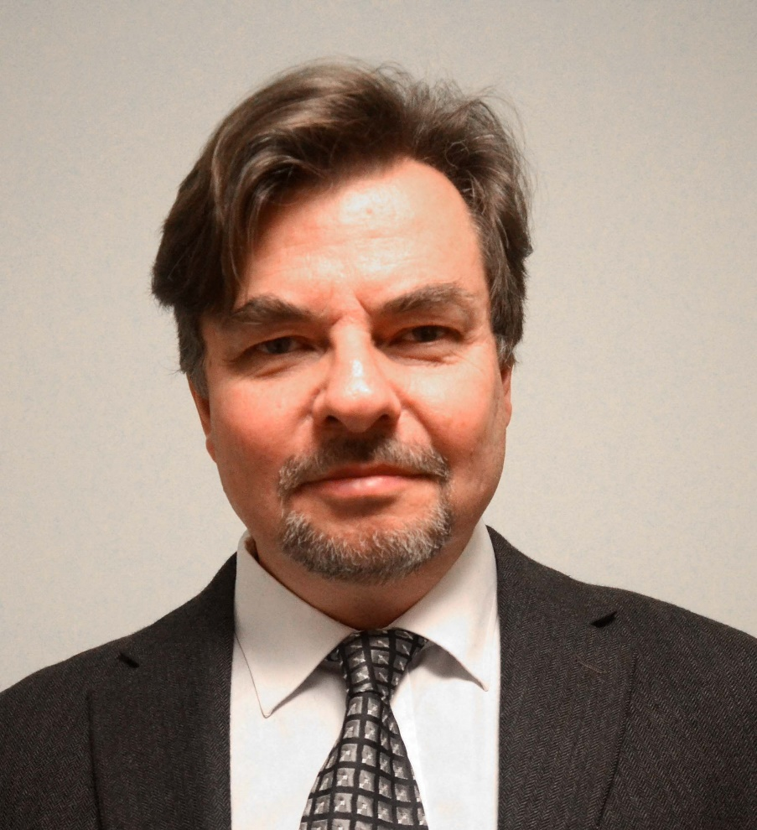
SUB MODELS FOR OPTIMAL CONTINUOUS COVER MULTI SPECIES FORESTRY IN IRAN
(One part of the joint presentation by Soleiman Mohammadi Limaei, PeterLohmander and Leif Olsson )
Professor Dr Peter Lohmander
SLU, Sweden, http://www.Lohmander.com
Peter@Lohmander.com
The 8th International Conference of
Iranian Operations Research Society
Department of Mathematics Ferdowsi University of Mashhad, Mashhad, Iran.
www.or8.um.ac.ir
21-22 May 2015

Slide 8
A dynamic two species model with competition
(A system of two ”extended logistic models”)

Slide 9
CASE 1.
y
Unique
and
Stable
0
x
0

Slide 10
CASE 2.
y
Unique
and
Stable
0
x
0

Slide 11
CASE 3.
y
Unique
and
Stable
0
x
0

Slide 12
CASE 3 and 4: Interior equilibrium equations

Slide 13
CASE 4.
y
Stable
Unstable
0
x
Observation:
The equilibrium is a function of the initial conditions.
Stable
0

Slide 14
In the next picture, we find that the population size of one species may increase if a parameter, h, increases,
even if the growth of the species is negatively affected by the change of that parameter.

Slide 15
CASE 3b.
y
Unique and Stable
Observation:
Some species are more
sensitive to changes
in h than others. The growth
function of x is negatively
affected by h but the
equilibrium value of x still
increases if h increases.
0
x
0

Slide 16
OBSERVATIONS:
- In three of the four cases (above), the forests with
two competing tree species develop into
forests with only one tree species.
- In case we are interested to keep several tree species
in the forest, this can be obtained if we sequentally
make species selective thinnings.
CONCLUSION:
With active forestry, with sequential thinnings, biodiversity may be higher than without harvesting.

Slide 17
If we have several tree species in the forest stand, we may sequentially adapt the species selective harvest decisions to unpredictable changes in prices, environmental changes, species specific damages etc.
As a result, the expected economic result is improved in relation to if we only have one tree species in the forest.
We can also avoid natural disasters where all trees die.
[7] Lohmander, P., The multi species forest stand, stochastic prices and adaptive selective thinning, SYSTEMS ANALYSIS - MODELLING - SIMULATION, Vol. 9, 229-250, 1992
http://www.Lohmander.com/PL_SAMS_9_1992.pdf
[8] Lohmander, P., Economic two stage multi period species management in a stochastic environment: The value of selective thinning options and stochastic growth parameters, SYSTEMS ANALYSIS - MODELLING -SIMULATION, Vol. 11, 287-302, 1993
http://www.Lohmander.com/PL_SAMS_11_1993.pdf

Slide 18
[9] Lohmander, P., Optimal sequential forestry decisions under risk, ANNALS OF OPERATIONS RESEARCH, Vol. 95, pp. 217-228, 2000
http://www.Lohmander.com/PL_AOR_95_2000.pdf
[10] Lohmander, P., Adaptive Optimization of Forest Management in a Stochastic World, in Weintraub A. et al (Editors), Handbook of Operations Research in Natural Resources, Springer, Springer Science, International Series in Operations Research and Management Science, New York, USA, pp 525-544, 2007
http://www.amazon.ca/gp/reader/0387718141/ref=sib_dp_pt/701-0734992-1741115#reader-link
http://www.Lohmander.com/PL_Handbook2007.pdf
[15] Lu, F., Lohmander, P., Optimal Decisions for Mixed Forests under Risk, Scientia Silvae Sinicae, Vol. 45, No. 11, Nov. 2009
http://www.Lohmander.com/Lu_Lohmander_2009.pdf

Slide 19
New growth functions for individual trees of different species in the Iranian Caspian forests exist.
With these functions, it is possible to develop optimal adaptive forest management decision models of relevance to multi species forestry in Iran. Such forest management can be designed to constantly keep some number of species growing (high biodiversity) and to avoid clearcuts.
[24] Hatami, N., Lohmander, P., Moayeri, M.H., Mohammadi Limaei, S., A basal area increment model for individual trees in mixed species continuous cover stands in Iranian Caspian forests, National Conference on the Caspian Forests of Iran, "Past, Current, Future", University of Guilan, Rasht, Iran, April 26-27, 2017
http://www.Lohmander.com/PPT_GUILAN_JOINT_2017.ppt
http://www.Lohmander.com/PPT_GUILAN_JOINT_2017.pdf
http://www.Lohmander.com/Paper_Guilan_joint_170321.pdf
http://www.Lohmander.com/Paper_Guilan_joint_170321.docx
http://conf.isc.gov.ir/forestnorth

Slide 20
The new growth functions are based on the new principles developed here:
[23] Lohmander, P., A general dynamic function for the basal area of individual trees derived from a production theoretically motivated autonomous differential equation, National Conference on the Caspian Forests of Iran, "Past, Current, Future", University of Guilan, Rasht, Iran, April 26-27, 2017
http://www.Lohmander.com/PPT_GUILAN_PL_DIFF_2017.pptx
http://www.Lohmander.com/PPT_GUILAN_PL_DIFF_2017.pdf
http://www.Lohmander.com/Paper_Guilan_Dynamic_170215.pdf
http://www.Lohmander.com/Paper_Guilan_Dynamic_170215.docx
http://conf.isc.gov.ir/forestnorth

Slide 21
A new approach to optimization of adaptive harvest control functions has recently been described:
[22] Lohmander, P., Optimal stochastic control of spatially distributed interdependent production units, International Conference on Mathematics and Decision Science, International Center of Optimization and Decision Making & Guangzhou University, Guangzhou, China, September 12-15, 2016
http://www.Lohmander.com/PL_BEST_PAPER_AWARD_MATH_2016.jpg
http://www.Lohmander.com/PL_ICODM_2016_CCF.pptx
http://www.Lohmander.com/PL_ICODM_2016_CCF.pdf
http://www.Lohmander.com/PL_ICODM_2016_CCF_PAPER.pdf
http://www.Lohmander.com/PL_ICODM_2016_CCF_PAPER.docx
http://icodm2020.com/en/
[29] Lohmander, P., Optimal Stochastic Dynamic Control of Spatially Distributed Interdependent Production Units. In: Cao BY. (ed) Fuzzy Information and Engineering and Decision. IWDS 2016. Advances in Intelligent Systems and Computing, vol 646. Springer, Cham, 2018
Print ISBN 978-3-319-66513-9, Online ISBN 978-3-319-66514-6, eBook Package: Engineering,
LOSDCSDI, https://doi.org/10.1007/978-3-319-66514-6_13

Slide 22
This approach to adaptive forest management optimization (and growth function modeling and estimation) has also been used in Sweden:
[27] Lohmander, P., Olsson, J.O., Fagerberg, N., Bergh, J., Adamopoulos, S., High resolution adaptive optimization of continuous cover spruce forest management in southern Sweden, SSAFR 2017, Symposium on Systems Analysis in Forest Resources, Clearwater Resort, Suquamish, Washington, (near Seattle), August 27-30, 2017
http://www.Lohmander.com/SSAFR_2017_Lohmander_et_al.pptx
http://www.Lohmander.com/SSAFR_2017_Lohmander_et_al.pdf
http://www.Lohmander.com/SSAFR_2017_Lohmander_Soft.txt
SSAFR 2017

Slide 23
ON GLOBAL WARMING:
How should we manage the forest if we are interested to avoid global warming?

Slide 24
How should the forests be managed if we want to avoid global warming? This study shows that the most efficient way to use the forest in several regions of the world with low degree of forest harvesting, is to increase harvesting.
Forest resources can replace some fossil fuels such as coal and oil in the production of energy, in particular in combined heat and power stations.
Before some of the forest resources, such as timber and pulpwood, are used for energy production, they can be used for wood and paper products. When these products are wasted, the waste wood and waste paper can also be used in energy production.

Slide 25
This way, since we use less fossil fuels such as coal and oil and keep that below ground, the carbon of these fuels will not reach the atmosphere.
It may seem to be a good idea to stop harvesting the forest and to increase the standing volume in the forest in order to store more carbon there.
Then, however, we forget that if we increase harvesting, we can store more carbon below ground, in the coal and oil reserves.
Furthermore, forests, where the harvest level is lower than the growth, will sooner or later reach a state of dynamic equilibrium, where the standing volume does not increase anymore.

Slide 26
This happens even if the harvest level reaches zero.
Trees grow old and tall. Then they die because of windthrows, insect damages and forest fires.
In the long run, the carbon found in the old trees comes back to the atmosphere.
Such forests, in dynamic equilibrium, do not contribute to solving the global warming problem any more.
Very large forest areas in our world have these properties.

Slide 27
This fundamental principle may seem simple and obvious.
However, in the debate and literature on global warming, many reports and articles suggest that we should increase the standing volume in the forests, since the trees contain carbon.
The ideal is often considered to be to stop harvesting completely.
The alternative to harvest trees and to store more carbon below ground, as coal and oil, is completely ignored.

Slide 28
The authors of these articles can often not show any analytical models and derivations that support the conclusions.
In other cases, models and derivations with completely unrealistic and irrelvant assumptions concerning model structure and parameter assumptions are reported.
The largest forest in the world is found in Russian Federation.
There, large forest areas have a very low degree of industrial utilization. Furthermore, the total harvest level in Russian Federation is very low in relation to the volume of standing timber.

Slide 29
In neighbour countries, such as Sweden, Finland and Norway, with similar natural conditions, the harvest level, in relation to the standing volume, is many times higher.
Still, even in these neighbour countries, the standing volume in the forest is increasing over time.
This situation is clearly documented by FAO.

Slide 30
Of course, it is valuable to several wildlife species to keep large, more or less natural, forests and reserves.
The areas of natural forests are however very large.
Furthermore, with optimized continuous cover forestry methods, it is possible to combine strongly increased and profitable harvesting with environmental considerations.

Slide 31
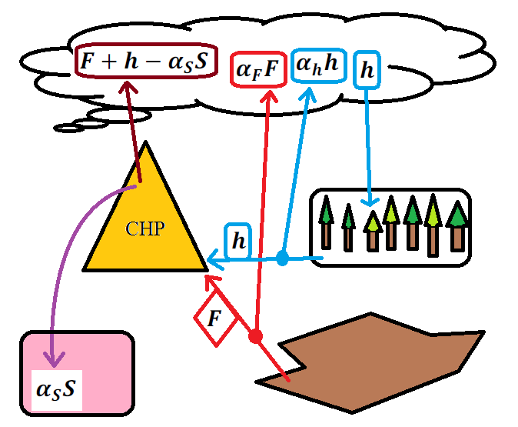
The Lohmander Energy, Forest, Fossil Fuels, CCS and Climate System Optimization Model

Slide 32
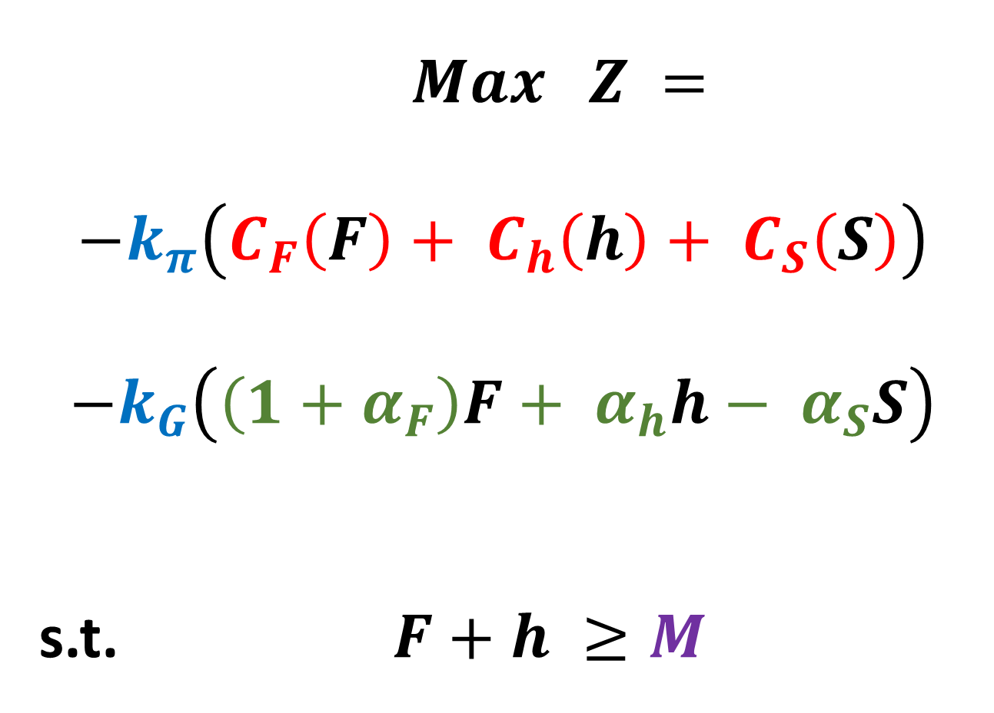
$$Max Z =$$
$$−k_{π}\left(C_{F}\left(F\right)+ C_{h}\left(h\right)+ C_{S}\left(S\right)\right)$$
$$−k_{G}\left(\left(1+α_{F}\right)F+ α_{h}h− α_{S}S\right)$$
s.t. $F+h ≥M$
Objective function
Costs of operations
Costs of CO2 in atmosphere
Energy input constraint

Slide 33
General function derivations and many general proofs are found here:
[19] Lohmander, P., With expanded bioenergy based on forest resources, we may simultaneously and sustainably reduce global warming, improve economic results, international relations and environmental conditions, BIT’S 4th Annual World Congress of Bioenergy-2014, Qingdao International Convention Center, China
http://www.Lohmander.com/PLWCBE2014A.pptx
http://www.Lohmander.com/PLWCBE2014A.pdf
http://www.Lohmander.com/WCBE2014_Expansion.pdf
http://www.bitcongress.com/wcbe2014/

Slide 34
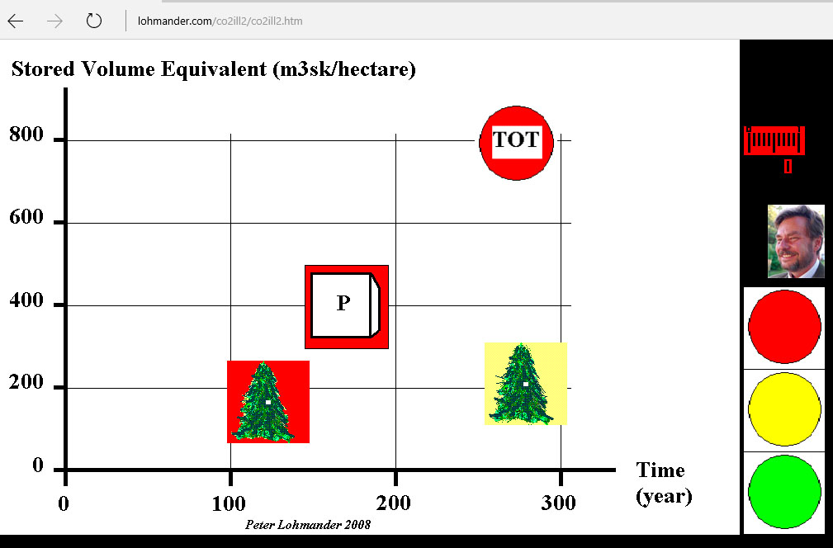
[14] Lohmander, P., Software for illustration of the CO2 and forest management issue in combination with CCS technology, 2008, http://www.lohmander.com/co2ill2/co2ill2.htm

Slide 35
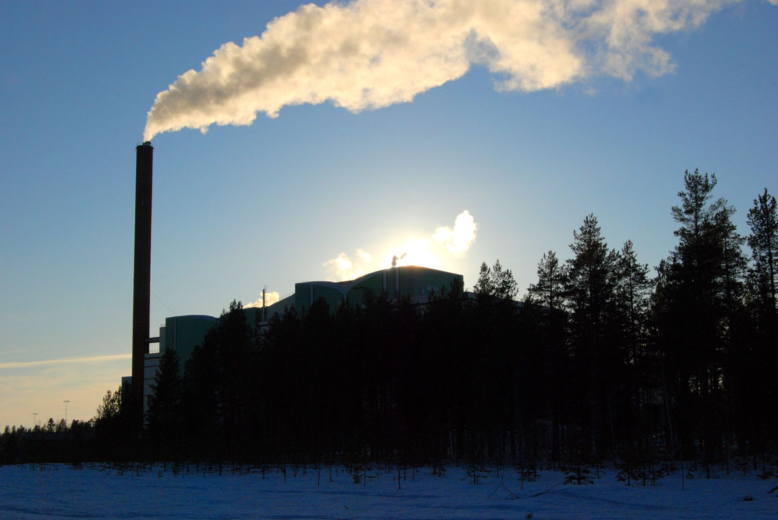
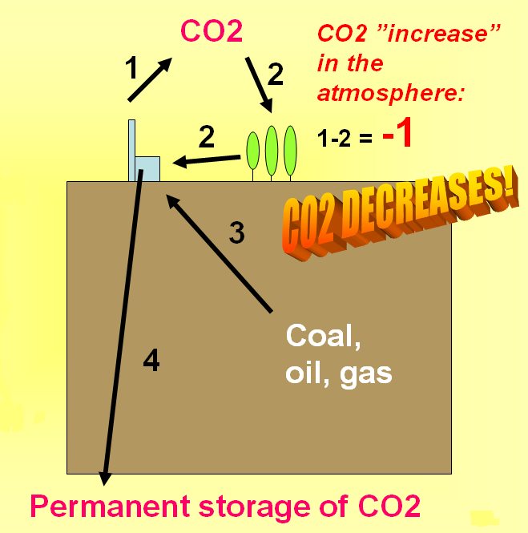

Slide 36
General optimization problem analyzed by Peter Lohmander
before and during the Gorgan workshop in November 2017
Present value of forest production
Present value of totally stored carbon

Slide 37
[13] Lohmander, P., Guidelines for Economically Rational and Coordinated Dynamic Development of the Forest and Bio Energy Sectors with CO2 constraints, Proceedings from the 16th European Biomass Conference and Exhibition, Valencia, Spain, 02-06 June, 2008 (In the version in the link, below, an earlier misprint has been corrected. ) http://www.Lohmander.com/Valencia2008.pdf
[14] Lohmander, P., Software for illustration of the CO2 and forest management issue in combination with CCS technology, 2008, http://www.lohmander.com/co2ill2/co2ill2.htm
[19] Lohmander, P., With expanded bioenergy based on forest resources, we may simultaneously and sustainably reduce global warming, improve economic results, international relations and environmental conditions, BIT’S 4th Annual World Congress of Bioenergy-2014, Qingdao International Convention Center, China
http://www.Lohmander.com/PLWCBE2014A.pptx
http://www.Lohmander.com/PLWCBE2014A.pdf
http://www.Lohmander.com/WCBE2014_Expansion.pdf
http://www.bitcongress.com/wcbe2014/

Slide 38
Conclusion:
It is possible to simultaneously and sustainably obtain higher total profitalibilty, with consideration of the environment, and to more efficiently fight global warming.

Slide 39
ON ECONOMIC RESULTS:
How should we manage the forest if we are interested in production economic results, the value of recreation, tourism and the environment?

Slide 40
ON OPTIMAL TOURISM AND RECREATION IN ENVIRONMENTALLY AND RECREATIONALLY VALUABLE FORESTS
Source:
[16] Lohmander, P., Zazykina, L., Rational and sustainable utilization of forest resources with consideration of recreation and tourism, bioenergy, the global warming problem, paper pulp and timber production: A mathematical approach, Proceedings of the II international workshop on Ecological tourism, Trends and perspectives on development in the global world, Saint Petersburg Forest Technical Academy, April 15-16, 2010
http://www.Lohmander.com/SPb201004/Lohmander_Zazykina_SPbFTA_2010.pdf
http://www.Lohmander.com/SPb201004/Lohmander_Zazykina_SPbFTA_2010.doc
http://www.Lohmander.com/SPb201004/PPT_Lohmander_Zazykina_SPbFTA_2010.ppt
http://www.Lohmander.com/SPb201004/PPT_Lohmander_Zazykina_SPbFTA_2010.pdf

Slide 41
Proof that wild tourism is not economically optimal

Slide 42

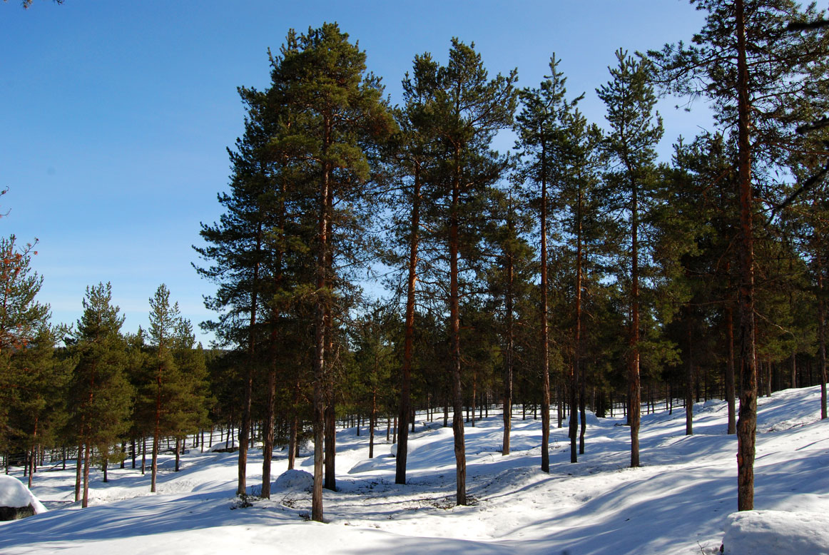




Slide 43

The case of free access (“Wild tourism”)

Slide 44



Slide 46
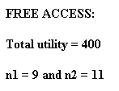

Slide 47
The case of optimally controlled tourism

Slide 48
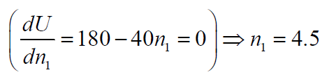

Slide 49
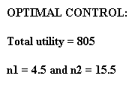

Slide 50
Conclusions:
It is important to utilize the environmentally and
recreationally valuable forest areas in the best possible way.
In order to utilize these areas in the optimal way, it is necessary to
optimize and control the number of visitors to the sensitive areas.
Free access may seem to be the best alternative. Then, however,
it has been proved that the total value of recreation and tourism
is lower than if the optimal number of visitors is determined and applied.
Free access leads to environmental degradation and reduced total utility.

Slide 51
Conclusions concerning economics and values
With adaptive optimization of forest management, it is possible to obtain the very best production economic result. A typical objective function is the expected present value. Many other types of objective functions can however also be used. Optimal forest management normally means that you should periodically harvest the largest trees, also taking the stochastic price variations and other stochastic events into account. Of course, the objective function may also include the value of tourism, recreation etc..
In case the forest is not managed at all, the result can not be better than the optimal result obtained with opimized management.
Summary:
Economic results normally decrease if management stops completely. There may be severe and costly damages and CO2 emissions by wild forest fires, windthrows and so on. Employment in the forest sector is reduced.

Slide 52
Workshop References
The following literature and presentations will be used as background to the workshop sessions. In the schedule, the references of relevance to each session are printed.
[1] Lohmander, P., Continuous extraction under risk, IIASA, International Institute for Applied Systems Analysis, Systems and Decisions Sciences, WP-86-16, March 1986
http://www.iiasa.ac.at/Admin/PUB/Documents/WP-86-016.pdf
http://www.lohmander.com/WP-86-016.pdf
[2] Lohmander, P., Pulse extraction under risk and a numerical forestry application, IIASA, International Institute for Applied Systems Analysis, Systems and Decisions Sciences, WP-87-49, June 1987
http://www.iiasa.ac.at/Admin/PUB/Documents/WP-87-049.pdf
http://www.lohmander.com/WP-87-049.pdf
[3] Lohmander, P., Continuous extraction under risk, SYSTEMS ANALYSIS - MODELLING - SIMULATION, Vol. 5, No. 2, 131-151, 1988
http://www.Lohmander.com/PL_SAMS_5_2_1988.pdf
[4] Lohmander, P., Pulse extraction under risk and a numerical forestry application, SYSTEMS ANALYSIS -MODELLING - SIMULATION, Vol. 5, No. 4, 339-354, 1988
http://www.Lohmander.com/PL_SAMS_5_4_1988.pdf

Slide 53
[5] Lohmander, P., Continuous harvesting with a nonlinear stock dependent growth function and stochastic prices: Optimization of the adaptive stock control function via a stochastic quasi-gradient method, Swedish University of Agricultural Sciences, Dept. of Forest Economics, No. 144, 1992
http://www.Lohmander.com/Lohmander_R144_1992.pdf
[6] Lohmander, P., Continuous harvesting with a nonlinear stock dependent growth function and stochastic prices: Optimization of the adaptive stock control function via a stochastic quasi-gradient method, in: Hagner, M. (editor), Silvicultural Alternatives, Proceedings from an internordic workshop, June 22-25, 1992, Swedish University of Agricultural Sciences, Dept. of Silviculture, No. 35, 198-214, 1992
http://www.Lohmander.com/Lohmander_SilvAlt_1992.pdf
[7] Lohmander, P., The multi species forest stand, stochastic prices and adaptive selective thinning, SYSTEMS ANALYSIS - MODELLING - SIMULATION, Vol. 9, 229-250, 1992
http://www.Lohmander.com/PL_SAMS_9_1992.pdf
[8] Lohmander, P., Economic two stage multi period species management in a stochastic environment: The value of selective thinning options and stochastic growth parameters, SYSTEMS ANALYSIS - MODELLING -SIMULATION, Vol. 11, 287-302, 1993
http://www.Lohmander.com/PL_SAMS_11_1993.pdf

Slide 54
[9] Lohmander, P., Optimal sequential forestry decisions under risk, ANNALS OF OPERATIONS RESEARCH, Vol. 95, pp. 217-228, 2000
http://www.Lohmander.com/PL_AOR_95_2000.pdf
[10] Lohmander, P., Adaptive Optimization of Forest Management in a Stochastic World, in Weintraub A. et al (Editors), Handbook of Operations Research in Natural Resources, Springer, Springer Science, International Series in Operations Research and Management Science, New York, USA, pp 525-544, 2007
http://www.amazon.ca/gp/reader/0387718141/ref=sib_dp_pt/701-0734992-1741115#reader-link
http://www.Lohmander.com/PL_Handbook2007.pdf
[11] Mohammadi, L.S., Lohmander, P., Stumpage Prices in the Iranian Caspian Forests, Asian Journal of Plant Sciences, 6 (7): 1027-1036, 2007, ISSN 1682-3974, 2007 Asian Network for Scientific Information, http://ansijournals.com/ajps/2007/1027-1036.pdf
http://www.Lohmander.com/MoLo2007.pdf
[12] Lohmander, P., Mohammadi, S., Optimal Continuous Cover Forest Management in an Uneven-Aged Forest in the North of Iran, Journal of Applied Sciences 8(11), 2008 http://ansijournals.com/jas/2008/1995-2007.pdf
http://www.Lohmander.com/LoMoOCC.pdf

Slide 55
[13] Lohmander, P., Guidelines for Economically Rational and Coordinated Dynamic Development of the Forest and Bio Energy Sectors with CO2 constraints, Proceedings from the 16th European Biomass Conference and Exhibition, Valencia, Spain, 02-06 June, 2008 (In the version in the link, below, an earlier misprint has been corrected. ) http://www.Lohmander.com/Valencia2008.pdf
[14] Lohmander, P., Software for illustration of the CO2 and forest management issue in combination with CCS technology, 2008, http://www.lohmander.com/co2ill2/co2ill2.htm
[15] Lu, F., Lohmander, P., Optimal Decisions for Mixed Forests under Risk, Scientia Silvae Sinicae, Vol. 45, No. 11, Nov. 2009
http://www.Lohmander.com/Lu_Lohmander_2009.pdf
[16] Lohmander, P., Zazykina, L., Rational and sustainable utilization of forest resources with consideration of recreation and tourism, bioenergy, the global warming problem, paper pulp and timber production: A mathematical approach, Proceedings of the II international workshop on Ecological tourism, Trends and perspectives on development in the global world, Saint Petersburg Forest Technical Academy, April 15-16, 2010
http://www.Lohmander.com/SPb201004/Lohmander_Zazykina_SPbFTA_2010.pdf
http://www.Lohmander.com/SPb201004/Lohmander_Zazykina_SPbFTA_2010.doc
http://www.Lohmander.com/SPb201004/PPT_Lohmander_Zazykina_SPbFTA_2010.ppt
http://www.Lohmander.com/SPb201004/PPT_Lohmander_Zazykina_SPbFTA_2010.pdf

Slide 56
[17] Lohmander, P., Zazykina, L., Methodology for optimization of continuous cover forestry with consideration of recreation and the forest and energy industries, Report and Abstract, Forests of Eurasia, Publishing House of Moscow State Forest University, September 19 - 25, 2010
http://www.lohmander.com/Moscow10/Moscow10_PL_LZ.pdf
http://www.lohmander.com/Moscow10/Moscow10_PL_LZ.doc
http://www.lohmander.com/Moscow_PL_2010.pdf
http://www.lohmander.com/Moscow_2010/Lohmander_Zazykina_Moscow_2010.ppt
http://www.lohmander.com/Moscow_2010/Programma-LE_10_01.doc
[18] Lohmander, P., Zazykina, L., Dynamic economical optimization of sustainable forest harvesting in Russia with consideration of energy, other forest products and recreation, SSAFR-2011, 14th Symposium for Systems Analysis in Forestry, Abstracts, Maitencillo, Chile, March 8-11, 2011,
http://www.lohmander.com/Chile_2011/Chile_2011_Dynamic_Lohmander.ppt
[19] Lohmander, P., With expanded bioenergy based on forest resources, we may simultaneously and sustainably reduce global warming, improve economic results, international relations and environmental conditions, BIT’S 4th Annual World Congress of Bioenergy-2014, Qingdao International Convention Center, China
http://www.Lohmander.com/PLWCBE2014A.pptx
http://www.Lohmander.com/PLWCBE2014A.pdf
http://www.Lohmander.com/WCBE2014_Expansion.pdf
http://www.bitcongress.com/wcbe2014/

Slide 57
[20] Mohammadi Limaei, S., Lohmander, P., Olsson, L., Sub models for optimal continuous cover multi species forestry in Iran, The 8th International Conference of Iranian Operations Research Society,
Department of Mathematics, Ferdowsi University of Mashhad, Mashhad, Iran, 21-22 May 2015
(The latest version of this manuscript has been accepted for publication in Journal of Forest Science (CAAS).
http://www.Lohmander.com/SML_PL_LO_IRAN_ABS_2015.pdf
http://www.Lohmander.com/PL_IRAN_B_2015.pdf
http://www.Lohmander.com/PL_IRAN_B_2015.pptx
http://www.Lohmander.com/PL_OR8_Abs_15.pdf
http://www.or8.um.ac.ir
[21] Lohmander, P., Applications and mathematical modeling in operations research, KEYNOTE, International Conference on Mathematics and Decision Science, International Center of Optimization and Decision Making & Guangzhou University, Guangzhou, China, September 12-15, 2016
http://www.Lohmander.com/PL_KEYNOTE_MATH_2016.jpg
http://www.Lohmander.com/PL_ICODM_2016_KEY.pptx
http://www.Lohmander.com/PL_ICODM_2016_KEY.pdf
http://www.Lohmander.com/PL_ICODM_2016_KEY_PAPER.pdf
http://www.Lohmander.com/PL_ICODM_2016_KEY_PAPER.docx
http://icodm2020.com/en/

Slide 58
[22] Lohmander, P., Optimal stochastic control of spatially distributed interdependent production units, International Conference on Mathematics and Decision Science, International Center of Optimization and Decision Making & Guangzhou University, Guangzhou, China, September 12-15, 2016
http://www.Lohmander.com/PL_BEST_PAPER_AWARD_MATH_2016.jpg
http://www.Lohmander.com/PL_ICODM_2016_CCF.pptx
http://www.Lohmander.com/PL_ICODM_2016_CCF.pdf
http://www.Lohmander.com/PL_ICODM_2016_CCF_PAPER.pdf
http://www.Lohmander.com/PL_ICODM_2016_CCF_PAPER.docx
http://icodm2020.com/en/
[23] Lohmander, P., A general dynamic function for the basal area of individual trees derived from a production theoretically motivated autonomous differential equation, National Conference on the Caspian Forests of Iran, "Past, Current, Future", University of Guilan, Rasht, Iran, April 26-27, 2017
http://www.Lohmander.com/PPT_GUILAN_PL_DIFF_2017.pptx
http://www.Lohmander.com/PPT_GUILAN_PL_DIFF_2017.pdf
http://www.Lohmander.com/Paper_Guilan_Dynamic_170215.pdf
http://www.Lohmander.com/Paper_Guilan_Dynamic_170215.docx
http://conf.isc.gov.ir/forestnorth

Slide 59
[24] Hatami, N., Lohmander, P., Moayeri, M.H., Mohammadi Limaei, S., A basal area increment model for individual trees in mixed species continuous cover stands in Iranian Caspian forests, National Conference on the Caspian Forests of Iran, "Past, Current, Future", University of Guilan, Rasht, Iran, April 26-27, 2017
http://www.Lohmander.com/PPT_GUILAN_JOINT_2017.ppt
http://www.Lohmander.com/PPT_GUILAN_JOINT_2017.pdf
http://www.Lohmander.com/Paper_Guilan_joint_170321.pdf
http://www.Lohmander.com/Paper_Guilan_joint_170321.docx
http://conf.isc.gov.ir/forestnorth
[25] Lohmander, P., Optimal stochastic control in continuous time with Wiener processes: - General results and applications to optimal wildlife management, KEYNOTE, The 10th International Conference of Iranian Operations Research Society, Balbosar, Iran, May 3-5, 2017
http://www.Lohmander.com/PPT_OR10_PL_KEYNOTE_2017.pptx
http://www.Lohmander.com/PPT_OR10_PL_KEYNOTE_2017.pdf
http://www.Lohmander.com/Paper_OR10_KEYNOTE_170127.pdf
http://www.Lohmander.com/Paper_OR10_KEYNOTE_170127.docx
http://www.icordm.ir/en/index.php

Slide 60
[26] Lohmander, P., ICMDS 2016 Conference report, Fuzzy Information and Engineering, Elsevier, Vol. 9, Issue 2, June 2017
https://authors.elsevier.com/sd/article/S1616865817301486
[27] Lohmander, P., Olsson, J.O., Fagerberg, N., Bergh, J., Adamopoulos, S., High resolution adaptive optimization of continuous cover spruce forest management in southern Sweden, SSAFR 2017, Symposium on Systems Analysis in Forest Resources, Clearwater Resort, Suquamish, Washington, (near Seattle), August 27-30, 2017
http://www.Lohmander.com/SSAFR_2017_Lohmander_et_al.pptx
http://www.Lohmander.com/SSAFR_2017_Lohmander_et_al.pdf
http://www.Lohmander.com/SSAFR_2017_Lohmander_Soft.txt
SSAFR 2017

Slide 61
[28] Lohmander, P., Applications and Mathematical Modeling in Operations Research, In: Cao BY. (ed) Fuzzy Information and Engineering and Decision. IWDS 2016. Advances in Intelligent Systems and Computing, vol 646. Springer, Cham, 2018,
Print ISBN 978-3-319-66513-9, Online ISBN 978-3-319-66514-6, eBook Package: Engineering, LAMMOR, https://doi.org/10.1007/978-3-319-66514-6_5
[29] Lohmander, P., Optimal Stochastic Dynamic Control of Spatially Distributed Interdependent Production Units. In: Cao BY. (ed) Fuzzy Information and Engineering and Decision. IWDS 2016. Advances in Intelligent Systems and Computing, vol 646. Springer, Cham, 2018
Print ISBN 978-3-319-66513-9, Online ISBN 978-3-319-66514-6, eBook Package: Engineering,
LOSDCSDI, https://doi.org/10.1007/978-3-319-66514-6_13

Slide 62
Thank you very much for your time!
I look forward to discussion, questions and cooperation!
On the following pages, the abstract follows.
Peter Lohmander

Slide 63
Should a forest be optimally managed or develop without control?
- Dynamic consequences for biodiversity, global warming and economics.
Gorgan University of Agricultural Sciences and Natural Resources (GUASNR), November 2017
Panel presentation Version 17-11-06
Peter Lohmander
Professor Dr., Optimal Solutions, www.Lohmander.com & Peter@Lohmander.com

Slide 64
Should a forest be optimally managed or develop without control?
- Dynamic consequences for biodiversity, global warming and economics.
Workshop at: Gorgan University of Agricultural Sciences and Natural Resources (GUASNR), November 2017
Panel presentation Version 17-11-06
Peter Lohmander
Abstract part 1
With active forestry, with sequential thinnings, biodiversity may be higher than without harvesting. In three of the four cases studied in the analysis, without control, the forests with two competing tree species develop into forests with only one tree species. In case we are interested to keep several tree species in the forest, this can be obtained if we control the forest and sequentally make species selective thinnings. If we control the forest and have several tree species in the forest stand, we may sequentially adapt the species selective harvest decisions to unpredictable changes in prices, environmental changes, species specific damages etc. With optimal control, the expected economic result is improved in relation to if we only have one tree species in the forest. We can also avoid natural disasters where all trees die.

Slide 65
Should a forest be optimally managed or develop without control?
- Dynamic consequences for biodiversity, global warming and economics.
Workshop at: Gorgan University of Agricultural Sciences and Natural Resources (GUASNR), November 2017
Panel presentation Version 17-11-06
Peter Lohmander
Abstract part 2
The most efficient way to use the forest in several regions of the world with low degree of forest harvesting, is to increase harvesting. Forest resources can replace some fossil fuels such as coal and oil in the production of energy, in particular in combined heat and power stations. Before some of the forest resources, such as timber and pulpwood, are used for energy production, they can be used for wood and paper products. When these products are wasted, the waste wood and waste paper can also be used in energy production. It may seem to be a good idea to stop harvesting the forest and to increase the standing volume in the forest in order to store more carbon there. Then, however, we forget that if we increase harvesting, we can store more carbon below ground, in the coal and oil reserves. Furthermore, forests, where the harvest level is lower than the growth, will sooner or later reach a state of dynamic equilibrium, where the standing volume does not increase anymore. Such forests, in dynamic equilibrium, do not contribute to solving the global warming problem any more.

Slide 66
Should a forest be optimally managed or develop without control?
- Dynamic consequences for biodiversity, global warming and economics.
Workshop at: Gorgan University of Agricultural Sciences and Natural Resources (GUASNR), November 2017
Panel presentation Version 17-11-06
Peter Lohmander
Abstract part 3
It is important to utilize the environmentally and recreationally valuable forest areas in the best possible way. In order to utilize these areas in the optimal way, it is necessary to optimize and control the number of visitors to the sensitive areas. Free access may seem to be the best alternative. Then, however, it has been proved that the total value of recreation and tourism is lower than if the optimal number of visitors is determined and applied. Free access leads to environmental degradation and reduced total utility.

Slide 67
Should a forest be optimally managed or develop without control?
- Dynamic consequences for biodiversity, global warming and economics.
Workshop at: Gorgan University of Agricultural Sciences and Natural Resources (GUASNR), November 2017
Panel presentation Version 17-11-06
Peter Lohmander
Abstract part 4
With adaptive optimization of forest management, it is possible to obtain the very best production economic result. A typical objective function is the expected present value. Many other types of objective functions can however also be used. Optimal forest management normally means that you should periodically harvest the largest trees, also taking the stochastic price variations and other stochastic events into account. Of course, the objective function may also include the value of tourism, recreation etc.. In case the forest is not managed at all, the result can not be better than the optimal result obtained with optimized management. Economic results normally decrease if management stops completely. There may be severe and costly damages and CO2 emissions by wild forest fires, windthrows and so on. Employment in the forest sector is reduced.

