Slide 1
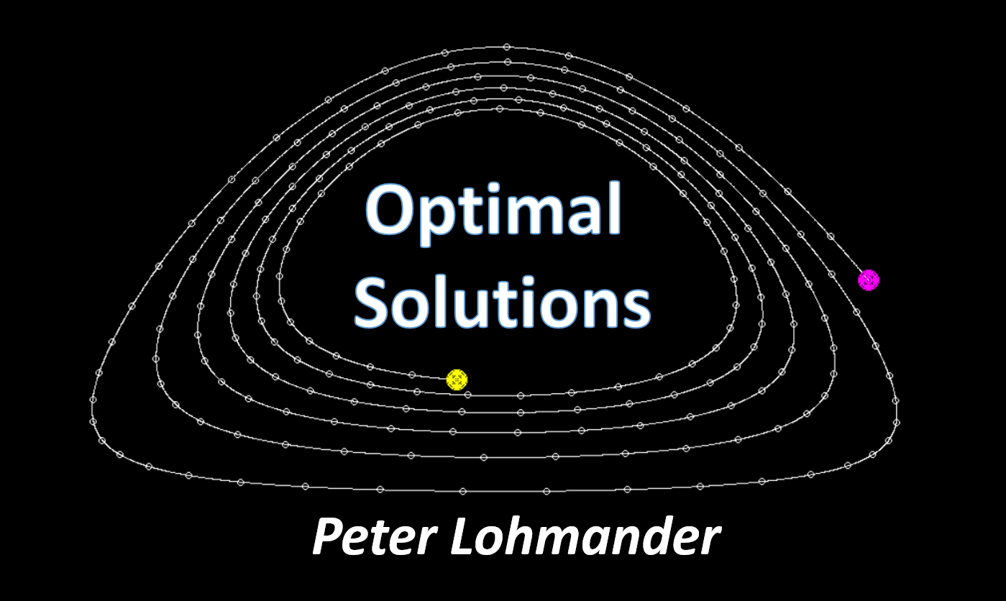

Climate change under CO2 emission control and optimal forestry (Edition 210214)
Webinar on Forest Management and Climate Changes
University of Guilan- Faculty of Natural Resources
February 15th, 2021, 13:00-14:30 (Iran time), 10:30-12:00 (CET)
Prof. Dr. Peter Lohmander
http://www.lohmander.com/Information/Ref.htm
Peter@Lohmander.com

Slide 2
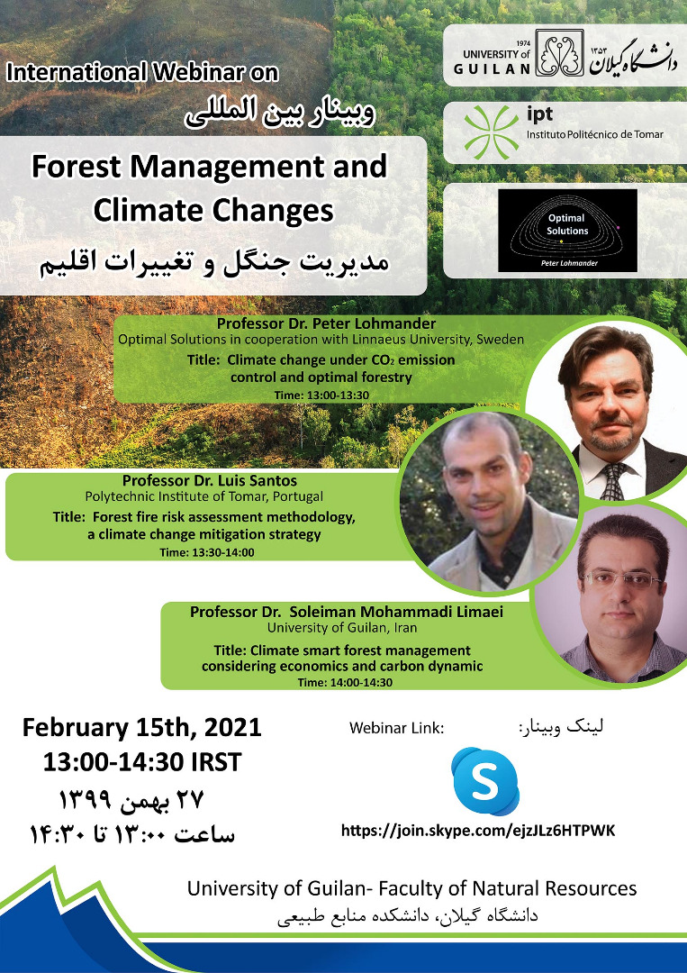
Contact details:
Prof. Dr. Peter Lohmander
Optimal Solutions
Hoppets Grand 6
SE-903 34 Umea
Sweden
Peter@Lohmander.com
Peter.Lohmander@icloud.com
http://www.lohmander.com/Information/Ref.htm

Slide 3
This presentation is based on the following articles:
Lohmander, P., Dynamics and control of the CO2 level via a differential equation and alternative global emissions strategies, International Robotics & Automation Journal, Volume 6, Issue 1, 2020, pages 7-15. https://medcraveonline.com/IRATJ/IRATJ-06-00197.pdf
Lohmander, P., Optimization of continuous cover forestry expansion under the influence of global warming, International Robotics & Automation Journal, Volume 6, Issue 3, 2020, 127-132.
https://medcraveonline.com/IRATJ/IRATJ-06-00211.pdf
https://medcraveonline.com/IRATJ/IRATJ-06-00211A.pdf

Slide 4
Connected articles:
Lohmander, P., Fundamental principles of optimal utilization of forests with consideration of global warming, Central Asian Journal of Environmental Science and Technology Innovation, Volume 1, Issue 3, May and June 2020, 134-142. doi: 10.22034/CAJESTI.2020.03.02
http://www.cas-press.com/article_111213.html
http://www.cas-press.com/article_111213_5ab21574a30f6f2c7bdc0a0733234181.pdf
Lohmander, P., Adaptive mobile firefighting resources, stochastic dynamic optimization of international cooperation, International Robotics & Automation Journal, Volume 6, Issue 4, 2020, pages 150-155.
https://medcraveonline.com/IRATJ/IRATJ-06-00213.pdf
Lohmander, P., Forest fire expansion under global warming conditions: multivariate estimation, function properties and predictions for 29 countries, Central Asian Journal of Environmental Science and Technology Innovation, Volume 1, Issue 5, 2020, 134-142. doi:10.22034/CAJESTI.2020.05.03.
http://www.cas-press.com/article_122566.html
Lohmander, P., Optimization of forestry, infrastructure and fire management,
Caspian Journal of Environmental Sciences (Forthcoming. Accepted for publication).

Slide 5
Lohmander, P., Dynamics and control of the CO2 level via a differential equation and alternative global emissions strategies, International Robotics & Automation Journal, Volume 6, Issue 1, 2020, pages 7-15.
Abstract PART 1(6):
The analysis in this paper shows that the fundamental theory of the CO2 level in the atmosphere, under the influence of changing CO2 emissions, can be modeled as a first order linear differential equation with a forcing function, describing industrial emissions.

Slide 6
The natural CO2 dynamics
Change of the
CO2 level in the
atmosphere
Natural emissions
from vulcanos etc.
Net absorbtion of CO2
by the sea and
natural environment

Slide 7
> 0
< 0

Slide 8
Natural “pre- industrial”
equilibrium

Slide 9
Lohmander, P., Dynamics and control of the CO2 level via a differential equation and alternative global emissions strategies, International Robotics & Automation Journal, Volume 6, Issue 1, 2020, pages 7-15.
Abstract PART 2(6):
Observations of the CO2 level at the Mauna Loa CO2 observatory and official statistics of global CO2 emissions, from Edgar, the Joint Research Centre at the European Commission, are used to estimate all parameters of the forced CO2 differential equation.

Slide 10
= CO2 in atmosphere, ppm
Year

Slide 11
= Emissions, Gt per year
Year

Slide 13
The CO2 dynamics affected by
industrial emissions
Industrial
emissions
of CO2

Slide 14
Reduction of CO2
in atmosphere in the
absence of emissions.
Emissions

Slide 16
Period
Change of CO2 in atmosphere (in the absence of emissions)

Slide 17
The estimated “natural”
differential function
The estimated
equilibrium of the
natural system without
industrial emissions

Slide 18
Change of CO2 in atmosphere
(in the absence of emissions)
In the absence of emissions, the CO2 level converges to a stable equilibrium of 280 ppm.

Slide 19
Determination of a solution of the form
to the differential equation
based on the historical emissions.

Slide 20
General form of
emission function
Specific form of
emission function
The differential equation with specific
emission function
Solution
of the homogenous differential equation.

Slide 21
Determination of the particular solution.

Slide 22
Determination of the numerical parameter values based on the historical data.
The solution based on the historical emissions:

Slide 23
The solution based on the historical emissions:

Slide 24
Lohmander, P., Dynamics and control of the CO2 level via a differential equation and alternative global emissions strategies, International Robotics & Automation Journal, Volume 6, Issue 1, 2020, pages 7-15.
Abstract PART 3(6):
The estimated differential equation has a logical theoretical foundation and convincing statistical properties. It is used to reproduce the time path of the CO2 data from Mauna Loa, from year 1990 to 2018, with very small errors.

Slide 25
(ppm)
Year

Slide 26
Lohmander, P., Dynamics and control of the CO2 level via a differential equation and alternative global emissions strategies, International Robotics & Automation Journal, Volume 6, Issue 1, 2020, pages 7-15.
Abstract PART 4(6):
Furthermore, the differential equation shows that the global CO2 level, without emissions, has a stable equilibrium at 280 ppm. This value has earlier been reported by IPCC as the pre-industrial CO2 level.

Slide 27
The estimated function
leads to stability.
The estimated
equilibrium is equal
to the pre-industrial
level.

Slide 28
Change of CO2 in atmosphere
(in the absence of emissions)
The differential
equation determines
the pre-industrial
equilibrium correctly.
Pre-
industrial
equilibrium

Slide 29
Lohmander, P., Dynamics and control of the CO2 level via a differential equation and alternative global emissions strategies, International Robotics & Automation Journal, Volume 6, Issue 1, 2020, pages 7-15.
Abstract PART 5(6):
The differential function is applied to derive four dynamic cases of the global CO2 level, from the year 2020 until 2100, conditional on four different strategies concerning the development of global CO2 emissions:
Emissions continue to increase according to the trend during 1990–2018.
Emissions stay for ever at the 2020 level.
iii. Emissions are reduced with a linear trend to become zero year 2100.
iv. Emissions are reduced with a linear trend to become zero year 2050.

Slide 30
Alternative
Emission
Strategies

Slide 31
Determination of a prediction model
based on the differential equation
and the different emission strategies.

Slide 32
Alternative
emission
strategies

Slide 33
Alternative
emission
strategies
Prediction
model

Slide 34
Lohmander, P., Dynamics and control of the CO2 level via a differential equation and alternative global emissions strategies, International Robotics & Automation Journal, Volume 6, Issue 1, 2020, pages 7-15.
Abstract PART 6(6):
In case i., the CO2 level year 2100 will be 688 ppm.
In cases ii. and iii., the CO2 levels in 2100 will be 517 ppm and 389 respectively.
In case iv., the CO2 level in 2050 is 408 ppm and then rapidly falls.

Slide 35
Emissions continue to increase
according to the trend during
1990–2018.
The different
emission
strategies
give
different future
developments of
the CO2 level
in the atmosphere.
Emissions are reduced with
a linear trend to become zero year 2050.

Slide 36
Optimization of
continuous cover forestry expansion
under the influence of global warming
Lohmander, P., Optimization of continuous cover forestry expansion under the influence of global warming, International Robotics & Automation Journal, Volume 6, Issue 3, 2020, 127-132.
https://medcraveonline.com/IRATJ/IRATJ-06-00211.pdf
https://medcraveonline.com/IRATJ/IRATJ-06-00211A.pdf

Slide 37
In this article:
Lohmander, P., Optimization of continuous cover forestry expansion under the influence of global warming, International Robotics & Automation Journal, Volume 6, Issue 3, 2020, 127-132.
https://medcraveonline.com/IRATJ/IRATJ-06-00211.pdf
https://medcraveonline.com/IRATJ/IRATJ-06-00211A.pdf
the CO2 differential function developed in this article:
Lohmander, P., Dynamics and control of the CO2 level via a differential equation and alternative global emissions strategies, International Robotics & Automation Journal, Volume 6, Issue 1, 2020, pages 7 -15. https://medcraveonline.com/IRATJ/IRATJ-06-00197.pdf
is applied and adjusted for alternative levels of CCF forestry area expansion paths.

Slide 38
Abstract part 1(4)
Planet Earth faces the problem of global warming. Recent research on the dynamics of the CO2 concentration in the atmosphere has shown how reductions of global industrial emissions of CO2 can solve a large part of the global warming problem. However, there are more control options available.
Our world is covered by large areas of primary (natural) forests that are almost not managed at all. They do not contribute very much to the net absorption of CO2.
Lohmander, P., Optimization of continuous cover forestry expansion under the influence of global warming, International Robotics & Automation Journal, Volume 6, Issue 3, 2020, 127-132.
https://medcraveonline.com/IRATJ/IRATJ-06-00211.pdf
https://medcraveonline.com/IRATJ/IRATJ-06-00211A.pdf

Slide 39
According to FAO, 2020, the world presently has at least 1.11 billion ha of primary forest. In these primary forests, of particular interest and relevance to the analysis developed in the later part of this paper, there are practically no human activities such as forest harvesting.
The forests are almost undisturbed by human industrial projects and have native forest species and original ecological processes. In the three countries Brazil, Russian Federation and Canada, we find 61% of these primary forests, which represents approximately 677 M ha.

Slide 40
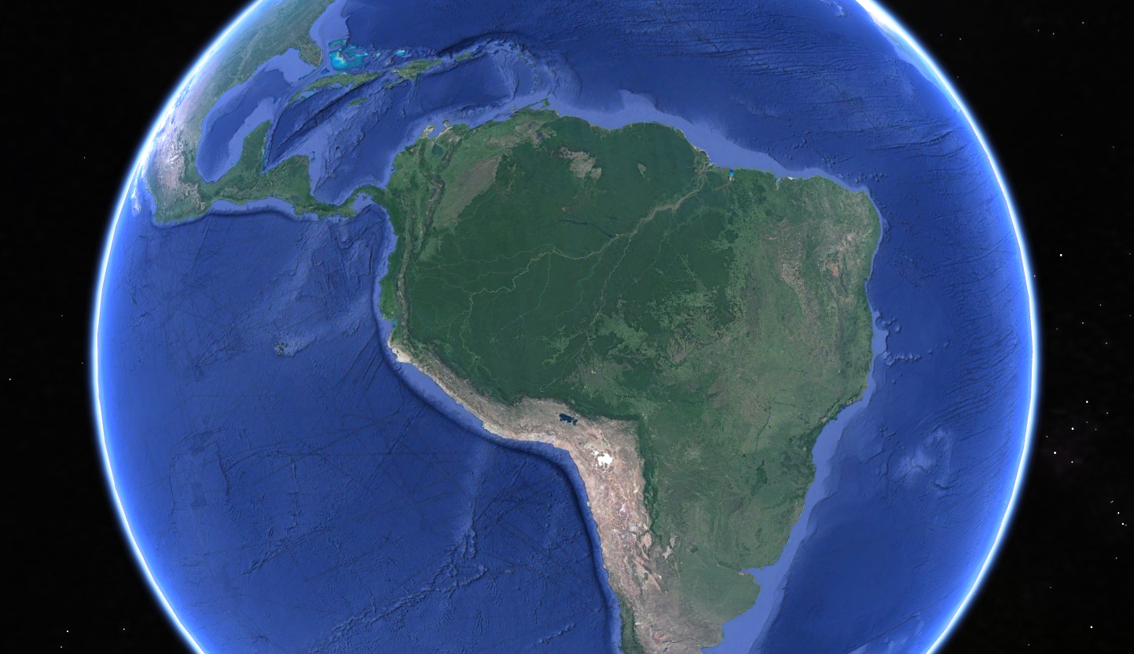
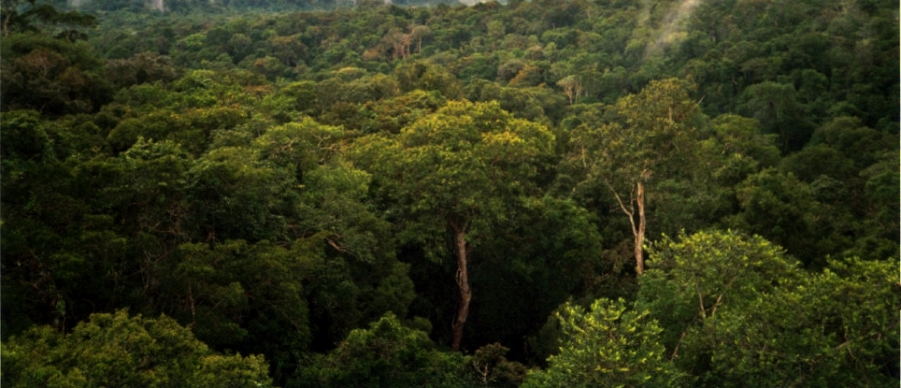
Our world contains very large areas of mixed species forests with trees of different sizes.
By Phil P Harris. - Own work, CC BY-SA 2.5, https://commons.wikimedia.org/w/index.php?curid=717267

Slide 41
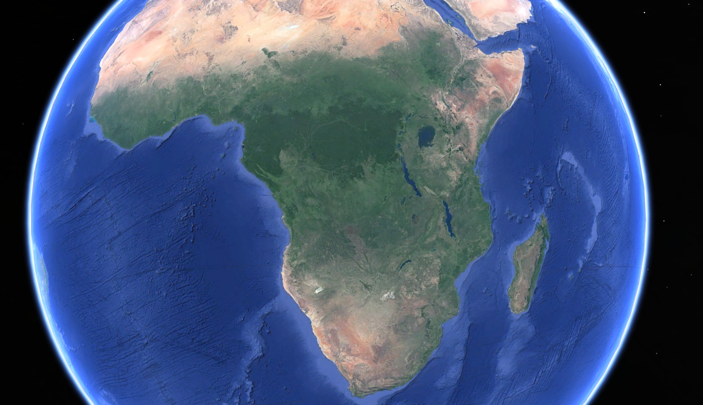

Slide 42
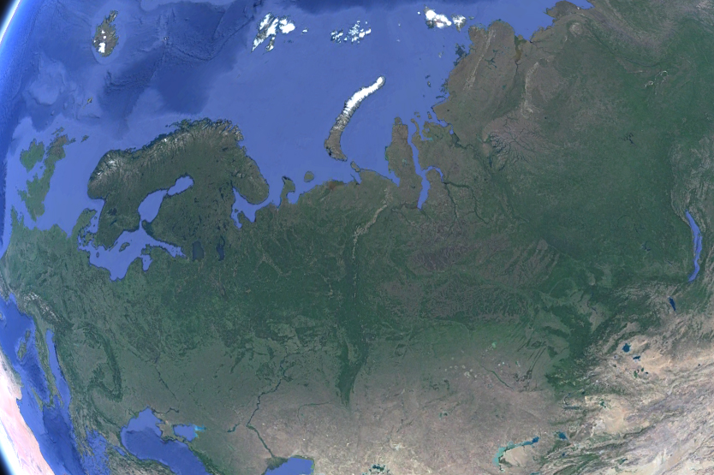
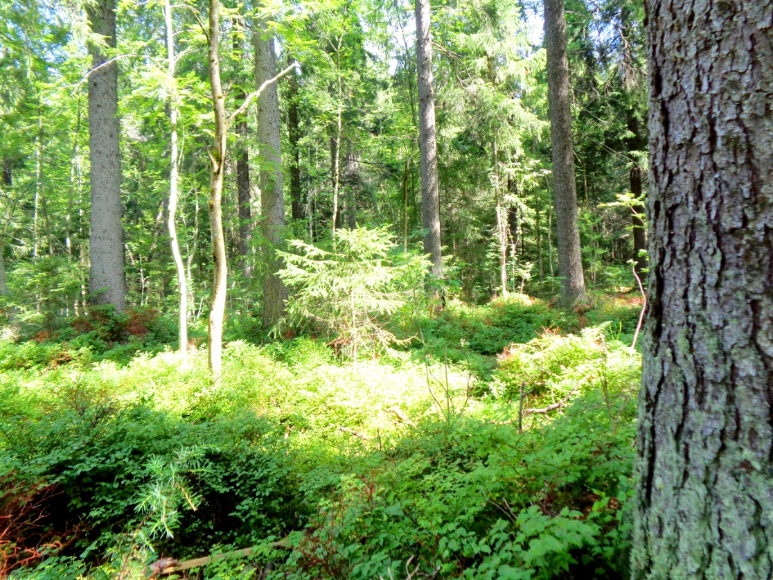

Slide 43
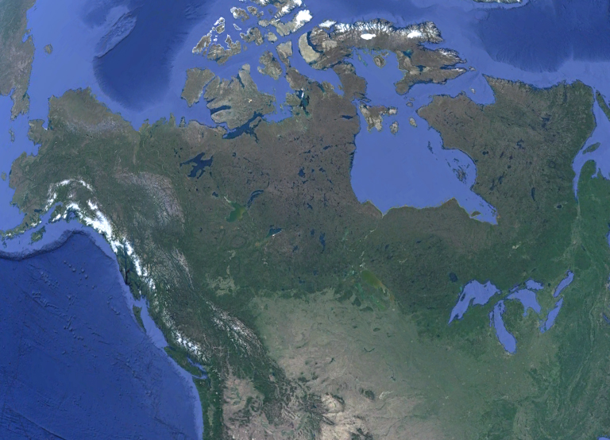

Slide 44
Abstract part 2(4)
Parts of these natural forests may be transformed to continuous cover forests, which mean that the absorption of CO2 increases so that the CO2 level in the atmosphere can be further reduced. This transformation can be made without severely damaging the environmental conditions.
The analysis in this paper shows how to define an optimization problem with two objectives with different weights in the objective function. These objectives are the economic present value of profits and the utility of the climate.
Lohmander, P., Optimization of continuous cover forestry expansion under the influence of global warming, International Robotics & Automation Journal, Volume 6, Issue 3, 2020, 127-132.
https://medcraveonline.com/IRATJ/IRATJ-06-00211.pdf
https://medcraveonline.com/IRATJ/IRATJ-06-00211A.pdf

Slide 45
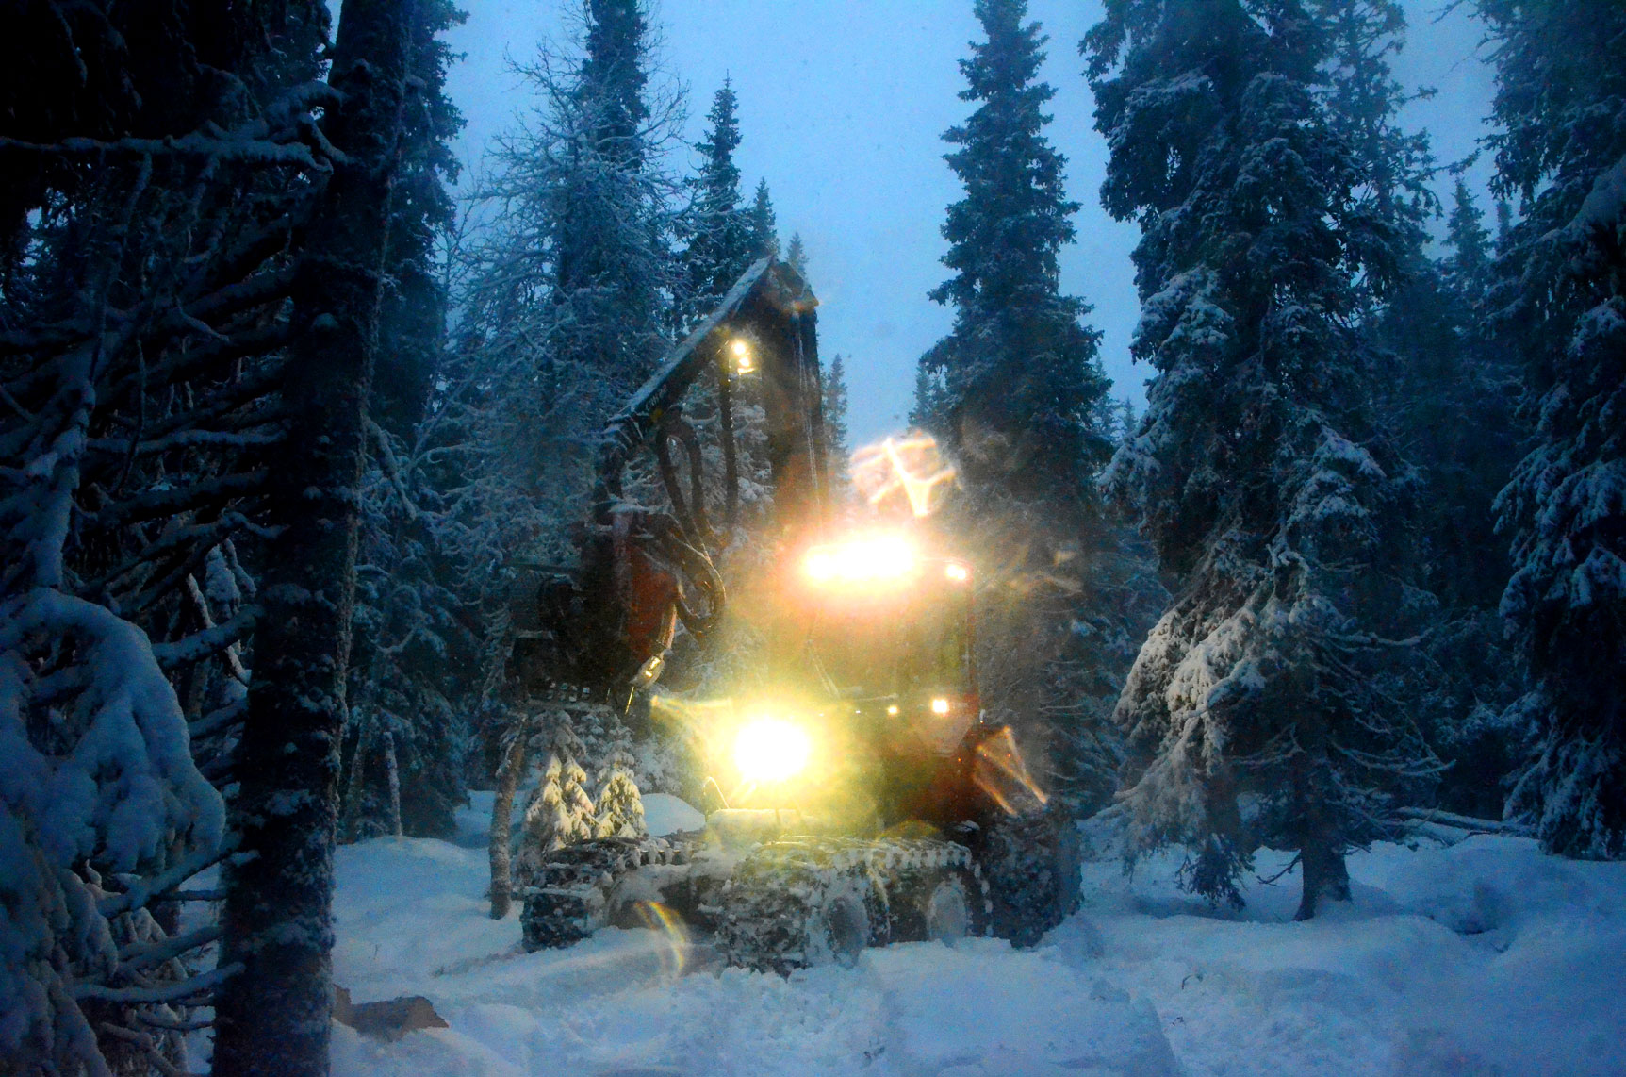
Continuous
cover
forest
harvesting
in the
Swedish
mountains,
December
2014

Slide 46
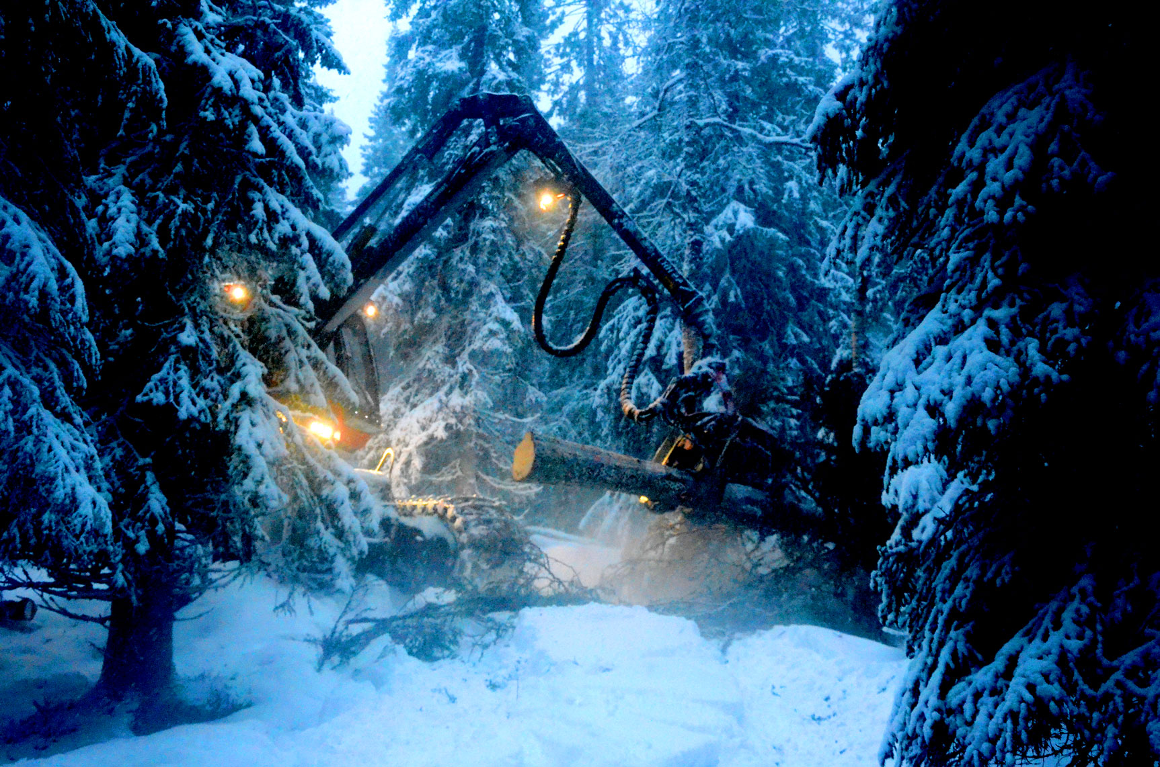

Slide 47
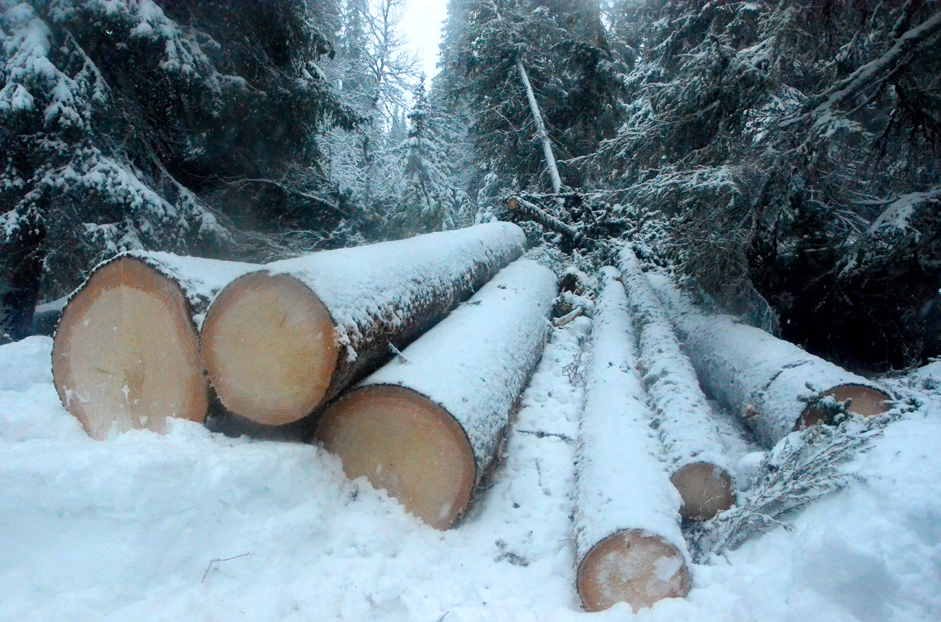

Slide 48
Multi objective optimization
Present value
of all profits

Slide 50
Abstract part 3(4)
The analysis shows how the optimal transformation of natural forests to managed continuous cover forests is affected by the relative weights of the utility of the climate and of the present value of the profits.
If the relative weight of the utility of the climate increases, the optimal area of natural forests that should be transformed to managed continuous cover forests increases.
Lohmander, P., Optimization of continuous cover forestry expansion under the influence of global warming, International Robotics & Automation Journal, Volume 6, Issue 3, 2020, 127-132.
https://medcraveonline.com/IRATJ/IRATJ-06-00211.pdf
https://medcraveonline.com/IRATJ/IRATJ-06-00211A.pdf

Slide 51
FOR y1 = 0 TO 10 STEP 0.1 (y1 = CCF area expansion per year)
FOR yt = 10 TO 60 STEP 0.1 (yt = number of years of CCF area expansion)
Determinations of the CO2 differential equation parameters and solutions
from year 2020 until 2100.
Derivations of forestry profits and forest dependent CO2 change during
80 years via the solution to the differential equation.
Selection of the optimal combination of y1 and yt based on the objective
function parameters.
NEXT yt
NEXT y1

Slide 52
Optimal
Total
Area
Expansion
(Mha)
kW

Slide 53
Optimal
time of
area
expansion
(Years)
kW

Slide 54
Optimal
area
expansion
per year
(Mha/year)
kW

Slide 55
Optimal
CO2 level in
year 2100
(ppm)
kW

Slide 56
PV
Present values of
optimal revenues,
costs and profits
(Relevant currency)
kW

Slide 57
PV
The frontier of optimal
combinations of the
present value of
total profits and
the CO2 level
in year 2100
(Relevant currency & ppm)
X(t=80) (ppm)

Slide 58
X (ppm)
The time path of the CO2 level
as a function of the number of
years of area expansion.
(ppm)
(In all three cases in the graph,
The expansion per year is
10 Mha.)
Year

Slide 59
X (ppm)
The time path of
the CO2 level
(ppm) as a
function of
the time of
area expansion.
(years).
(In all three cases
in the graph,
the area expansion
per year is
10 Mha.)
0 years
30 years
60 years
Year
60 years
0 years
30 years

Slide 61
Abstract part 3(4)
The analysis shows how the optimal transformation of natural forests to managed continuous cover forests is affected by the relative weights of the utility of the climate and of the present value of the profits.
If the relative weight of the utility of the climate increases, the optimal area of natural forests that should be transformed to managed continuous cover forests increases.
Lohmander, P., Optimization of continuous cover forestry expansion under the influence of global warming, International Robotics & Automation Journal, Volume 6, Issue 3, 2020, 127-132.
https://medcraveonline.com/IRATJ/IRATJ-06-00211.pdf
https://medcraveonline.com/IRATJ/IRATJ-06-00211A.pdf

Slide 62
Abstract part 4(4)
If 600 M hectares are transformed during 60 years,
from 2020 until 2080,
then the concentration of CO2 in the atmosphere
can be reduced by 8 ppm until the year 2100.
Lohmander, P., Optimization of continuous cover forestry expansion under the influence of global warming, International Robotics & Automation Journal, Volume 6, Issue 3, 2020, 127-132.
https://medcraveonline.com/IRATJ/IRATJ-06-00211.pdf
https://medcraveonline.com/IRATJ/IRATJ-06-00211A.pdf

Slide 63
Conclusions 1(2)
#1. Now, it is possible to understand the dynamics of the CO2 level of the atmosphere, under the influence of global emissions.
#2. A first order differential equation with emission forcing has been able to explain the development of the dynamics of the CO2 level in the atmosphere, with very high precision.
#3. The function shows that the CO2 equilibrium level, before the industrial revolution, was 280 ppm, which confirms earlier empirical research.
#4. The model has predicted how the global CO2 level can be dynamically changed via different emissions strategies.

Slide 64
Conclusions 2(2)
#5. Large areas of primary (natural) forests do not contribute very much to the net absorption of CO2. They may be transformed to CCF.
#6. Then, the absorption of CO2 increases and the CO2 level in the atmosphere can be reduced. This transformation can be made without severely damaging the environmental conditions.
#7. If the weight of the utility of the climate increases, the optimal area of natural forests that should be transformed to CCF increases.
#8. If 600 M hectares are transformed during 60 years, from 2020 until 2080, the CO2 level in the atmosphere is reduced by 8 ppm year 2100.

Slide 65
This presentation is based on the following articles:
Lohmander, P., Dynamics and control of the CO2 level via a differential equation and alternative global emissions strategies, International Robotics & Automation Journal, Volume 6, Issue 1, 2020, pages 7-15. https://medcraveonline.com/IRATJ/IRATJ-06-00197.pdf
Lohmander, P., Optimization of continuous cover forestry expansion under the influence of global warming, International Robotics & Automation Journal, Volume 6, Issue 3, 2020, 127-132.
https://medcraveonline.com/IRATJ/IRATJ-06-00211.pdf
https://medcraveonline.com/IRATJ/IRATJ-06-00211A.pdf

Slide 66
Connected articles:
Lohmander, P., Fundamental principles of optimal utilization of forests with consideration of global warming, Central Asian Journal of Environmental Science and Technology Innovation, Volume 1, Issue 3, May and June 2020, 134-142. doi: 10.22034/CAJESTI.2020.03.02
http://www.cas-press.com/article_111213.html
http://www.cas-press.com/article_111213_5ab21574a30f6f2c7bdc0a0733234181.pdf
Lohmander, P., Adaptive mobile firefighting resources, stochastic dynamic optimization of international cooperation, International Robotics & Automation Journal, Volume 6, Issue 4, 2020, pages 150-155.
https://medcraveonline.com/IRATJ/IRATJ-06-00213.pdf
Lohmander, P., Forest fire expansion under global warming conditions: multivariate estimation, function properties and predictions for 29 countries, Central Asian Journal of Environmental Science and Technology Innovation, Volume 1, Issue 5, 2020, 134-142. doi:10.22034/CAJESTI.2020.05.03.
http://www.cas-press.com/article_122566.html
Lohmander, P., Optimization of forestry, infrastructure and fire management,
Caspian Journal of Environmental Sciences (Forthcoming. Accepted for publication).

Slide 67
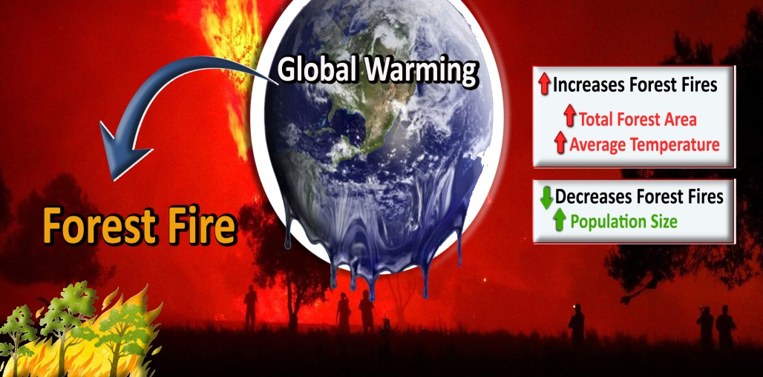

Slide 68
Climate change under CO2 emission control and optimal forestry
Webinar on Forest Management and Climate Changes
University of Guilan- Faculty of Natural Resources
February 15th, 2021, 13:00-14:30 (Iran time), 10:30-12:00 (CET)
Prof. Dr. Peter Lohmander
http://www.lohmander.com/Information/Ref.htm
Peter@Lohmander.com

Slide 69
Contact details:
Prof. Dr. Peter Lohmander
Optimal Solutions
Hoppets Grand 6
SE-903 34 Umea
Sweden
Peter@Lohmander.com
Peter.Lohmander@icloud.com
http://www.lohmander.com/Information/Ref.htm

