Slide 1
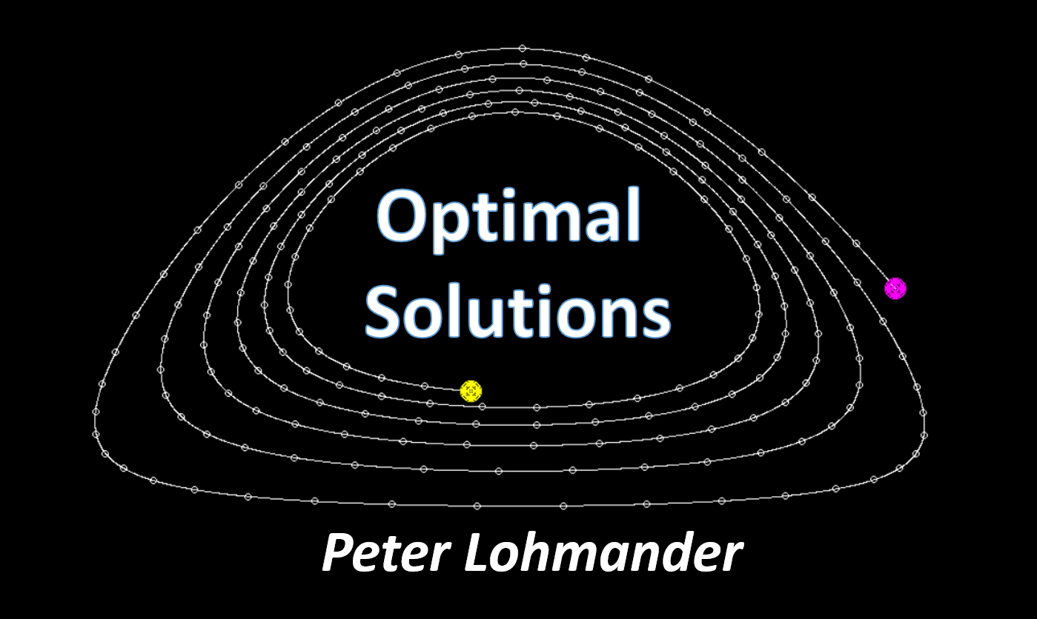

Global Stability via the Forced Global Warming Equation,
Fire Control with Joint Fire Fighting Resources, and Optimal Forestry (Edition 210330_1846)
KEYNOTE at ICASE 2021:
International Conference on Applied Science & Engineering,
March 31, 10.00 GMT.
Prof. Dr. Peter Lohmander
Peter@Lohmander.com

Slide 4
General Problem Structure and the Six Articles
CO2 in
Atmosphere
Global
Warming
#5
Fire Areas in
Different Countries
#1
#2 & #3
#6
#4
CO2
emission
reductions
Increased Absorbtion of CO2 via increased Area of Managed Forests
Adaptive
Optimization of
Internationally
Mobile
Fire Fighting
Optimization of
Forestry,
Infrastructure,
Fire Management
and Fire Fighting
Capacity

Slide 5
References to this presentation
#1. Lohmander, P., Dynamics and control of the CO2 level via a differential equation and alternative global emissions strategies, International Robotics & Automation Journal, Volume 6, Issue 1, 2020, pages 7-15. https://medcraveonline.com/IRATJ/IRATJ-06-00197.pdf
#2. Lohmander, P., Optimization of continuous cover forestry expansion under the influence of global warming, International Robotics & Automation Journal, Volume 6, Issue 3, 2020, 127-132.
https://medcraveonline.com/IRATJ/IRATJ-06-00211.pdf
https://medcraveonline.com/IRATJ/IRATJ-06-00211A.pdf

Slide 6
References to this presentation
#3. Lohmander, P., Fundamental principles of optimal utilization of forests with consideration of global warming, Central Asian Journal of Environmental Science and Technology Innovation, Volume 1, Issue 3, May and June 2020, 134-142. http://www.cas-press.com/article_111213.html
#4. Lohmander, P., Adaptive mobile firefighting resources, stochastic dynamic optimization of international cooperation, International Robotics & Automation Journal, Volume 6, Issue 4, 2020, pages 150-155.
https://medcraveonline.com/IRATJ/IRATJ-06-00213.pdf

Slide 7
References to this presentation
#5. Lohmander, P., Forest fire expansion under global warming conditions: multivariate estimation, function properties and predictions for 29 countries, Central Asian Journal of Environmental Science and Technology Innovation, Volume 1, Issue 5, 2020, 134-142. doi:10.22034/CAJESTI.2020.05.03.
http://www.cas-press.com/article_122566.html
#6. Lohmander, P., Optimization of forestry, infrastructure and fire management, Caspian Journal of Environmental Sciences (Forthcoming. Accepted for publication). http://www.lohmander.com/PL_CJES_21_MANUS.pdf

Slide 9
The natural CO2 dynamics
Change of the
CO2 level in the
atmosphere
Natural emissions
from vulcanos etc.
Net absorbtion of CO2
by the sea and
natural environment

Slide 10
> 0
< 0

Slide 11
Natural “pre- industrial”
equilibrium

Slide 12
= CO2 in atmosphere, ppm
Year

Slide 13
= Emissions, Gt per year
Year

Slide 15
The CO2 dynamics affected by
industrial emissions
Industrial
emissions
of CO2

Slide 16
Reduction of CO2
in atmosphere in the
absence of emissions.
Emissions

Slide 18
Period
Change of CO2 in atmosphere (in the absence of emissions)

Slide 19
Determination of a solution of the form
to the differential equation
based on the historical emissions.

Slide 20
A general functional form of the emission function is used here
Specific form of
emission function
The differential equation with specific
emission function
Solution
of the homogenous differential equation.

Slide 21
Determination of the particular solution.

Slide 22
Determination of the numerical parameter values based on the historical data.
The solution based on the historical emissions:

Slide 23
The solution based on the historical emissions:

Slide 24
(ppm)
Year

Slide 25
The estimated differential
equation leads to stability.
The estimated
equilibrium is equal
to the pre-industrial
level.

Slide 26
Change of CO2 in atmosphere
(in the absence of emissions)
The differential
equation determines
the pre-industrial
equilibrium correctly.
Pre-
industrial
equilibrium

Slide 27
The differential function is applied to derive four dynamic cases of the global CO2 level, from the year 2020 until 2100, conditional on four different strategies concerning the development of global CO2 emissions:
Emissions continue to increase according to the trend during 1990–2018.
Emissions stay for ever at the 2020 level.
iii. Emissions are reduced with a linear trend to become zero year 2100.
iv. Emissions are reduced with a linear trend to become zero year 2050.

Slide 28
Alternative
Emission
Strategies

Slide 29
Determination of a prediction model
based on the differential equation
and the different emission strategies.

Slide 30
Alternative
emission
strategies
Parameters in the Gt prediction function

Slide 31
Parameters in the ppm prediction function
Alternative
emission
strategies
Prediction
model

Slide 32
Emissions continue to increase
according to the trend during
1990–2018.
The different
emission
strategies
give
different future
developments of
the CO2 level
in the atmosphere.
Emissions are reduced with
a linear trend to become zero year 2050.

Slide 33
Conclusions
#1. Now, it is possible to understand the dynamics of the CO2 level of the atmosphere, under the influence of global emissions.
#2. A first order differential equation with emission forcing has been able to explain the development of the dynamics of the CO2 level in the atmosphere, with very high precision.
#3. The function shows that the CO2 equilibrium level, before the industrial revolution, was 280 ppm, which confirms earlier empirical research.
#4. The model has predicted how the global CO2 level can be dynamically changed via different emissions strategies.

Slide 34
#2. will now be described in more details. (The complete open access article #3. can be studied at any time.)

Slide 35
Planet Earth faces the problem of global warming. Recent research on the dynamics of the CO2 concentration in the atmosphere has shown how reductions of global industrial emissions of CO2 can solve a large part of the global warming problem. However, there are more control options available.
Our world is covered by large areas of primary (natural) forests that are almost not managed at all. They do not contribute very much to the net absorption of CO2.

Slide 36
According to FAO, 2020, the world presently has at least 1.11 billion ha of primary forest. In these primary forests, of particular interest and relevance to the analysis developed in the later part of this paper, there are practically no human activities such as forest harvesting.
The forests are almost undisturbed by human industrial projects and have native forest species and original ecological processes. In the three countries Brazil, Russian Federation and Canada, we find 61% of these primary forests, which represents approximately 677 M ha.

Slide 37
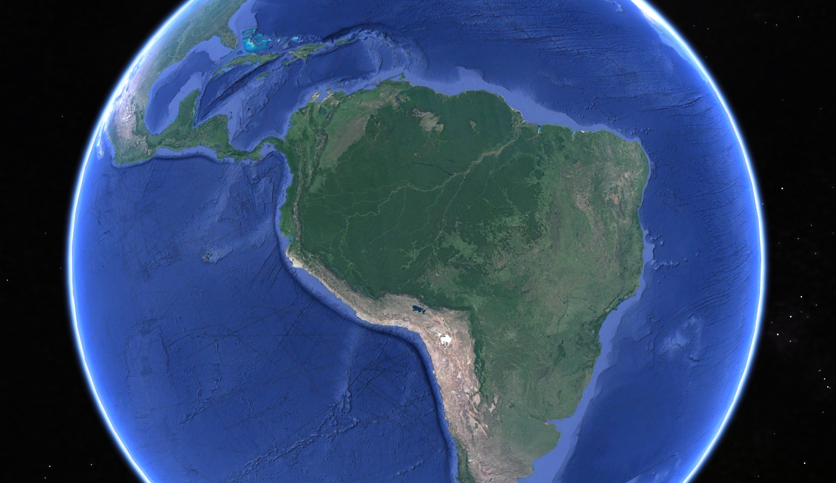
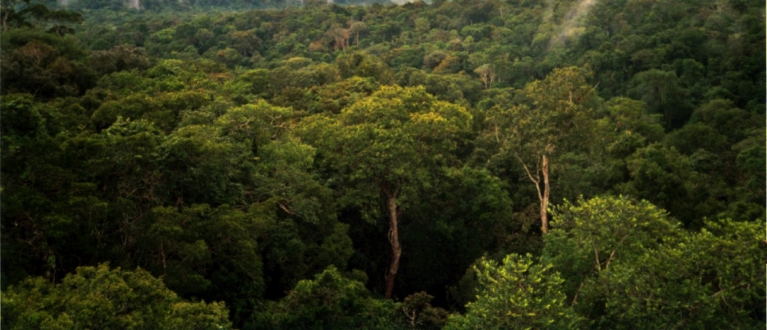
Our world contains very large areas of mixed species forests with trees of different sizes.
By Phil P Harris. - Own work, CC BY-SA 2.5, https://commons.wikimedia.org/w/index.php?curid=717267

Slide 38
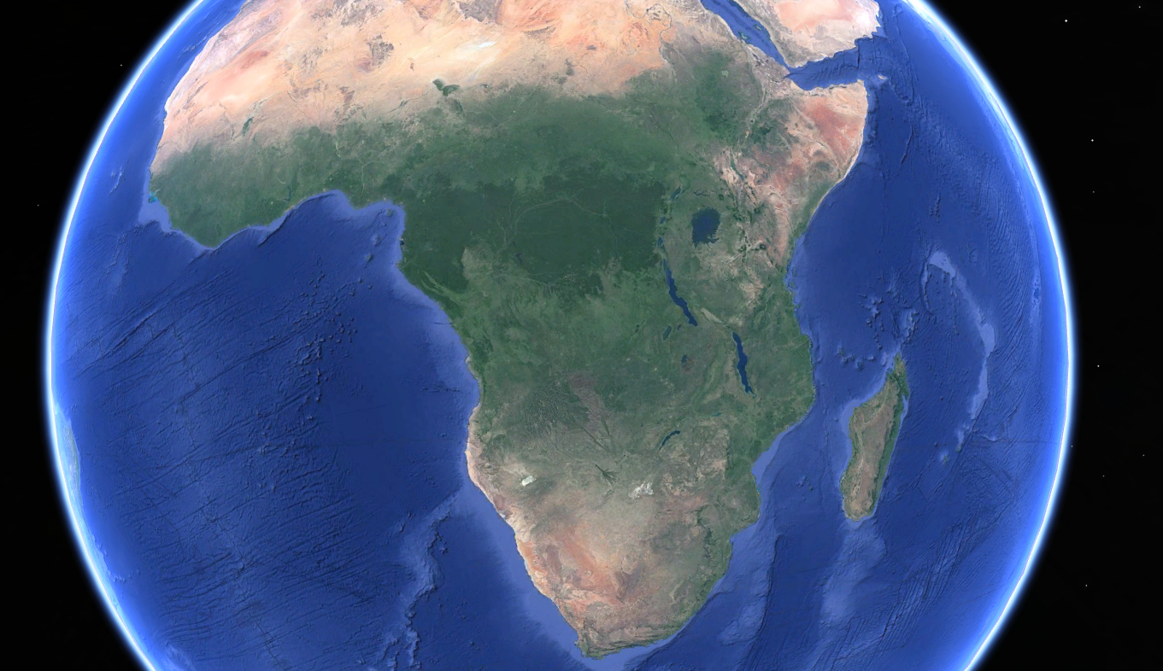

Slide 39
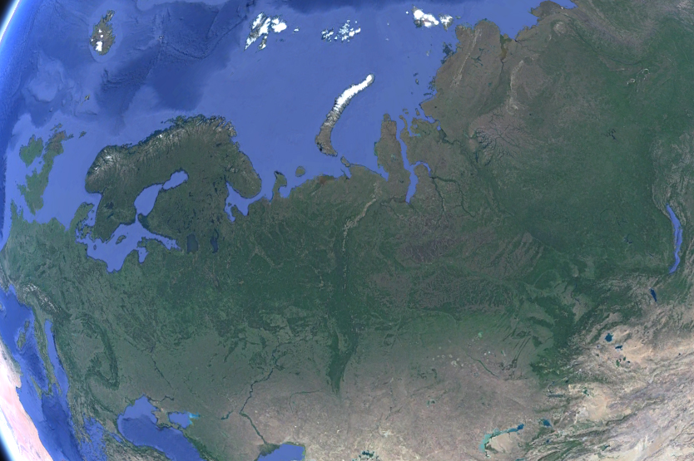
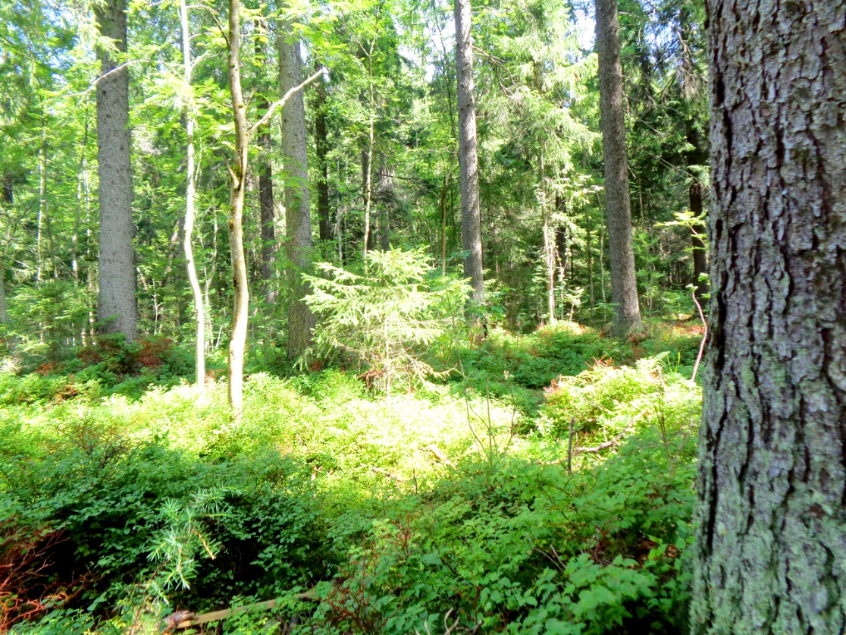

Slide 40
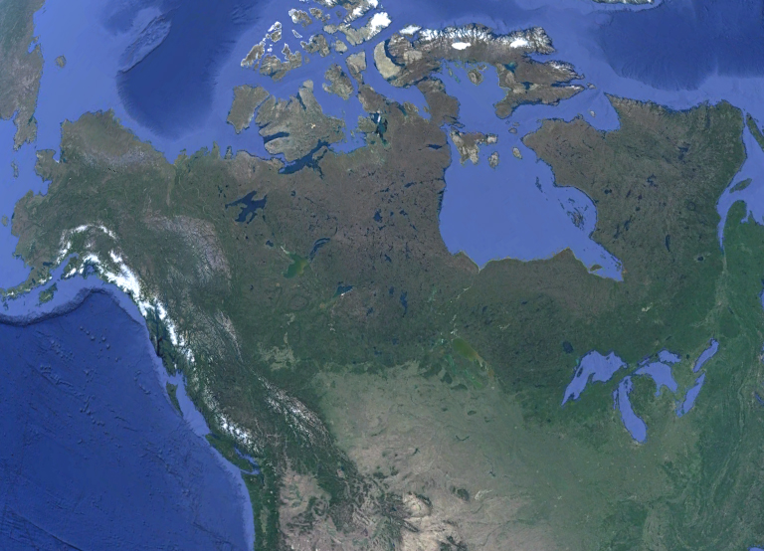

Slide 41
Parts of these natural forests may be transformed to continuous cover forests, which mean that the absorption of CO2 increases so that the CO2 level in the atmosphere can be further reduced. This transformation can be made without severely damaging the environmental conditions.
The analysis in this paper shows how to define an optimization problem with two objectives with different weights in the objective function. These objectives are the economic present value of profits and the utility of the climate.

Slide 42
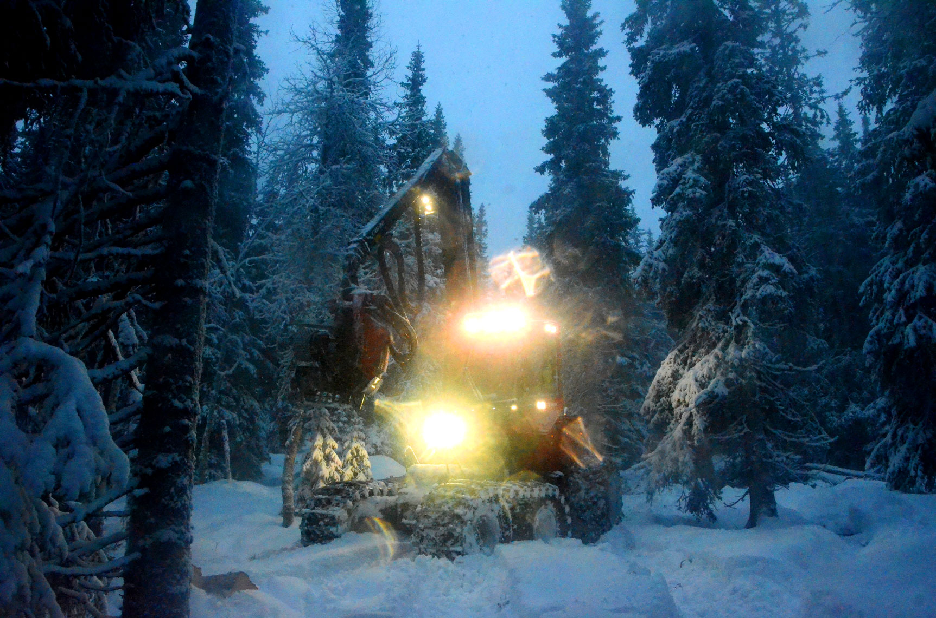
Continuous
cover
forest
harvesting
in the
Swedish
mountains,
December
2014

Slide 43
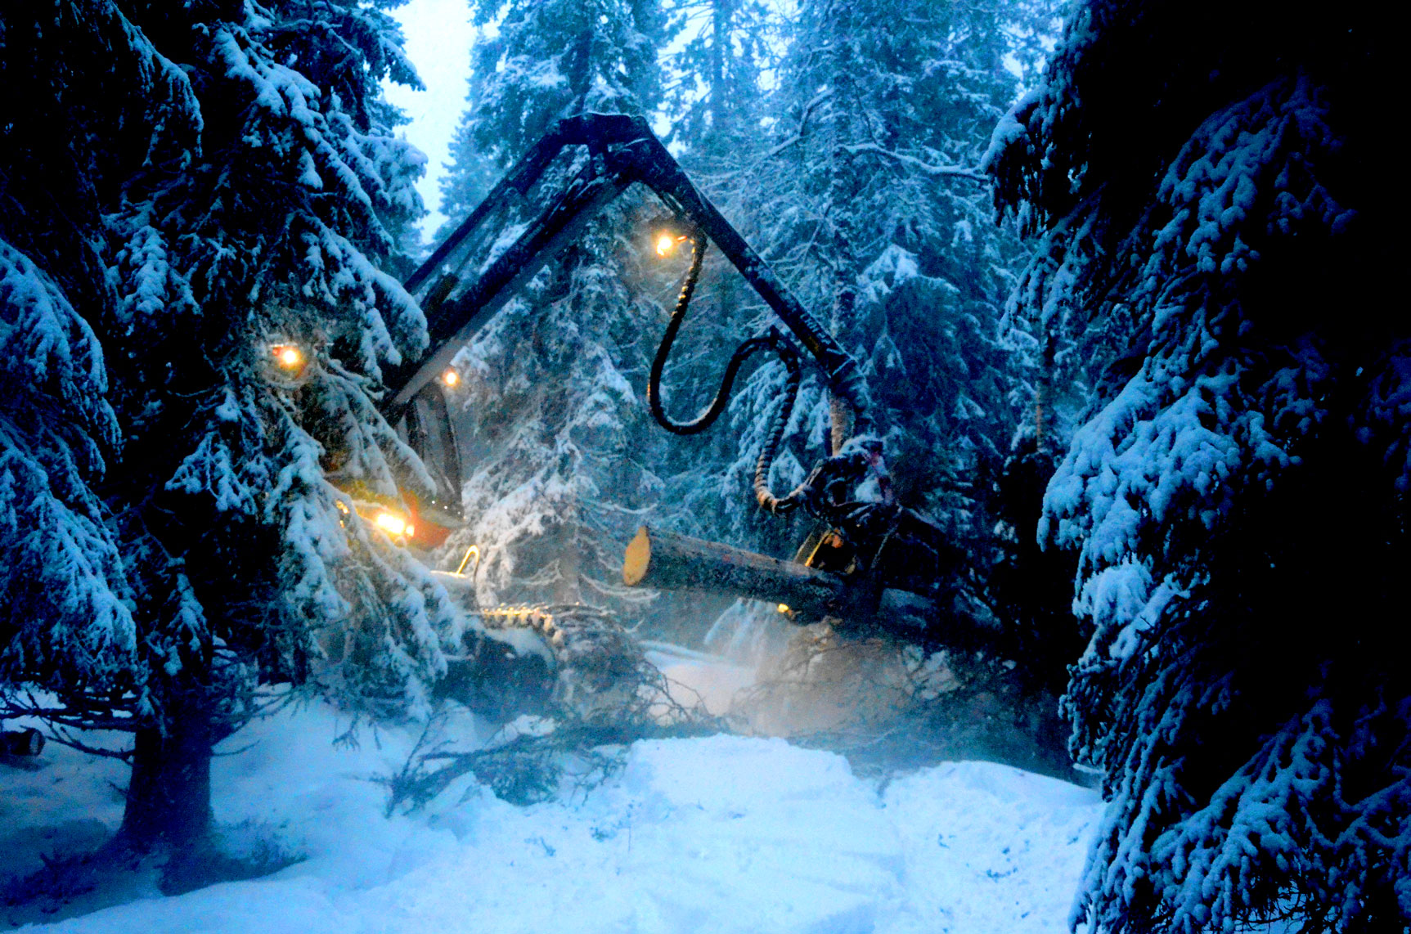

Slide 44
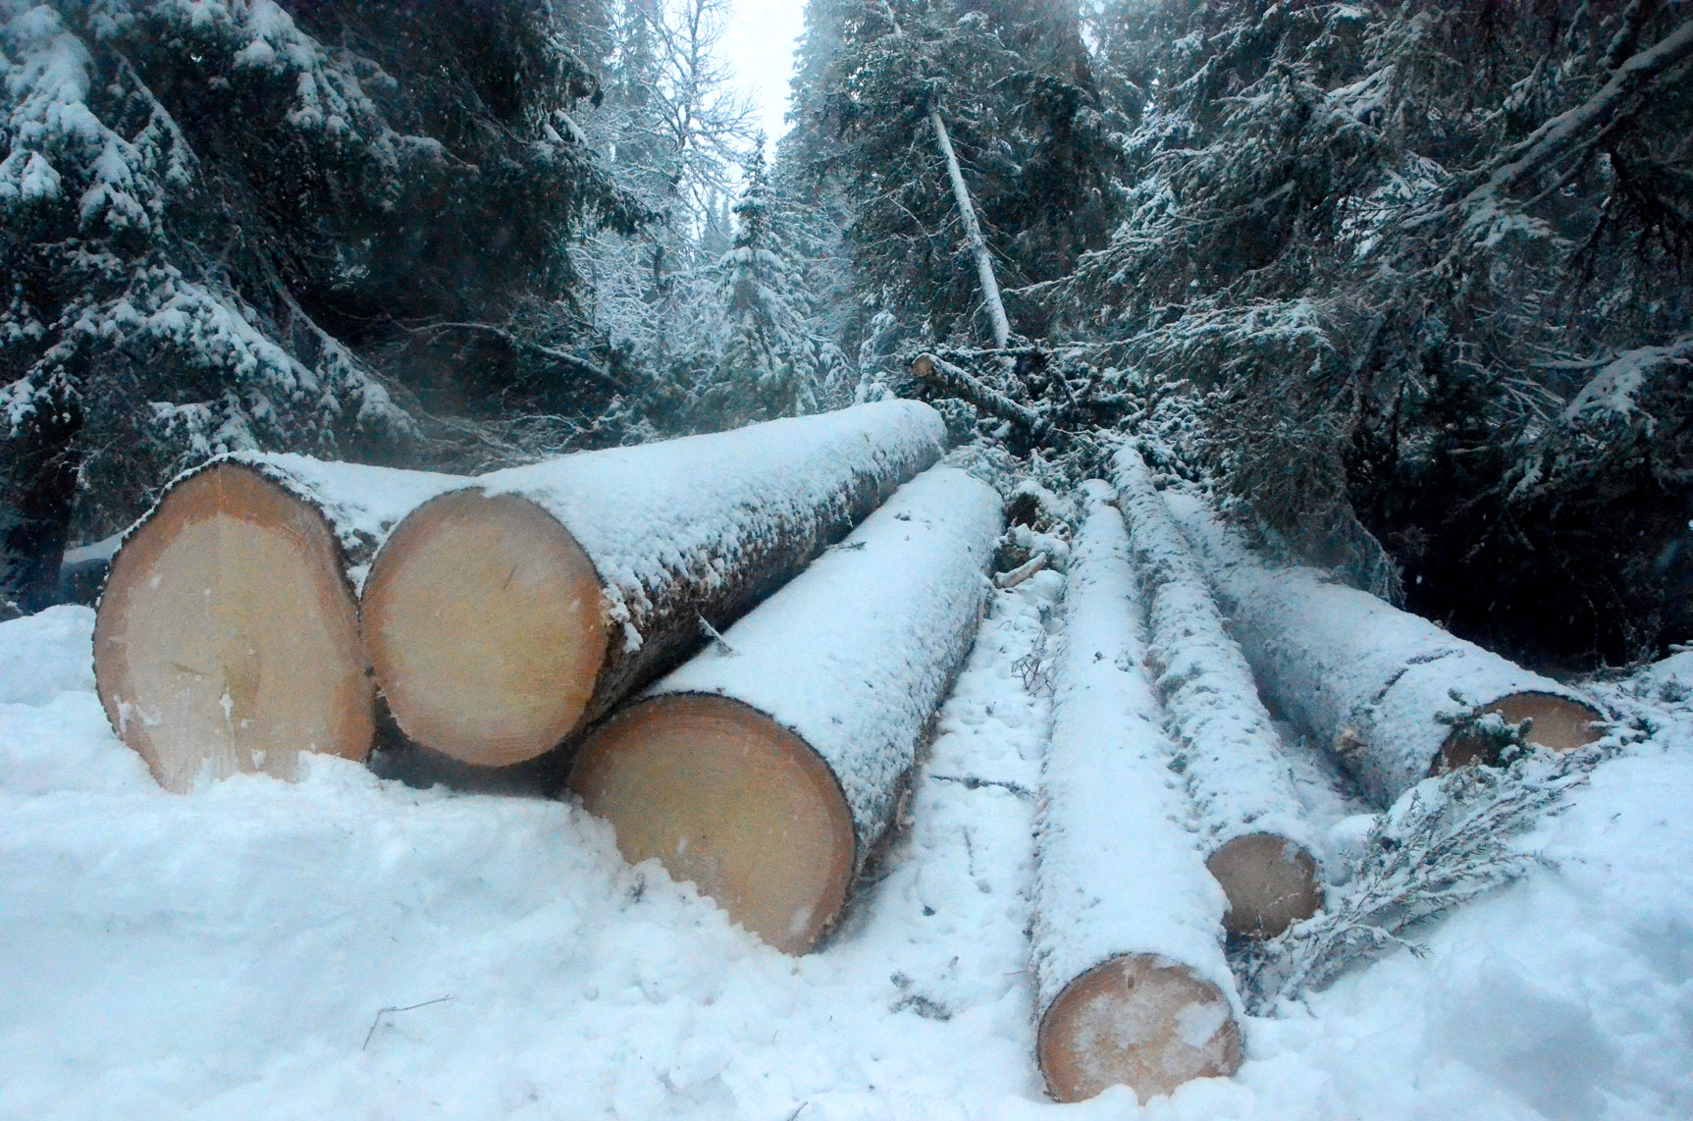

Slide 45
Multi objective optimization
Present value
of all profits

Slide 46
FOR y1 = 0 TO 10 STEP 0.1 (y1 = CCF area expansion per year)
FOR yt = 10 TO 60 STEP 0.1 (yt = number of years of CCF area expansion)
Determinations of the CO2 differential equation parameters and solutions
from year 2020 until 2100.
Derivations of forestry profits and forest dependent CO2 change during
80 years via the solution to the differential equation.
Selection of the optimal combination of y1 and yt based on the objective
function parameters.
NEXT yt
NEXT y1

Slide 47
Optimal
Total
Area
Expansion
(Mha)
kW

Slide 48
Optimal
time of
area
expansion
(Years)
kW

Slide 49
Optimal
area
expansion
per year
(Mha/year)
kW

Slide 50
Optimal
CO2 level in
year 2100
(ppm)
kW

Slide 51
PV
Present values of
optimal revenues,
costs and profits
(Relevant currency)
kW

Slide 52
PV
The frontier of optimal
combinations of the
present value of
total profits and
the CO2 level
in year 2100
(Relevant currency & ppm)
X(t=80) (ppm)

Slide 53
X (ppm)
The time path of
the CO2 level
(ppm) as a
function of
the time of
area expansion.
(years).
(In all three cases
in the graph,
the area expansion
per year is
10 Mha.)
0 years
30 years
60 years
Year
60 years
0 years
30 years

Slide 54
The analysis shows how the optimal transformation of natural forests to managed continuous cover forests is affected by the relative weights of the utility of the climate and of the present value of the profits.
If the relative weight of the utility of the climate increases, the optimal area of natural forests that should be transformed to managed continuous cover forests increases.

Slide 55
If 600 M hectares are transformed during 60 years,
from 2020 until 2080,
then the concentration of CO2 in the atmosphere
can be reduced by 8 ppm until the year 2100.

Slide 56
Conclusions
#5. Large areas of primary (natural) forests do not contribute very much to the net absorption of CO2. They may be transformed to CCF.
#6. Then, the absorption of CO2 increases and the CO2 level in the atmosphere can be reduced. This transformation can be made without severely damaging the environmental conditions.
#7. If the weight of the utility of the climate increases, the optimal area of natural forests that should be transformed to CCF increases.
#8. If 600 M hectares are transformed during 60 years, from 2020 until 2080, the CO2 level in the atmosphere is reduced by 8 ppm year 2100.

Slide 57
#5. is illustrated with a few pictures on the following slides. The complete open access article can be studied at any time.

Slide 60
#4. is illustrated with a few pictures on the following slides. The complete open access article can be studied at any time.

Slide 65
The complete open access article #6. can be studied later.

Slide 66
Global Stability via the Forced Global Warming Equation,
Fire Control with Joint Fire Fighting Resources, and Optimal Forestry (Edition 210330_1846)
KEYNOTE at ICASE 2021:
International Conference on Applied Science & Engineering,
March 31, 10.00 GMT.
Prof. Dr. Peter Lohmander
Peter@Lohmander.com

Slide 67
Contact details:
Prof. Dr. Peter Lohmander, Optimal Solutions, Hoppets Grand 6, SE-903 34 Umea, Sweden
Peter@Lohmander.com
Peter.Lohmander@icloud.com
http://www.lohmander.com/Information/Ref.htm

