Slide 1

APPLICATIONS AND MATHEMATICAL MODELING IN OPERATIONS RESEARCH
Version 160828
Peter Lohmander
Professor Dr., Optimal Solutions & Linnaeus University, Sweden www.Lohmander.com & Peter@Lohmander.com
Keynote presentation at:

Slide 2
APPLICATIONS AND MATHEMATICAL MODELING IN OPERATIONS RESEARCH
Peter Lohmander
Abstract
Theoretical understanding of the relevant problem structure and consistent mathematical modeling are necessary keys to formulating operations research models to be used for optimization of decisions in real applications.
The numbers of alternative models, methods and applications of operations research are very large.
This paper presents fundamental and general decision and information structures, theories and examples that can be expanded and modified in several directions.
The discussed methods and examples are motivated from the points of view of empirical relevance and computability.
Keywords: Operations Research, Mathematical Modeling, Optimization.

Slide 3
Introductory examples of important real world decision problems that can be developed to applications of operations research

Slide 5


Optimal oil extraction

Slide 6



Optimal
domestic
oil logistics

Slide 7
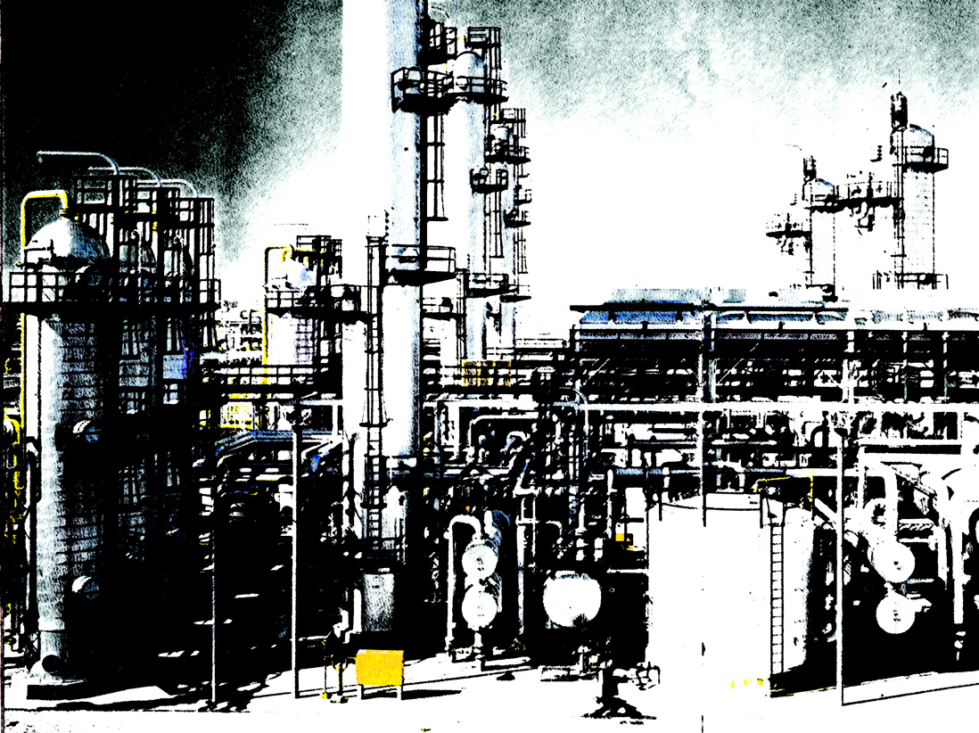
Optimal
oil
refining

Slide 8

Optimal international trade and
oil logistics

Slide 9





Optimal oil industry management

Slide 10
Introduction to mathematical modeling and operations research

Slide 11
Operations research is a very large area.
In this paper, we will focus on operations research in connection to optimization of decisions, with one or more decision maker(s).
The classical analytical methods of optimization and comparative statics analysis, basic economic theory and fundamental linear programming are well presented in Chiang [3].
[3] Chiang, A.C., Fundamental Methods of Mathematical Economics, McGraw-Hill, Inc., 2 ed., 1974

Slide 12
Mathematical modeling is central to operations research.
Usually, in applied problems, there are many different ways to define the mathematical models representing the components of the system under analysis.
The reference book of the software package LINGO [1] contains large numbers of alternative operations research models and applications with numerical solutions.
[1] Anon, LINGO, the Modeling Language and Optimizer, Lindo Systems Inc., Chicago, 2013

Slide 13
A particular applied problem should, if possible, be analyzed with a problem relevant operations research method, using a problem relevant set of mathematical models.
This may seem obvious to the reader, but
it is far from trivial to determine the problem relevant method and models.
The two books by Winston, references [16] and [17], give a good and rather complete presentation of most operations research methods, algorithms and typical applications.
[16] Winston, W.L., Operations Research, Applications and Algorithms, Thomson, Brooks/Cole, Belmont, USA, 2004
[17] Winston, W.L., Introduction to Probability Models, Operations Research: Volume two, Thomson, Brooks/Cole, Belmont, USA, 2004

Slide 14
The operations research literature contains large numbers of alternative methods and models, applied to very similar types of applied problems.
In many cases, the optimal decisions that are the results of the analyses, differ considerably.
For instance, if we want to determine the optimal decision in a particular problem, we may define it as a one dimensional optimization problem, or as a multidimensional problem where we simultaneously optimize several decisions that may be linked in different ways.

Slide 15
We may also consider constraints of different sorts.
In most problems, present decisions have consequences for the future development of the system under analysis.
Hence, multi period analysis is often relevant.

Slide 16
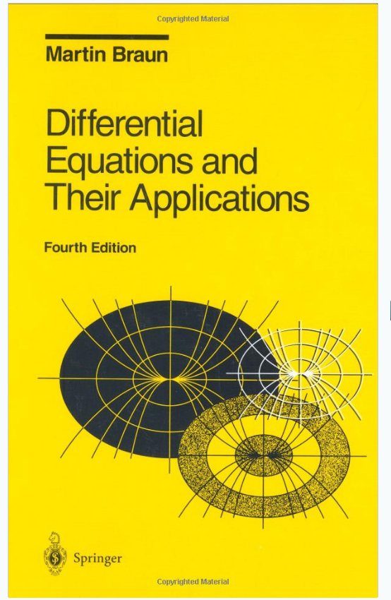
Many types of resources are continuously used, thanks to biological growth.
Braun [2] gives a very good presentation of ordinary differential equations, which is key to the understanding and modeling of dynamical systems, including biological resources of all kinds.
[2] Braun, M., Differential Equations and Their Applications, Springer-Verlag, Applied Mathematical Sciences 15, 3 ed., 1983

Slide 17
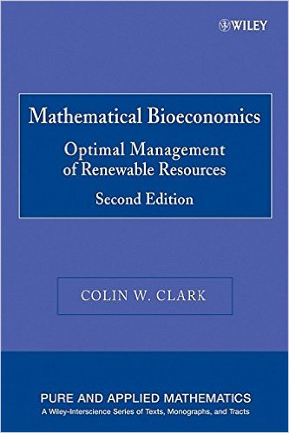
In agriculture, fishing, forestry, wildlife management and hunting, resources are used for many different purposes, including food, building materials, paper, energy and much more. In order to determine optimal present decisions in such industries, it is necessary to develop and use dynamic models that describe how the biological resources grow and how the growth is affected by present harvesting and other management decisions.
Clark [4] contains several examples and solutions of deterministic optimal control theory problems in natural resource sectors.

Slide 18

Weintraub et al [15] contains many dynamic operations research problems and solutions from different natural resource
sectors.
[15] Weintraub, A. et al., Handbook of Operations Research in Natural Resources, Springer, New York, 2007

Slide 19
Then, we realize that the future state of the world can change for several reasons.
In resource management problems, for instance, we often want to determine optimal present extraction of some resource, such as coal or oil.
If we take more today, we have to take less in the future.

Slide 20
The present and future prices are very important parameters in such decision problems and we usually have to agree that the future prices are not perfectly known today.
Price changes may occur because of technical innovations, political changes and many other reasons.
We simply have to accept that
future prices can never be perfectly predicted.
Hence, the
stochastic properties of prices have to be analyzed and used in the operations research studies in order to determine optimal present decisions.

Slide 22
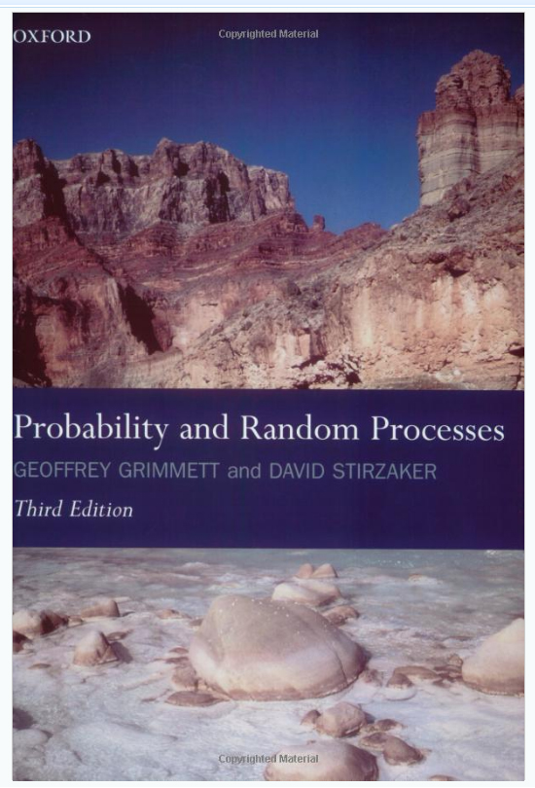
The degree of unexplained variation in the future state of the resource is often considerable. Many crops are sensitive to extreme rains, heat, floods, parasites and pests. Forests are sensitive to storms and hurricanes, fires etc..
Obviously, risk is of central importance to modeling and applied problem solving in these sectors.
Grimmet and Stirzaker [6] contains most of the important theory of probability and random processes.
[6] Grimmet, G.R., Stirzaker, D.R., Probability and Random Processes, Oxford University Press, New York, Reprint with corrections, 1985

Slide 23
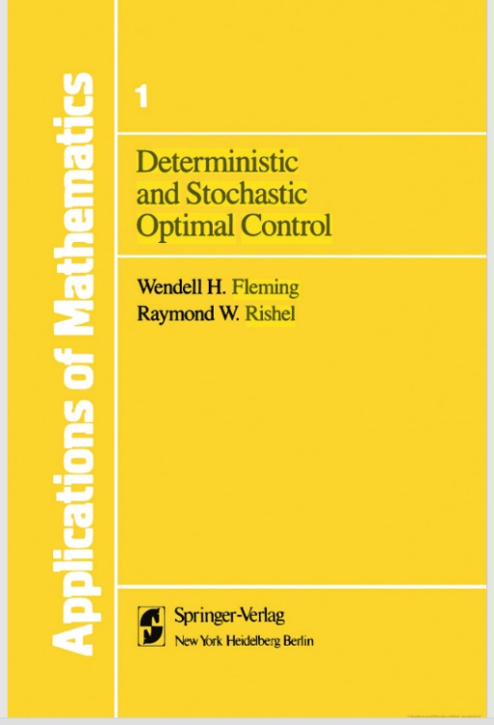
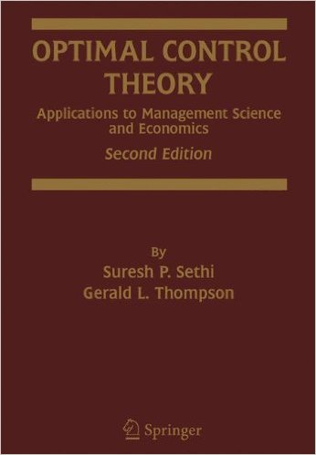
Fleming and Rishel [5] contains the general theory of deterministic and stochastic optimal control.
Sethi and Thompson [12] cover a field very similar to [5], but is more focused on applied derivations.
[5] Fleming, W.H., Rishel, R.W., Deterministic and Stochastic Optimal Control, Springer-Verlag, Applications of Mathematics, New York, 1975
[12] Sethi, S.P., Thompson, G.L., Optimal Control Theory, Applications to Management Science and Economics, 2 ed., Kluwer Academic Publishers, 2000

Slide 24

Lohmander [8] and [9] shows how dynamic and stochastic management decisions can be optimized with different methods, including different versions of stochastic dynamic programming.
[8] Lohmander, P., Optimal sequential forestry decisions under risk, Annals of Operations Research, Vol. 95, pp. 217-228, 2000
[9] Lohmander, P., Adaptive Optimization of Forest Management in a Stochastic World, in Weintraub A. et al (Editors), Handbook of Operations Research in Natural Resources, Springer, Springer Science, International Series in Operations Research and Management Science, New York, USA, pp 525-544, 2007

Slide 26
Stochastic dynamic programming
A very flexible method for optimization of decisions over time
under the influence of exogenous stochastic processes

Slide 27
Lohmander [10] develops methodology for optimization of large scale energy production under risk, using stochastic dynamic programming with a quadratic programming subroutine.
[10] Lohmander, P., Optimal adaptive stochastic control of large scale energy production under the influence of market risk, KEYNOTE at the: 9th International Conference of the Iranian Society of Operations Research, IORC 2016, Shiraz University of Technology, Iran, April 27-30, 2016
http://www.Lohmander.com/PL_Shiraz_KEYNOTE_16.pdf &
http://www.Lohmander.com/PL_Shiraz_KEYNOTE_Paper_16.pdf

Slide 28







Inclusion of:
Linear and quadratic programming
sub problems
File = PL_OptOil_cases 160219, OptOil Cases, Peter Lohmander 2016-02-19

Slide 29
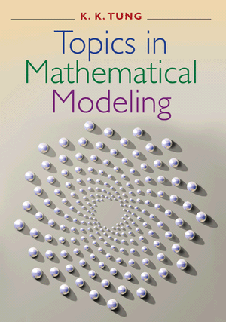
Deterministic systems are not necessarily predictable.
Tung [13] is a fantastic book that contains many kinds of mathematical modeling topics and applications, including modern chaos theory and examples. Such theories and methods are also relevant to rational decision making in resource management problems.
[13] Tung, K.K., Topics in Mathematical Modeling, Princeton University Press, Princeton, 2007

Slide 30
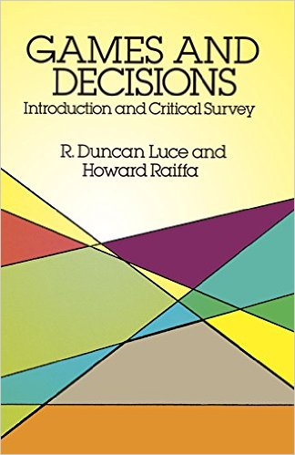
In reality, we often find many decision makers that all influence the development of the same system. In such cases, we can model this situation using game theory. Luce and Raiffa [11] gives a very good coverage of the classical field.
[11] Luce, R.D., Raiffa, H., Games and Decisions, Introduction and Critical Survey, (First published 1957), Dover Books on Mathematics, Dover Publications, Inc., New York, 1989

Slide 31
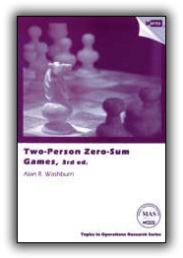
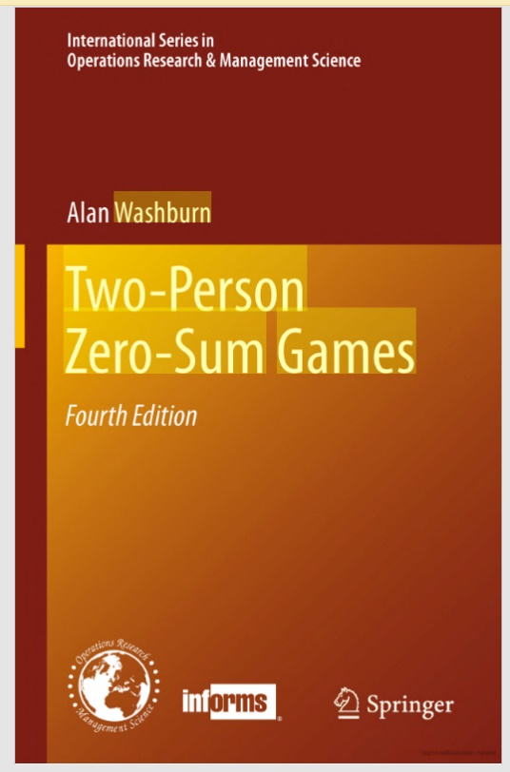
In games without cooperation, the Nash equilibrium theory is very useful.
Each player maximizes his/her own objective given that the other player maximizes his/her objective. Washburn [14] focuses on such games and the important and often quite relevant subset “two person zero sum games”. In such games, linear programming finds many relevant applications.
[14] Washburn, A.R., Two-Person Zero-Sum Games, 3 ed., INFORMS, Topics in Operations Research Series, 2003

Slide 32
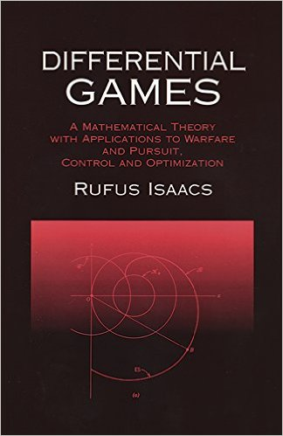
Isaacs [7] describes and analyses several games of this nature, but in continuous time, with the method differential games. This manuscript could have been expanded in the direction of dynamic and stochastic games.
[7] Isaacs, R., Differential Games, A Mathematical Theory with Applications to Warfare and Pursuit, Control and Optimization, (First published 1965), Dover Publications, Inc., New York, 1999

Slide 33
Isaacs (1965) analyses many alternative differential game models.
One central version of these models is called “The war of attrition and attack”.

Slide 34
In the “attrition and attack” problem, the objective function is linear in the decision variables and time is continuous.
The optimal control decisions become “bang-bang” (0 or 1), which means and the differential equations governing the state variables become very simple. Explicit solutions are easily obtained.
With alternative nonlinear specifications of the objective function, the optimal decisions may become continuous nonlinear functions.
Then, explicit solutions may no longer be obtained from the differential equation system.

Slide 35
Stochastic dynamic games with arbitrary functions, with and without mixed strategies
Lohmander, P., A Stochastic Differential (Difference) Game Model With an LP Subroutine for Mixed and Pure Strategy Optimization, INFORMS International Meeting 2007, Puerto Rico, 2007 http://www.Lohmander.com/SDG.ppt

Slide 36
Let us conclude this section with the finding that:
Mathematical modeling in operations research is a rich field with an almost unlimited number of applications.

Slide 37
Alternative methods
and properties

Slide 39
In case we have a linear objective function, such as the total profit,
, we may express that as (2).

Slide 40
Linear programming is a relevant optimization method if we want to maximize (2) subject to (1).
The simplex algorithm will give the optimal solution in a finite number of iterations.

Slide 41
In many applied problems, such as production optimization problems, it is also important to be able to handle the fact that market prices often are decreasing functions of the produced and sold quantities of different products.
Furthermore, the production volume of one product may affect the prices of other products, the marginal production costs of different products may be linked and so on.
Then, the objective function of the company may be approximated as a quadratic function (3).

Slide 42
(Note that (3) may be further simplified.)

Slide 43
With a quadratic objective function and linear constraints, we have a quadratic programming problem (4). Efficient quadratic programming computer codes are available, that have several similarities to the simplex algorithm for linear programming.
The Kuhn-Tucker conditions can be considered as linear constraints and in [16] and [1], many such examples are solved.
[16] Winston, W.L., Operations Research, Applications and Algorithms, Thomson, Brooks/Cole, Belmont, USA, 2004
[1] Anon, LINGO, the Modeling Language and Optimizer, Lindo Systems Inc., Chicago, 2013

Slide 44
Quadratic programming

Slide 45
In real applications, we are often interested to handle the sequential nature of information.
Market prices usually have to be regarded as partially stochastic.
We may influence the price level via our production and sales volumes.
Still, there is usually a considerable price variation outside the control of the producer.
Then, we can optimize our decisions via stochastic dynamic programming, as shown in the example in (5) and (6).

Slide 49
With the stochastic dynamic programming method as a general tool, we may again consider the detailed production and/or logistics problem (4).
Now, we can solve many such problems, (4), as sub problems, within the general stochastic dynamic programming formulation (5), (6). Hence, for each state and stage, we solve the relevant sub problems.

Slide 50
Now, the capacity levels (7) may be defined as functions of the control decisions, time, the remaining reserve and the market state.

Slide 51
Furthermore, all other “parameters”, may be considered as functions, as described in (8), (9) and (10).

Slide 52
As a result, we may describe the sub problems as (11) or even as (12).

Slide 53
Now, we include the sub problems in the stochastic dynamic programming recursion equation (13).
A problem of this kind is defined and numerically solved using LINGO software [1] by Lohmander [10].

Slide 54
Optimal oil industry management

Slide 55
EXAMPLE SOLUTION FROM LOHMANDER (2016):
Price is stochastic and partly endogenous.
p = 30+(m-5)-h
There is only one product: Crude oil.
There are no production constraints.
Optimal decisions:
The optimal extraction level is an increasing function of the state of the market and of the size of the remaining reserve.

Slide 56
Optimal extraction levels
Year = 0
Reserve = 0 1 2 3 4 5 6 7 8 9 10
Market = 1 0 0 0 0 0 1 1 1 1 1 2
Market = 2 0 0 0 0 1 1 1 1 2 2 2
Market = 3 0 0 0 1 1 1 2 2 2 2 2
Market = 4 0 0 1 1 1 2 2 2 2 3 3
Market = 5 0 1 1 1 2 2 2 3 3 3 3
Market = 6 0 1 1 2 2 2 3 3 3 3 4
Market = 7 0 1 2 2 2 3 3 3 4 4 4
Market = 8 0 1 2 2 3 3 3 4 4 4 4
Market = 9 0 1 2 3 3 3 4 4 4 5 5

Slide 57
Optimal expected present values
Year = 0
Reserve = 0 1 2 3 4 5 6 7 8 9 10
Market = 1 0 28 55 81 107 132 157 181 205 228 251
Market = 2 0 28 55 81 107 133 158 182 206 230 253
Market = 3 0 28 55 82 108 134 159 184 208 232 255
Market = 4 0 28 56 83 109 135 161 186 210 234 258
Market = 5 0 29 57 84 111 137 163 188 213 237 261
Market = 6 0 30 58 86 113 139 165 191 216 240 264
Market = 7 0 31 60 88 115 142 168 194 219 244 268
Market = 8 0 32 62 90 118 145 171 197 223 248 272
Market = 9 0 33 64 93 121 148 175 201 227 252 277

Slide 58
Observe that (13) represents a very general and flexible way to formulate and solve applied stochastic multi period production and logistics problems of many kinds.
The true sequential nature of decisions and information is explicitly handled, stochastic market prices and very large numbers of decision variables and constraints may be consistently considered.
Furthermore, many other stochastic phenomena may be consistently handled with this approach.
Several examples of how different kinds of stochastic disturbances may be included in optimal dynamic decisions are found in Lohmander [8] and [9].

Slide 59
SEVERAL DECISION MAKERS

Slide 61
Towards stochastic dynamic game models
We may develop and analyze constant sum games in a similar way as the earlier discussed problems, via the stochastic dynamic programming framework.
In (15) and (16), one player maximizes and one player minimizes the value of the game.

Slide 65
Note that the specification of the structure described by (15) and (16) can be adjusted to specific applications.
This structure can be regarded as a generalization of many problems in [7] and [14].

Slide 67
ON COMPUTATION AND THE LEVEL OF DETAIL
Linear or quadratic programming as a tool in the sub problems makes this possible.
Furthermore, the stochastic dynamic main program can provide solutions with almost unlimited resolution in the time dimension.
The recursive structure of problem solving does not make it necessary to store all results in the internal memory.
Of course, computation time increases with resolution.

Slide 68
In simple situations, continuous time versions of dynamic game problems can be defined as differential games, as reported by Isaacs [7].

Slide 69
With a higher level of detail, we usually have to use discrete time and state space. Several interesting discrete examples are found in Washburn [14].
Washburn writes (citation):
”- It is a curious fact that in no case is a mixed strategy ever needed; in fact, in all cases each player assigns either all or none of his air force to GS.” (end of citation)
The objective function used by Washburn is linear and there are no synergy effects. Compare the later derivations in this presentation.

Slide 70
Stochastic dynamic games with arbitrary functions, with and without mixed strategies
Lohmander, P., A Stochastic Differential (Difference) Game Model With an LP Subroutine for Mixed and Pure Strategy Optimization, INFORMS International Meeting 2007, Puerto Rico, 2007 http://www.Lohmander.com/SDG.ppt

Slide 71
Stochastic dynamic games with arbitrary functions, with and without mixed strategies
?
Lohmander, P., A Stochastic Differential (Difference) Game Model With an LP Subroutine for Mixed and Pure Strategy Optimization, INFORMS International Meeting 2007, Puerto Rico, 2007 http://www.Lohmander.com/SDG.ppt

Slide 72
New proof that mixed strategy Nash equilibria exist
in multi period constant sum games when the payoff
function has nonzero synergy effects

Slide 73
0
1
0
1

Slide 74
1
0
1
0

Slide 75
0
1
0
1

Slide 76
0
1
0
1

Slide 77
Probabilities:

Slide 79
In Nash equilibrium:

Slide 80
Nash Equilibrium:

Slide 81
Nash Equilibrium:

Slide 82
Finding:
Mixed strategy Nash equilibria exist in multi period constant sum games when the payoff function has nonzero synergy effects

Slide 83
Examples from Lohmander (2007)

Slide 84
Model 3; (x,y,t) = (2,2,T-1)
 | GS2 = 0 CA2 = 2 | GS2 = 1 CA2 = 1 | GS2 = 2 CA2 = 0
GS1 = 0 CA1 = 2 | 3/2*(0-0) + 0 = 0 | 3/2*(0 – (5/3)/(1+4)) + 0.25*(0) + 0.75*(+1) = 0.25 | 3/2*(0 – (5/3)*2/(1+4)) + 0.25*(0) + 0.5*(1) + 0.25*(2) = 0
GS1 = 1 CA1 = 1 | 3/2*(1/(1+4)-0) + 0.25*(0) + 0.75*(-1) = -0.45 | 3/2*(1/(1+1) – (5/3)/(1+1)) + 0.5*(0)+0.25*(1) + 0.25*(-1) = -0.5 | 3/2*(1/(1+0) – (5/3)*2/(1+1)) + 0.5*(0) + 0.5*(1) = -0.5
GS1 = 2 CA1 = 0 | 3/2*(4/(1+4) – 0) + 0.25*(0) + 0.5*(-1) + 0.25*(-2) = 0.2 | 3/2*(4/(1+1) – (5/3)/(1+0)) + 0.5*(0) + 0.5*(-1) = 0 | 3/2*(4/(1+0)-(5/3)*2/(1+0)) + 0 = 1

Slide 85
Model 3; (x,y,t) = (2,2,T-1)
 | GS2 = 0 CA2 = 2 | GS2 = 1 CA2 = 1 | GS2 = 2 CA2 = 0
GS1 = 0 CA1 = 2 | 0 | 0.25 | 0
GS1 = 1 CA1 = 1 | -0.45 | -0.5 | -0.5
GS1 = 2 CA1 = 0 | 0.2 | 0 | 1

Slide 90
EXAMPLES from Lohmander (2007):
(GS1*, GS2*) at n=3 with Model 4
(0,2) | (0,2) | (0,0) Prob = .6666667 * .1515152 = .101010 (2,0) Prob = .3333333 * .1515152 = .050505 (0,1) Prob = .6666667 * .8484849 = .565657 (2,1) Prob = .3333333 * .8484849 = .282828 Sum = 1.000000
(0,1) | (0,1) | (2,0)
(0,0) | (1,0) | (2,0)

Slide 91
Detailed study of optimal strategies:
Optimal strategies with Model 3
(In Model 3, future results are not discounted. d = 1)
P1:
P2:
Strategy | Probability
Full CA | 0.4444444
Full GS | 0.5555556
Strategy | Probability
Full CA | 0.5555556
50% CA & 50% GS | 0.4444444

Slide 92
Detailed study of optimal strategies:
Optimal strategies with Model 4
(In Model 3, future results are not discounted. d = 0.85)
P1:
P2:
Strategy | Probability
Full CA | 2/3
Full GS | 1/3
Strategy | Probability
Full CA | 0.1515152
50% CA & 50% GS | 0.8484848

Slide 93
When the importance of instant results in relation to future results increases (= when the discounting of future results increases from 0 to 15%):
P1 increases the probability of instant full CA.
P1 decreases the probability of instant GS.
P2 decreases the probability of instant full CA.
P2 increases the probability of partial CA and partial GS.

Slide 94
Observations:
Even in case there is just one more period of conflict ahead of us and even if the participants only have two units available per participant, we find that the optimal strategies are mixed.
The optimal decision frequencies are affected by the result discounting.
The different participants should optimally change the strategies in qualitatively different ways when the degree of discounting changes.

Slide 95
Observations cont.:
Differential games in continuous time can not describe these mixed strategies.
Furthermore, even if we would replace deterministic differential games in continuous time by “stochastic differential games” based on stochastic differential equations in continuous time, this would not capture the real situation, since the optimal frequencies are results of the scales of missions.
Two resource units used during one time interval will not give the same result as one resource unit during two time intervals.

Slide 96
Isaacs (1965), in section 5.4, The war of attrition and attack:
“The realistic execution of the strategies would comprise of a series of discrete decisions. But we shall smooth matters into a continuous process. Such is certainly no farther from truth than our assumptions and therefore can be expected to be as reliable as a stepped model. It is also more facile to handle and yields general results more readily.”

Slide 97
Isaacs (1965), page 66:
”Similarily, except possibly on singular surfaces, the optimal strategies will be continuous functions denoted by ... when they are unique; when they are not, we shall often assume such continuous functions can be selected.”
Observation (Lohmander):
With economies of scale in operations, the optimal strategies will usually not be continuous functions.

Slide 98
Isaacs (1965) obtains differential equations that describe the optimal decisions over time by the two participants:
The system moves according to these equations:

Slide 99
The objective function in Isaacs (1965) is linear in the decision variables and time is continuous:

Slide 100
There is no reason to expect that the Isaacs (1965) model would lead to mixed strategies.
The objective function is linear.
Furthermore there are no scale effects in the “dynamic transition”.
There are no synergy effects in the objective function.

Slide 101
An analogy to optimal control:
The following observations are typical when optimal management of natural resources is investigated:
If the product price is a constant or a decreasing function of the production and sales volume and if the cost of extraction is a strictly convex function of the extraction volume, the objective function is strictly concave in the production volume. Then we obtain a smooth differentiable optimal time path of the resource stock.
However, if the extraction cost is concave, which is sometimes the case if you have considerable set up costs or other scale advantages, then the optimal strategy is usually “pulse harvesting”. In this case, the objective function that we are maximizing is convex in the decision variable. The optimal stock level path then becomes non differentiable.

Slide 102
Technology differences:
The reason why the two participants should make different decisions with different strategies is that they have different “GS-technologies”. These technologies have different degree of convexity of results with respect to the amount of resources used.
Such differences are typical in real conflicts. They are caused by differences in equipment and applied methods. Of course, in most cases we can expect that the applied methods are adapted to the equipment and other relevant conditions.

Slide 103
Conclusions (from Lohmander (2007):
This paper presents a stochastic two person differential (difference) game model with a linear programming subroutine that is used to optimize pure and/or mixed strategies as a function of state and time.
In ”classical dynamic models”, ”pure strategies” are often assumed to be optimal and deterministic continuous path equations can be derived. In such models, scale and timing effects in operations are however usually not considered.
When ”strictly convex scale effects” in operations with defence and attack (”counter air” or ”ground support”) are taken into consideration, dynamic mixed OR pure strategies are optimal in different states.
The optimal decision frequences are also functions of the relative importance of the results from operations in different periods.
The expected cost of forcing one participant in the conflict to use only pure strategies is determined.
The optimal responses of the opposition in case one participant in the conflict is forced to use only pure strategies are calculated.
Dynamic models of the presented type, that include mixed strategies, are highly relevant and must be used to determine the optimal strategies. Otherwise, considerable and quite unnecessary losses should be expected.

Slide 104
GENERAL CONCLUSIONS
Operations research contains a large number of alternative approaches.
With logically consistent mathematical modeling, relevant method selection and good empirical data, the best possible decisions can be obtained.
This paper has presented arguments for using some particular combinations of methods that often are empirically motivated and computationally feasible.
ACKNOWLEDGEMENTS. My thanks go to Professor Hadi Nasseri for kind, rational and clever suggestions.

Slide 105
APPLICATIONS AND MATHEMATICAL MODELING IN OPERATIONS RESEARCH
Version 160825
Peter Lohmander
Professor Dr., Optimal Solutions & Linnaeus University, Sweden www.Lohmander.com & Peter@Lohmander.com
Keynote presentation at:

