Slide 1

Optimal Deployment by
Peter Lohmander
ICSTC-2024
Tenth International Conference on Statistics for the Twenty-First Century
December 13 - 16, 2024, Special Invited Talk.
Organized by International Statistics Fraternity (ISF) in collaboration with the Department of Statistics, University of Kerala and School of Physical and Mathematical Sciences at the University of Kerala and the American Statistical Association.
Version 241211_1448
Peter Lohmander
Prof Dr
Peter Lohmander Optimal Solutions, Sweden

Slide 2
Lohmander, P., Optimal Deployment, December 13 - 16, 2024, Special Invited Talk, ICSTC-2024, Tenth International Conference on Statistics for the Twenty-First Century.
Abstract
This study focuses on the optimal deployment problem, and determines the optimal size of a military force to send to the battle field. The decision is optimized, based on an objective function, that considers the cost of deployment, the cost of the time it takes to win the battle, and the costs of killed and wounded soldiers with equipment. The cost of deployment is modeled as an explicit function of the number of deployed troops and the value of a victory with access to a free territory, is modeled as a function of the length of the time it takes to win the battle. The cost of lost troops and equipment, is a function of the size of the reduction of these lives and resources. An objective function, based on these values and costs, is optimized, under different parameter assumptions. The battle dynamics is modeled via the Lanchester differential equation system based on the principles of directed fire. First, the deterministic problem is solved analytically, via derivations and comparative statics analysis. General mathematical results are reported, including the directions of changes of the optimal deployment decisions, under the influence of alternative types of parameter changes. Then, the first order optimum condition from the analytical model, in combination with numerically specified parameter values, is used to determine optimal values of the levels of deployment in different situations. A concrete numerical case, based on documented facts from the Battle of Iwo Jima, during WW II, is analyzed, and the optimal US deployment decisions are determined under different assumptions. The known attrition coefficients of both armies, from USA and Japan, and the initial size of the Japanese force, are parameters. The analysis is also based on some parameters without empirical documentation, that are necessary to include to make optimization possible. These parameter values are motivated in the text. The optimal solutions are found via Newton- Raphson iteration. Finally, a stochastic version of the optimal deployment problem is defined. The attrition parameters are considered as stochastic, before the deployment decisions have been made. The attrition parameters of the two armies have the same expected values as in the deterministic analysis, are independent of each other, have correlation zero, and have relative standard deviations of 20%. All possible deployment decisions, with 5000 units intervals, from 0 to 150000 troops, are investigated, and the optimal decisions are selected. The analytical, and the two numerical, methods, all show that the optimal deployment level is a decreasing function of the marginal deployment cost, an increasing function of the marginal cost of the time to win the battle, an increasing function of the marginal cost of killed and wounded soldiers and lost equipment, an increasing function of the initial size of the opposing army, an increasing function of the efficiency of the soldiers in the opposing army and a decreasing function of the efficiency of the soldiers in the deployed army. With stochastic attrition parameters, the stochastic model also shows that the probability to win the battle is an increasing function of the size of the deployed army. When the optimal deployment level is selected, the probability of a victory is usually less than 100%, since it would be too expensive to guarantee a victory with 100% probability.

Slide 3
This study focuses on the optimal deployment problem, and determines the optimal size of a military force to send to the battle field.
The decision is optimized, based on an objective function, that considers the cost of deployment,
the cost of the time it takes to win the battle, and
the costs of killed and wounded soldiers with equipment.
The cost of deployment is modeled as an explicit function of the number of deployed troops and the value of a victory with access to a free territory, is modeled as a function of the length of the time it takes to win the battle. The cost of lost troops and equipment, is a function of the size of the reduction of these lives and resources.

Slide 4
An objective function, based on these values and costs, is optimized, under different parameter assumptions.
The battle dynamics is modeled via the Lanchester differential equation system based on the principles of directed fire.
First, the deterministic problem is solved analytically, via derivations and comparative statics analysis. General mathematical results are reported, including the directions of changes of the optimal deployment decisions, under the influence of alternative types of parameter changes.
Then, the first order optimum condition from the analytical model, in combination with numerically specified parameter values, is used to determine optimal values of the levels of deployment in different situations.

Slide 5
A concrete numerical case, based on documented facts from the Battle of Iwo Jima, during WW II, is analyzed, and the optimal US deployment decisions are determined under different assumptions.
The known attrition coefficients of both armies, from USA and Japan, and the initial size of the Japanese force, are parameters. The analysis is also based on some parameters without empirical documentation, that are necessary to include to make optimization possible. These parameter values are motivated in the text.
The optimal solutions are found via Newton- Raphson iteration.

Slide 6
Finally, a stochastic version of the optimal deployment problem is defined. The attrition parameters are considered as stochastic, before the deployment decisions have been made.
The attrition parameters of the two armies have the same expected values as in the deterministic analysis, are independent of each other, have correlation zero, and have relative standard deviations of 20%.
All possible deployment decisions, with 5000 units intervals, from 0 to 150000 troops, are investigated, and the optimal decisions are selected.

Slide 7
Background information:
Lohmander, P., Attrition coefficient estimations via differential equation systems, initial and
terminal conditions, and nonlinear iterative equation system solutions,
WSTA-2024, Recent Trends in Statistical Theory and Applications-2024 (WSTA-2024)
June 29 – July 02, 2024, Invited Talk.
Organized by the Department of Statistics, School of Physical and
Mathematical Sciences, University of Kerala, Trivandrum in association
with Indian Society for Probability and Statistics (ISPS) and Kerala Statistical Association (KSA).
http://www.Lohmander.com/PL_WSTA_2024.pdf
http://www.Lohmander.com/PL_WSTA_2024.pptx
Lohmander, P., Attrition coefficient estimations via differential equation systems, initial and
terminal conditions, and nonlinear iterative equation system solutions,
Journal of Statistics and Computer Science, Vol. 3, Issue 1, 2024, pp. 51-78.
https://www.arfjournals.com/jscs/issue/322
https://www.arfjournals.com/image/catalog/Journals%20Papers/JSCS/2024/No%201%20(2024)/ART_4.pdf
Lohmander, P. Optimal Deployment. Preprints 2024, 2024021265.
https://doi.org/10.20944/preprints202402.1265.v1
https://www.preprints.org/manuscript/202402.1265/v1/download

Slide 8
The Lanchester differential equations:

Slide 9
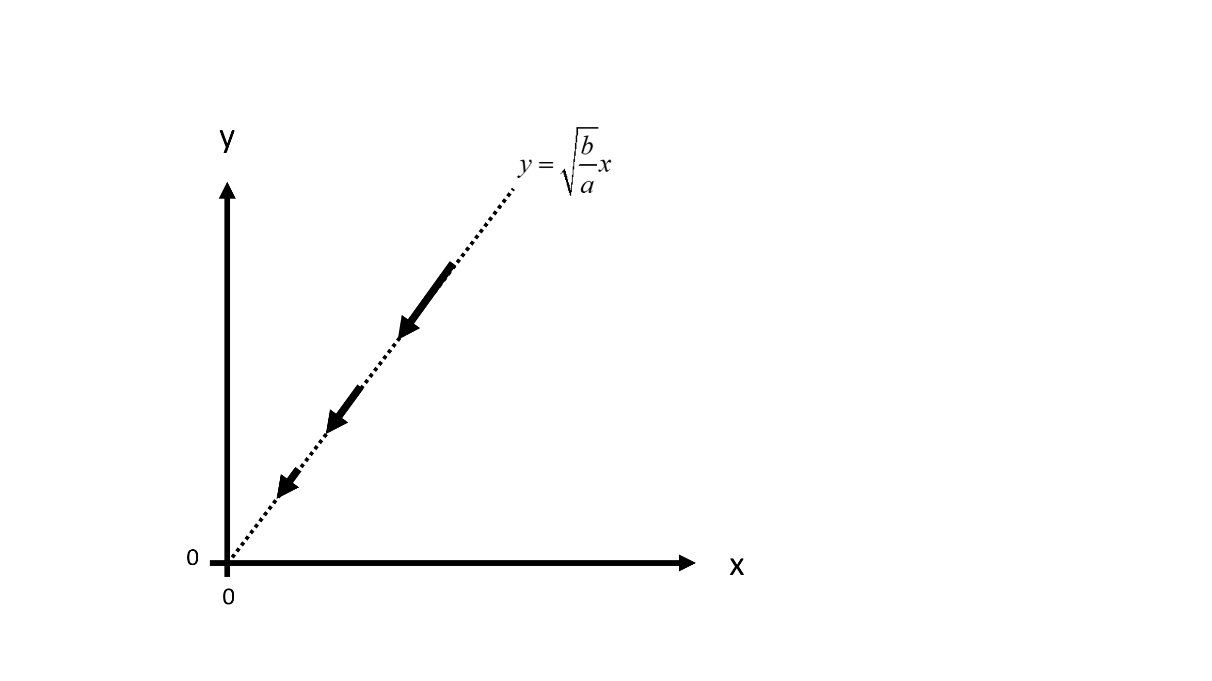
Figure 1.
The time path of (x, y) in the special case, when bx²=ay².
Why is that the case?

Slide 11
y
x

Slide 13
y
x

Slide 14
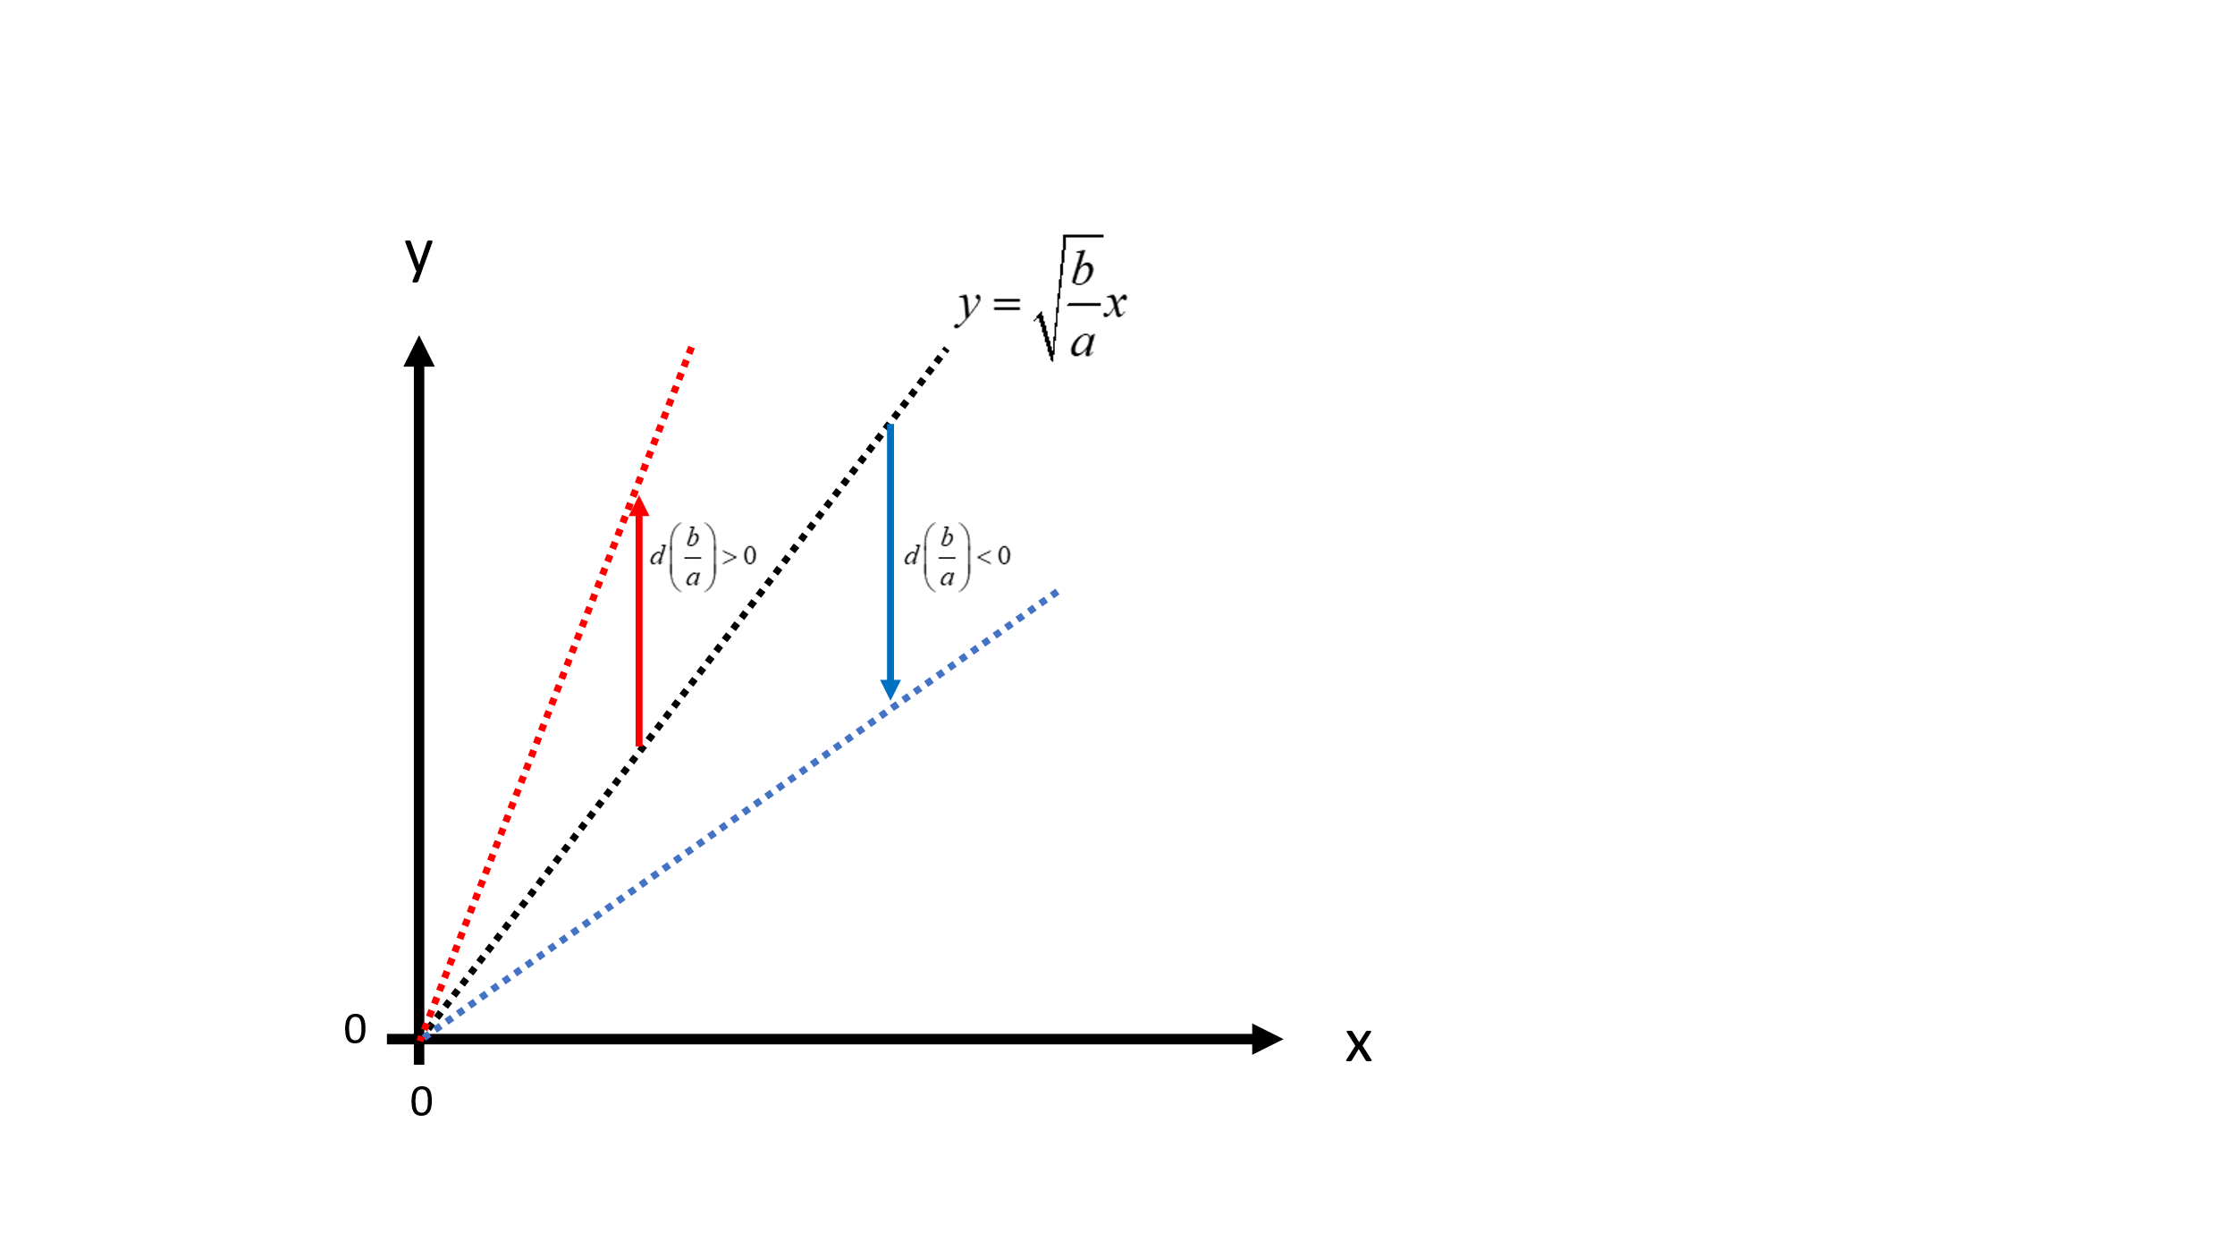
Figure 2.
The time path of (x,y) in the special case, when bx²=ay², is a function of the ratio b/a. The graph shows how the time path changes if the ratio b/a increases or decreases.

Slide 15
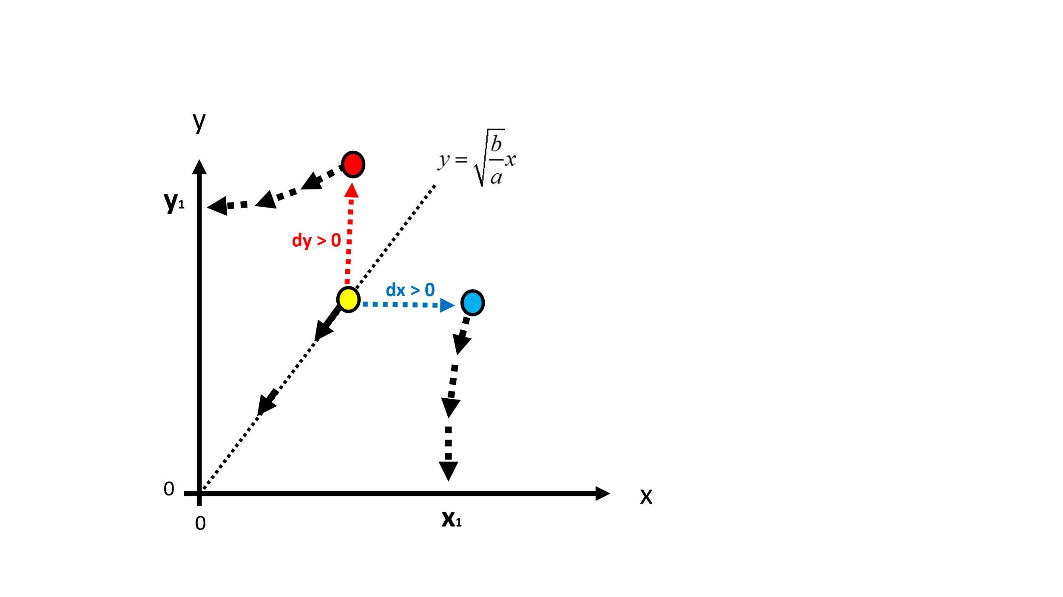
Figure 3.
Deviations from the line
imply that (x, y) will not converge to origo.

Slide 16
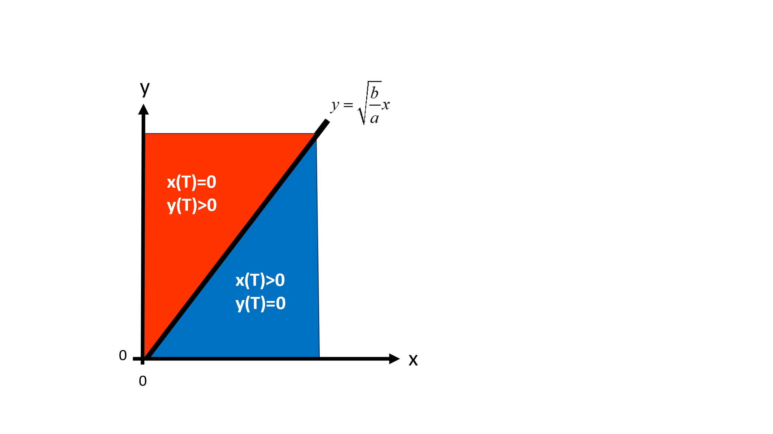
Figure 4.
T is the point in time when x or y equals zero. If (x, y) at some point in time, t, such that t<T, is found in the blue sector, then x(T)>0 and y(T)=0. If (x, y) at some point in time, t, such that t<T, is found in the red sector, then x(T)=0 and y(T)>0.

Slide 17
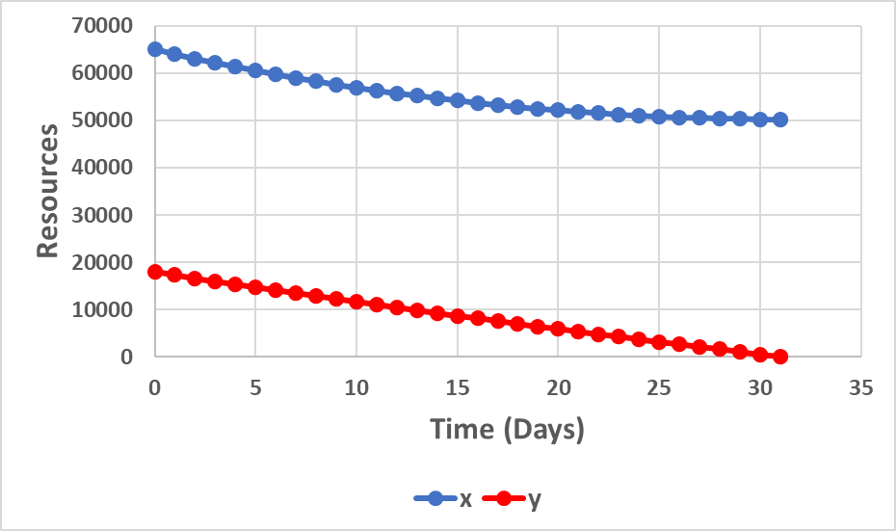
0.05347
0.01045
Source:
Lohmander, P., Attrition coefficient estimations via differential equation systems, initial and
terminal conditions, and nonlinear iterative equation system solutions,
Journal of Statistics and Computer Science, Vol. 3, Issue 1, 2024, pp. 51-78.
https://www.arfjournals.com/jscs/issue/322
https://www.arfjournals.com/image/catalog/Journals%20Papers/JSCS/2024/No%201%20(2024)/ART_4.pdf

Slide 18
Initial condition

Slide 23
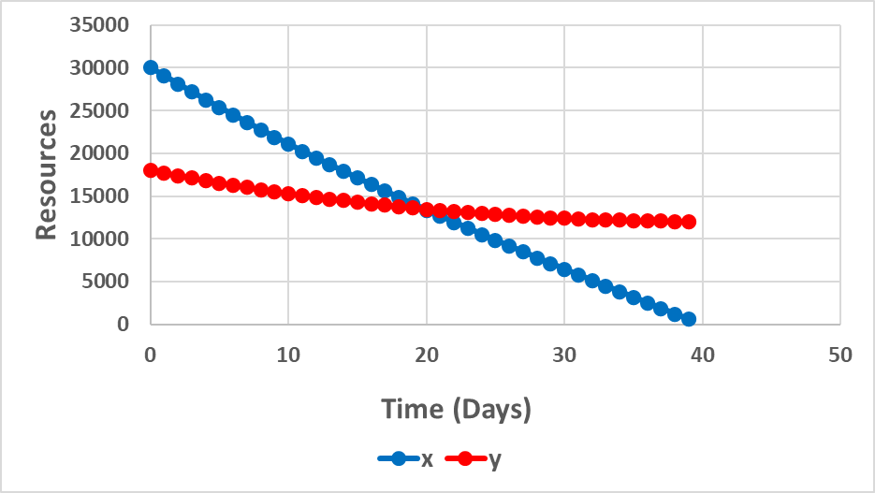
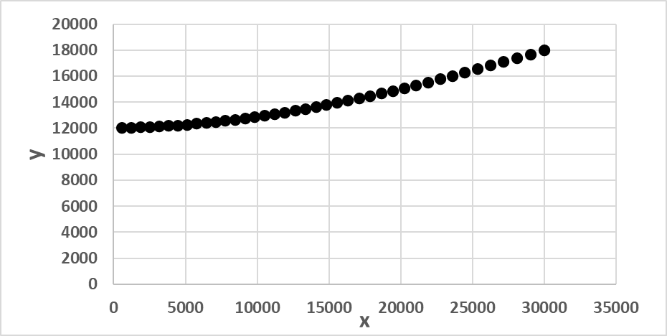

Slide 25
Figure 15.
KIAx denotes the total number of lost x resources, at different points in time, t, until t = T.
T is the point in time, when y(T) = 0. KIAx(x₀/1000) = x₀ – x(t).
a = 0.05347 and b = 0.01045. y₀ = 18000.
In the four different cases, x₀ takes the value 45000, 65000, 85000, or 105000.
The graph is constructed via a discrete time approximation of the differential equation system (1).

Slide 26
Figure 16.
KIAy is the total number of lost y resources, at different points in time, t, until t = T.
T is the point in time when y(T) = 0. KIAy(x₀/1000) = y₀ – y(t).
a = 0.05347 and b = 0.01045. In all cases, y₀ = 18000.
In the four different cases, x₀ takes the value 45000, 65000, 85000, or 105000.
The graph is constructed via a discrete time approximation of the differential equation system (1).

Slide 27
Figure 17.
T, the time of termination, is the point in time, when y(T) = 0.
a = 0.05347 and b = 0.01045.
y₀ = 18000.
In the four different cases, x₀ takes the value 45000, 65000, 85000, or 105000.
The graph is constructed via a discrete time approximation of the differential equation system (1).

Slide 28
Figure 18.
KIAx at termination is the total number of lost x resources, at time t = T.
T is the point in time, when y(T) = 0.
a = 0.05347 and b = 0.01045.
y₀ = 18000.
In the four different cases, x₀ takes the value 45000, 65000, 85000, or 105000.
The graph is constructed via a discrete time approximation of the differential equation system (1).

Slide 44
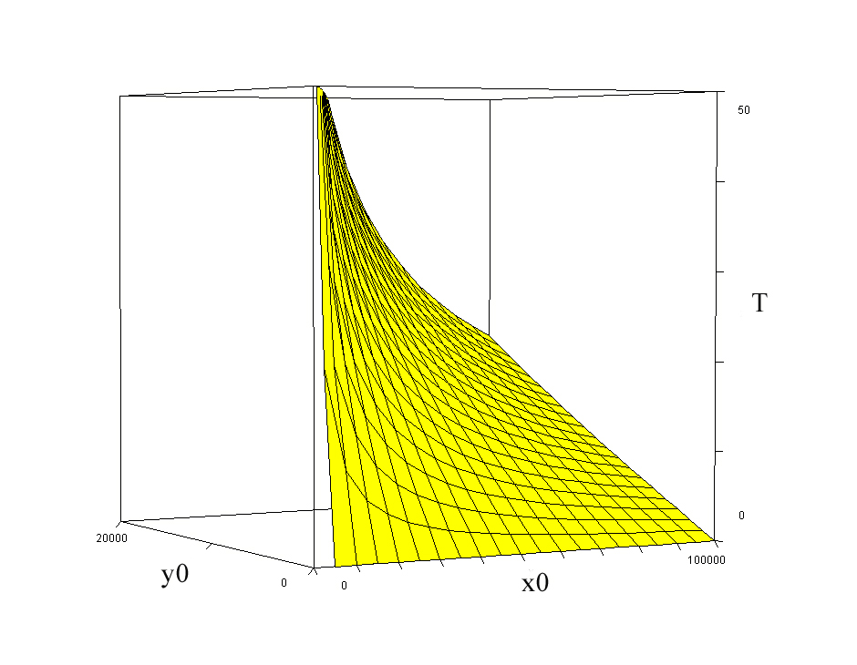
Figure 15.
T(x0, y0).
a = 0.05347, b = 0.01045.
Compare equation (51).

Slide 45
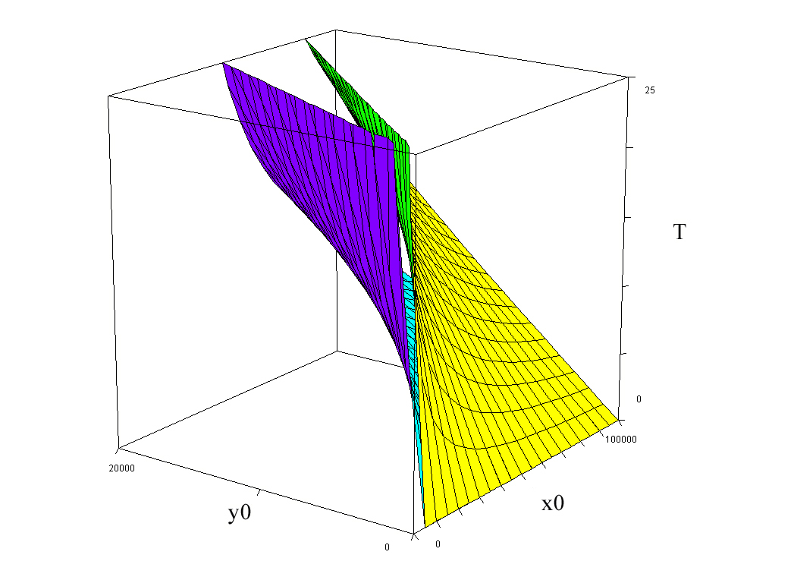
Figure 16.
T(x0, y0).
a = 0.05347
b = 0.01045
a = 0.05347
b = 0.02045

Slide 55
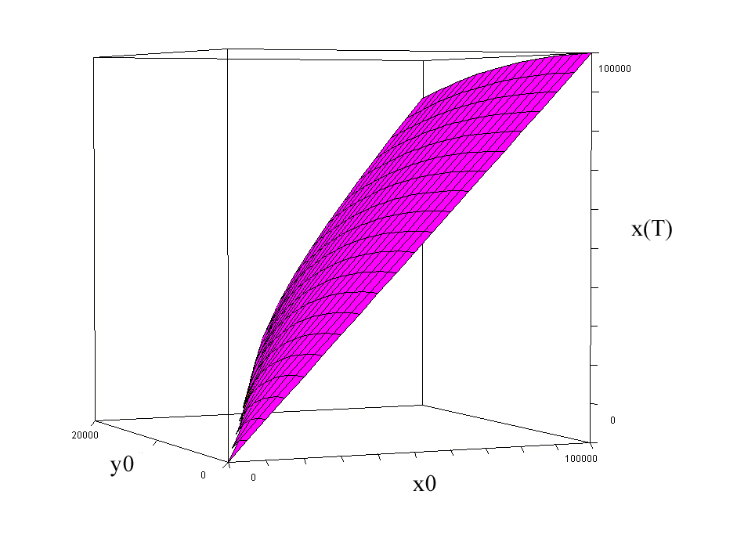
Figure 17.
x_{T}(x0,y0).
a = 0.05347, b = 0.01045.
Compare equation (83).

Slide 56
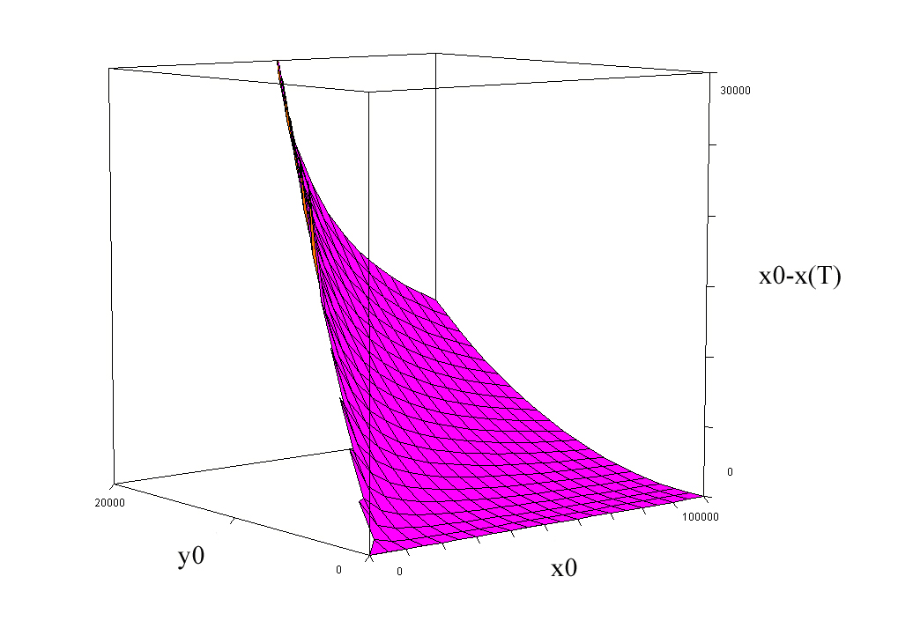
Figure 18.
K(x0, y0) = x₀ - x_{T}(x0,y0).
a = 0.05347, b = 0.01045.
Compare equation (83).

Slide 57
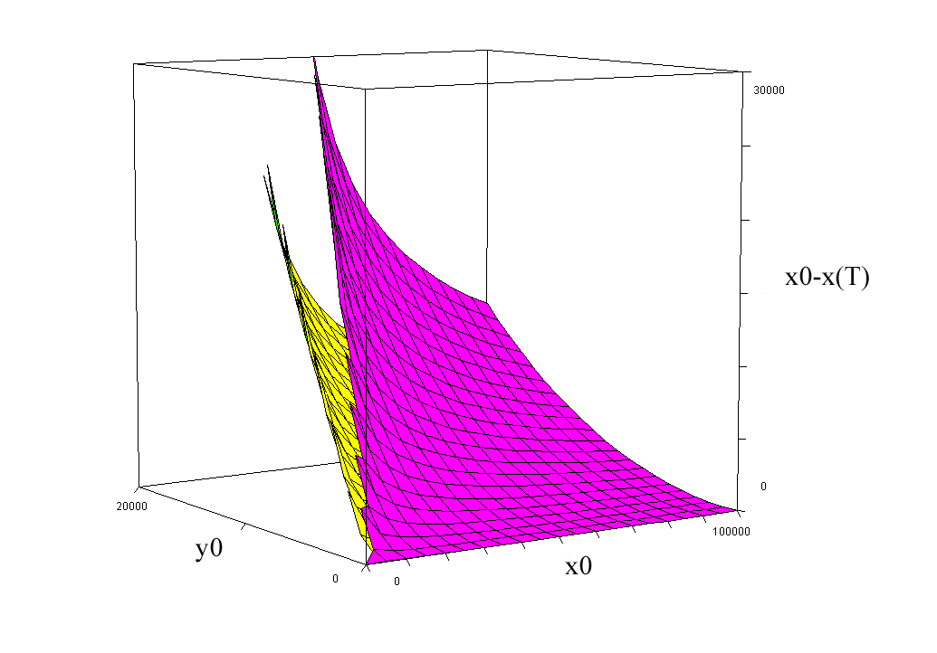
Figure 19.
K(x0, y0) = x₀ - x_{T}(x0,y0).
a = 0.05347
b = 0.01045
Compare equation (83).
a = 0.05347
b = 0.02045

Slide 64
Economic optimization in the deterministic case:
Cost
per
time unit
of
delay
Cost
per
unit
of
lost
resources
Revenue
from
instant
access
to free
territory

Slide 65
Revenue
from
territory
Total cost of
deployment
Cost of delay
Cost of lost units

Slide 66
The Figures 20 and 21 illustrate the objective function (104) as a function of the initial sizes of the two forces.
The functions and values in Figure 20 are:
C(x₀) = 1000 + 1x₀
G = 200000
c_{T} = 730
c_{xT} =2
a = 0.05347
b = 0.01045

Slide 67
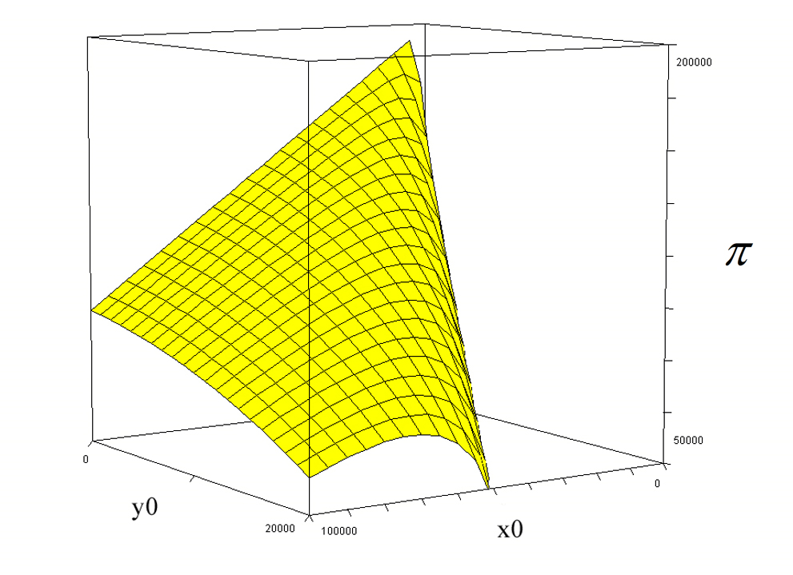
Figure 20.
The objective function in equation (104), as a function of the initial sizes of the two forces.
x0
y0

Slide 68
The graph illustrates that the optimal value of x₀ is an increasing function of y₀.
Furthermore, the optimal value of the objective function of the commander of force x, is a decreasing function of the initial size of the force y.
Clearly, if the value y₀ would have a much larger value than 20000, as illustrated in the graph, the maximum of the objective function value, would be strictly negative.
Then, the optimal decision of the commander of the x forces would be not to participate in the battle at all.
x0
y0

Slide 69
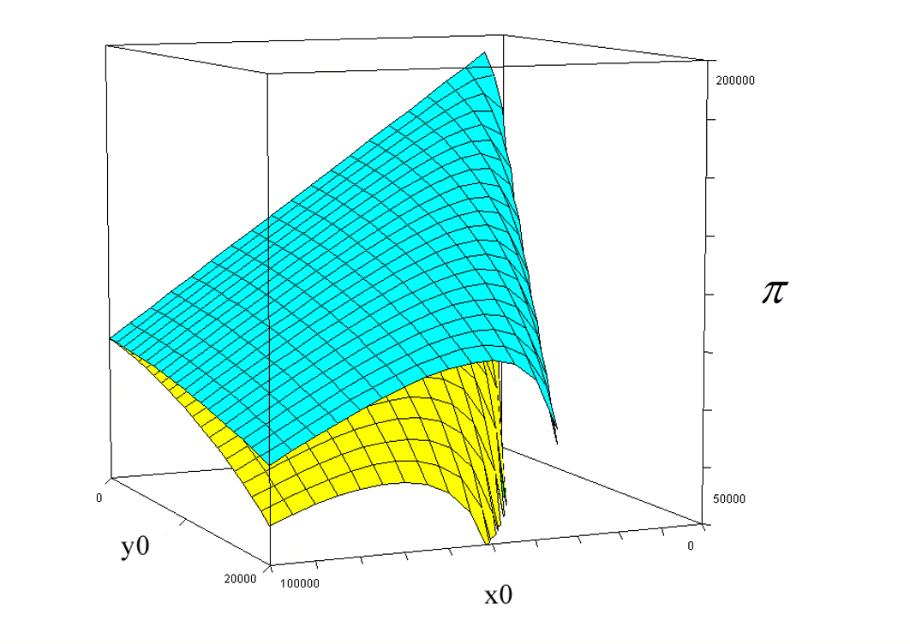
Figure 21.
The objective function in equation (104), as a function of the initial sizes of the two forces, with alternative values of the attrition coefficient “b”.
Yellow:
a = 0.05347, b = 0.01045
Turquoise:
a = 0.05347, b = 0.02045

Slide 70
The graph illustrates that the objective function value of the commander of the x forces is an increasing function of the attrition coefficient b,
and that the optimal number of units x to send to the battle field is a decreasing function of b,
for all possible sizes of the enemy force, if the optimal decision x₀ is strictly positive.
b large
b small

Slide 72
Hence, the solution of the first order optimum condition represents a unique maximum of the objective function.

Slide 73
The cost per day
Hence, if the cost per day before the victory increases, then the optimal deployment level increases. This is understandable, since the process will end more rapidly if the initial number of units is larger.

Slide 74
The cost per unit
The result shows that if the cost per unit of killed or wounded troops with equipment increases, then the optimal deployment level increases.
This is understandable, since the number of surviving units is an increasing function of the initial number of units.

Slide 75
Attrition coefficient a

Slide 77
Hence, if the attrition coefficient a increases,
then the optimal deployment increases.

Slide 78
Attrition coefficient b

Slide 80
Hence, if the attrition coefficient b increases, then the optimal deployment decreases.
This is also illustrated in Figure 21.

Slide 81
Numerical optimization
with known attrition parameters

Slide 82
Numerical Model 1:
Continuous optimization model with Newton Raphson iteration. CASE 0.
Parameters and initial guess
Initial guess
Newton Raphson iteration
Optimal solution

Slide 83
Figure 22.
The optimal values of x₀, according to Numerical model 1, in alternative cases.

Slide 84
Figure 23.
The optimal values of T, the day of the victory, according to Numerical model 1, in alternative cases.

Slide 85
Figure 24.
The optimal values of K, the number of killed and wounded soldiers, according to Numerical model 1, in alternative cases.

Slide 86
Numerical optimization
with stochastic attrition parameters
z = the stochastic deviation from the expected value (of an attrition parameter).
When the operation is planned, the true value of z is not known, but the probability distribution ”and/or” the probability density function, ”are/is” known.

Slide 87
Assumption in stochastic analysis (with continuous z).
0
z
Assumption in
deterministic analysis.

Slide 88
f
In the first quadrant,
the function f reaches
the z-axes where z = c.
a – bc = 0
bc = a
b = a/c
f = a + (a/c)z
f = a(1 + 1/c)z
The total probability
(yellow) is 1.
ac = 1
a = 1/c
f = a + bz
f = a - bz
z
- c
0
c
(In the first quadrant)

Slide 89
f
f = a + bz
f = a - bz
z
- c
0
c
(In the first quadrant)

Slide 90
f
f = a + bz
f = a - bz
z
- c
0
c

Slide 91
After the deployment, when the operation starts, z is observed.
Then, the expected value of the attrition parameter is multiplied
by w = (1+z), to get the true value of the attrition parameter.

Slide 92
”Increasing risk”
with continuous z

Slide 93
Examples of the attrition parameter multiplier probability density function.

Slide 94
Assumptions in stochastic analysis (with discrete z).
First, we consider this discrete approximation of a triangular probability distribution:
z | freq | Probability
-5 | 1 | 0.027778
-4 | 2 | 0.055556
-3 | 3 | 0.083333
-2 | 4 | 0.111111
-1 | 5 | 0.138889
0 | 6 | 0.166667
1 | 5 | 0.138889
2 | 4 | 0.111111
3 | 3 | 0.083333
4 | 2 | 0.055556
5 | 1 | 0.027778

Slide 95
The total probability = 1.
P(z) = (1/36) x (6-z) for 0<=z<=5
P(z) = (1/36) x (6+z) for 5<=z<0
z | Freq | Probability
-5 | 1 | 0.027778
-4 | 2 | 0.055556
-3 | 3 | 0.083333
-2 | 4 | 0.111111
-1 | 5 | 0.138889
0 | 6 | 0.166667
1 | 5 | 0.138889
2 | 4 | 0.111111
3 | 3 | 0.083333
4 | 2 | 0.055556
5 | 1 | 0.027778

Slide 96
Now, we multiply each z-value by k, and investigate the variance :
If we know
the variance,
we know k.

Slide 97
Discrete Z
Acceptable approximation.
z | Probability
-0.41404 | 0.027778
-0.33123 | 0.055556
-0.24842 | 0.083333
-0.16562 | 0.111111
-0.08281 | 0.138889
0 | 0.166667
0.082808 | 0.138889
0.165616 | 0.111111
0.248424 | 0.083333
0.331232 | 0.055556
0.41404 | 0.027778
f = a - bz
f = a + bz
f = a - bz
Continuous Z
z
- c
0
c

Slide 98
First, we recall the deterministic version of the problem:
is affected by a and b.
is affected by a and b.

Slide 99
The deterministic version was:
Now, however, we want to maximize the expected total result.
The parameters a and b are not known before has been decided.
Stochastic problem with discrete a and b:
General
Corr = 0

Slide 100
The deterministic version was:
Now, however, we want to maximize the expected total result.
The parameters a and b are not known before has been decided.
Stochastic problem with continuous a and b:
General
Corr = 0

Slide 101
Numerical Model 2:
Discrete optimization model with stochastic attrition coefficients:
This model, partly based on the analytical derivations presented in the earlier sections, determines the optimal decisions and consequences, via numerical calculations, for alternative deployment levels.
The optimal value of the objective functions is defined as the highest value of the investigated alternatives.

Slide 102
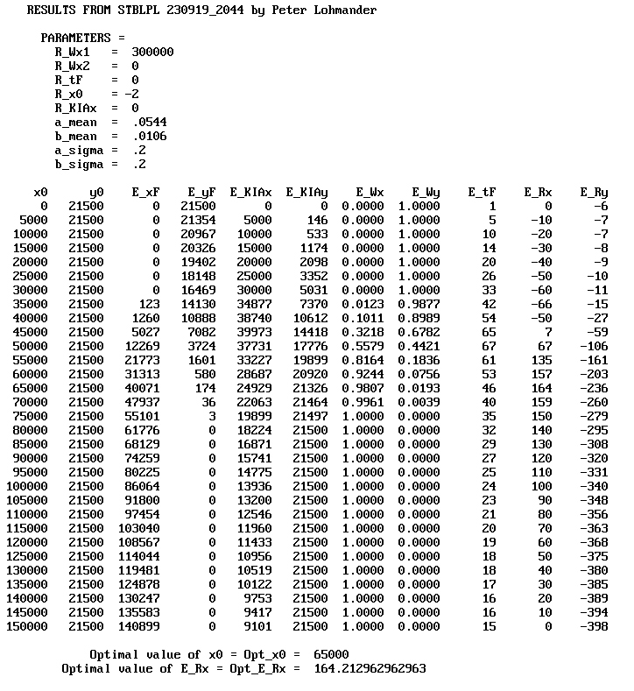
G
-1 x (Marginal Deployment Cost)
Attrition parameter a:
Expected value 0.0544 and
relative standard deviation 0.2
Attrition parameter b:
Expected value 0.0106 and
relative standard deviation 0.2
Correlation between a and b is zero.
Optimum

Slide 103
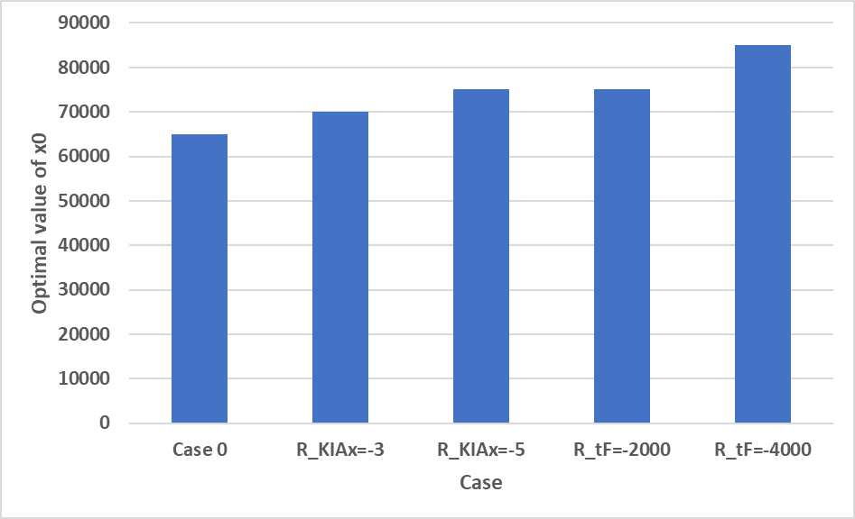

Slide 104
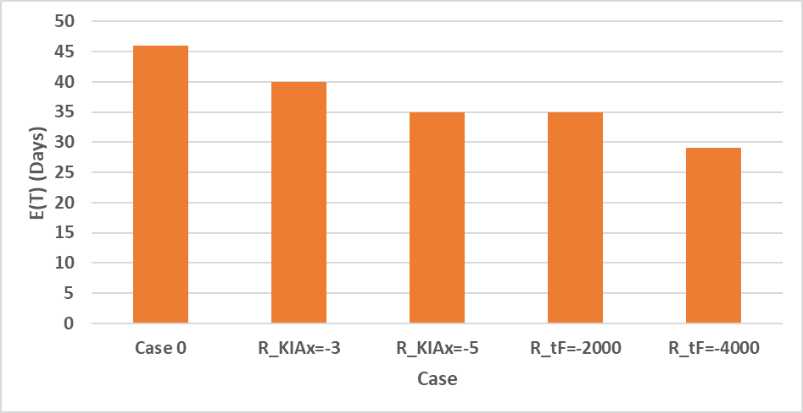

Slide 105
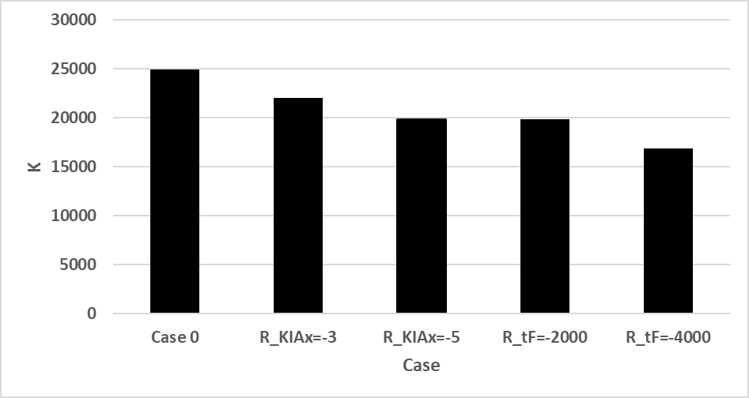

Slide 106
Short summary of the results:
The analytical, and the two numerical, methods, all show that the optimal deployment level is
a decreasing function of the marginal deployment cost,
an increasing function of the marginal cost of the time to win the battle,
an increasing function of the marginal cost of killed and wounded soldiers and lost equipment,
an increasing function of the initial size of the opposing army,
an increasing function of the efficiency of the soldiers in the opposing army and
a decreasing function of the efficiency of the soldiers in the deployed army.
With stochastic attrition parameters, the stochastic model also shows that the
probability to win the battle is an increasing function of the size of the deployed army.
When the optimal deployment level is selected, the probability of a victory is usually less than 100%, since it would be too expensive to guarantee a victory with 100% probability.

Slide 107
Optimal Deployment by
Peter Lohmander
Thank you for
your time!
Questions?
ICSTC-2024
Tenth International Conference on Statistics for the Twenty-First Century
December 13 - 16, 2024, Special Invited Talk.
Organized by International Statistics Fraternity (ISF) in collaboration with the Department of Statistics, University of Kerala and School of Physical and Mathematical Sciences at the University of Kerala and the American Statistical Association.
Version 241211_1448
Peter Lohmander
Prof Dr
Peter Lohmander Optimal Solutions, Sweden

