Slide 1
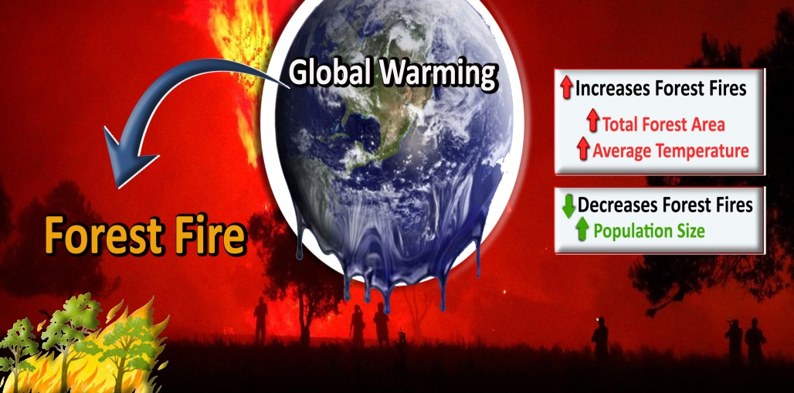
Forest fire expansion under global warming conditions: multivariate estimation, function properties and predictions for 29 countries
Problem:
Forest fires create large economical and environmental
problems in many countries.
Question:
How will forest fires be affected by global warming
in different countries?
Solution:
A new prediction model has been developed and used.
Lohmander, Peterª
Optimal Solutions in cooperation with Linnaeus University, Hoppets Grand 6, 903 34 Umea, Sweden

Slide 2
Slide 1: Results
The relative burned area (B,%) in a country (i ) is determined from the following equation. T represents the average temperature. P is the size of the population and A is the total forest area in the country.

Slide 3

Slide 2: Main Conclusion and Articles
The estimated model predicts that global warming will increase the areas of forest fires. The future developments of expected forest fire areas in the different 29 countries have been predicted for alternative levels of global warming.
The published open access article (with some misprints):
Lohmander, P., Forest fire expansion under global warming conditions: multivariate estimation, function properties and predictions for 29 countries, Central Asian Journal of Environmental Science and Technology Innovation, Volume 1, Issue 5, 2020, 134-142. doi:10.22034/CAJESTI.2020.05.03. http://www.cas-press.com/article_122566_c3544cd0c21d5c077f72e985a77d30e9.pdf
The original version without misprints:
http://www.lohmander.com/PL_CAJESTI_20_2_MANUS.pdf
Related Research:
http://www.lohmander.com/Information/Ref.htm
Contact:
Peter@Lohmander.com

