Slide 1

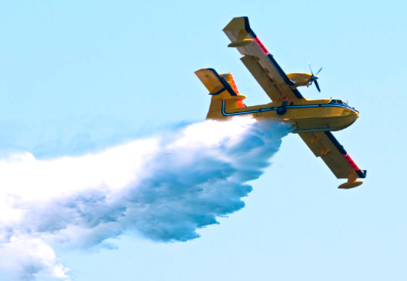
Adaptive Mobile Firefighting Resources:
- Stochastic Dynamic Optimization of International Cooperation
Lohmander, Peterª
Optimal Solutions in cooperation with Linnaeus University, Hoppets Grand 6, 903 34 Umea, Sweden

Slide 2
Abstract
Forest fires cause severe problems in many countries. Forest fire areas in nine European countries are investigated with respect to yearly averages, standard deviations and correlations between nations. In the region IFPS (Italy, France, Portugal and Spain), the average yearly burned area during the years 2010 to 2018 was 313.4 kha and in FGLNS (Finland, Germany, Latvia, Norway and Sweden) the corresponding area was only 7.6 kha. The correlations between the regions are strictly negative and the correlations within the regions are strictly positive.
Since forest fires usually do not occur in every country at the same time, there is a potential expected gain from international cooperation, where easily mobile firefighting resources such as water bombing airplanes are moved between nations. A general stochastic dynamic programming approach to adaptive moves of such resources is defined and suggested. General properties of the solution are derived. A particular version of the model is created and analytical derivations are performed. It is demonstrated that the expected objective function value, the expected present value of total costs, is a strictly increasing function of the fire correlation between nations. Adaptive moves of mobile resources between the regions IFPS and FGLNS have the advantage of negative correlations between these regions. Some adaptive moves can also be motivated within the regions even with positive correlations, thanks to the low costs of short moves.

Slide 3
Methods
The optimization problem is defined as a stochastic dynamic programming problem, STDP. Hence, it is possible to sequentially optimize the decisions, based on the latest information about the stochastic events and the state of the complete system. This methodology is absolutely necessary in this problem in order to make it relevant, since the fires are truly stochastic in nature and the central problem is to act in a way that is optimal and adaptive.

Slide 4
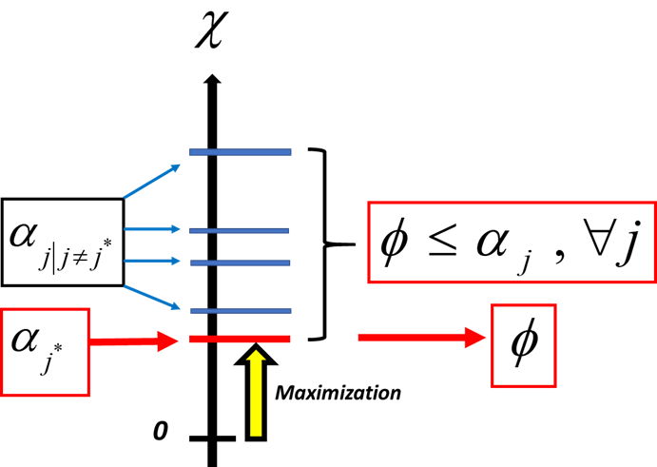
Figure 1.
Minimization in STDP can be solved via maximization in LP.

Slide 5
Figure 2.

Slide 6
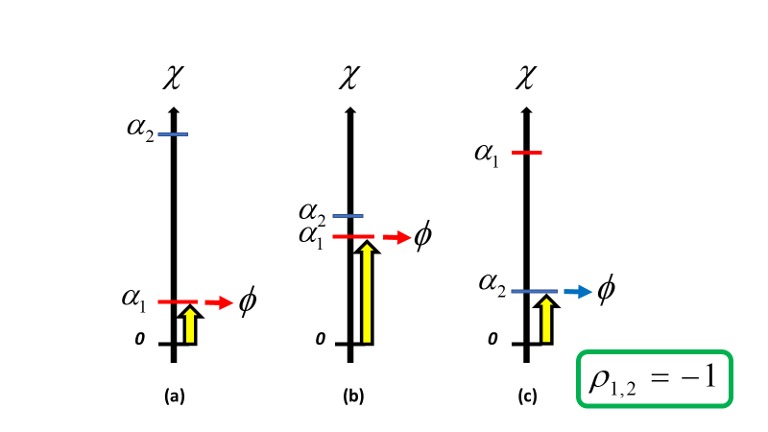
Figure 3.
The Figure shows what happens if we have strongly negative correlation between the fire problems in the different regions. When conditions are difficult in one region, they are often better in the other region. Hence, it is rather likely that the importance of using the resource in some region is high.

Slide 7
Figure 4.
Observations of combinations of burned areas in two regions during eight years (from 2010 until 2018).

Slide 8
Conclusion
Statistical properties of fires in different countries and regions in nine European countries were derived and described. It was found that two regions, IFPS and FGLNS, could be defined and that the fire correlations within the regions are negative and that the correlations between the regions are positive. This turned out to have important consequences for optimal international firefighting cooperation.
Allocation of internationally mobile firefighting units, such as water bombing airplanes, has been defined as a general multi period adaptive optimization problem. This was done via stochastic dynamic programming. Furthermore, a linear programming solution procedure was used to derive general conclusions. It was found that the objective function non-strictly decreases if the number of possible moves of the firefighting resources increase. This motivates expansion of international cooperation in firefighting operations. Furthermore, the objective function is a non-strictly increasing function of the correlation between the forest fire levels in different countries.

Slide 9
Acknowledgements / Funding:
None.
The published open access article (with some index misprints):
Lohmander, P., Adaptive mobile firefighting resources, stochastic dynamic optimization of international cooperation, International Robotics & Automation Journal, Volume 6, Issue 4, 2020, pages 150-155. https://medcraveonline.com/IRATJ/IRATJ-06-00213.pdf
(Index adjustments in progress. Details available on request.)

Slide 10

Author contact
Peter@Lohmander.com
http://www.lohmander.com/Information/Ref.htm
Keywords (select up to 3):
Forest Fires, Systems Analysis, Science to Policy

