Slide 1
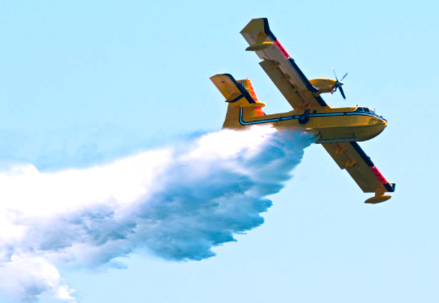
Adaptive Mobile Firefighting Resources:
- Stochastic Dynamic Optimization of International Cooperation
Problem:
Forest fires create large economical and environmental
problems in many countries.
Questions:
What are the stochastic properties of fires in different countries? Is international cooperation rational?
Solution:
Adaptive optimization can optimize international cooperation. General methods and principles have been derived.
Lohmander, Peterª
Optimal Solutions in cooperation with Linnaeus University, Hoppets Grand 6, 903 34 Umea, Sweden

Slide 2
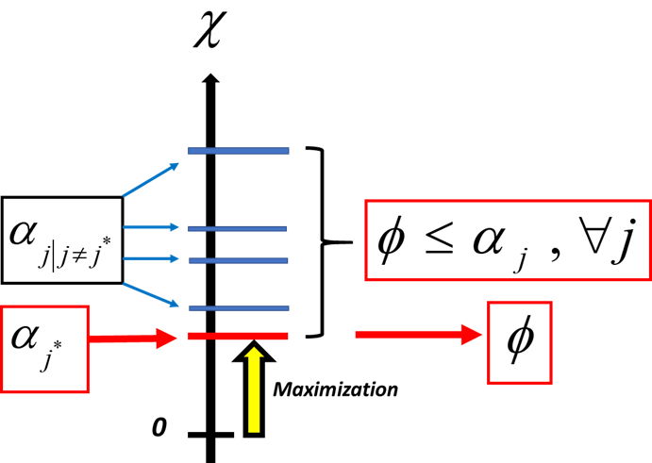
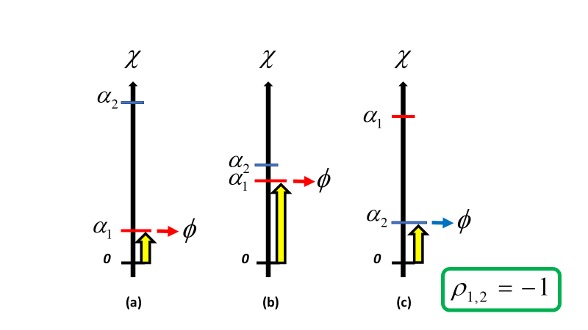
Slide 1: Results
Optimal solutions via analytical and numerical methods.
Statistical properties of fires in different countries
Optimization of adaptive international fire fighting
coordination via stochastic dynamic programming

Slide 3

Slide 2: Main Conclusions and Article
Statistical properties of fires in different countries and regions in nine European countries were derived.
Allocation of internationally mobile firefighting units, such as water bombing airplanes, has been defined and analyzed via stochastic dynamic programming.
Adaptive international cooperation in firefighting operations is rational.
The published open access article:
Lohmander, P., Adaptive mobile firefighting resources, stochastic dynamic optimization of international cooperation, International Robotics & Automation Journal, Volume 6, Issue 4, 2020, pages 150-155. https://medcraveonline.com/IRATJ/IRATJ-06-00213.pdf
Contact: Peter@Lohmander.com
Related Research:
http://www.lohmander.com/Information/Ref.htm

