Slide 1

OPTIMAL PRESENT RESOURCE EXTRACTION UNDER THE INFLUENCE OF FUTURE RISK
Professor Dr Peter Lohmander
SLU, Sweden, http://www.Lohmander.com
Peter@Lohmander.com
The 8th International Conference of
Iranian Operations Research Society
Department of Mathematics Ferdowsi University of Mashhad, Mashhad, Iran.
www.or8.um.ac.ir
21-22 May 2015
One index corrected 150606

Slide 2
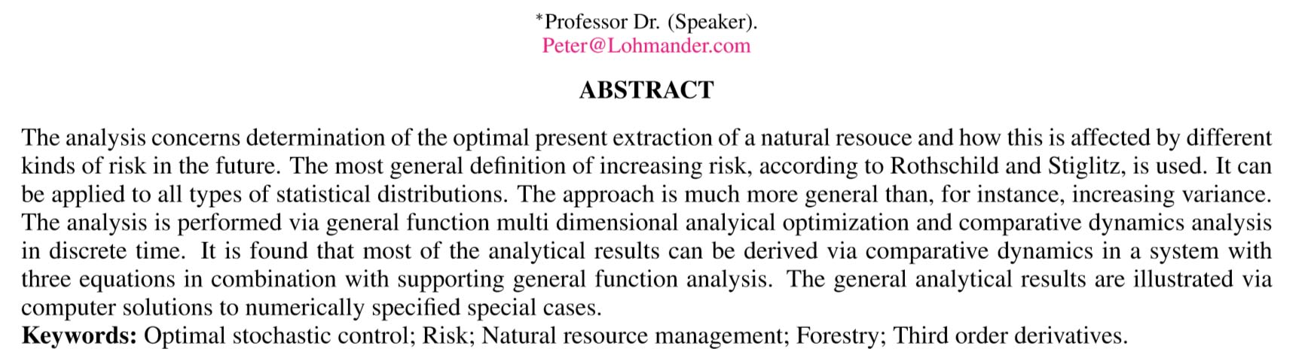
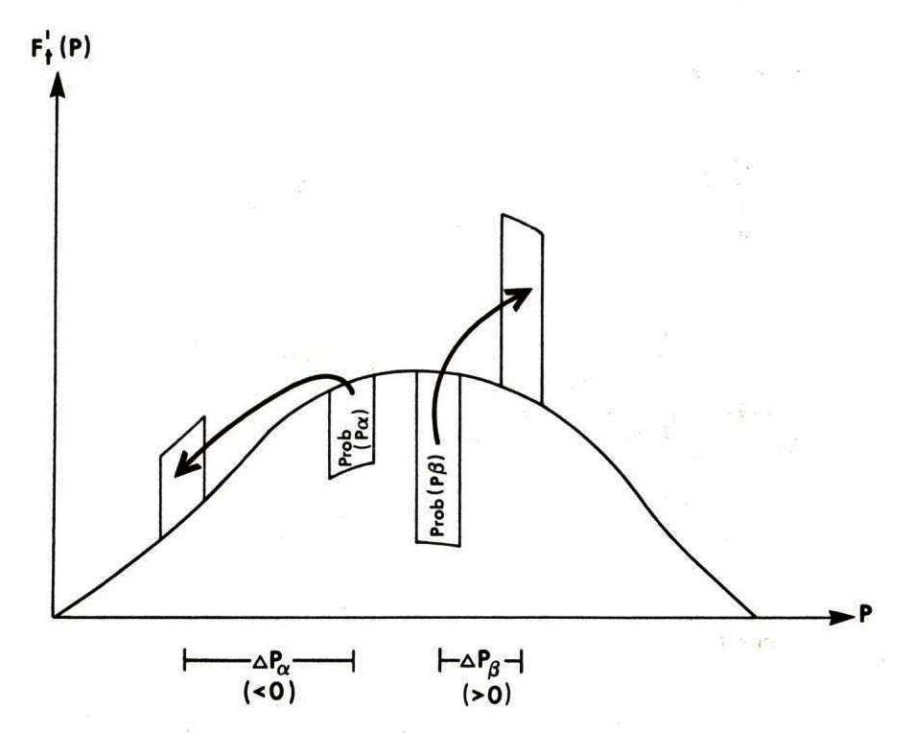
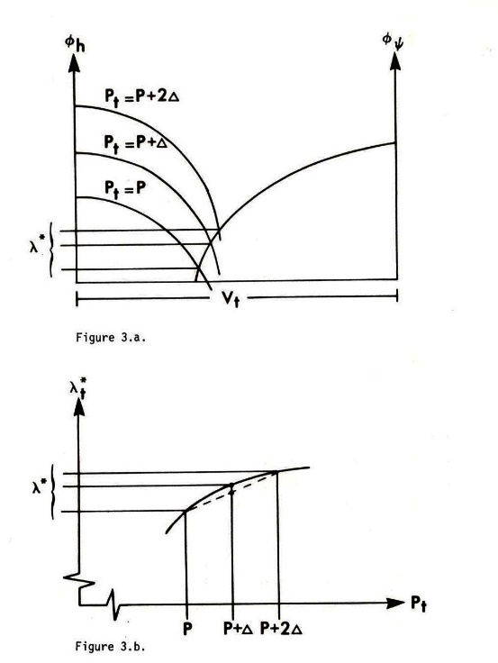
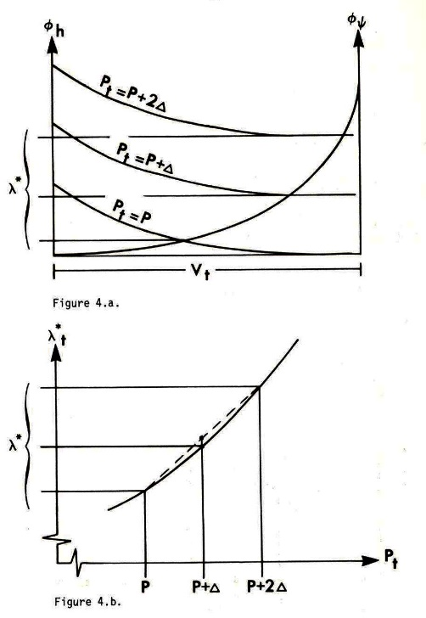

Slide 3
Contents:
1. Introduction via one dimensional optimization in dynamic problems, comparative statics analysis, probabilities, increasing risk and the importance of third order derivatives.
2. Explicit multi period analysis, stationarity and corner solutions.
3. Multi period problems and model structure with sequential adaptive decisions and risk.
4. Optimal decisions under future price risk.
5. Optimal decisions under future risk in the volume process (growth risk).
6. Optimal decisions under future price risk with mixed species.

Slide 4
Contents:
1. Introduction via one dimensional optimization in dynamic problems, comparative statics analysis, probabilities, increasing risk and the importance of third order derivatives.
2. Explicit multi period analysis, stationarity and corner solutions.
3. Multi period problems and model structure with sequential adaptive decisions and risk.
4. Optimal decisions under future price risk.
5. Optimal decisions under future risk in the volume process (growth risk).
6. Optimal decisions under future price risk with mixed species.

Slide 5
In the following analyses, we study the solutions to maximization problems. The objective functions are the total expected present values. In particular, we study how the optimal decisions at different points in time are affected by stochastic variables, increasing risk and optimal adaptive future decisions.
In all derivations in this document, continuously differentiable functions are assumed. In the optimizations and comparative statics calculations, local optima and small moves of these optima under the influence of parameter changes, are studied. For these reasons, derivatives of order four and higher are not considered. Derivatives of order three and lower can however not be neglected. We should be aware that functions that are not everywhere continuously differentiable may be relevant in several cases.

Slide 6
Introduction with a simplified problem

Slide 11
Probabilities and outcomes:

Slide 12
Increasing risk:

Slide 13
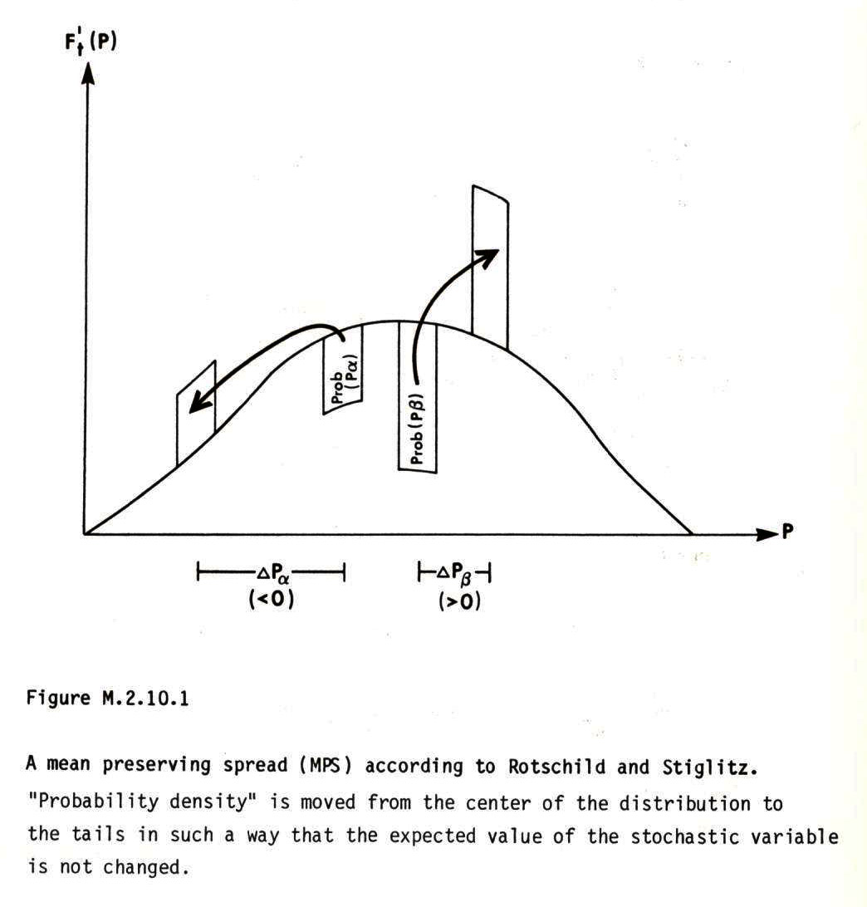
Probability
density

Slide 17
The sign of this third order derivative
determines the optimal direction of
change of our present extraction level
under the influence of increasing
risk in the future.

Slide 20
Contents:
1. Introduction via one dimensional optimization in dynamic problems, comparative statics analysis, probabilities, increasing risk and the importance of third order derivatives.
2. Explicit multi period analysis, stationarity and corner solutions.
3. Multi period problems and model structure with sequential adaptive decisions and risk.
4. Optimal decisions under future price risk.
5. Optimal decisions under future risk in the volume process (growth risk).
6. Optimal decisions under future price risk with mixed species.

Slide 21
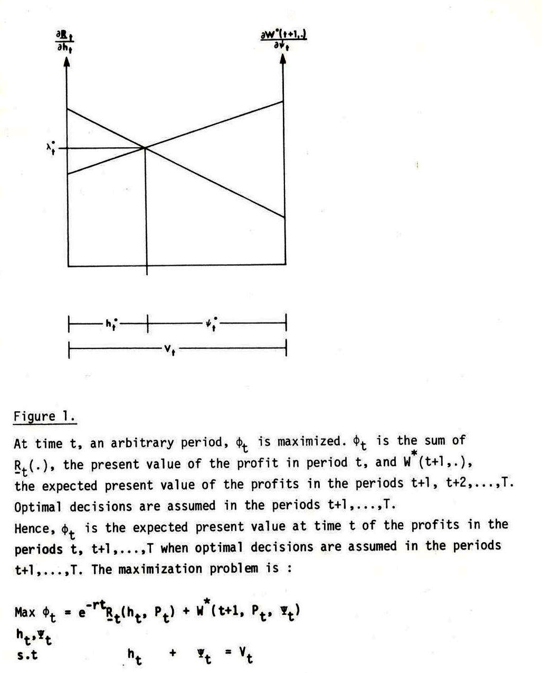
Towards
multi
period
analysis
Marginal
resource value
In period t
Expected marginal
resource value
In period t+1

Slide 22
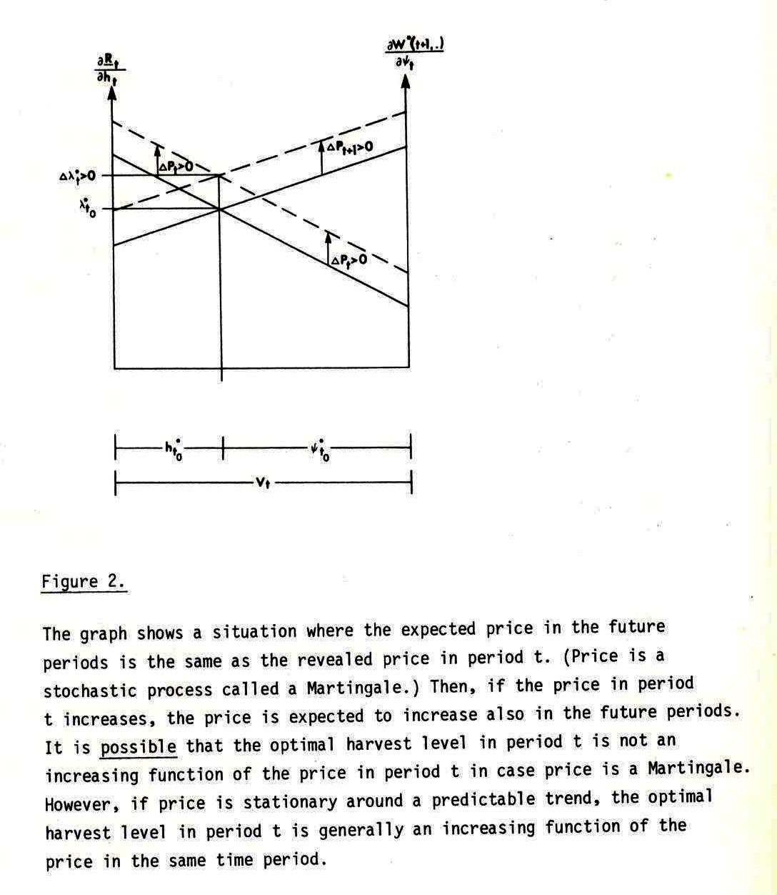
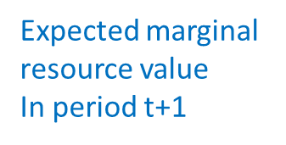
On
stationary
and
nonstationary
processes
Marginal
resource value
In period t

Slide 23
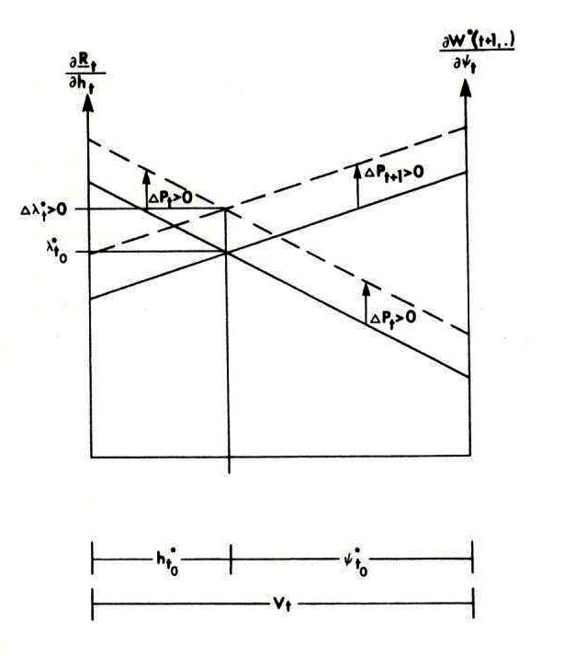
Marginal
resource value
In period t

Slide 24
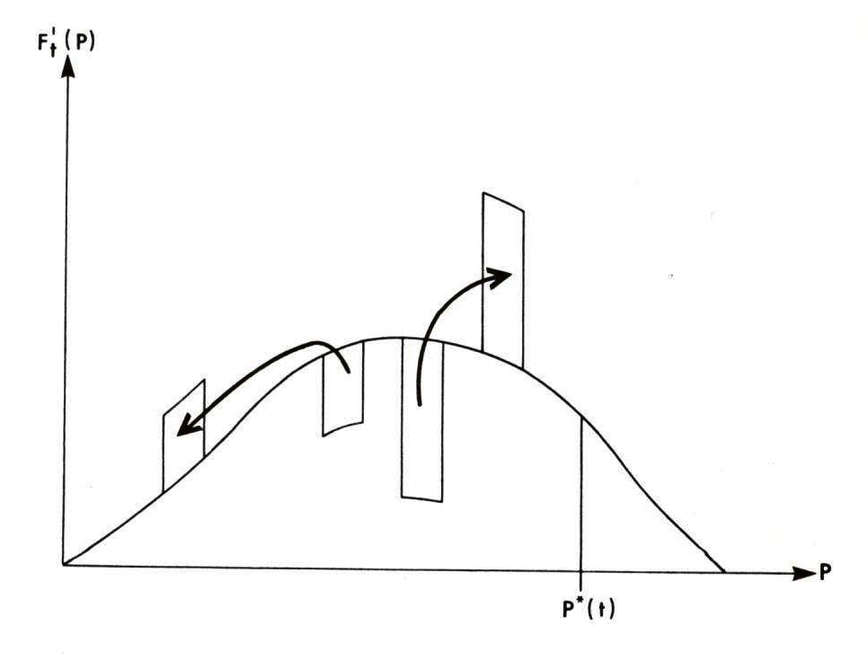
Probability
density
On
corner
solutions

Slide 25
Contents:
1. Introduction via one dimensional optimization in dynamic problems, comparative statics analysis, probabilities, increasing risk and the importance of third order derivatives.
2. Explicit multi period analysis, stationarity and corner solutions.
3. Multi period problems and model structure with sequential adaptive decisions and risk.
4. Optimal decisions under future price risk.
5. Optimal decisions under future risk in the volume process (growth risk).
6. Optimal decisions under future price risk with mixed species.

Slide 26
Optimization in multi period problems
One index corrected 150606

Slide 29
Three free decision variables and three first order optimum conditions

Slide 31
Let us differentiate the first order optimum conditions with respect to the decision variables and the risk parameters:
:

Slide 32
Contents:
1. Introduction via one dimensional optimization in dynamic problems, comparative statics analysis, probabilities, increasing risk and the importance of third order derivatives.
2. Explicit multi period analysis, stationarity and corner solutions.
3. Multi period problems and model structure with sequential adaptive decisions and risk.
4. Optimal decisions under future price risk.
5. Optimal decisions under future risk in the volume process (growth risk).
6. Optimal decisions under future price risk with mixed species.

Slide 36
Simplification gives:
A unique maximum is assumed.

Slide 37
Observation:
We assume decreasing marginal profits in all periods.

Slide 38
The following results follow from optimization:

Slide 40
The results may also be summarized this way:

Slide 41
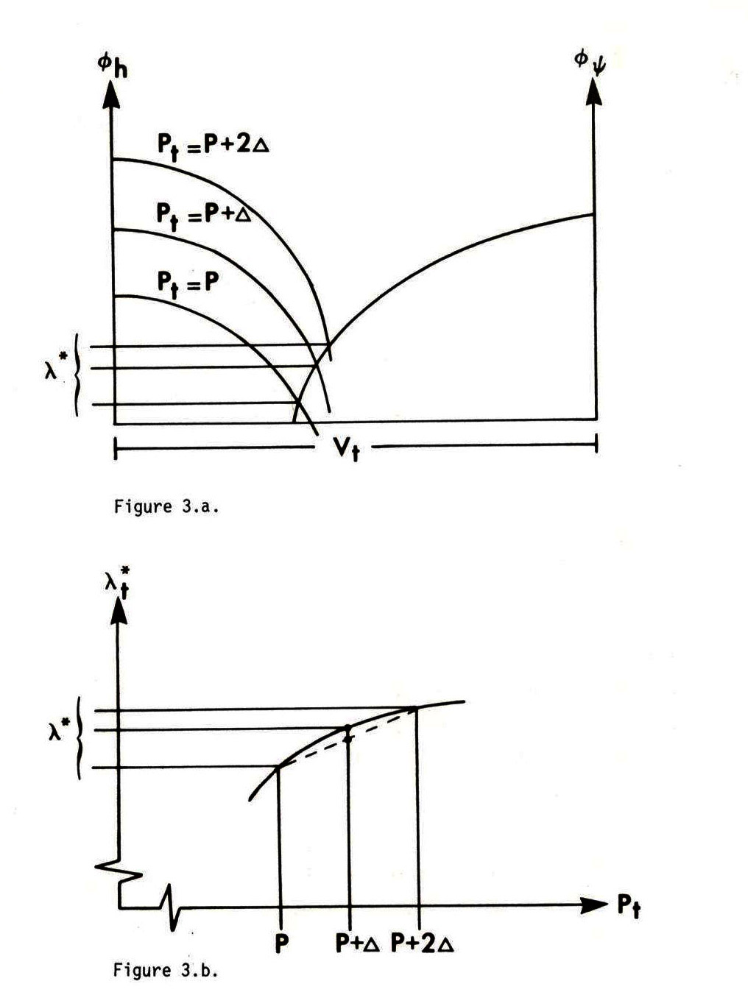
The expected future marginal
resource value decreases from
increasing price risk and we should
increase present extraction.

Slide 42
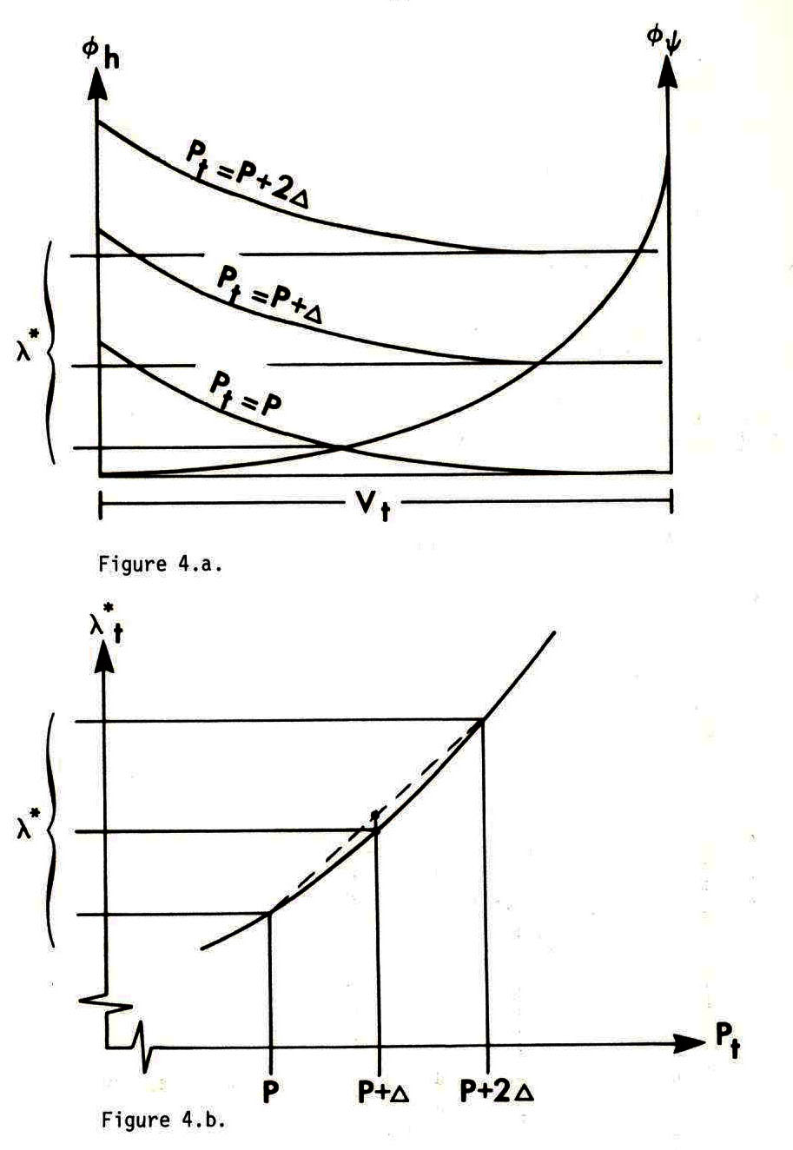
The expected future marginal
resource value increases from
increasing price risk and we should
decrease present extraction.

Slide 43
Some results of increasing risk in the price process:
If the future risk in the price process increases, we should increase the present extraction level in case the third order derivatives of profit with respect to volume are strictly negative.
If the future risk in the price process increases, we should not change the present extraction level in case the third order derivatives of profit with respect to volume are zero.
If the future risk in the price process increases, we should decrease the present extraction level in case the third order derivatives of profit with respect to volume are strictly positive.

Slide 44
Contents:
1. Introduction via one dimensional optimization in dynamic problems, comparative statics analysis, probabilities, increasing risk and the importance of third order derivatives.
2. Explicit multi period analysis, stationarity and corner solutions.
3. Multi period problems and model structure with sequential adaptive decisions and risk.
4. Optimal decisions under future price risk.
5. Optimal decisions under future risk in the volume process (growth risk).
6. Optimal decisions under future price risk with mixed species.

Slide 45
The effects of increasing future risk in the volume process:
Now, we will investigate how the optimal values of the decision variables change if g increases.
We recall these first order derivatives:

Slide 56
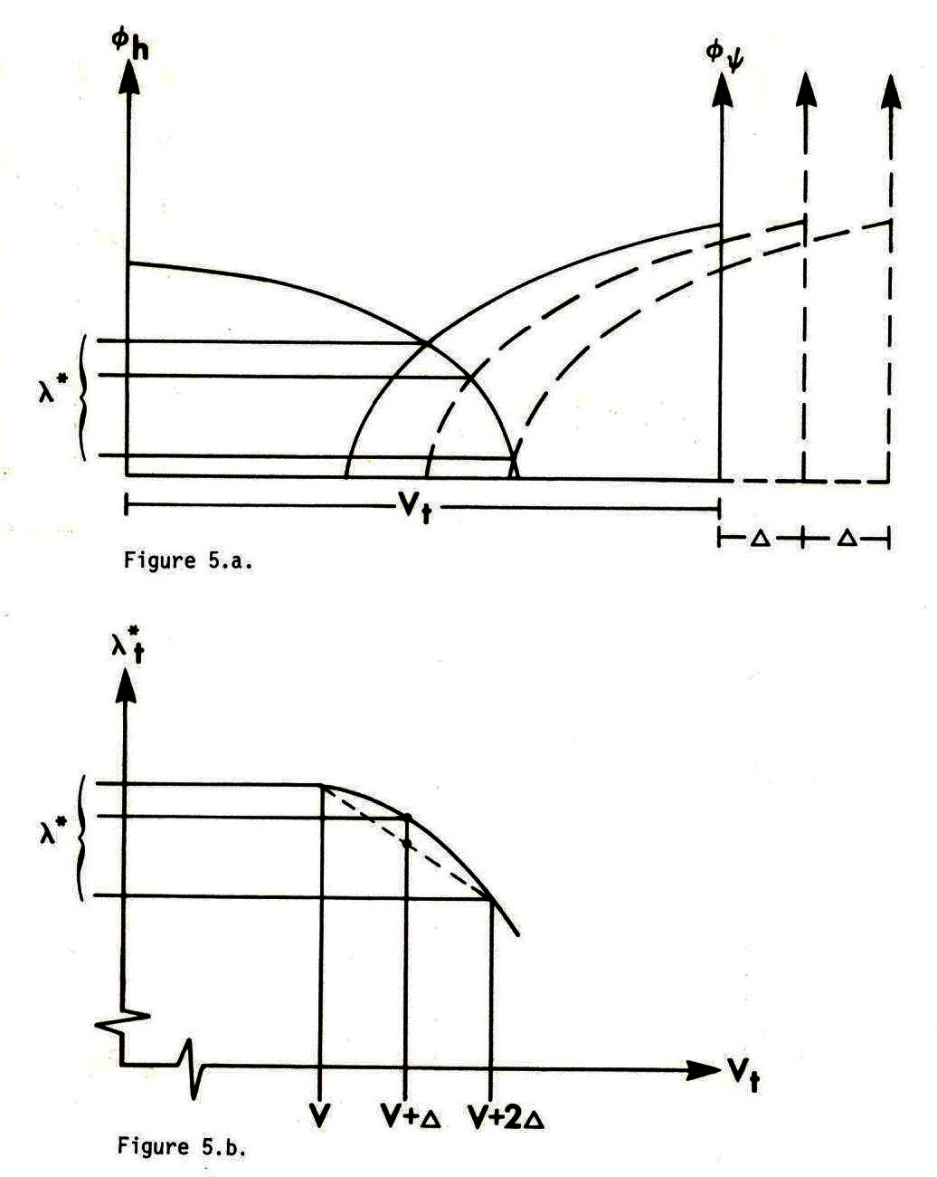
The expected future marginal
resource value decreases from
increasing risk in the volume
process (growth) and we should
increase present extraction.

Slide 57
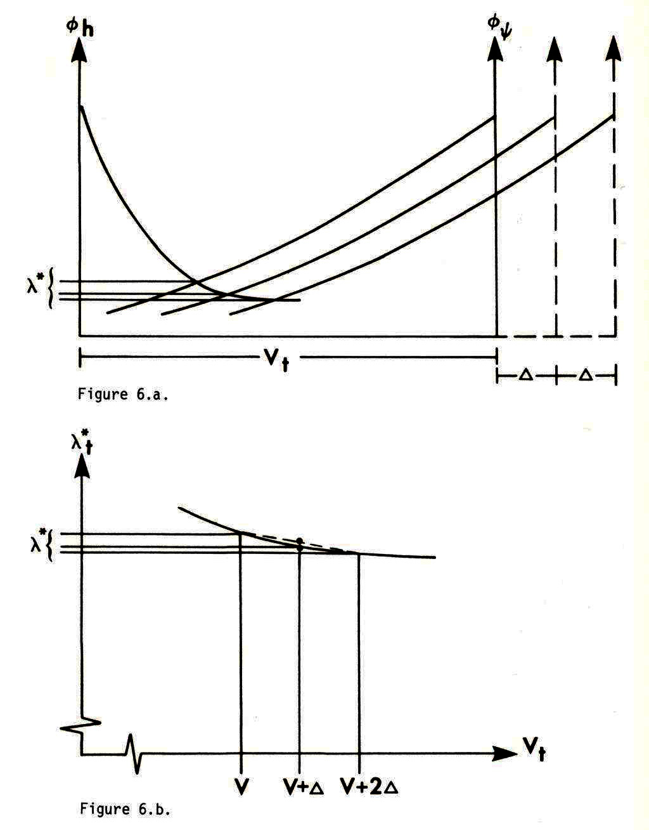
The expected future marginal
resource value increases from
increasing risk in the volume
process (growth) and we should
decrease present extraction.

Slide 58
Some results of increasing risk in the volume process (growth process):
If the future risk in the volume process increases, we should increase the present extraction level in case the third order derivatives of profit with respect to volume are strictly negative.
If the future risk in the volume process increases, we should not change the present extraction level in case the third order derivatives of profit with respect to volume are zero.
If the future risk in the volume process increases, we should decrease the present extraction level in case the third order derivatives of profit with respect to volume are strictly positive.

Slide 59
Contents:
1. Introduction via one dimensional optimization in dynamic problems, comparative statics analysis, probabilities, increasing risk and the importance of third order derivatives.
2. Explicit multi period analysis, stationarity and corner solutions.
3. Multi period problems and model structure with sequential adaptive decisions and risk.
4. Optimal decisions under future price risk.
5. Optimal decisions under future risk in the volume process (growth risk).
6. Optimal decisions under future price risk with mixed species.

Slide 60
The mixed species case:
A complete dynamic analysis of optimal natural resource management with several species should include decisions concerning total stock levels and interspecies competition.
In the following analysis, we study a case with two species, where the growth of a species is assumed to be a function of the total stock level and the stock level of the individual species.
The total stock level has however already indirectly been determined via binding constraints on total harvesting in periods 1 and 2.
We start with a deterministic version of the problem and later move to the stochastic counterpart.

Slide 62
Period 1
Period 2
Period 3

Slide 71
Now, there are three free decision variables and three first order optimum conditions:

Slide 80
Some multi species results:
With multiple species and total harvest volume constraints:
Case 1:
If the future price risk of one species, A, increases, we should now harvest less of this species (A) and more of the other species, in case the third order derivative of the profit function of species A with respect to harvest volume is greater than the corresponding derivative of the other species.
Case 3:
If the future price risk of one species, A, increases, we should not change the present harvest of this species (A) and not change the harvest of the other species, in case the third order derivative of the profit function of species A with respect to harvest volume is equal to the corresponding derivative of the other species.
Case 5:
If the future price risk of one species, A, increases, we should now harvest more of this species (A) and less of the other species, in case the third order derivative of the profit function of species A with respect to harvest volume is less than the corresponding derivative of the other species.

Slide 81
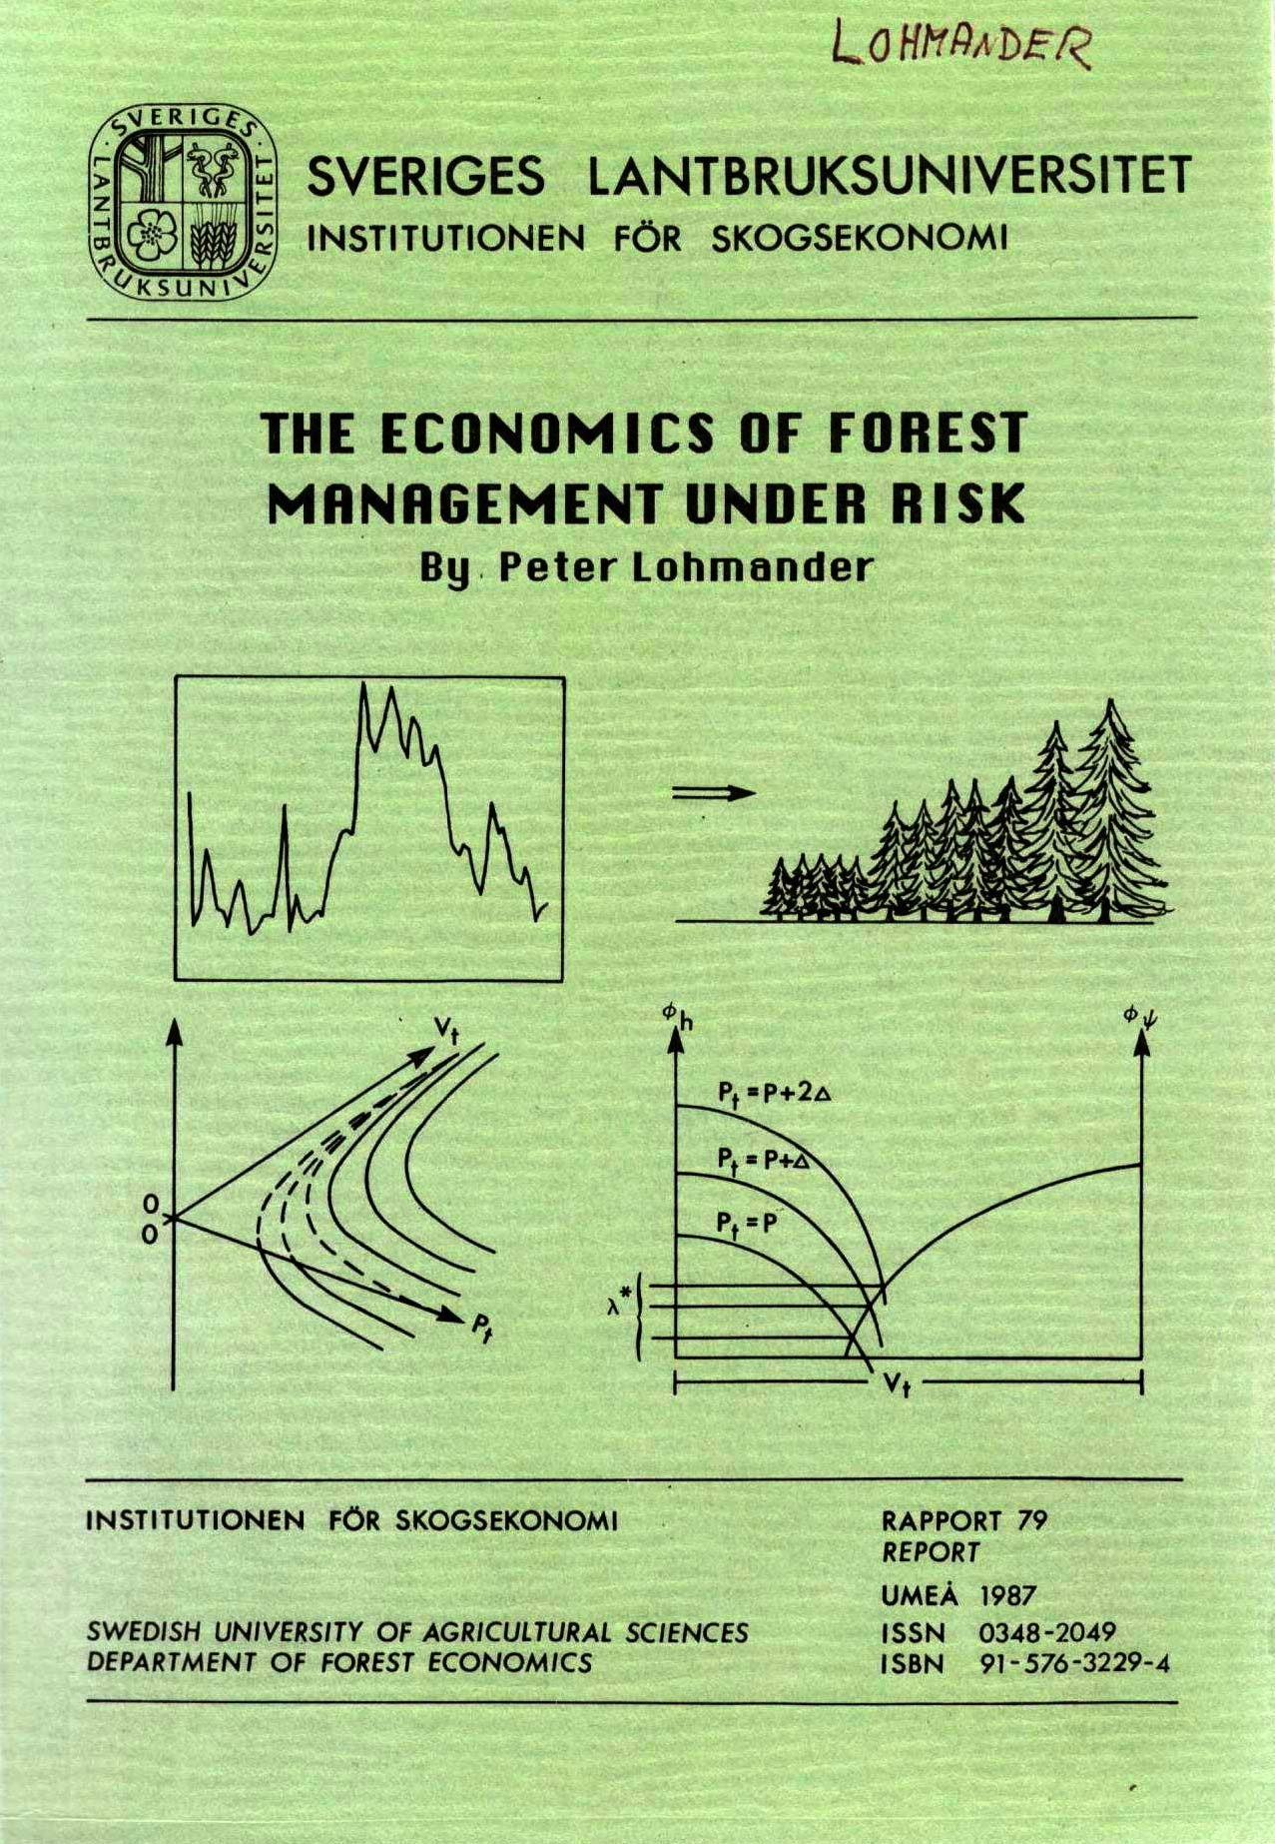
Related analyses, via stochastic dynamic programming, are found here:

Slide 82
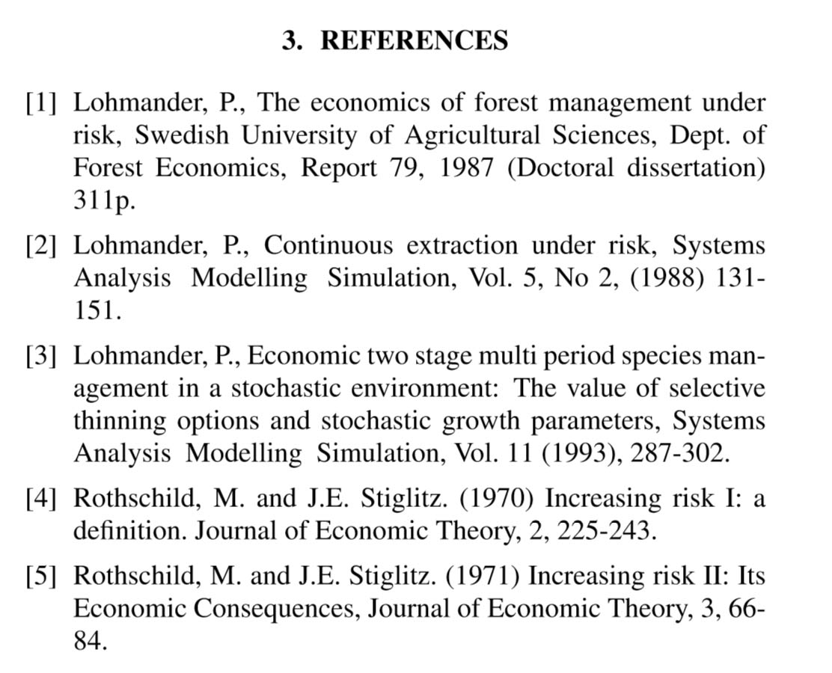
Many more references, including this presentation, are found here:
http://www.lohmander.com/Information/Ref.htm

Slide 83
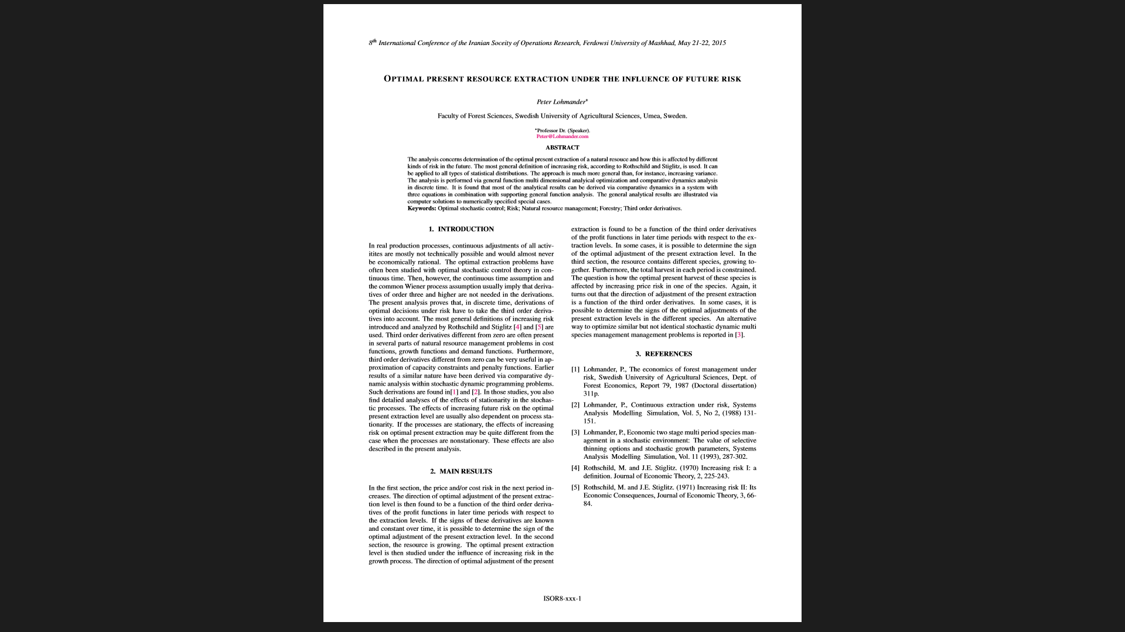
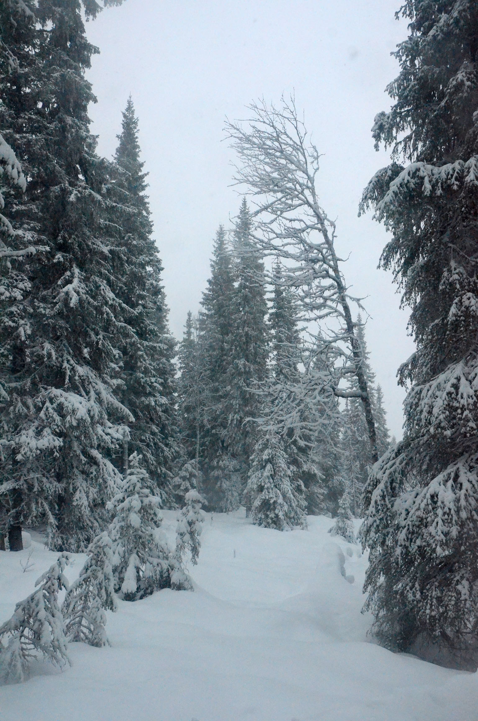

Slide 84
OPTIMAL PRESENT RESOURCE EXTRACTION UNDER THE INFLUENCE OF FUTURE RISK
Professor Dr Peter Lohmander
SLU, Sweden, http://www.Lohmander.com
Peter@Lohmander.com
The 8th International Conference of
Iranian Operations Research Society
Department of Mathematics Ferdowsi University of Mashhad, Mashhad, Iran.
www.or8.um.ac.ir
21-22 May 2015

