Slide 1
SUB MODELS FOR OPTIMAL CONTINUOUS COVER MULTI SPECIES FORESTRY IN IRAN (One part of the joint presentation by Soleiman Mohammadi Limaei, PeterLohmander and Leif Olsson )
Professor Dr Peter Lohmander
SLU, Sweden, http://www.Lohmander.com
Peter@Lohmander.com
The 8th International Conference of
Iranian Operations Research Society
Department of Mathematics Ferdowsi University of Mashhad, Mashhad, Iran.
www.or8.um.ac.ir
21-22 May 2015

Slide 2
The available empirical data was used to estimate a modified logistic growth model where stand density, altitude and species mix were considered as explanatory variables. Logistics growth models have been found useful in continuous cover forest management optimization and examples of such studies are found in Lohmander [3] and Lohmander and Mohammadi [4].
The general dynamics of forests based on such models was analyzed and dynamic equilibrium conditions (stand densities and species mixes) for different altitudes were determined.
In some cases, dynamic multi species model parameters are possible to determine via steady state observations of unmanaged forests.
Optimization of management decisions in a changing and not perfectly predictable world, should always be based on adaptive optimization. Lohmander [2] describes these principles and typical implications for optimal forestry decisions. Adaptable logistic growth functions work well in such cases.

Slide 3
References

Slide 4
Part 1.
The available empirical data was used to estimate a modified logistic growth model where stand density, altitude and species mix were considered as explanatory variables. Logistics growth models have been found useful in continuous cover forest management optimization and examples of such studies are found in Lohmander [3] and Lohmander and Mohammadi [4].

Slide 5
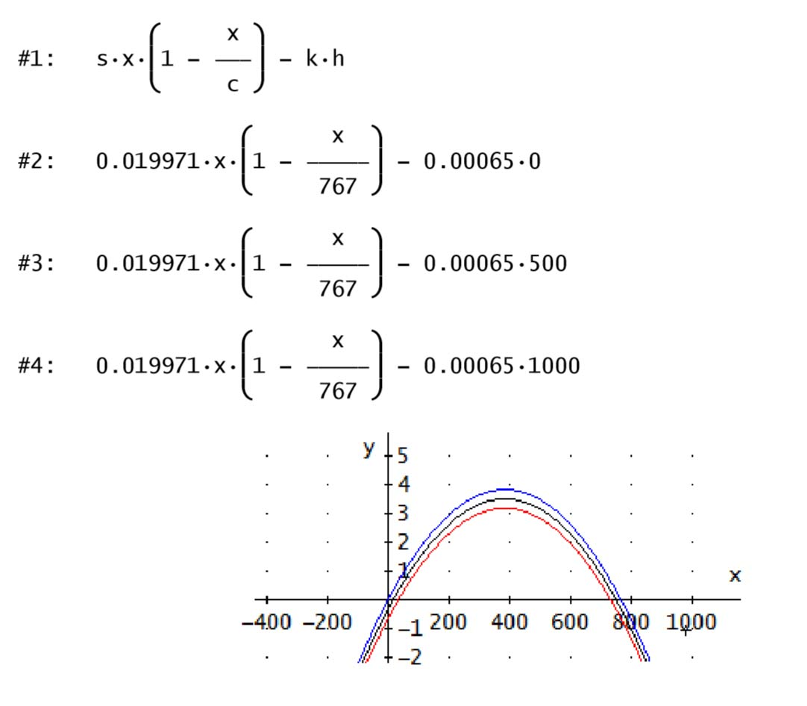
The available empirical data was used to estimate a modified logistic growth model where stand density, altitude and species mix were considered as explanatory variables.
Definitions
x = Stand density (m3/ha)
s = Intrinsic growth rate
c = Carrying capacity (m3/ha)
h = Altitude (meters)
k = Altitude parameter
At sea level
Growth (m3/ha/year)
Stand density
(m3/ha)
1000 meters above sea level

Slide 8
Empirical data

Slide 9
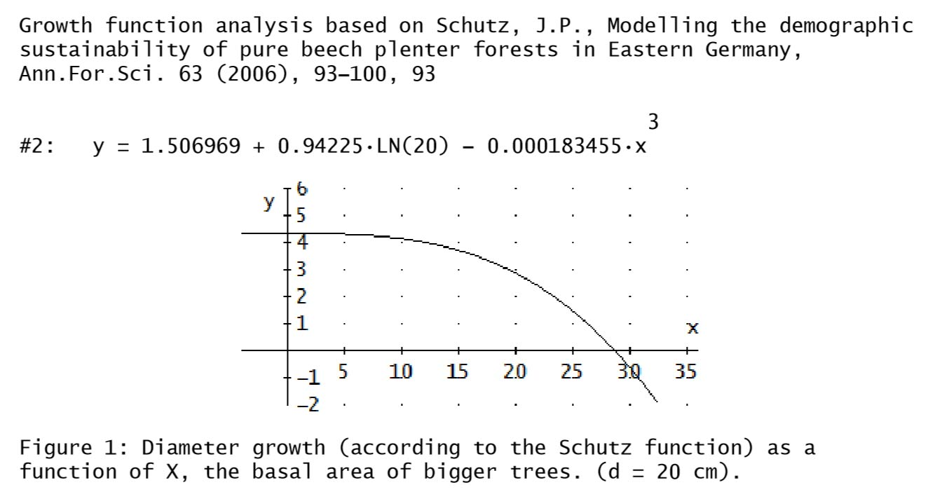
Competition within the forest stands (This particular slide is based on the results reported by Schutz (2006)

Slide 10
Area growth of individual trees
y = 0.1586038 xxLN(x) + 0.07038919999 x
x = area of individual tree (before growth) (m2)
y = area growth of individual tree (as area growth during the coming ten years divided by 10.) (m2/year)
Regression statistics:
F = 211.8, R2 = 0.872
t(x) = 13.09, t(xxLN(x)) = 9.56

Slide 12
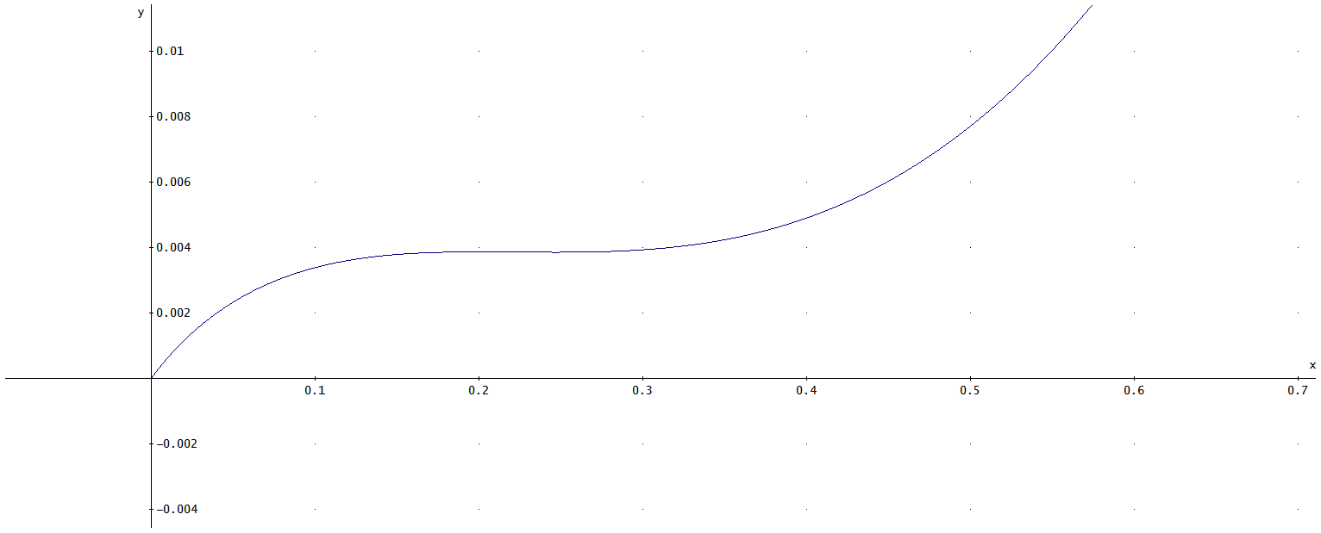
Area growth per tree per year as a function of the area before growth (per tree)
Growth of area of individual tree
(m2/year)
Area before growth
(m2)

Slide 13
Observations and suggestions for future estimations:
It would have been valuable to have more variation in the raw data. Now, the degrees of competition and the stand densities have low degrees of variation.
In the presently analyzed raw data, there are correlations different from zero between the possibly explaining variables ”direction” and ”altitude”. In the future, such correlations should be removed.
In the present data, there are also correlations different from zero between species and elevation. For instance, Beech is almost only found at the highest elevations.

Slide 14
Part 2.
The general dynamics of forests based on such models was analyzed and dynamic equilibrium conditions (stand densities and species mixes) for different altitudes were determined.

Slide 15
A dynamic two species model with competition (A system of two ”extended logistic models”)

Slide 16
CASE 1.
y
Unique
and
Stable
0
x
0

Slide 17
CASE 2.
y
Unique
and
Stable
0
x
0

Slide 18
CASE 3.
y
Unique
and
Stable
0
x
0

Slide 19
CASE 3 and 4: Interior equilibrium equations

Slide 20
CASE 4.
y
Stable
Unstable
0
x
Observation:
The equilibrium is a function of the initial conditions.
Stable
0

Slide 21
CASE 3b.
y
Unique and Stable
Observation:
Some species are more
sensitive to changes
in h than others. The growth
function of x is negatively
affected by h but the
equilibrium value of x still
increases if h increases.
0
x
0

Slide 22
Part 3.
In some cases, dynamic multi species model parameters are possible to determine via steady state observations of unmanaged forests.
If we can observe x and y in several equilibria, we can in some cases estimate relations between the parameters.
We can introduce altitude and direction in the ”parameters” and evaluate the equilibria at different altitudes and directions.
If we can observe x and y in several equilibria, at different altitudes and directions, we can in some cases estimate relations between the parameters and simultaneously determine the species specific sensitivities to altitude and direction.

Slide 23
Part 4.
Optimization of management decisions in a changing and not perfectly predictable world, should always be based on adaptive optimization. Lohmander [2] describes these principles and typical implications for optimal forestry decisions. Adaptable logistic growth functions work well in such cases.

Slide 24
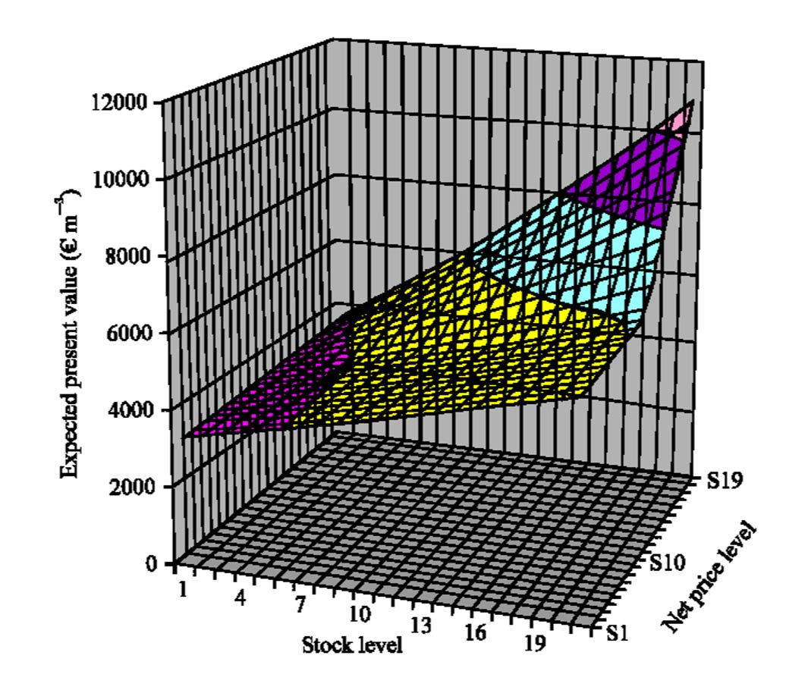
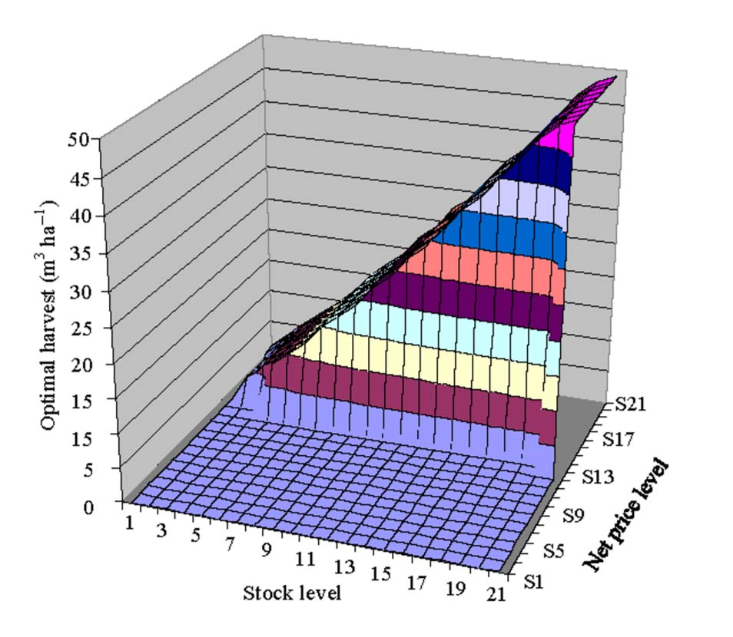
Lohmander and Mohammadi (2008)

Slide 26
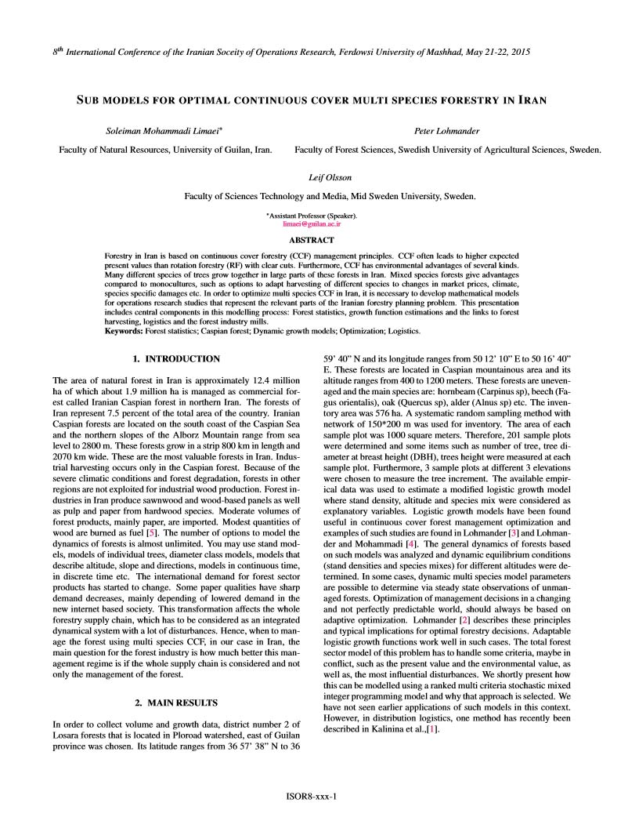

Slide 27
SUB MODELS FOR OPTIMAL CONTINUOUS COVER MULTI SPECIES FORESTRY IN IRAN (One part of the joint presentation by Soleiman Mohammadi Limaei, PeterLohmander and Leif Olsson )
Professor Dr Peter Lohmander
SLU, Sweden, http://www.Lohmander.com
Peter@Lohmander.com
The 8th International Conference of
Iranian Operations Research Society
Department of Mathematics Ferdowsi University of Mashhad, Mashhad, Iran.
www.or8.um.ac.ir
21-22 May 2015

