Slide 1

MATHEMATICAL APPENDIX to
Optimal continuous cover forest management:
- Economic and environmental effects and legal considerations
Professor Dr Peter Lohmander
http://www.Lohmander.com
Peter@Lohmander.com
BIT's 5th Low Carbon Earth Summit
(LCES 2015 & ICE-2015)
Theme: "Take Actions for Rebuilding a Clean World"
September 24-26, 2015
Venue: Xi'an, China

Slide 2
This mathematical appendix includes derivations of most of the results presented in:
”Optimal continuous cover forest management:
- Economic and environmental effects and legal considerations” by
Professor Dr Peter Lohmander http://www.Lohmander.com
Peter@Lohmander.com
BIT's 5th Low Carbon Earth Summit
(LCES 2015 & ICE-2015)
Theme: "Take Actions for Rebuilding a Clean World"
September 24-26, 2015
Venue: Xi'an, China

Slide 65
Optimal continuous cover forest management
First, we study:
One dimensional optimization in the time interval dimension
(of relevance when the stock level after harvest is determined by law or can not be determined for some other reason)

Slide 68
Optimal principle in the time dimension:

Slide 69
How is the optimal time interval affected if the parameter c marginally increases (ceteres paribus)?

Slide 70
A unique optimum is assumed in the time interval dimension
Conclusion:
The optimal time interval is a strictly increasing function of c.

Slide 71
How is the optimal time interval affected if the parameter r marginally increases (ceteres paribus)?
Conclusion:
The optimal time interval is
a strictly decreasing function
of the parameter r.

Slide 72
How is the optimal time interval affected if the future prices marginally increase (ceteres paribus)?

Slide 73
Conclusion:
The optimal time interval is a strictly decreasing function of the parameter p.

Slide 74
Optimal continuous cover forest management
Now, we study:
One dimensional optimization in the volume dimension
(of relevance when the time interval is determined by law or can not be determined for some other reason)

Slide 76
Optimal principle in the volume dimension:

Slide 77
How is the optimal volume affected if one parameter marginally increases (ceteres paribus)?
- The optimal volume is not affected by changes of c.
- The optimal volume is a strictly decreasing function of r.
- The optimal volume is a strictly increasing function of p.

Slide 78
Observation:
If the volume is constrained (by law or something else), we may study the effects of the volume constraint on the optimal time interval, via one dimensional optimization.

Slide 79
Observation (extended):
If the time interval is constrained (by law or something else), we may study the effects of the time interval constraint on the volume, via one dimensional optimization.

Slide 80
Optimal continuous cover forest management
Now, we study:
Two dimensional optimization in the volume AND time interval dimensions

Slide 82
The first order optimum conditions:

Slide 83
Assumption: A unique maximum exists. The following conditions hold:

Slide 85
Comparative statics analysis based on two dimensional optimization:

Slide 93
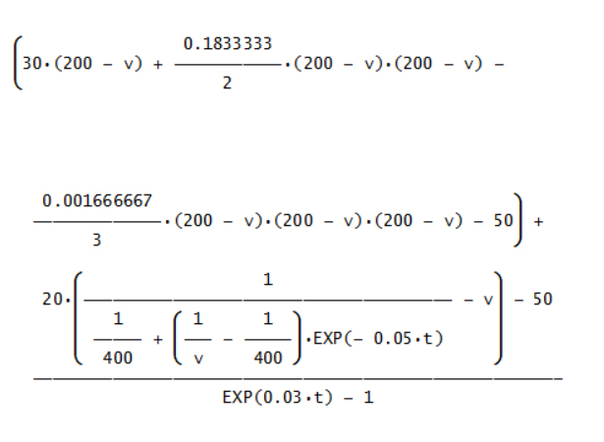
Graphical
illustrations
based on
specified
functions
and
parameters

Slide 94
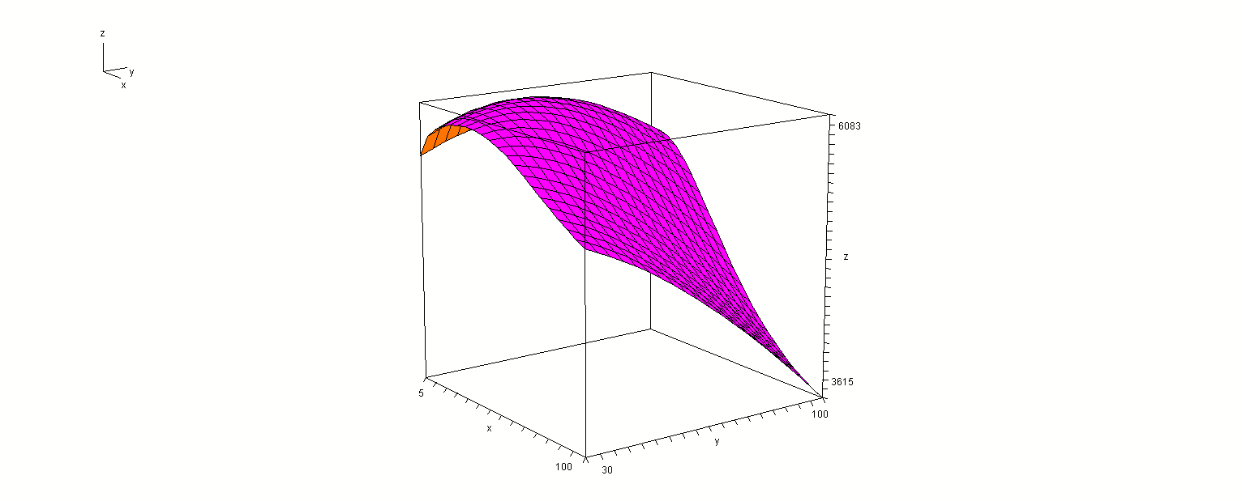
Present
value
t
v1

Slide 95
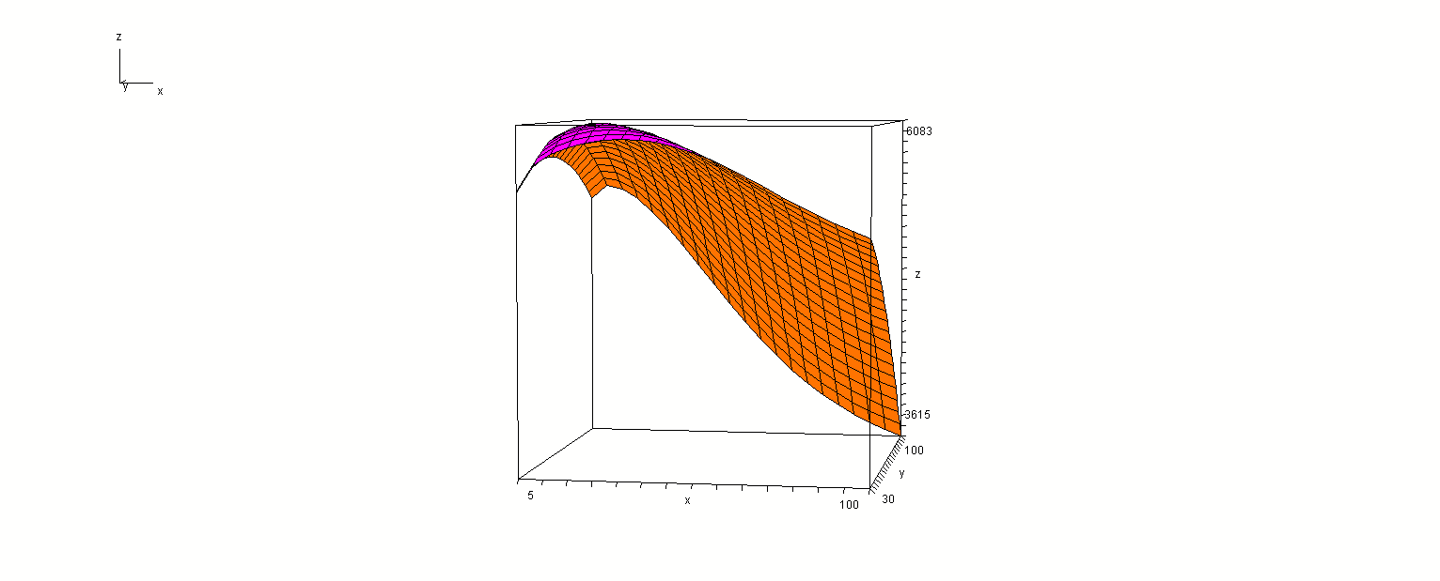
Present
value
v1
t

Slide 96
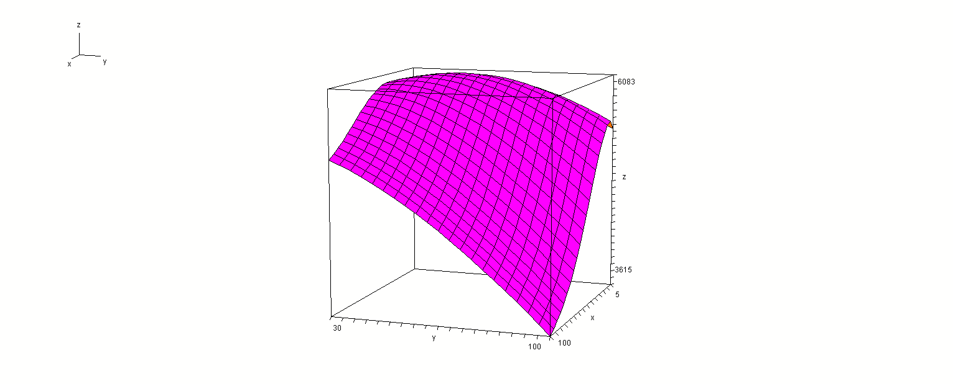
Present
value
t
v1

Slide 97
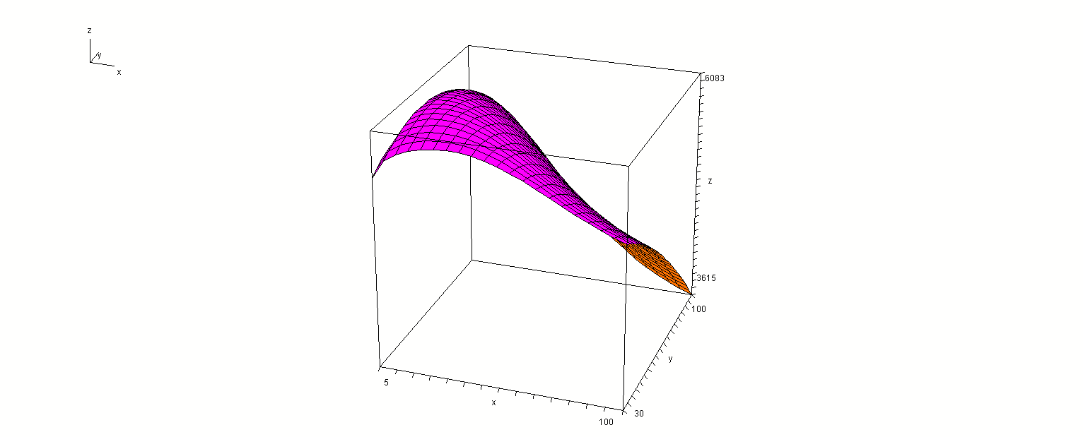
Present
value
v1
t

Slide 98
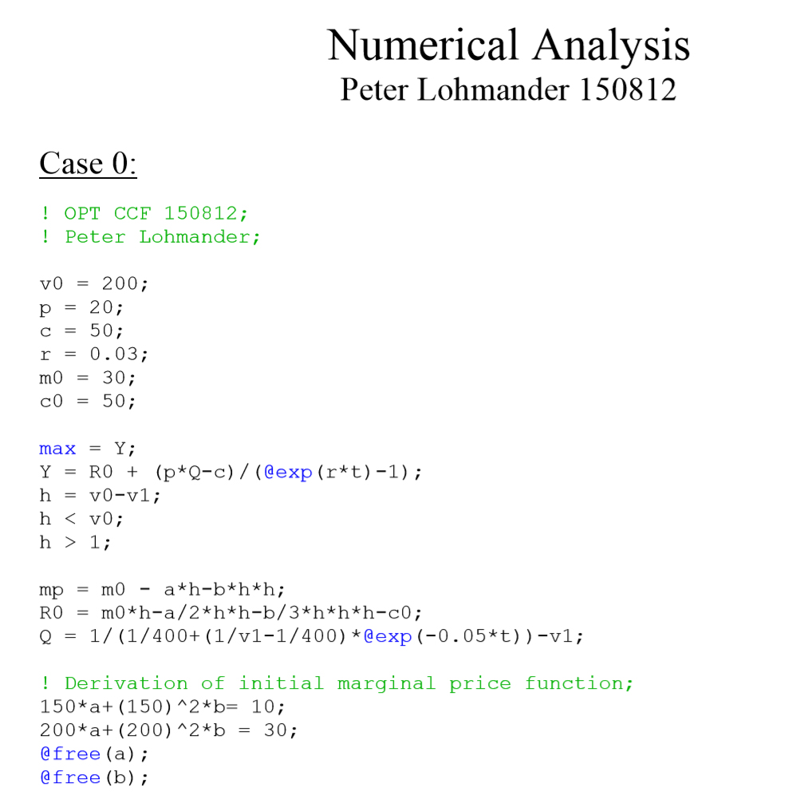

Slide 99
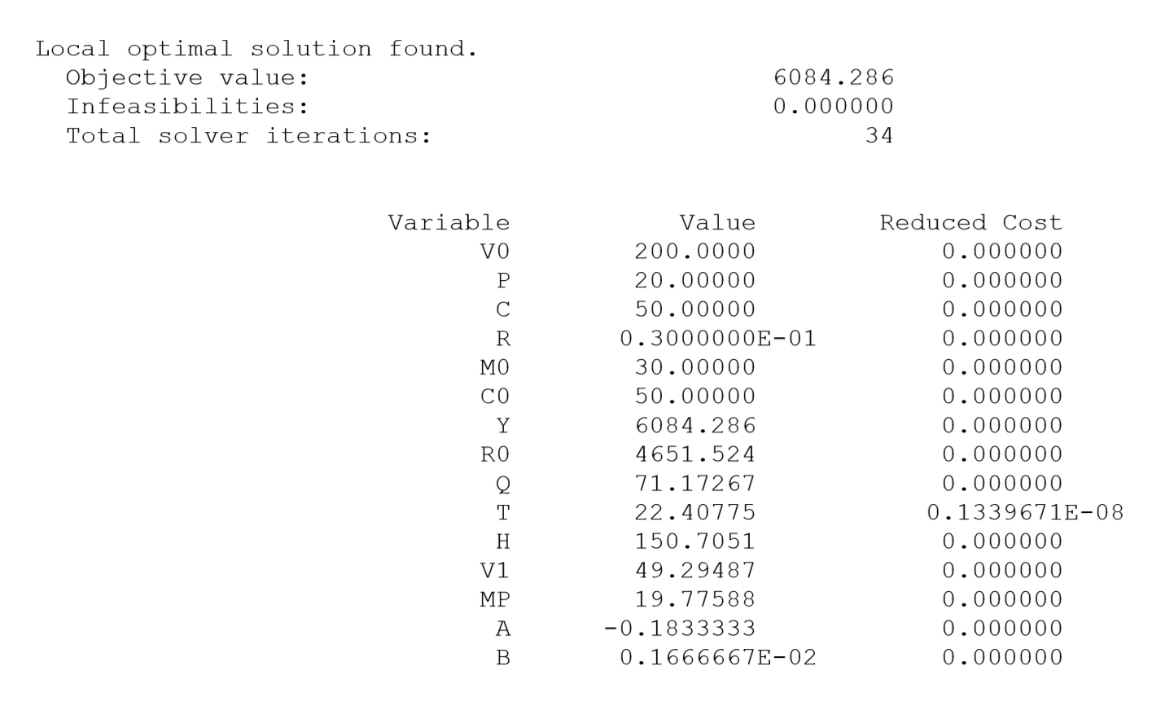

Slide 108
The following pages include general second order conditions with notation following Chiang, A., Fundamental methods of mathematical economics, McGraw-Hill, 2 ed., 1974

Slide 112
MATHEMATICAL APPENDIX to
Optimal continuous cover forest management:
- Economic and environmental effects and legal considerations
Professor Dr Peter Lohmander
http://www.Lohmander.com
Peter@Lohmander.com
BIT's 5th Low Carbon Earth Summit
(LCES 2015 & ICE-2015)
Theme: "Take Actions for Rebuilding a Clean World"
September 24-26, 2015
Venue: Xi'an, China

