Slide 1
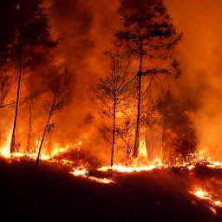


The Future of Forest Wildfires in the Czech Republic
Scientific Workshop
The Czech University of Life Sciences (CZU)
Faculty of Forestry and Wood Sciences
2 PM, August 23, 2022
Peter Lohmander
Prof Dr
Optimal Solutions
Sweden
Peter@Lohmander.com
Version 220813_1405

Slide 2
This presentation is based on the following open access articles and documents. More details can be obtained from the links found below.
[1] Lohmander P. (2020a). Dynamics and control of the CO2 level via a differential equation and alternative global emission strategies. Int Rob Auto J. 2020;6(1):7‒15. DOI: 10.15406/iratj.2020.06.0019, https://medcraveonline.com/IRATJ/IRATJ-06-00197.pdf
[2] Lohmander, P. (2020b)., Optimization of continuous cover forestry expansion under the influence of global warming, International Robotics & Automation Journal, Volume 6, Issue 3, 2020, 127-132. https://medcraveonline.com/IRATJ/IRATJ-06-00211.pdf ,
https://medcraveonline.com/IRATJ/IRATJ-06-00211A.pdf
[3] Lohmander, P. (2020c). Fundamental principles of optimal utilization of forests with consideration of global warming, Central Asian Journal of Environmental Science and Technology Innovation, Volume 1, Issue 3, May and June 2020, 134-142. doi: 10.22034/CAJESTI.2020.03.02 http://www.cas-press.com/article_111213.html http://www.cas-press.com/article_111213_5ab21574a30f6f2c7bdc0a0733234181.pdf

Slide 3
[4] Lohmander P. (2020d). Adaptive mobile firefighting resources: stochastic dynamic optimization of international cooperation. Int Rob Auto J. 2020;6(4):150‒155. DOI: 10.15406/iratj.2020.06.00213, https://medcraveonline.com/IRATJ/IRATJ-06-00213.pdf
[5] Lohmander, P. (2020e). Forest fire expansion under global warming conditions: -Multivariate estimation, function properties and predictions for 29 countries. Cent. Asian J. Environ. Sci. Technol. Innov., 5, 262-276, https://www.cas-press.com/article_122566_c3544cd0c21d5c077f72e985a77d30e9.pdf
[6] Lohmander, P. (2021a). Optimization of Forestry, Infrastructure and Fire Management. Caspian Journal of Environmental Sciences, 19: 287-316, https://cjes.guilan.ac.ir/article_4746_197fe867639c4cc5e317b63f9f9d370b.pdf

Slide 4
[7] Lohmander P. (2021b). Optimization of distance between fire stations: effects of fire ignition probabilities, fire engine speed and road limitations, property values and weather conditions. Int Rob Auto J. 2021;7(4):112‒120. DOI: 10.15406/iratj.2021.07.0023 , https://medcraveonline.com/IRATJ/IRATJ-07-00235.pdf
[8] Lohmander, P. (2021c). Global Stability via the Forced Global Warming Equation, Fire Control with Joint Fire Fighting Resources, and Optimal Forestry, KEYNOTE at ICASE 2021: International Conference on Applied Science & Engineering, March 31, 2021., http://www.Lohmander.com/PL_ICASE_2021_Abstract.pdf, http://www.Lohmander.com/PL_ICASE_2021_KEYNOTE.pdf
[9] Mohammadi, Z., Lohmander, P., Kašpar, J., Berčák, R., Holuša, J., & Marušák, R. (2021). The effect of climate factors on the size of forest wildfires (case study: Prague-East district, Czech Republic). Journal of Forestry Research. https://doi.org/10.1007/s11676-021-01413-w

Slide 5
[10] Lohmander, P., Statistics and Mathematics of General Control Function Optimization
for Continuous Cover Forestry, with a Swedish Case Study based on Picea abies,
including Nils Fagerberg, Forest data and functions,
Statistics for Twenty-first Century 2021, (ICSTC 2021), 16-19 December 2021,
Organized by Department of Statistics, University of Kerala, Trivandrum, India,
Complete pdf version that can not show movie clips: http://www.Lohmander.com/PL_NF_ICSTC_2021.pdf
Complete pptx version with movie clips (243 Mb): http://www.Lohmander.com/PL_NF_ICSTC_2021.pptx
Complete presentation as movie: https://www.youtube.com/watch?v=RL2qaZ9O5rU
[11] Nils Fagerberg, Peter Lohmander, Ola Eriksson, Jan-Ola Olsson, Bishnu Chandra Poudel & Johan Bergh (2022),
Evaluation of individual-tree growth models for Picea abies based on a case study of an uneven-sized stand in
southern Sweden, Scandinavian Journal of Forest Research, DOI: 10.1080/02827581.2022.2037700
https://www.tandfonline.com/doi/pdf/10.1080/02827581.2022.2037700
[12] Fagerberg, N., Olsson, J-O., Lohmander, P., Andersson, M., Bergh, J.,
Individual-tree distance-dependent growth models for uneven-sized Norway spruce,
Forestry: An International Journal of Forest Research, 2022;, cpac017,
https://doi.org/10.1093/forestry/cpac017
http://www.Lohmander.com/cpac017.pdf

Slide 6
[13] Lohmander, P., Mohammadi, Z., Kaspar, J., Tahry, M., Bercak, R., Holusa, J., Marusak, R., (2022). Future forest fires as a functions of climate change and attack time for central Bohemian region, Czech Republic, Annals of Forest Research 65(1): 17-30. https://www.afrjournal.org/index.php/afr/issue/archive
[14] Lohmander, P., (2022). Rational Control of Global Warming Dynamics via Emission Reductions and Forestry Expansion (International Journal of Earth and Environmental Sciences, Accepted for publication).
[15] Lohmander, P., Fagerberg, N. (2022). Statistics and Mathematics of General Control Function Optimization for Continuous Cover Forestry, with a Swedish Case Study based on Picea abies (AJSS, Asean Journal of Statistical Sciences, In print).
[16] Lohmander, P., Optimal Dynamic Forest Fire Management Adapted to Stochastic Weather and Mohammadi, Z., Empirical data and support, Sixth International Webinar on RECENT TRENDS IN STATISTICAL THEORY AND APPLICATIONS-2022 (WSTA-2022), June 29 to July 02, 2022, Organized by: Department of Statistics, School of Physical and Mathematical Sciences, University of Kerala, Trivandrum in association with Indian Society for Probability and Statistics (ISPS) and Kerala Statistical Association (KSA). The first link is a presentation movie. The second and third links give the pdf and the pptx versions.
https://youtu.be/BBmLmBAvBjU
http://www.Lohmander.com/PL_WSTA_2022.pdf
http://www.Lohmander.com/PL_WSTA_2022.pptx

Slide 7
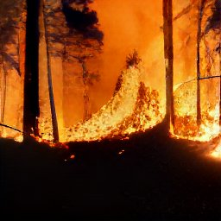
The Future of Forest Wildfires in the Czech Republic:
This future is a function of several things.
#1. Some of these can not be very much affected by humans.
#2. Some of these can be affected by humans in all countries, in the long run.
#3. Some of these can be affected by humans, in the country, in the long run.
#4. Some of these can be affected by humans, in the country, in the short run.

Slide 8



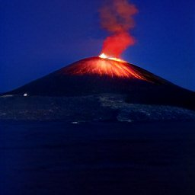
Asteroids can hit the Earth. A volcanic winter can occur if volcanoes explode and increase the reflection of solar radiation. The orbit of the Earth changes, periodically and aperiodically. The planetary system contains deterministic chaos and cannot be perfectly predicted and/or proved to be stable in the long run. Temperature changes follow.

Slide 9
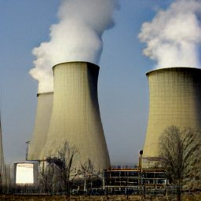
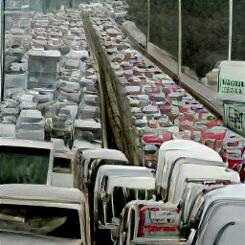
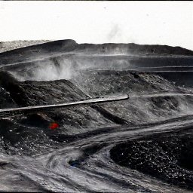
SUB-TOPIC 1: CO2 Dynamics and Emission Control
The emissions can be changed.
Even with strong emission reductions, however, the CO2 level in the atmosphere changes very slowly.
Global long term cooperation
is necessary.

Slide 10
SUB-TOPIC 1: CO2 Dynamics and Emission Control
Recent results from the author:
[1] Lohmander P. (2020a). Dynamics and control of the CO2 level via a differential equation and alternative global emission strategies. Int Rob Auto J. 2020;6(1):7‒15. DOI: 10.15406/iratj.2020.06.0019, https://medcraveonline.com/IRATJ/IRATJ-06-00197.pdf
[8] Lohmander, P. (2021c). Global Stability via the Forced Global Warming Equation, Fire Control with Joint Fire Fighting Resources, and Optimal Forestry, KEYNOTE at ICASE 2021: International Conference on Applied Science & Engineering, March 31, 2021., http://www.Lohmander.com/PL_ICASE_2021_Abstract.pdf, http://www.Lohmander.com/PL_ICASE_2021_KEYNOTE.pdf
[14] Lohmander, P., (2022). Rational Control of Global Warming Dynamics via Emission Reductions and Forestry Expansion (International Journal of Earth and Environmental Sciences, Accepted for publication).

Slide 11
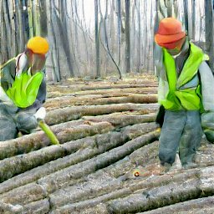

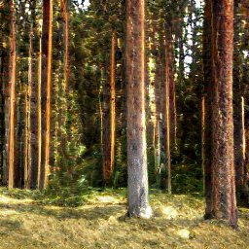
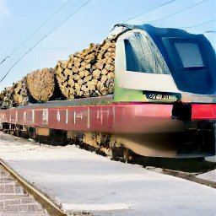
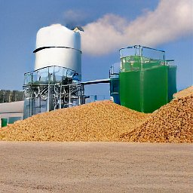
SUB-TOPIC 2: Environmentally acceptable forestry expansion and CO2 effects
Environmentally acceptable expansion of optimal and active forestry, adapted to climate change and fire risk, railways and green energy, can reduce CO2 in the atmosphere.

Slide 12
SUB-TOPIC 2: Environmentally acceptable forestry expansion and CO2 effects
Recent results from the author:
[2] Lohmander, P. (2020b)., Optimization of continuous cover forestry expansion under the influence of global warming, International Robotics & Automation Journal, Volume 6, Issue 3, 2020, 127-132. https://medcraveonline.com/IRATJ/IRATJ-06-00211.pdf ,
https://medcraveonline.com/IRATJ/IRATJ-06-00211A.pdf
[3] Lohmander, P. (2020c). Fundamental principles of optimal utilization of forests with consideration of global warming, Central Asian Journal of Environmental Science and Technology Innovation, Volume 1, Issue 3, May and June 2020, 134-142. doi: 10.22034/CAJESTI.2020.03.02 http://www.cas-press.com/article_111213.html http://www.cas-press.com/article_111213_5ab21574a30f6f2c7bdc0a0733234181.pdf
[6] Lohmander, P. (2021a). Optimization of Forestry, Infrastructure and Fire Management. Caspian Journal of Environmental Sciences, 19: 287-316, https://cjes.guilan.ac.ir/article_4746_197fe867639c4cc5e317b63f9f9d370b.pdf
[14] Lohmander, P., (2022). Rational Control of Global Warming Dynamics via Emission Reductions and Forestry Expansion (International Journal of Earth and Environmental Sciences, Accepted for publication).

Slide 13
SUB-TOPIC 2: Environmentally acceptable forestry expansion and CO2 effects
Recent results from the author and some colleagues (continued from the earlier page):
[10] Lohmander, P., Statistics and Mathematics of General Control Function Optimization for Continuous Cover Forestry, with a Swedish Case Study based on Picea abies, including Nils Fagerberg, Forest data and functions, Statistics for Twenty-first Century 2021, (ICSTC 2021), 16-19 December 2021, Organized by Department of Statistics, University of Kerala, Trivandrum, India,
Complete pdf version that can not show movie clips: http://www.Lohmander.com/PL_NF_ICSTC_2021.pdf
Complete pptx version with movie clips (243 Mb): http://www.Lohmander.com/PL_NF_ICSTC_2021.pptx
Complete presentation as movie: https://www.youtube.com/watch?v=RL2qaZ9O5rU
[11] Nils Fagerberg, Peter Lohmander, Ola Eriksson, Jan-Ola Olsson, Bishnu Chandra Poudel & Johan Bergh (2022),
Evaluation of individual-tree growth models for Picea abies based on a case study of an uneven-sized stand in
southern Sweden, Scandinavian Journal of Forest Research, DOI: 10.1080/02827581.2022.2037700
https://www.tandfonline.com/doi/pdf/10.1080/02827581.2022.2037700
[12] Fagerberg, N., Olsson, J-O., Lohmander, P., Andersson, M., Bergh, J.,
Individual-tree distance-dependent growth models for uneven-sized Norway spruce,
Forestry: An International Journal of Forest Research, 2022;, cpac017,
https://doi.org/10.1093/forestry/cpac017
http://www.Lohmander.com/cpac017.pdf
[15] Lohmander, P., Fagerberg, N. (2022). Statistics and Mathematics of General Control Function Optimization for Continuous Cover Forestry, with a Swedish Case Study based on Picea abies (AJSS, Asean Journal of Statistical Sciences, In print).

Slide 14
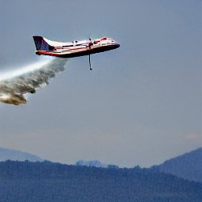
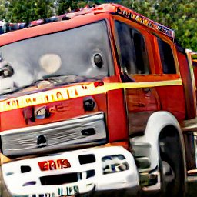
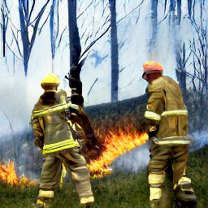
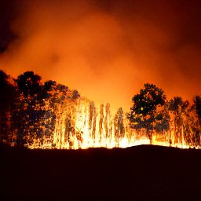
SUB-TOPIC 3: Fire fighting resources, infrastructure investments and cooperation
Investments in firefighting capacity and infrastructure take considerable time.
International fire cooperation plans and agreements are important.
These things are necessary to make it possible to rapidly fight fires.

Slide 15
SUB-TOPIC 3: Fire fighting resources, infrastructure investments and cooperation
Recent results concerning these topics from the author:
[4] Lohmander P. (2020d). Adaptive mobile firefighting resources: stochastic dynamic optimization of international cooperation. Int Rob Auto J. 2020;6(4):150‒155. DOI: 10.15406/iratj.2020.06.00213, https://medcraveonline.com/IRATJ/IRATJ-06-00213.pdf
[6] Lohmander, P. (2021a). Optimization of Forestry, Infrastructure and Fire Management. Caspian Journal of Environmental Sciences, 19: 287-316, https://cjes.guilan.ac.ir/article_4746_197fe867639c4cc5e317b63f9f9d370b.pdf
[7] Lohmander P. (2021b). Optimization of distance between fire stations: effects of fire ignition probabilities, fire engine speed and road limitations, property values and weather conditions. Int Rob Auto J. 2021;7(4):112‒120. DOI: 10.15406/iratj.2021.07.0023 , https://medcraveonline.com/IRATJ/IRATJ-07-00235.pdf

Slide 16

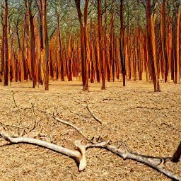

SUB-TOPIC 4: Forest fire dynamics as a function of weather and attack time
The size of a forest fire increases rapidly if the air is hot and dry, and the wind speed is high.
Fire size functions have been estimated for 29 countries.
Detailed functions have been estimated in Czech Republic.
In CR, the fire size has also been studied as a function of the time it takes to reach the fire.

Slide 17
SUB-TOPIC 4: Forest fire dynamics as a function of weather and attack time
Recent results from the author and some colleagues:
[5] Lohmander, P. (2020e). Forest fire expansion under global warming conditions: -Multivariate estimation, function properties and predictions for 29 countries. Cent. Asian J. Environ. Sci. Technol. Innov., 5, 262-276, https://www.cas-press.com/article_122566_c3544cd0c21d5c077f72e985a77d30e9.pdf
[9] Mohammadi, Z., Lohmander, P., Kašpar, J., Berčák, R., Holuša, J., & Marušák, R. (2021). The effect of climate factors on the size of forest wildfires (case study: Prague-East district, Czech Republic). Journal of Forestry Research. (2021). https://doi.org/10.1007/s11676-021-01413-w
[13] Lohmander, P., Mohammadi, Z., Kaspar, J., Tahry, M., Bercak, R., Holusa, J., Marusak, R., (2022). Future forest fires as a functions of climate change and attack time for central Bohemian region, Czech Republic, Annals of Forest Research 65(1): 17-30. https://www.afrjournal.org/index.php/afr/issue/archive

Slide 18

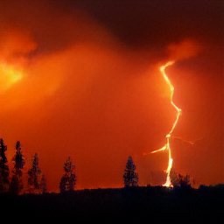
A fire can start in almost any position. Before it has started, the position can be considered as stochastic.
In some cases, we may estimate probability density functions.

Slide 19
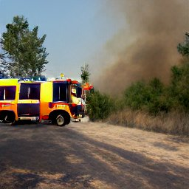
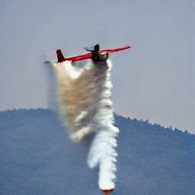
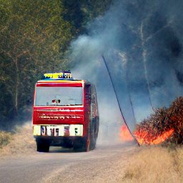
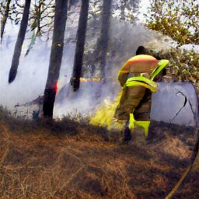
SUB-TOPIC 5: Optimal adaptive fire fighting decisions conditional on the latest weather information and predictions
We should dynamically adapt the positioning and readiness of fire fighting units to the latest weather information and weather forecasts.
If the temperature will be high, the air will be dry and the wind will be strong:
Make sure that more resources are ready to act, and that they are placed in the optimal initial positions!

Slide 20
SUB-TOPIC 5: Optimal adaptive fire fighting decisions conditional on the latest weather information and predictions
Recent results from the author and a colleague:
[7] Lohmander P. (2021b). Optimization of distance between fire stations: effects of fire ignition probabilities, fire engine speed and road limitations, property values and weather conditions. Int Rob Auto J. 2021;7(4):112‒120. DOI: 10.15406/iratj.2021.07.0023 , https://medcraveonline.com/IRATJ/IRATJ-07-00235.pdf
[16] Lohmander, P., Optimal Dynamic Forest Fire Management Adapted to Stochastic Weather and Mohammadi, Z., Empirical data and support, Sixth International Webinar on RECENT TRENDS IN STATISTICAL THEORY AND APPLICATIONS-2022 (WSTA-2022), June 29 to July 02, 2022, Organized by: Department of Statistics, School of Physical and Mathematical Sciences, University of Kerala, Trivandrum in association with Indian Society for Probability and Statistics (ISPS) and Kerala Statistical Association (KSA). The first link is a presentation movie. The second and third links give the pdf and the pptx versions.
https://youtu.be/BBmLmBAvBjU
http://www.Lohmander.com/PL_WSTA_2022.pdf
http://www.Lohmander.com/PL_WSTA_2022.pptx

Slide 21
The Future of Forest Wildfires in the Czech Republic:
This future is a function of several things.
#1. Some of these can not be very much affected by humans.
#2. Some of these can be affected by humans in all countries, in the long run.
#3. Some of these can be affected by humans, in the country, in the long run.
#4. Some of these can be affected by humans, in the country, in the short run.

Slide 22
A general fire fighting decision optimization problem under present investigation:
“Optimal Dynamic Forest Fire Management Adapted to Stochastic Weather (marginally updated)”
Thank you Dr Zohreh Mohammadi
for very valuable data and information!

Slide 23
Contents:
The firefighting capacity optimization problem
General solution to the firefighting capacity optimization problem
Comparative statics analysis of the optimal solution: How is the optimal solution affected by the parameters?
Fire growth as a function of weather conditions
Background to empirical weather and fire data
Dynamic and stochastic properties of air temperature, relative humidity and wind speed
Conclusions

Slide 24
The firefighting capacity optimization problem
Forest fires have a spatially uniform probability density function.
Fire fighting units (blue balls) have initial locations in a regular ”infinite” network with roads in directions N-S and E-W.
The distances between roads is small and fire fighting units can always use roads in the two directions to reach the different fires. (See the purple arrows.)
The decision problem is to determine
the optimal value of k, where the
distance between the nearest neighbours
is L = 2k.
The optimal value of k is affected by many
different parameters, some of which
are functions of the season, for instance air temperature, relative humidity and wind speed. These parameters affect fire growth.
N
k
k
y
Fire fighting
unit 1.
x

Slide 25
Expected total
costs as a
function of k.
Expected cost of
fire fighting capacity
”investment”
and use of these
resources
Fire fighting groups are
located in a regular network with
roads in directions South-North
and East- West. The distance
in one of these directions, between
two neighbour groups, is L = 2k.
Expected cost of destroyed and damaged forests
including costs of CO2 emissions

Slide 26
Expected cost
per burned ha.
A = Air temperature (Stochastic)
H = Relative humidity (Stochastic)
W = Wind speed (Stochastic)
t(k,m) = expected time of fire life.
m = fire life time before the
fire fighting unit leaves the initial
location and starts to move towards
the fire.
Expected size of burned forest, per fire.
Expected number of fires
per time unit.
Expected cost of destroyed and damaged forests
including costs of CO2 emissions

Slide 27
Number of units per 10000 square km
Expected cost of
fire fighting capacity
”investment”
and use of these
Resources.
Expected cost
per unit.

Slide 28
Obs: In the
analysis of B1(k,m), k and m are both expressed in the unit ”time”. We may consider the distance between fire stations as the time it takes to go from one station to the other. Of course, this can also be considered as a function of the road quality and the capacity of the fire engines.
This has been estimated
with empirical data.
Expected size of burned forest,
per fire.
This will be shown to hold
in general cases.

Slide 29
Why is
?
k
Random fires in the square
that is closest to fire fighting
unit 1.
k
y
Fire fighting
unit 1.
x

Slide 30
Convolution

Slide 40
Hence,
Important properties:

Slide 41
General solution to the firefighting capacity optimization problem

Slide 44
0
k
0
k

Slide 45
Comparative statics analysis of the optimal solution: How is the optimal solution affected by the parameters?

Slide 47
If the cost per fire fighting unit increases,
the optimal distance between fire fighting units increases.

Slide 48
0
k

Slide 49
If the cost per fire damaged hectare of forest increases,
the optimal distance between fire fighting units decreases.
Note that, if the cost of CO2 emissions is considered, the
optimal value of k is lower than if we do not care
about CO2 emissions.

Slide 50
0
k

Slide 51
If the expected number of fires per area unit increases,
the optimal distance between fire fighting units decreases.

Slide 52
If the general fire speed parameter c increases,
the optimal distance between fire fighting units decreases.
Possible reasons: More open terrain and/or
larger amounts of dry grass and other fuels.

Slide 53
If m increases, the fires get more time to grow before fire supression starts,
and the optimal distance between fire fighting units decreases.
Possible reasons: Less efficient and/or intensive fire surveillance,
fog, smoke or worse road conditions, forcing the fire fighting units
to decrease the travel speed.

Slide 54
Fire growth as a function of weather conditions
The comparative statics analysis now needs some empirical information.

Slide 55
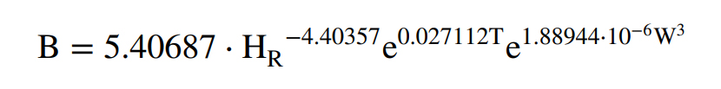
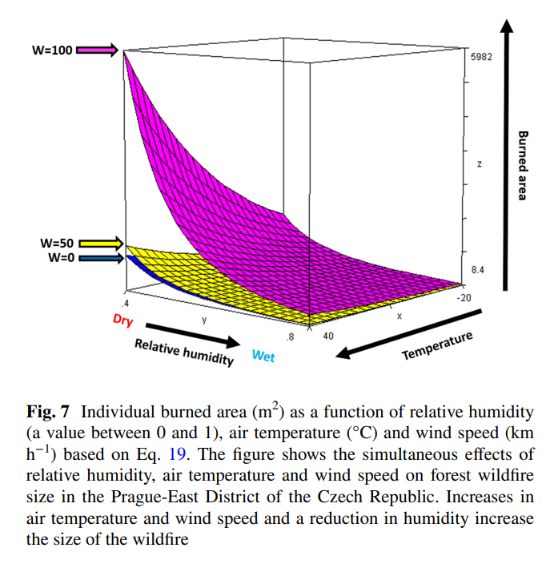
Mohammadi, Z., Lohmander, P., Kašpar, J. et al. The effect of climate factors on the size of forest wildfires (case study: Prague-East district, Czech Republic). J. For. Res. (2021). https://doi.org/10.1007/s11676-021-01413-w

Slide 56
The empirical estimations gave these results:

Slide 57
If the air temperature increases, the speed of fire growth increases,
and the optimal distance between fire fighting units decreases.

Slide 58
If the relative humidity increases, the speed of fire growth decreases,
and the optimal distance between fire fighting units increases.

Slide 59
If the wind speed increases, the speed of fire growth increases,
and the optimal distance between fire fighting units decreases.

Slide 60
Comments on the optimimization problem
Above, we have assumed that labor employment constraints are applied, that require that the numbers of fire fighting units at different points in time are determined before the true weather component residuals are known.
Optimality conditions of the dynamically changing firefighting capacity levels have been analytically determined.
The solutions have been found to be unique minima.
Comparative statics analysis has been used to determine the directions of change of the optimal capacity levels under the influence of alternative parameter changes.
The expected fire sizes can also be numerically approximated via random numbers with relevant correlations, based on Cholesky factorization.
A stochastic dynamic programming version of the dynamic investment decision problem is also possible to present, based on a very flexible labor market, where the number of fire fighting units rapidly can be adapted to the sequentially revealed weather situation. However, since time is limited and since such labour conditions are not relevant in many countries, this will not be presented here.

Slide 61
Background to empirical weather and fire data
Thank you Dr Zohreh Mohammadi
for very valuable data and information!

Slide 62
Dynamic and stochastic properties of air temperature, relative humidity and wind speed
The following parameter estimations related to dynamic and stochastic properties of air temperature, relative humidity and wind speed, can be used in the fire fighting capacity optimization problem.

Slide 65
Relative humidity

Slide 72
Conclusions
The optimal fire fighting capacity is a dynamically changing function of several parameters. The optimal solution has been derived and presented in general form. Comparative statics analysis has been used to show how the optimal decisions are affected by parameter changes.
Since the optimal decisions are functions of many local cost parameters and since different regions have different and dynamically changing weather parameters, the optimal capacity solutions are not the same in different regions.
The general approach presented here should be possible to use in most countries and regions of our world.

Slide 73
Thank you very much for your time and for inviting me to Prague!
Professor Dr Peter Lohmander
Peter@Lohmander.com
http://www.lohmander.com/Information/Ref.htm

