Slide 1
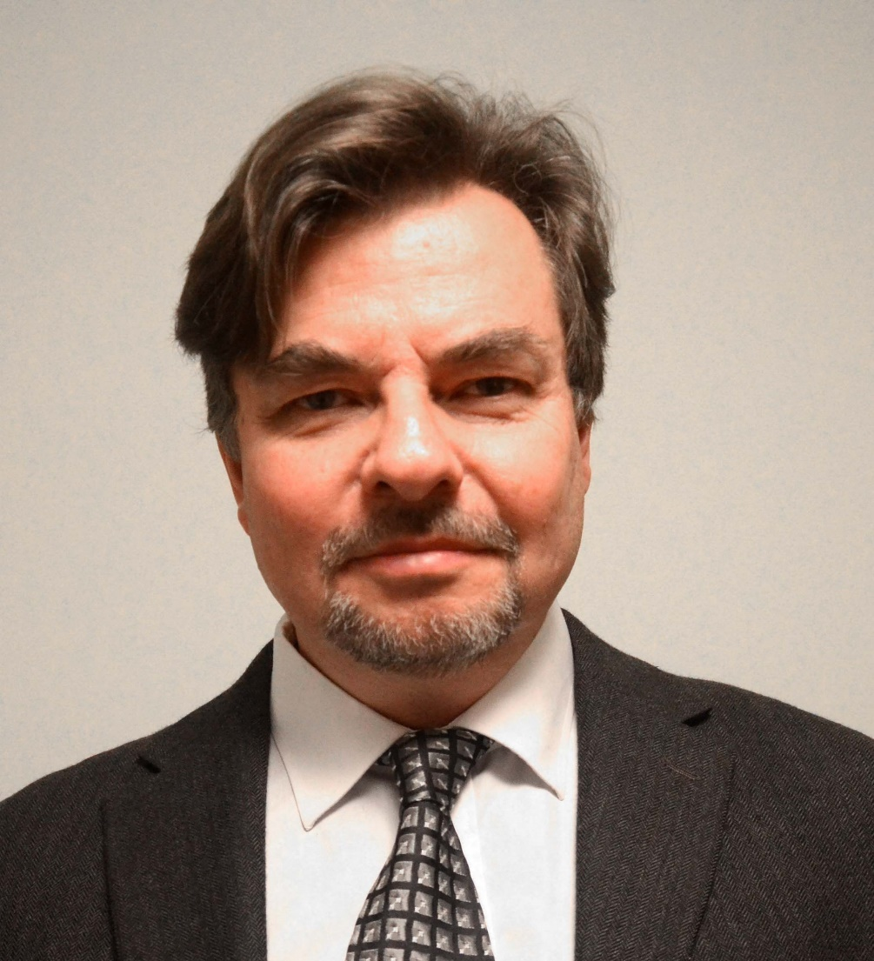
Optimization of adaptive control functions in multidimensional forest management via stochastic simulation and grid search
Version 160408
Peter Lohmander
Professor Dr., Optimal Solutions & Linnaeus University, Sweden www.Lohmander.com & Peter@Lohmander.com
Presentation at:
The 9th International Conference of Iranian Operations Research Society
28-30 Apr. 2016, Shiraz, Iran
www.iscconferences.ir/IORC2016 & IORC2016@sutech.ac.ir

Slide 2
Optimization of adaptive control functions in multidimensional forest management via stochastic simulation and grid search
Peter Lohmander
Abstract
A dynamic multidimensional production system, with several interdependent processes, is adaptively controlled under the influence of stochastic market changes. An adaptive control function with low dimensionality that makes it possible to directly and indirectly control all parts of the interdependent processes is determined. Discrete parameter value combinations are investigated. Grid search is applied to find optimal control function parameter values via stochastic simulation, where the complete production system is simulated 100 times, during 200 years. The 100 time series of random numbers, each representing 200 years, used to represent stochastic market changes, are the same for every control function parameter combination. The optimal control function is determined for beech stands in Germany, as an adaptive harvest diameter rule, for different rates of interest and for different levels of market risk. With a uniform price probability density function with price variation within the interval -40 to +40 EURO/m3, 3% rate of interest and optimal control, the expected present value was 62% higher than without risk. Without risk the optimal harvest diameter was 55 cm and with risk, (115 – 2 ) cm, where denotes wood price deviation in period t from the expected wood price (EURO/m3).
Keywords:
Adaptive control function; Stochastic system optimization; Forest management

Slide 3
A dynamic multidimensional production system,
with several interdependent processes,
is adaptively controlled
under the influence of stochastic market changes.

Slide 4
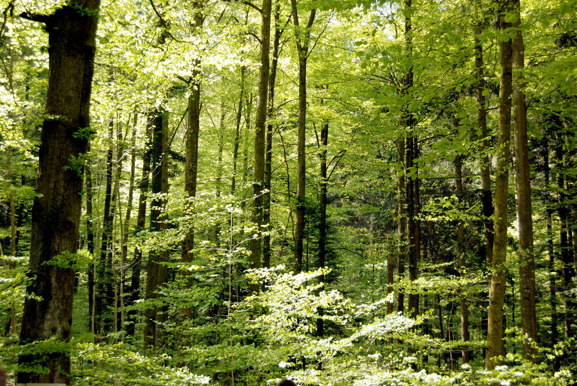

Slide 5
diameter increment per year of trees in diameter class
average diameter before increment of trees in diameter class
total basal area per hectare of trees with diameter larger than
Source:
Schütz, J-P. (2006) Modelling the demographic sustainability of pure beech plenter forests in Eastern
Germany, Ann.For.Sci. 63 (2000), 93-100, http://dx.doi.org/10.1051/forest:2005101

Slide 6
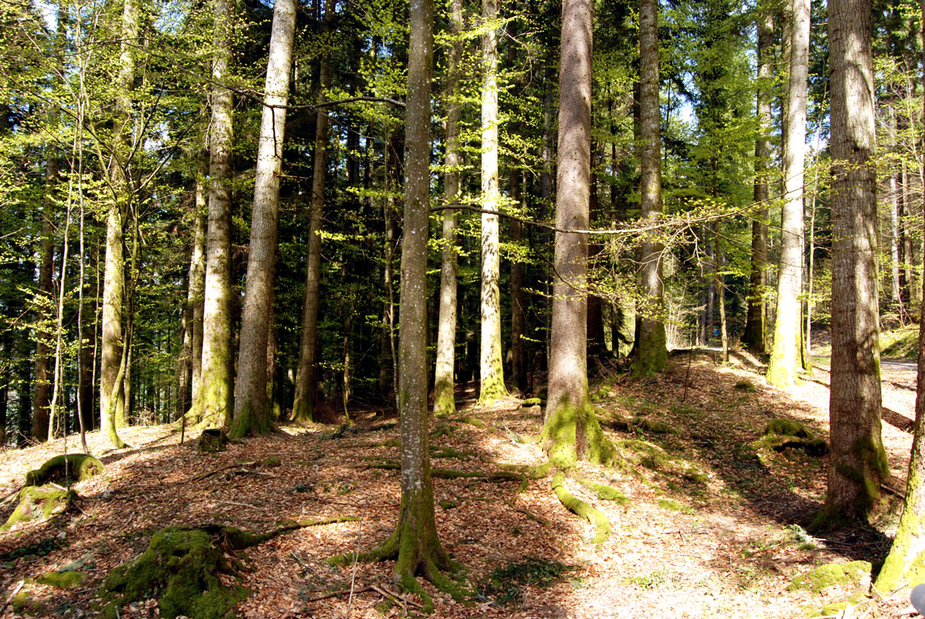

Slide 8
All trees with diameters exceeding the limit diameter should be harvested, in case the total stock
level per hectare exceeds the lowest feasible stock level. Otherwise, the largest trees with diameters
exceeding the limit diameter are harvested until the lowest feasible stock level is reached.
stochastic market price deviation from the expected market price in period t.

Slide 9
Observations:

Slide 10
An adaptive control function with low dimensionality that makes it possible to directly and indirectly control all parts of the interdependent processes is determined.

Slide 11
Discrete parameter value combinations,
are investigated.
Grid search is applied to find optimal control function parameter values via stochastic simulation, where the complete production system is simulated 100 times, during 200 years.
The 100 time series of random numbers, each representing 200 years, used to represent stochastic market changes, are the same for every control function parameter combination.

Slide 12
Calculation of the ”Market price adjusted diameter limit”
”DlimitADJ” in the computer code:
REM Price adaptive diameter limit adjustment
DlimitADJ = x + (y - 10) / 1 * PDEV(NumS, t)
REM Dlimit limitation
IF DlimitADJ < 10 THEN DlimitADJ = 10
IF DlimitADJ > 100 THEN DlimitADJ = 100

Slide 13
”Expected present values - 6000” (EURO/ha)
 | -10 | -9 | -8 | -7 | -6 | -5 | -4 | -3 | -2 | -1 | 0
40 | 6269 | 6262 | 6253 | 6243 | 6231 | 6202 | 6162 | 6107 | 5966 | 5615 | 2536
45 | 6314 | 6311 | 6308 | 6304 | 6302 | 6294 | 6280 | 6263 | 6212 | 6081 | 3126
50 | 6367 | 6367 | 6368 | 6369 | 6382 | 6397 | 6411 | 6438 | 6469 | 6558 | 3432
55 | 6427 | 6437 | 6447 | 6462 | 6483 | 6515 | 6545 | 6609 | 6710 | 7048 | 3437
60 | 6487 | 6506 | 6530 | 6551 | 6573 | 6622 | 6679 | 6768 | 6945 | 7552 | 3273
65 | 6554 | 6569 | 6591 | 6624 | 6663 | 6722 | 6796 | 6915 | 7218 | 8024 | 3006
70 | 6602 | 6628 | 6654 | 6698 | 6743 | 6814 | 6903 | 7079 | 7487 | 8477 | 2664
75 | 6653 | 6686 | 6722 | 6763 | 6821 | 6905 | 7019 | 7270 | 7743 | 8864 | 2271
80 | 6702 | 6742 | 6778 | 6829 | 6900 | 6989 | 7158 | 7455 | 7978 | 9133 | 1847
85 | 6752 | 6790 | 6836 | 6892 | 6966 | 7090 | 7304 | 7631 | 8221 | 9197 | 1405
90 | 6796 | 6840 | 6892 | 6955 | 7045 | 7206 | 7441 | 7803 | 8458 | 8936 | 955
95 | 6842 | 6886 | 6942 | 7018 | 7134 | 7326 | 7578 | 7970 | 8698 | 8433 | 507
100 | 6884 | 6933 | 6995 | 7093 | 7234 | 7436 | 7704 | 8130 | 8910 | 7781 | 65
105 | 6930 | 6980 | 7055 | 7176 | 7338 | 7543 | 7833 | 8298 | 9085 | 7040 | 65
110 | 6970 | 7032 | 7128 | 7263 | 7430 | 7650 | 7962 | 8462 | 9212 | 6247 | 65
115 | 7015 | 7093 | 7199 | 7351 | 7520 | 7749 | 8074 | 8618 | 9276 | 5416 | 65
120 | 7066 | 7152 | 7278 | 7423 | 7606 | 7857 | 8198 | 8781 | 9237 | 4514 | 65
125 | 7123 | 7220 | 7356 | 7501 | 7694 | 7960 | 8330 | 8927 | 9020 | 3485 | 65
130 | 7180 | 7292 | 7421 | 7576 | 7772 | 8053 | 8464 | 9039 | 8571 | 2272 | 65
Assumptions:
Uniform price
probability
density function
with price
variation within
the interval
-40 to +40
EURO/m3,
Rate of interest
3%.

Slide 14
The optimal control function is determined for beech stands in Germany, as an adaptive harvest diameter rule, for different rates of interest and for different levels of market risk.

Slide 15
THE DETERMINISTIC CASE

Slide 16
Example:
With a uniform price probability density function with price variation within the interval -40 to +40 EURO/m3, 3% rate of interest and optimal control, the expected present value was 62% higher than without risk.
(The expected present value is a strictly increasing function of the degree of price variation.)

Slide 18
Example with 3% rate of interest:
Without risk, the optimal limit diameter was 55 cm.
With risk (*), the optimal limit diameter was (115 – 2 ) cm.
(*) = Prices distributed according to
a uniform price probability density function with price variation within the interval -40 to +40 EURO/m3

Slide 19
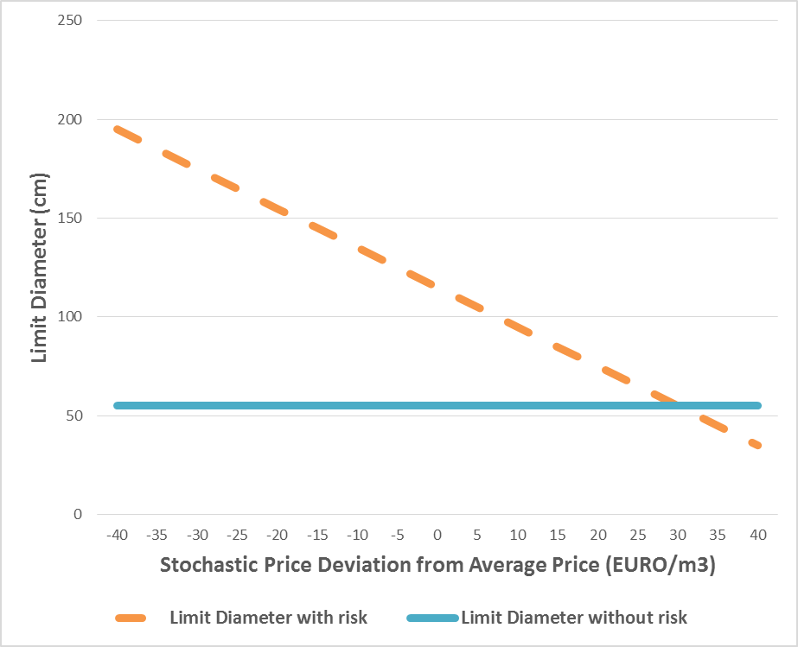

Slide 20
Detailed numerical analysis:
CCF9 (Optimization software) by Peter Lohmander in QB64

Slide 21
REM
REM CCF9.bas
REM Peter Lohmander
REM 160106
REM Date of first version of this software 090416
REM http://www.Lohmander.com
REM Peter@Lohmander.com
REM
REM A dynamic diameter distribution model for numerical economic
REM optimization of continuous cover forest management
REM
REM Acknowledgements:
REM My thanks go to Prof. Dr. Jean-Philippe Schutz.
REM Several of the equations in this preliminary computer model
REM were obtained from his article found below. Furthermore, he
REM showed me interesting experiments in Switzerland.
REM
REM References:
REM Schutz, J-P. (2006) Modelling the demographic sustainability
REM of pure beech plenter forests in Eastern Germany,
REM Ann.For.Sci. 63 (2000), 93-100
REM http://dx.doi.org/10.1051/forest:2005101
REM

Slide 22
Parameters inputs and generation of the random price deviation series:
CLS
DIM PDEV(100, 200)
INPUT "Risk multiplier = ", rmp
INPUT "Rate of interest = ", r
INPUT "Random number seed = ", randseed
INPUT "Number of time series = ", NumSer
RANDOMIZE randseed
FOR t = 0 TO 200
FOR NumS = 1 TO NumSer
PDEV(NumS, t) = rmp * (2 * RND - 1)
NEXT NumS
NEXT t

Slide 23
OPEN "CCF9optout.txt" FOR OUTPUT AS #2
PRINT #2, "CCF Optimization (CCF9)"
PRINT #2, "with market adaptive adjustment of diameter limit."
PRINT #2, "Peter Lohmander 160106"
PRINT #2, ""
PRINT #2, "Risk multiplier = ", rmp
PRINT #2, "Rate of interest = ", r
PRINT #2, "Random seed = ", randseed
PRINT #2, "Number of time series = ", NumSer
PRINT #2, ""
PRINT #2, " Alfa Beta (Columns) "
PRINT #2, " "
PRINT #2, " (Rows) "
PRINT #2, " ";
FOR y = 0 TO 10
PRINT #2, USING "###.##"; (y - 10) / 1;
NEXT y
PRINT #2, ""
PRINT #2, ""

Slide 24
The main program:
FOR x = 40 TO 200 STEP 5
PRINT #2, USING "###"; x;
PRINT #2, " ";
FOR y = 0 TO 10
AveTotPV = 0
FOR NumS = 1 TO NumSer
GOSUB Subroutine_CCF
AveTotPV = AveTotPV + TotPV
NEXT NumS
AveTotPV = AveTotPV / NumSer
PRINT #2, USING "######"; AveTotPV;
NEXT y
PRINT #2, " "
NEXT x
CLOSE #2
END
The subroutine is called.

Slide 25
The subroutine starts here:
Subroutine_CCF:
DIM n(20), i(20), p(20), e(20), gcum(20), sapt(20), v(20), h(20), np(20)
DIM nnext(20), nharv(20), npADJ(20)
pi = 3.141593
p0 = 25
p1 = 2.5
Stockmin = 150
TotPV = 0
TotHarv = 0

Slide 26
b0 = 1.506969
b1 = .94255
b2 = -.000183455#
FOR k = 1 TO 20
d = k * .05
h(k) = 3 * k - (k / 8) ^ 2
n(k) = .1
i(k) = 0
p(k) = 0
e(k) = 0
sapt(k) = pi * (d / 2) ^ 2
v(k) = .5 * sapt(k) * h(k)
np(k) = p0 + p1 * k
NEXT k

Slide 27
REM ******************** Time loop ********************
FOR t = 1 TO 200
disc = 1 / (1 + r) ^ t
n(2) = 100
Stock = 0
FOR k = 1 TO 20
Stock = Stock + n(k) * v(k)
NEXT k
StDif = 0
IF Stock > Stockmin THEN StDif = Stock - Stockmin

Slide 28
REM Price adaptive diameter limit adjustment
DlimitADJ = x + (y - 10) / 1 * PDEV(NumS, t)
REM Dlimit limitation
IF DlimitADJ < 10 THEN DlimitADJ = 10
IF DlimitADJ > 100 THEN DlimitADJ = 100
KlimitADJ = INT(DlimitADJ / 5)

Slide 29
REM Price adaptive profit function adjustment
FOR k = 1 TO 20
npADJ(k) = np(k) + PDEV(NumS, t)
NEXT k

Slide 30
FOR k = 20 TO KlimitADJ STEP -1
e(k) = 0
volk = v(k) * n(k)
hshare = StDif / (volk + .001)
e(k) = hshare
IF hshare > 1 THEN e(k) = 1
StDif = StDif - e(k) * volk
nharv(k) = n(k) * e(k)
n(k) = n(k) * (1 - e(k))
NEXT k

Slide 31
harv = 0
prof = 0
FOR k = 20 TO KlimitADJ STEP -1
prof = prof + nharv(k) * npADJ(k) * v(k)
harv = harv + nharv(k) * v(k)
NEXT k
TotPV = TotPV + disc * prof
TotHarv = TotHarv + harv

Slide 32
FOR k = 1 TO 20
gcum(k) = 0
NEXT k
REM Calculation of GCUM
FOR k = 1 TO 20
FOR j = k + 1 TO 20
gcum(k) = gcum(k) + n(j) * sapt(j)
NEXT j
NEXT k

Slide 33
REM Calculation of diameter increments
FOR k = 1 TO 20
d = k * 50
i(k) = b0 + b1 * LOG(d) + b2 * gcum(k) ^ 3
IF i(k) < 0 THEN i(k) = 0
NEXT k

Slide 34
REM Calculation of the probabilities to move up
FOR k = 1 TO 20
p(k) = i(k) / 50
NEXT k

Slide 35
FOR k = 2 TO 20
nnext(k) = n(k) + p(k - 1) * n(k - 1) - p(k) * n(k)
NEXT k
FOR k = 2 TO 20
n(k) = nnext(k)
NEXT k

Slide 36
IF t < 200 GOTO 100
YearHarv = TotHarv / 200
100 REM
NEXT t
RETURN

Slide 37
CCF Optimization (CCF9)
with market adaptive adjustment of diameter limit.
Peter Lohmander 160106
Risk multiplier = 0
Rate of interest = .03
Random seed = 3
Number of time series = 10
Alfa Beta (Columns)
(Rows)
-10.00 -9.00 -8.00 -7.00 -6.00 -5.00 -4.00 -3.00 -2.00 -1.00 0.00
40 8526 8526 8526 8526 8526 8526 8526 8526 8526 8526 8526
45 9138 9138 9138 9138 9138 9138 9138 9138 9138 9138 9138
50 9439 9439 9439 9439 9439 9439 9439 9439 9439 9439 9439
55 9449 9449 9449 9449 9449 9449 9449 9449 9449 9449 9449
60 9292 9292 9292 9292 9292 9292 9292 9292 9292 9292 9292
65 9035 9035 9035 9035 9035 9035 9035 9035 9035 9035 9035
70 8699 8699 8699 8699 8699 8699 8699 8699 8699 8699 8699
75 8310 8310 8310 8310 8310 8310 8310 8310 8310 8310 8310
80 7888 7888 7888 7888 7888 7888 7888 7888 7888 7888 7888
85 7447 7447 7447 7447 7447 7447 7447 7447 7447 7447 7447
90 6996 6996 6996 6996 6996 6996 6996 6996 6996 6996 6996
95 6545 6545 6545 6545 6545 6545 6545 6545 6545 6545 6545
100 6099 6099 6099 6099 6099 6099 6099 6099 6099 6099 6099
105 6099 6099 6099 6099 6099 6099 6099 6099 6099 6099 6099
110 6099 6099 6099 6099 6099 6099 6099 6099 6099 6099 6099
115 6099 6099 6099 6099 6099 6099 6099 6099 6099 6099 6099
120 6099 6099 6099 6099 6099 6099 6099 6099 6099 6099 6099
125 6099 6099 6099 6099 6099 6099 6099 6099 6099 6099 6099
130 6099 6099 6099 6099 6099 6099 6099 6099 6099 6099 6099
135 6099 6099 6099 6099 6099 6099 6099 6099 6099 6099 6099
140 6099 6099 6099 6099 6099 6099 6099 6099 6099 6099 6099
145 6099 6099 6099 6099 6099 6099 6099 6099 6099 6099 6099
150 6099 6099 6099 6099 6099 6099 6099 6099 6099 6099 6099
155 6099 6099 6099 6099 6099 6099 6099 6099 6099 6099 6099
160 6099 6099 6099 6099 6099 6099 6099 6099 6099 6099 6099
165 6099 6099 6099 6099 6099 6099 6099 6099 6099 6099 6099
170 6099 6099 6099 6099 6099 6099 6099 6099 6099 6099 6099
175 6099 6099 6099 6099 6099 6099 6099 6099 6099 6099 6099
180 6099 6099 6099 6099 6099 6099 6099 6099 6099 6099 6099
185 6099 6099 6099 6099 6099 6099 6099 6099 6099 6099 6099
190 6099 6099 6099 6099 6099 6099 6099 6099 6099 6099 6099
195 6099 6099 6099 6099 6099 6099 6099 6099 6099 6099 6099
200 6099 6099 6099 6099 6099 6099 6099 6099 6099 6099 6099
Case 1:
No price variation.

Slide 38
CCF Optimization (CCF9)
with market adaptive adjustment of diameter limit.
Peter Lohmander 160106
Risk multiplier = 0
Rate of interest = .03
Random seed = 3
Number of time series = 10

Slide 39
Alfa Beta (Columns)
(Rows)
-10.00 -9.00 -8.00 -7.00 -6.00 -5.00 -4.00 -3.00 -2.00 -1.00 0.00
40 8526 8526 8526 8526 8526 8526 8526 8526 8526 8526 8526
45 9138 9138 9138 9138 9138 9138 9138 9138 9138 9138 9138
50 9439 9439 9439 9439 9439 9439 9439 9439 9439 9439 9439
55 9449 9449 9449 9449 9449 9449 9449 9449 9449 9449 9449
60 9292 9292 9292 9292 9292 9292 9292 9292 9292 9292 9292
65 9035 9035 9035 9035 9035 9035 9035 9035 9035 9035 9035
70 8699 8699 8699 8699 8699 8699 8699 8699 8699 8699 8699
75 8310 8310 8310 8310 8310 8310 8310 8310 8310 8310 8310
80 7888 7888 7888 7888 7888 7888 7888 7888 7888 7888 7888
85 7447 7447 7447 7447 7447 7447 7447 7447 7447 7447 7447
90 6996 6996 6996 6996 6996 6996 6996 6996 6996 6996 6996
95 6545 6545 6545 6545 6545 6545 6545 6545 6545 6545 6545
100 6099 6099 6099 6099 6099 6099 6099 6099 6099 6099 6099
105 6099 6099 6099 6099 6099 6099 6099 6099 6099 6099 6099
110 6099 6099 6099 6099 6099 6099 6099 6099 6099 6099 6099
115 6099 6099 6099 6099 6099 6099 6099 6099 6099 6099 6099
120 6099 6099 6099 6099 6099 6099 6099 6099 6099 6099 6099
125 6099 6099 6099 6099 6099 6099 6099 6099 6099 6099 6099
130 6099 6099 6099 6099 6099 6099 6099 6099 6099 6099 6099
135 6099 6099 6099 6099 6099 6099 6099 6099 6099 6099 6099
140 6099 6099 6099 6099 6099 6099 6099 6099 6099 6099 6099
145 6099 6099 6099 6099 6099 6099 6099 6099 6099 6099 6099
150 6099 6099 6099 6099 6099 6099 6099 6099 6099 6099 6099
155 6099 6099 6099 6099 6099 6099 6099 6099 6099 6099 6099
160 6099 6099 6099 6099 6099 6099 6099 6099 6099 6099 6099
165 6099 6099 6099 6099 6099 6099 6099 6099 6099 6099 6099
170 6099 6099 6099 6099 6099 6099 6099 6099 6099 6099 6099
175 6099 6099 6099 6099 6099 6099 6099 6099 6099 6099 6099
180 6099 6099 6099 6099 6099 6099 6099 6099 6099 6099 6099
185 6099 6099 6099 6099 6099 6099 6099 6099 6099 6099 6099
190 6099 6099 6099 6099 6099 6099 6099 6099 6099 6099 6099
195 6099 6099 6099 6099 6099 6099 6099 6099 6099 6099 6099
200 6099 6099 6099 6099 6099 6099 6099 6099 6099 6099 6099
Optimal expected
present value
=
9 449 EURO/ha

Slide 40
CCF Optimization (CCF9)
with market adaptive adjustment of diameter limit.
Peter Lohmander 160106
Risk multiplier = 20
Rate of interest = .03
Random seed = 3
Number of time series = 100
Alfa Beta (Columns)
(Rows)
-10.00 -9.00 -8.00 -7.00 -6.00 -5.00 -4.00 -3.00 -2.00 -1.00 0.00
40 10424 10416 10403 10390 10373 10339 10298 10236 10112 9791 8531
45 10474 10470 10466 10461 10458 10446 10431 10408 10363 10265 9132
50 10530 10535 10538 10544 10553 10564 10571 10592 10623 10753 9436
55 10594 10603 10611 10626 10646 10672 10702 10759 10893 11256 9443
60 10652 10666 10683 10704 10732 10775 10831 10952 11176 11716 9283
65 10706 10722 10747 10777 10813 10876 10982 11149 11448 12051 9020
70 10757 10777 10805 10846 10903 10998 11132 11333 11717 12052 8681
75 10806 10829 10869 10930 11009 11120 11276 11516 11956 11806 8291
80 10852 10890 10947 11021 11113 11234 11410 11697 12139 11410 7867
85 10908 10961 11028 11108 11211 11350 11552 11872 12217 10920 7426
90 10973 11033 11104 11196 11308 11462 11690 12028 12076 10367 6976
95 11039 11103 11180 11274 11403 11576 11831 12147 11741 9780 6526
100 11101 11169 11250 11358 11494 11687 11957 12212 11278 9173 6082
105 11160 11235 11324 11435 11592 11807 12064 12170 10734 8534 6082
110 11220 11294 11396 11515 11688 11909 12144 11943 10141 7802 6082
115 11275 11360 11460 11601 11778 11999 12189 11550 9514 6917 6082
120 11336 11422 11532 11687 11873 12077 12173 11046 8850 6082 6082
125 11394 11481 11609 11764 11957 12138 12043 10471 8134 6082 6082
130 11448 11546 11687 11849 12024 12175 11752 9850 7356 6082 6082
135 11504 11617 11754 11923 12086 12166 11318 9196 6594 6082 6082
140 11561 11686 11823 11988 12133 12092 10788 8508 6082 6082 6082
145 11622 11747 11896 12039 12160 11910 10197 7786 6082 6082 6082
150 11684 11804 11954 12089 12157 11578 9565 7073 6082 6082 6082
155 11739 11871 12007 12127 12110 11116 8900 6459 6082 6082 6082
160 11792 11930 12051 12148 11991 10566 8215 6082 6082 6082 6082
165 11854 11981 12093 12150 11757 9960 7529 6082 6082 6082 6082
170 11911 12024 12125 12114 11385 9318 6894 6082 6082 6082 6082
175 11953 12058 12141 12029 10894 8652 6389 6082 6082 6082 6082
180 11996 12093 12141 11864 10324 7984 6082 6082 6082 6082 6082
185 12031 12121 12112 11595 9704 7344 6082 6082 6082 6082 6082
190 12059 12135 12048 11196 9056 6785 6082 6082 6082 6082 6082
195 12091 12134 11934 10689 8401 6348 6082 6082 6082 6082 6082
200 12116 12113 11731 10110 7766 6082 6082 6082 6082 6082 6082
Case 2:
Price variation within
the interval
-20 to +20 EURO/m3

Slide 41
CCF Optimization (CCF9)
with market adaptive adjustment of diameter limit.
Peter Lohmander 160106
Risk multiplier = 20
Rate of interest = .03
Random seed = 3
Number of time series = 100

Slide 42
Alfa Beta (Columns)
(Rows)
-10.00 -9.00 -8.00 -7.00 -6.00 -5.00 -4.00 -3.00 -2.00 -1.00 0.00
40 10424 10416 10403 10390 10373 10339 10298 10236 10112 9791 8531
45 10474 10470 10466 10461 10458 10446 10431 10408 10363 10265 9132
50 10530 10535 10538 10544 10553 10564 10571 10592 10623 10753 9436
55 10594 10603 10611 10626 10646 10672 10702 10759 10893 11256 9443
60 10652 10666 10683 10704 10732 10775 10831 10952 11176 11716 9283
65 10706 10722 10747 10777 10813 10876 10982 11149 11448 12051 9020
70 10757 10777 10805 10846 10903 10998 11132 11333 11717 12052 8681
75 10806 10829 10869 10930 11009 11120 11276 11516 11956 11806 8291
80 10852 10890 10947 11021 11113 11234 11410 11697 12139 11410 7867
85 10908 10961 11028 11108 11211 11350 11552 11872 12217 10920 7426
90 10973 11033 11104 11196 11308 11462 11690 12028 12076 10367 6976
95 11039 11103 11180 11274 11403 11576 11831 12147 11741 9780 6526
100 11101 11169 11250 11358 11494 11687 11957 12212 11278 9173 6082
105 11160 11235 11324 11435 11592 11807 12064 12170 10734 8534 6082
110 11220 11294 11396 11515 11688 11909 12144 11943 10141 7802 6082
115 11275 11360 11460 11601 11778 11999 12189 11550 9514 6917 6082
120 11336 11422 11532 11687 11873 12077 12173 11046 8850 6082 6082
125 11394 11481 11609 11764 11957 12138 12043 10471 8134 6082 6082
130 11448 11546 11687 11849 12024 12175 11752 9850 7356 6082 6082
135 11504 11617 11754 11923 12086 12166 11318 9196 6594 6082 6082
140 11561 11686 11823 11988 12133 12092 10788 8508 6082 6082 6082
145 11622 11747 11896 12039 12160 11910 10197 7786 6082 6082 6082
150 11684 11804 11954 12089 12157 11578 9565 7073 6082 6082 6082
155 11739 11871 12007 12127 12110 11116 8900 6459 6082 6082 6082
160 11792 11930 12051 12148 11991 10566 8215 6082 6082 6082 6082
165 11854 11981 12093 12150 11757 9960 7529 6082 6082 6082 6082
170 11911 12024 12125 12114 11385 9318 6894 6082 6082 6082 6082
175 11953 12058 12141 12029 10894 8652 6389 6082 6082 6082 6082
180 11996 12093 12141 11864 10324 7984 6082 6082 6082 6082 6082
185 12031 12121 12112 11595 9704 7344 6082 6082 6082 6082 6082
190 12059 12135 12048 11196 9056 6785 6082 6082 6082 6082 6082
195 12091 12134 11934 10689 8401 6348 6082 6082 6082 6082 6082
200 12116 12113 11731 10110 7766 6082 6082 6082 6082 6082 6082
Optimal expected
present value
=
12 217 EURO/ha

Slide 43
CCF Optimization (CCF9)
with market adaptive adjustment of diameter limit.
Peter Lohmander 160106
Risk multiplier = 40
Rate of interest = .03
Random seed = 3
Number of time series = 100
Alfa Beta (Columns)
(Rows)
-10.00 -9.00 -8.00 -7.00 -6.00 -5.00 -4.00 -3.00 -2.00 -1.00 0.00
40 12269 12262 12253 12243 12231 12202 12162 12107 11966 11615 8536
45 12314 12311 12308 12304 12302 12294 12280 12263 12212 12081 9126
50 12367 12367 12368 12369 12382 12397 12411 12438 12469 12558 9432
55 12427 12437 12447 12462 12483 12515 12545 12609 12710 13048 9437
60 12487 12506 12530 12551 12573 12622 12679 12768 12945 13552 9273
65 12554 12569 12591 12624 12663 12722 12796 12915 13218 14024 9006
70 12602 12628 12654 12698 12743 12814 12903 13079 13487 14477 8664
75 12653 12686 12722 12763 12821 12905 13019 13270 13743 14864 8271
80 12702 12742 12778 12829 12900 12989 13158 13455 13978 15133 7847
85 12752 12790 12836 12892 12966 13090 13304 13631 14221 15197 7405
90 12796 12840 12892 12955 13045 13206 13441 13803 14458 14936 6955
95 12842 12886 12942 13018 13134 13326 13578 13970 14698 14433 6507
100 12884 12933 12995 13093 13234 13436 13704 14130 14910 13781 6065
105 12930 12980 13055 13176 13338 13543 13833 14298 15085 13040 6065
110 12970 13032 13128 13263 13430 13650 13962 14462 15212 12247 6065
115 13015 13093 13199 13351 13520 13749 14074 14618 15276 11416 6065
120 13066 13152 13278 13423 13606 13857 14198 14781 15237 10514 6065
125 13123 13220 13356 13501 13694 13960 14330 14927 15020 9485 6065
130 13180 13292 13421 13576 13772 14053 14464 15039 14571 8272 6065
135 13244 13361 13486 13658 13865 14151 14581 15142 13946 6983 6065
140 13306 13417 13548 13724 13953 14250 14701 15218 13208 6065 6065
145 13366 13477 13617 13794 14035 14355 14827 15261 12398 6065 6065
150 13417 13535 13690 13876 14106 14462 14930 15258 11528 6065 6065
155 13469 13592 13750 13950 14193 14559 15020 15185 10592 6065 6065
160 13518 13660 13808 14021 14284 14651 15096 15001 9585 6065 6065
165 13572 13717 13881 14083 14375 14758 15165 14647 8523 6065 6065
170 13628 13768 13948 14151 14464 14857 15218 14097 7484 6065 6065
175 13686 13819 14007 14228 14548 14934 15246 13397 6618 6065 6065
180 13733 13885 14068 14306 14620 15007 15248 12598 6065 6065 6065
185 13782 13946 14121 14384 14692 15067 15208 11729 6065 6065 6065
190 13831 13997 14185 14459 14785 15116 15114 10807 6065 6065 6065
195 13890 14053 14250 14536 14869 15168 14944 9846 6065 6065 6065
200 13946 14103 14320 14599 14935 15211 14646 8877 6065 6065 6065
Case 3:
Price variation within
the interval
-40 to +40 EURO/m3

Slide 44
CCF Optimization (CCF9)
with market adaptive adjustment of diameter limit.
Peter Lohmander 160106
Risk multiplier = 40
Rate of interest = .03
Random seed = 3
Number of time series = 100

Slide 45
Alfa Beta (Columns)
(Rows)
-10.00 -9.00 -8.00 -7.00 -6.00 -5.00 -4.00 -3.00 -2.00 -1.00 0.00
40 12269 12262 12253 12243 12231 12202 12162 12107 11966 11615 8536
45 12314 12311 12308 12304 12302 12294 12280 12263 12212 12081 9126
50 12367 12367 12368 12369 12382 12397 12411 12438 12469 12558 9432
55 12427 12437 12447 12462 12483 12515 12545 12609 12710 13048 9437
60 12487 12506 12530 12551 12573 12622 12679 12768 12945 13552 9273
65 12554 12569 12591 12624 12663 12722 12796 12915 13218 14024 9006
70 12602 12628 12654 12698 12743 12814 12903 13079 13487 14477 8664
75 12653 12686 12722 12763 12821 12905 13019 13270 13743 14864 8271
80 12702 12742 12778 12829 12900 12989 13158 13455 13978 15133 7847
85 12752 12790 12836 12892 12966 13090 13304 13631 14221 15197 7405
90 12796 12840 12892 12955 13045 13206 13441 13803 14458 14936 6955
95 12842 12886 12942 13018 13134 13326 13578 13970 14698 14433 6507
100 12884 12933 12995 13093 13234 13436 13704 14130 14910 13781 6065
105 12930 12980 13055 13176 13338 13543 13833 14298 15085 13040 6065
110 12970 13032 13128 13263 13430 13650 13962 14462 15212 12247 6065
115 13015 13093 13199 13351 13520 13749 14074 14618 15276 11416 6065
120 13066 13152 13278 13423 13606 13857 14198 14781 15237 10514 6065
125 13123 13220 13356 13501 13694 13960 14330 14927 15020 9485 6065
130 13180 13292 13421 13576 13772 14053 14464 15039 14571 8272 6065
135 13244 13361 13486 13658 13865 14151 14581 15142 13946 6983 6065
140 13306 13417 13548 13724 13953 14250 14701 15218 13208 6065 6065
145 13366 13477 13617 13794 14035 14355 14827 15261 12398 6065 6065
150 13417 13535 13690 13876 14106 14462 14930 15258 11528 6065 6065
155 13469 13592 13750 13950 14193 14559 15020 15185 10592 6065 6065
160 13518 13660 13808 14021 14284 14651 15096 15001 9585 6065 6065
165 13572 13717 13881 14083 14375 14758 15165 14647 8523 6065 6065
170 13628 13768 13948 14151 14464 14857 15218 14097 7484 6065 6065
175 13686 13819 14007 14228 14548 14934 15246 13397 6618 6065 6065
180 13733 13885 14068 14306 14620 15007 15248 12598 6065 6065 6065
185 13782 13946 14121 14384 14692 15067 15208 11729 6065 6065 6065
190 13831 13997 14185 14459 14785 15116 15114 10807 6065 6065 6065
195 13890 14053 14250 14536 14869 15168 14944 9846 6065 6065 6065
200 13946 14103 14320 14599 14935 15211 14646 8877 6065 6065 6065
Optimal expected
present value
=
15 276 EURO/ha

Slide 47
Conclusions:
It is possible to use the described method to improve the control of large stochastic systems of very different kinds.
In many cases, there are no alternative approaches available that can solve the relevant problems in reasonable time.
The concrete numerical results presented in this study should be considered as illustrations of what is possible to derive in similar problems.

Slide 48
One of the important modelling topics that is fundamental to work of this nature is definition and estimation of stochastic processes representing market prices and other stochastic disturbances of particular application relevance.
In Lohmander [1], we find that alternative specifications of price processes and damage probability functions can lead to drastically different types of optimal resource control functions.
For instance, autocorrelation functions and stationarity are important concepts to consider and estimate before detailed resource control models are developed and solved.
In the present analysis, stationary and independently distributed market prices were assumed in all periods. Of course, in other cases, the process properties may be different.

Slide 49
Furthermore, expected prices minus costs for harvesting and terrain transport in different size classes, were assumed to follow a diameter dependent net price function.
Several examples of stochastic price processes in the round wood markets have been described and analysed in Lohmander [1].
In Finland, Sweden and Norway, these prices could be described as stationary first order autoregressive processes.

Slide 50
In future applications of the optimization method described in this paper, it is suggested that the relevant price process parameters are first estimated from available historical tables and that the simulations of the 100 random price series are based on these parameters.
It is also important to be aware of the fact that historical price series data are not always relevant to analysis of optimal decisions, at the present and in the future.
New technologies, new demand structures and new discoveries of natural resources may change the fundamental structures and parameters also of stochastic market price processes.
Relevant analysis has to explicitly take these things into account.

Slide 52
Optimization of adaptive control functions in multidimensional forest management via stochastic simulation and grid search
Version 160408
Peter Lohmander
Professor Dr., Optimal Solutions & Linnaeus University, Sweden www.Lohmander.com & Peter@Lohmander.com
Presentation at:
The 9th International Conference of Iranian Operations Research Society
28-30 Apr. 2016, Shiraz, Iran
www.iscconferences.ir/IORC2016 & IORC2016@sutech.ac.ir

