Slide 1
Optimal forest management based on growth data from the Iranian Caspian forests
Peter Lohmanderª, Soleiman Mohammadi Limaei^{b}*, Leif Olsson^{c}, Zohreh Mohammadi^{d}
ªProfessor Dr., Optimal Solutions & Linnaeus University, Sweden
^{b}Associate Professor, Faculty of Natural Resources, University of Guilan, Sowmeh Sara, P.O.Box 1144, Iran
^{c}Associate Professor, Faculty of Sciences, Technology and Media, Mid Sweden University, Sweden
^{d}PhD Student, Faculty of Natural Resources, University of Guilan, Sowmeh Sara, P.O.Box 1144, Iran

Slide 2
There are conditions in the environment that can not be perfectly predicted.
Decisions can take place over time and future decisions should be based on the best and latest information available at the time, concerning the exogenous conditions (Adaptive decisions)
The tradition of long term planning in forestry is not rational. It is based on the assumption that long term predictions with high precision are possible.
Timber and stumpage prices have to be considered as stochastic processes.
Other phenomena, such as the growth of the forest, forest damages, forest fires etc. may also be stochastic.
Price variation and market risks are most important sources of risk [2] & [3].
Introduction
Materials and methods
Results
Conclusions
Acknowledgment
References

Slide 3
General Questions:
#1: Harvest decision rules that give the optimal economic value under price risk in Iran.
#2: The optimal economic values under different levels of price risk in Iran.
#3: Forest and market conditions and functions in Iran needed in the optimizations.
.
Introduction
Materials and methods
Results
Conclusions
Acknowledgment
References

Slide 4
The optimal forest harvesting decision problem is formulated as a stochastic dynamic programming problem in discrete time according to the principles developed by Lohmander [4], [5] and [6].
Why? Because it is a very efficient method to handle this type of problem when problem size is moderate
.
Empirical data from the Caspian forest of Iran was used to estimate the basal area growth and volume functions used in the optimizations.
Introduction
Materials and methods
Results
Conclusions
Acknowledgment
References

Slide 5
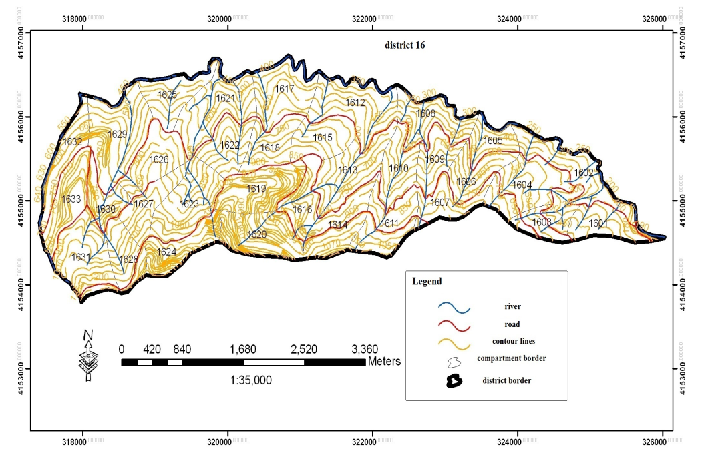
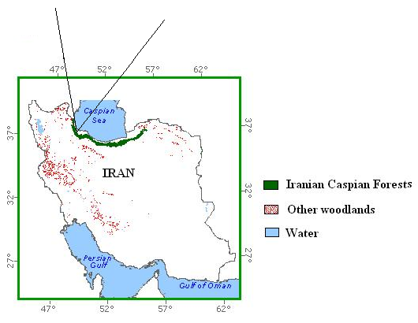
Study area
District 16 at Shafaroud forest, Guilan province in northern Iran.
Altitude: 300m to 1200m,
Latitude: 37°32′ 30" to 37°31′ 50" Longitude: 48°54′ to 49°2′.
Total area: 1444 ha .
Forest communities :
Fagus oreintalis- carpinus betulus, Parrotia persica – carpinus betulus, mixed broad leaf type, Fagus oreintalis with the other species type.
Soils classes:
Forest brown soils, brown soils, acidic brown soils and brown soils [7]
Introduction
Materials and methods
Results
Conclusions
Acknowledgment
References

Slide 6
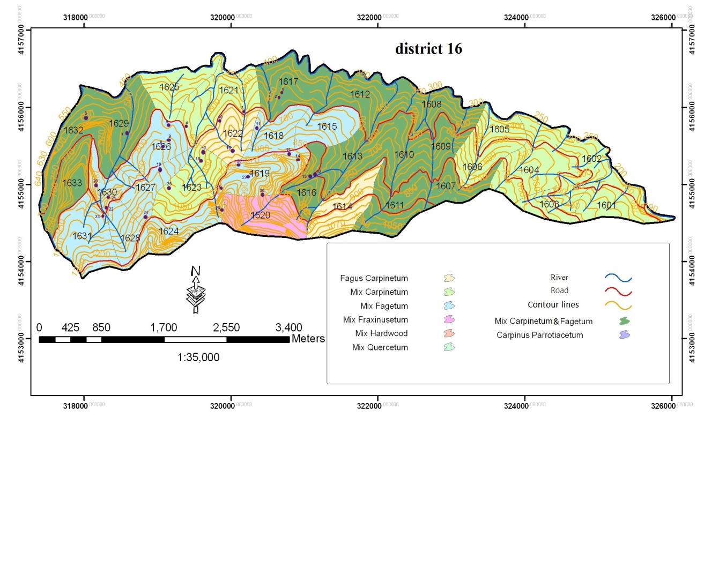
Study area
Forest types, district 16, Shafaroud forests, north of Iran
Introduction
Materials and methods
Results
Conclusions
Acknowledgment
References

Slide 7
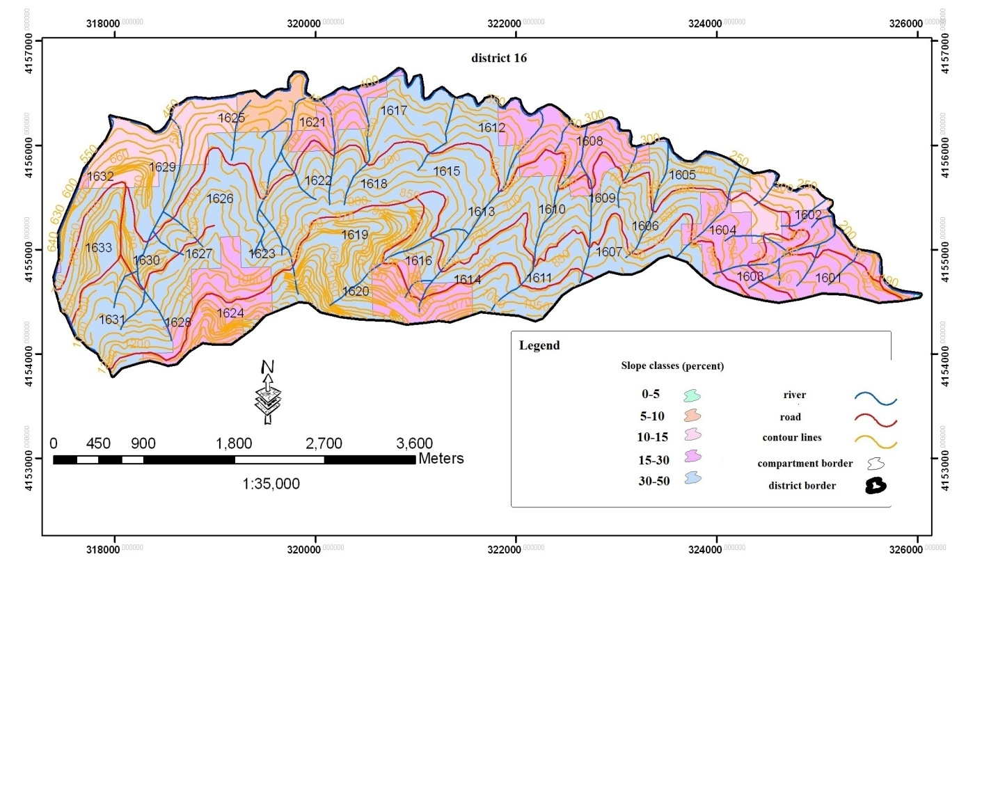
Study area
Slope classes, district 16, Shafaroud forests, north of Iran
Introduction
Materials and methods
Results
Conclusions
Acknowledgment
References

Slide 8
method
Sampling method
volume per hectare
number of tree per hectare
diameter classes
Data such as
was collected from previous research [8].
In order to measure growth, 30 sample plots were taken based on random method. The sample plots were in circular shape with surface area of 1000 m2.
Introduction
Materials and methods
Results
Conclusions
Acknowledgment
References

Slide 9
method
Sampling method
6 trees were selected in each sample based on the following criteria:
Four trees were selected at the farthest distance to the center of sample plot in four main aspects
One tree with highest diameter at sample plot
Nearest tree to the center of sample plot [8].
Introduction
Materials and methods
Results
Conclusions
Acknowledgment
References

Slide 10
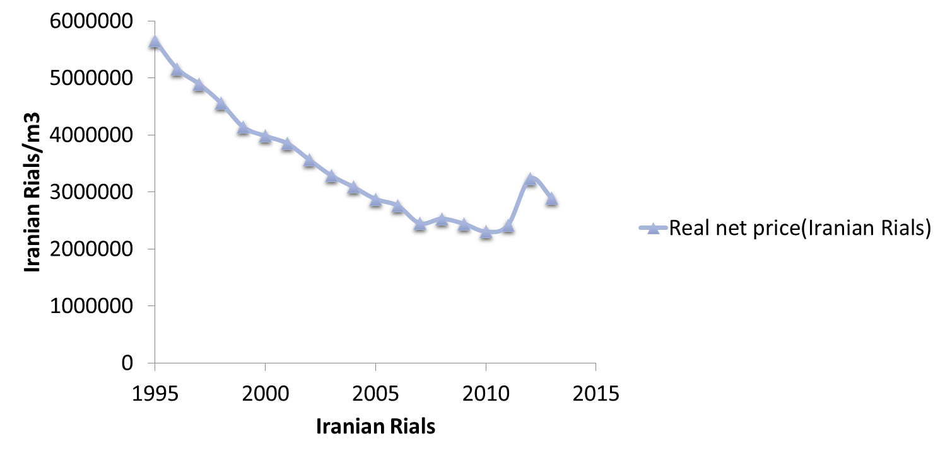
Stumpage prices were collected from the Shafaroud Forest Company.
In the present study, the optimization concerns management decisions for beech trees. The reported functions are relevant to that species.
Introduction
Materials and methods
Results
Conclusions
Acknowledgment
References

Slide 11
Model and method
We maximize the objective function, the expected present value, via stochastic dynamic programming, via backward recursion.
The horizon is T. At T+1, the objective function value is zero.
In each period, we determine the optimal reservation price.
If the stochastic price outcome is higher, we harvest. Otherwise we wait at least one more period.
Introduction
Materials and methods
Results
Conclusions
Acknowledgment
References

Slide 12
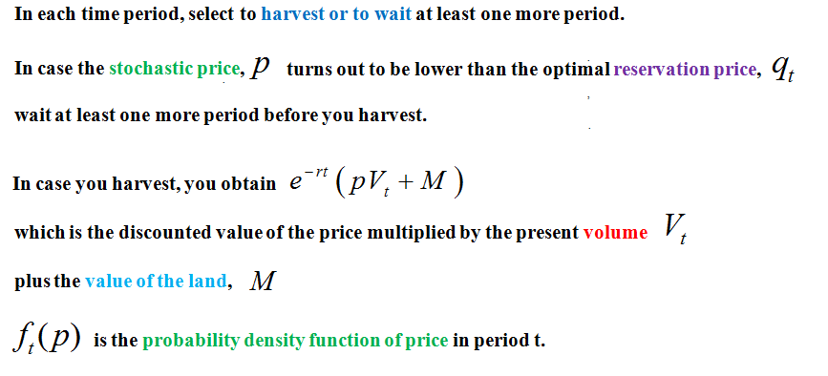
Variables and Parameters
Introduction
Materials and methods
Results
Conclusions
Acknowledgment
References

Slide 13
Maximize
Optimal reservation price via first order condition.
Investigation of the second order maximum condition.
Introduction
Materials and methods
Results
Conclusions
Acknowledgment
References

Slide 14
Introduction
Materials and methods
Results
Conclusions
Acknowledgment
References

Slide 15
The optimal reservation price formula gives a unique maximum of the expected present value.
Introduction
Materials and methods
Results
Conclusions
Acknowledgment
References

Slide 16
Empirically estimated functions
Introduction
Materials and methods
Results
Conclusions
Acknowledgment
References

Slide 17
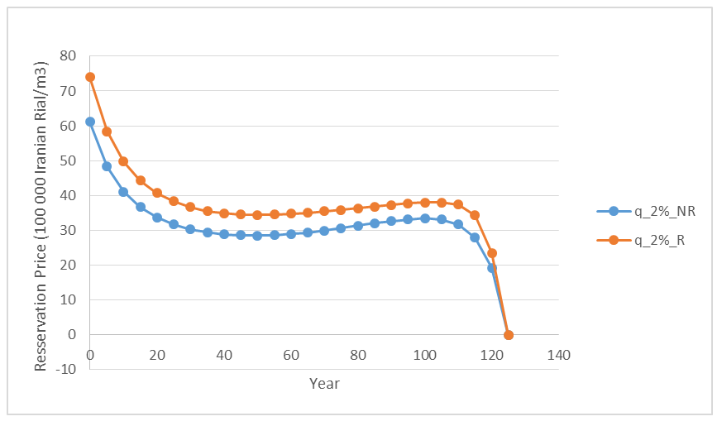
Optimal reservation price as a function of time.
Real rate of interest: 2%. At time 0, the trees belong to diameter class 40 cm.
Risk level: NR = No risk. R = Risk ( = As in the Iranian market)
Introduction
Materials and methods
Results
Conclusions
Acknowledgment
References

Slide 18
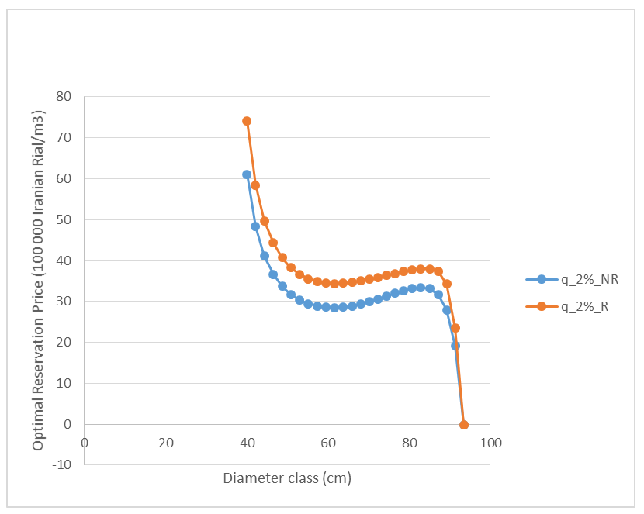
Optimal reservation price as a function of tree diameter.
Real rate of interest: 2%.
Risk level: NR = No Risk. R = Risk ( = As in the Iranian market)
Introduction
Materials and methods
Results
Conclusions
Acknowledgment
References

Slide 19
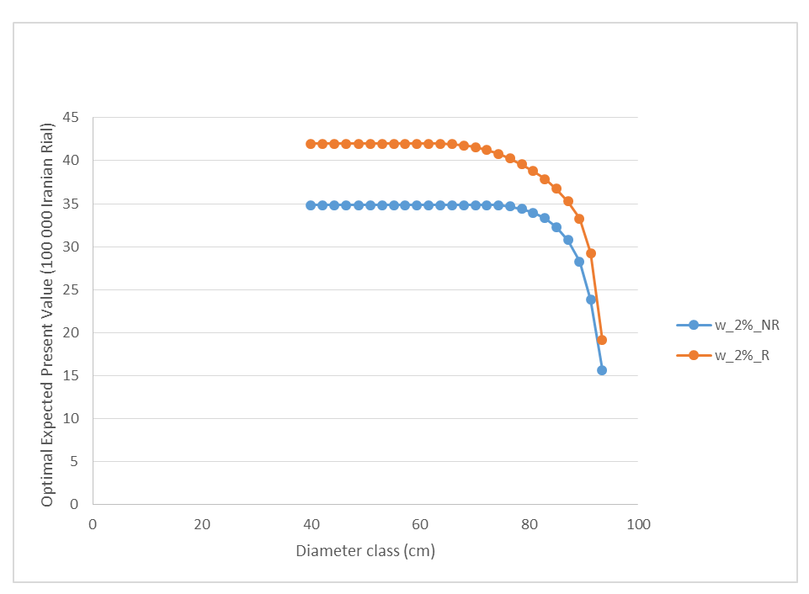
Optimal expected present value as a function of diameter.
Real rate of interest: 2%.
Risk level: NR = No Risk level, R = Risk ( = As in the Iranian market)
Introduction
Materials and methods
Results
Conclusions
Acknowledgment
References

Slide 20
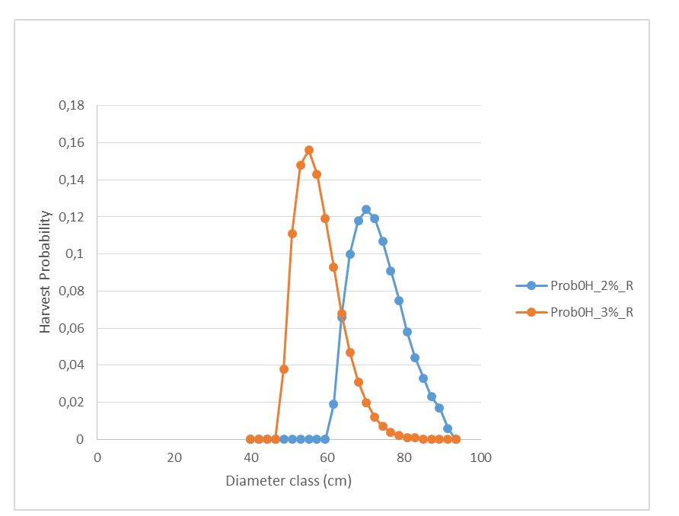
Optimal harvest diameter probability distributions.
Real rates of interest: 2% (blue) and 3% (red).
The real risk level of the Iranian market is considered.
Introduction
Materials and methods
Results
Conclusions
Acknowledgment
References

Slide 21
Results
A new basal area growth function and a new volume function have been derived for beech in the Iranian Caspian forest.
An optimal reservation price function and an optimal expected present value function are determined via stochastic dynamic programming for alternative levels of interest rate and risk.
Optimal harvest year and optimal harvest diameter frequency distributions are determined for different degrees of risk and rate of interest.
Introduction
Materials and methods
Results
Conclusions
Acknowledgment
References

Slide 22
The authors are grateful
to economic support
from
FORMAS.
Introduction
Materials and methods
Results
Conclusions
Acknowledgment
References

Slide 23
[1] I. N. Vladimirov, and A. K. Chudnenko, “Multilevel Modeling of the Forest Resource Dynamics,” Math. Model. Nat. Phenom. Vol.4, pp. 72-88, 2009
[2] S. Mohammadi Limaei, Economically optimal values and decisions in Iranian forest management. Doctoral thesis, Dept. of Forest Economics, SLU. Acta Universitatis agriculturae Sueciae, Vol. 2006:91. 2006.
[3] E. E. Peters, Fractal Market Analysis, Applying Chaos theory to investment and economics. Wiley,1994
[4] P. Lohmander, “Pulse extraction under risk and a numerical forestry application,,” Syst. Anal. Model. Sim., Vol. 5, No. 4, pp. 339-354, 1988.
[5] P. Lohmander, Pulse extraction under risk and a numerical forestry application. IIASA, International Institute for Applied Systems Analysis, Systems and Decisions Sciences, WP-87-49, 1987.
[6] P. Lohmander, The economics of forest management under risk. Doctoral thesis , Dept. of Forest Economics, Swedish University of Agricultural Sciences, Report 79, 1987.
[7] Shafaroud Forest Management Plan, General Office of Natural Resources in Guilan Province, Forest Management booklet, 2006.
[8] P. Attarod, Investigation and statically analysis of forest growth in two ecological using multivariate southern and northern aspects using multivariate statically method, M.Sc thesis, Dept., of Forestry, University of Guilan, Iran, 1999.
Introduction
Materials and methods
Results
Conclusions
Acknowledgment
References

