Slide 1

Optimal continuous natural resource extraction with increasing risk in prices and stock dynamics
Professor Dr Peter Lohmander
http://www.Lohmander.com
Peter@Lohmander.com
BIT's 5th Annual World Congress of Bioenergy 2015
(WCBE 2015)
Theme: “Boosting the development of green bioenergy"
September 24-26, 2015
Venue: Xi'an, China

Slide 2
Lohmander, P., Optimal continuous natural resource extraction with increasing risk in prices and stock dynamics, WCBE 2015
Abstract
Bioenergy is based on the dynamic utilization of natural resources. The dynamic supply of such energy resources is of fundamental importance to the success of bioenergy. This analysis concerns the optimal present extraction of a natural resouce and how this is affected by different kinds of future risk. The objective function is the expected present value of all operations over time. The analysis is performed via general function multi dimensional analyical optimization and comparative dynamics analysis in discrete time. First, the price and/or cost risk in the next period increases. The direction of optimal adjustment of the present extraction level is found to be a function of the third order derivatives of the profit functions in later time periods with respect to the extraction levels. In the second section, the optimal present extraction level is studied under the influence of increasing risk in the growth process. Again, the direction of optimal adjustment of the present extraction is found to be a function of the third order derivatives of the profit functions in later time periods with respect to the extraction levels. In the third section, the resource contains different species, growing together. Furthermore, the total harvest in each period is constrained. The directions of adjustments of the present extraction levels are functions of the third order derivatives, if the price or cost risk of one of the species increases.

Slide 3
Case:
We control a natural resource.
We want to maximize the expected present value of all activites over time.
Questions:
What is the optimal present extraction level?
How is the optimal present extraction level affected by different kinds of future risk?

Slide 4
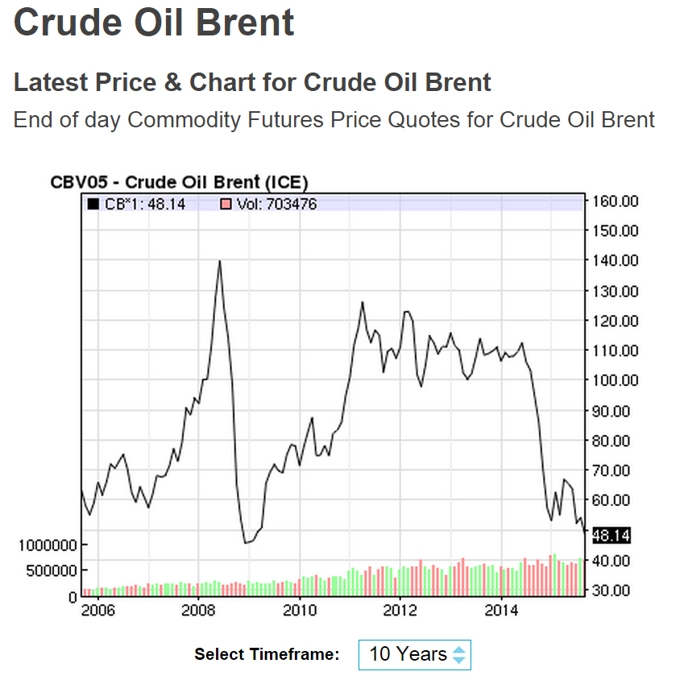
Motivation:
Source:
http://www.nasdaq.com/
2015-09-13

Slide 5
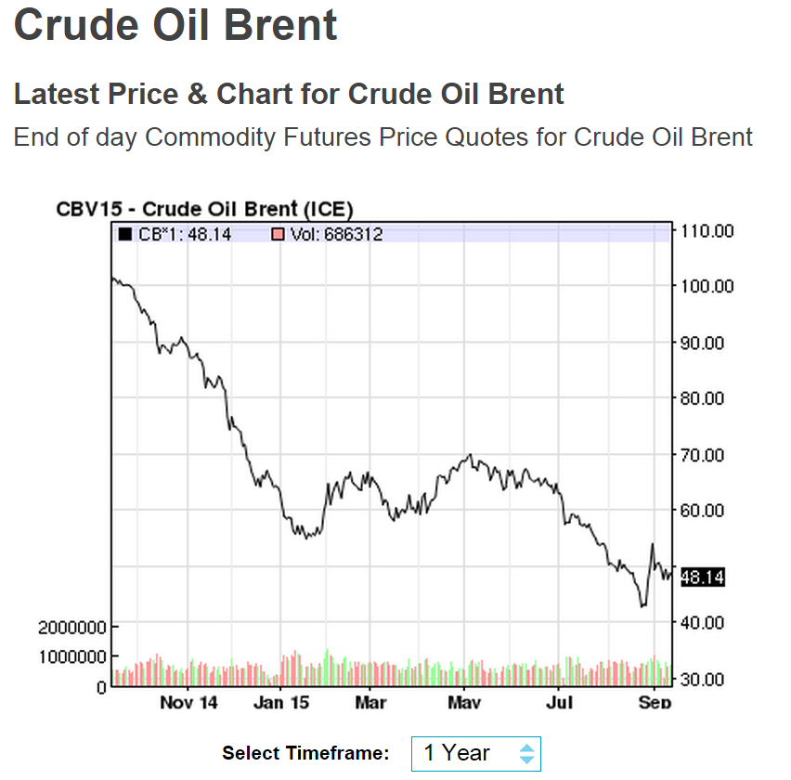
Source:
http://www.nasdaq.com/
2015-09-13

Slide 6
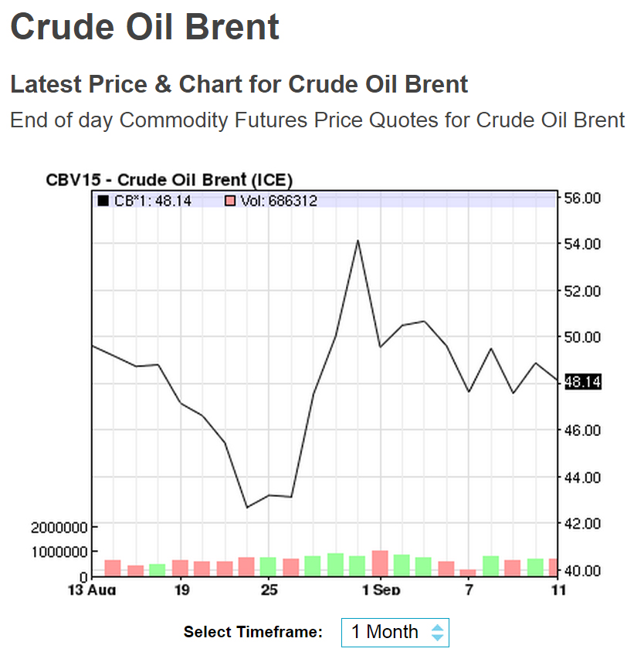
Source:
http://www.nasdaq.com/
2015-09-13

Slide 7
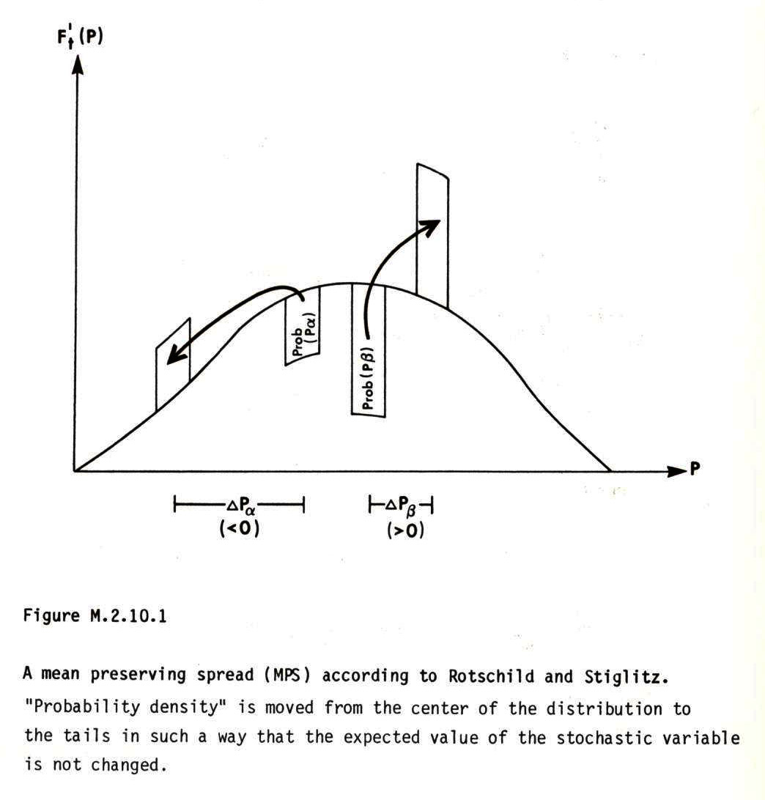
Probability
density

Slide 8
In the following analyses, we study the solutions to maximization problems. The objective functions are the total expected present values. In particular, we study how the optimal decisions at different points in time are affected by stochastic variables, increasing risk and optimal adaptive future decisions.
In all derivations in this document, continuously differentiable functions are assumed. In the optimizations and comparative statics calculations, local optima and small moves of these optima under the influence of parameter changes, are studied. For these reasons, derivatives of order four and higher are not considered. Derivatives of order three and lower can however not be neglected. We should be aware that functions that are not everywhere continuously differentiable may be relevant in several cases.

Slide 9
The profit functions used in the analyses are functions of the revenue and cost functions.
The continuous profit functions may be interpreted as approximations of profit functions with penalty functions representing capacity constraints.
The analysis will show that the third order derivatives of these functions determine the optimal present extraction response to increasing future risk.

Slide 10
Optimization in multi period problems

Slide 13
Three free decision variables and three first order optimum conditions

Slide 15
Let us differentiate the first order optimum conditions with respect to the decision variables and the risk parameters:
:

Slide 19
Simplification gives:
A unique maximum is assumed.

Slide 20
Observation:
We assume decreasing marginal profits in all periods.

Slide 21
The following results follow from optimization:

Slide 23
The results may also be summarized this way:

Slide 24
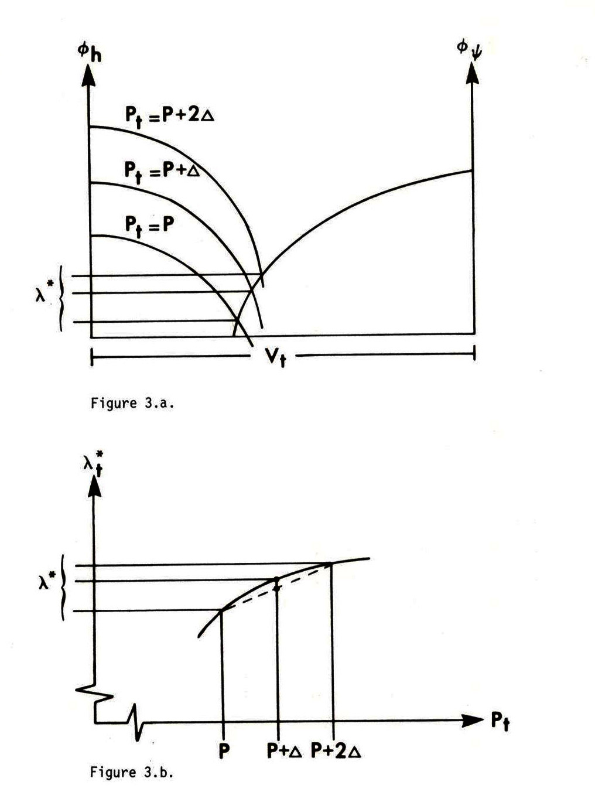
The expected future marginal
resource value decreases from
increasing price risk and we should
increase present extraction.

Slide 25
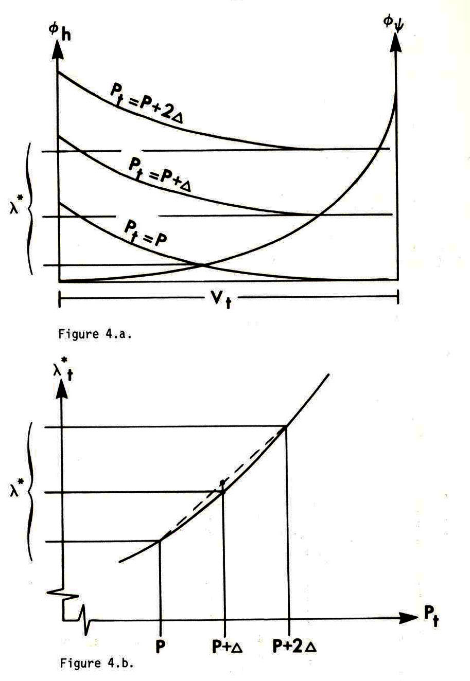
The expected future marginal
resource value increases from
increasing price risk and we should
decrease present extraction.

Slide 26
Some results of increasing risk in the price process:
If the future risk in the price process increases, we should increase the present extraction level in case the third order derivatives of profit with respect to volume are strictly negative.
If the future risk in the price process increases, we should not change the present extraction level in case the third order derivatives of profit with respect to volume are zero.
If the future risk in the price process increases, we should decrease the present extraction level in case the third order derivatives of profit with respect to volume are strictly positive.

Slide 27
The effects of increasing future risk in the volume process:
Now, we will investigate how the optimal values of the decision variables change if g increases.
We recall these first order derivatives:

Slide 28
The details of these derivations can be found in the mathematical appendix.

Slide 29
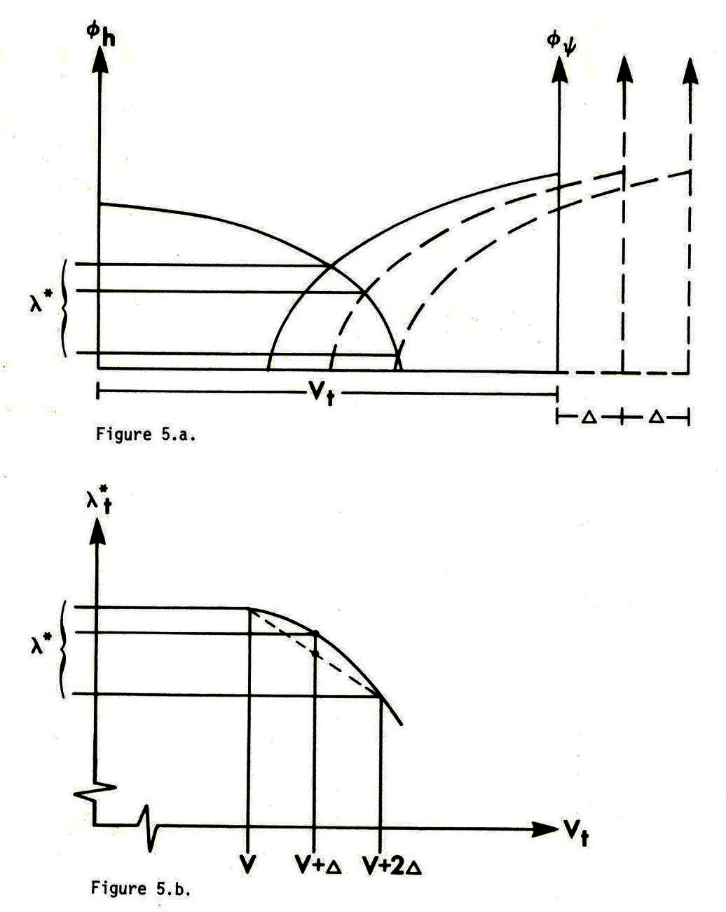
The expected future marginal
resource value decreases from
increasing risk in the volume
process (growth) and we should
increase present extraction.

Slide 30
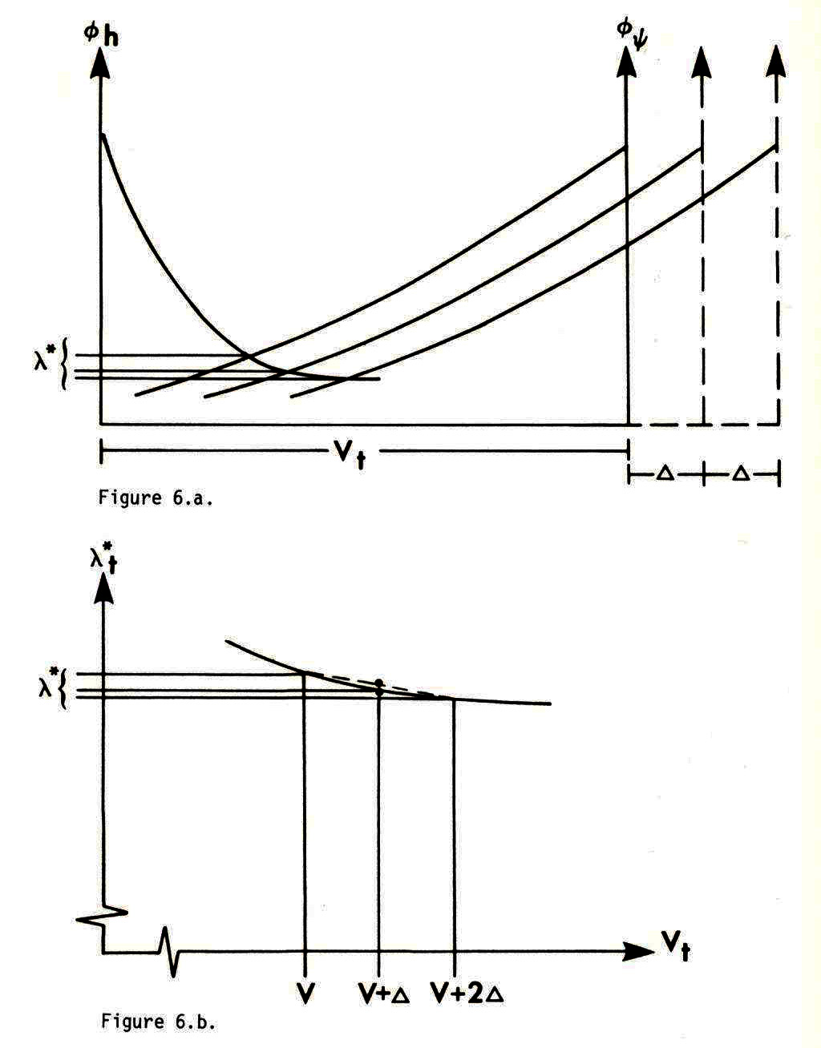
The expected future marginal
resource value increases from
increasing risk in the volume
process (growth) and we should
decrease present extraction.

Slide 31
Some results of increasing risk in the volume process (growth process):
If the future risk in the volume process increases, we should increase the present extraction level in case the third order derivatives of profit with respect to volume are strictly negative.
If the future risk in the volume process increases, we should not change the present extraction level in case the third order derivatives of profit with respect to volume are zero.
If the future risk in the volume process increases, we should decrease the present extraction level in case the third order derivatives of profit with respect to volume are strictly positive.

Slide 32
The mixed species case:
A complete dynamic analysis of optimal natural resource management with several species should include decisions concerning total stock levels and interspecies competition.
In the following analysis, we study a case with two species, where the growth of a species is assumed to be a function of the total stock level and the stock level of the individual species.
The total stock level has however already indirectly been determined via binding constraints on total harvesting in periods 1 and 2.
We start with a deterministic version of the problem and later move to the stochastic counterpart.

Slide 34
Period 1
Period 2
Period 3

Slide 35
The details of these derivations can be found in the mathematical appendix.

Slide 36
Some multi species results:
With multiple species and total harvest volume constraints:
Case 1:
If the future price risk of one species, A, increases, we should now harvest less of this species (A) and more of the other species, in case the third order derivative of the profit function of species A with respect to harvest volume is greater than the corresponding derivative of the other species.
Case 3:
If the future price risk of one species, A, increases, we should not change the present harvest of this species (A) and not change the harvest of the other species, in case the third order derivative of the profit function of species A with respect to harvest volume is equal to the corresponding derivative of the other species.
Case 5:
If the future price risk of one species, A, increases, we should now harvest more of this species (A) and less of the other species, in case the third order derivative of the profit function of species A with respect to harvest volume is less than the corresponding derivative of the other species.

Slide 37
CONCLUSIONS:
The properties of the revenue and cost functions, including capacity constraints with penalty functions, determine the optimal present response to risk.
Conclusive and general results have been derived and reported for the following cases:
Increasing risk in the price and cost functions.
Increasing risk in the dynamics of the physical processes.

Slide 38
Optimal continuous natural resource extraction with increasing risk in prices and stock dynamics
Professor Dr Peter Lohmander
http://www.Lohmander.com
Peter@Lohmander.com
BIT's 5th Annual World Congress of Bioenergy 2015
(WCBE 2015)
Theme: “Boosting the development of green bioenergy"
September 24-26, 2015
Venue: Xi'an, China

Slide 39
Mathematical Appendix presented at:
The 8th International Conference of
Iranian Operations Research Society
Department of Mathematics
Ferdowsi University of Mashhad, Mashhad, Iran. www.or8.um.ac.ir
21-22 May 2015

Slide 40
OPTIMAL PRESENT RESOURCE EXTRACTION UNDER THE INFLUENCE OF FUTURE RISK
Professor Dr Peter Lohmander
SLU, Sweden, http://www.Lohmander.com
Peter@Lohmander.com
The 8th International Conference of
Iranian Operations Research Society
Department of Mathematics Ferdowsi University of Mashhad, Mashhad, Iran.
www.or8.um.ac.ir
21-22 May 2015

Slide 41
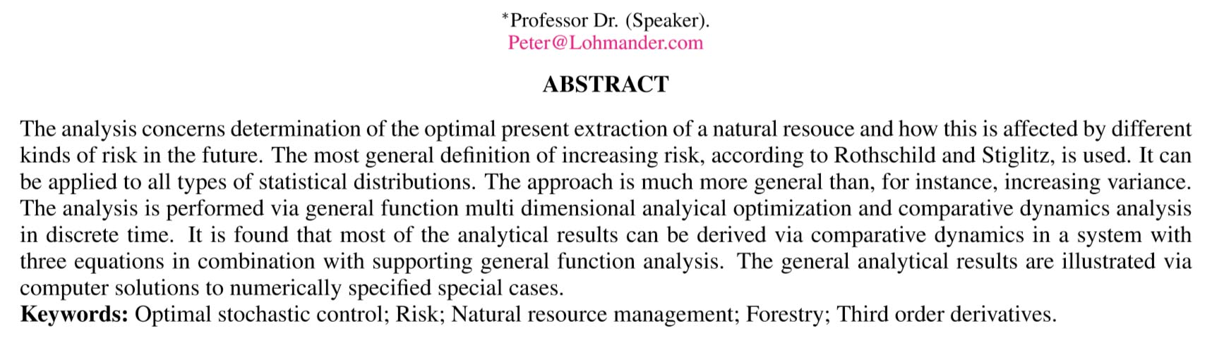
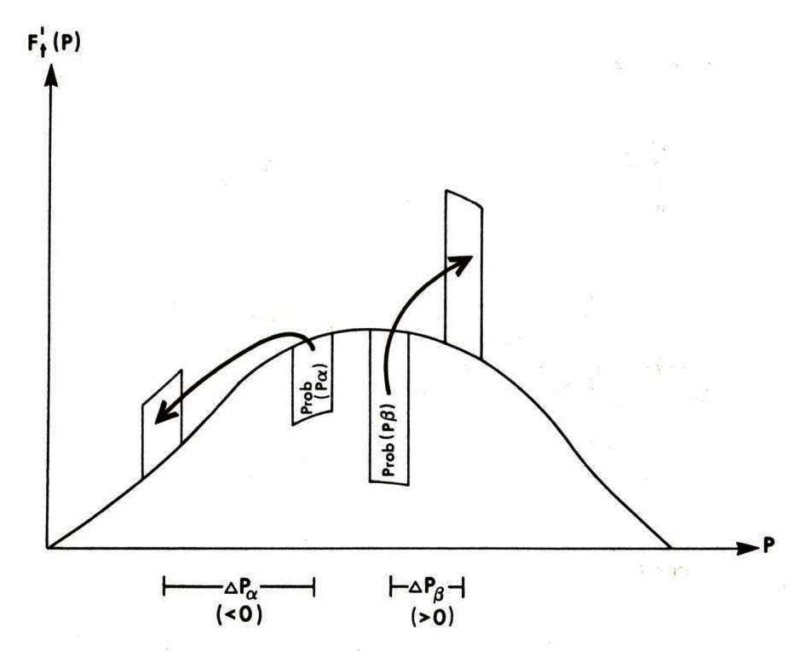
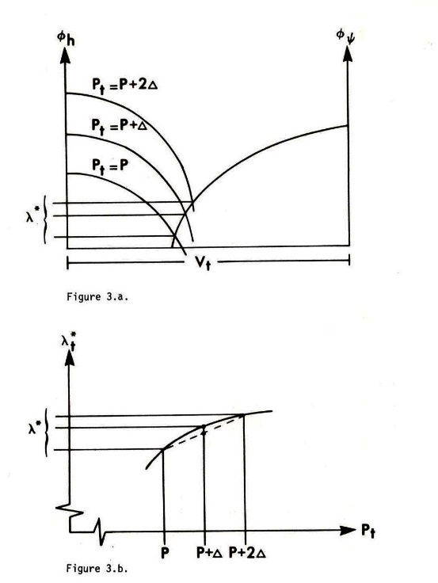
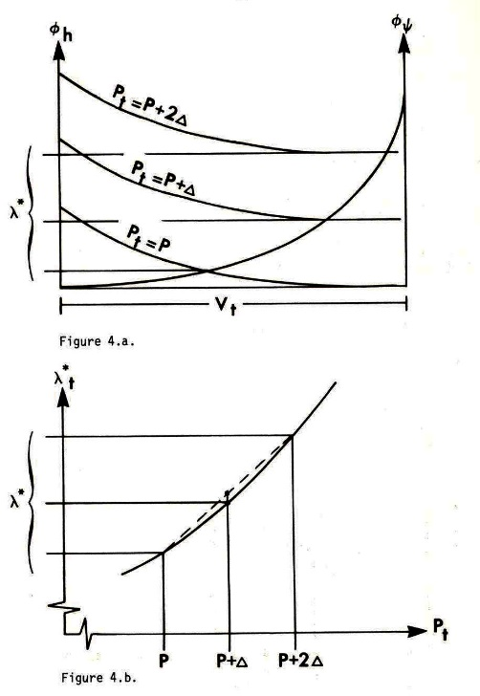

Slide 42
Contents:
1. Introduction via one dimensional optimization in dynamic problems, comparative statics analysis, probabilities, increasing risk and the importance of third order derivatives.
2. Explicit multi period analysis, stationarity and corner solutions.
3. Multi period problems and model structure with sequential adaptive decisions and risk.
4. Optimal decisions under future price risk.
5. Optimal decisions under future risk in the volume process (growth risk).
6. Optimal decisions under future price risk with mixed species.

Slide 43
Contents:
1. Introduction via one dimensional optimization in dynamic problems, comparative statics analysis, probabilities, increasing risk and the importance of third order derivatives.
2. Explicit multi period analysis, stationarity and corner solutions.
3. Multi period problems and model structure with sequential adaptive decisions and risk.
4. Optimal decisions under future price risk.
5. Optimal decisions under future risk in the volume process (growth risk).
6. Optimal decisions under future price risk with mixed species.

Slide 44
In the following analyses, we study the solutions to maximization problems. The objective functions are the total expected present values. In particular, we study how the optimal decisions at different points in time are affected by stochastic variables, increasing risk and optimal adaptive future decisions.
In all derivations in this document, continuously differentiable functions are assumed. In the optimizations and comparative statics calculations, local optima and small moves of these optima under the influence of parameter changes, are studied. For these reasons, derivatives of order four and higher are not considered. Derivatives of order three and lower can however not be neglected. We should be aware that functions that are not everywhere continuously differentiable may be relevant in several cases.

Slide 45
Introduction with a simplified problem

Slide 50
Probabilities and outcomes:

Slide 51
Increasing risk:

Slide 52
Probability
density

Slide 56
The sign of this third order derivative
determines the optimal direction of
change of our present extraction level
under the influence of increasing
risk in the future.

Slide 59
Contents:
1. Introduction via one dimensional optimization in dynamic problems, comparative statics analysis, probabilities, increasing risk and the importance of third order derivatives.
2. Explicit multi period analysis, stationarity and corner solutions.
3. Multi period problems and model structure with sequential adaptive decisions and risk.
4. Optimal decisions under future price risk.
5. Optimal decisions under future risk in the volume process (growth risk).
6. Optimal decisions under future price risk with mixed species.

Slide 60
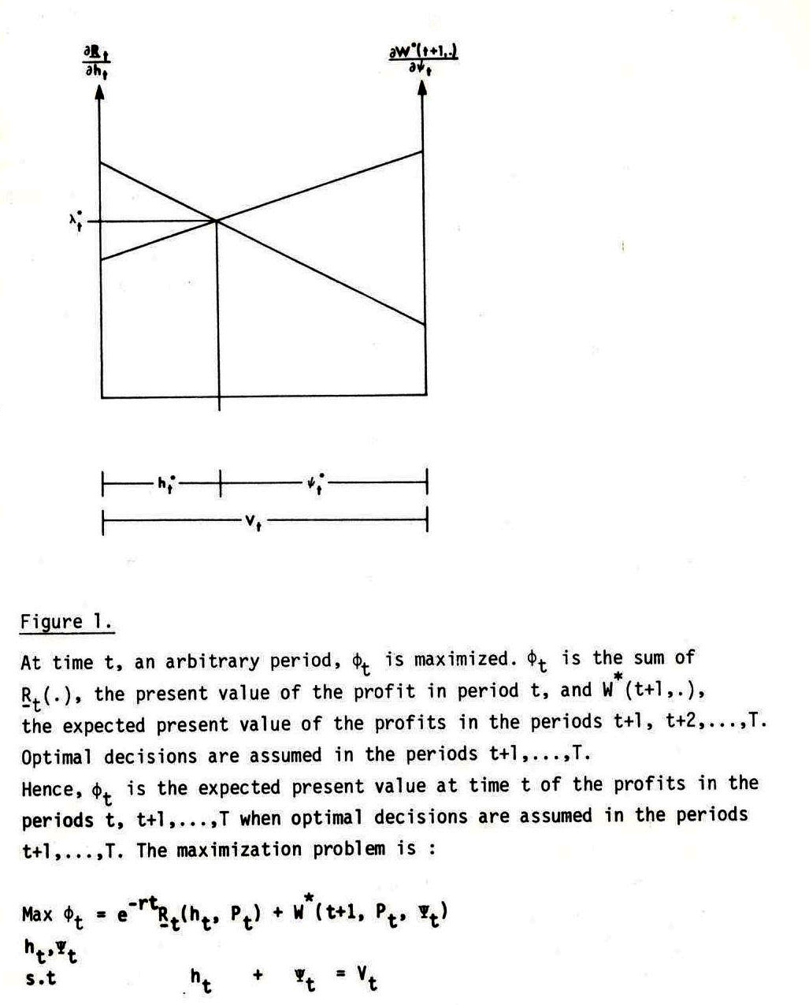
Towards
multi
period
analysis
Marginal
resource value
In period t
Expected marginal
resource value
In period t+1

Slide 61
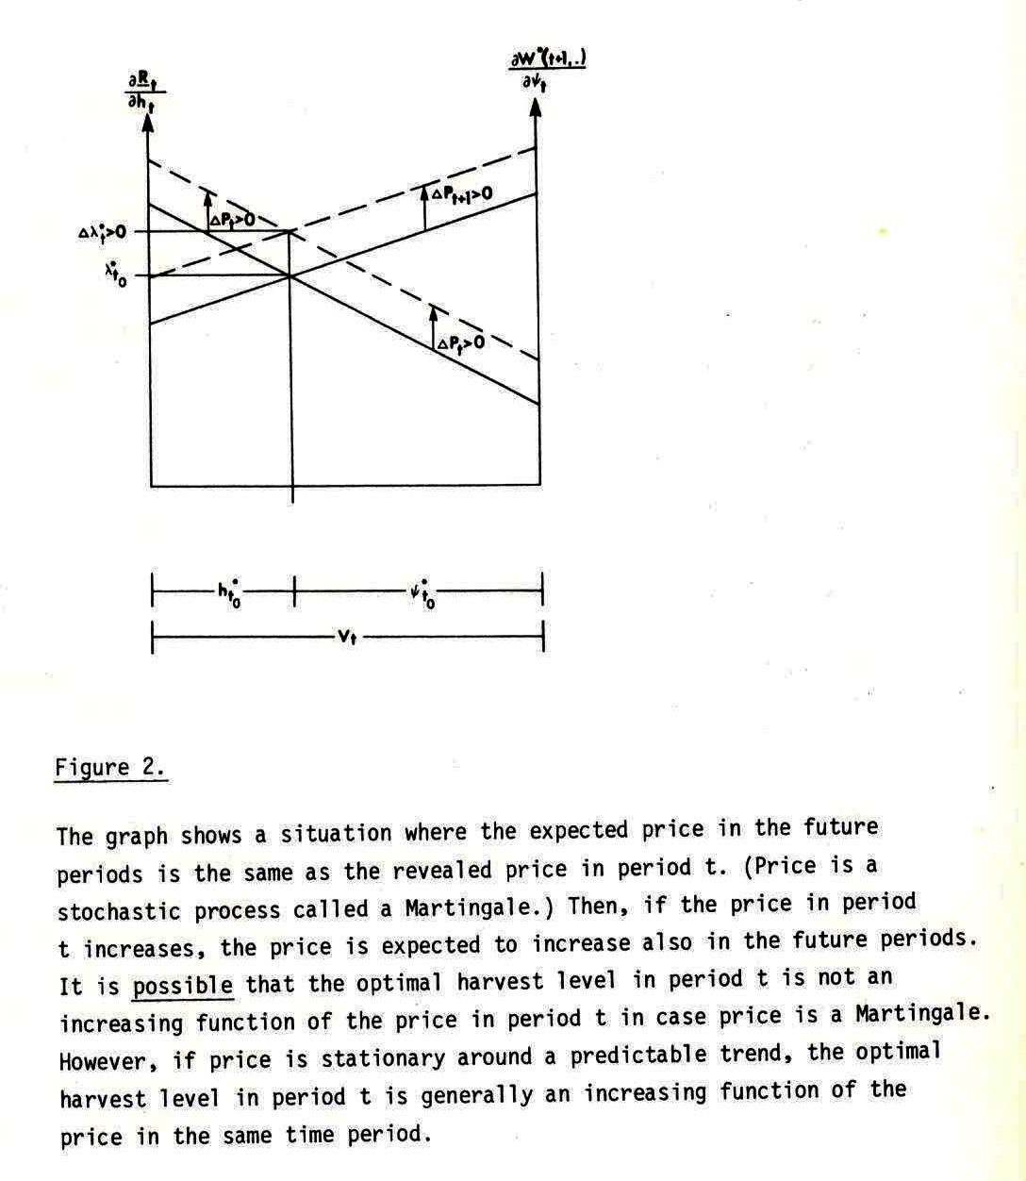
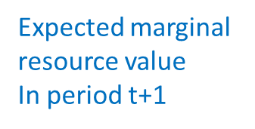
On
stationary
and
nonstationary
processes
Marginal
resource value
In period t

Slide 62
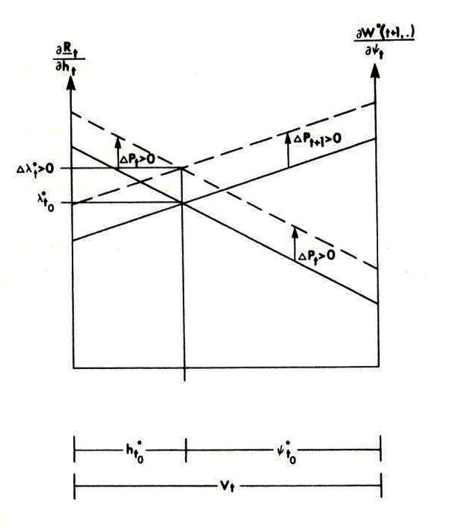
Marginal
resource value
In period t

Slide 63
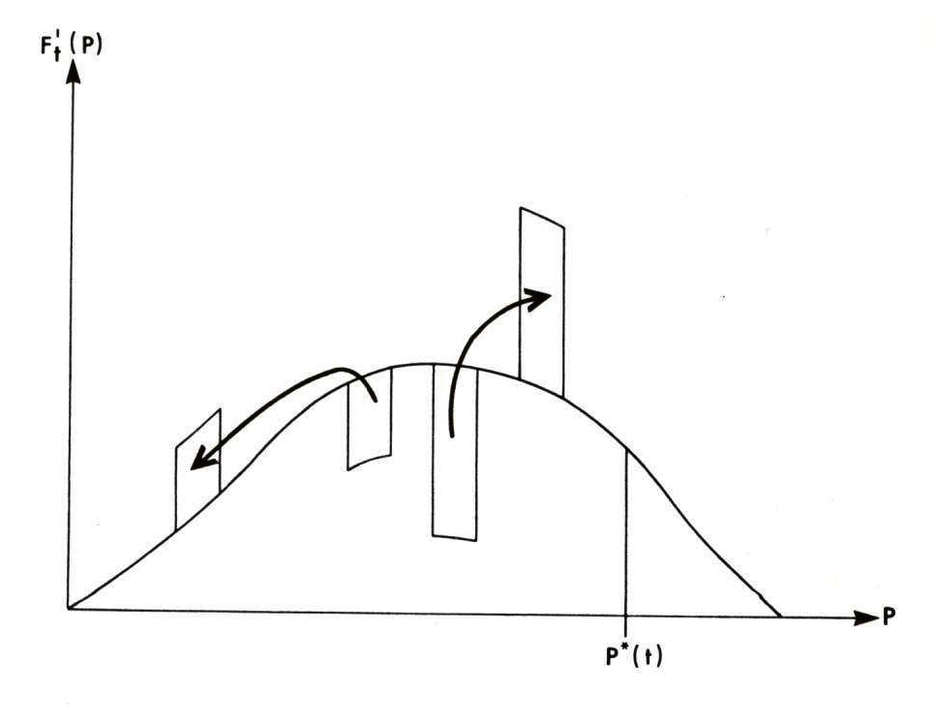
Probability
density
On
corner
solutions

Slide 64
Contents:
1. Introduction via one dimensional optimization in dynamic problems, comparative statics analysis, probabilities, increasing risk and the importance of third order derivatives.
2. Explicit multi period analysis, stationarity and corner solutions.
3. Multi period problems and model structure with sequential adaptive decisions and risk.
4. Optimal decisions under future price risk.
5. Optimal decisions under future risk in the volume process (growth risk).
6. Optimal decisions under future price risk with mixed species.

Slide 65
Optimization in multi period problems
One index corrected 150606

Slide 68
Three free decision variables and three first order optimum conditions

Slide 70
Let us differentiate the first order optimum conditions with respect to the decision variables and the risk parameters:
:

Slide 71
Contents:
1. Introduction via one dimensional optimization in dynamic problems, comparative statics analysis, probabilities, increasing risk and the importance of third order derivatives.
2. Explicit multi period analysis, stationarity and corner solutions.
3. Multi period problems and model structure with sequential adaptive decisions and risk.
4. Optimal decisions under future price risk.
5. Optimal decisions under future risk in the volume process (growth risk).
6. Optimal decisions under future price risk with mixed species.

Slide 75
Simplification gives:
A unique maximum is assumed.

Slide 76
Observation:
We assume decreasing marginal profits in all periods.

Slide 77
The following results follow from optimization:

Slide 79
The results may also be summarized this way:

Slide 80
The expected future marginal
resource value decreases from
increasing price risk and we should
increase present extraction.

Slide 81
The expected future marginal
resource value increases from
increasing price risk and we should
decrease present extraction.

Slide 82
Some results of increasing risk in the price process:
If the future risk in the price process increases, we should increase the present extraction level in case the third order derivatives of profit with respect to volume are strictly negative.
If the future risk in the price process increases, we should not change the present extraction level in case the third order derivatives of profit with respect to volume are zero.
If the future risk in the price process increases, we should decrease the present extraction level in case the third order derivatives of profit with respect to volume are strictly positive.

Slide 83
Contents:
1. Introduction via one dimensional optimization in dynamic problems, comparative statics analysis, probabilities, increasing risk and the importance of third order derivatives.
2. Explicit multi period analysis, stationarity and corner solutions.
3. Multi period problems and model structure with sequential adaptive decisions and risk.
4. Optimal decisions under future price risk.
5. Optimal decisions under future risk in the volume process (growth risk).
6. Optimal decisions under future price risk with mixed species.

Slide 84
The effects of increasing future risk in the volume process:
Now, we will investigate how the optimal values of the decision variables change if g increases.
We recall these first order derivatives:

Slide 95
The expected future marginal
resource value decreases from
increasing risk in the volume
process (growth) and we should
increase present extraction.

Slide 96
The expected future marginal
resource value increases from
increasing risk in the volume
process (growth) and we should
decrease present extraction.

Slide 97
Some results of increasing risk in the volume process (growth process):
If the future risk in the volume process increases, we should increase the present extraction level in case the third order derivatives of profit with respect to volume are strictly negative.
If the future risk in the volume process increases, we should not change the present extraction level in case the third order derivatives of profit with respect to volume are zero.
If the future risk in the volume process increases, we should decrease the present extraction level in case the third order derivatives of profit with respect to volume are strictly positive.

Slide 98
Contents:
1. Introduction via one dimensional optimization in dynamic problems, comparative statics analysis, probabilities, increasing risk and the importance of third order derivatives.
2. Explicit multi period analysis, stationarity and corner solutions.
3. Multi period problems and model structure with sequential adaptive decisions and risk.
4. Optimal decisions under future price risk.
5. Optimal decisions under future risk in the volume process (growth risk).
6. Optimal decisions under future price risk with mixed species.

Slide 99
The mixed species case:
A complete dynamic analysis of optimal natural resource management with several species should include decisions concerning total stock levels and interspecies competition.
In the following analysis, we study a case with two species, where the growth of a species is assumed to be a function of the total stock level and the stock level of the individual species.
The total stock level has however already indirectly been determined via binding constraints on total harvesting in periods 1 and 2.
We start with a deterministic version of the problem and later move to the stochastic counterpart.

Slide 101
Period 1
Period 2
Period 3

Slide 110
Now, there are three free decision variables and three first order optimum conditions:

Slide 119
Some multi species results:
With multiple species and total harvest volume constraints:
Case 1:
If the future price risk of one species, A, increases, we should now harvest less of this species (A) and more of the other species, in case the third order derivative of the profit function of species A with respect to harvest volume is greater than the corresponding derivative of the other species.
Case 3:
If the future price risk of one species, A, increases, we should not change the present harvest of this species (A) and not change the harvest of the other species, in case the third order derivative of the profit function of species A with respect to harvest volume is equal to the corresponding derivative of the other species.
Case 5:
If the future price risk of one species, A, increases, we should now harvest more of this species (A) and less of the other species, in case the third order derivative of the profit function of species A with respect to harvest volume is less than the corresponding derivative of the other species.

Slide 120
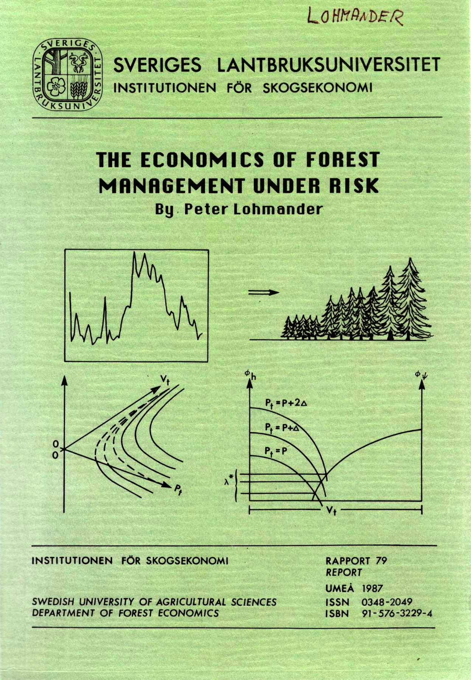
Related analyses, via stochastic dynamic programming, are found here:

Slide 121
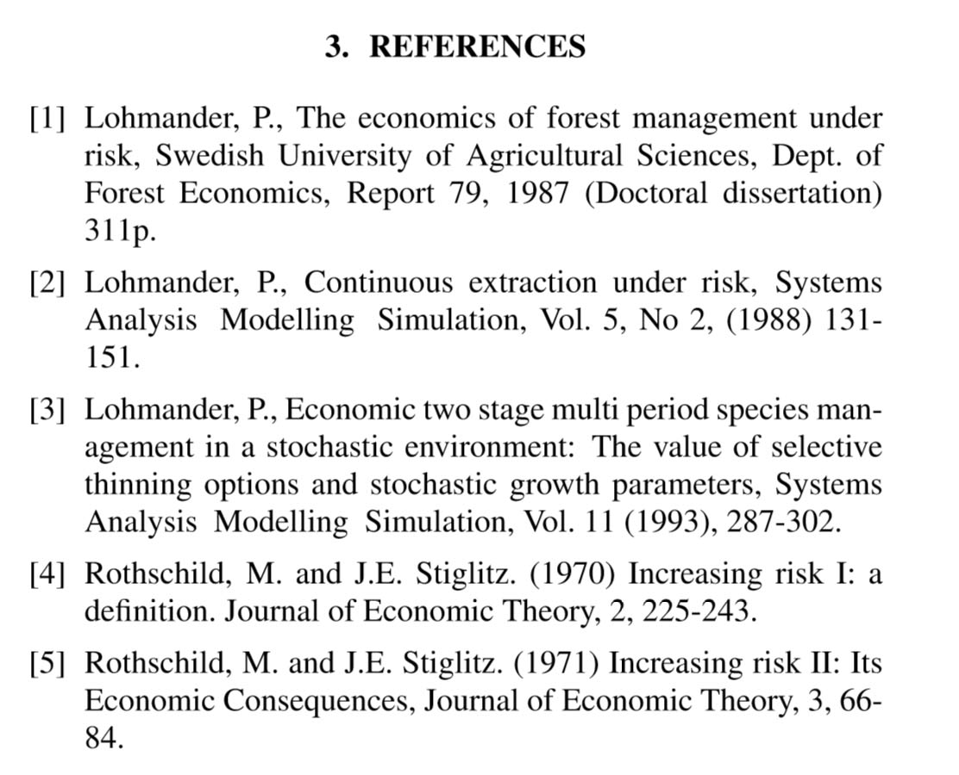
Many more references, including this presentation, are found here:
http://www.lohmander.com/Information/Ref.htm

Slide 122
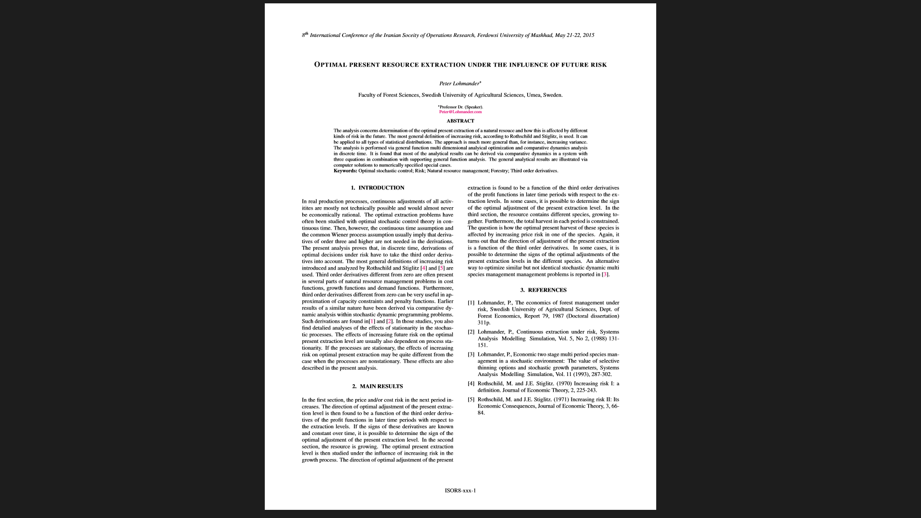
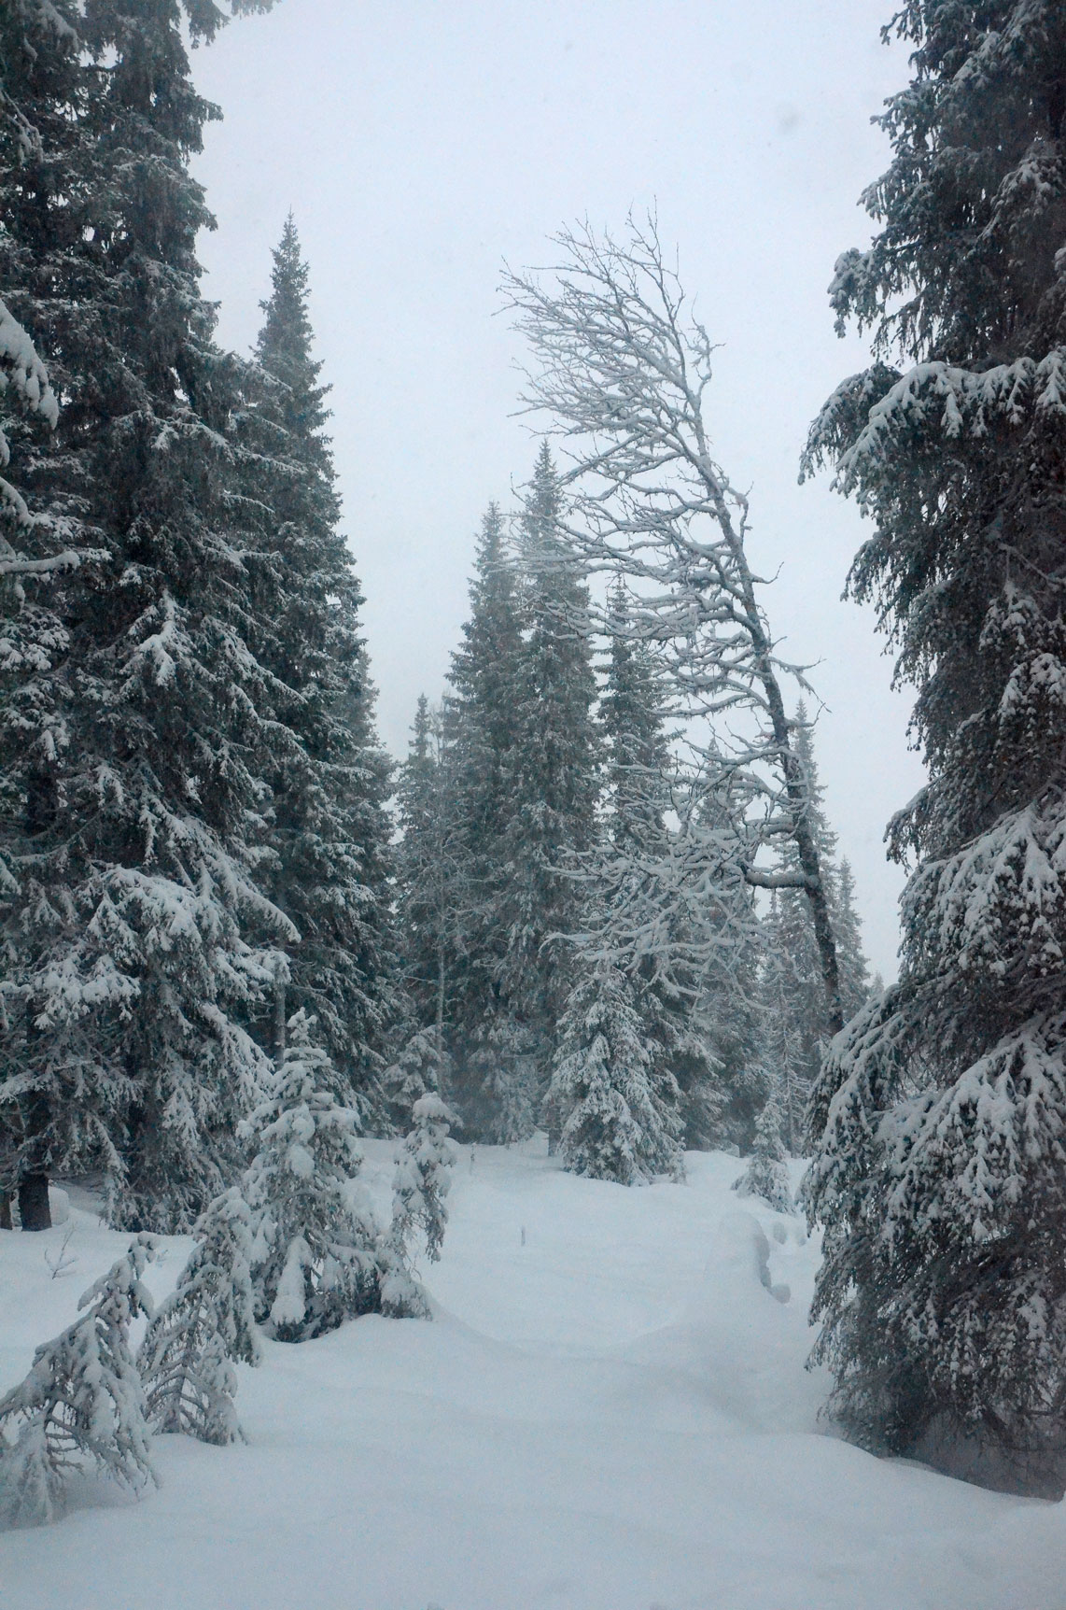

Slide 123
OPTIMAL PRESENT RESOURCE EXTRACTION UNDER THE INFLUENCE OF FUTURE RISK
Professor Dr Peter Lohmander
SLU, Sweden, http://www.Lohmander.com
Peter@Lohmander.com
The 8th International Conference of
Iranian Operations Research Society
Department of Mathematics Ferdowsi University of Mashhad, Mashhad, Iran.
www.or8.um.ac.ir
21-22 May 2015

