Slide 1
Optimal Dynamic Forest Fire Management Adapted to Stochastic Weather (Marginal Revision 220703. No results have been adjusted.) by Peter Lohmander Empirical data and support by Zohreh Mohammadi
Professor Peter Lohmander
Optimal Solutions
Sweden
Sixth International Webinar on
RECENT TRENDS IN STATISTICAL THEORY AND APPLICATIONS-2022 (WSTA-2022)
June 29 – July 02, 2022
Organized by
Department of Statistics, School of Physical and Mathematical Sciences, University of Kerala, Trivandrum in association with Indian Society for Probability and Statistics (ISPS) and Kerala Statistical Association (KSA).
Postdoctoral at
Czech University of Life Sciences
Prague

Slide 2
This presentation is based on the following open access articles and documents. More details can be obtained from the links found below.
[1] Lohmander P. (2020a). Dynamics and control of the CO2 level via a differential equation and alternative global emission strategies. Int Rob Auto J. 2020;6(1):7‒15. DOI: 10.15406/iratj.2020.06.0019, https://medcraveonline.com/IRATJ/IRATJ-06-00197.pdf
[2] Lohmander, P. (2020b)., Optimization of continuous cover forestry expansion under the influence of global warming, International Robotics & Automation Journal, Volume 6, Issue 3, 2020, 127-132. https://medcraveonline.com/IRATJ/IRATJ-06-00211.pdf ,
https://medcraveonline.com/IRATJ/IRATJ-06-00211A.pdf
[3] Lohmander, P. (2020c). Fundamental principles of optimal utilization of forests with consideration of global warming, Central Asian Journal of Environmental Science and Technology Innovation, Volume 1, Issue 3, May and June 2020, 134-142. doi: 10.22034/CAJESTI.2020.03.02 http://www.cas-press.com/article_111213.html http://www.cas-press.com/article_111213_5ab21574a30f6f2c7bdc0a0733234181.pdf

Slide 3
[4] Lohmander P. (2020d). Adaptive mobile firefighting resources: stochastic dynamic optimization of international cooperation. Int Rob Auto J. 2020;6(4):150‒155. DOI: 10.15406/iratj.2020.06.00213, https://medcraveonline.com/IRATJ/IRATJ-06-00213.pdf
[5] Lohmander, P. (2020e). Forest fire expansion under global warming conditions: -Multivariate estimation, function properties and predictions for 29 countries. Cent. Asian J. Environ. Sci. Technol. Innov., 5, 262-276, https://www.cas-press.com/article_122566_c3544cd0c21d5c077f72e985a77d30e9.pdf
[6] Lohmander, P. (2021a). Optimization of Forestry, Infrastructure and Fire Management. Caspian Journal of Environmental Sciences, 19: 287-316, https://cjes.guilan.ac.ir/article_4746_197fe867639c4cc5e317b63f9f9d370b.pdf

Slide 4
[7] Lohmander P. (2021b). Optimization of distance between fire stations: effects of fire ignition probabilities, fire engine speed and road limitations, property values and weather conditions. Int Rob Auto J. 2021;7(4):112‒120. DOI: 10.15406/iratj.2021.07.0023 , https://medcraveonline.com/IRATJ/IRATJ-07-00235.pdf
[8] Lohmander, P. (2021c). Global Stability via the Forced Global Warming Equation, Fire Control with Joint Fire Fighting Resources, and Optimal Forestry, KEYNOTE at ICASE 2021: International Conference on Applied Science & Engineering, March 31, 2021., http://www.Lohmander.com/PL_ICASE_2021_Abstract.pdf, http://www.Lohmander.com/PL_ICASE_2021_KEYNOTE.pdf
[9] Mohammadi, Z., Lohmander, P., Kašpar, J. et al. (2021). The effect of climate factors on the size of forest wildfires (case study: Prague-East district, Czech Republic). J. For. Res. https://doi.org/10.1007/s11676-021-01413-w

Slide 5
[10] Lohmander, P., Mohammadi, Z., Kaspar, J., Tahry, M., Bercak, R., Holusa, J., Marusak, R., (2022). Future forest fires as a functions of climate change and attack time for central Bohemian region, Czech Republic, Annals of Forest Research 65(1): 17-30 (in press). https://www.afrjournal.org/index.php/afr/issue/archive
[11] Lohmander, P., Rational Control of Global Warming Dynamics via Emission Reductions and Forestry Expansion (Submitted).

Slide 6
Abstract
Optimal Dynamic Forest Fire Management Adapted to Stochastic Weather
By Peter Lohmander. Empirical data and support: Zohreh Mohammadi.
Global warming is a major problem of our planet, which can be solved, [1], [2], [3], [8], [11]. Forest fires represent growing and severe direct safety problems in large parts of the world [5], [9]. Furthermore, the fires send large amounts of CO₂ to the atmosphere, which increase the speed of global warming. Recent research has estimated the size of a forest fire as a nonlinear function of the air temperature, relative humidity, wind speed and the time it takes for the fire brigade to reach the fire and start the fire suppression, [10]. Several ways to handle the forest fire problems have been suggested, [4], [6]. The sizes of fires can be reduced if the fire brigades reach the fires more rapidly. Central decisions in fire management optimization are to determine the numbers of fire brigade units, and their locations, at different points in time. A first study in this direction is [7]. If the spatial pattern of fire brigade locations is held constant and the number of fire brigade units per area unit increases, the capacity cost of the fire brigades increases. This represents an investment in firefighting capacity. Simultaneously, the expected distance to forest fires in random locations decreases, and the expected fire sizes are reduced. The reduced expected costs of burned forests can be interpreted as an expected economic revenue caused by the investment in firefighting capacity. In this paper, the optimal level of this investment is determined. The expected values of air temperature, relative humidity and wind speed, are determined as deterministic functions of time, during a typical year, in a region of Czech Republic. Furthermore, probability density functions and probability functions of the stochastic residuals of these weather components are derived. The air temperature residuals and the relative humidity residuals have considerable negative correlation. First, labor employment constraints are applied, that require that the numbers of fire brigade units at different points in time are determined before the true weather component residuals are known. Optimality conditions of the dynamically changing firefighting capacity levels are analytically determined. The solutions are found to give unique maxima. Comparative statics analysis is used to determine the directions of change of the optimal capacity levels under the influence of alternative parameter changes. The expected fire sizes can also be numerically approximated via random numbers with relevant correlations, based on Cholesky factorization. Finally, a generalized stochastic dynamic programming version of the dynamic investment decision problem is presented, based on a very flexible labor market, where the number of fire brigades rapidly can be adapted to the sequentially revealed weather situation.

Slide 7
Contents:
The firefighting capacity optimization problem
General solution to the firefighting capacity optimization problem
Comparative statics analysis of the optimal solution: How is the optimal solution affected by the parameters?
Fire growth as a function of weather conditions
Background to empirical weather and fire data
Dynamic and stochastic properties of air temperature, relative humidity and wind speed
Conclusions

Slide 8
The firefighting capacity optimization problem
Forest fires have a spatially uniform probability density function.
Fire fighting units (blue balls) have initial locations in a regular ”infinite” network with roads in directions N-S and E-W.
The distances between roads is small and fire fighting units can always use roads in the two directions to reach the different fires. (See the purple arrows.)
The decision problem is to determine
the optimal value of k, where the
distance between the nearest neighbours
is L = 2k.
The optimal value of k is affected by many
different parameters, some of which
are functions of the season, for instance air temperature, relative humidity and wind speed. These parameters affect fire growth.
N
k
k
y
Fire fighting
unit 1.
x

Slide 9
Expected total
costs as a
function of k.
Expected cost of
fire fighting capacity
”investment”
and use of these
resources
Fire fighting groups are
located in a regular network with
roads in directions South-North
and East- West. The distance
in one of these directions, between
two neighbour groups, is L = 2k.
Expected cost of destroyed and damaged forests
including costs of CO2 emissions

Slide 10
Expected cost
per burned ha.
A = Air temperature (Stochastic)
H = Relative humidity (Stochastic)
W = Wind speed (Stochastic)
t(k,m) = expected time of fire life.
m = fire life time before the
fire fighting unit leaves the initial
location and starts to move towards
the fire.
Expected size of burned forest, per fire.
Expected number of fires
per time unit.
Expected cost of destroyed and damaged forests
including costs of CO2 emissions

Slide 11
Number of units per 10000 square km
Expected cost of
fire fighting capacity
”investment”
and use of these
Resources.
Expected cost
per unit.

Slide 12
This has been estimated
with empirical data.
Expected size of burned forest,
per fire.
This will be shown to hold
in general cases.

Slide 13
Why is
?
k
Random fires in the square
that is closest to fire fighting
unit 1.
k
y
Fire fighting
unit 1.
x

Slide 14
Convolution

Slide 24
Hence,
Important properties:

Slide 25
General solution to the firefighting capacity optimization problem

Slide 28
0
k
0
k

Slide 29
Comparative statics analysis of the optimal solution: How is the optimal solution affected by the parameters?

Slide 31
If the cost per fire fighting unit increases,
the optimal distance between fire fighting units increases.

Slide 32
0
k

Slide 33
If the cost per fire damaged hectare of forest increases,
the optimal distance between fire fighting units decreases.
Note that, if the cost of CO2 emissions is considered, the
optimal value of k is lower than if we do not care
about CO2 emissions.

Slide 34
0
k

Slide 35
If the expected number of fires per area unit increases,
the optimal distance between fire fighting units decreases.

Slide 36
If the general fire speed parameter c increases,
the optimal distance between fire fighting units decreases.
Possible reasons: More open terrain and/or
larger amounts of dry grass and other fuels.

Slide 37
If m increases, the fires get more time to grow before fire supression starts,
and the optimal distance between fire fighting units decreases.
Possible reasons: Less efficient and/or intensive fire surveillance,
fog, smoke or worse road conditions, forcing the fire fighting units
to decrease the travel speed.

Slide 38
Fire growth as a function of weather conditions
The comparative statics analysis now needs some empirical information.

Slide 39
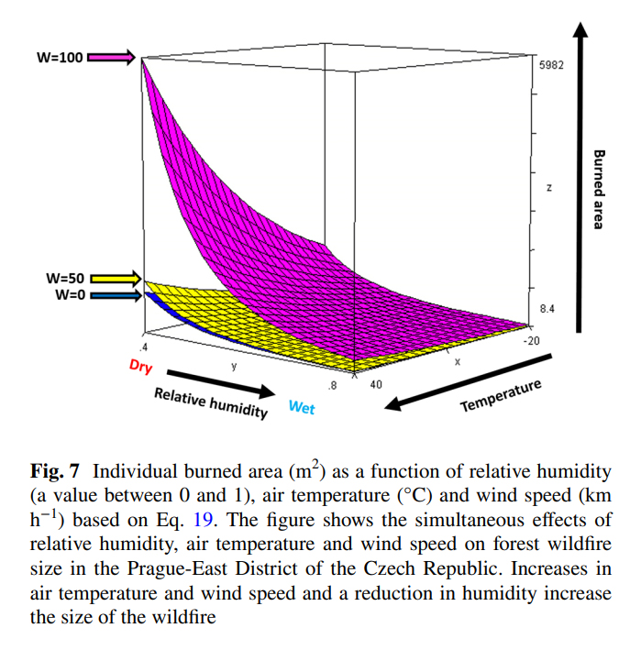
Mohammadi, Z., Lohmander, P., Kašpar, J. et al. The effect of climate factors on the size of forest wildfires (case study: Prague-East district, Czech Republic). J. For. Res. (2021). https://doi.org/10.1007/s11676-021-01413-w

Slide 40
The empirical estimations gave these results:

Slide 41
If the air temperature increases, the speed of fire growth increases,
and the optimal distance between fire fighting units decreases.

Slide 42
If the relative humidity increases, the speed of fire growth decreases,
and the optimal distance between fire fighting units increases.

Slide 43
If the wind speed increases, the speed of fire growth increases,
and the optimal distance between fire fighting units decreases.

Slide 44
Comments on the optimimization problem
Above, we have assumed that labor employment constraints are applied, that require that the numbers of fire fighting units at different points in time are determined before the true weather component residuals are known.
Optimality conditions of the dynamically changing firefighting capacity levels have been analytically determined.
The solutions have been found to be unique minima.
Comparative statics analysis has been used to determine the directions of change of the optimal capacity levels under the influence of alternative parameter changes.
The expected fire sizes can also be numerically approximated via random numbers with relevant correlations, based on Cholesky factorization.
A stochastic dynamic programming version of the dynamic investment decision problem is also possible to present, based on a very flexible labor market, where the number of fire fighting units rapidly can be adapted to the sequentially revealed weather situation. However, since time is limited and since such labour conditions are not relevant in many countries, this will not be presented here.

Slide 45
Background to empirical weather and fire data

Slide 46
Dynamic and stochastic properties of air temperature, relative humidity and wind speed
The following parameter estimations related to dynamic and stochastic properties of air temperature, relative humidity and wind speed, can be used in the fire fighting capacity optimization problem.

Slide 49
Relative humidity

Slide 56
Conclusions
The optimal fire fighting capacity is a dynamically changing function of several parameters. The optimal solution has been derived and presented in general form. Comparative statics analysis has been used to show how the optimal decisions are affected by parameter changes.
Since the optimal decisions are functions of many local cost parameters and since different regions have different and dynamically changing weather parameters, the optimal capacity solutions are not the same in different regions.
The general approach presented here should be possible to use in most countries and regions of our world.

Slide 57
Thank you very much for your time and a most interesting conference!
Professor Dr Peter Lohmander
Peter@Lohmander.com
http://www.lohmander.com/Information/Ref.htm

