Slide 1

Attrition coefficient estimations via differential equation systems, initial and terminal conditions, and nonlinear iterative equation system solutions by
Peter Lohmander
WSTA-2024
Recent Trends in Statistical Theory and Applications-2024 (WSTA-2024)
June 29 – July 02, 2024, Invited Talk.
Organized by the Department of Statistics, School of Physical and Mathematical Sciences, University of Kerala, Trivandrum in association with Indian Society for Probability and Statistics (ISPS) and Kerala Statistical Association (KSA).
Version 240624_2337
Peter Lohmander
Prof Dr
Peter Lohmander Optimal Solutions, Sweden

Slide 2
Attrition coefficient estimations via differential equation systems, initial and terminal conditions, and nonlinear iterative equation system solutions, by Peter Lohmander, WSTA-2024
ABSTRACT:
In battles with aimed fire, the attrition of a force can under simplified assumptions be shown to be proportional to the number of enemies. Lanchester models for aimed fire are differential equation systems that can be applied to describe the dynamics of such battles. In order to determine the attrition coefficients and the complete dynamics of the battle in continuous time, the following procedure is introduced: First, the general solution of the Lanchester differential equation system, which is a homogenous second order differential equation system, is derived. The four parameters of the solution are determined. In these equations, the initial and terminal sizes of the two forces, are parameters. A 4-dimensional fix point iteration algorithm is developed and implemented as a computer code, that rapidly solves the nonlinear equation system. After 40 iterations, the absolute relative errors in all equations are smaller than 10^(-12) . Then, a discrete time version of the Lanchester differential equation system, with stochastic attrition coefficients, is defined as a difference equation system. The effects of increasing risk in the attrition coefficients, that determine how the time derivative of the size of force X is affected by the size of force Y, at different points in time, is analyzed. It is shown that the expected size of force X is a strictly convex function of the risk in the attrition coefficients. According to the Jensen’s inequality, the expected size of force X at time t+2 is a strictly increasing function of the risk in the attrition coefficients at time t and t+1 for arbitrary values of t. In case the attrition coefficients in different periods are stochastic, and the system parameters are determined according to the suggested procedure, then the expected attrition coefficients obtain higher values than if the attrition coefficients would be constant over time. This can explain differences between attrition coefficient estimates based on different methods and coefficient risk assumptions.

Slide 3
Abstract Part 1:
In battles with aimed fire, the attrition of a force can under simplified assumptions be shown to be proportional to the number of enemies. Lanchester models for aimed fire are differential equation systems that can be applied to describe the dynamics of such battles.
In order to determine the attrition coefficients and the complete dynamics of the battle in continuous time, the following procedure is introduced:
First, the general solution of the Lanchester differential equation system, which is a homogenous second order differential equation system, is derived.

Slide 4
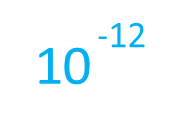
Abstract Part 2:
The four parameters of the solution are determined. In these equations, the initial and terminal sizes of the two forces, are parameters.
A 4-dimensional fix point iteration algorithm is developed and implemented as a computer code, that rapidly solves the nonlinear equation system. After 40 iterations, the absolute relative errors in all equations are smaller than .

Slide 5
Abstract Part 3:
Then, a discrete time version of the Lanchester differential equation system, with stochastic attrition coefficients, is defined as a difference equation system.
The effects of increasing risk in the attrition coefficients, that determine how the time derivative of the size of force X is affected by the size of force Y, at different points in time, is analyzed.

Slide 6
Abstract Part 4:
It is shown that the expected size of force X is a strictly convex function of the risk in the attrition coefficients.
According to the Jensen’s inequality, the expected size of force X at time t+2 is a strictly increasing function of the risk in the attrition coefficients at time t and t+1 for arbitrary values of t.
In case the attrition coefficients in different periods are stochastic, and the system parameters are determined according to the suggested procedure, then the expected attrition coefficients obtain higher values than if the attrition coefficients would be constant over time.
This can explain differences between attrition coefficient estimates based on different methods and coefficient risk assumptions.

Slide 7
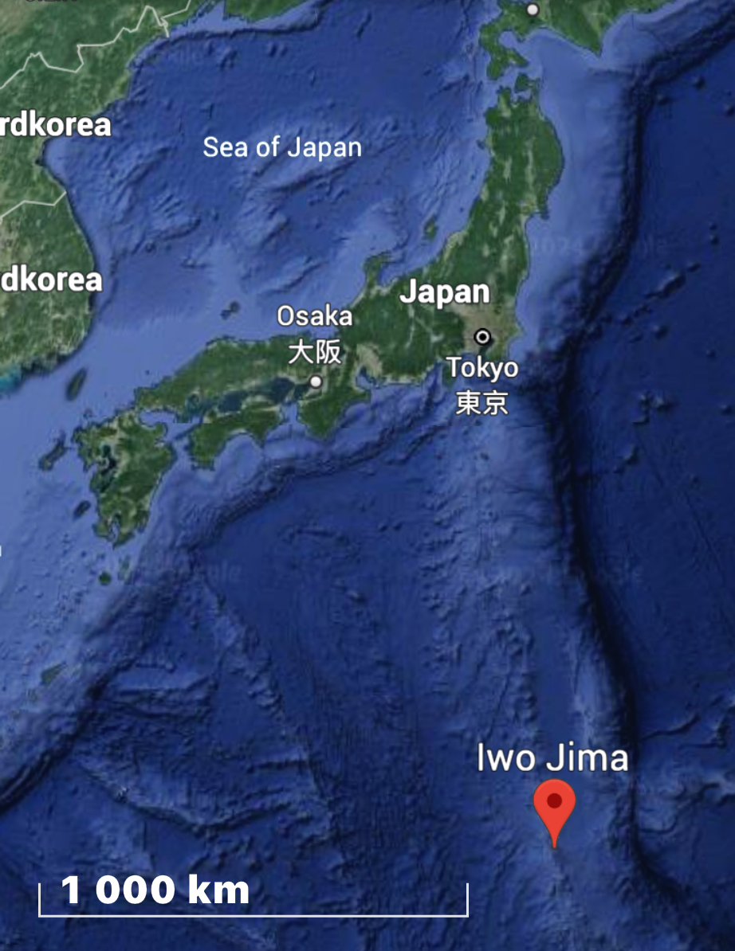
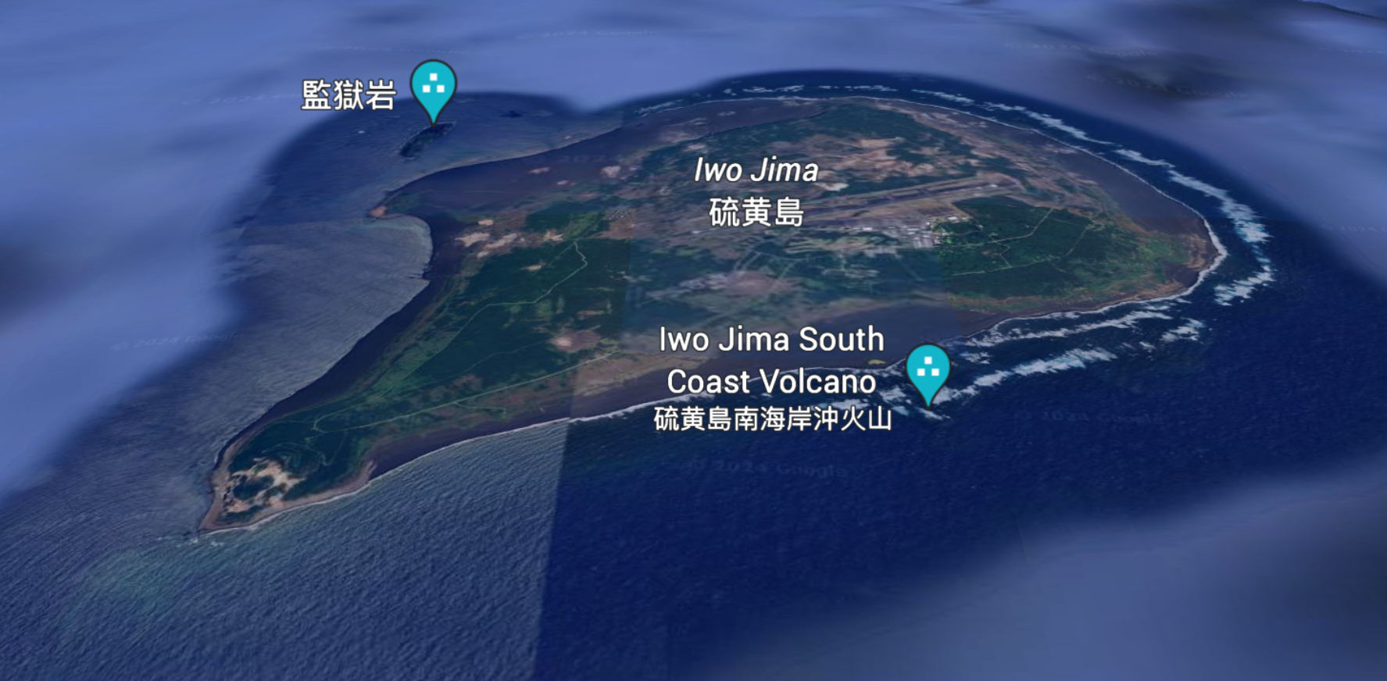
Empirical data:
The Battle of Iwo Jima during World War II:

Slide 8

The Battle of Iwo Jima:
(AI generated picture)

Slide 9
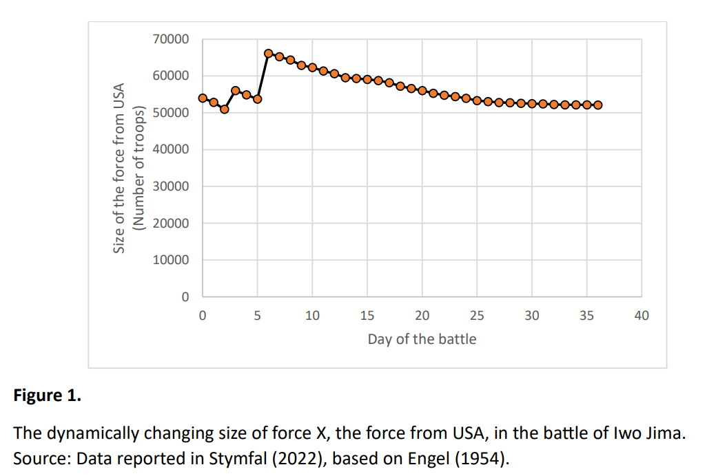

Slide 10
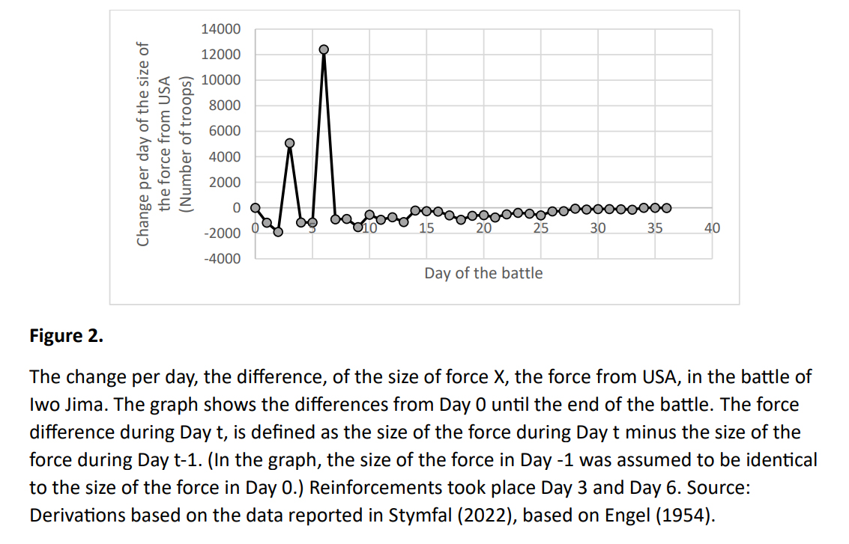

Slide 11
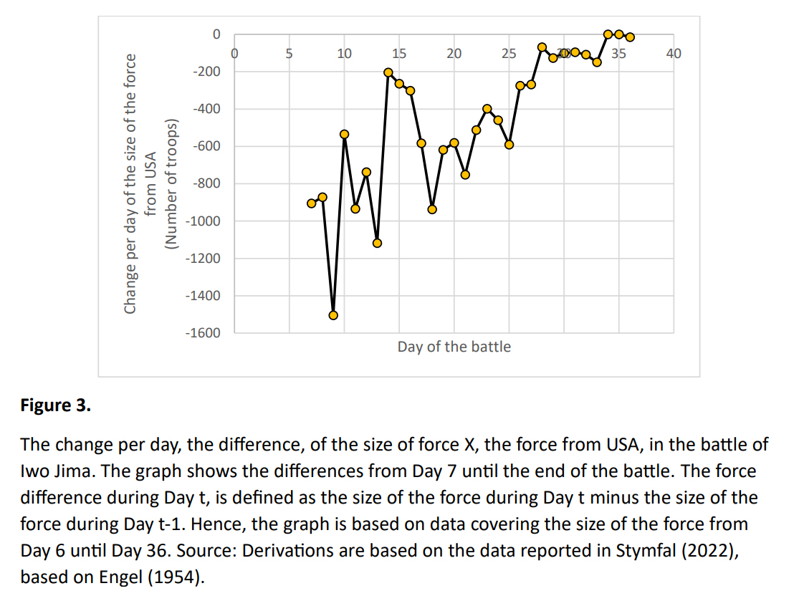

Slide 12
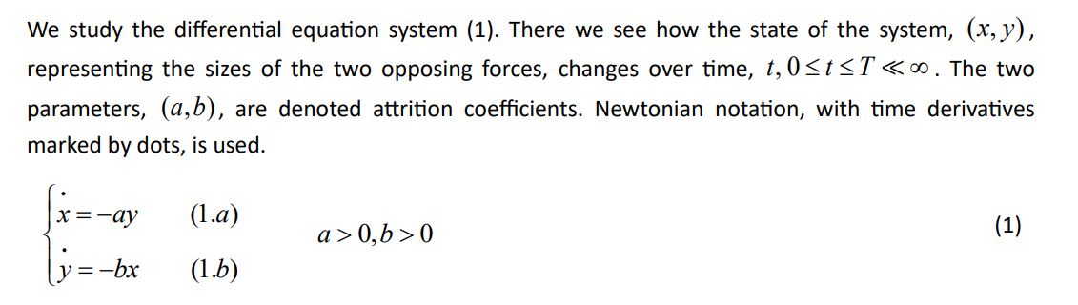

Slide 13
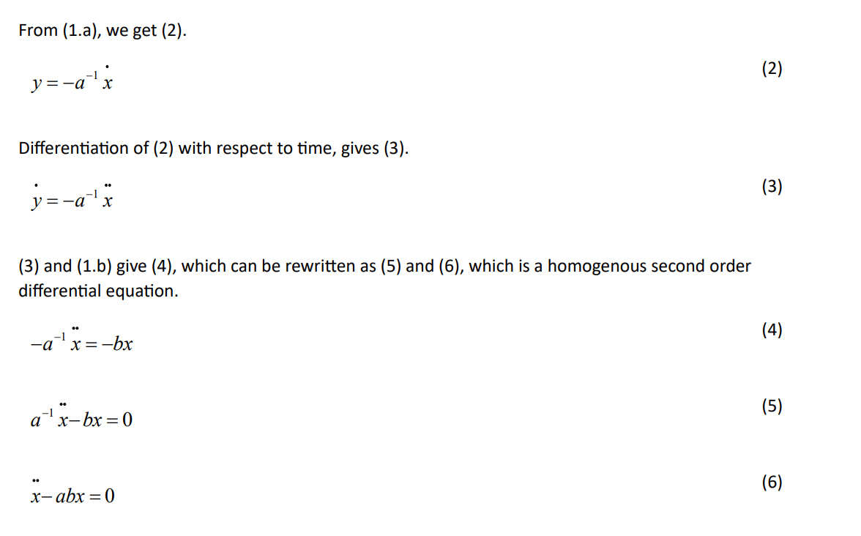

Slide 14
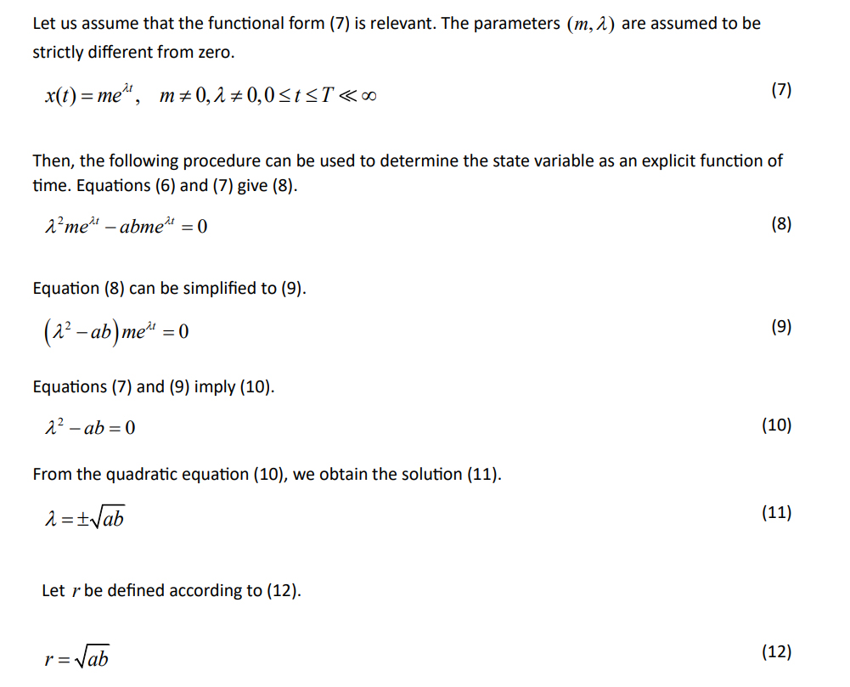

Slide 15
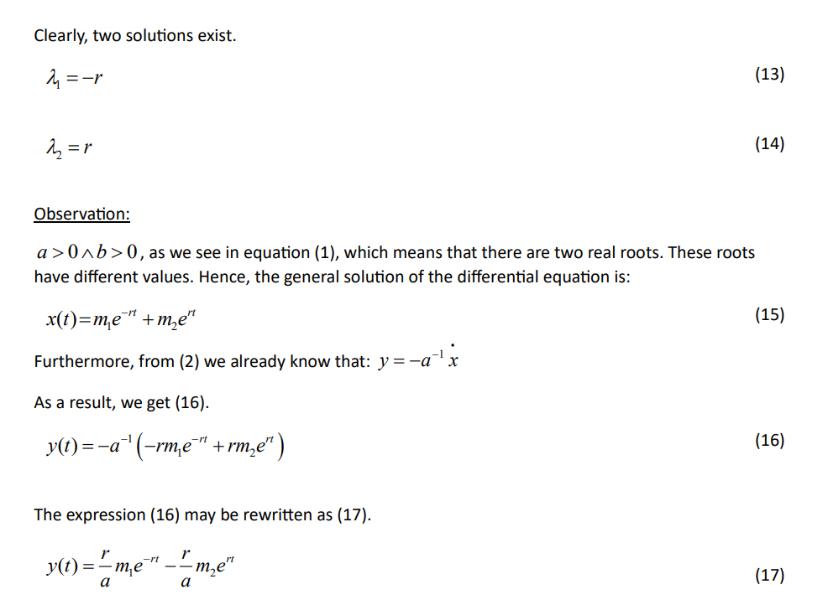

Slide 16
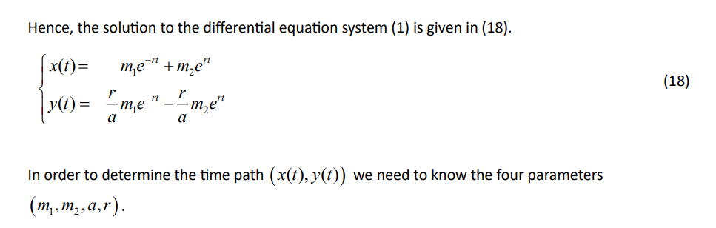

Slide 17
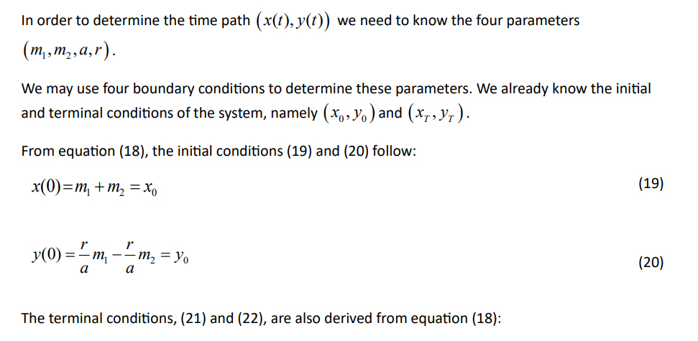
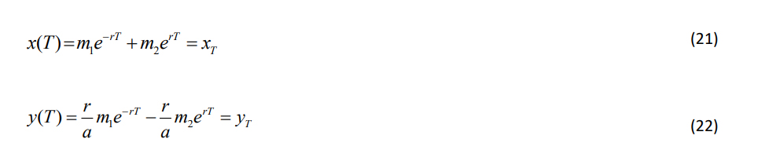

Slide 18
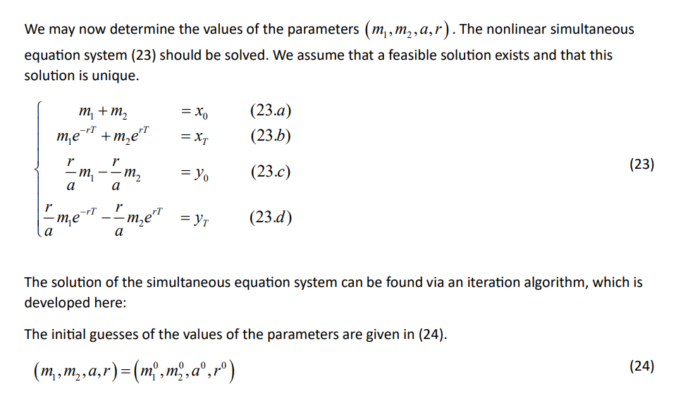

Slide 19
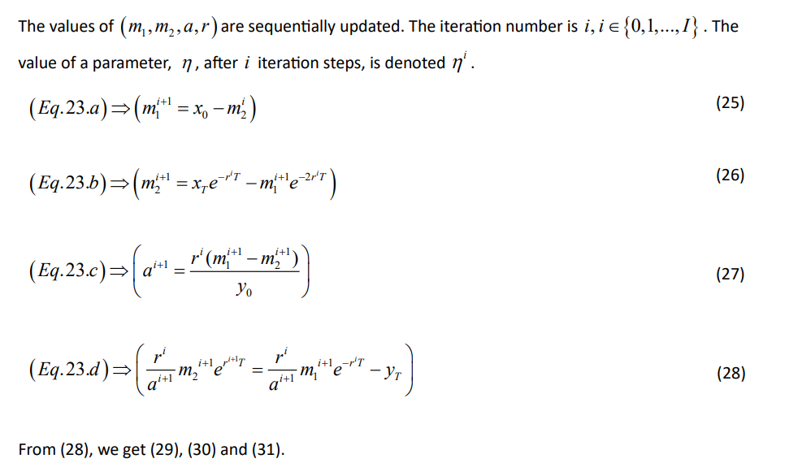

Slide 20
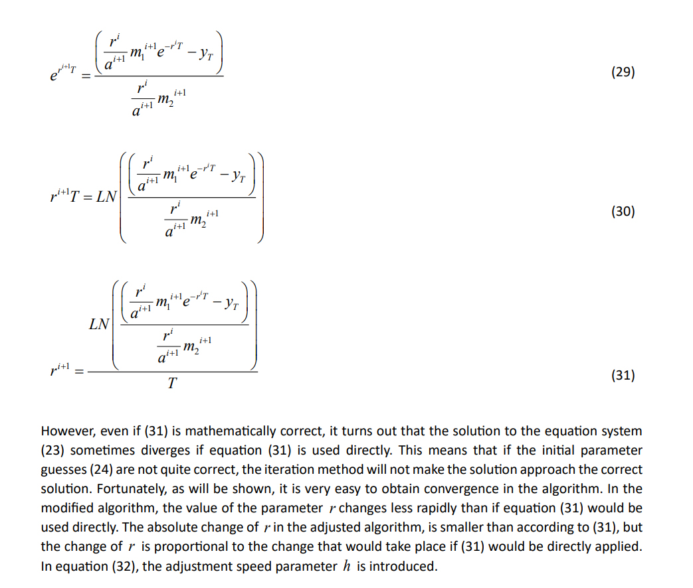

Slide 21
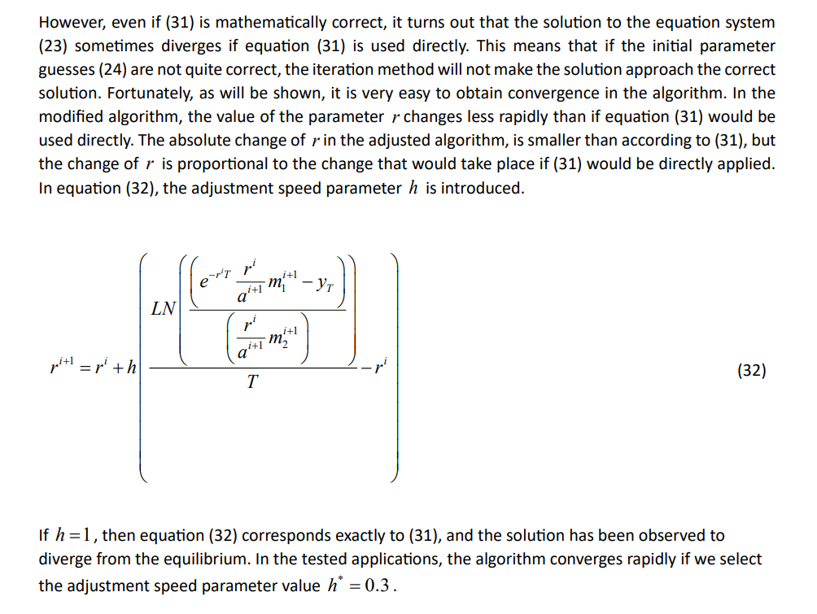

Slide 22
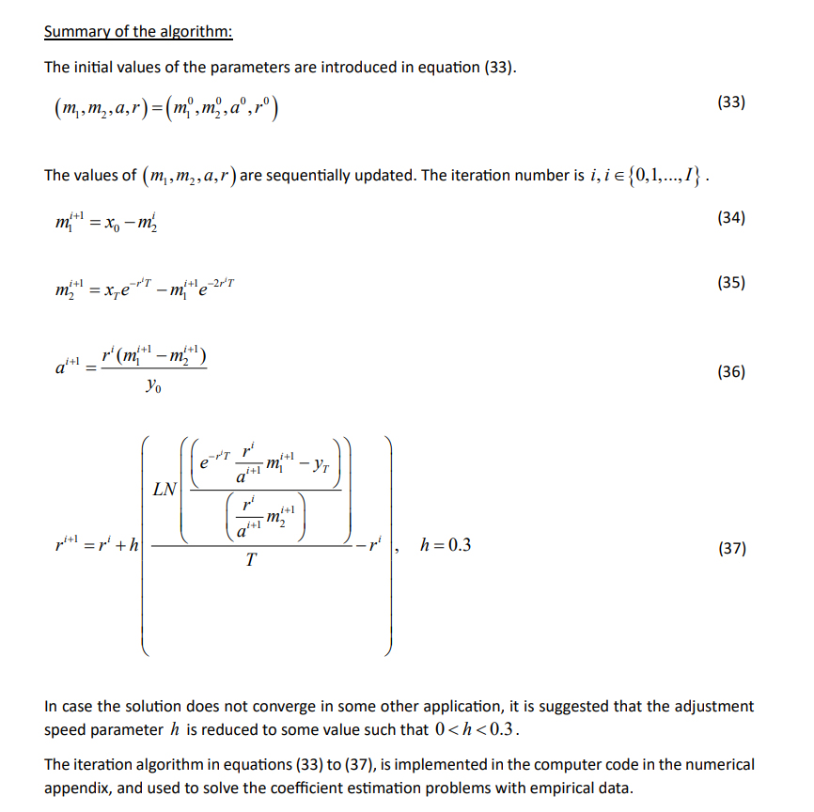

Slide 23
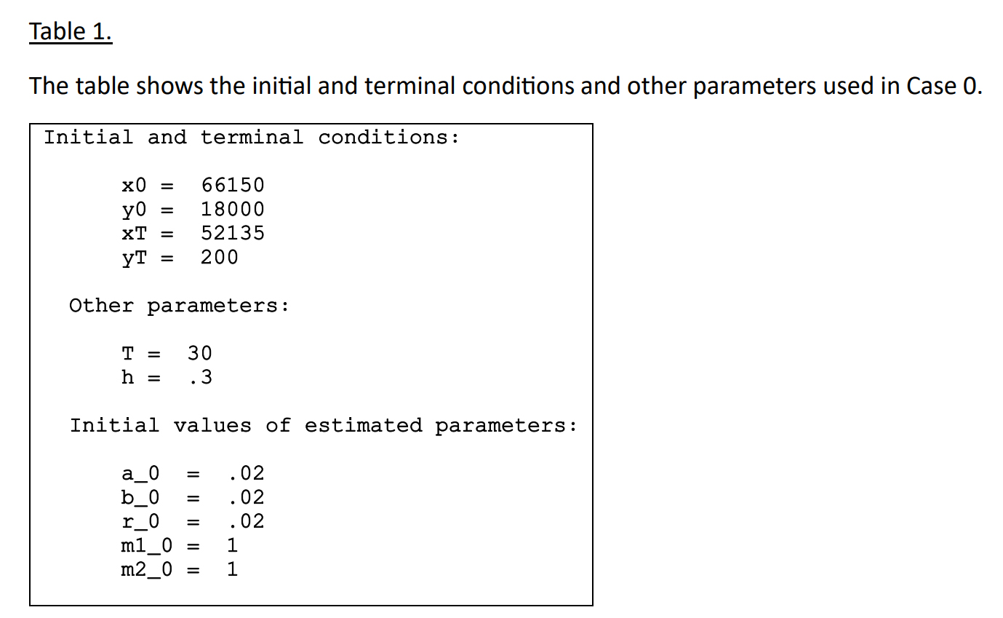

Slide 24
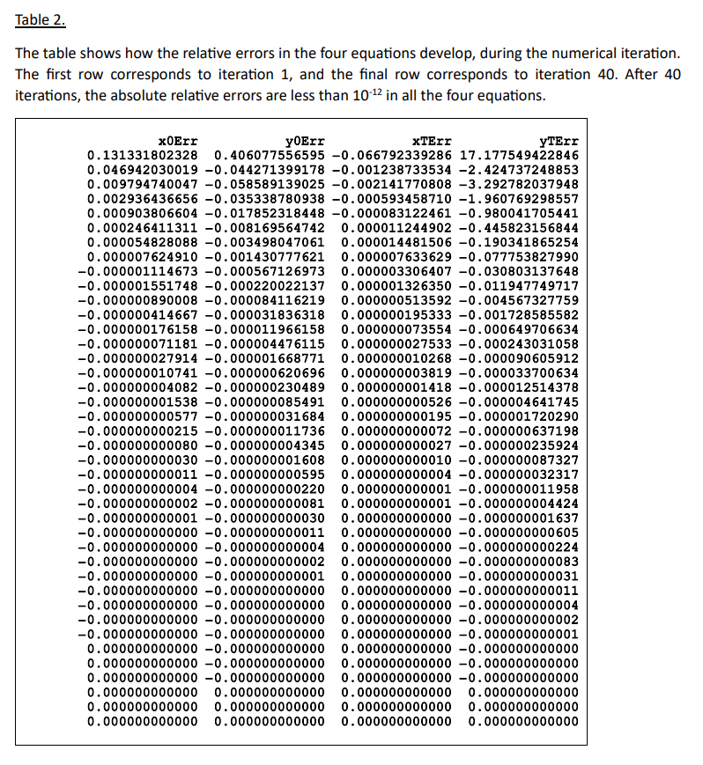

Slide 25
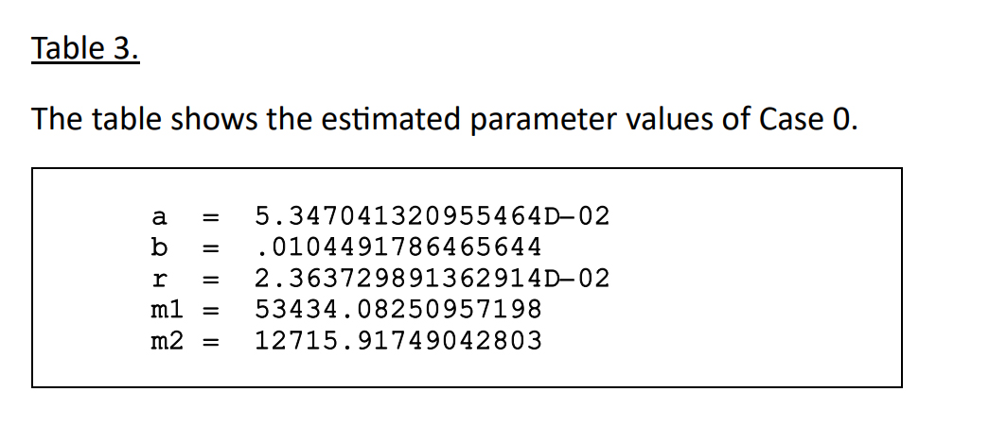

Slide 26
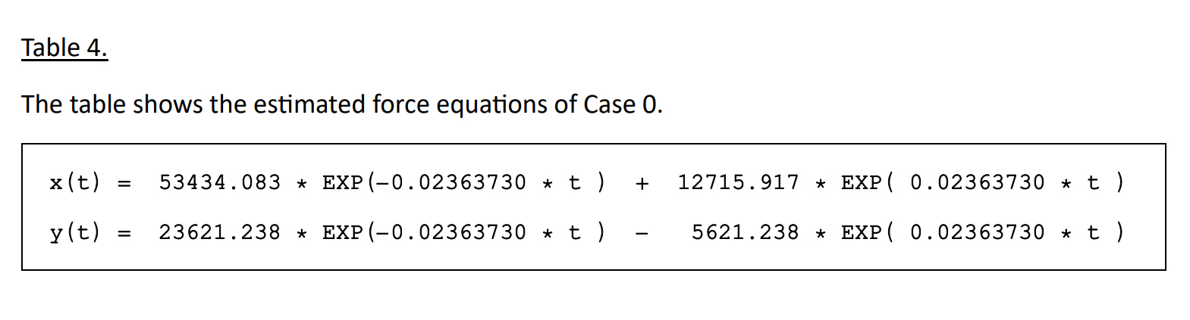

Slide 27
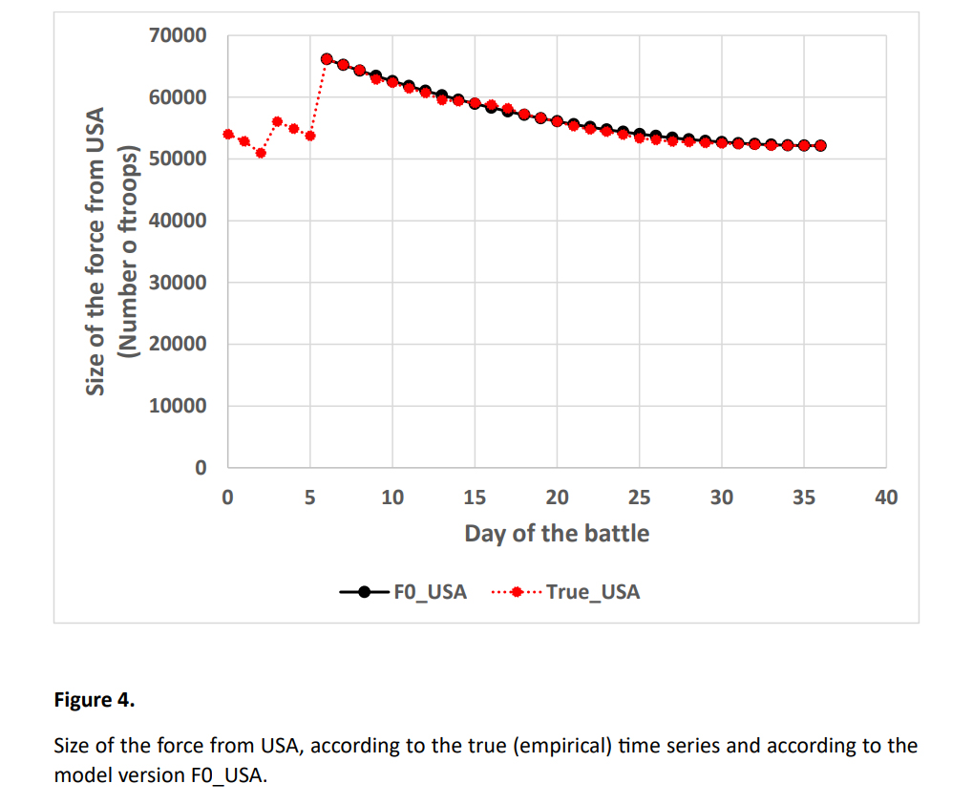

Slide 28
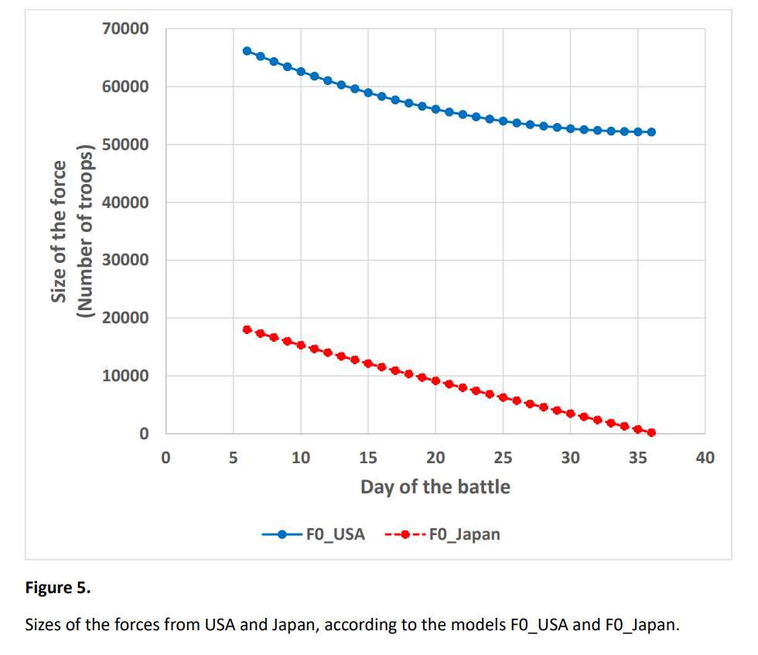

Slide 29
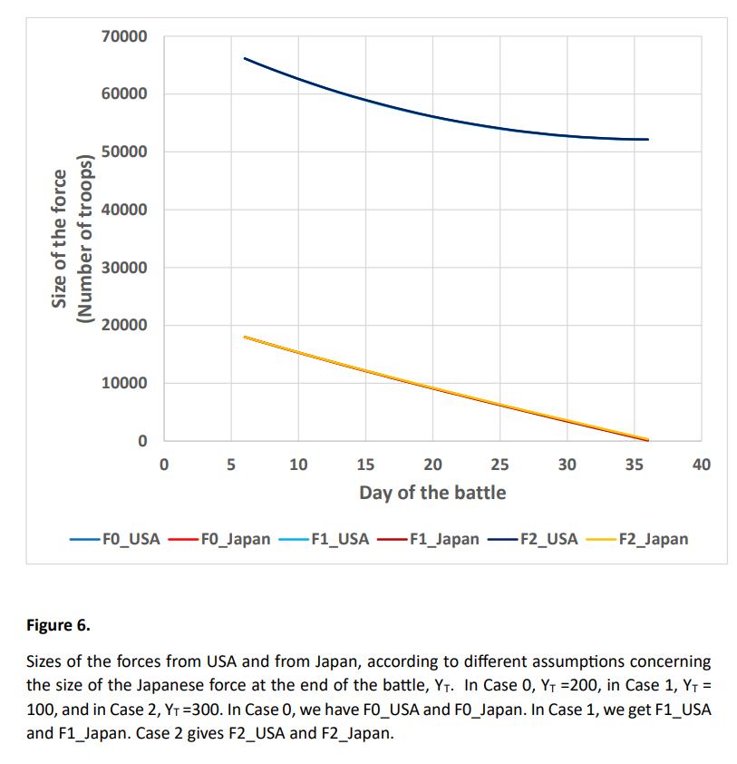

Slide 30
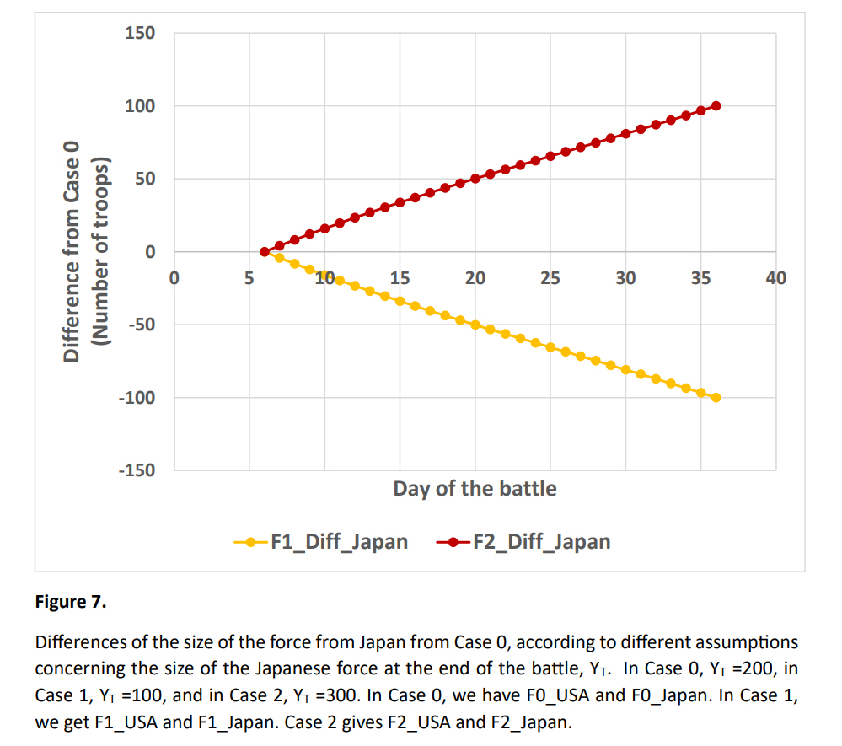

Slide 31
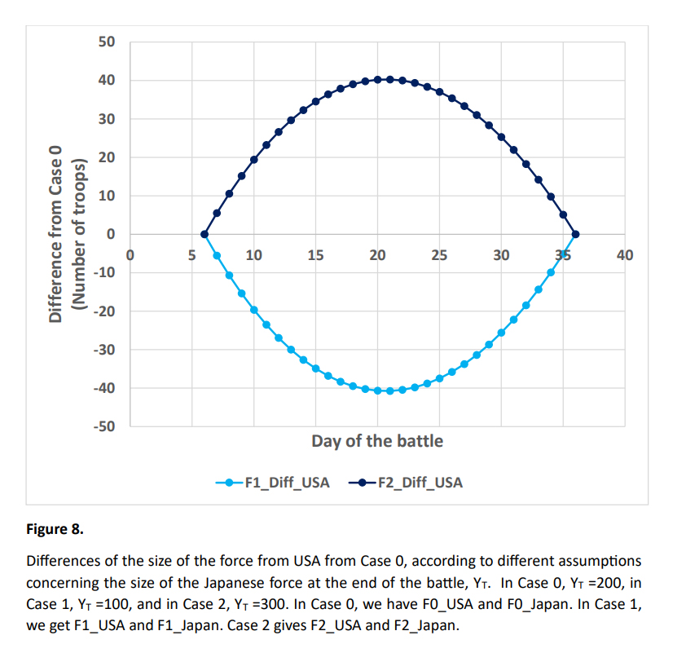

Slide 32
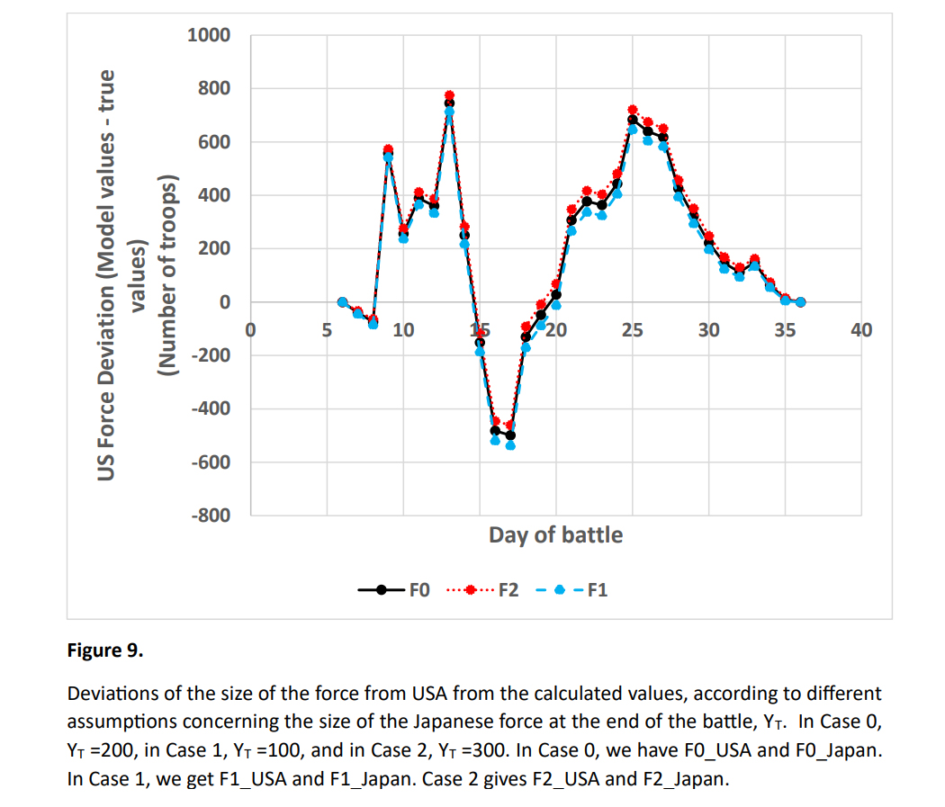

Slide 33
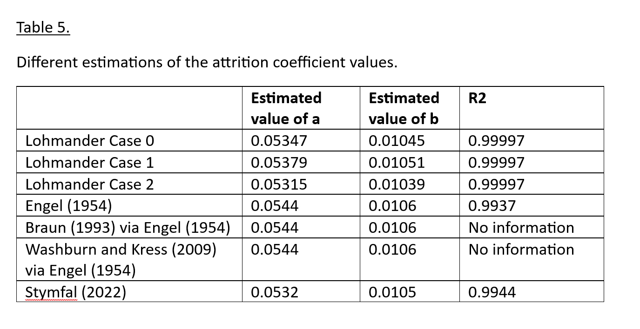

Slide 39
X
2
E(X (S))
>
X (E(S))
2
2
E(X (S))
2
X (E(S))
2
S
-h
0
+h
P(S)
0.5
S
-h
0
+h

Slide 46
X
2
E(X (S))
>
X (E(S))
2
2
E(X (S))
2
X (E(S))
2
S
-h
0
+h
P(S)
0.5
S
-h
0
+h

Slide 47
X
2
The expected survival of Force X increases.
S
-h
0
+h
The variation in the efficiency of Force Y, ”the attrition parameter a”, increases (from the assumed value 0).
The expected survival of Force X increases. (This means that the expected attrition by Force Y is reduced.)
However, the terminal value of the size of Force X is an empirical fact and does not change.
Hence, it is necessary that the expected efficiency of Force Y, ”the attrition parameter a”, increases.
In other words: The true value of the expected attrition parameter ”a” has to increase.

Slide 48
Conclusions:
This study has shown the following:
It is possible to determine the expected attrition coefficients of a battle, if the initial and terminal sizes of the forces of the involved parties are known, and the general solution to the relevant differential equation system can be derived.
This means that detailed statistical data tables, representing the time series of the sizes of the involved forces, are not necessary.
This is an important conclusion since it is often very difficult, costly, dangerous and/or impossible to get access to detailed and reliable military statistical data, particularly during wars that have not yet ended.

Slide 49
In the earlier mentioned articles on the battle of Iwo Jima, the authors of those articles used different statistical procedures and approximations to estimate the attrition coefficients.
Now, with the new estimation procedure, based on a general differential equation system solution and a numerical iteration algorithm, it is possible to rapidly obtain almost identical estimates of the attrition parameters.

Slide 50
Furthermore, with the new procedure, it is also possible to instantly, in less than a second, determine how possible changes of different parameters, such as the not exactly known terminal size of the Japanese force, influence the estimated attrition parameters.
The new procedure automatically reports not only the estimated attrition coefficients, but also the equations that describe the dynamics of the involved forces, as explicit functions of time.

Slide 51
The expected size of Force X at a later point in time is a strictly increasing function of the risk in the attrition coefficients of Force Y, during earlier points in time.
If the attrition coefficients of Force Y are stochastic, and the expected attrition coefficients are estimated via regression analysis based on the complete detailed time series of the involved forces, then the estimated expected attrition coefficients should be larger, than if the attrition coefficient estimates are calculated based on the assumption that the attrition coefficients never change.

Slide 52
Thank you for your time!
Thank you also for a very nice conference!
Peter Lohmander
https://www.lohmander.com/Information/Ref.htm

Slide 53
Attrition coefficient estimations via differential equation systems, initial and terminal conditions, and nonlinear iterative equation system solutions by
Peter Lohmander
WSTA-2024
Recent Trends in Statistical Theory and Applications-2024 (WSTA-2024)
June 29 – July 02, 2024, Invited Talk.
Organized by the Department of Statistics, School of Physical and Mathematical Sciences, University of Kerala, Trivandrum in association with Indian Society for Probability and Statistics (ISPS) and Kerala Statistical Association (KSA).
Version 240624_2337
Peter Lohmander
Prof Dr
Peter Lohmander Optimal Solutions, Sweden

