Slide 1

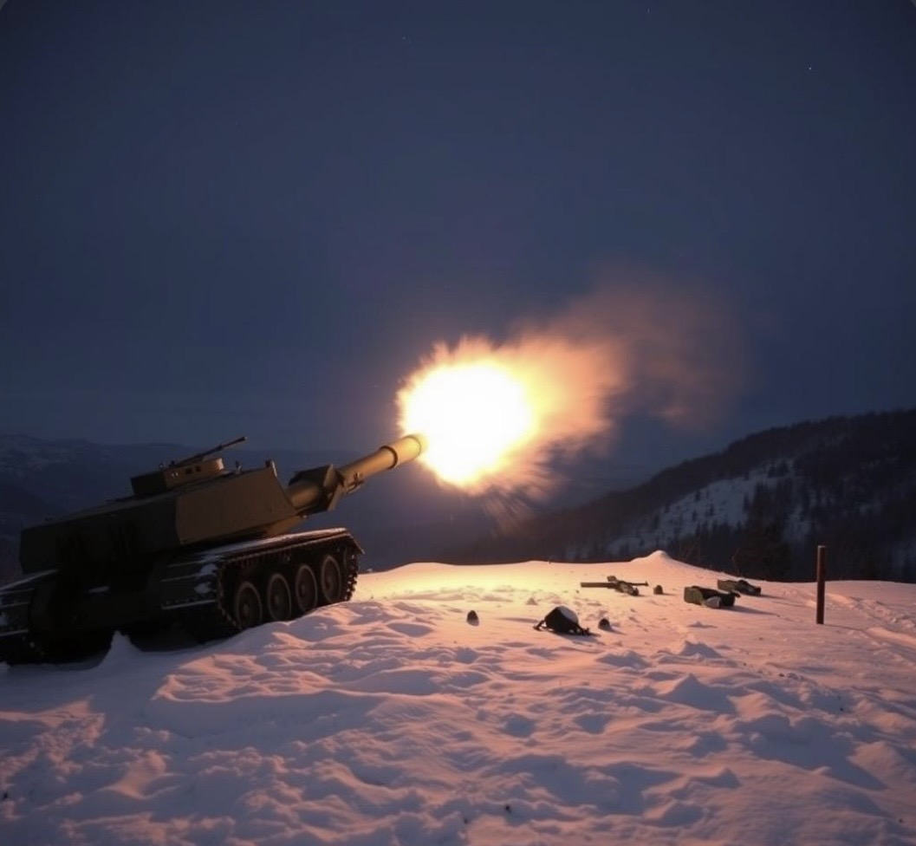
Optimal Strategies and Tactical Decisions for Army Brigades
Peter Lohmander
Prof Dr Peter Lohmander
Peter Lohmander Optimal Solutions
Sweden
Eleventh International Statistical Conference
(WSTA 2026) of the University of Kerala,
India, 2026
Version 260623

Slide 2
Summary
This presentation shows new methods for optimizing delay operations with brigades.
The objective function takes into account all the costs of the war and its consequences.
Part 1: In advance, at the strategic level: Determination of the optimal depth of defense, the optimal initial number of soldiers, the optimal investments in fieldworks for defense, as well as fieldworks for attacks.
Part 2: Gradually, at the tactical level: Determination of how the different battalions should allocate their total capacity, i.e., the use of time and thus also other resources.
The optimal strategic and tactical decisions are influenced by the prices of various resources and measures. Examples of how different strategic and tactical decisions are affected by various conditions are presented.
References https://www.lohmander.com/Information/Ref.htm

Slide 4
Connected articles:
Lohmander, P. (2017). Applications and Mathematical Modeling in Operations Research, In: Cao BY. (ed) Fuzzy Information and Engineering and Decision. IWDS 2016. Advances in Intelligent Systems and Computing, vol 646. Springer, Cham, 2018 Print ISBN 978-3-319 66513-9, Online ISBN 978-3-319-66514-6, Pages 46-53, eBook Package: Engineering, https://doi.org/10.1007/978-3-319-66514-6_5
Lohmander, P. (2019a). Optimal decisions and expected values in two player zero sum games with diagonal game matrixes, - Explicit functions, general proofs and effects of parameter estimation errors, International Robotics & Automation Journal, Volume 5, Issue 5, 2019, pages 186-198. https://medcraveonline.com/IRATJ/IRATJ-05-00193.pdf
Lohmander, P. (2019b). Four central military decision problems, General methods and solutions, The Royal Swedish Academy of War Sciences Proceedings and Journal, 2/2019, pages 119-134.
https://kkrva.se/hot/2019:2/09-lohmander-fyra-centrala-militara-beslutsproblem.pdf
Lohmander, P. (2023). Optimal Dynamic Control of Proxy War Arms Support, Automation, 2023, 4, pages 31-56. Publisher: MDPI Journals, Zürich, Switzerland. https://doi.org/10.3390/automation4010004 https://www.mdpi.com/2673-4052/4/1/4
Lohmander, P. (2024). Attrition coefficient estimations via differential equation systems, initial and terminal conditions, and nonlinear iterative equation system solutions, Journal of Statistics and Computer Science, Vol. 3, Issue 1, 2024, pages 51-78. Publisher: ARF India. https://www.arfjournals.com/image/catalog/Journals%20Papers/JSCS/2024/No%201%20(2024)/ART_4.pdf
Lohmander, P. (2025). Optimal Deployment, Mathematics and Systems Science, 2025, 3(1), 3055, pages 1–46. Publisher: Asia Pacific Academy of Science Pte. Ltd., Singapore. http://doi.org/10.54517/mss3055

Slide 5

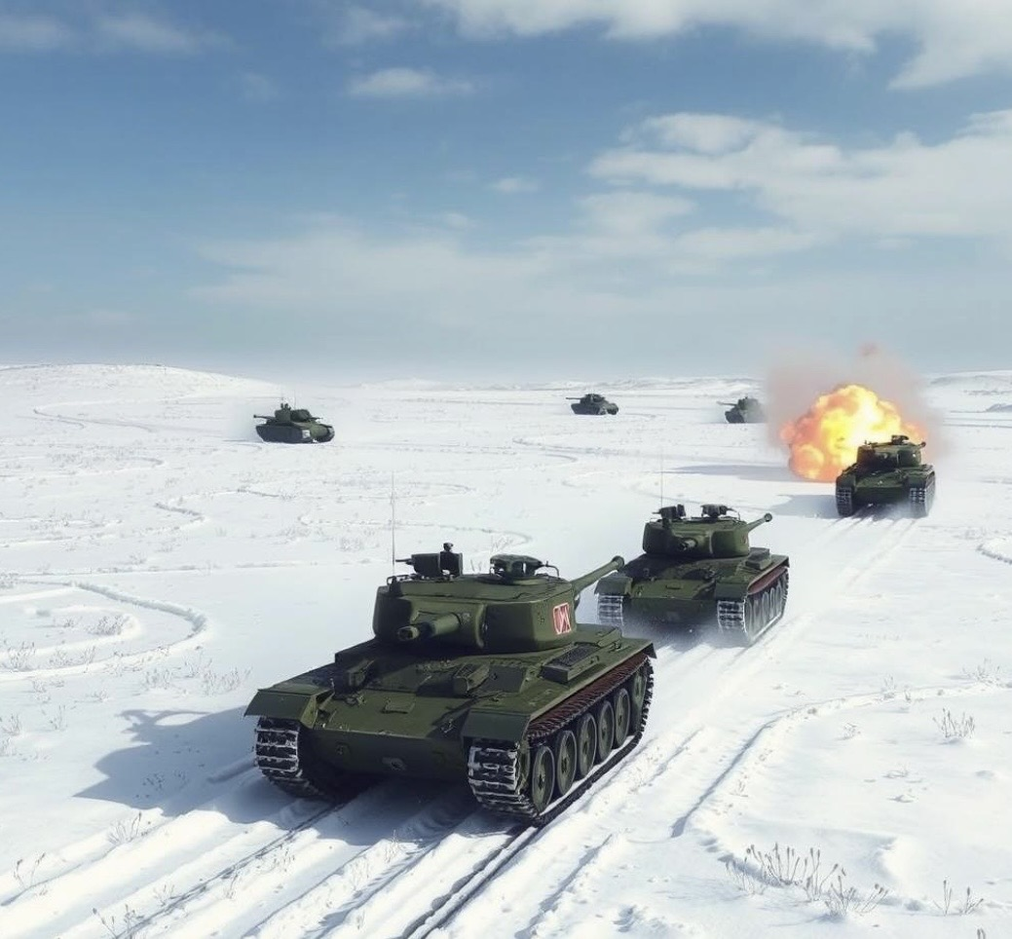
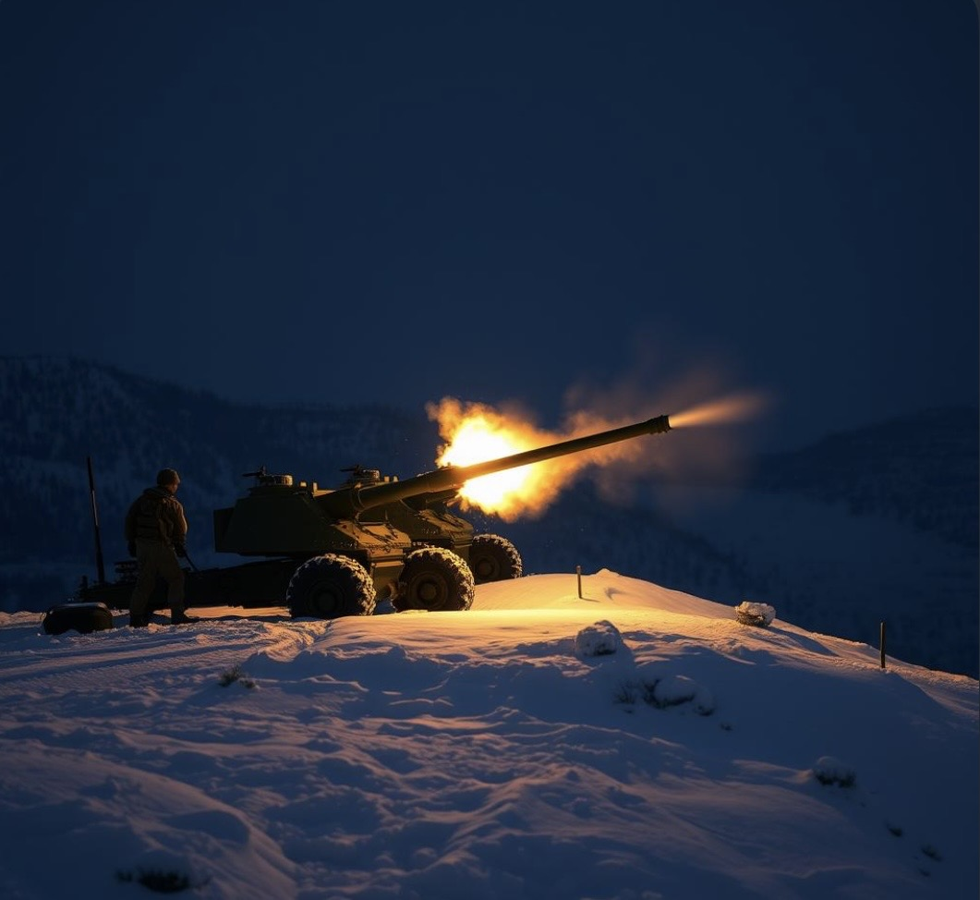
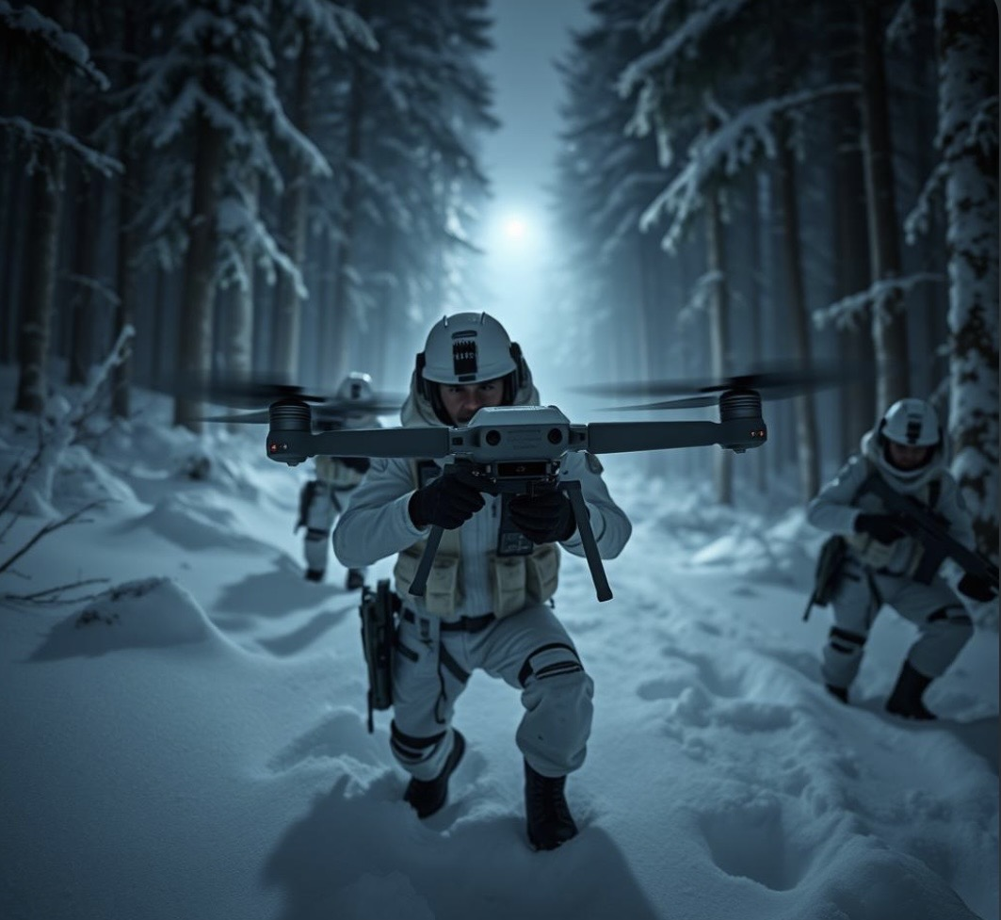
Ranger battalion
Mechanized battalion
Artillery battalion

Slide 6
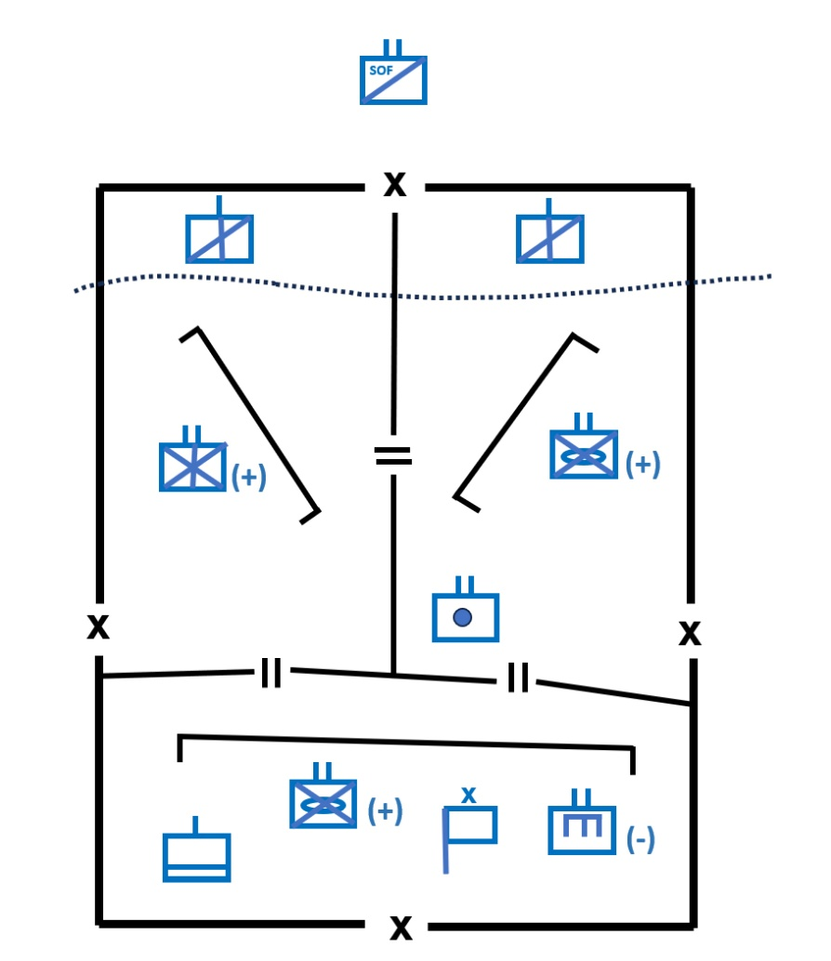
A Brigade Defense Area

Slide 7
Part 1:
Optimization of the depth of defense, Depth.
Depth

Slide 8
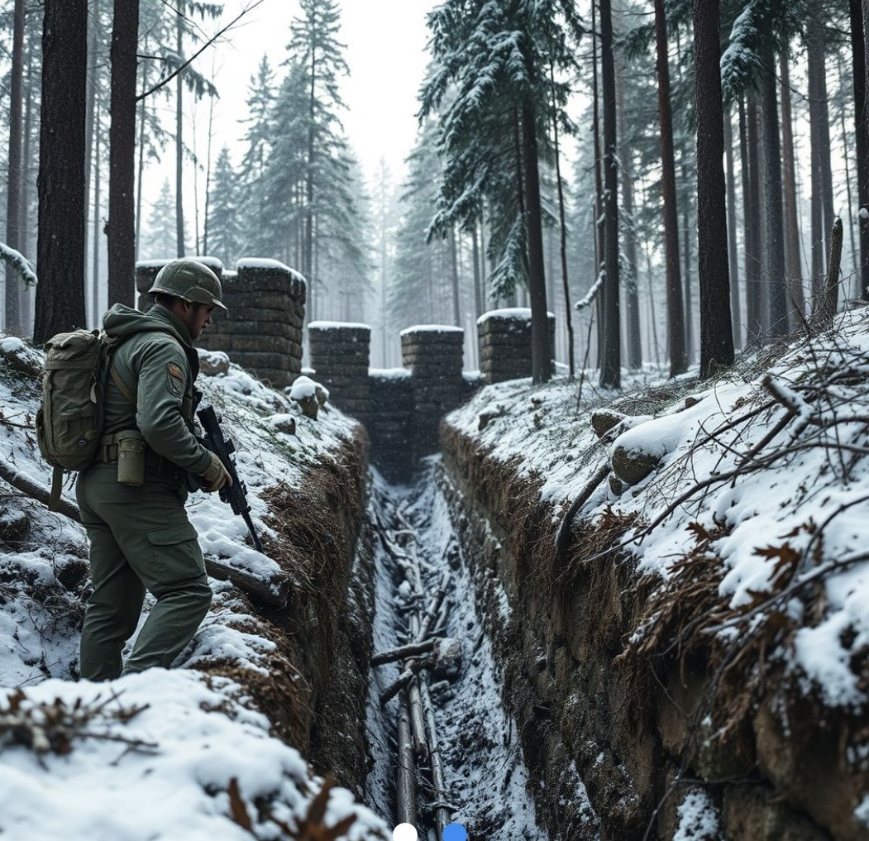
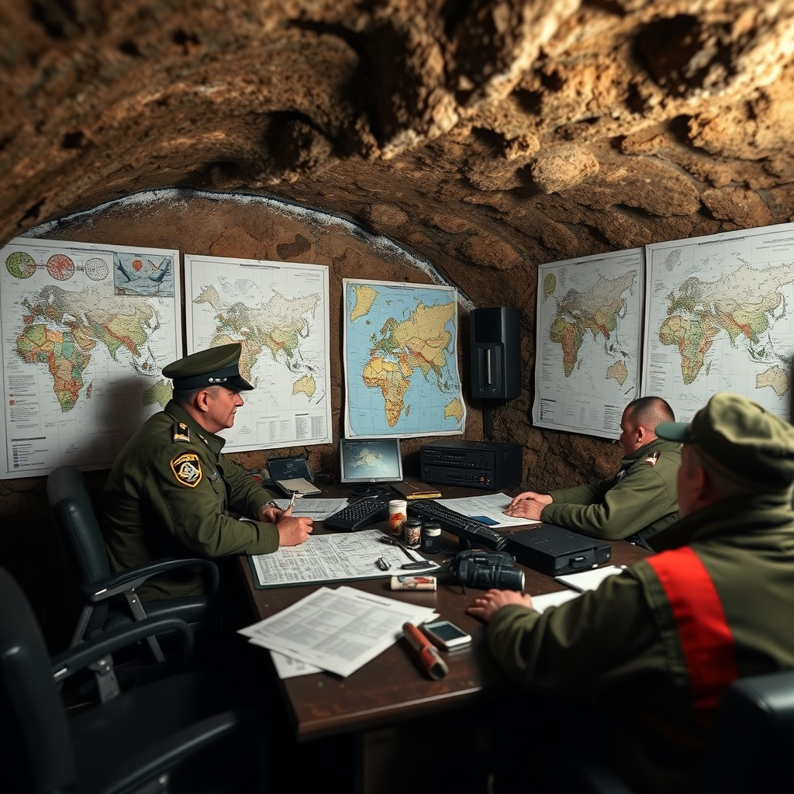
Simultaneously, the optimal levels of field work for attack, FWA, and protection, FWP, are determined.
FWA
FWP

Slide 9
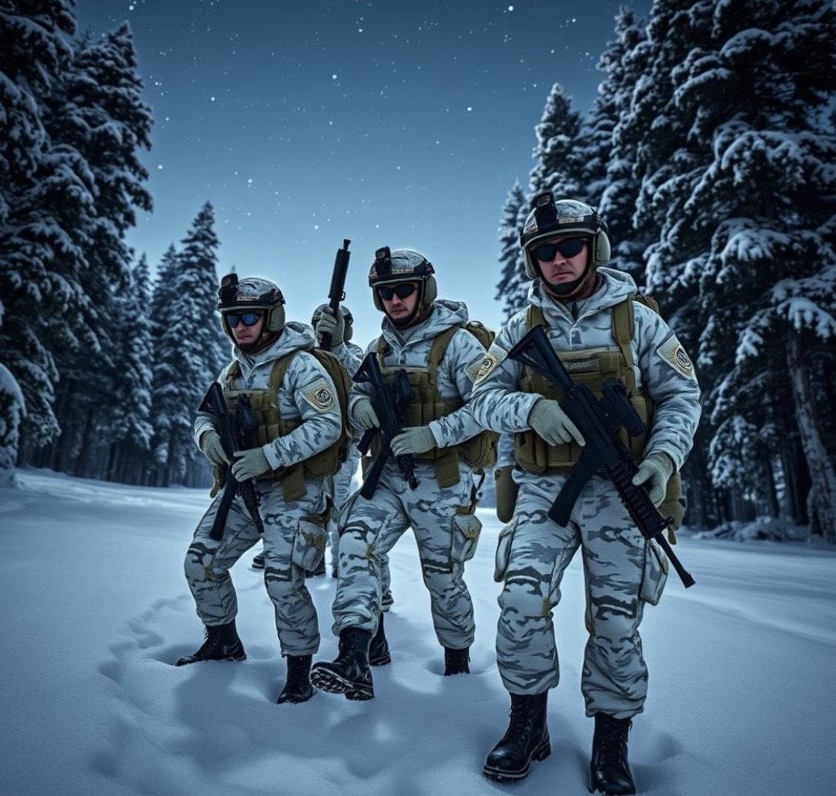
Simultaneously, the optimal initial number of defending soldiers, x0, is also determined.
x0

Slide 10
A differential equation system model of extended Lanchester type is constructed and solved,
with attrition coefficients that are functions of Depth, FWA and FWP.
The differential equation system model is used as a sub routine in a new defense optimization model.

Slide 11
The Classical
Lanchester Model
Time derivative
of the size of
the defending
force
Size of the
attacking force
Attrition
coefficients
Time derivative
of the size
of the
attacking force
Size of the
defending force

Slide 12
Reinforcements per time unit
of the defending force
The Extended
Lanchester Model
Time derivative
of the size of
the defending
force
Size of the
attacking force
Attrition
coefficients
Time derivative
of the size
of the
attacking force
Size of the
defending force
Reinforcements per time unit
of the attacking force

Slide 13
The Extended Lanchester Model
with attrition coefficients that
are functions of decision variables.

Slide 14
The Extended Lanchester Model
The time path of
(x(t), y(t))

Slide 15
With the initial conditions, (x(0),y(0)) = (x0, y0), we may determine (A1, A2)
from this linear 2x2 equation system.

Slide 16
x(t) and y(t) are functions of A1, A2 and more.
The parameters A1 and A2 are
functions of the parameters of the
Extended Lanchester differential
equation system and of the initial
conditions (x(0),y(0)) = (x0,y0)
Furthermore, the parameters of the
Extended Lanchester differential
equation system are functions of several
decision variables.
(Depth, FWA, FWP)

Slide 17
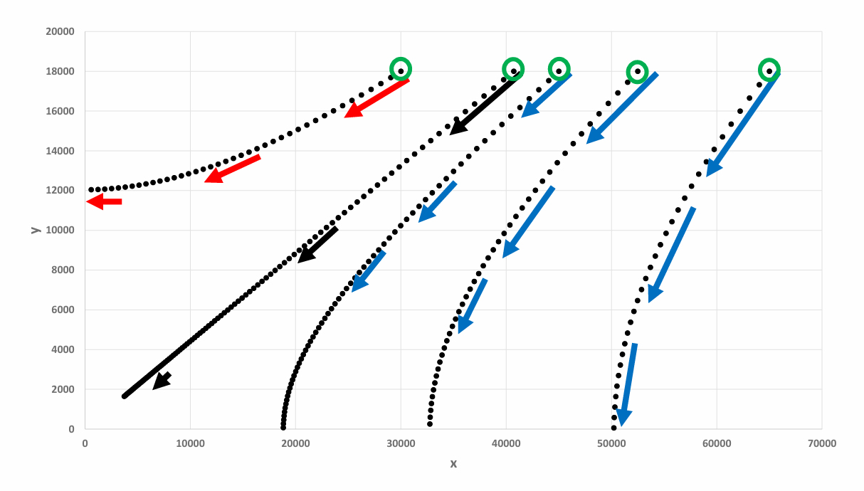
Alternative versions of the Battle of Iwo Jima, 1945:
(x0, y0)
Reality

Slide 18
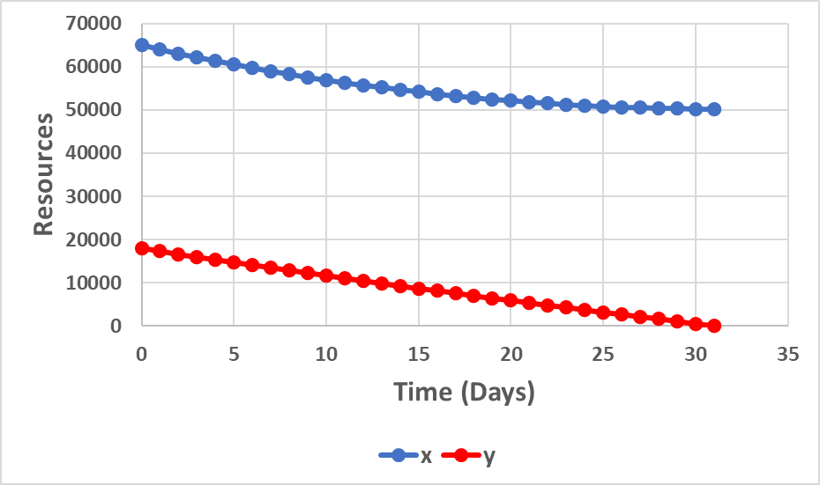
Numbers from the Battle
of Iwo Jima, 1945:
Soldiers from USA
0.05347
Soldiers from Japan
0.01045
Source:
Lohmander, P., Attrition coefficient estimations via differential equation systems, initial and
terminal conditions, and nonlinear iterative equation system solutions,
Journal of Statistics and Computer Science, Vol. 3, Issue 1, 2024, pp. 51-78.
https://www.arfjournals.com/jscs/issue/322
https://www.arfjournals.com/image/catalog/Journals%20Papers/JSCS/2024/No%201%20(2024)/ART_4.pdf

Slide 19
The attrition coefficients are functions of Depth, FWP and FWA.
(Functions of these types can and should be determined with local empirical data.)
alpha = alpha_a * (50 / Depth) * (1 - .3 * FWP ^ .5)
beta = beta_a * (Depth / 50) * (1 + .3 * FWA ^ .5)
constant decreases with Depth decreases with FWP
constant increases with Depth increases with FWA

Slide 20
Master Decision Optimization Problem:
Sub Routine:
All results of the conflict are calculated, based on the Extended Lanchester differential equation system, all parameters, and decision variables.
Answers sent to the Master Decision Optimization Problem:
Will x(t) or y(y) reach size zero first? What is then the value of t, called T?
What will be the size of the force that does not reach zero?
What are the costs of different used and lost resources etc.

Slide 21
Example of Objective function in the Master Problem:
Objective =
- P_Depth * Depth
- P_x0 * x0
- .0002 * x0 * x0
- 1 * u * T
- 170 * FWP - 170 * FWA
+ Exp(-r * T) * (xT - yT)
- 10000 * ywins
Decision variables
that the defending
nation can control.
Decision variables
that a coalition
can control.

Slide 22
Optimal decisions:
Opt_Depth and Opt_x0 are decreasing functions of the respective prices.

Slide 23
Opt_FWP is an increasing function of the prices for land and soldiers.
Opt_FWA är is an increasing function of the price of land.

Slide 24
T, the time when the war ends, (when x or y is zero) is determined as a function of the parameters and the optimal decisions.

Slide 25
The number of unharmed defending soldiers, when the war ends, xT, is a function of the parameters and the optimal decisions.

Slide 26
The optimal objective function value, Opt_Obj, is a decreasing function of the prices of land and soldiers.

Slide 27
The optimal value of the attriction coefficient that shows how rapidly the size of the defending force is reduced, Alpha, is a decreasing function of the prices of land and soldiers.
The optimal value of the attrition coefficient that shows how rapidly the size of the attacking force is reduced, Beta, is a decresing function of the price of land.

Slide 28
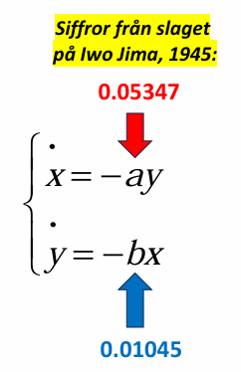
Observations:
Left Graph:
Assume that P_Depth = 50.
(P_x0 = 1, which is not seen the the graph).
Alpha = 0.88% and Beta = 5.35%
Then, a defending soldier deletes 6.08 attacking soldiers when one attacking soldier deletes one defending soldier. Compare the attack by USA on Iwo Jima during WW II. See the differential equation system to the right. Then, the situation was almost the same.
Lohmander, P. (2024). Attrition coefficient estimations via differential equation systems, initial and terminal conditions, and nonlinear iterative equation system solutions, Journal of Statistics and Computer Science, Vol. 3, Issue 1, 2024, pages 51-78. Publisher: ARF India. https://www.arfjournals.com/image/catalog/Journals%20Papers/JSCS/2024/No%201%20(2024)/ART_4.pdf

Slide 29
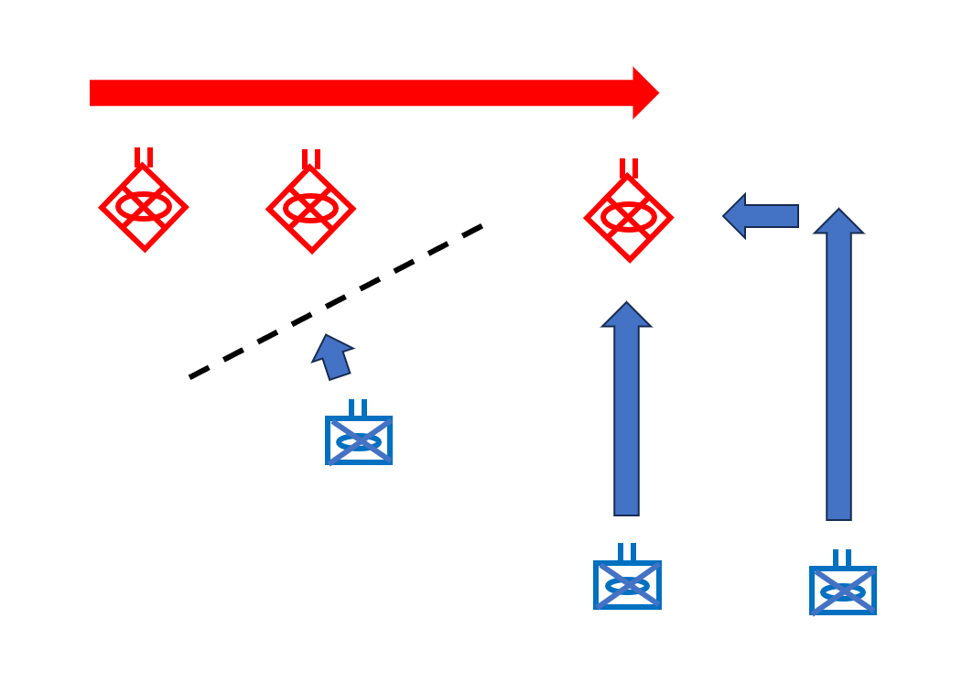
Brigades and dynamic cooperation between battalions

Slide 30
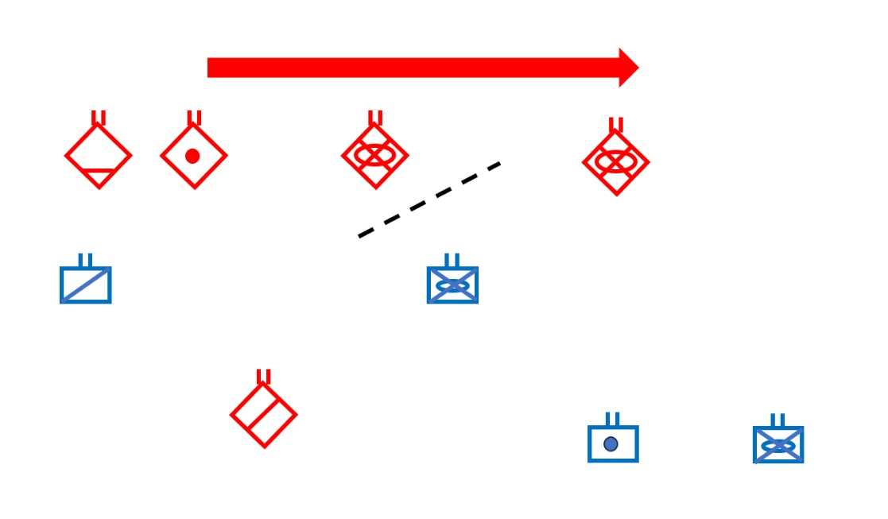
Alternative situation

Slide 31
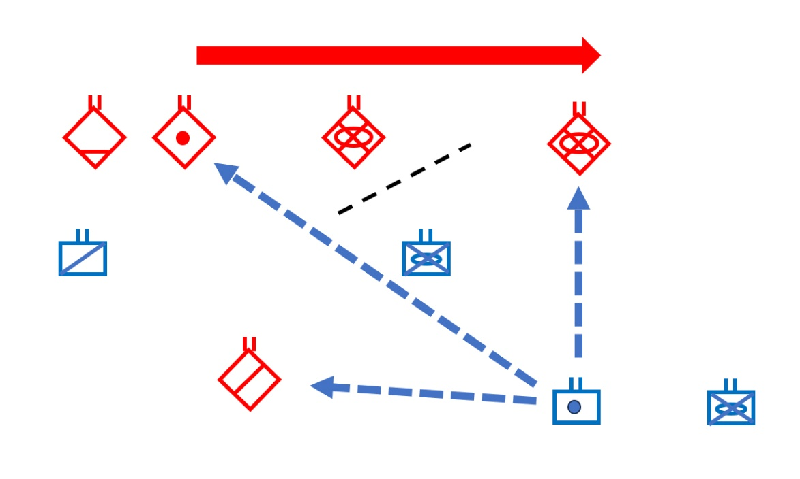

Slide 32
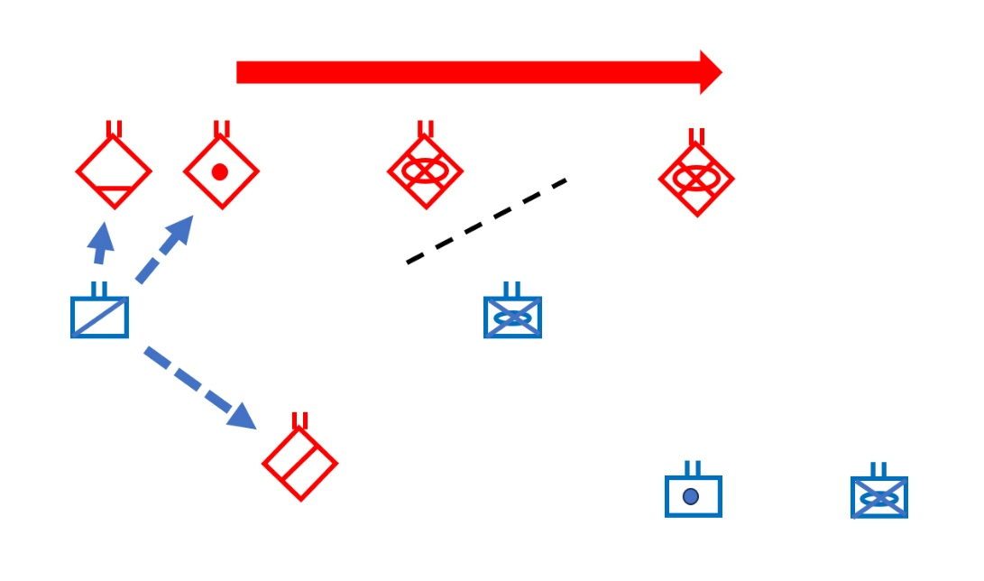

Slide 33
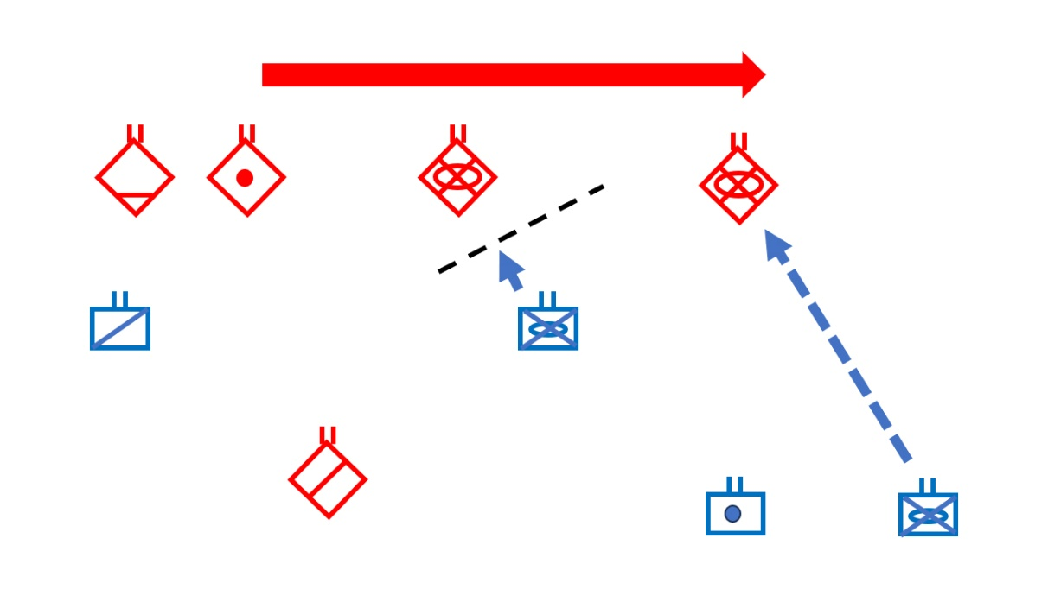

Slide 34

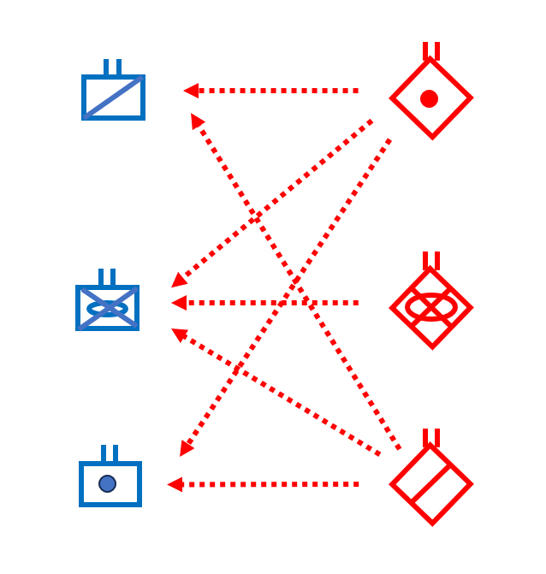
Part 2:
The acivitites within the defending Blue and the attacking Red Brigades are analyzed in detail.

Slide 35
Artillery battalions, mechanized battalions and ranger battalions cooperate with each other.

Slide 36
A controlled discrete time nonlinear difference equation system in six dimensions is constructed and numerically solved.

Slide 37
This model represents the part of the war that occurs within the area defended by the Blue Brigade.
The model describes the dynamic developments of the Blue and Red resources.
The model optimizes the degree of cooperation and selection of targets for different types of battalions.

Slide 38
The attrition levels are nonlinear functions of the time that different types of battalions spend in different ways in this cooperation.
For instance, a Blue ranger battalion can search and find targets for a Blue artillery battalion and/or attack Red rangers or other Red units.
Every battalion has limited total time available.

Slide 39
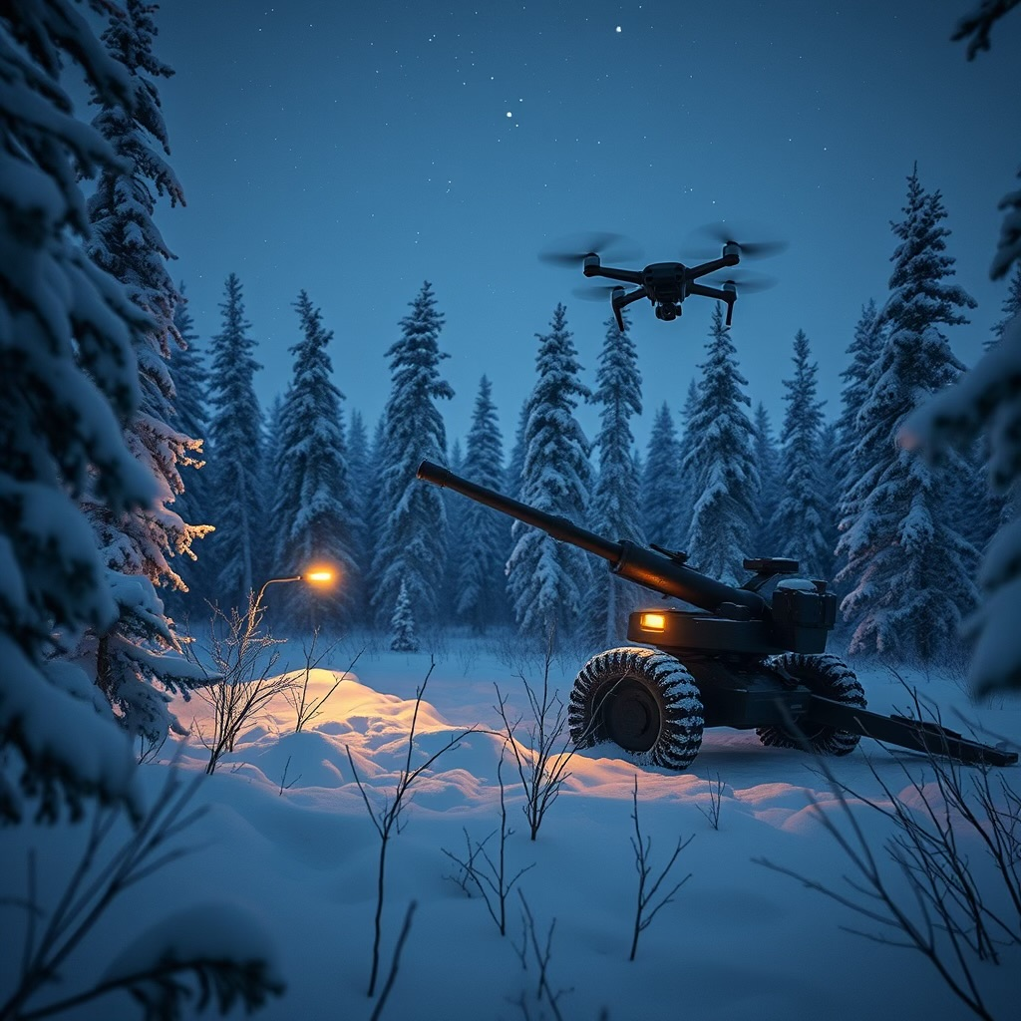
For example: A Blue ranger battalion can search and find targets for a Blue artillery battalion.

Slide 40
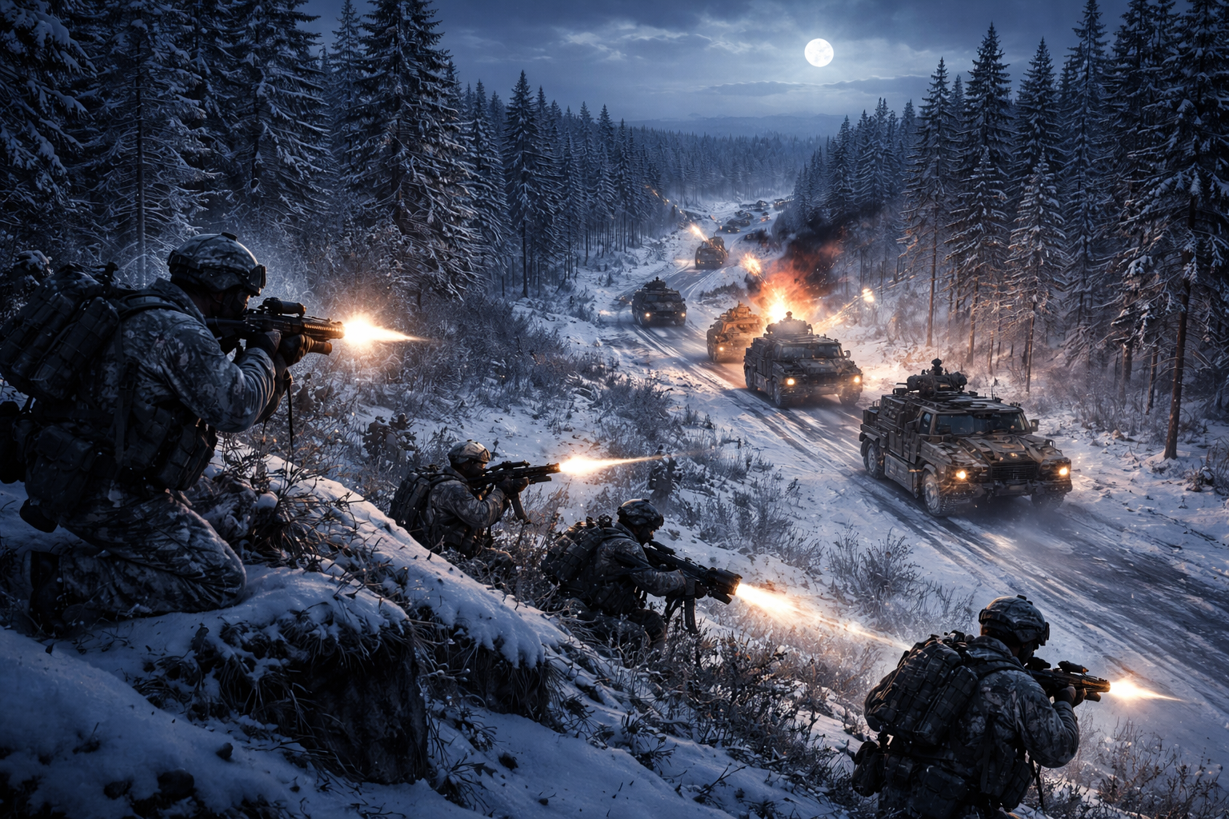
A Blue ranger battalion can attack Red forces.

Slide 41
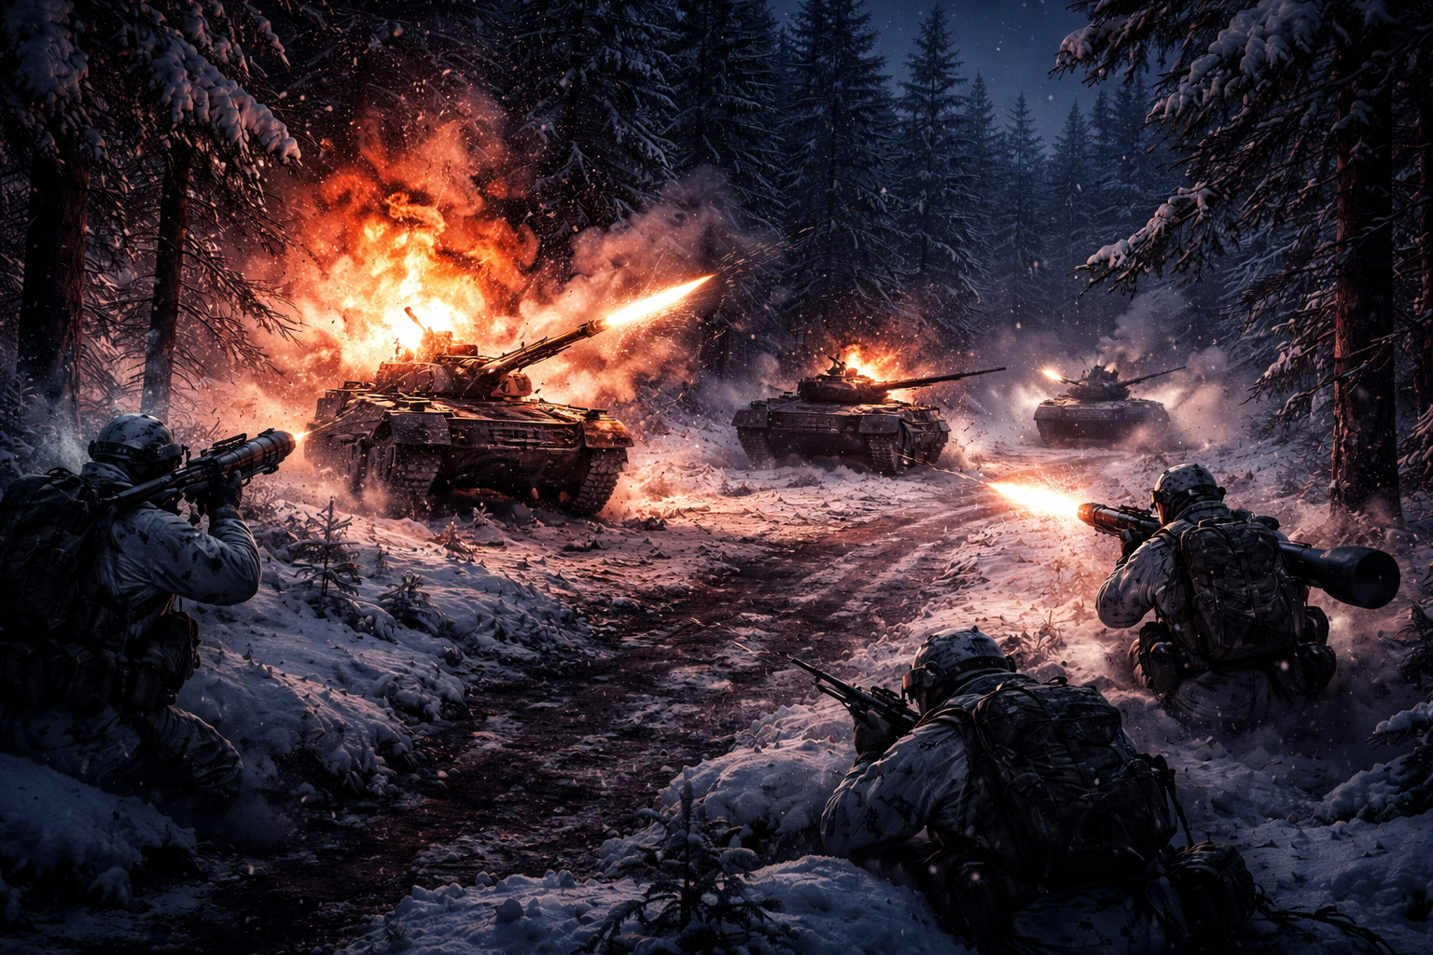
A Blue ranger battalion can destroy Red tanks.
Till exempel kan en kavalleri-jägar-bataljon söka och hitta mål åt en artilleribataljon och/eller anfalla fiendens kavallerienheter eller andra fiender.

Slide 42
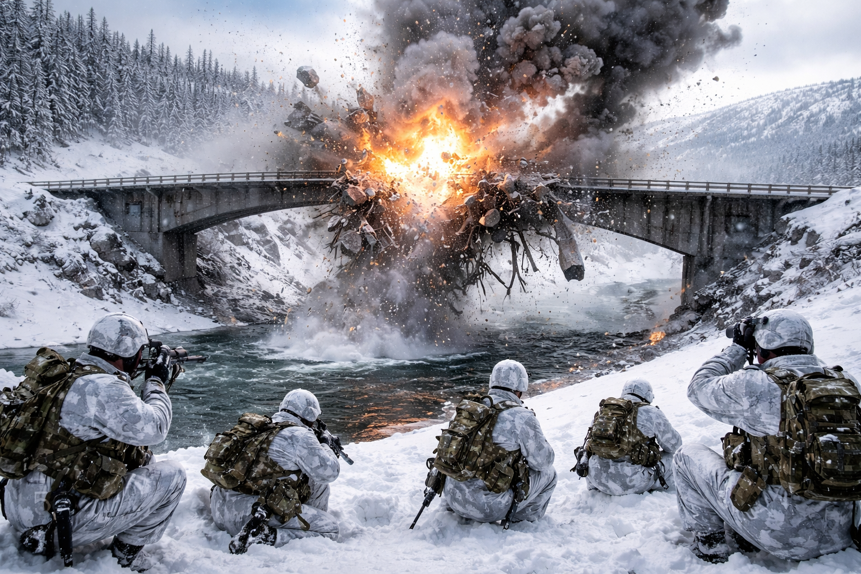
A Blue ranger
battalion can
destroy a bridge.

Slide 43
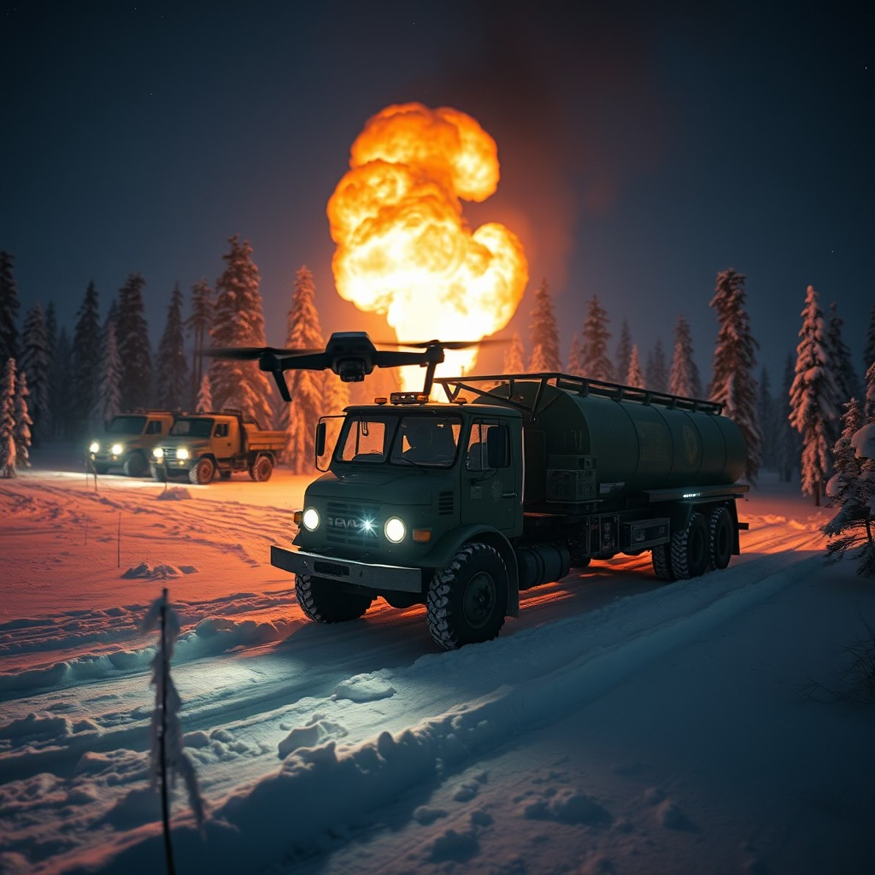
A Blue ranger
battalion can
use drones
to destroy Red
fuel deliveries.

Slide 44
Possible extension:
With marginal adjustments, the model can be used to determine the outcomes and the optimal decisions if Blue and Red dynamically adjust the decisions.

Slide 45
Illustration:
The optimal use of time of a Blue Ranger battalion, as a function of the cost per unit of the remaining Red artillery battalions at a future point in time, T.
Red Artillery battalions
Red Cavalry Rangers battalions
Red Mechanized battalions
This ”cost per unit” will be adjusted.

Slide 46
Cost (for Blue) per unit of
Red Artillery battalion
at time T.
Optimal share of time of the Blue Ranger battalion, to fight Red Cavalry Rangers.
Table 1.
Parameter fYa = -15
Optimal Solution:
objective function = -1085.318
uca ucc ucm
0.75 0.03 0.22
Art Cav Mec
X(topt) = 9.557317 12.77866 40.5522
Y(topt) = 9.670883 29.32049 79.3652
Optimal share of time of the Blue Ranger battalion, to fight Red Mechanized units.
Optimal share of time of the Blue Ranger battalion, to search for targets for the Blue artillery battalion to fight
Red artillery.
Estimated remaining number of Red artillery Battalions at time T.

Slide 47
Cost (for Blue) per unit of
Red Artillery battalion
at time T.
Table 2.
Parameter fYa = -10
Optimal Solution:
objective function = -1031.586
uca ucc ucm
0.60 0.06 0.34
Art Cav Mec
X(topt) = 9.185617 12.59281 40.33058
Y(topt) = 12.17004 28.23752 76.86983
Optimal share of time of the Blue Ranger battalion, to search for targets for the Blue artillery battalion to fight
Red artillery.
Estimated remaining number of Red artillery
Battalions at time T.

Slide 48
Cost (for Blue) per unit of
Red Artillery battalion
at time T.
Table 3.
Parameter fYa = -5
Optimal Solution:
objective function = -959.2858
uca ucc ucm
0.32 0.11 0.57
Art Cav Mec
X(topt) = 8.382638 12.19132 39.83494
Y(topt) = 17.75569 26.98911 73.55618
Optimal share of time of the Blue Ranger battalion, to search for targets for the Blue artillery battalion to fight
Red artillery.
Estimated remaining number of Red artillery
Battalions at time T.

Slide 49
Observations:
If it becomes more important for the Blue brigade to reduce the number of Red artillery battalions at time T = 100, (fYa goes from -5 to -15) ,
Then,
The Blue rangers should increase the relative time spent on searching
for Red artillery locations, to be reported to the Blue artillery.
fYa | Optimal share of time | Red artillery Battalions at time T
-5 | 32% | 18
-10 | 60% | 12
-15 | 75% | 10

Slide 50

Conclusions:
It is possible to optimize delay operations with army brigades.
All costs of the war and the consequences may be considered.
In advance, at the strategic level, we should determine the optimal depth of defense, the optimal initial number of soldiers, and optimal investments in field works for defense and attack
Over time, at the tactical level, we should optimize the use of time (capacity) of the different battalions.
The optimal strategic and tactical decisions are strongly affected by changes of prices for different kinds of resources and activities.
Examples of how optimal decisions are affected by prices and costs of different kinds have been given.

Slide 51
Connected presentations in Swedish:
Lohmander, P., Optimal Fördröjningsstrid med Brigad,
Kamratforeningen Blå Dragoner, Umeå Skvadron, 260416,
http://www.Lohmander.com/PL_K4_Brigad_26.pdf
http://www.Lohmander.com/PL_K4_Brigad_26.pptx
Lohmander, P., Optimal Krigföring via Tullar,
Kamratforeningen Blå Dragoner, Umeå Skvadron, 251127,
http://www.lohmander.com/PL_K4_Tullar_25.pdf
http://www.lohmander.com/PL_K4_Tullar_25.pptx
Lohmander, P., Optimal Utnötning, från Iwo Jima till Ukraina och Framtiden, Kamratforeningen Blå Dragoner, Umeå Skvadron, 250327,
http://www.lohmander.com/PL_K4_25.pdf
http://www.lohmander.com/PL_K4_25.pptx
Lohmander, P., Optimal Jägarstrid, Kamratföreningen Blå Dragoner, Umeå Skvadron,
Garnisonsmässen, Umeå, Sverige, Torsdagen den 18 April, 2024.
http://www.Lohmander.com/PL Optimal Jagarstrid 240418.pdf
http://www.Lohmander.com/PL Optimal Jagarstrid 240418.pptx
References:
https://www.lohmander.com/Information/Ref.htm

Slide 52
Thank you for your time!
Questions?
Peter@Lohmander.com
peter.lohmander@icloud.com

