Slide 1

The production of apartments as a function of GNP, building costs and population changes:
Statistical analysis and predictions until 2050, based on official Swedish data, from 1975 to 2021. by
Peter Lohmander
Peter Lohmander
Prof Dr
Peter Lohmander Optimal Solutions, Sweden
Eighth International Webinar on
“Recent Trends in Statistical Theory and Applications-2023 (WSTA-2023)
June 29 – July 02, 2023, Invited Talk.
Organized by the Department of Statistics, School of Physical and Mathematical Sciences, University of Kerala, Trivandrum in association with Indian Society for Probability and Statistics (ISPS) and Kerala Statistical Association (KSA).
Version 230624_1906

Slide 2
Abstract
The production of new apartments in Sweden, has varied strongly during the period from 1975 to 2021. A new statistical function, which explains these production changes, has been developed. This function is designed, based on a set of hypotheses, of how the production level should be affected by different explaining factors; the GNP, the size of the population, the growth of the population, and the cost of construction.
The following hypotheses could not be rejected: The apartment production is a strictly increasing and strictly convex function of GNP, and a strictly increasing function of the size of the population, and of the growth of the population. The apartment production is a strictly decreasing function of the cost of construction.
The parameters of the statistical function have been estimated with high precision, via multiple regression analysis. It was not possible to detect heteroscedasticity via residual analysis. Furthermore, no indications that nonlinear transformations would improve the selected model were found. The apartment production model contains a strongly significant negative time trend.
The estimated function is used to predict the future apartment production, until year 2050. The predictions are based on assumed growth levels of GNP and the population, and on alternative future time trends of the construction cost index.
If the real construction cost index will continue to grow with the same average trend as from year 1993 to 2021, then the future apartment construction level will stay almost constant, at 40 000 apartments per year, until year 2050. If the future real construction cost index will stay constant at the 2022 level, then the production of new apartments will grow to almost 90 000 apartments per year, in year 2050. If the real construction cost index can be decreased to the 1993 level, then the production of new apartments will grow to almost 130 000 apartments per year, in year 2050.

Slide 3
Contents:
Empirical background from Sweden.
Generation of some hypotheses (via constrained nonlinear optimization) concerning how the number of constructed apartments should be affected by changes of some explaining variables.
Statistical tests of hypotheses.
Conditional predictions of future numbers of constructed apartments.

Slide 4
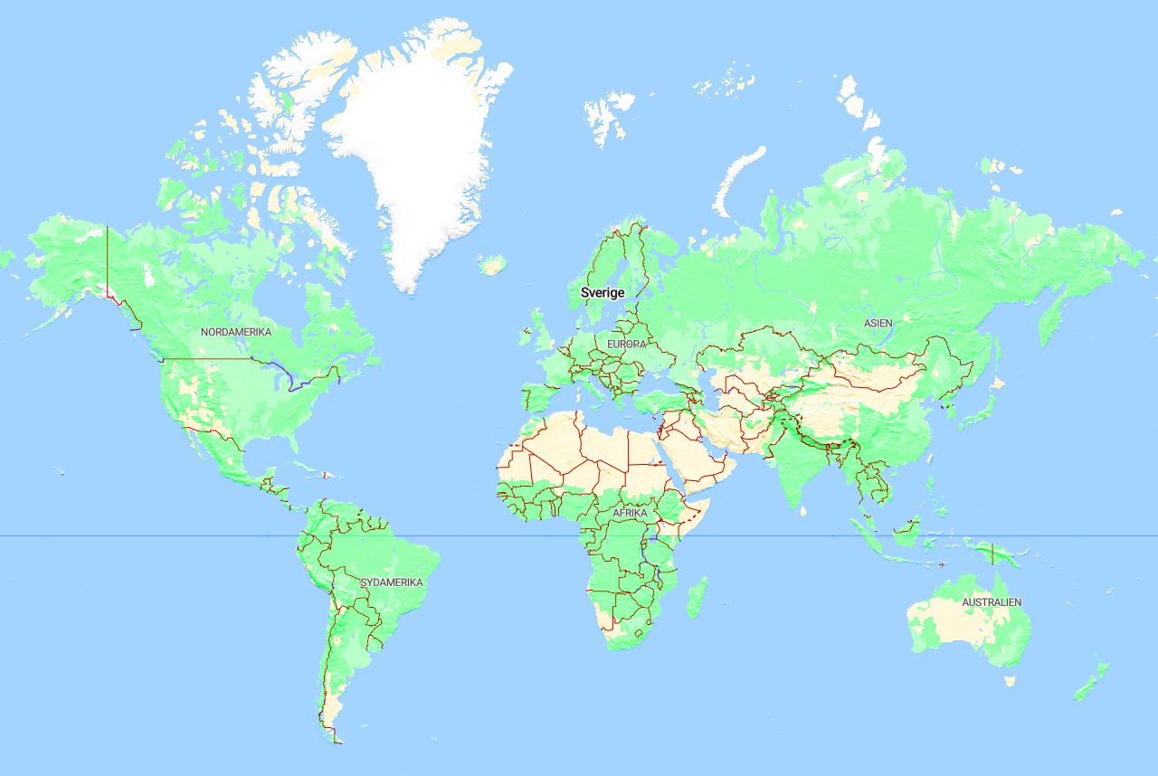
Empirical background
Sweden

Slide 5
Figure 1.
Number of apartments finished in Sweden, A(t), from year 1975 to 2021. Source: Statistics Sweden (2023).

Slide 6
Figure 2.
Real Gross National Product in Sweden, G(t), from year 1975 to 2021. Unit: Billion SEK, real prices in the price level of 2022. Source: Statistics Sweden (2023).

Slide 7
Figure 3.
Population growth per year in Sweden, P(t)-P(t-1), from year 1975 to 2021. Compare Figure 4, where P(t) is found. Source: Statistics Sweden (2023).

Slide 8
Figure 4.
Population in Sweden, P(t), from year 1975 to 2021. Source: Statistics Sweden (2023).

Slide 9
Figure 5.
Real building cost index in Sweden, C(t), from year 1975 to 2021. The index takes the value 100 in year 2022. Source: Statistics Sweden (2023).

Slide 10
Generation of some hypotheses (via constrained nonlinear optimization) concerning how the number of constructed apartments should be affected by changes of some explaining variables:
In the general utility optimization problem,
we simultaneously consider investments in living space, S,
investments in other fundamental investments, F,
and the total budget, B.

Slide 11
Figure 6.
Assumed functional form of the utility of S as a function of S. The parameters are found in Table 1.

Slide 12
Figure 7.
Assumed functional form of the utility of F as a function of F. The parameters are found in Table 1.

Slide 13
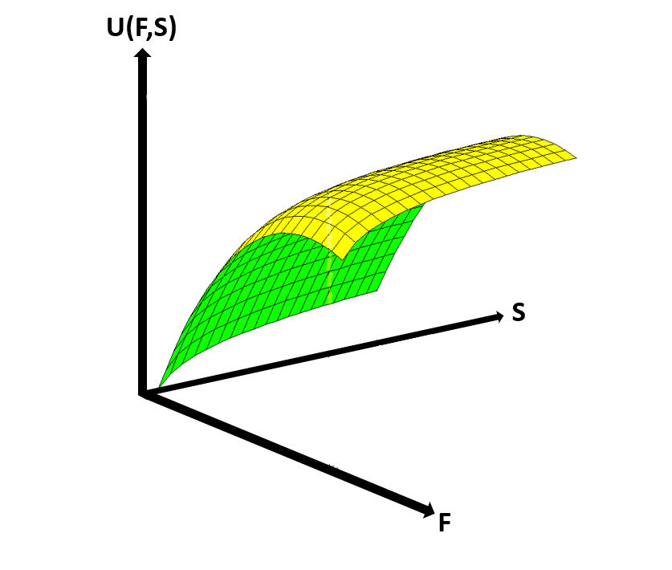
Figure 8.
The utility, U, of F and S,
as a function of F and S.
The parameters are found in Table 1.

Slide 14
s.t.

Slide 15
In the optimization, we only consider interior solutions, where S > 0, F > 0 and the marginal value of B, the “shadow price of the budget”, are strictly positive.
Then, according to the Karush- Kuhn- Tucker- conditions, the following three simultaneous equations must be satisfied by the optimal solution.
In the later part of the analysis, we will find that the optimal values of S, F and the shadow price, really are strictly positive, when they are determined from the three simultaneous equations, which confirms that the initial assumptions were correct.

Slide 16
These equations give the interior optimal solution:

Slide 22
Two different real solutions of F, denoted F1 and F2, are found.
F1 is the solution when the negative sign is selected before the square root expression and F2 is obtained if the positive sign is used.
One of these F- values, F1, will satisfy the budget constraint.
F1 contributes to the maximization of the utility function.
F2 does not satisfy the budget constraint and can be shown to lead to an unfeasible minimum.

Slide 23
The optimization problem contains a strictly concave objective function and a linear constraint.
If the first order optimum conditions are satisfied and the solution is feasible, the solution is a unique and feasible maximum.
The optimal value of S can now be found via F = F1 and the parameters.
Then, the shadow price of the budget, can be derived.
Finally, the optimal value of U is found via the parameters, F1 and S.

Slide 26
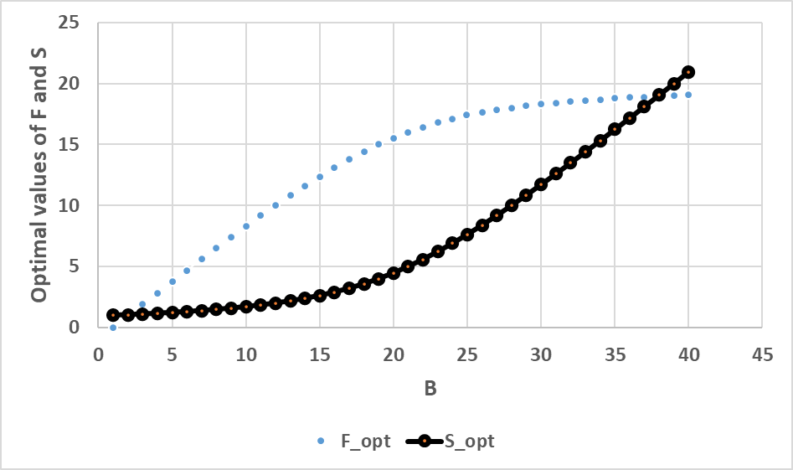
(This can also be
shown with more
general functional
forms. Then, however,
the procedure may be
more difficult to follow.)
S_opt(B)
is a
strictly
convex
function
Figure 9.
Optimal decisions for alternative levels of the budget B. The optimization problem is defined in equations (1) and (2). All parameters, except for B, have the numerical values defined in the computer code in the numerical example, in Table 1.

Slide 27
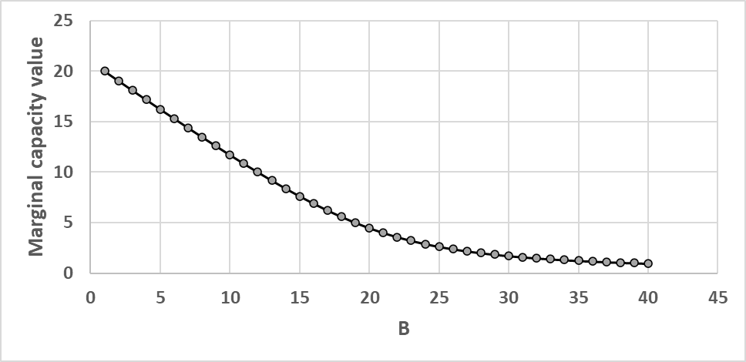

Slide 28
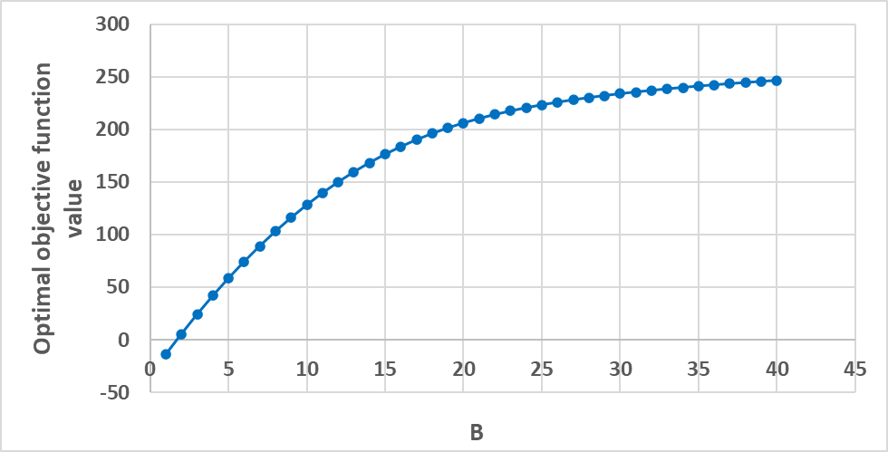
Figure 11.
The optimal objective function value, U, for alternative levels of the budget B. The optimization problem is defined in equations (1) and (2). All parameters, except for B, have the numerical values defined in the computer code in the numerical example, in Table 1. We observe that the optimal objective function value is a strictly increasing and strictly concave function of B.

Slide 29
H1. The apartment production is a strictly increasing and strictly convex function of GNP.
If the number of apartments, A, increases, then the living space, S, increases.
In the statistical analysis, we may consider the gross national product, GNP, to be proportional to the budget, B.
In case the investment process really maximizes the utility of the people in the country: The optimal production of apartments, A, should be a strictly increasing and strictly convex function of the gross national product, the GNP.
The exact and relevant level of convexity of the relationship between the apartment construction level and the GNP level is not known. We assume that the GNP should be raised to 1.5 to reflect how it influences the apartment construction level.

Slide 31
Statistical tests of hypotheses

Slide 33
Regression function:

Slide 34
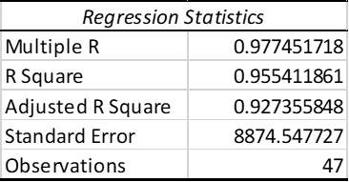
Table 5.
Regression statistics part 1.

Slide 35
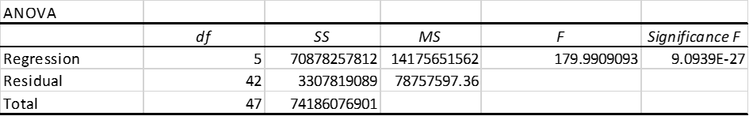
Table 6.
Regression statistics part 2.

Slide 36
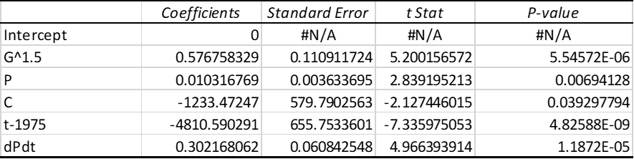
Table 7.
Regression statistics part 3.

Slide 37
Regression function with optimized parameters:

Slide 38
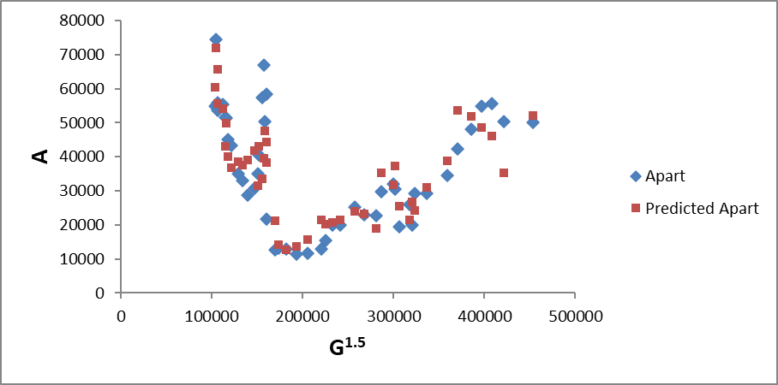
Figure 12.
The number of produced apartments, A, during the years 1975 to 2021: True values (Apart, blue) and predictions (Predicted Apart, red) according to the estimated function, for different values of the factor G^{1.5}, the GNP raised to 1.5.

Slide 39
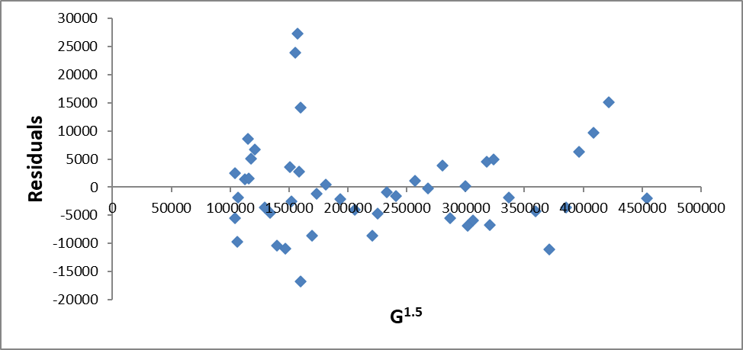
Figure A2.
The residuals for different values of G^{1.5}.

Slide 40
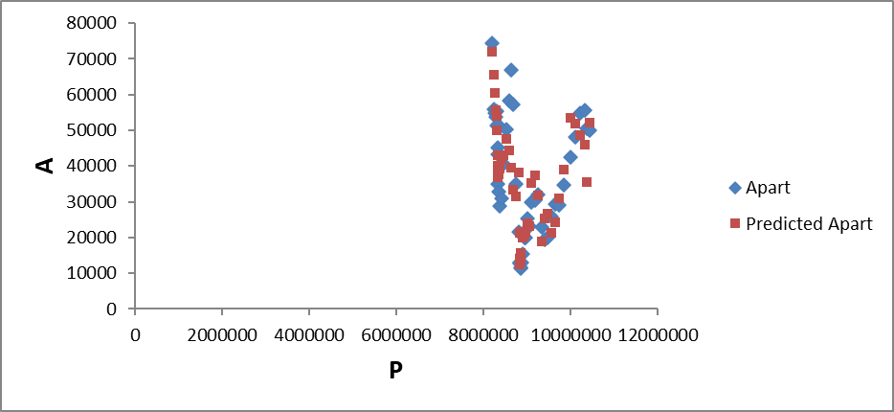
Figure 13.
The number of produced apartments, A, during the years 1975 to 2021: True values (Apart, blue) and predictions (Predicted Apart, red) according to the estimated function, for different values of the factor P, the size of the population.

Slide 41
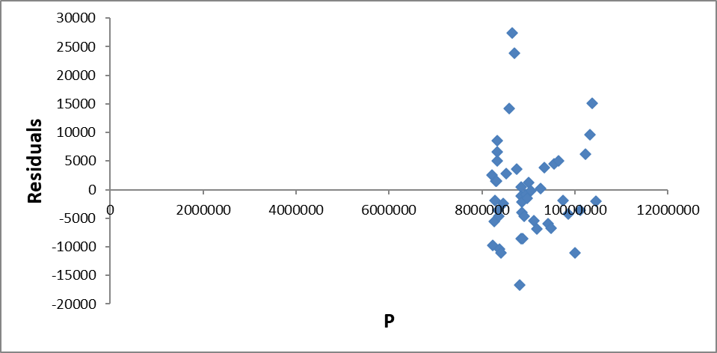
Figure A3.
The residuals for different values of P.

Slide 42
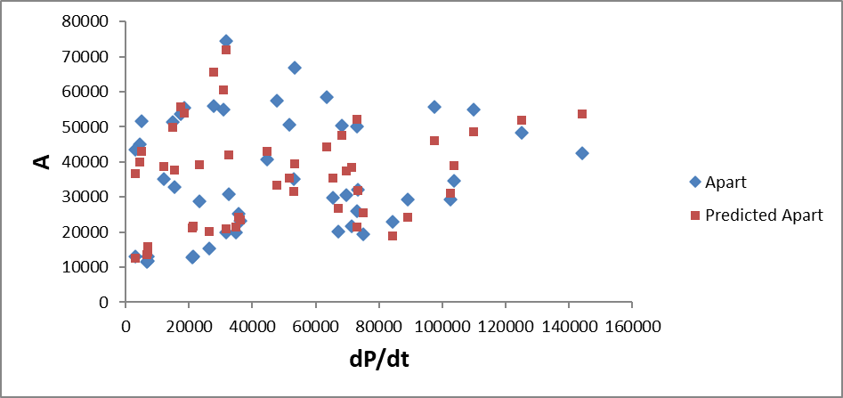
Figure 14.
The number of produced apartments, A, during the years 1975 to 2021: True values (Apart, blue) and predictions (Predicted Apart, red) according to the estimated function, for different values of the factor dP/dt, an approximation of P(t)-P(t-1), the growth of the population.

Slide 43
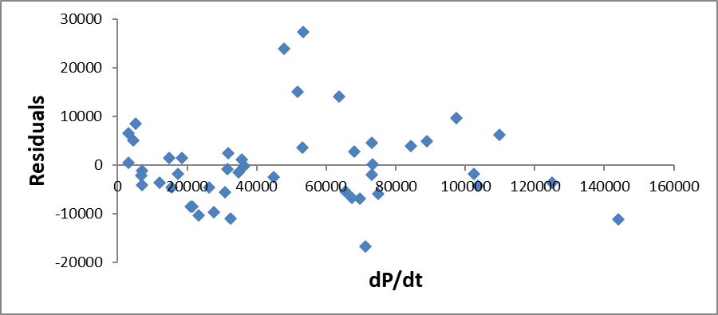
Figure A4.
The residuals for different values of dP/dt.

Slide 44
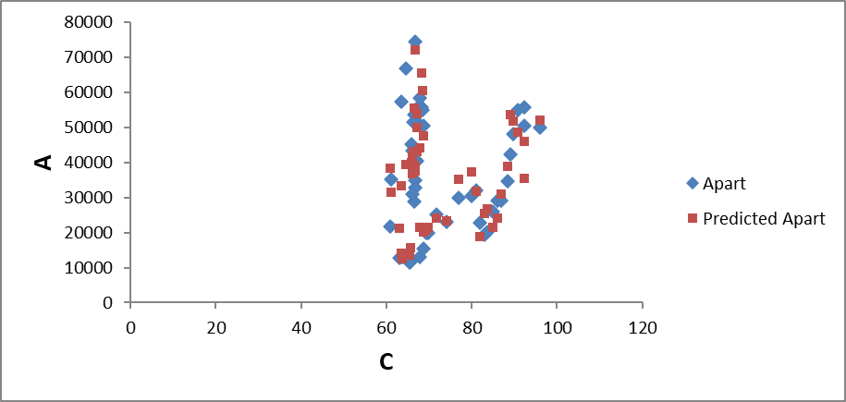
Figure 15.
The number of produced apartments, A, during the years 1975 to 2021: True values (Apart, blue) and predictions (Predicted Apart, red) according to the estimated function, for different values of the factor C, the real building cost index.

Slide 45
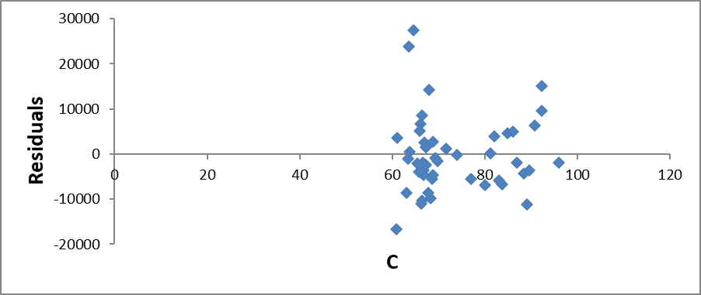
Figure A5.
The residuals for different values of C.

Slide 46
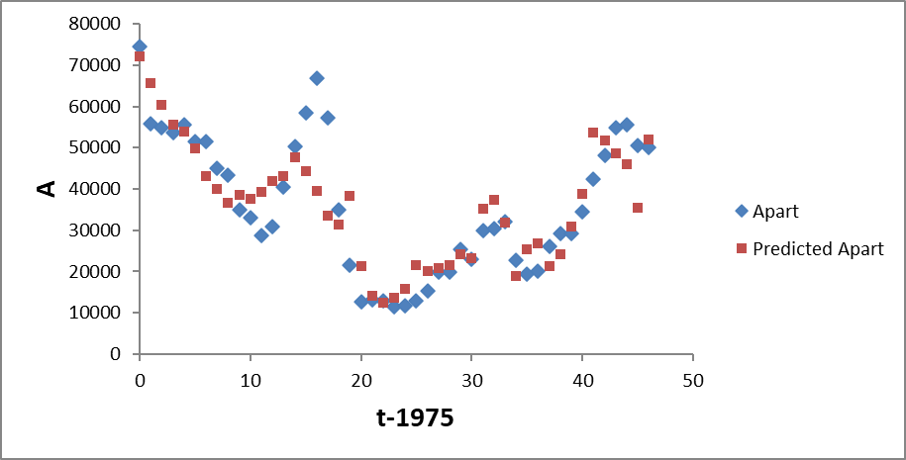
Figure 16.
The number of produced apartments, A, during the years 1975 to 2021: True values (Apart, blue) and predictions (Predicted Apart, red) according to the estimated function, for different values of the factor t-1975.

Slide 47
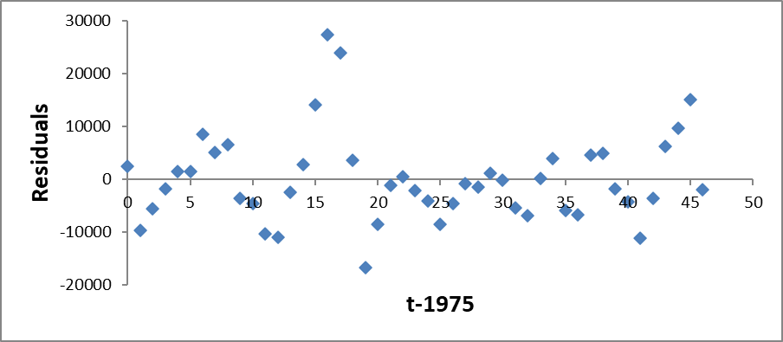
Figure A6.
The residuals for different values of t-1975.

Slide 48
Conditional predictions of future numbers of constructed apartments:
The estimated function is used to predict the future apartment production, until year 2050. The predictions are based on assumed growth levels of GNP and the population, and on alternative levels of the cost of construction.
In Figure 17, we find the GNP prediction, based on the assumption that the derivative of GNP with respect to time will be the same as the average value of the derivative during the time period 1975 to 2021.
In Figure 18, the population prediction is illustrated. The hypothesis is that the derivative of P with respect to time will be the same as the average value of the derivative during the time period 1975 to 2021.

Slide 49
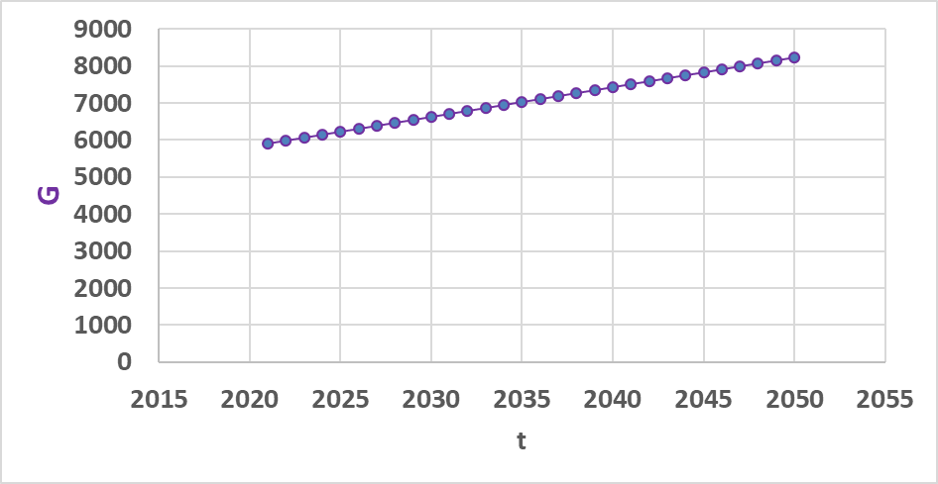
Figure 17.
The future time path of GNP, G, from year 2021 to 2050, under the assumption that the derivative of GNP with respect to time will be the same as the average value of the derivative during the time period 1975 to 2021.

Slide 50
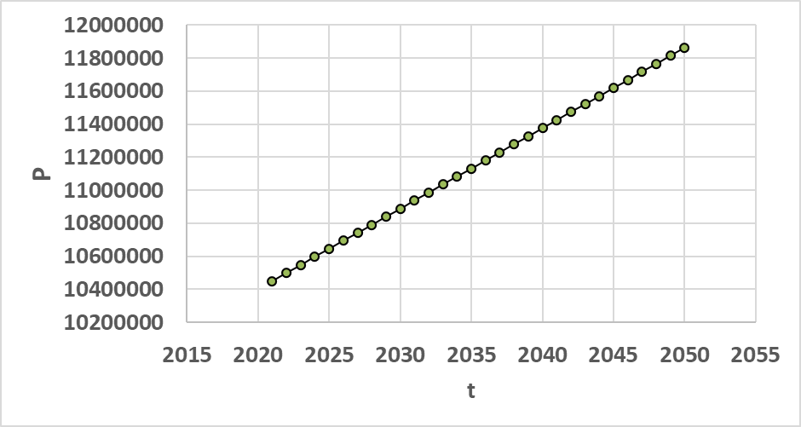
Figure 18.
The future time path of the population, P, from year 2021 to 2050, under the assumption that the derivative of P with respect to time will be the same as the average value of the derivative during the time period 1975 to 2021.

Slide 51
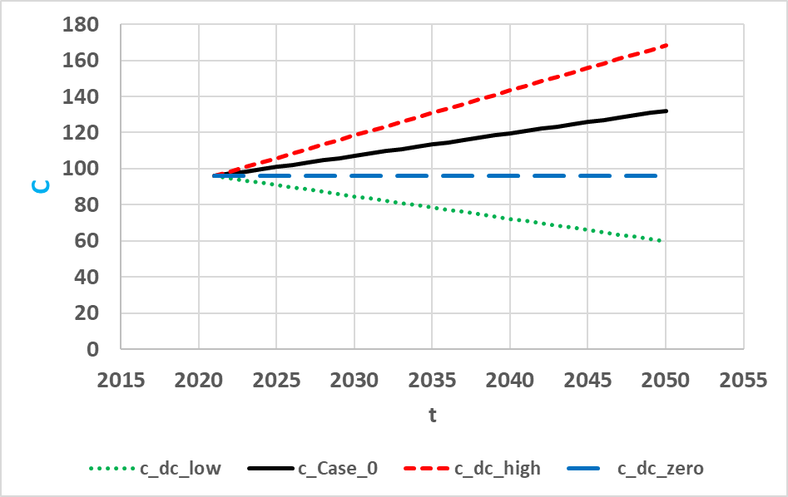
Figure 19.
The future time paths of C from year 2021 to 2050, under four alternative assumptions:
c_dc_low (green): C decreases. The trend is (-1) x the trend during the time period 1993 to 2021.
c_Case 0 (black): C increases according to the trend during the time period 1993 to 2021.
c_dc_high (red): C increases according to 2 x the trend during the time period 1993 to 2021.
c_dc_zero (blue): C stays constant at the level of 2021.

Slide 52
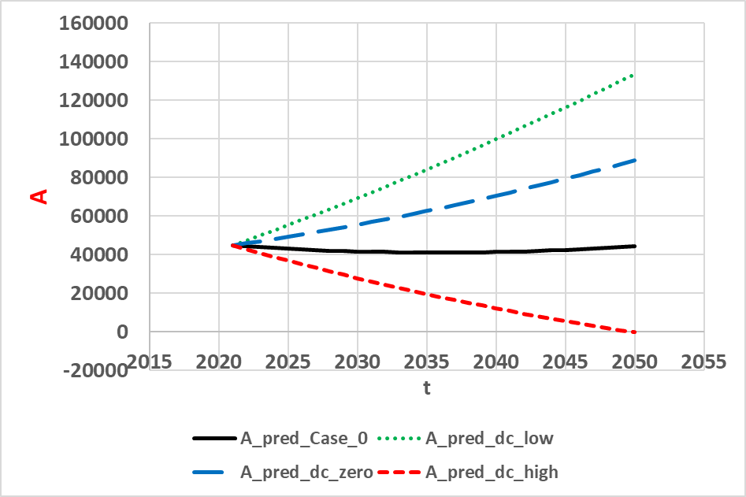
Figure 20.
The future time paths of A from year 2021 to 2050, under four alternative assumptions. Compare Figure 19, where the alternative assumptions are illustrated.
c_dc_low (green): C decreases. The trend is (-1) x the trend during the time period 1993 to 2021.
c_Case 0 (black): C increases according to the trend during the time period 1993 to 2021.
c_dc_high (red): C increases according to 2 x the trend during the time period 1993 to 2021.
c_dc_zero (blue): C stays constant at the level of 2021.

Slide 53
Summary of the prediction results:
If the real construction cost index will grow with the same average time trend as from year 1993 to 2021, then the future apartment construction will stay almost constant, at 40 000 apartments per year, until year 2050.
If the future real construction cost index stays constant at the 2022 level, then the production of new apartments will grow to almost 90 000 apartments per year, in year 2050.
If the real construction cost index can be decreased to the 1993 level, then the production of new apartments will grow to almost 130 000 apartments per year, in year 2050.
If the future real construction cost index will grow two times more rapidly than the average level from 1993 to 2021, then the production of apartments will stop completely in 2050.

Slide 54
Discussion (part):
The signs of third derivatives of functions sometimes turn out to be of fundamental importance to optimal decision making. This is particularly relevant and true in multi period models, when stochastic processes and adaptive decisions are optimized, as reported by Lohmander (1988).
The author encourages future research in the construction area to be directed towards multi period optimization and sequential decision making under risk.
Lohmander (2018) describes alternative adaptive stochastic dynamic optimization methods that may be useful in this context. In this research, it is important to explicitly handle risk in predictions of future demand, prices, GNP, immigration, and other factors of relevance.

Slide 55
References
Barr, J. (2012). Skyscraper Height, J Real Estate Finan Econ, 45, 723–753. https://doi.org/10.1007/s11146-010-9274-z
Barr, J., Luo, J. (2021). Growing Skylines: The Economic Determinants of Skyscrapers in China, J Real Estate Finan Econ, 63, 210–248. https://doi.org/10.1007/s11146-020-09764-7
Dipasquale, D. (1999). Why Don't We Know More About Housing Supply?, The Journal of Real Estate Finance and Economics, 18, 9–23. https://doi.org/10.1023/A:1007729227419
Gat, D. (1995). Optimal development of a building site, J Real Estate Finan Econ, 11, 77–84. https://doi.org/10.1007/BF01097938
Guthrie, G. (2022). Land Hoarding and Urban Development, J Real Estate Finan Econ. https://doi.org/10.1007/s11146-021-09880-y
Koblyakova, A., Fleishman, L. & Furman, O. (2022). Accuracy of Households’ Dwelling Valuations, Housing Demand and Mortgage Decisions: Israeli Case, J Real Estate Finan Econ, 65, 48–74. https://doi.org/10.1007/s11146-021-09823-7
Lohmander, P. (1988). Continuous extraction under risk, Systems Analysis- Modelling – Simulation, Vol. 5, No. 2, 131-151. http://www.Lohmander.com/PL_SAMS_5_2_1988.pdf
Lohmander, P. (2018). Applications and Mathematical Modeling in Operations Research, In: Cao BY. (ed) Fuzzy Information and Engineering and Decision. IWDS 2016. Advances in Intelligent Systems and Computing, vol 646. Springer, Cham, Print ISBN 978-3-319-66513-9, Online ISBN 978-3-319-66514-6, eBook Package: Engineering, https://doi.org/10.1007/978-3-319-66514-6_5
Ott, S.H., Hughen, W.K. & Read, D.C. (2012). Optimal Phasing and Inventory Decisions for Large-Scale Residential Development Projects, J Real Estate Finan Econ, 45, 888–918. https://doi.org/10.1007/s11146-011-9299-y
Pyhrr, S., Roulac, S. & Born, W. (1999). Real Estate Cycles and Their Strategic Implications for Investors and Portfolio Managers in the Global Economy, Journal of Real Estate Research, 18:1, 7-68, DOI: 10.1080/10835547.1999.12090986
Statistics Sweden (2023). https://www.scb.se/en/
Wigren, R., Wilhelmsson, M. (2007). Construction investments and economic growth in Western Europe, Journal of Policy Modeling, Volume 29, Issue 3, 439-451. ISSN 0161-8938. https://doi.org/10.1016/j.jpolmod.2006.10.001 .
Witkiewicz, W. (2002). The Use of the HP-filter in Constructing Real Estate Cycle Indicators, Journal of Real Estate Research, 23:1-2, 65-88. DOI: 10.1080/10835547.2002.12091070

Slide 56
The production of apartments as a function of GNP, building costs and population changes:
Statistical analysis and predictions until 2050, based on official Swedish data, from 1975 to 2021. by
Peter Lohmander
Peter Lohmander
Prof Dr
Peter Lohmander Optimal Solutions, Sweden
Eighth International Webinar on
“Recent Trends in Statistical Theory and Applications-2023 (WSTA-2023)
June 29 – July 02, 2023, Invited Talk.
Organized by the Department of Statistics, School of Physical and Mathematical Sciences, University of Kerala, Trivandrum in association with Indian Society for Probability and Statistics (ISPS) and Kerala Statistical Association (KSA).

Slide 57
Thank you very much for your time and a most interesting conference!
Professor Dr Peter Lohmander
Peter@Lohmander.com
http://www.lohmander.com/Information/Ref.htm

