Slide 1



Fundamental Principles of Optimal
Continuous Cover Forestry
Linnaeus University Research Seminar (RESEM)
Tuesday 2017-05-23, 10.15-11.00, Lecture Hall: Karlavagnen
Version 170518
Peter Lohmander
Professor Dr., Optimal Solutions in cooperation with Linnaeus University www.Lohmander.com & Peter@Lohmander.com

Slide 2
Fundamental Principles of Optimal Continuous Cover Forestry
Introduction
Simple analytical method to optimize the stock level in continuous cover forestry.
More advanced analytical method to simultaneously optimize the stock level after harvest and the harvest interval. General aspects on optimal CCF, forest regulations and environmental issues.
Advanced method to optimize CCF at the individual tree level, considering spatial competition, stochastic prices and timber quality variations.

Slide 3
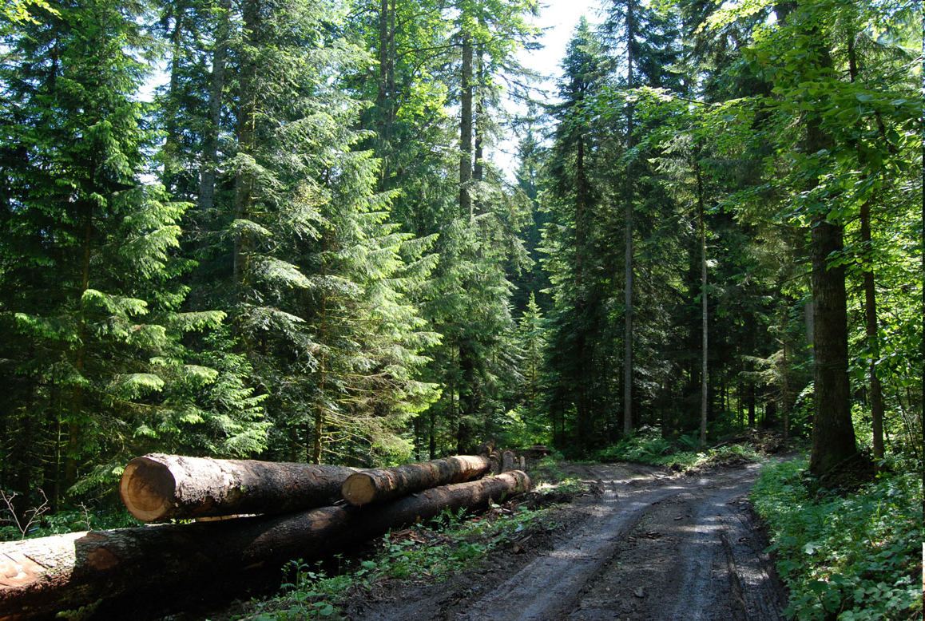
CCF in Neuchatel, Switzerland

Slide 4
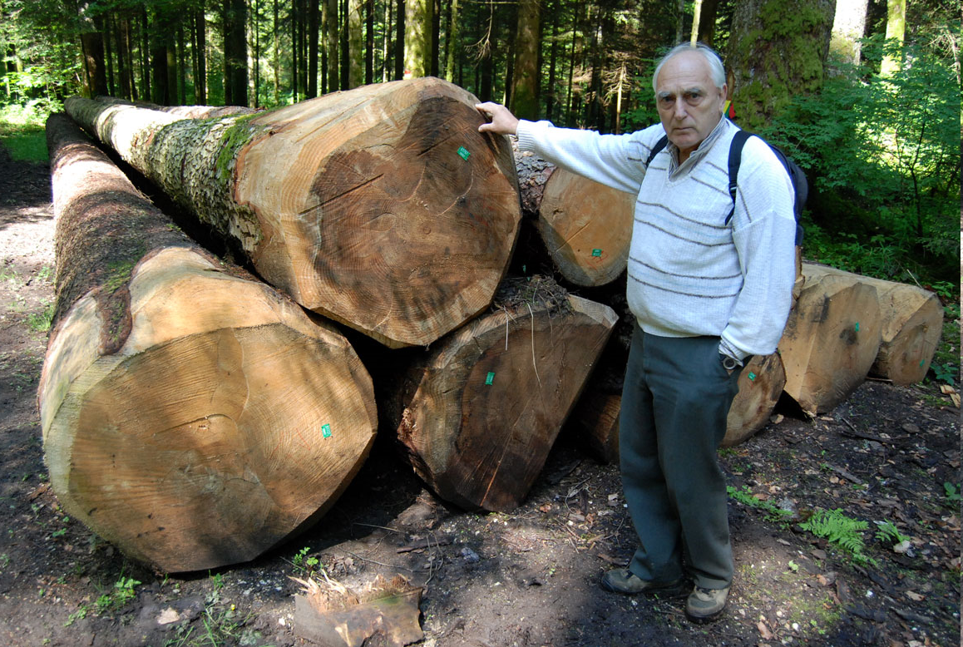
CCF in Neuchatel, Switzerland and Professor J.P. Shütz, ETH.

Slide 5
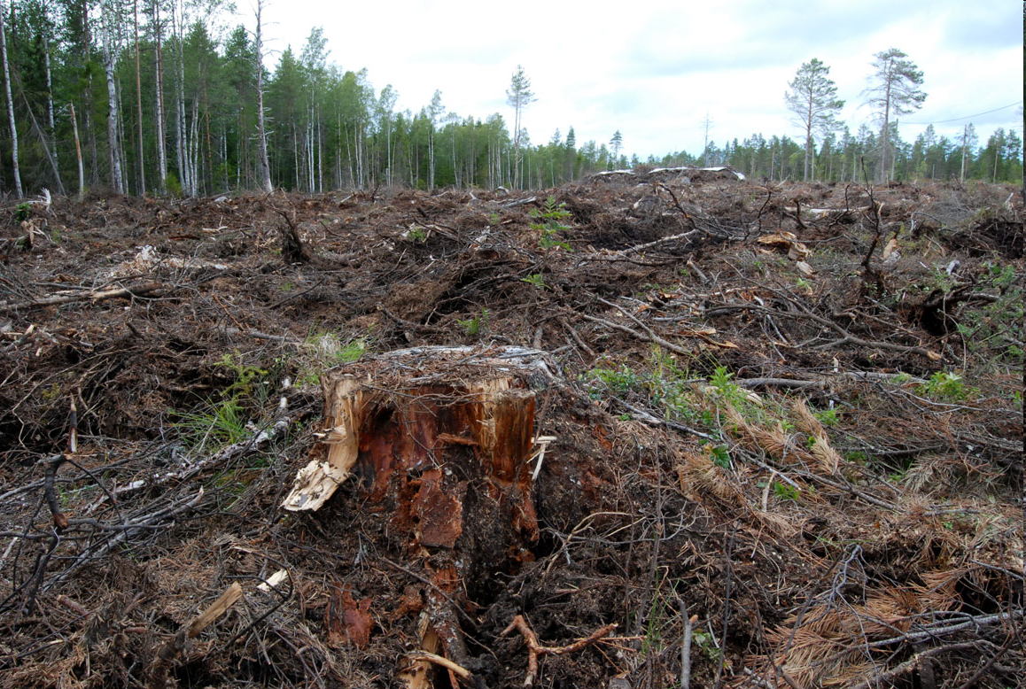
Rotation forestry with clear cuts in Sweden (10 km S Umeå).

Slide 6

Lohmander (2000) and (2007) shows how dynamic and stochastic management decisions can be optimized with different methods, including different versions of stochastic dynamic programming.
Lohmander, P., Optimal sequential forestry decisions under risk, Annals of Operations Research, Vol. 95, pp. 217-228, 2000
Lohmander, P., Adaptive Optimization of Forest Management in a Stochastic World, in Weintraub A. et al (Editors), Handbook of Operations Research in Natural Resources, Springer, Springer Science, International Series in Operations Research and Management Science, New York, USA, pp 525-544, 2007

Slide 7
Lohmander, P., Mohammadi, S., Optimal Continuous Cover Forest Management in an Uneven-Aged Forest in the North of Iran, Journal of Applied Sciences 8(11), 2008
Schütz, J-P., Modelling the demographic sustainability of pure beech plenter forests in Eastern Germany, Ann. For. Sci. 63 (2006) 93–100

Slide 8
Fundamental Principles of Optimal Continuous Cover Forestry
Introduction
Simple analytical method to optimize the stock level in continuous cover forestry.
More advanced analytical method to simultaneously optimize the stock level after harvest and the harvest interval. General aspects on optimal CCF, forest regulations and environmental issues.
Advanced method to optimize CCF at the individual tree level, considering spatial competition, stochastic prices and timber quality variations.

Slide 9
Simple analytical method to optimize the stock level in continuous cover forestry:
Determination of the optimal initial harvest and the stock level after the initial harvest.

Slide 10
We start with the stock level V0.
After the initial harvest, h, we have the stock level V1 ( = V0-h).
Our objective function is the total present value (*).
* = The sum of all revenues minus costs, at all points in time, with consideration of the rate of interest in the capital market.

Slide 11
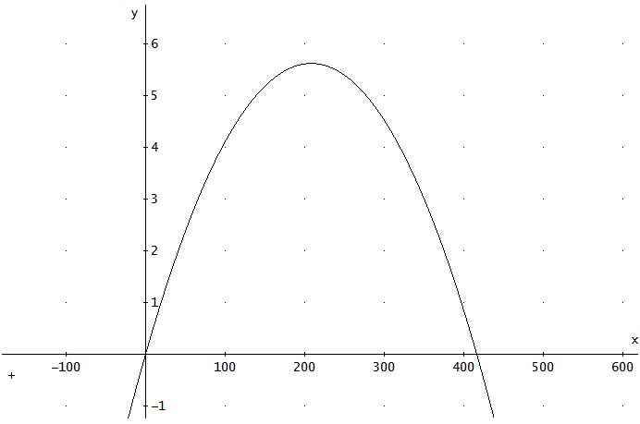
This is a growth function example:
G(V) = Growth (m3 per hectare and year)
V = Stock level (m3 per hectare)

Slide 12
Maximization of , the total present value :
V0 = Initial stock level (m3 per hectare).
p0 = Net price per cubic metre (price minus cost per m3) in the initial harvest.
p1 = Net price per cubic metre (price minus cost per m3) in future harvests.
h = Initial harvest (m3 per hectare).
V0-h = Stock level after the initial harvest (m3 per hectare).
G(V0-h) = Growth (m3/year) after the initial harvest.
(Note that the future harvest level is identical to the future growth.)
r = Rate of interest in the capital market.

Slide 14
Optimization of the initial harvest, h, (and indirectly of the optimal stock level after the initial harvest), V0-h, via derivatives:

Slide 15
First order optimum condition
Second order maximum condition

Slide 17
The optimal stock level after the initial harvest, V1, can be determined from this equation.
(Then, the optimal initial harvest level, h, is determined from V1=V0-h. h=V0-V1.)

Slide 18
EXAMPLE: Optimization with specific parameters and a graphical approach:
Initial stock level = 130 m3/ha.
p0 = p1 = 200 SEK/m3.
r = 3%.
Estimated growth function: G = 0.054011123·V - 0.000129731·V·V

Slide 19
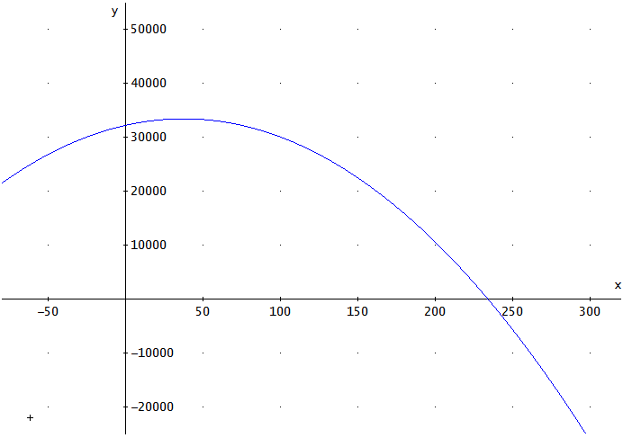
Present value (SEK/ha)
h (m3/ha)

Slide 20
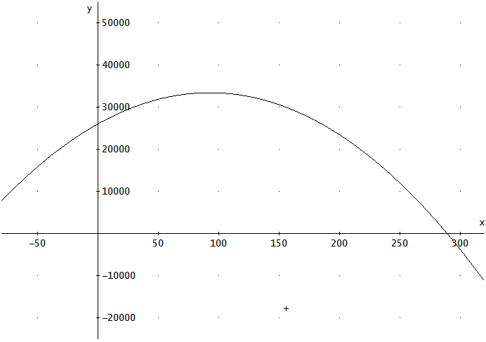
Present value (SEK/ha)
V1=V0-h (m3/ha)

Slide 21
Illustration via an estimated growth function:
G(V)
V

Slide 22
Growth function derivatives:

Slide 23
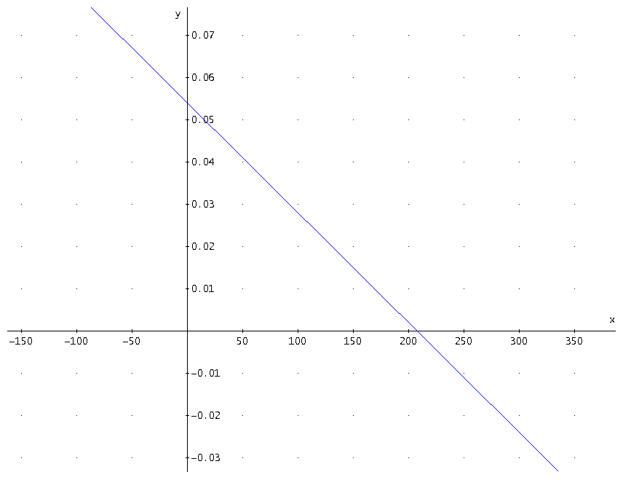
V

Slide 24
Determinaion of the optimal stock level:

Slide 25
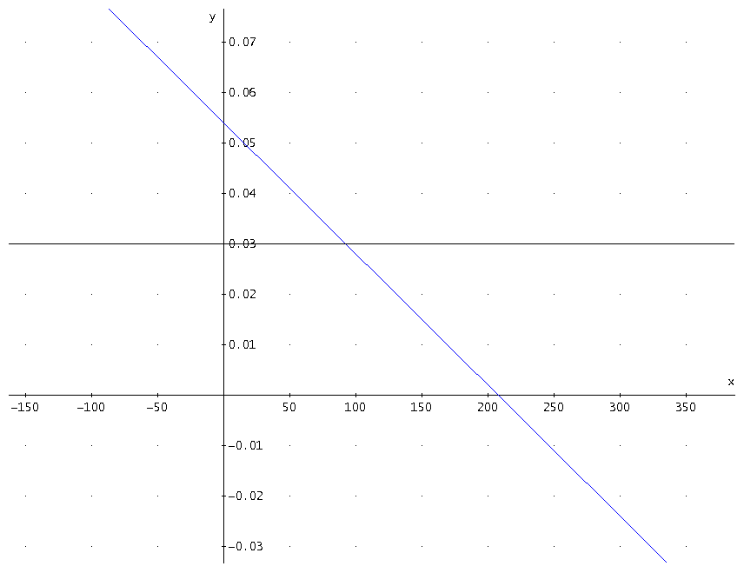
V
92.3

Slide 26
Conclusion:
The optimal stock level is 92.3 m3 per hectare if the rate of interst is 3% in this case.

Slide 27
We can also determine an equation for the optimal stock level.

Slide 29
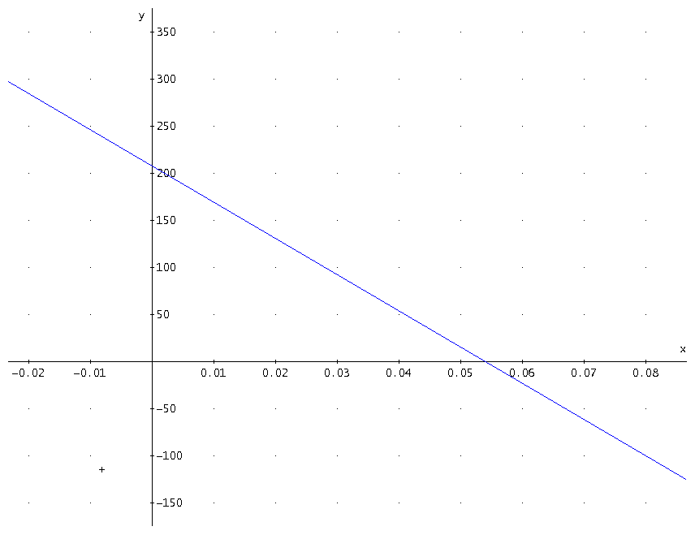
Here, we have an expression
for the optimal stock level
as a function of the rate of interest
and the net prices.

Slide 30
General principles of rational continuous cover forestry derived from the simple analytical method:
1. The optimal stock level is a decreasing function of the rate of interest.
2. The optimal stock level decreases if the net price per cubic metre in the initial harvest increases in relation to the net price per cubic metre in future harvests.
3. The optimal stock level increases if the net price per cubic metre in the initial harvest decreases in relation to the net price per cubic metre in future harvests.
4. It is optimal to let the stock level be equal to the stock level that maximizes the average growth (MSY) only if the rate of interest in the capital market is zero.

Slide 31
Fundamental Principles of Optimal Continuous Cover Forestry
Introduction
Simple analytical method to optimize the stock level in continuous cover forestry.
More advanced analytical method to simultaneously optimize the stock level after harvest and the harvest interval. General aspects on optimal CCF, forest regulations and environmental issues.
Advanced method to optimize CCF at the individual tree level, considering spatial competition, stochastic prices and timber quality variations.

Slide 32

Optimal continuous cover forest management:
- Economic and environmental effects and legal considerations
Professor Dr Peter Lohmander
http://www.Lohmander.com
Peter@Lohmander.com
BIT's 5th Low Carbon Earth Summit
(LCES 2015 & ICE-2015)
Theme: "Take Actions for Rebuilding a Clean World"
September 24-26, 2015
Venue: Xi'an, China

Slide 33
Optimal forest management

Slide 34
Forest management can be performed in many different ways.
Decisions in forestry affect economic results, the flow of bioenergy raw materials, the CO2 balance of the world, species diversity, recreation options for humans and much more.

Slide 35
Some of the fundamental decision problems concern:
Continuous Cover Forestry (CCF) or Plantation Forestry (PF),
the Stand Density (SD),
the Harvest Interval (HI),
Single Species Forestry (SSF) or Multi Species Forestry (MSF).

Slide 36
With present prices, costs, technology and initial forest conditions in many dominating forest countries, CCF is often a better choice than PF when we optimize the economic present values.
CCF is also a better choice than PF from several environmental perspectives.
The optimal levels of SD and HI are affected by all parameters.

Slide 37
MSF can give environmental benefits in relation to SSF.
MSF can also give economically valuable options to sequentially adjust forest production to future market changes.
MSF is less sensitive to species specific damages and is more flexible to changing environmental conditions.
Therefore, the expected present value of MSF is often higher than the expected present value of SSF.

Slide 38
Similar countries with very different forest laws

Slide 39
The forest laws in different countries, also neighbour countries such as Finland and Sweden, with almost the same prices, costs, technology and forest conditions, are very different with respect to the fundamental decisions: CCF or PF, SD, HI and SSF or MSF.
The economic and environmental development of the world would benefit from more rational forest management.
Several forest laws need to be adjusted in order to make rational decisions legal.

Slide 40
Present value
h = The first harvest volume
R(h) = Profit from the first harvest
P(.) = Price per cubic metre
(reduced by variable cost per
cubic metre)
in future harvests
Q(.) = Harvest volume per hectare
in future harvests
c = Set up cost per harvest
occation
r = Rate of interest
v = volume per hectare
v0
v1
0
time
0
t

Slide 41
In Finland, continuous cover forest management can be optimized without constraints.
In Sweden, there are several constraints in the forest act. For instance, the volume always has to stay above
a specified lower limit. If the volume is below the limit, you have to make a clearcut.
WITH Swedish constraints, forestry with clearcuts often is the economically optimal choice.
WITHOUT Swedish constraints, continuous cover forestry is very often the economically optimal choice.
v = volume per hectare
v0
v1
0
time
0
t

Slide 43
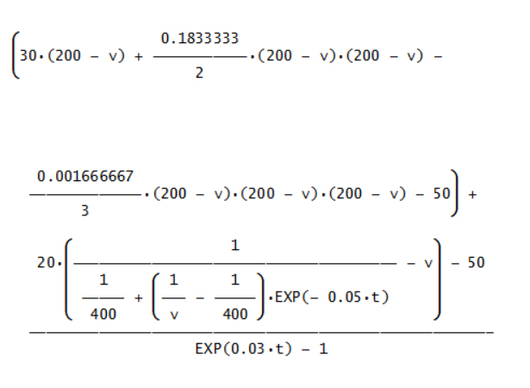
Example:
Graphical
illustrations
based on
specified
functions
and
parameters

Slide 44
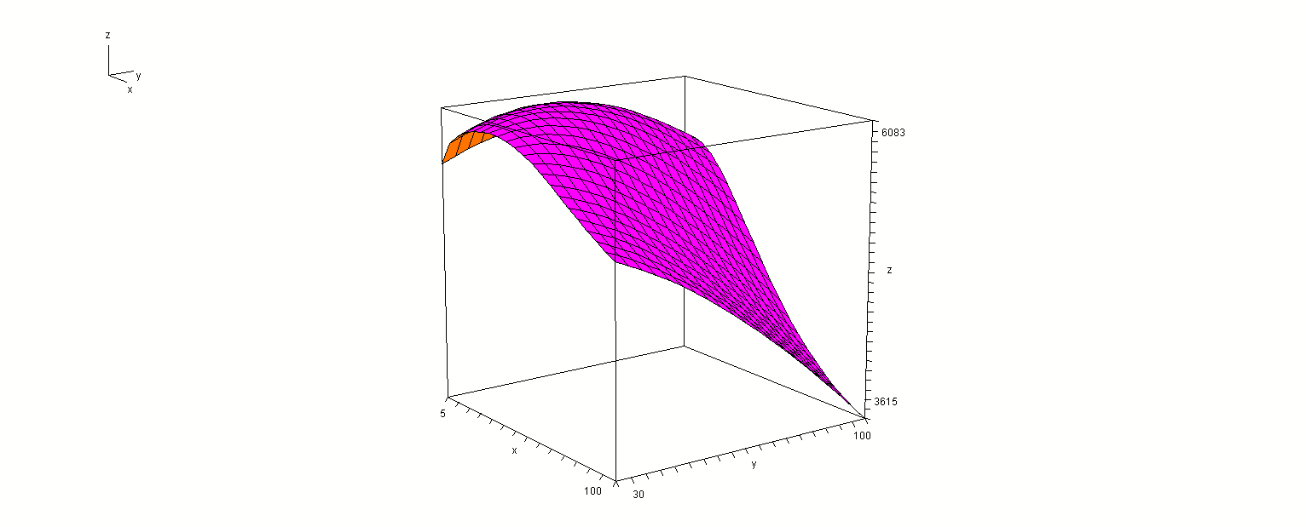
Present
value
t
v1

Slide 45
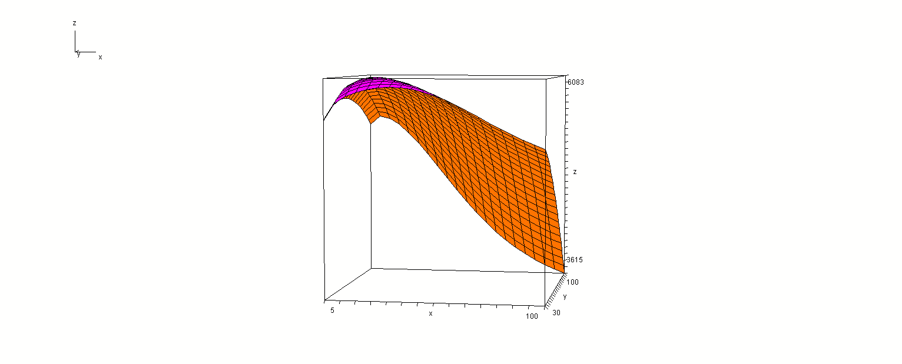
Present
value
v1
t

Slide 46
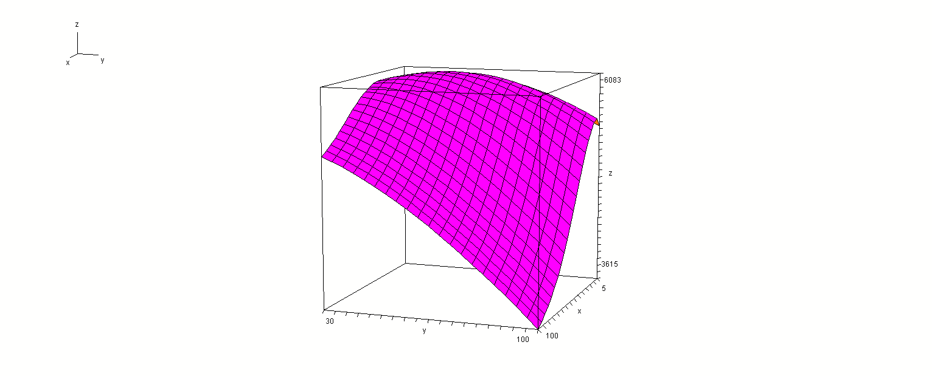
Present
value
t
v1

Slide 47
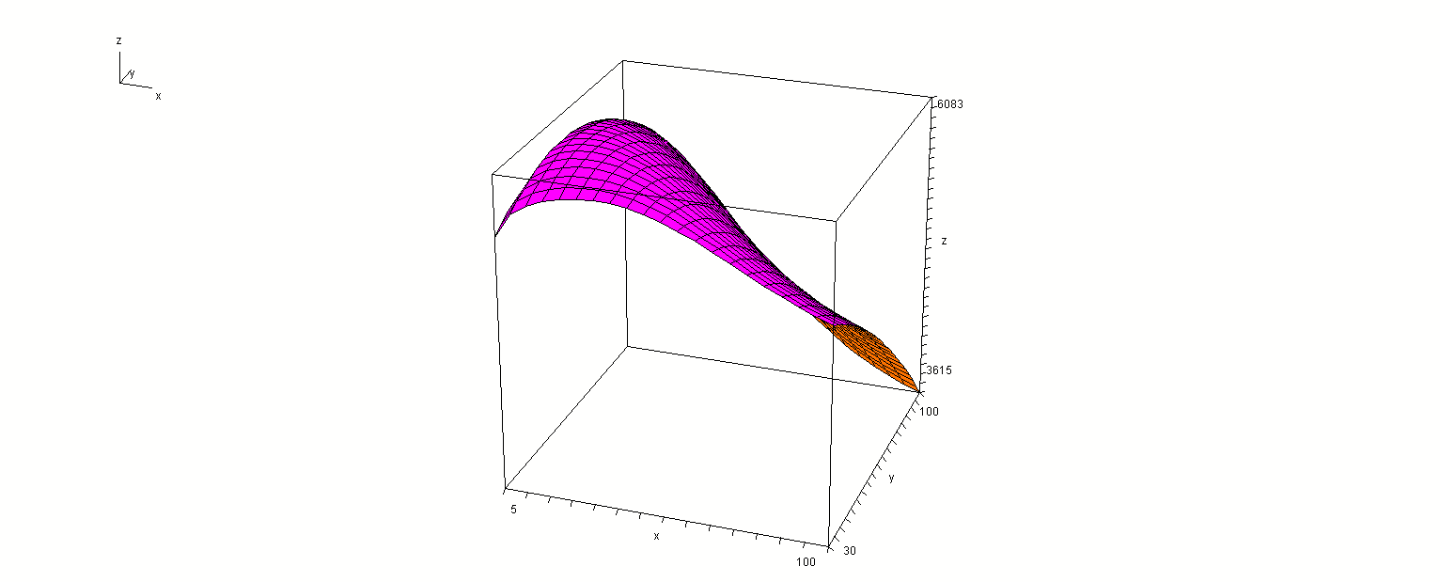
Present
value
v1
t

Slide 48
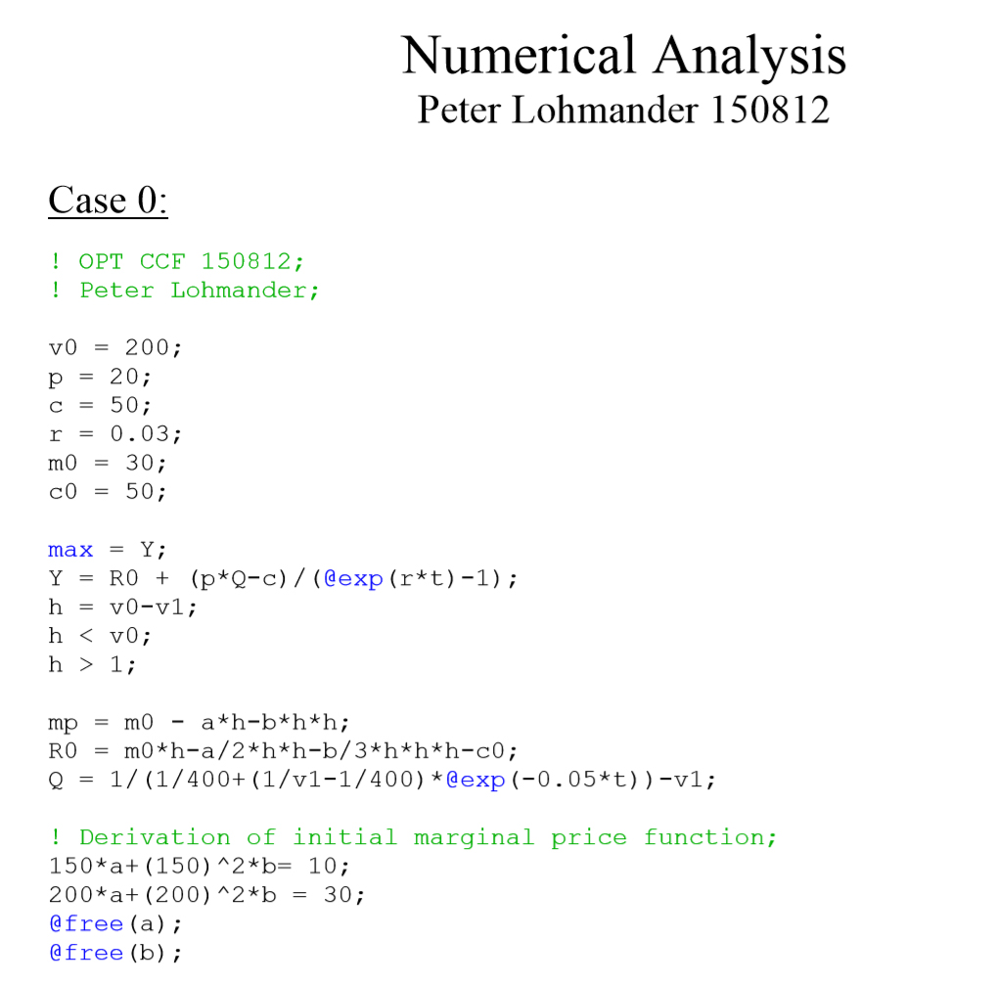

Slide 49
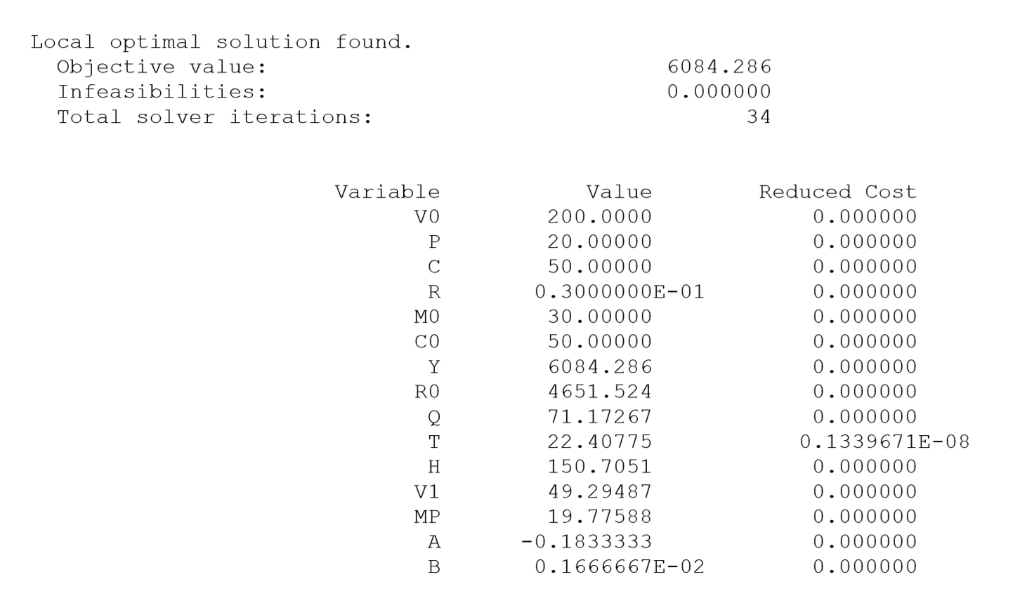
Maximum
present
value
Optimal
harvest
interval
The optimal value of V1 is far below the Swedish constraint.

Slide 50
Optimal continuous cover forest management
First, we study:
One dimensional optimization in the time interval dimension
(of relevance when the stock level after harvest is determined by law or can not be determined for some other reason)

Slide 53
Optimal principle in the time dimension:

Slide 54
How is the optimal time interval affected if the parameter c marginally increases (ceteres paribus)?

Slide 55
A unique maximum is assumed in the time interval dimension
Conclusion:
The optimal time interval is a strictly increasing function of c.

Slide 56
How is the optimal time interval affected if the parameter r marginally increases (ceteres paribus)?
Conclusion:
The optimal time interval is
a strictly decreasing function
of the parameter r.

Slide 57
How is the optimal time interval affected if the future prices marginally increase (ceteres paribus)?

Slide 58
Conclusion:
The optimal time interval is a strictly decreasing function of the parameter p.

Slide 59
Optimal continuous cover forest management
Now, we study:
One dimensional optimization in the volume dimension
(of relevance when the time interval is determined by law or can not be determined for some other reason)

Slide 61
Optimal principle in the volume dimension:

Slide 62
How is the optimal volume affected if one parameter marginally increases (ceteres paribus)?
- The optimal volume is not affected by changes of c.
- The optimal volume is a strictly decreasing function of r.
- The optimal volume is a strictly increasing function of p.

Slide 63
Observation:
If the volume is constrained (by law or something else), we may study the effects of the volume constraint on the optimal time interval, via one dimensional optimization.

Slide 64
Observation (extended):
If the time interval is constrained (by law or something else), we may study the effects of the time interval constraint on the volume, via one dimensional optimization.

Slide 65
Optimal continuous cover forest management
Now, we study:
Two dimensional optimization in the volume AND time interval dimensions

Slide 67
The first order optimum conditions:

Slide 68
Assumption: A unique maximum exists. The following conditions hold:

Slide 70
Comparative statics analysis based on two dimensional optimization:

Slide 78
Conclusions:
The forest laws in different countries, also neighbour countries such as Finland and Sweden, with almost the same prices, costs, technology and forest conditions, are very different.
If constraints that make continuous cover forest management less profitable than clear cut forestry are removed, we can expect better economic results and environmental improvements.
The analyses have shown how optimal decisions in forestry can be determined and how these optimal decisions are affected by parameter changes.
Several laws need to be adjusted in order to make rational forestry decisions legal.
The economic and environmental development of the world would benefit from more rational forest management.

Slide 79
There is a mathematical appendix available that contains all of the derivations.

Slide 80
Fundamental Principles of Optimal Continuous Cover Forestry
Introduction
Simple analytical method to optimize the stock level in continuous cover forestry.
More advanced analytical method to simultaneously optimize the stock level after harvest and the harvest interval. General aspects on optimal CCF, forest regulations and environmental issues.
Advanced method to optimize CCF at the individual tree level, considering spatial competition, stochastic prices and timber quality variations.

Slide 81
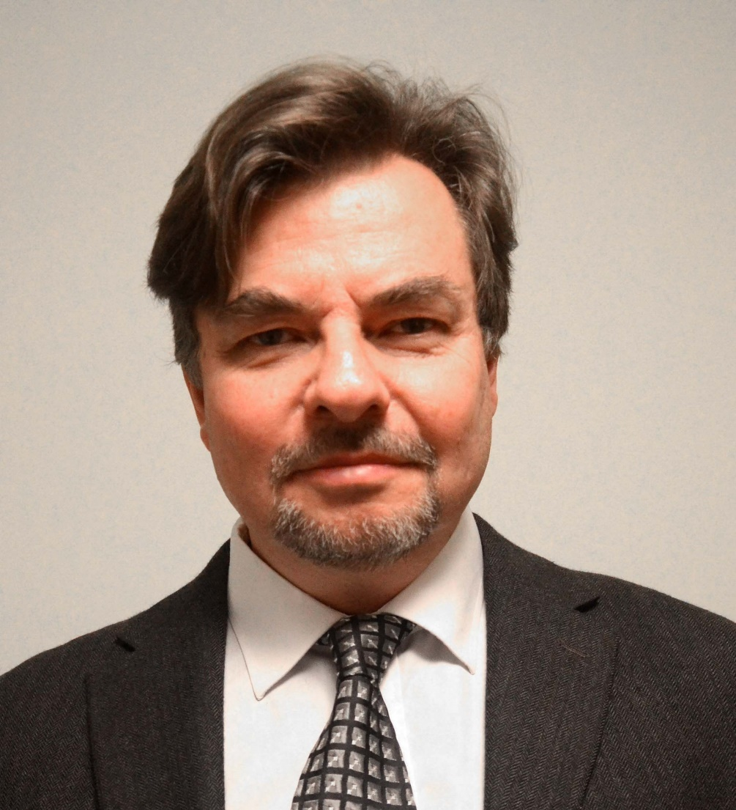
OPTIMAL STOCHASTIC DYNAMIC CONTROL OF SPATIALLY DISTRIBUTED INTERDEPENDENT PRODUCTION UNITS
Version 160901
Peter Lohmander
Professor Dr., Optimal Solutions & Linnaeus University, Sweden www.Lohmander.com & Peter@Lohmander.com

Slide 82
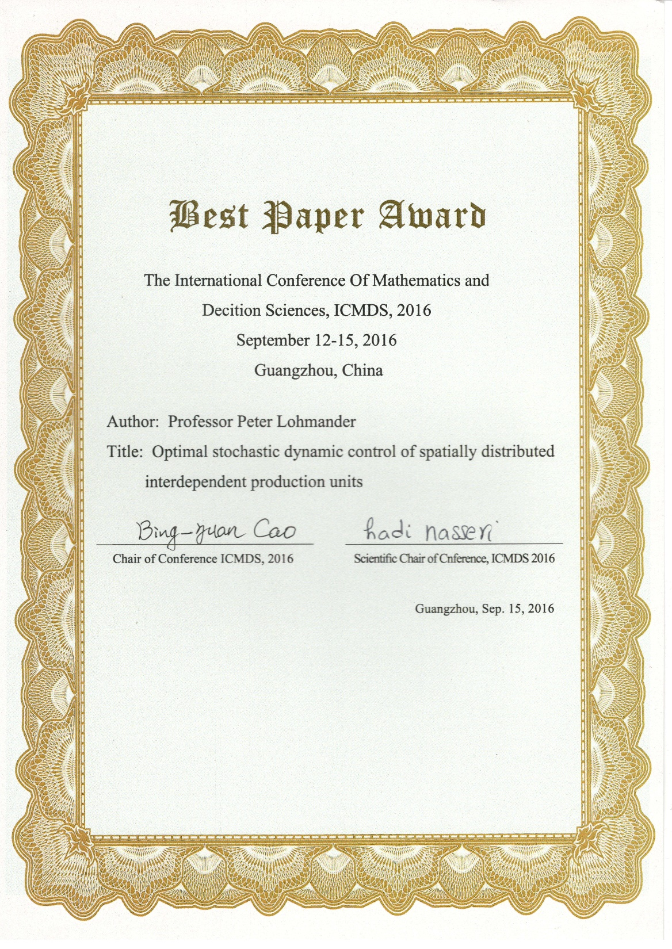

Slide 83
The ambition of this study is to develop
a general method for optimization of stochastic and dynamic decision problems
with spatial dependencies that cannot be neglected and
where the need to use a multidimensional state space in high resolution
makes it computationally and economically impossible to apply the otherwise relevant method stochastic dynamic programming.

Slide 84
Applications can be found in most sectors of the economies.
One of the most obvious cases, where useful and statistically estimated functions already exist, is the forest sector.
We start with a forest area with 1000 trees of different sizes, as shown in Figure 1.
The initial locations and sizes of the trees are simulated.

Slide 85
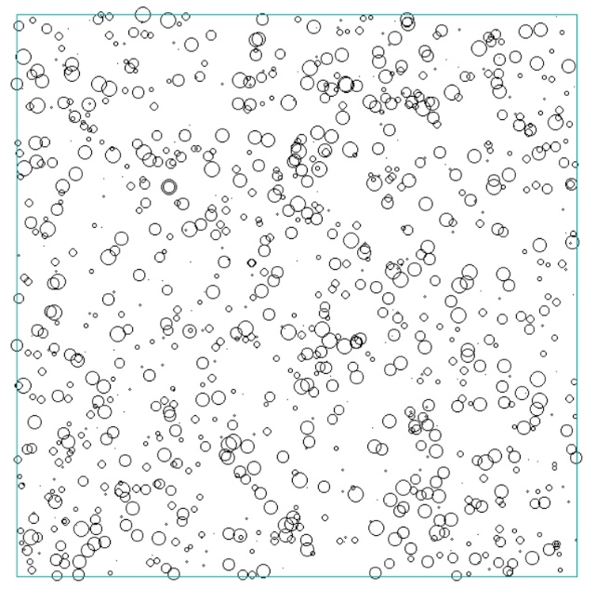
Figure 1:
Spatial map of initial conditions at t = -1 (years from the present time).
The locations of the circle centers are the locations of the trees. The circle diameters are proportional to the tree diameters.
The square represents one hectare (100m*100m).

Slide 86
The problem is to determine an adaptive control function to be used in this forest,
giving the maximum of the total expected present value of all activities over time.

Slide 87
The annual increment of each tree is a function of tree size and competition from neighbor trees.
The different trees have different wood qualities, initially randomly assigned to the individuals.
The market value of a tree is a function of size, quality and stochastic price variations.
The variable harvesting cost of a tree is size dependent.

Slide 88
Every five years, the trees in the forest are inspected.
Then, depending on market prices, tree sizes, competition, quality etc., it is possible that some or many trees are harvested.
The optimized control function is used to make all of these decisions.
Figure 2 shows the structure of the forest directly after optimal harvesting at t = 0.

Slide 89
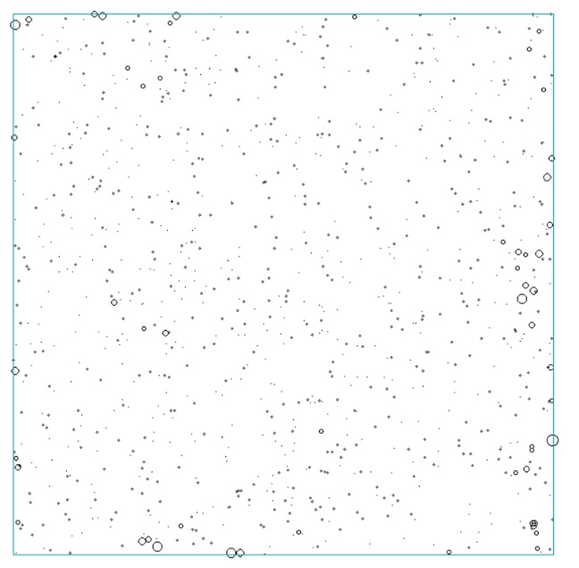
Figure 2:
The state after the first application of the optimized control function at t = 0.
Most of the largest trees have been removed.

Slide 90
Obviously, a considerable number of large trees have been removed.
Many new seedlings are however found on the land, in random positions.
The trees continue to grow and Figure 3 illustrates the situation 35 years later.

Slide 91
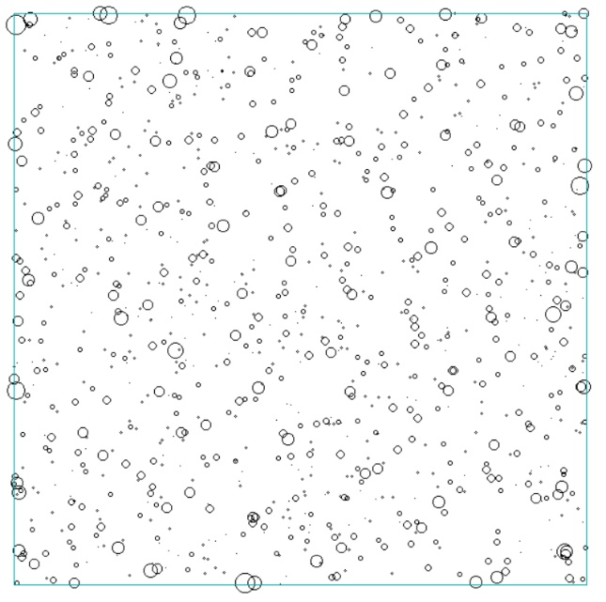
Figure 3:
The forest at t = 35.

Slide 92
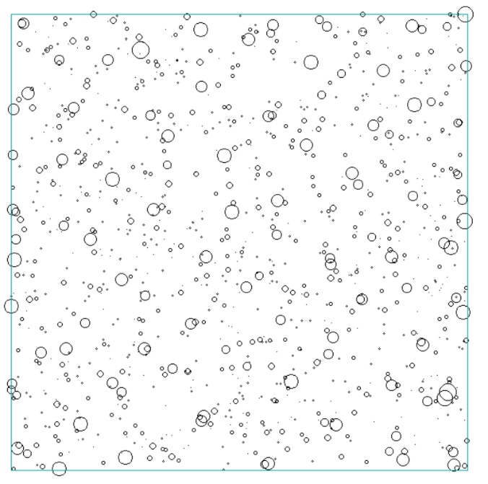
69 years after the first harvest, trees of considerable sizes exist (Figure 4).
The total number of large trees in year 69 is however much lower than before the harvest during year 0.
Figure 4:
The forest at t = 69.

Slide 93
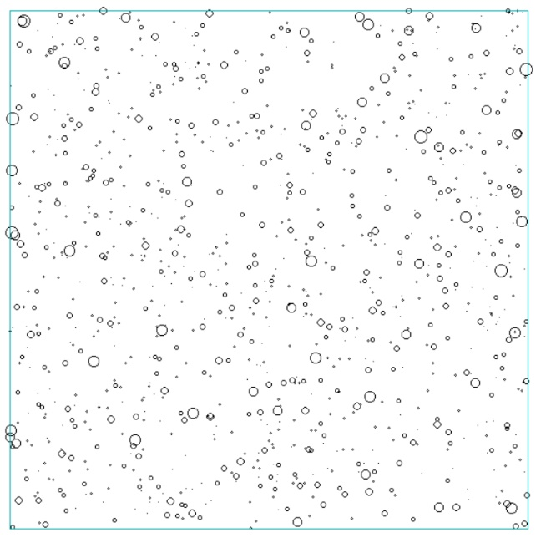
Several large trees
are harvested in
year 70
(Figure 5).
Figure 5:
The forest at t = 70.

Slide 94
This type of stochastic dynamic and spatial forest development is sustainable. Furthermore, there are always trees in the forest. We have a system of “optimal continuous cover forestry”.
Lohmander [1] describes several alternative methods to optimize
forest management decisions at higher levels.
[1] Lohmander, P., Adaptive Optimization of Forest Management in a Stochastic World, in Weintraub A. et al (Editors), Handbook of Operations Research in Natural Resources, Springer, Springer Science, International Series in Operations Research and Management Science, New York, USA, pp 525-544, 2007

Slide 95
Lohmander and Mohammadi [2] determine optimal harvest levels in beech forests in Iran, using stochastic dynamic programming.
Then, however, the tree selection decisions were never analyzed.
[2] Lohmander, P., Mohammadi, S., Optimal Continuous Cover Forest Management in an Uneven-Aged Forest in the North of Iran, Journal of Applied Sciences 8(11), 2008

Slide 97
The parameters
are optimized in this study. In the graphs and software, they are denoted
(dlim_0, dlim_c, dlim_q and dlim_p).

Slide 98
denote competition index for tree i,
quality of tree i and
the stochastic deviation of the market price from the expected price, at time t.
The stochastic price deviations are i.i.d. and have uniform pdf on the interval -10 to +10 EURO/cubic metre.

Slide 99
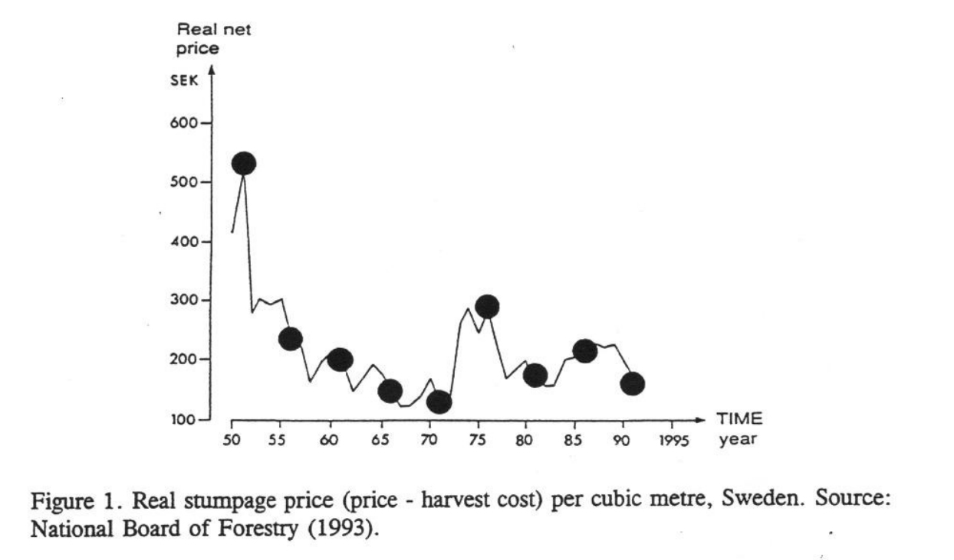
Lohmander, P., Reservation price models in forest management: Errors in the estimation of probability density function parameters and optimal adjustment of the biasfree point estimates, Management Systems for a Global Forest Economy with Global Resource Concerns, Society of American Foresters, Asilomar, California, September 1994, Brodie, D. & Sessions, J., (Editors), College of Forestry, Oregon State University, Corvallis, Oregon, USA, 439-456, 1995
http://www.Lohmander.com/Lohmander_SAF_1995.pdf
20 EURO
interval

Slide 100
The objective function is the
total expected present value of all revenues minus all costs from year 0 until year 200.
The real rate of interest is set to 3%.
The computer model includes functions for
tree height as a function of diameter,
functions used in tree volume calculations,
set up costs,
tree size dependent revenues and variable harvesting costs etc.

Slide 101
The trees grow according to a modified version of the function reported by Schütz [3].
The modification is that in [3], competition is assumed to come from all parts of the forest area, also far away from the individual tree.
In the function applied in this new analysis, only competition from trees at distances ten meters or closer, is considered.
[3] Schütz, J-P., Modelling the demographic sustainability of pure beech plenter forests in Eastern Germany, Ann. For. Sci. 63 (2006) 93–100

Slide 102
Furthermore, in the Schütz function, each tree is only affected by competition from trees with larger diameters.
In the present study, also competition from trees with smaller diameters is considered.
However, it is probably the case that trees with smaller diameter give a lower degree of competition.
The motivation for the new function, used here, is that competition for light, water and nutrients, obviously is stronger from neighbor trees than from trees far away. Furthermore, also smaller trees use some of the available light, water and nutrients.

Slide 103
is the diameter increment of tree i and
is the diameter.
is a set of empirically estimated parameters, published by Schütz [3], for beech in Germany.
is now expressed as the basal area per hectare of larger competing trees plus the basal area of smaller competing trees divided by 2 (all within the 10 meter radius circle). In future studies, the competition function should be estimated with locally relevant data.

Slide 104
The optimization of the total expected present value, via the parameters of the adaptive control function, contained the following steps:
A software code was constructed and tested in QB64.
The objective function was estimated for a set of combinations of the control function parameters

Slide 105
For this purpose, a four dimensional loop with alternative parameter values was run.
Preliminary iterative studies were first made to determine interesting parameter intervals.
Then, a 3*3*3*4 loop was used, which gave 108 parameter combinations.
For each parameter combination, the total expected present value during 200 years was estimated for 10 different forest areas of one hectare, each with 1000 initial random trees.

Slide 106
That analysis took approximately 8 hours on an Acer Aspire V personal computer with an Intel Core i5 processor.
Next, the parameter values of
determined in the “108-loop”, were considered optimal and fixed. A more detailed analysis, with higher resolution, of the parameters
was made.

Slide 107
3 Main Results
The adaptive control function parameters
were determined in a general loop.
108 combinations were evaluated.
This is the adaptive control function:

Slide 108
This is the optimal adaptive control function:
The optimal objective function value was estimated to
2571 EURO/hectare.

Slide 109
Next, the parameter values of
determined in the “108-loop”, were considered optimal and fixed.
A more detailed analysis, with higher resolution, of the parameters
= (dlim_0, dlim_p) was made.
Figure 6 shows the objective function and in Figure 7, the objective function level curves are given.

Slide 110
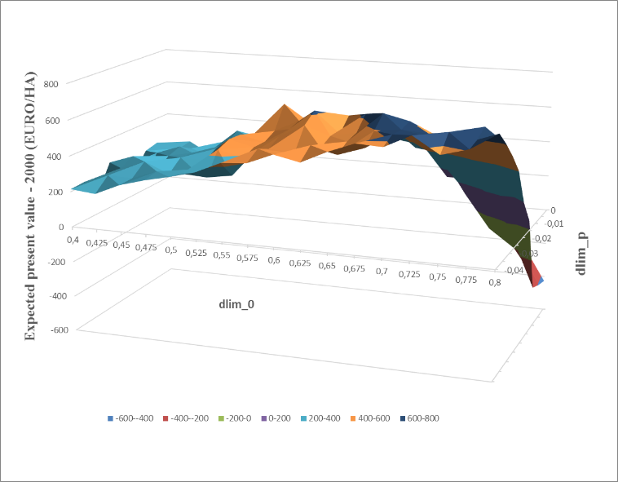
Figure 6:
The objective function reduced by a constant
as a function of the parameters
dlim_0 and dlim_p,
for optimal values of the other parameters, namely dlim_c = -0.003 and dlim_q = 0.02.

Slide 111
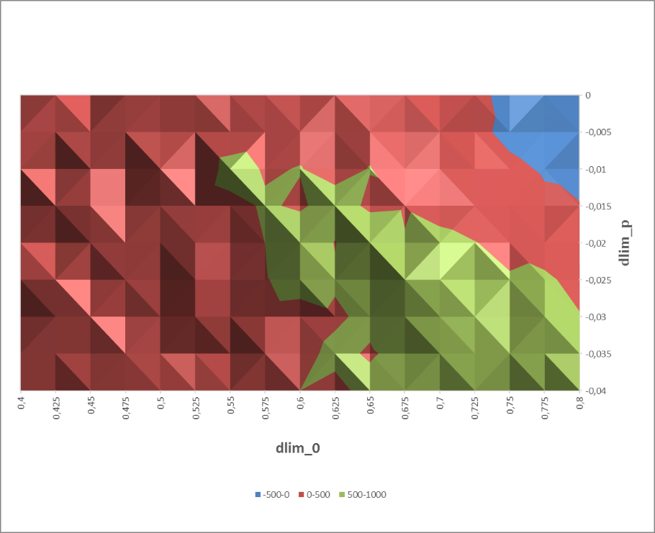
Figure 7:
The level curves of the objective function as a function of the parameters dlim_0 and dlim_p,
when the other parameters were held constant at their optimal values.

Slide 112
Multiple regression analysis
and the data presented in Figure 6 were used to estimate a
quadratic approximation of the objective function, Z.
Let (x, y) =
The R2 value of the regression was 0.999 and all coefficients were statistically significant, with p-values below 0.00003.

Slide 113
Approximation of the objective function, Z
The first order optimum conditions are:

Slide 114
The equation system
gives this unique solution:
Now, the objective function value is 2690 EURO/hectare.

Slide 115
The derived optimum is a unique maximum, which is confirmed by:
and

Slide 116
The quadratic approximation gave this optimal control function:

Slide 117
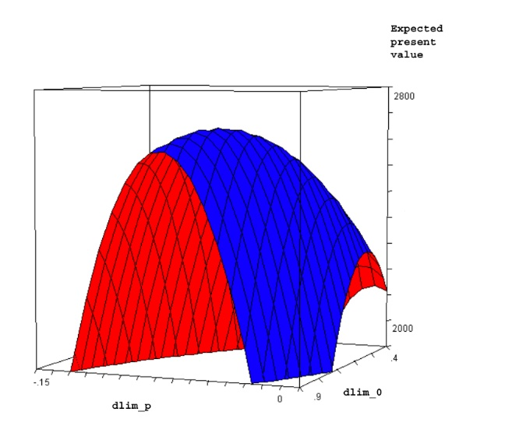
Figure 8:
The objective function as a function of the parameters dlim_0 and dlim_p, according to the quadratic approximation, when the other parameters were held constant at their optimal values.

Slide 118
The quadratic approximation gave this optimal control function:
Three General Forest Management Conclusions:
A tree should be harvested at a smaller tree diameter, in case the
local competition from other trees increases.
A tree should be harvested at a larger tree diameter, in case the
wood quality of the tree increases.
A tree should be harvested at a smaller tree diameter, in case the
market net price (price – harvesting cost) for wood increases.

Slide 119
FINAL CONCLUSIONS
The general principles of optimal continuous cover forestry have been derived and presented.
General analytical solutions have been obtained for the optimal stock level and the optimal harvest time interval, via stand level optimization.
Optimal CCF rules for decisions concerning individual trees have been derived via numerical optimization of adaptive control functions. These rules handle tree dimension, timber quality, spatial distribution, local competition and stochastic prices.

Slide 120
Fundamental Principles of Optimal
Continuous Cover Forestry
Linnaeus University Research Seminar (RESEM)
Tuesday 2017-05-23, 10.15-11.00, Lecture Hall: Karlavagnen
Version 170518
Peter Lohmander
Professor Dr., Optimal Solutions in cooperation with Linnaeus University www.Lohmander.com & Peter@Lohmander.com

