Slide 1
HIGH RESOLUTION ADAPTIVE OPTIMIZATION OF CONTINUOUS COVER SPRUCE FOREST MANAGEMENT IN SOUTHERN SWEDEN
Peter Lohmander (Optimal Solutions), (presenter and corresponding author), Jan-Ola Olsson, Nils Fagerberg, Johan Bergh & Stergios Adamopoulos (all at Linnaeus University) Version 170808
August 27-30, 2017, Clearwater Resort Suquamish, Washington, (near Seattle)

Slide 2
HIGH RESOLUTION ADAPTIVE OPTIMIZATION OF CONTINUOUS COVER SPRUCE FOREST MANAGEMENT IN SOUTHERN SWEDEN METHODOLOGY and MOTIVATION
Stochastic dynamic programming, SDP, can be used, and has often been used, to optimize forest management decisions under the influence of stochastic disturbances.
If the number of decision variables is large and the optimal decisions are dependent on detailed information in a state space of large dimensionality, SDP can however not be applied.
For this reason, optimal control functions for local decisions are defined and the parameters are determined via stochastic full system simulation and multidimensional regression analysis.

Slide 3
Structure of the analysis:
The maximum
expected present
value is determined
via the determined
control function
parameter values.
A multidimensional loop with different adaptive
control function parameter value combinations is created.
For each parameter combination:
10 stochastic simulations
of the complete system
during 200 years with estimation
of the expected present value.
The adaptive control
function parameters
are analytically
determined via
the first order
optimum conditions
and the second
order maximum
conditions.
A table with expected present values for different
adaptive control function parameter value combinations is created.
A multidimensional nonlinear approximation of the expected
present value, as a function of the adaptive control function
parameters, is derived via regression analysis.

Slide 4
HIGH RESOLUTION ADAPTIVE OPTIMIZATION OF CONTINUOUS COVER SPRUCE FOREST MANAGEMENT IN SOUTHERN SWEDEN METHODOLOGY and MOTIVATION
All local harvest decisions are based on locally relevant state space information within stochastic dynamic and spatially explicit forest production.
The expected present value of all harvests, over time and space, in a forest area, is maximized.
Each tree is affected by competition from neighbor trees.
The harvest decisions, for each tree, are functions of the prices in the stochastic market, the dimension and quality of the individual tree, and the local competition.

Slide 5
HIGH RESOLUTION ADAPTIVE OPTIMIZATION OF CONTINUOUS COVER SPRUCE FOREST MANAGEMENT IN SOUTHERN SWEDEN METHODOLOGY and MOTIVATION
The market value of a tree is a function of size, quality and stochastic price variations.
The variable harvesting cost of a tree is size dependent.
The random quality differences are defined via the effects on the timber prices.

Slide 6
HIGH RESOLUTION ADAPTIVE OPTIMIZATION OF CONTINUOUS COVER SPRUCE FOREST MANAGEMENT IN SOUTHERN SWEDEN METHODOLOGY and MOTIVATION
The adaptive control function, a limit diameter function, to be used in this forest is determined, that gives the maximum of the total expected present value of all activities over time.
If the diameter of a particular tree is larger than the limit diameter, then the tree should be instantly harvested.
Otherwise, it should be left for continued production.

Slide 7
The optimal limit diameter function:
Diameter of tree n1
Local competition
of tree n1
Real timber price (of average
timber quality) minus expected
real equilibrium price
Timber quality
of tree n1
1.0
IF d(n1) > (dlim_0 + dlim_c * c(n1) + dlim_q * qual(n1) + dlim_p * SigmaK * pdev(nums, t)) THEN h(n1) = 1
?
?
?
If h(n1)=0 (default value),
then the tree should not be
instantly harvested.
If h(n1) = 1, then the tree
should be instantly harvested.
?
These four parameters, in the control function,
should be optimized (for real rate of interest 3%) .

Slide 8
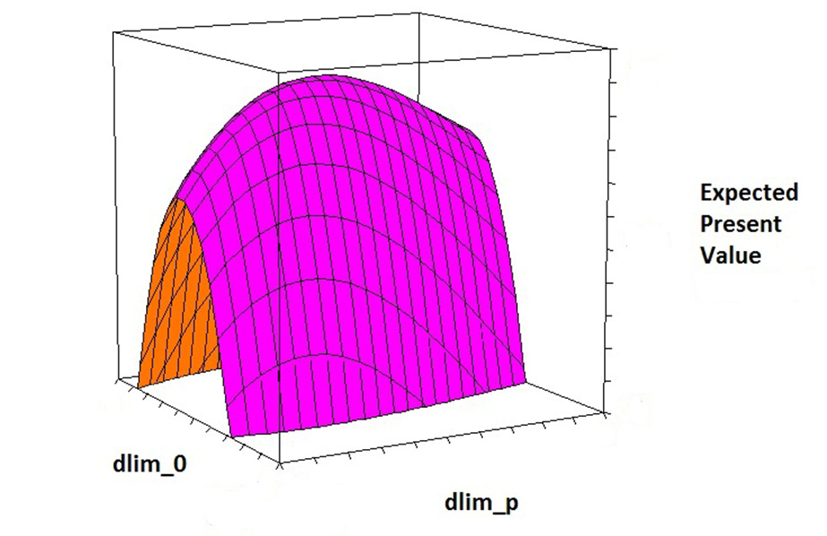
Partial objective
function surface
The expected present value as a function of the values of two parameters in the limit diameter
(= adaptive harvest control) function.
(The other parameters are assumed to have the optimal values.)

Slide 9
HIGH RESOLUTION ADAPTIVE OPTIMIZATION OF CONTINUOUS COVER SPRUCE FOREST MANAGEMENT IN SOUTHERN SWEDEN APPLICATION
Economically optimal forest management decisions are determined within the continuous cover framework, in forests of Norway spruce in southern Sweden.
The general methodological approach can also be applied to other species and in other regions.
This study is based on a new growth function for individual trees of Norway spruce in southern Sweden managed with a continuous cover system.
The function determines the basal area increment of individual trees based on the state of the tree itself, i.e. current basal area, and local competition in the neighborhood of each tree.
The model set includes a stochastic timber quality sub model that assigns qualities to the trees.

Slide 10
The software:
In the end of this presentation, the complete software is documented and followed by a few lines of a typical output file.
The software estimates, via repeated stochastic simulations, the total expected present value of all activities during 200 years, for different control function parameter value combinations.

Slide 11
Some of the empirical background and derived functions used in the optimization, are briefly described on the following pages.
All statistics concerning prices, costs and forests,
concern ”Southern Sweden”.

Slide 12
TIMBER
PULPWOOD
Stdef = Real price of spruce timber, Tdef = Real price of timber, PWSoftdef = Real price of pulpwood from softwoods,
PWSdef = Real price of pulpwood from spruce. (Spruce = Norway spruce = Picea abies.
All prices concern southern Sweden.) Sources: Swedish Forest Agency and SCB.

Slide 13
Regression statistics
Multipel-R | 0,992636
R2 | 0,985325
Adjusted R2 | 0,937706
Standard error | 38,03903
Observations | 22
ANOVA
 | fg | KvS | MKv | F | p-value of F
Regression | 1 | 2040284 | 2040284 | 1410,041 | 5,08E-20
Residual | 21 | 30386,33 | 1446,968
Total | 22 | 2070670
 | Coefficient | Standard error | t-ratio | p-value
Constant | 0
Stdef | 0,600793 | 0,016 | 37,55051 | 9,72E-21
ALMOST a perfect and very simple function:
PWSdef = 0.60*Stdef
(Pulpwood price = 0.6 * Timber price)

Slide 14
Deflated price of spruce timber year t as a function of the deflated price of spruce timber year t-1.
Regression statistics
Multipel-R | 0,515774551
R2 | 0,266023388
Adjusted R2 | 0,22739304
Standard error | 59,02778581
Observations | 21
ANOVA
 | fg | KvS | MKv | F | p-value of F
Regression | 1 | 23994,08455 | 23994,08455 | 6,886383417 | 0,016699293
Residual | 19 | 66201,31046 | 3484,279498
Total | 20 | 90195,39502
 | Coefficient | Standard error | t-ratio | p-value
Constant | 235,9102296 | 101,8500004 | 2,316251632 | 0,031871867
STP0 | 0,531329826 | 0,202473689 | 2,624191955 | 0,016699293
First order autoregressive process:
P(t) = 236 + 0.531*P(t-1) + s(t)
stdev = 59

Slide 15
Observation | PREDICTED PRICE | Residual | YEAR OF PREDICTED PRICE
1 | 522,2832849 | -58,76277704 | 1996
2 | 482,1925005 | 74,91123053 | 1997
3 | 531,9160583 | -3,71189486 | 1998
4 | 516,560856 | 14,29613738 | 1999
5 | 517,9703837 | -19,11065991 | 2000
6 | 500,96928 | -12,87807824 | 2001
7 | 495,2476431 | -31,27403606 | 2002
8 | 482,4332457 | -7,958919878 | 2003
9 | 488,0125907 | -6,340850039 | 2004
10 | 491,8367919 | -191,65712 | 2005 | OBS
11 | 395,4046425 | 9,846641678 | 2006
12 | 451,2323241 | 26,9363104 | 2007
13 | 489,9754871 | -20,50414552 | 2008
14 | 485,354356 | -17,56255864 | 2009
15 | 484,4619641 | 94,25895467 | 2010
16 | 543,4019149 | 30,66914444 | 2011
17 | 540,9313059 | -1,127104713 | 2012
18 | 522,7243021 | -17,94359137 | 2013
19 | 504,115277 | 40,94899941 | 2014
20 | 525,5191369 | 64,22115349 | 2015
21 | 549,2568357 | 32,7431643 | 2016
The storm Gudrun
came in 2005

Slide 16
First order autoregressive process:
P(t) = 236 + 0.531*P(t-1) + s(t)
(stdev = 59)

Slide 17
Thinnings
All harvests
Clear fellings

Slide 18
Diameter frequency distribution (Initial conditions)

Slide 19
Diameter frequency distribution (Initial conditions)
Forest = Mosshult
Diameter (upper class limit, mm) | Frequency | Cumulative percentage
100 | 128 | 27,47%
200 | 181 | 66,31%
300 | 82 | 83,91%
400 | 34 | 91,20%
500 | 25 | 96,57%
600 | 13 | 99,36%
700 | 3 | 100,00%
800 | 0 | 100,00%
900 | 0 | 100,00%

Slide 20
Diameter frequency distribution (Initial conditions)

Slide 21
Diameter frequency distribution (Initial conditions)
Forest = Romperöd
Diameter (upper class limit, mm) | Frequency | Cumulative percentage
100 | 97 | 32,66%
200 | 77 | 58,59%
300 | 49 | 75,08%
400 | 38 | 87,88%
500 | 26 | 96,63%
600 | 9 | 99,66%
700 | 1 | 100,00%
800 | 0 | 100,00%
900 | 0 | 100,00%

Slide 22
Basal area increment function with motivation
This basal area increment function
was motivated and analyzed by
Lohmander (2017) :
Basal area increment is negatively affected by competition
from other trees. Relative size, size and distance affect the degree of influence.

Slide 23
Basal area increment function with more details concerning competition from different species
Competition from ”AT” = ”ALL TREE SPECIES”
Competition from ”S” = ”SPRUCE”

Slide 24
Basal area increment function with more details concerning competition
Basal area of competing tree
Distance to competing tree
The effect of competition on increment is proportional to increment for low values of basal area.

Slide 25
Basal area increment function used in the optimization
Parameters derived in two different areas

Slide 26
Estimated basal area increment function

Slide 27
Parameter | Optimized Value
a_{1,M} | 88.50
a_{2,M} | -154.71
a_{1,R} | 73.03
a_{2,R} | -85.33
a_{3,AT} | -83.16
a_{3,S} | -55.96
k₁ | 1.1768
k₂ | 0.1515
k₃ | 5.630
k₄ | 2 (*) (* = The value of k₄ was not optimized.)

Slide 28
Height function
Symbol | Explanation
H | Tree height (dm)
D | Tree diameter at breast height (1.3 meters) (mm)
Parameter | Value
a₀ | 13
a₁ | 1.4743
a₂ | -0.037864

Slide 29
On the importance of quality and size in the timber price lists
Different sawmills pay for timber in different ways.
Some sawmills pay much more for the highest quality compared to the lower qualities.
Some sawmills pay much more for timber with large diameter than for timber with low diameter.

Slide 30
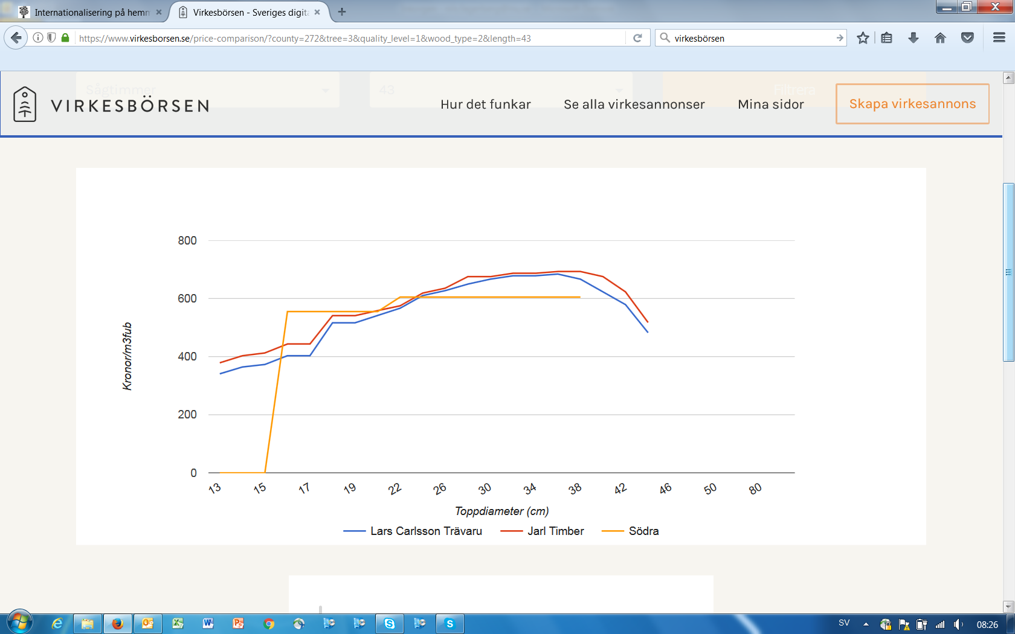
Quality 1
Sågtimmer gran, Värnamo, klass 1, 43 dm, 2017-06-02, www.virkesbörsen.se
Price
(SEK/m3 solid)
Top diameter
(cm)

Slide 31
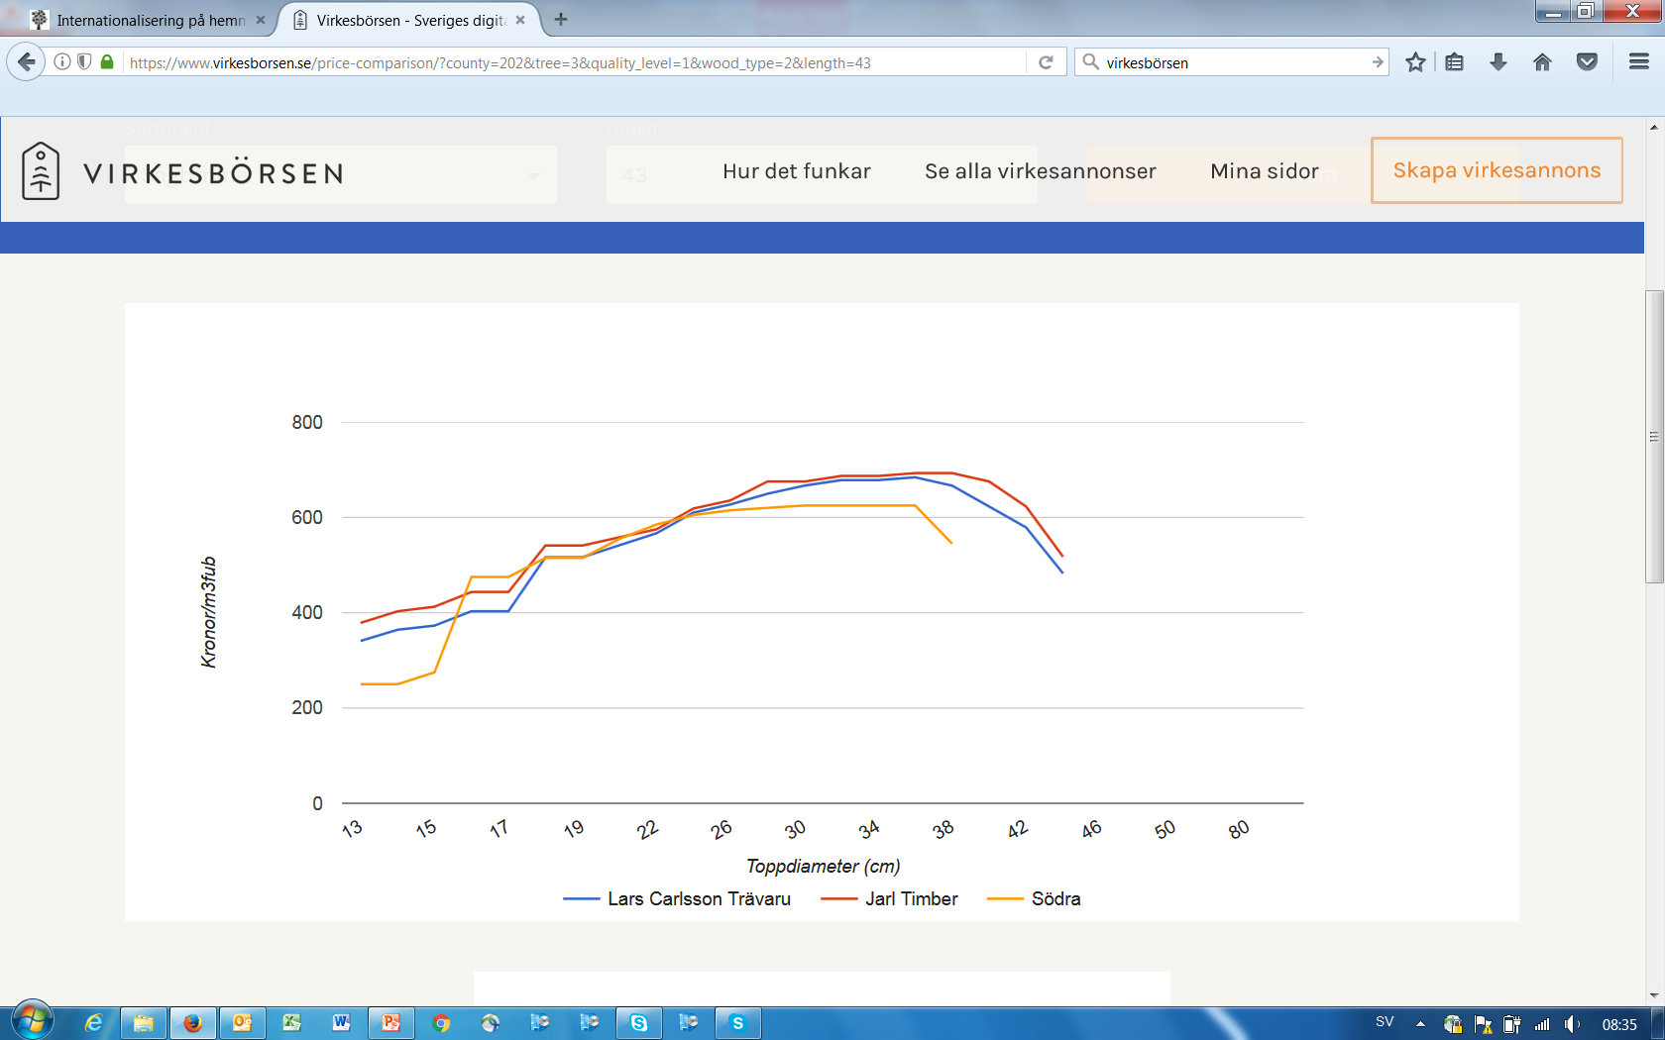
Quality 1
Sågtimmer gran, Östra Göinge, klass 1, 43 dm, 2017-06-02, www.virkesbörsen.se
Price
(SEK/m3 solid)
Top diameter
(cm)

Slide 32
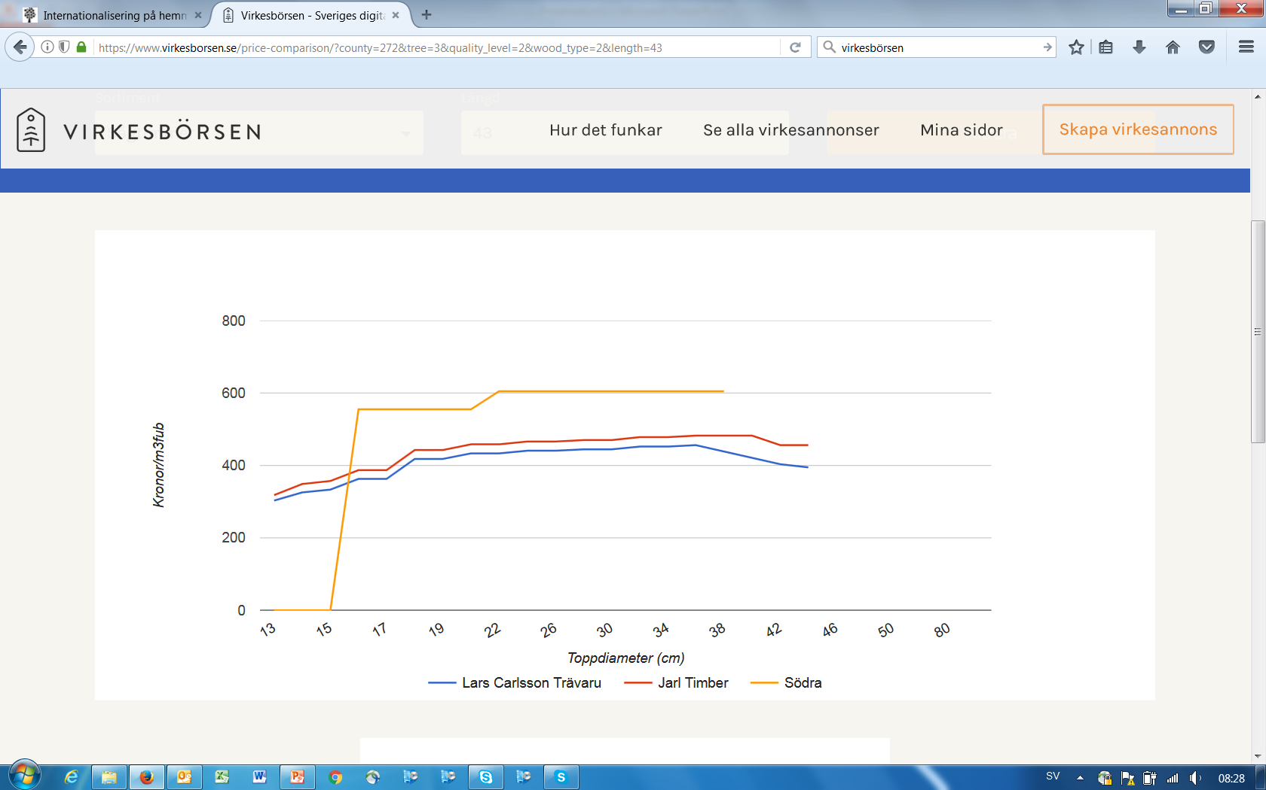
Quality 2
Sågtimmer gran, Värnamo, klass 2, 43 dm, 2017-06-02, www.virkesbörsen.se
Price
(SEK/m3 solid)
Top diameter
(cm)

Slide 33
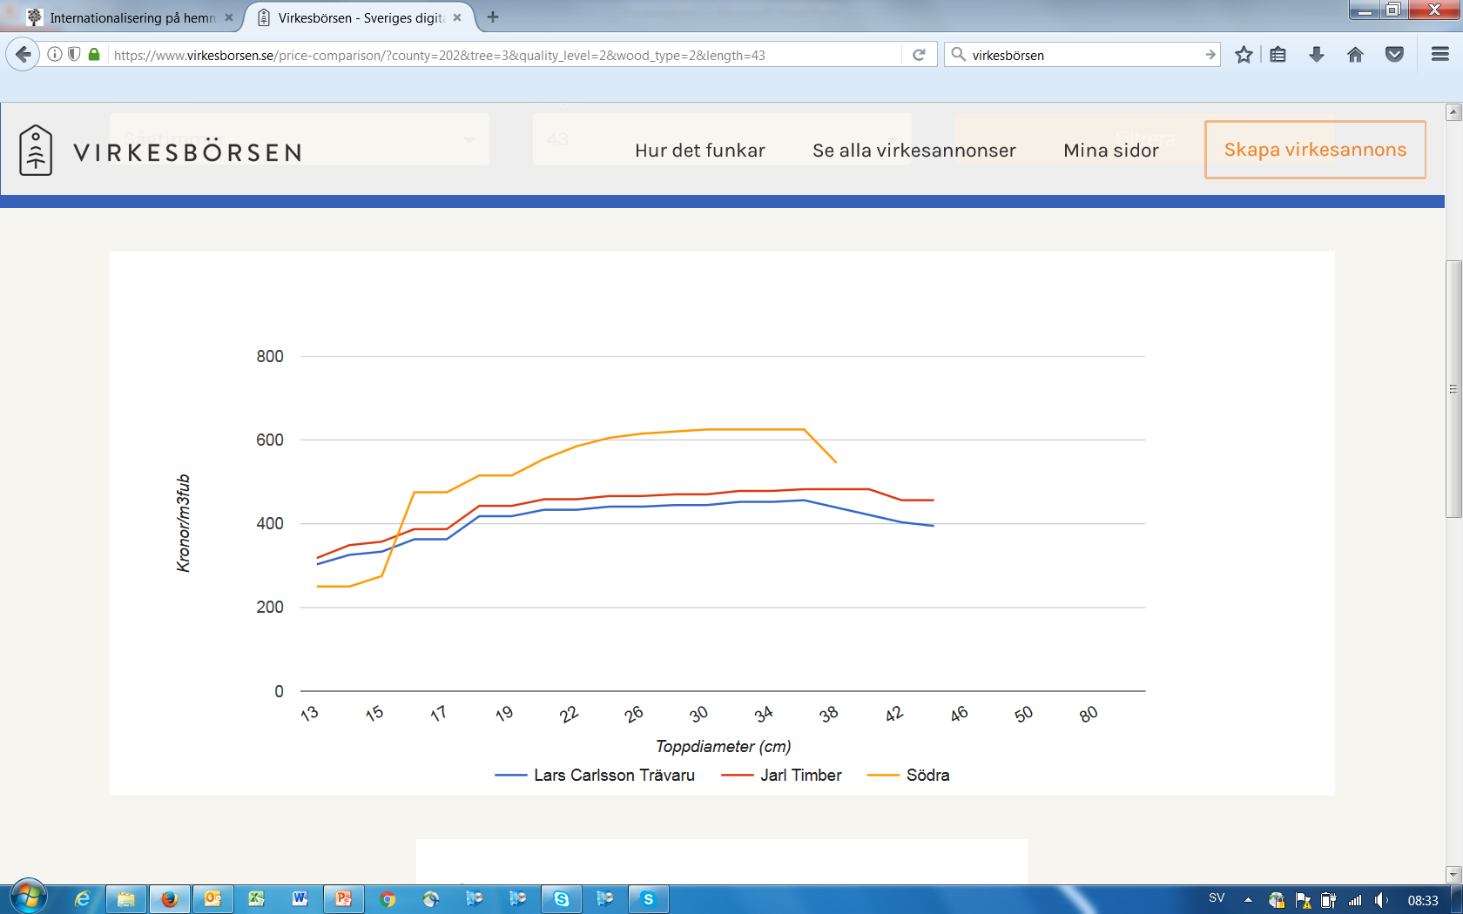
Quality 2
Sågtimmer gran, Östra Göinge, klass 2, 43 dm, 2017-06-02, www.virkesbörsen.se
Price
(SEK/m3 solid)
Top diameter
(cm)

Slide 34
The long list of results from the software has been used to estimate ”smooth function approximations” of the total expected present value function (the objective function) as a function of the control function parameters. Such approximations are found on the following pages.

Slide 35
REG SSAFR 18 170709_2253
regres 1
THE APPROXIMATION IS VERY GOOD!
Regression statistics
Multipel-R | 0,996060268
R2 | 0,992136058
Adjusted R2 | 0,989761492
Standard error of estimate | 14,5934915
Number of observations | 448
ANOVA
 | fg | KvS | MKv | F | p-value for F
Regression | 7 | 11849170,53 | 1692738,647 | 7948,24949 | 0
Residual | 441 | 93919,76743 | 212,9699942
Total | 448 | 11943090,3

Slide 36
REG SSAFR 18 170709_2253
regres 1
 | Coefficient | Standard error | t-ratio | p-value
Constant | 0
x | 92,23657812 | 1,637862818 | 56,31520363 | 1,6304E-203
xx | -15,12419474 | 0,379080306 | -39,89707323 | 1,9827E-148
xy | -3,971394886 | 0,168170542 | -23,61528261 | 2,69321E-80
yyy | 0,162419153 | 0,012052529 | 13,4759396 | 6,60883E-35
z | -10,87340641 | 2,854717482 | -3,80892557 | 0,000159361
zz | -1,247730986 | 0,598599346 | -2,084417556 | 0,037697081
xz | 1,272859441 | 0,561028884 | 2,268794845 | 0,023763276
dlim_0 = 0.1*x
dlim_p = 0.001*y
dlim_c = 0.001*z
The estimated parameter values have reliable t-values and make sence.

Slide 37
Then, via analytical derivations,
the optimal control function
parameter combination was determined.
This is found on the following pages.

Slide 38
cont opt SSAFR18 170711_2002
The expected present value
Below, we have the approximation of the objective function. The unit is "kSEK/ha". The following transformations and
rescalings have been made to avoid numerical problems:
dlim_0 = 0.1*x
dlim_p = 0.001*y
dlim_c = 0.001*z
92.237·x - 15.124·x·x - 3.9714·x·y + 0.16242·y·y·y - 10.873·z - 1.2477·z·z + 1.2729·x·z
OBS: dlim_q is assumed to be constant, at an already determined value, in this process.

Slide 39
The expected present value, , as a function
of the rescaled control function parameters:

Slide 40
First order optimum conditions:
Here, we have a nonlinear
component in the equation system.

Slide 46
We want to investigate the second order maximum conditions.
We have a three-variable quadratic form.
Note that you find y in one place!

Slide 47
Second order maximum conditions
of the three principal minors

Slide 48
Maximum condition always satisfied.

Slide 49
Maximum condition satisfied if
y<-0.53506

Slide 50
Maximum condition satisfied if
y<-0.54678

Slide 51
Maximum!

Slide 53
The optimal values of x, y and z, calculated with more decimals, are:
x = 3.661887475
y = -5.463160161
z = -2.489293673

Slide 54
If we use the calculated values of x, y and z, we get the optimal objective function value:
92.237·3.661887475 - 15.124·3.661887475·3.661887475 - 3.9714·3.661887475·(-5.463160161) + 0.16242·(-5.463160161)·(-5.463160161)·(-5.463160161) - 10.873·(-2.489293673) - 1.2477·(-2.489293673)·(-2.489293673) + 1.2729·3.661887475·(-2.489293673)
195,6554283
(kSEK/ha)
EXPECTED PRESENT VALUE MAXIMUM
Note that this is a unique maximum!

Slide 55
It is possible to get the same solution via a standard nonlinear programming software (Lingo), if we already have the correct nonlinear approximation of the expected present value function.

Slide 56
! contopt;
! Peter Lohmander 170711;
f = 92.237*x-15.124*x*x-3.9714*x*y+0.16242*y*y*y - 10.873*z -1.2477*z*z + 1.2729*x*z;
x<10;
x>1;
@free(y);
y<-1;
y>-10;
@free(z);
z<-1;
z>-10;
max = f;

Slide 57
Local optimal solution found.
Objective value: 195.6554
Infeasibilities: 0.000000
Extended solver steps: 5
Total solver iterations: 95
Elapsed runtime seconds: 0.28
Variable Value Reduced Cost
F 195.6554 0.000000
X 3.661887 0.000000
Y -5.463160 0.000000
Z -2.489294 0.000000
OBS!!! EXACTLY THE SAME VALUES VIA THIS METHOD!

Slide 58
The optimal limit diameter function:
Diameter of tree n1
Local competition
of tree n1
Real timber price (of average
timber quality) minus expected
real equilibrium price
Timber quality
of tree n1
1.0
IF d(n1) > (dlim_0 + dlim_c * c(n1) + dlim_q * qual(n1) + dlim_p * SigmaK * pdev(nums, t)) THEN h(n1) = 1
0.366
0.00600
If h(n1)=0 (default value),
then the tree should not be
instantly harvested.
If h(n1) = 1, then the tree
should be instantly harvested.
-0.00546
-0.00249
These four parameters, in the control function,
have been optimized (for real rate of interest 3%) .

Slide 59
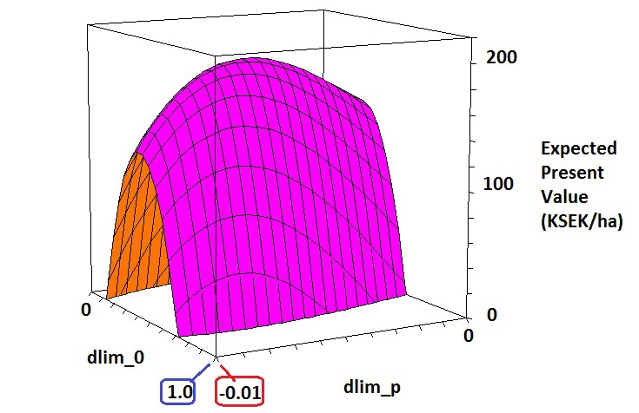
Partial objective
function surface
The expected present value as a function of the values of two parameters in the limit diameter (= adaptive harvest control) function.
(The other parameters are assumed to have the optimal values.)

Slide 60
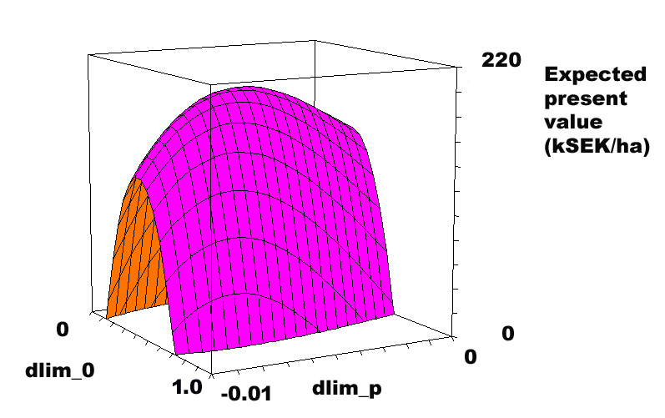
(The other parameters have optimal values.)

Slide 61
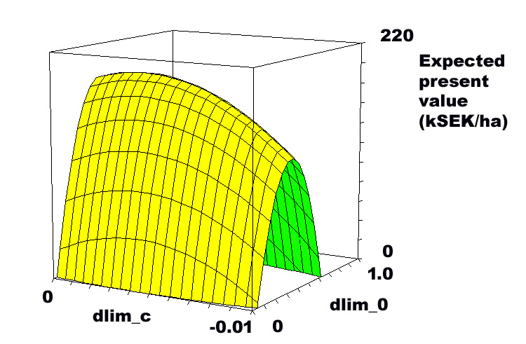
(The other parameters have optimal values.)

Slide 62
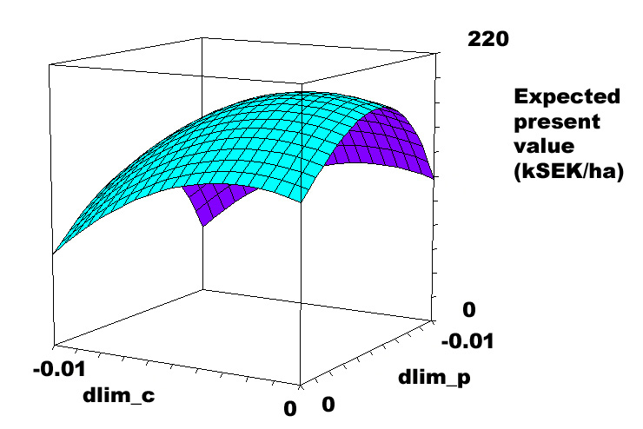
(The other parameters have optimal values.)

Slide 63
HIGH RESOLUTION ADAPTIVE OPTIMIZATION OF CONTINUOUS COVER SPRUCE FOREST MANAGEMENT IN SOUTHERN SWEDEN GENERAL CONCLUSIONS
Three general forest management conclusions can be made:
A tree should be harvested at a smaller diameter, if the local competition from other trees is high than if it is low.
A tree should be harvested at a larger diameter, if the wood quality of the tree is high than if it is low.
A tree should be harvested at a smaller diameter, if the market net price for wood is high than if it is low.

Slide 64
HIGH RESOLUTION ADAPTIVE OPTIMIZATION OF CONTINUOUS COVER SPRUCE FOREST MANAGEMENT IN SOUTHERN SWEDEN PARTICULAR CONCLUSIONS
#1:
The optimal expected present value
is 195,655 kSEK/hectare.

Slide 65
#2: The optimal limit diameter function is:
Diameter of tree n1
Local competition
of tree n1
Real timber price (of average
timber quality) minus expected
real equilibrium price
Timber quality
of tree n1
1.0
IF d(n1) > (dlim_0 + dlim_c * c(n1) + dlim_q * qual(n1) + dlim_p * SigmaK * pdev(nums, t)) THEN h(n1) = 1
0.366
0.00600
If h(n1)=0 (default value),
then the tree should not be
instantly harvested.
If h(n1) = 1, then the tree
should be instantly harvested.
-0.00546
-0.00249
These four parameters, in the control function,
have been optimized (for real rate of interest 3%) .

Slide 66
HIGH RESOLUTION ADAPTIVE OPTIMIZATION OF CONTINUOUS COVER SPRUCE FOREST MANAGEMENT IN SOUTHERN SWEDEN FUTURE OPTIONS
The growth functions are preliminary and based on a limited sample. For this reason, the particular numerical results should not be considered as final.
Future data collection from continuous cover managed stands will increase the precision and widen the scope of the growth function, covering the range of site fertility relevant in southern Sweden.
The general approach, however, can be used also with updated growth functions, derived via larger datasets.

Slide 67
THE SOFTWARE:

Slide 68
REM
REM SSAFR18.bas Large loop model including (dlim_0, dlim_c, dlim_p).
REM Peter Lohmander 170708_2200
REM Software references:
REM tutorial: https://www.youtube.com/watch?v=GjrSxMUb9F8
REM http://www.qb64.net/wiki/index.php/COLOR
DIM x(1000), y(1000), d(1000), a(1000), c(1000), dist(1000, 1000)
DIM h(1000), vol(1000), p(1000), net(1000), csmall(1000), qual(1000)
DIM pdev(100, 200), height(1000), dadt(1000)
CLS
OPEN "a_OutSSAFR18.txt" FOR OUTPUT AS #2
PRINT #2, "Results from SSAFR18.bas by Peter Lohmander 170708"
PRINT "Results from SSAFR18.bas by Peter Lohmander 170708"
PRINT #2, " r SigmaK dlim_0 dlim_c dlim_q dlim_p avHARV TotalPV"
PRINT " r SigmaK dlim_0 dlim_c dlim_q dlim_p avHARV TotalPV"
REM parameters
PI = 3.1415926536

Slide 69
dmax = 10
hacorr = 10000 / (PI * (dmax / 2) ^ 2)
formnumb = 0.5
setupc = 1000
r = 0.03
TMAX = 200
REM Harvest parameter definitions
harvt = 5
REM Generation of random market price deviations
randseed = 1
RANDOMIZE randseed

Slide 70
Numser = 10
PEQU = 503.3
SigmaP = 59.03
FOR nums = 1 TO Numser
Price_t = PEQU
pdev(nums, 0) = 0
FOR t = 1 TO 200
REM Generation of Random Number N(0,1):
epsilon = 0
FOR ii = 1 TO 12
epsilon = epsilon + RND
NEXT ii
epsilon = (epsilon - 6)
Price_t = 235.9 + 0.5313 * Price_t + SigmaP * epsilon
pdev(nums, t) = Price_t - PEQU
NEXT t
NEXT nums

Slide 71
REM Here the loop starts with alternative values of
REM some important exogenous parameters.
REM FOR r = 0.02 TO 0.041 STEP 0.01
r = 0.03
REM FOR SigmaK = 0.5 TO 1.51 STEP 0.5
SigmaK = 1
REM Here is the loop where all total system simulations are made
REM with different control function parameter values

Slide 72
FOR dlim_0 = 0.20 TO 0.51 STEP .050
FOR dlim_c = 0.0000 TO -0.0036 STEP -0.0005
REM FOR dlim_q = 0.00 TO 0.061 STEP 0.02
dlim_q = 0.0600
FOR dlim_p = -0.0070 TO 0.0001 STEP 0.001
Detail = 0
sum_Totharv = 0
sum_Totpresv = 0
FOR nums = 1 TO Numser
GOSUB Subroutine_SDOC
sum_Totharv = sum_Totharv + Totharv
sum_Totpresv = sum_Totpresv + Totpresv
NEXT nums

Slide 73
PRINT #2, USING "###.####"; r;
PRINT #2, USING "###.####"; SigmaK;
PRINT #2, USING "###.####"; dlim_0;
PRINT #2, USING "###.####"; dlim_c;
PRINT #2, USING "###.####"; dlim_q;
PRINT #2, USING "###.####"; dlim_p;
PRINT #2, USING "####.####"; sum_Totharv / 200 / Numser;
PRINT #2, USING "#######.###"; sum_Totpresv / Numser
PRINT USING "###.####"; r;
PRINT USING "###.####"; SigmaK;
PRINT USING "###.####"; dlim_0;
PRINT USING "###.####"; dlim_c;
PRINT USING "###.####"; dlim_q;
PRINT USING "###.####"; dlim_p;
PRINT USING "####.####"; sum_Totharv / 200 / Numser;
PRINT USING "#######.###"; sum_Totpresv / Numser

Slide 74
NEXT dlim_p
REM NEXT dlim_q
NEXT dlim_c
NEXT dlim_0
REM NEXT SigmaK
REM NEXT r
CLOSE #2
END
REM Here the main program ends.

Slide 75
REM Here, the subroutine starts, where all of the full system simulations are made
Subroutine_SDOC:
IF Detail = 1 THEN SCREEN _NEWIMAGE(800, 800, 256)
IF Detail = 1 THEN COLOR 30, 15
REM Initial conditions via diameter frequences
REM The following data are relevant to the Romperod forest area.
REM In Rompedod, there are 825 trees per hectare. Here, however, we
REM assume that there are 1000 trees per hectare, but with the same
REM relative frequency distribution.

Slide 76
randseed = 1
RANDOMIZE randseed
FOR N = 1 TO 1000
x(N) = 100 * RND
y(N) = 100 * RND
dialim = 0
random1 = RND
IF random1 > 0.3266 THEN dialim = 0.1
IF random1 > 0.5859 THEN dialim = 0.2
IF random1 > 0.7508 THEN dialim = 0.3
IF random1 > 0.8788 THEN dialim = 0.4
IF random1 > 0.9663 THEN dialim = 0.5
IF random1 > 0.9966 THEN dialim = 0.6
d(N) = dialim + RND * 0.1
a(N) = PI * (d(N) / 2) ^ 2
qual(N) = 0
IF RND > .3 THEN qual(N) = 1
NEXT N

Slide 77
FOR n1 = 1 TO 1000
FOR n2 = 1 TO 1000
dist(n1, n2) = ((x(n1) - x(n2)) ^ 2 + (y(n1) - y(n2)) ^ 2) ^ .5
NEXT n2
NEXT n1

Slide 78
Totharv = 0
Totpresv = 0
FOR t = 1 TO TMAX
IF Detail = 1 THEN CLS
IF Detail = 1 THEN COLOR 3: PRINT ""
IF Detail = 1 THEN COLOR 3: PRINT " t = "; t
harvper = 0
IF (INT(t / harvt) = t / harvt) THEN harvper = 1
IF harvper = 1 AND Detail = 1 THEN PRINT " This year, harvest is possible."

Slide 79
REM Calculation of competition for individual n1.
REM Only trees closer than dmax are considered.
REM
FOR n1 = 1 TO 1000
sumAT = 0
sumS = 0
FOR n2 = 1 TO 1000
IF n2 = n1 THEN GOTO 100
IF dist(n1, n2) > dmax THEN GOTO 100
sumAT = sumAT + (a(n2) / a(n1)) ^ 0.1515 * a(n2) * EXP(-dist(n1, n2) / 5.630) ^ 2
sumS = sumS + (a(n2) / a(n1)) ^ 0.1515 * a(n2) * EXP(-dist(n1, n2) / 5.630) ^ 2
100 NEXT n2
c(n1) = 83.16 * sumAT ^ 1.1768 + 55.96 * sumS ^ 1.1768
NEXT n1

Slide 80
REM Harvest decisions
IF harvper = 0 THEN GOTO 200
FOR n1 = 1 TO 1000
h(n1) = 0
IF d(n1) > (dlim_0 + dlim_c * c(n1) + dlim_q * qual(n1) + dlim_p * SigmaK * pdev(nums, t)) THEN h(n1) = 1
NEXT n1

Slide 81
REM Harvest volumes and values etc
Hvolume = 0
Hnet = 0
Hpresv = 0
FOR n1 = 1 TO 1000
IF h(n1) = 0 THEN GOTO 500
diam_mm = d(n1) * 1000
IF diam_mm > 674 THEN diam_mm = 674
hojd_dm = 13 + 1.4743 * diam_mm - 0.037864 * diam_mm ^ 1.5
height(n1) = hojd_dm / 10
vol(n1) = (PI * (d(n1) / 2) ^ 2) * height(n1) * formnumb
Hvolume = Hvolume + vol(n1)

Slide 82
p(n1) = (PEQU + SigmaK * pdev(nums, t) + 150 * (qual(n1) - 0.5) + 2 * (d(n1) - 40)) * (0.8 * 1.0 + 0.2 * 0.6) - 206
net(n1) = p(n1) * vol(n1)
Hnet = Hnet + net(n1)
500 REM
NEXT n1
Totharv = Totharv + Hvolume
Hpresv = EXP(-r * t) * (-setupc + Hnet)
Totpresv = Totpresv + Hpresv

Slide 83
IF Detail = 1 THEN PRINT " Harvest volume this year = "; Hvolume;
IF Detail = 1 THEN PRINT " Present value of activitites this year = "; Hpresv
IF Detail = 1 THEN PRINT " Total harvest volume= "; Totharv;
IF Detail = 1 THEN PRINT " Total present value = "; Totpresv
REM Consequences after harvesting:
REM In case n1 has been harvested, the individual n1
REM is removed and a individual with random coordinates
REM appears in the list with small size
FOR n1 = 1 TO 1000
IF h(n1) = 0 THEN GOTO 300
x(n1) = 100 * RND
y(n1) = 100 * RND
d(n1) = 0.1 * RND
a(n1) = PI * (d(n1) / 2) ^ 2
qual(n1) = 0
IF RND > .5 THEN qual(n1) = 1
300 REM
NEXT n1

Slide 84
REM Calculation of new distances between n1 and n2
REM in case at least one of them has been harvested.
FOR n1 = 1 TO 1000
FOR n2 = 1 TO 1000
newdist = h(n1) + h(n2)
IF newdist < 1 THEN GOTO 400
dist(n1, n2) = ((x(n1) - x(n2)) ^ 2 + (y(n1) - y(n2)) ^ 2) ^ .5
400 REM
NEXT n2
NEXT n1

Slide 85
200 REM
REM Calculation of growth of all individuals n.
REM first, the basal area increment dadt(n) (m2/year), is calculated.
REM Then, the basal area after growth, a(n) (m2) is calculated.
REM Finally, the diameter after growth, d(n) (m), is calculated.
FOR N = 1 TO 1000
dadt(N) = (88.50 + 73.03) / 2 * a(N) ^ 0.5 + (-154.71 - 85.33) / 2 * a(N) ^ 1.5
dadt(N) = dadt(N) - c(N) * a(N) ^ 0.5
dadt(N) = dadt(N) / 10000
IF dadt(N) < 0 THEN dadt(N) = 0
a(N) = a(N) + dadt(N)
d(N) = (4 * a(N) / PI) ^ 0.5
NEXT N

Slide 86
IF Detail = 0 THEN GOTO 600
FOR N = 1 TO 1000
CIRCLE (INT(6 * x(N) + 100), INT(6 * y(N) + 100)), INT(100 * d(N) / 5), 0
NEXT N
LINE (100, 100)-(700, 100), 3
LINE (100, 100)-(100, 700), 3
LINE (700, 100)-(700, 700), 3
LINE (100, 700)-(700, 700), 3
SLEEP
600 REM
NEXT t
RETURN

Slide 87
Results from SSAFR18.bas by Peter Lohmander 170708
r SigmaK dlim_0 dlim_c dlim_q dlim_p avHARV TotalPV
0.0300 1.0000 0.2000 0.0000 0.0600 -0.0070 9.2169 168574.641
0.0300 1.0000 0.2000 0.0000 0.0600 -0.0060 9.1339 164125.391
0.0300 1.0000 0.2000 0.0000 0.0600 -0.0050 9.4153 171340.875
0.0300 1.0000 0.2000 0.0000 0.0600 -0.0040 9.4504 165719.969
0.0300 1.0000 0.2000 0.0000 0.0600 -0.0030 9.7598 166267.719
0.0300 1.0000 0.2000 0.0000 0.0600 -0.0020 10.3343 163299.469
0.0300 1.0000 0.2000 0.0000 0.0600 -0.0010 11.7373 161918.297
0.0300 1.0000 0.2000 0.0000 0.0600 0.0000 13.0930 146660.469
(This is just the start of the very long list …)

