Slide 1
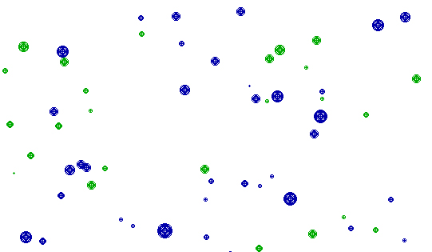

Optimization of Multi Species Continuous Cover Forest Management with Stochastic Prices via Determination of the Adaptive Harvest Control Function
Peter Lohmander
Prof.Dr. Optimal Solutions in cooperation with Linnaeus University
Peter@Lohmander.com , www.Lohmander.com
18th Symposium on Systems Analysis in Forest Resources,
SSAFR 2019
March 3 - 7, 2019 Puerto Varas, Chile Version 2019_02_14_0001

Slide 2
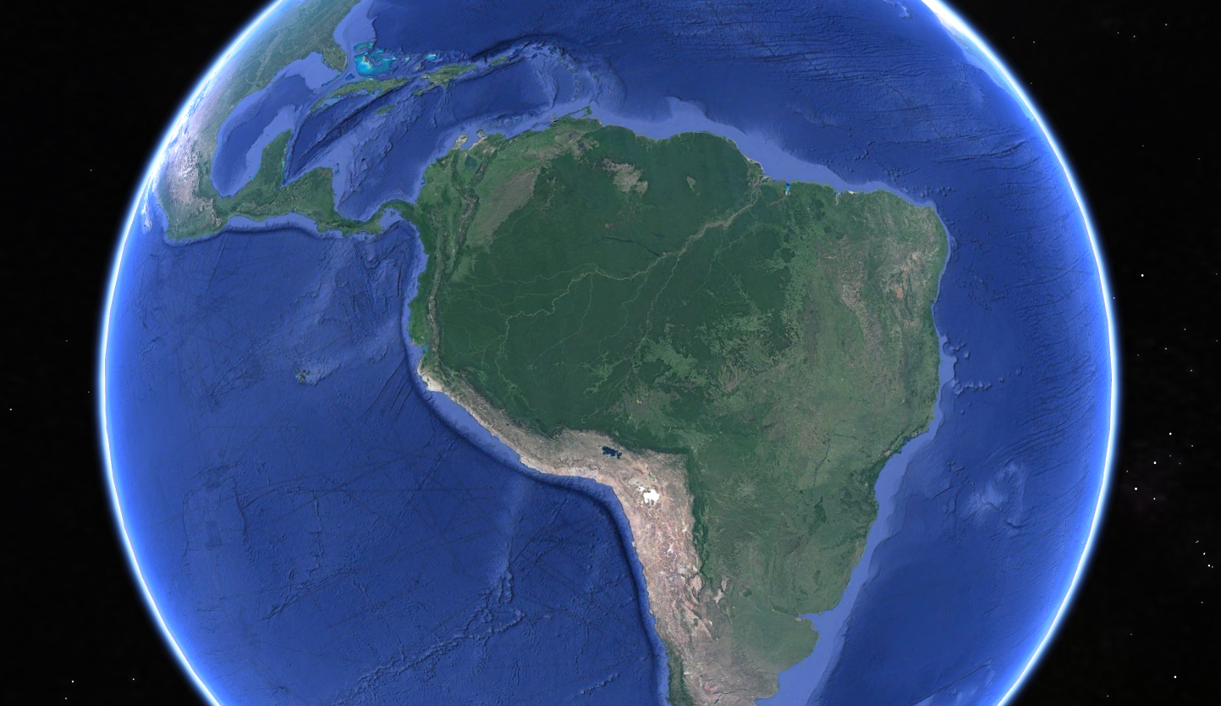
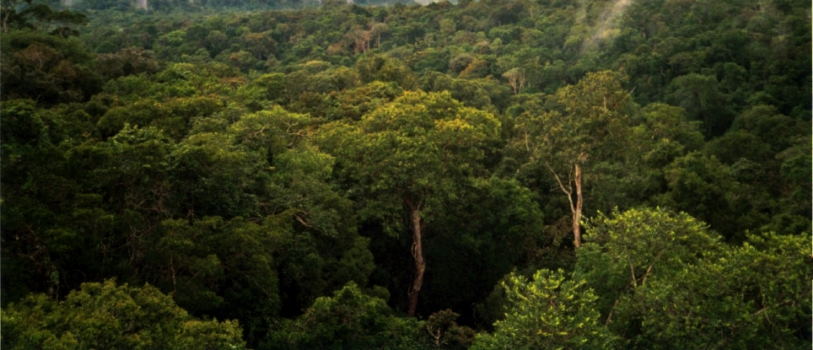
Our world contains very large areas of mixed species forests with trees of different sizes.
By Phil P Harris. - Own work, CC BY-SA 2.5, https://commons.wikimedia.org/w/index.php?curid=717267

Slide 3


Slide 4
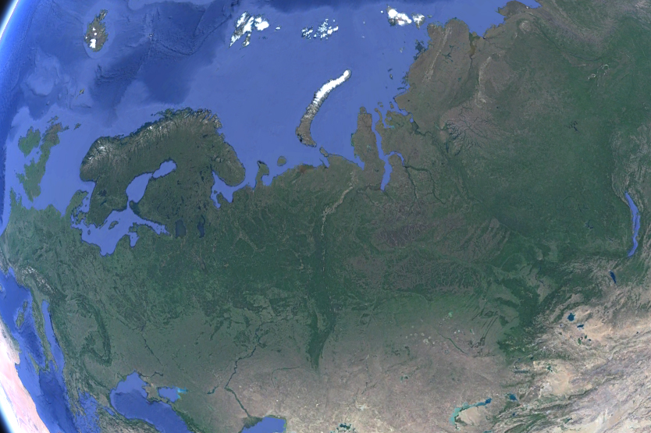
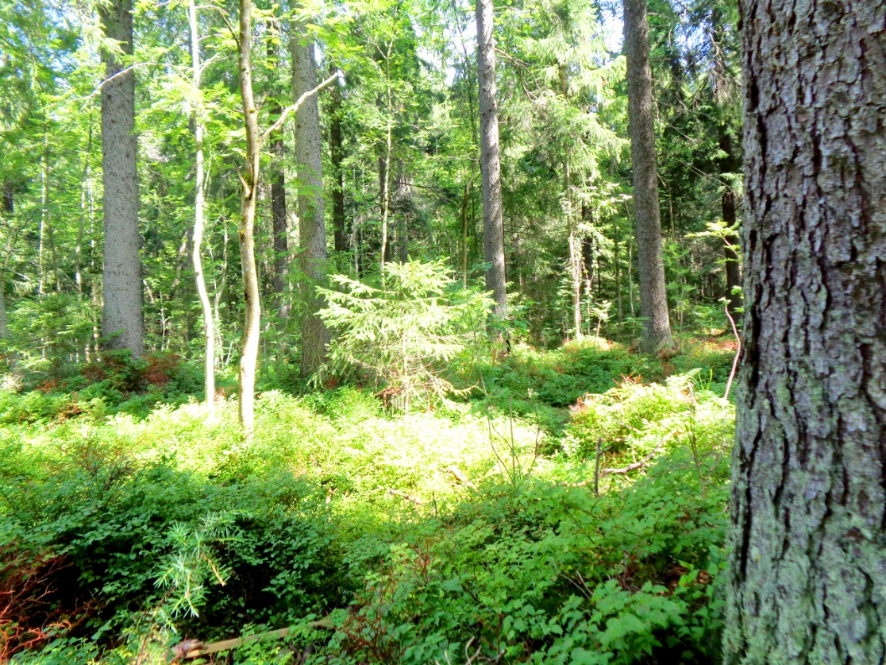

Slide 5
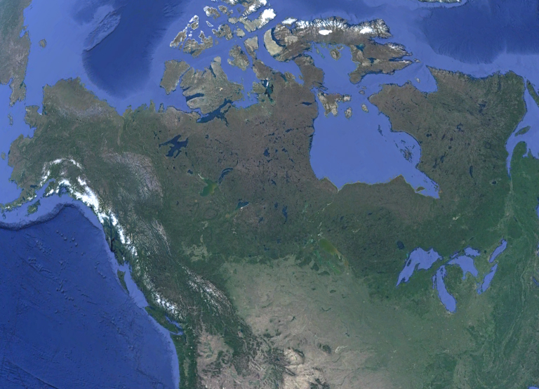

Slide 6
These forests are important to several industries and to the environment.
The prices for wood from different species of trees are stochastic.
This paper presents a new adaptive method for sustainable and economically optimal management of these forests.

Slide 7
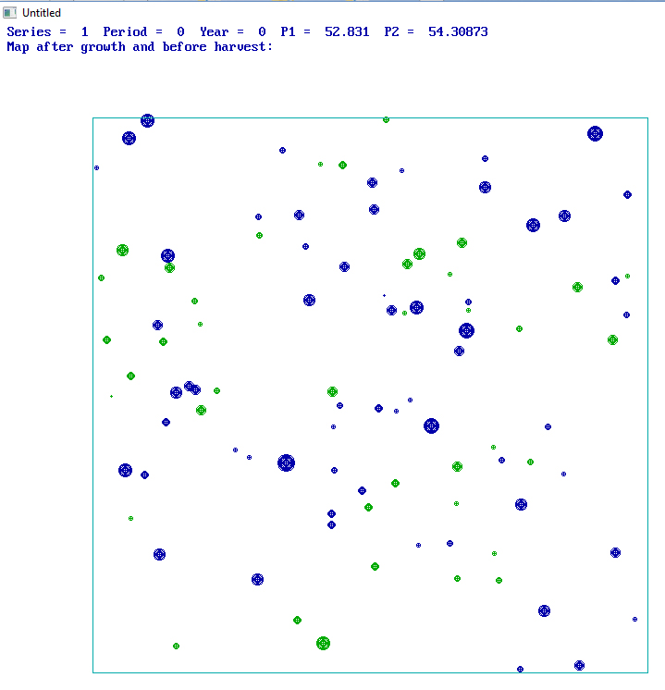
Example of a multi species continuous cover forest:
Different species have different
colors (blue and green).
Trees have different sizes.

Slide 8
In principle, this problem could be correctly solved via stochastic dynamic programming, SDP.
However, SDP can not in reasonable time handle the extremely large number of state dimensions.
The method used here includes optimization of adaptive control function parameters via repeated full system stochastic simulations, objective function approximation and analytical parameter optimization.

Slide 9
A computer model was constructed for this purpose.
The expected present value of a mixed species continuous cover forest is maximized with consideration of correlated stochastic roundwood market prices, dynamically changing tree sizes and local competition.

Slide 10
Method references:
Optimization of adaptive control function parameters via repeated full system stochastic simulations, objective function approximation and analytical parameter optimization
Lohmander, P., Two Approaches to Optimal Adaptive Control under Large Dimensionality, INTERNATIONAL ROBOTICS AND AUTOMATION JOURNAL, Volume 3, Issue 4, 2017, DOI:10.15406/iratj.2017.03.00062
http://medcraveonline.com/IRATJ/IRATJ-03-00062.php
http://www.Lohmander.com/PL_171204a.pdf
http://www.Lohmander.com/PL_171204aORIG.pdf
http://www.Lohmander.com/PL_171204aORIG.docx
Lohmander, P., Optimal Stochastic Dynamic Control of Spatially Distributed Interdependent Production Units. In: Cao BY. (ed) Fuzzy Information and Engineering and Decision. IWDS 2016.
Advances in Intelligent Systems and Computing, vol 646. Springer, Cham, 2018
Print ISBN 978-3-319-66513-9, Online ISBN 978-3-319-66514-6, eBook Package: Engineering, LOSDCSDI
https://doi.org/10.1007/978-3-319-66514-6_13

Slide 11
The initial conditions:
A forest with spatially distributed trees of different species, initial diameters and spatial coordinates.

Slide 12

Softwood trees are
affected by
local competition
from other softwood
trees.

Slide 13
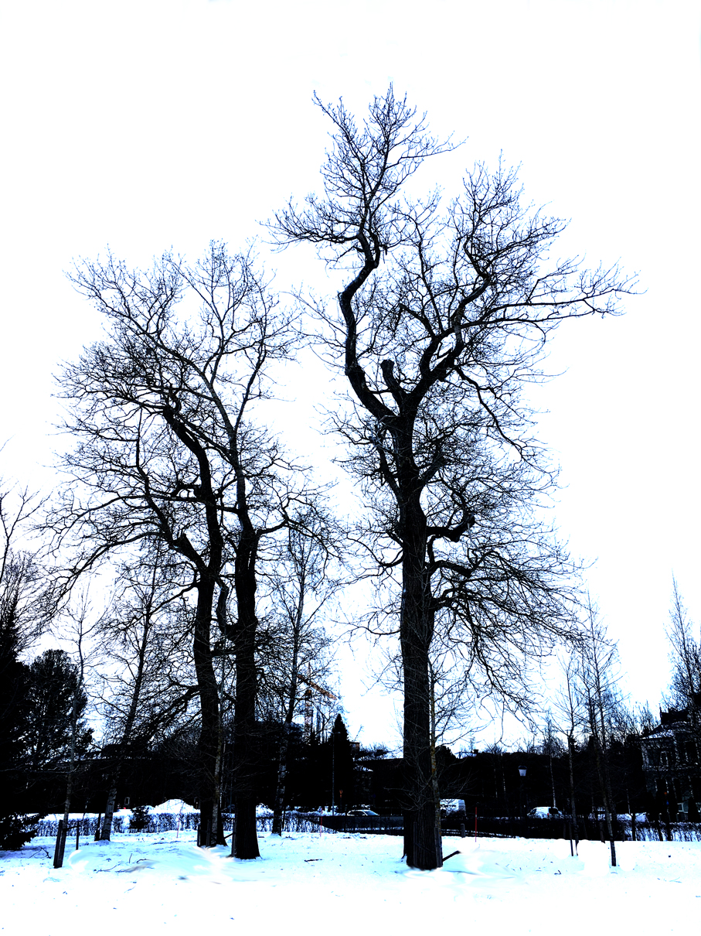
Hardwood trees are
affected by
local competition
from other hardwood
trees.

Slide 14

Trees are
affected by
local competition
from other trees
of different species.

Slide 15
A complete numerical forest model has been developed with individual tree growth functions that are sensitive to local competition from neighbour trees.
References to related papers on tree growth functions:
Lohmander, P., A General Dynamic Function for the Basal Area
of Individual Trees Derived from a Production Theoretically
Motivated Autonomous Differential Equation,
Iranian Journal of Management Studies (IJMS), Vol. 10, No. 4,
Autumn 2017, pp. 917-928,
https://ijms.ut.ac.ir/article_64225_61b32fe374f9df8bca512abbe3b5c379.pdf
https://ijms.ut.ac.ir/article_64225.html
http://www.Lohmander.com/PL_IJMS_2017.pdf
Hatami, N., Lohmander, P., Moayeri, M.H., Mohammadi Limaei, S.,
A basal area increment model for individual trees
in mixed continuous cover forests in Iranian Caspian forests,
Journal of Forestry Research, 2018. pp 1-8. Springer Link.
HLMM
https://doi.org/10.1007/s11676-018-0862-8
https://link.springer.com/article/10.1007%2Fs11676-018-0862-8
Link for reading
Mohammadi, Z., Mohammadi Limaei, S., Lohmander, P., Olsson, L.,
Estimation of a basal area growth model for individual trees
in uneven-aged Caspian mixed species forests,
JOURNAL OF FORESTRY RESEARCH, November 30, 2017
DOI: https://doi.org/10.1007/s11676-017-0556-7
https://link.springer.com/article/10.1007%2Fs11676-017-0556-7
http://www.Lohmander.com/PL_171204f.pdf

Slide 16
References to related papers on tree growth functions (continued):
Mohammadi Limaei, S., Lohmander, P., Olsson, L.,
Dynamic growth models for continuous cover multi-species forestry
in Iranian Caspian forests,
JOURNAL OF FOREST SCIENCE, 63, 2017 (11): 519-529,
doi: 10.17221/32/2017-JFS
http://www.agriculturejournals.cz/publicFiles/232535.pdf
http://www.Lohmander.com/PL_171204d.pdf
Lohmander, P., Optimal Stochastic Dynamic Control of Spatially Distributed Interdependent
Production Units. In: Cao BY. (ed) Fuzzy Information and Engineering and Decision. IWDS 2016.
Advances in Intelligent Systems and Computing, vol 646. Springer, Cham, 2018
Print ISBN 978-3-319-66513-9, Online ISBN 978-3-319-66514-6, eBook Package: Engineering,
LOSDCSDI
https://doi.org/10.1007/978-3-319-66514-6_13
Lohmander, P., Olsson, J.O., Fagerberg, N., Bergh, J., Adamopoulos, S.,
High resolution adaptive optimization of continuous cover
spruce forest management in southern Sweden,
SSAFR 2017, Symposium on Systems Analysis in Forest Resources,
Clearwater Resort, Suquamish, Washington, (near Seattle), August 27-30, 2017
http://www.Lohmander.com/SSAFR_2017_Lohmander_et_al.pptx
http://www.Lohmander.com/SSAFR_2017_Lohmander_et_al.pdf
http://www.Lohmander.com/SSAFR_2017_Lohmander_Soft.txt
SSAFR 2017

Slide 17
Every five year period, a harvesting team visits the forest.
Optimal adaptive harvest decisions are taken, based on the prices of the different species, the local competition conditions in the forest, harvest cost and revenue functions and interest rate in the capital market.

Slide 18
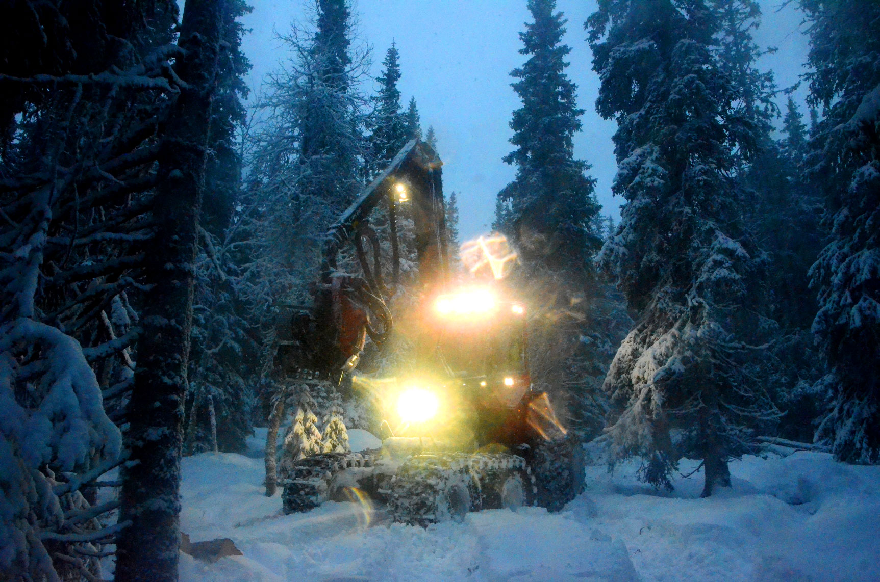
Continuous
cover
forest
harvesting
in the
Swedish
mountains,
December
2014

Slide 19
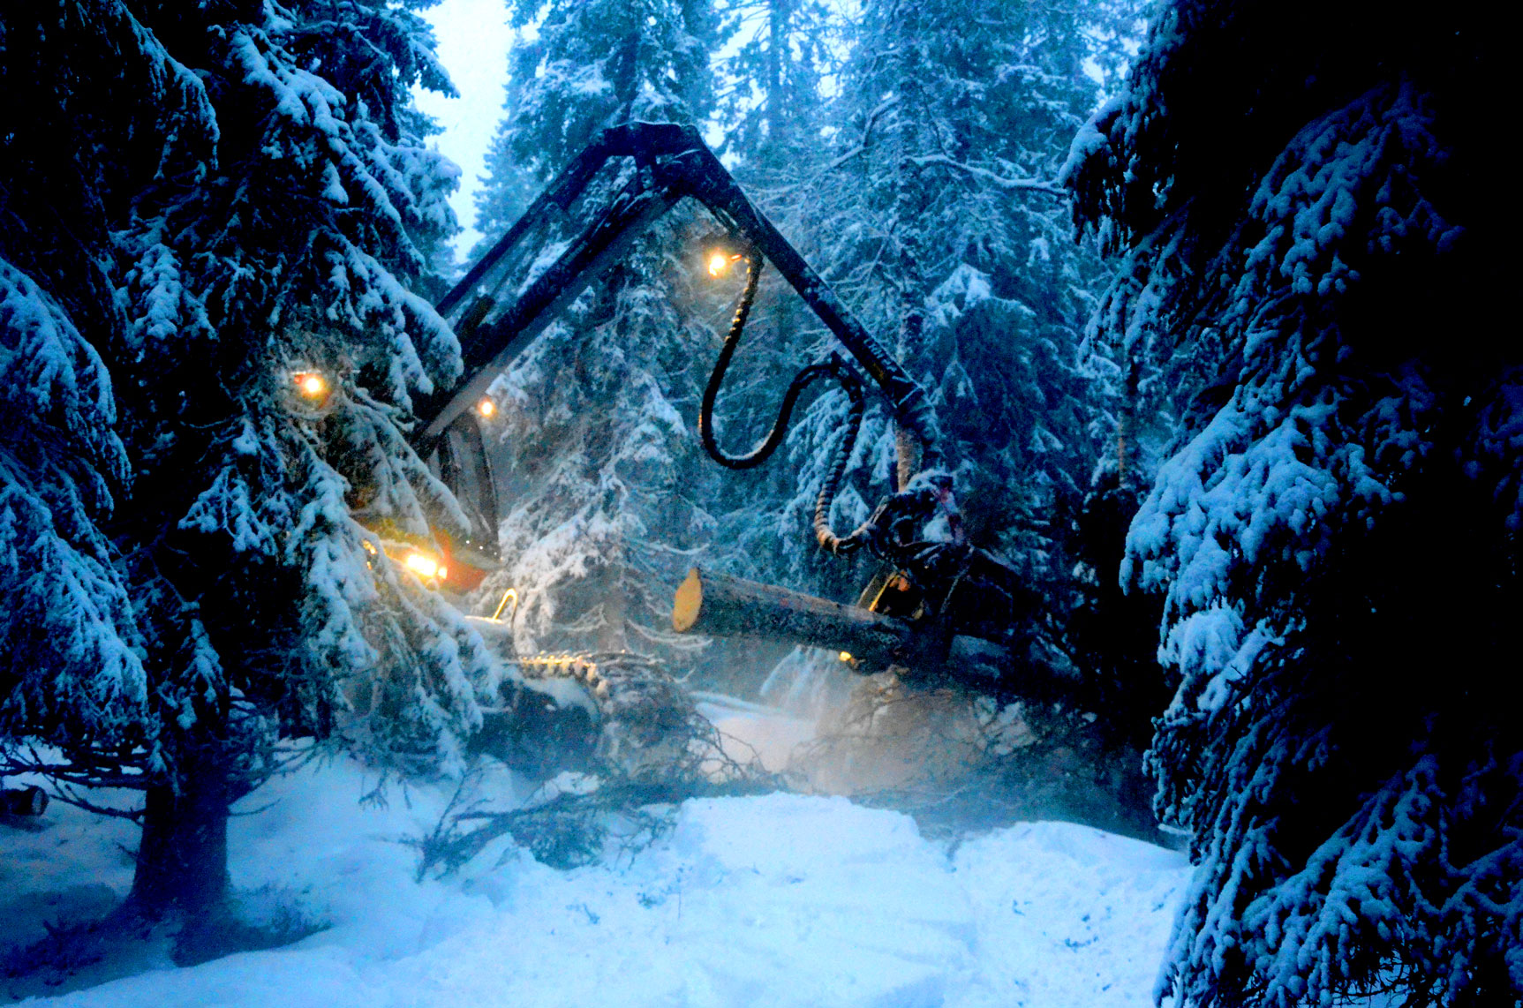

Slide 20
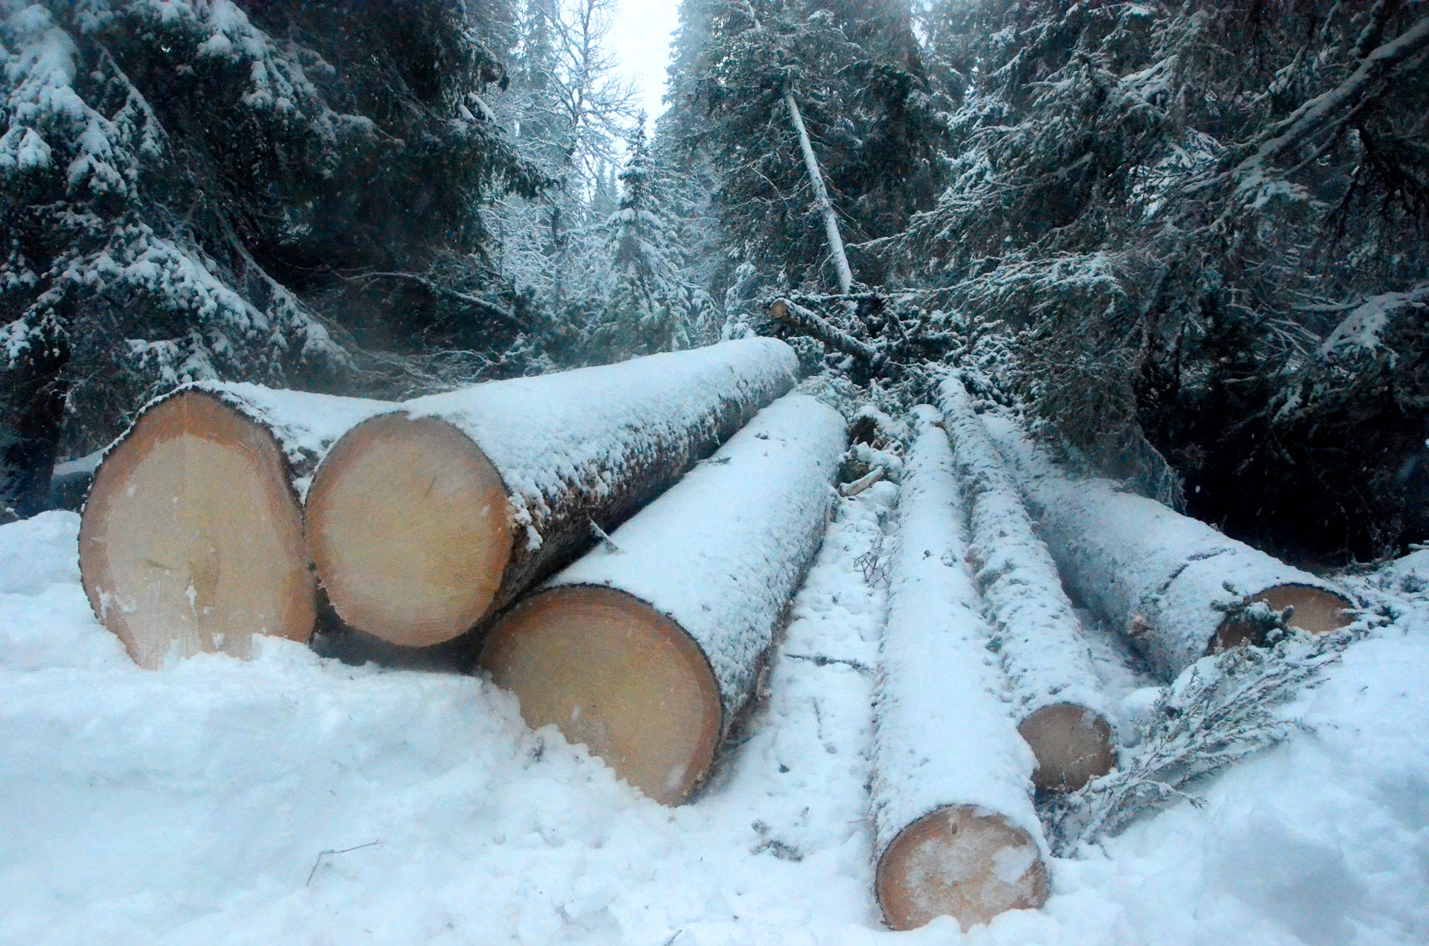

Slide 21
The optimal adaptive control of the system works this way:
A limit diameter function value, DL, is calculated.
The value of the DL is derived for each tree, in every period. If the diameter of the tree exceeds the DL, then the tree is instantly harvested.
Otherwise, the tree is left to continue to grow at least one more period.
The parameters of the DL are optimized via a large number of stochastic full system simulations, expected objective function approximation and analytical control function parameter optimization.

Slide 22
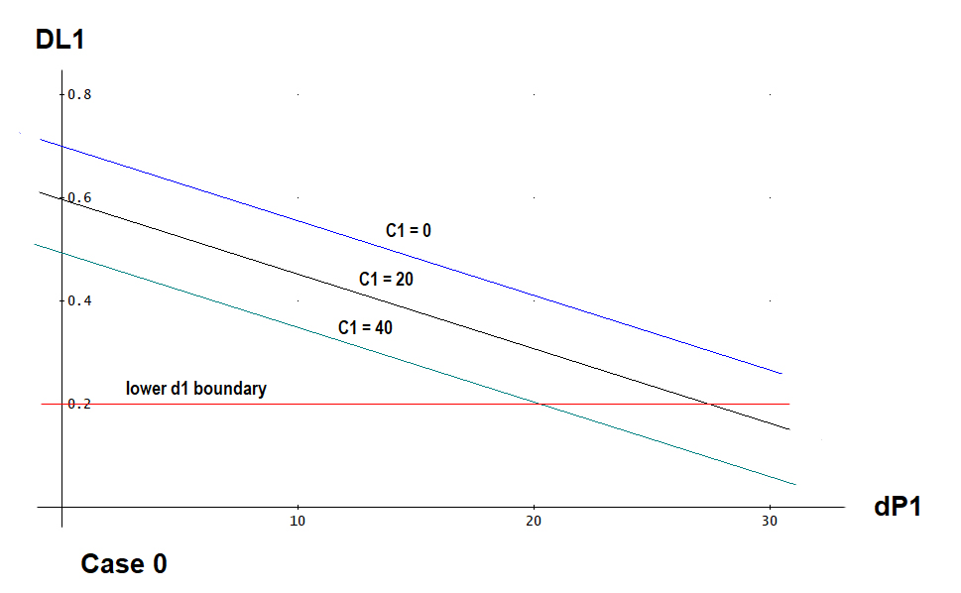
= Optimal Limit Diameter of Species 1
Optimal
Control
Boundaries
as
functions of
the local
competition
levels
Instant Harvest
Region
Wait Longer
Region
Deviation of the price of species 1 from the expected price level

Slide 23
Example with particular parameters and particular stochastic price developments

Slide 24
Period = 0
Year = 0
P1 = 52.831
P2 = 54.309
Map after growth
and before harvest

Slide 25
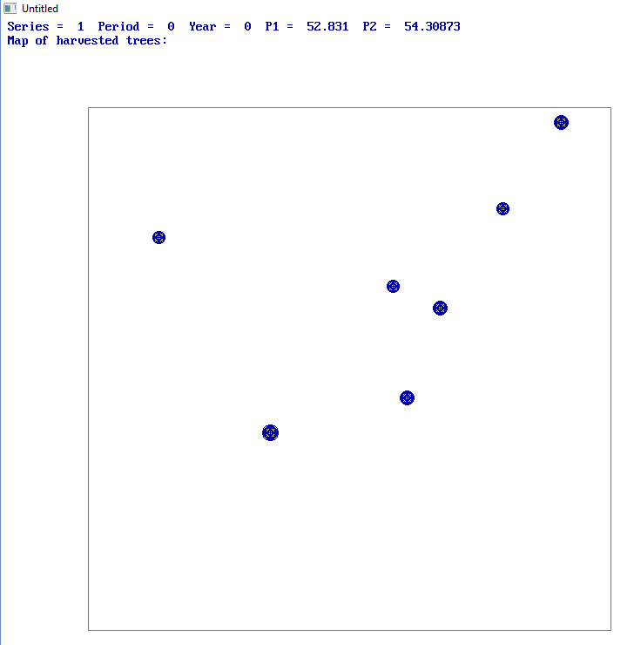
Period = 0
Year = 0
P1 = 52.831
P2 = 54.309
Map of harvested
trees

Slide 26
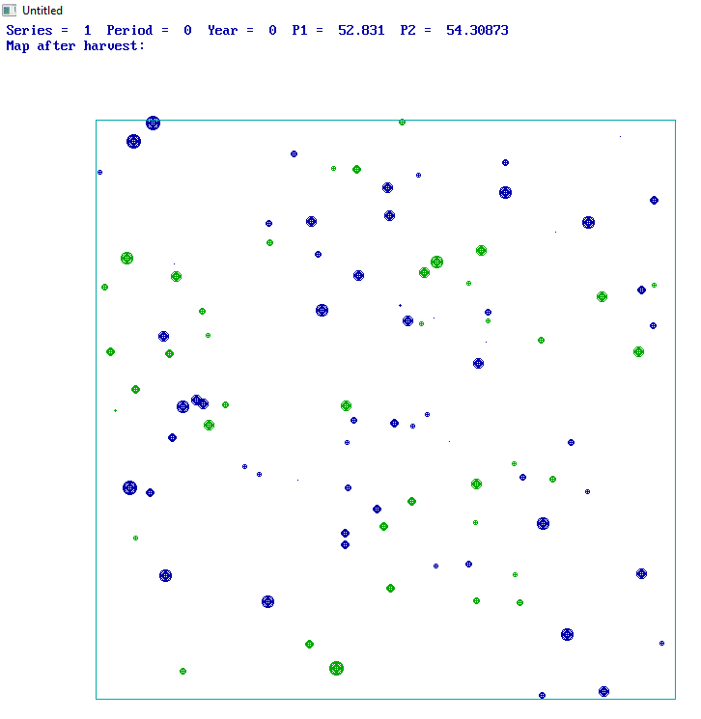
Period = 0
Year = 0
P1 = 52.831
P2 = 54.309
Map after
harvest

Slide 27
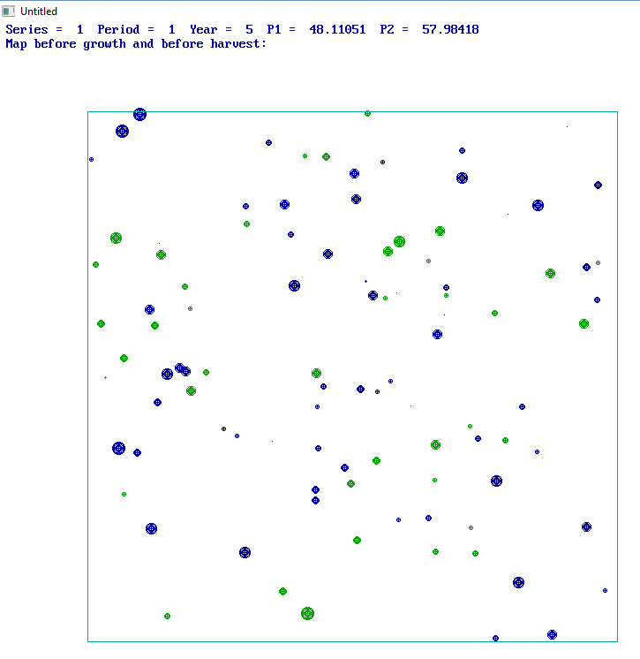
Period = 1
Year = 5
P1 = 48.111
P2 = 57.984
Map before growth
and before harvest

Slide 28
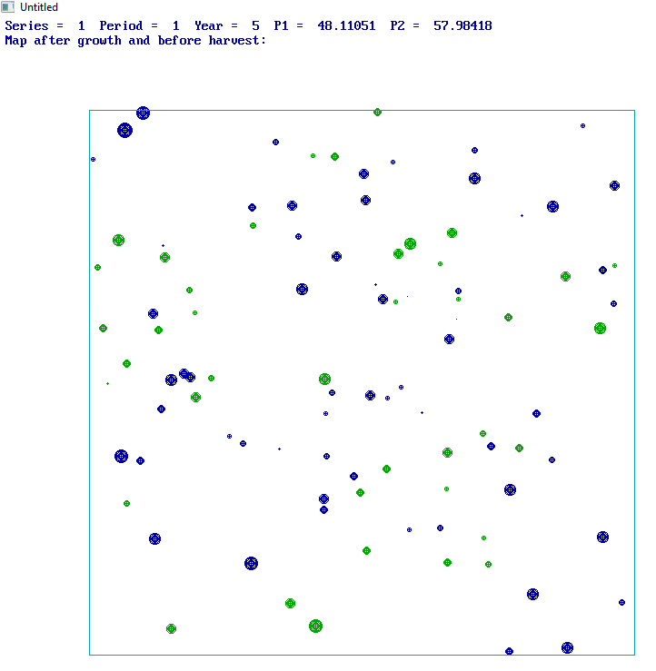
Period = 1
Year = 5
P1 = 48.111
P2 = 57.984
Map after growth
and before harvest

Slide 29
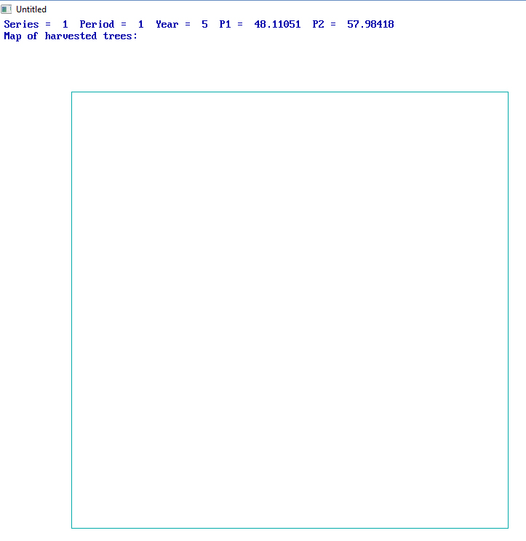
Period = 1
Year = 5
P1 = 48.111
P2 = 57.984
Map of
harvested trees

Slide 30
Then, some periods follow
with low prices of both species.
Trees grow and no harvest takes place.
Then, we reach period 6.

Slide 31
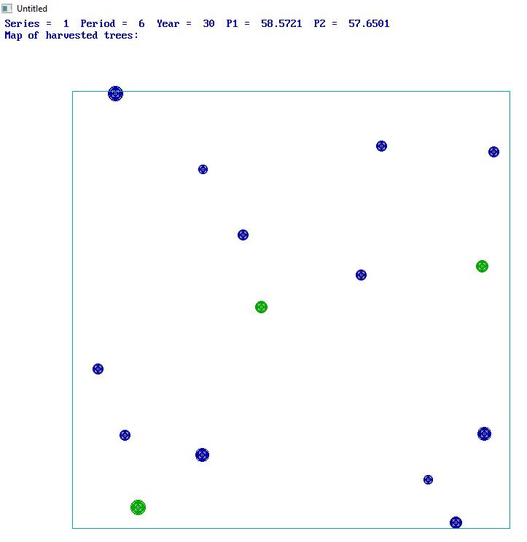
Period = 6
Year = 30
P1 = 58.572
P2 = 57.650
Map of
harvested trees

Slide 32
The stochastic simulation model

Slide 33
Below, the structure of the software is described.
(The complete software contains many more details.)
SOFTWARE: AdMultRnd1_EQDIST.bas
Peter Lohmander 190107
"AdmultRndIn.txt" (= INPUT file)
"AdMultRndOut.txt" (= OUTPUT file)
If needed, maps may be produced.

Slide 34
SECTION A.
The initial conditions of relevance to all calculations are determined.
Generation of 100 market prices series for two species with correlation pcorr.
Generation of the positions
Generation of the species
Calculation of the distances
Generation of initial diameters

Slide 35
SECTION B. The control function parameter loops start here.
EPVmax = 0
RANDOMIZE seed2
FOR SIMN = 1 TO TOTSIMN
Ds = Dsstart + RND * (Dsstop - Dsstart)
D0 = D0start + RND * (D0stop - D0start)
Dp1 = Dpstart + RND * (Dpstop - Dpstart)
Dp2 = Dpstart + RND * (Dpstop - Dpstart)
Dc1 = Dcstart + RND * (Dcstop - Dcstart)
Dc2 = Dcstart + RND * (Dcstop - Dcstart)
Uniform
probability
density
of
control
function
parameters
in six
dimensional
space

Slide 36
SECTION C. A number of loops of stochastic simulations start here.
FOR series = 1 TO 100
FOR i = 1 TO 100
d(i) = d0(i)
NEXT I
FOR T = 0 TO 60
A new series of stochastic prices is selected.
The same initial forest conditions
are used for every price series.
A stochastic 300 year simulation starts here.

Slide 37
Here, the local competition (In this case expressed as
”competing basal area per hectare” within a circle with radius 5 meters)
is calculated for every tree.
Comp(i) = 0
FOR j = 1 TO 100
IF dist(i, j) < 5 THEN Comp(i) = Comp(i) + PI / 4 * d(j) * d(j)
NEXT j
CompBA(i) = 127.32 * Comp(i)
growth occurs

Slide 38
Harvests of individual trees may or may not occur
The harvest decision of tree i is set to zero. Then the limit diameter is calculated.
In case the tree diameter exceeds the limit diameter, the harvest decision is set to one.
In case the tree diameter is below the minimum diameter, harvest is set to zero.
harv(i) = 0
Dlim = D0 + Dp * (Price - meanprice) / stdev(speci) + Ds * (speci - 1) + Dc * CompBA(i)
IF d(i) > Dlim THEN harv(i) = 1
IF d(i) < dmin(speci) THEN harv(i) = 0
The limit diameter
harvest control function

Slide 39
The revenues and costs of the harvested trees are calculated.
The discounted net revenue of all harvested trees is
added to the present value of the series.
NEXT T
NEXT series
End of SECTION C.

Slide 40
SECTION D.
Results for each control function parameter combination are calculated and printed.
End of SECTION D.
NEXT SIMN

Slide 41
.03
0.5
50
50
15
15
40
40
0.2
0.2
0.70
0.70
0.0
-0.30
-0.0
0.02
-0.010
0.0
0.0
0
0
0.02
300
1
INPUT #2, r
INPUT #2, pcorr
INPUT #2, EP(1)
INPUT #2, EP(2)
INPUT #2, stdev(1)
INPUT #2, stdev(2)
INPUT #2, kheight(1)
INPUT #2, kheight(2)
INPUT #2, dmin(1)
INPUT #2, dmin(2)
INPUT #2, D0start
INPUT #2, D0stop
INPUT #2, D0step
INPUT #2, Dpstart
INPUT #2, Dpstop
INPUT #2, Dpstep
INPUT #2, Dcstart
INPUT #2, Dcstop
INPUT #2, Dcstep
INPUT #2, Dsstart
INPUT #2, Dsstop
INPUT #2, Dsstep
INPUT #2, TOTSIMN
INPUT #2, seed2
EXAMPLE
Input file
(CASE 0)
AdMultRndIn.txt
Input section
In the software

Slide 42
EXAMPLE AdMultRndOut.txt
Output file
(CASE 0)
Program AdMultRnd_EQDIST by Peter Lohmander 2019:
Parameters from external file:
r = .03 pcorr = .5 EP(1) = 50 EP(2) = 50
stdev(1) = 15 stdev(2) = 15 kheight(1) = 40 kheight(2) = 40
dmin(1) = .2 dmin(2) = .2
D0start = .7 D0stop = .7 D0step = 0
Dpstart = -.3 Dpstop = 0 Dpstep = .02
Dcstart = -.01 Dcstop = 0 Dcstep = 0
Dsstart = 0 Dsstop = 0 Dsstep = .02
TOTSIMN = 300
seed2 = 1

Slide 43
The output from the simulation
model is the input file to the
regression software.
(Variable transformations
will be made within Excel.)
Program AdMultRnd_EQDIST by Peter Lohmander 2019:
Parameters from external file:
r = .03 pcorr = .5 EP(1) = 50 EP(2) = 50
stdev(1) = 15 stdev(2) = 15 kheight(1) = 40 kheight(2) = 40
dmin(1) = .2 dmin(2) = .2
D0start = .7 D0stop = .7 D0step = 0
Dpstart = -.3 Dpstop = 0 Dpstep = .02
Dcstart = -.01 Dcstop = 0 Dcstep = 0
Dsstart = 0 Dsstop = 0 Dsstep = .02
TOTSIMN = 300
seed2 = 1
D0 Dp1 Dp2 Dc1 Dc2 Ds r EPV
700 -149 -113 -90 -40 0 30 5546176
700 -54 -133 -95 -59 0 30 5419922
700 -1 -49 -87 -74 0 30 5177052
700 -74 -139 -49 -45 0 30 5824453
700 -30 -5 -12 -81 0 30 1807685
Many more rows follow…

Slide 44
Determination of the approximation of the expected present value as a multivariate polynomial of the control function parameters

Slide 45
The expected present value as a quadratic function
of the parameters in the DL function (Case 0)

Slide 46
Objective function
First
order
optimum
conditions

Slide 47
First order
optimum conditions
of species 1 = ”Blue”
Separability
First order
optimum conditions
of species 2 = ”Green”

Slide 48
First order optimum conditions
Second order maximum conditions
1 =
Blue
2 =
Green

Slide 49
1 =
Blue
1 =
Blue

Slide 50
The optimal parameter value via the
analytical solution:
The second order
maximum conditions:

Slide 51
With figures from CASE 0, we get:
With figures from CASE 0, we get:

Slide 52
Case 0
Regressionsstatistik
Multipel-R | 0,94869828
R-kvadrat | 0,900028426
Justerad R-kvadrat | 0,896569202
Standardfel | 357239,6095
Observationer | 300
ANOVA
 | fg | KvS | MKv | F | p-värde för F
Regression | 10 | 3,32045E+14 | 3,32045E+13 | 260,1821758 | 3,8861E-138
Residual | 289 | 3,68822E+13 | 1,2762E+11
Totalt | 299 | 3,68927E+14
 | Koefficienter | Standardfel | t-kvot | p-värde
Konstant | -2051272,546 | 149401,4285 | -13,72993931 | 2,27661E-33
Dp1 | -27225,34464 | 1108,252192 | -24,56601922 | 9,83949E-73
Dp2 | -16391,15333 | 1043,094784 | -15,71396347 | 1,20624E-40
Dc1 | -101963,8556 | 3172,163703 | -32,14331452 | 1,98109E-97
Dc2 | -42856,37519 | 3055,416205 | -14,02636247 | 1,9043E-34
Dp1Dp1 | -37,89528101 | 3,24952884 | -11,6617771 | 5,16894E-26
Dp2Dp2 | -27,99794181 | 3,055076955 | -9,16439822 | 9,54992E-18
Dc1Dc1 | -549,0229524 | 26,93047653 | -20,38667796 | 7,1657E-58
Dc2Dc2 | -229,0582263 | 27,60918492 | -8,296450147 | 4,13298E-15
Dp1Dc1 | -208,1579104 | 8,435028634 | -24,67779534 | 4,04107E-73
Dp2Dc2 | -105,4858035 | 8,451945763 | -12,48065315 | 6,93176E-29
All parameters have the expected signs.
All p-values are very low.
All t-values are very negative.
All estimations have very good precision.

Slide 53
The expected present value as a quadratic function
of the parameters in the DL function (Case 0)
EPV =
- 2051.273
- 27.225 * Dp1
- 16.391 * Dp2
- 101.964 * Dc1
- 42.856 * Dc2
- 0.037895 * Dp1 * Dp1
- 0.027998 * Dp2 * Dp2
- 0.54902 * Dc1 * Dc1
- 0.22906 * Dc2 * Dc2
- 0.20816 * Dp1 * Dc1
0.10549 * Dp2 * Dc2 ;

Slide 54
Case 1 (r = low)
All parameters have the expected signs.
All p-values are very low.
All t-values are very negative.
All estimations have very good precision.
Regressionsstatistik
Multipel-R | 0,89617769
R-kvadrat | 0,803134452
Justerad R-kvadrat | 0,796322495
Standardfel | 1602172,583
Observationer | 300
ANOVA
 | fg | KvS | MKv | F | p-värde för F
Regression | 10 | 3,02646E+15 | 3,02646E+14 | 117,9006986 | 8,29119E-96
Residual | 289 | 7,41851E+14 | 2,56696E+12
Totalt | 299 | 3,76831E+15
 | Koefficienter | Standardfel | t-kvot | p-värde
Konstant | -3574468,076 | 670045,7233 | -5,334662923 | 1,93542E-07
Dp1 | -99493,25346 | 4970,365069 | -20,01729291 | 1,59232E-56
Dp2 | -50839,32599 | 4678,142681 | -10,86741672 | 2,71691E-23
Dc1 | -337550,3677 | 14226,73628 | -23,72647956 | 8,23251E-70
Dc2 | -101690,6792 | 13703,13913 | -7,420976916 | 1,30491E-12
Dp1Dp1 | -160,0287581 | 14,57370873 | -10,98064749 | 1,12399E-23
Dp2Dp2 | -101,2691704 | 13,70161764 | -7,391037541 | 1,57737E-12
Dc1Dc1 | -2031,223255 | 120,7796392 | -16,81759665 | 9,93045E-45
Dc2Dc2 | -620,5012689 | 123,8235569 | -5,01117303 | 9,44111E-07
Dp1Dc1 | -728,0266741 | 37,82999212 | -19,24469536 | 1,0762E-53
Dp2Dc2 | -312,2009082 | 37,90586322 | -8,23621682 | 6,21763E-15

Slide 55
Case 2 (EP1 = high)
Regressionsstatistik
Multipel-R | 0,96589442
R-kvadrat | 0,932952031
Justerad R-kvadrat | 0,930632032
Standardfel | 485810,3003
Observationer | 300
ANOVA
 | fg | KvS | MKv | F | p-värde för F
Regression | 10 | 9,49085E+14 | 9,49085E+13 | 402,1346794 | 3,8197E-163
Residual | 289 | 6,82074E+13 | 2,36012E+11
Totalt | 299 | 1,01729E+15
 | Koefficienter | Standardfel | t-kvot | p-värde
Konstant | -3642061,571 | 203171,0675 | -17,92608374 | 7,82048E-49
Dp1 | -42368,95875 | 1507,112637 | -28,11266902 | 1,11596E-84
Dp2 | -17332,83011 | 1418,505051 | -12,21908241 | 5,82141E-28
Dc1 | -173652,0372 | 4313,8268 | -40,25475414 | 1,6411E-120
Dc2 | -46918,99694 | 4155,061826 | -11,29200934 | 9,74495E-25
Dp1Dp1 | -53,98305371 | 4,419035683 | -12,21602576 | 5,96751E-28
Dp2Dp2 | -29,16684782 | 4,154600479 | -7,020373672 | 1,58237E-11
Dc1Dc1 | -828,5692999 | 36,62276674 | -22,62443211 | 6,35187E-66
Dc2Dc2 | -250,4301089 | 37,54574258 | -6,670000156 | 1,29957E-10
Dp1Dc1 | -353,1962025 | 11,47079911 | -30,79089775 | 2,99728E-93
Dp2Dc2 | -111,128594 | 11,49380472 | -9,668564646 | 2,42745E-19
All parameters have the expected signs.
All p-values are very low.
All t-values are very negative.
All estimations have very good precision.

Slide 56
Case 3 (Stdev1 = high)
Regressionsstatistik
Multipel-R | 0,953421533
R-kvadrat | 0,909012619
Justerad R-kvadrat | 0,905864266
Standardfel | 499842,9392
Observationer | 300
ANOVA
 | fg | KvS | MKv | F | p-värde för F
Regression | 10 | 7,21363E+14 | 7,21363E+13 | 288,7264618 | 4,9804E-144
Residual | 289 | 7,22046E+13 | 2,49843E+11
Totalt | 299 | 7,93567E+14
 | Koefficienter | Standardfel | t-kvot | p-värde
Konstant | -3237805,016 | 209039,6673 | -15,48895029 | 8,17263E-40
Dp1 | -43986,50192 | 1550,645612 | -28,36657298 | 1,65317E-85
Dp2 | -17701,19141 | 1459,478593 | -12,12843511 | 1,21317E-27
Dc1 | -154515,3959 | 4438,431761 | -34,81306106 | 2,1481E-105
Dc2 | -43823,70622 | 4275,080858 | -10,25096546 | 3,10141E-21
Dp1Dp1 | -61,53616208 | 4,546679604 | -13,53430799 | 1,16395E-32
Dp2Dp2 | -30,70382818 | 4,274606185 | -7,182843717 | 5,81534E-12
Dc1Dc1 | -803,5153906 | 37,68061599 | -21,32436983 | 2,8664E-61
Dc2Dc2 | -224,8491006 | 38,630252 | -5,820544495 | 1,55702E-08
Dp1Dc1 | -336,7686865 | 11,80213334 | -28,5345604 | 4,69401E-86
Dp2Dc2 | -109,4513287 | 11,82580346 | -9,255297453 | 4,96251E-18
All parameters have the expected signs.
All p-values are very low.
All t-values are very negative.
All estimations have very good precision.

Slide 57
Optimization of the control function parameters

Slide 58
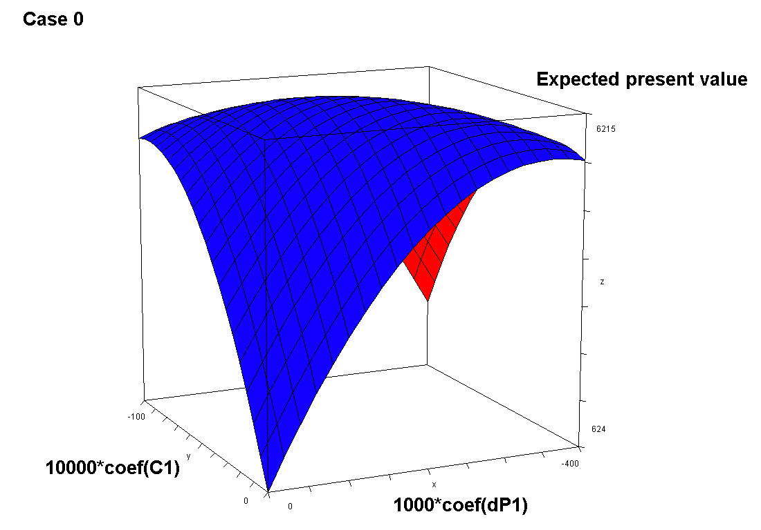
Influence
of local
competition
levels
on instant
harvesting
decisions
Influence of price deviations
from expected price levels on
instant harvesting decisions

Slide 59
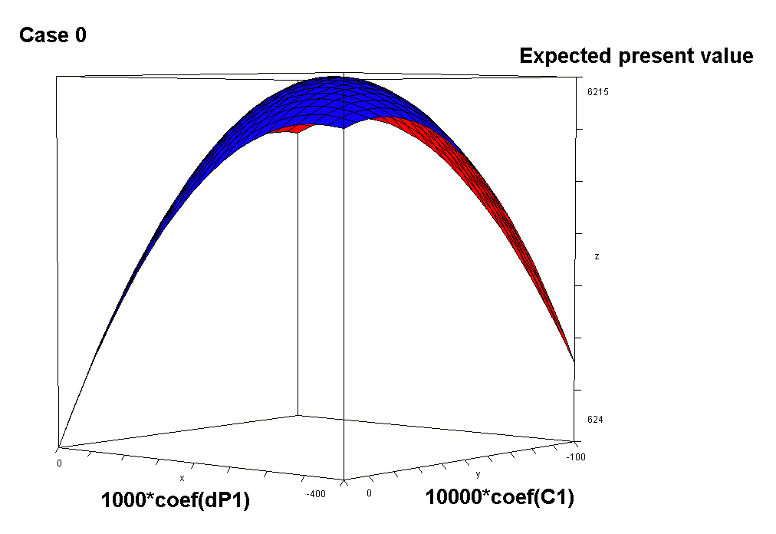

Slide 60
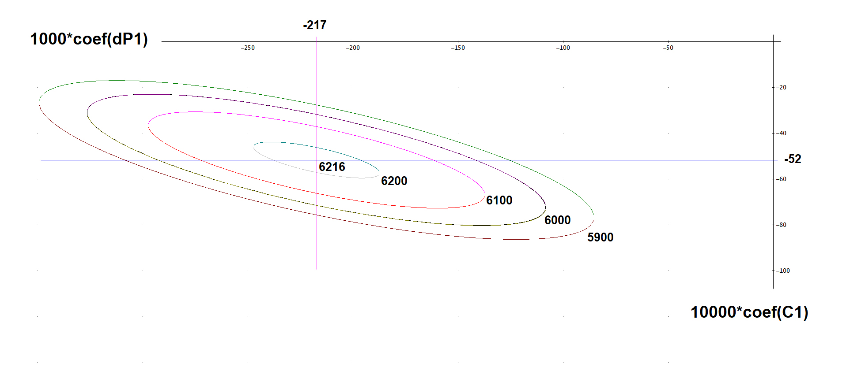
Influence of deviations from expected price levels on instant harvesting decisions
Influence of local competition levels
on instant harvesting decisions

Slide 61
! Case 0_EQDIST_190108_1337;
! Peter Lohmander;
model:
max = EPV;
EPV =
- 2051.273
- 27.225 * Dp1
- 16.391 * Dp2
- 101.964 * Dc1
- 42.856 * Dc2
- 0.037895 * Dp1 * Dp1
- 0.027998 * Dp2 * Dp2
- 0.54902 * Dc1 * Dc1
- 0.22906 * Dc2 * Dc2
- 0.20816 * Dp1 * Dc1
- 0.10549 * Dp2 * Dc2 ;
@free(Dp1);
@free(Dp2);
@free(Dc1);
@free(Dc2);
end
Case 0
Variable Value
EPV 6216.348
DP1 -217.3312
DP2 -205.7293
DC1 -51.65963
DC2 -46.17485

Slide 62
The analytical method gave
the same answer:
The analytical method also told us
that the solution is a unique maximum.

Slide 63
Case 1
! Case 1_r is low_190108_1353;
! Peter Lohmander;
model:
max = EPV;
EPV =
- 3574.468
- 99.493 * Dp1
- 50.839 * Dp2
- 337.550 * Dc1
- 101.691 * Dc2
- 0.160029 * Dp1 * Dp1
- 0.101269 * Dp2 * Dp2
- 2.031223 * Dc1 * Dc1
- 0.620501 * Dc2 * Dc2
- 0.728027 * Dp1 * Dc1
- 0.312201 * Dp2 * Dc2 ;
@free(Dp1);
@free(Dp2);
@free(Dc1);
@free(Dc2);
end
(r = low)
Variable Value
EPV 21199.22
DP1 -205.7134
DP2 -203.6856
DC1 -46.22464
DC2 -30.70111

Slide 64
! Case 2 EP1 is high_EQDIST_190108_1408;
! Peter Lohmander;
model:
max = EPV;
EPV =
- 3642.062
- 42.369 * Dp1
- 17.333 * Dp2
- 173.652 * Dc1
- 46.919 * Dc2
- 0.053983 * Dp1 * Dp1
- 0.029167 * Dp2 * Dp2
- 0.82857 * Dc1 * Dc1
- 0.25043 * Dc2 * Dc2
- 0.35320 * Dp1 * Dc1
- 0.11113 * Dp2 * Dc2 ;
@free(Dp1);
@free(Dp2);
@free(Dc1);
@free(Dc2);
end
Case 2
(EP1 = high)
Variable Value
EPV 8804.599
DP1 -163.8983
DP2 -205.5634
DC1 -69.85717
DC2 -48.06680

Slide 65
Case 3
! Case 3 Stdev1 is high_EQDIST_190108_1424;
! Peter Lohmander;
model:
max = EPV;
EPV =
- 3237.805
- 43.987 * Dp1
- 17.701 * Dp2
- 154.515 * Dc1
- 43.824 * Dc2
- 0.061536 * Dp1 * Dp1
- 0.030704 * Dp2 * Dp2
- 0.80352 * Dc1 * Dc1
- 0.22485 * Dc2 * Dc2
- 0.33677 * Dp1 * Dc1
- 0.10945 * Dp2 * Dc2 ;
@free(Dp1);
@free(Dp2);
@free(Dc1);
@free(Dc2);
end
(Stdev1 = high)
Variable Value
EPV 8320.552
DP1 -221.0902
DP2 -202.3298
DC1 -49.81733
DC2 -48.20771

Slide 66
The optimal control of the forest

Slide 67
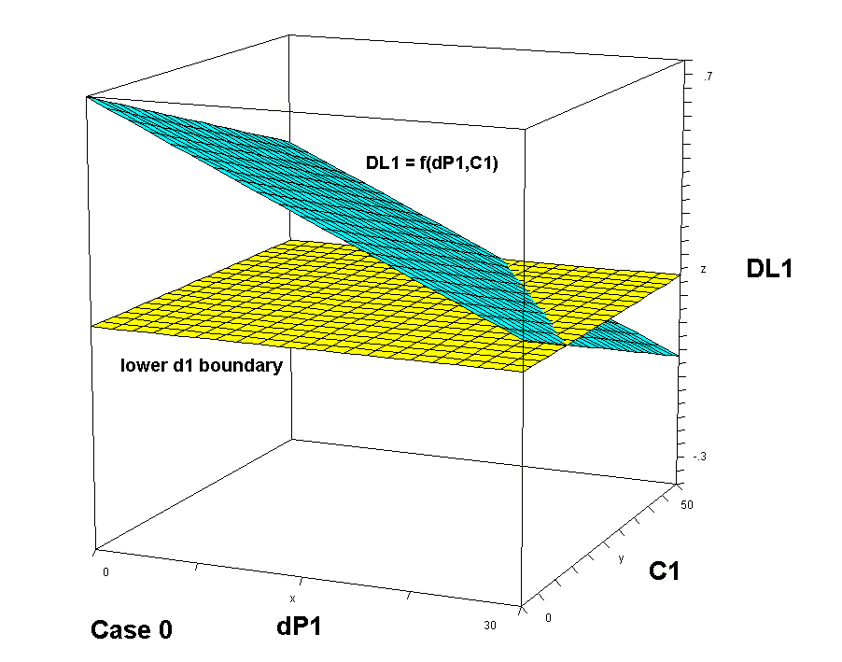
OPTIMAL CONTROL:
(of trees of species 1)
Instant Harvest
Region
Wait Longer
Region
Deviation of the price of species 1
from the expected price level
Local competition level
Case 0

Slide 68
= Optimal Limit Diameter of Species 1
Optimal
Control
Boundaries
as
functions of
the local
competition
levels
Instant Harvest
Region
Wait Longer
Region
Deviation of the price of species 1 from the expected price level

Slide 69
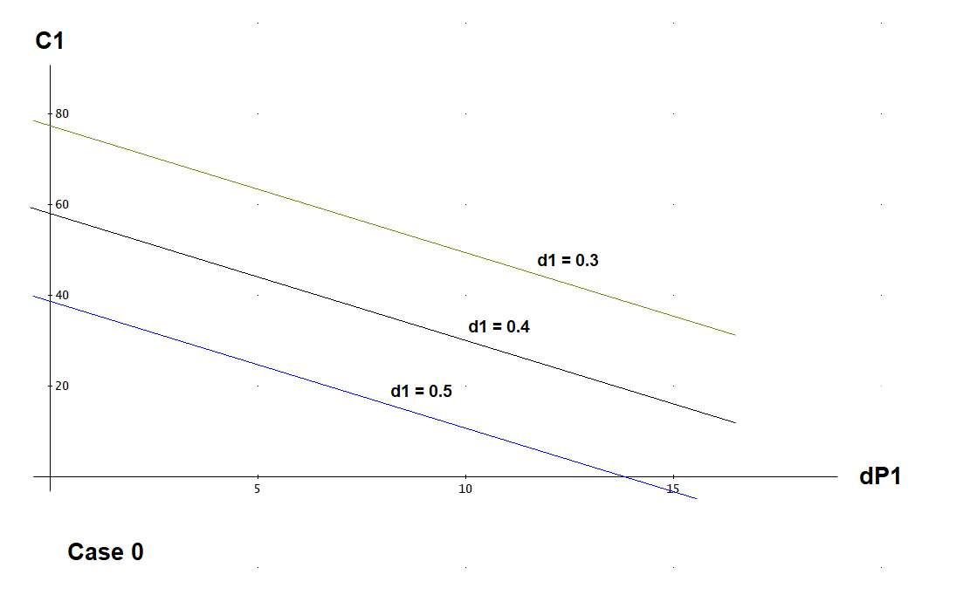
= Local competition level
Optimal
Control
Boundaries
as
functions of
the diameters
of the
individual
trees
Instant Harvest
Region
Wait Longer
Region
Deviation of the price of species 1 from the expected price level

Slide 70
Optimal changes of forest control decisions if these parameters change:
- the rate of interest,
- the expected prices,
- the degrees of stochastic price variations

Slide 71
Case 1 (r = low)
The real rate of interest, r, decreases from 3% to 1%.

Slide 72
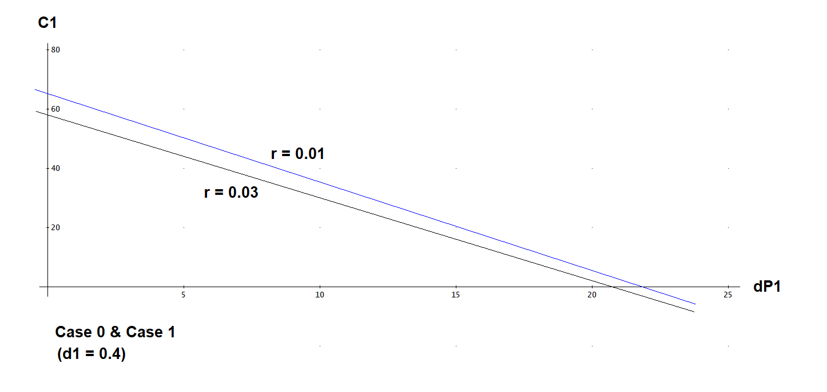
The optimal control boundary shifts to North East.

Slide 73
Case 1 (r = low)
The real rate of interest, r, decreases from 3% to 1%.
The optimal control boundary shifts to North East.
To motivate instant harvesting, the level of competition and/or the price has to be higher than before the change.
The expected size of the trees (when they are harvested) is larger with a low rate of interest.
The expected present value is 3.41 times higher than if r = 0.03.

Slide 74
Case 2 (EP1 = high)
The expected price of species 1 increases by 40% (from 50 to 70).

Slide 75
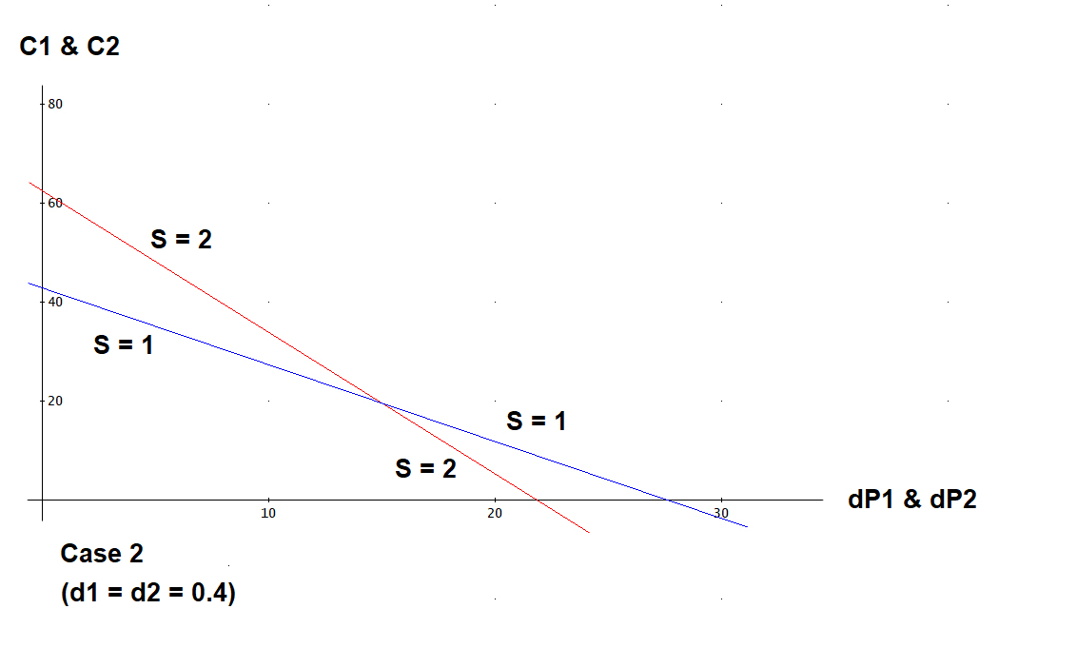
The optimal control boundary of
species 1 is rotated to the left.

Slide 76
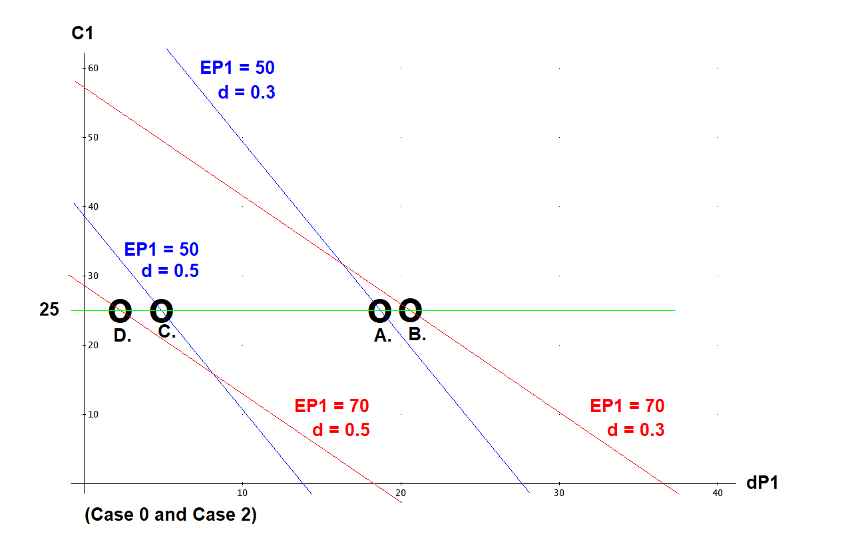

Slide 77
Consider a small tree (d = 0.3).
Assume that the expected price of that species, EP1, increases (from 50 to 70).
Consider normal competition C1 = 25.
The dP1 needed to motivate instant harvesting increases (from A. to B.).
Hence, the probability of instant harvesting of the small tree decreases.

Slide 78
Consider a large tree (d = 0.5).
Assume that the expected price of that species, EP1, increases (from 50 to 70).
Consider normal competition C1 = 25.
The dP1 needed to motivate instant harvesting decreases (from C. to D.).
Hence, the probability of instant harvesting of the large tree increases.

Slide 79
If the expected price of one species increases (and the absolute standard deviation of the price is not changed), it is less likely that it is optimal to harvest trees of that species when they are still small.
The probability that a small tree (d = 0.3)
should be harvested decreases if the expected
price of that species increases.

Slide 80
If the expected price of one species increases (and the absolute standard deviation of the price is not changed), it is more likely that it is optimal to harvest trees of that species when they have reached some optimal size. Stochastic market price changes influence the optimal harvesting less.
The probability that a small tree (d = 0.3)
should be harvested decreases if the expected
price of that species increases.

Slide 81
Case 2 (EP1 = high)
The expected price of species 1 increases by 40% (from 50 to 70).
The optimal control boundary of species 1 is rotated to the left.
If the expected price of one species increases (and the absolute standard deviation of the price is not changed), it is less likely that it is optimal to harvest trees of that species when they are still small.
If the expected price of one species increases (and the absolute standard deviation of the price is not changed), it is more likely that it is optimal to harvest trees of that species when they have reached some optimal size. Stochastic market price changes influence the optimal harvesting less.
The expected present value is 1.42 times higher than before.

Slide 82
Case 3 (Stdev1 = high)
The standard deviation of the price of species 1 increases by 100% (from 15 to 30).

Slide 83
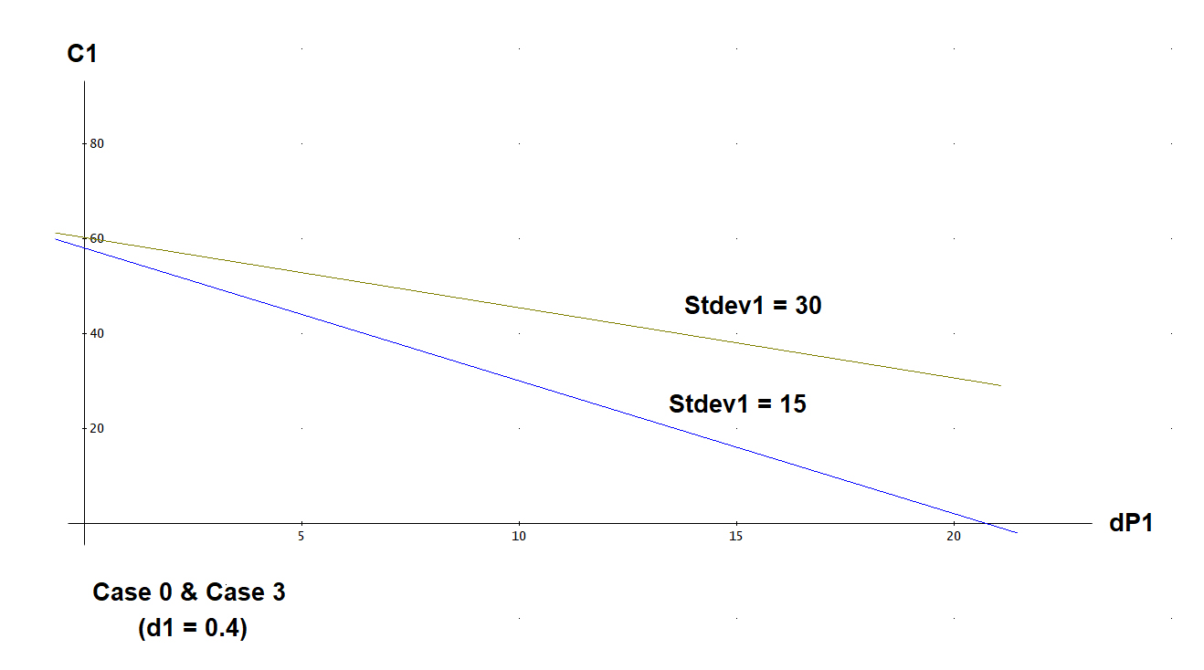
The optimal control boundary of
species 1 shifts to North East.

Slide 84
Case 3 (Stdev1 = high)
The standard deviation of the price of species 1 increases by 100% (from 15 to 30).
The optimal control boundary of species 1 shifts to North East.
If harvesting of a tree of species 1 should be optimal, the price has to be higher than before. This is reasonable since the probabilities of high prices are higher than before and we want to harvest when prices are high. Hence, we should request a higher price in order to harvest. Otherwise we can wait longer for a good price.
The expected present value is 1.34 times higher than before.

Slide 85
CONCLUSIONS

Slide 86
Optimization of Multi Species Continuous Cover Forest Management with Stochastic Prices via Determination of the Adaptive Harvest Control Function
Peter Lohmander
18th Symposium on Systems Analysis in Forest Resources, SSAFR March 3 - 7, 2019 Puerto Varas, Chile
The Limit Diameter ( = DL) is a function of the tree species.
Furthermore, if the rate of interest in the capital market increases, the DL decreases.
The DL is also a decreasing function of the stochastic deviations of the price from the expected values
and a decreasing function of the local competition from neighbour trees.

Slide 87
Optimization of Multi Species Continuous Cover Forest Management with Stochastic Prices via Determination of the Adaptive Harvest Control Function
Peter Lohmander
18th Symposium on Systems Analysis in Forest Resources, SSAFR March 3 - 7, 2019 Puerto Varas, Chile
A particular tree should be harvested also at a smaller diameter than otherwise
in case it belongs to a species with lower value of the species parameter in the DL,
in case the rate of interest increases,
if the market price of wood from the particular species unexpectedly increases and/or
if the local competition from neighbour trees increases.

Slide 88
Optimization of Multi Species Continuous Cover Forest Management with Stochastic Prices via Determination of the Adaptive Harvest Control Function
Peter Lohmander
18th Symposium on Systems Analysis in Forest Resources, SSAFR March 3 - 7, 2019 Puerto Varas, Chile
The expected present value of an optimally managed mixed species continuous cover forest is
a decreasing function of the rate of interest in the capital market,
an increasing function of the expected price levels of different species,
an increasing function of the degree of market price variation

Slide 89
APPENDIX:
THE SOFTWARE

Slide 90
REM AdMultRnd1_EQDIST.bas
REM Peter Lohmander 190107_1720
REM
DIM x(100), y(100), d(100), ba(100), dist(100, 100), d0(100), harv(100)
DIM height(100), vol(100), revenue(100), cost(100), species(100), qual(100)
DIM MarketP(100, 2, 100), Comp(100), Volperha(2), PresVal(100)
DIM dmin(2), kheight(2), EP(2), stdev(2), CompBA(100)
PI = 3.141593
OPEN "AdmultRndIn.txt" FOR INPUT AS #2
OPEN "AdMultRndOut.txt" FOR OUTPUT AS #1
REM SCREEN 12
SCREEN _NEWIMAGE(1800, 800, 12)
COLOR 1, 15

Slide 91
REM ***************************************************************************
REM SECTION 0. Parameter inputs from external file and parameter documentation.
REM ***************************************************************************
INPUT #2, r
INPUT #2, pcorr
INPUT #2, EP(1)
INPUT #2, EP(2)
INPUT #2, stdev(1)
INPUT #2, stdev(2)
INPUT #2, kheight(1)
INPUT #2, kheight(2)
INPUT #2, dmin(1)
INPUT #2, dmin(2)
INPUT #2, D0start
INPUT #2, D0stop
INPUT #2, D0step
INPUT #2, Dpstart
INPUT #2, Dpstop
INPUT #2, Dpstep
INPUT #2, Dcstart
INPUT #2, Dcstop
INPUT #2, Dcstep
INPUT #2, Dsstart
INPUT #2, Dsstop
INPUT #2, Dsstep
INPUT #2, TOTSIMN
INPUT #2, seed2

Slide 92
PRINT " Program AdMultRnd_EQDIST by Peter Lohmander 2019:"
PRINT #1, " Program AdMultRnd_EQDIST by Peter Lohmander 2019:"
PRINT " Parameters from external file: "
PRINT " r = "; r; " pcorr = "; pcorr; " EP(1) = "; EP(1); " EP(2) = "; EP(2)
PRINT " stdev(1) = "; stdev(1); " stdev(2) = "; stdev(2); " kheight(1) = "; kheight(1); " kheight(2) = "; kheight(2)
PRINT " dmin(1) = "; dmin(1); " dmin(2) = "; dmin(2)
PRINT " D0start = "; D0start; " D0stop = "; D0stop; " D0step = "; D0step
PRINT " Dpstart = "; Dpstart; " Dpstop = "; Dpstop; " Dpstep = "; Dpstep
PRINT " Dcstart = "; Dcstart; " Dcstop = "; Dcstop; " Dcstep = "; Dcstep
PRINT " Dsstart = "; Dsstart; " Dsstop = "; Dsstop; " Dsstep = "; Dsstep
PRINT " TOTSIMN = "; TOTSIMN
PRINT " seed2 = "; seed2

Slide 93
PRINT #1, " Parameters from external file: "
PRINT #1, " r = "; r; " pcorr = "; pcorr; " EP(1) = "; EP(1); " EP(2) = "; EP(2)
PRINT #1, " stdev(1) = "; stdev(1); " stdev(2) = "; stdev(2); " kheight(1) = "; kheight(1); " kheight(2) = "; kheight(2)
PRINT #1, " dmin(1) = "; dmin(1); " dmin(2) = "; dmin(2)
PRINT #1, " D0start = "; D0start; " D0stop = "; D0stop; " D0step = "; D0step
PRINT #1, " Dpstart = "; Dpstart; " Dpstop = "; Dpstop; " Dpstep = "; Dpstep
PRINT #1, " Dcstart = "; Dcstart; " Dcstop = "; Dcstop; " Dcstep = "; Dcstep
PRINT #1, " Dsstart = "; Dsstart; " Dsstop = "; Dsstop; " Dsstep = "; Dsstep
PRINT #1, " TOTSIMN = "; TOTSIMN
PRINT #1, " seed2 = "; seed2

Slide 94
drawmaps = 0
INPUT "Draw maps? Then write 1, otherwise 0", drawmaps
IF drawmaps = 0 THEN PRINT " "
IF drawmaps = 0 THEN PRINT " D0 Dp1 Dp2 Dc1 Dc2 Ds r EPV"
PRINT #1, " "
PRINT #1, " D0 Dp1 Dp2 Dc1 Dc2 Ds r EPV"
REM *****************
REM End of SECTION 0.
REM *****************

Slide 95
RANDOMIZE 5
REM **********************************************************************************
REM SECTION A. The initial conditions of relevance to all calculations are determined.
REM **********************************************************************************
REM Generation of 100 market prices series for two species with correlation pcorr.
FOR series = 1 TO 100
pcorr = 0.5
FOR T = 0 TO 100
FOR i = 1 TO 2
epsilon = 0
FOR ii = 1 TO 12
epsilon = epsilon + RND
NEXT ii
epsilon = (epsilon - 6)
IF i = 1 THEN randn1 = epsilon
IF i = 2 THEN randn2 = epsilon
IF i = 2 THEN randn3 = pcorr * randn1 + (1 - pcorr ^ 2) ^ .5 * randn2
NEXT i
MarketP(T, 1, series) = EP(1) + stdev(1) * randn1
MarketP(T, 2, series) = EP(2) + stdev(2) * randn3
NEXT T
NEXT series
PRINT ""

Slide 96
REM Generation of the positions
FOR i = 1 TO 100
x(i) = 30 * RND
y(i) = 30 * RND
NEXT i
PRINT ""
REM Generation of the species
FOR i = 1 TO 100
species(i) = 1
IF RND > 0.5 THEN species(i) = 2
NEXT i

Slide 97
REM Calculation of the distances
FOR i = 1 TO 100
FOR j = 1 TO 100
distx = x(i) - x(j)
disty = y(i) - y(j)
dist(i, j) = (distx * distx + disty * disty) ^ 0.5
NEXT j
NEXT i

Slide 98
REM Generation of initial diameters
FOR i = 1 TO 100
REM Note that in this version of the code, the initial distributions
REM of the two species are identical. (Compare next row.)
IF species(i) > 0.5 THEN GOTO 1010
1001 REM New diameter suggestion
dia = 0.1 + RND * 0.4
freq = 1 - (2 * dia) ^ 2
test = RND
IF test > freq THEN GOTO 1001
d0(i) = dia
GOTO 1020
1010 REM

Slide 99
1011 REM New diameter suggestion
dia = 0.1 + RND * 0.3
freq = 1 - (2.5 * dia) ^ 2
test = RND
IF test > freq THEN GOTO 1011
d0(i) = dia
1020 REM
NEXT i
REM *****************
REM End of SECTION A.
REM *****************

Slide 100
REM ***********************************************************
REM SECTION B. The control function parameter loops start here.
REM ***********************************************************
EPVmax = 0
RANDOMIZE seed2
FOR SIMN = 1 TO TOTSIMN
Ds = Dsstart + RND * (Dsstop - Dsstart)
D0 = D0start + RND * (D0stop - D0start)
Dp1 = Dpstart + RND * (Dpstop - Dpstart)
Dp2 = Dpstart + RND * (Dpstop - Dpstart)
Dc1 = Dcstart + RND * (Dcstop - Dcstart)
Dc2 = Dcstart + RND * (Dcstop - Dcstart)

Slide 101
REM *******************************************************************
REM SECTION C. A number of loops of stochastic simulations start here.
REM *******************************************************************
FOR series = 1 TO 100
PresVal(series) = 0
REM PRINT "Series = "; series
REM A new simulation is started from year 0
FOR i = 1 TO 100
d(i) = d0(i)
NEXT i

Slide 102
FOR T = 0 TO 60
MarketP1 = MarketP(T, 1, series)
MarketP2 = MarketP(T, 2, series)
year = T * 5
discf = EXP(-year * r)
IF drawmaps = 0 THEN GOTO 600
CLS
PRINT " Series = "; series; " Period = "; T; " Year = "; year; " P1 = "; MarketP1; " P2 = "; MarketP2
PRINT " Map before growth and before harvest: "

Slide 103
FOR i = 1 TO 100
FOR interior = 0.05 TO 1 STEP 0.05
CIRCLE (INT(20 * x(i) + 100), INT(20 * y(i) + 100)), INT(100 * d(i) * interior / 5), species(i)
NEXT interior
NEXT i
LINE (100, 100)-(700, 100), 3
LINE (100, 100)-(100, 700), 3
LINE (700, 100)-(700, 700), 3
LINE (100, 700)-(700, 700), 3
SLEEP
600 REM
REM growth occurs
FOR speci = 1 TO 2
Volperha(speci) = 0
NEXT speci

Slide 104
FOR i = 1 TO 100
Comp(i) = 0
FOR j = 1 TO 100
IF dist(i, j) < 5 THEN Comp(i) = Comp(i) + PI / 4 * d(j) * d(j)
NEXT j
CompBA(i) = 127.32 * Comp(i)
Compadjust = (1 - 0.02 * CompBA(i))
IF Compadjust < 0 THEN Compadjust = 0
d(i) = d(i) + 0.1 * (1 - 0.5 * d(i)) * Compadjust
speci = species(i)
ba(i) = PI / 4 * d(i) * d(i)
height(i) = kheight(speci) * d(i)
vol(i) = 0.5 * ba(i) * height(i)
Volperha(speci) = Volperha(speci) + vol(i) / 0.09
NEXT i

Slide 105
IF drawmaps = 0 THEN GOTO 601
CLS
PRINT " Series = "; series; " Period = "; T; " Year = "; year; " P1 = "; MarketP1; " P2 = "; MarketP2
PRINT " Map after growth and before harvest: "
FOR i = 1 TO 100
FOR interior = 0.05 TO 1 STEP 0.05
CIRCLE (INT(20 * x(i) + 100), INT(20 * y(i) + 100)), INT(100 * d(i) * interior / 5), species(i)
NEXT interior
NEXT i
LINE (100, 100)-(700, 100), 3
LINE (100, 100)-(100, 700), 3
LINE (700, 100)-(700, 700), 3
LINE (100, 700)-(700, 700), 3
SLEEP
601 REM

Slide 106
REM Harvests of individual trees may or may not occur
Totvolperha = Volperha(1) + Volperha(2)
FOR i = 1 TO 100
speci = species(i)
Price = MarketP(T, speci, series)
meanprice = EP(speci)
Dp = Dp1
IF speci > 1.5 THEN Dp = Dp2
Dc = Dc1
IF speci > 1.5 THEN Dc = Dc2
REM The harvest decision of tree i is set to zero. Then the limit diameter is calculated.
REM In case the tree diameter exceeds the limit diameter, the harvest decision is set to one.
harv(i) = 0
Dlim = D0 + Dp * (Price - meanprice) / stdev(speci) + Ds * (speci - 1) + Dc * CompBA(i)
IF d(i) > Dlim THEN harv(i) = 1
IF d(i) < dmin(speci) THEN harv(i) = 0

Slide 107
REM The revenues and costs of the harvested trees are calculated.
psizecorr = -0.25 + 2.5 * d(i)
IF psizecorr > 1 THEN psizecorr = 1
IF psizecorr < 0 THEN psizecorr = 0
revenue(i) = Price * psizecorr * vol(i) * harv(i)
costperm3 = 125 - 250 * d(i)
IF costperm3 < 25 THEN costperm3 = 25
cost(i) = costperm3 * vol(i) * harv(i)
IF revenue(i) < cost(i) THEN harv(i) = 0
NEXT i

Slide 108
REM The discounted net revenue of all harvested trees is added to the present value of the series.
netrev = 0
FOR i = 1 TO 100
netrev = netrev + (revenue(i) - cost(i)) * harv(i)
NEXT i
PresVal(series) = PresVal(series) + discf * netrev

Slide 109
IF drawmaps = 0 THEN GOTO 602
CLS
PRINT " Series = "; series; " Period = "; T; " Year = "; year; " P1 = "; MarketP1; " P2 = "; MarketP2
PRINT " Map of harvested trees: "
FOR i = 1 TO 100
IF harv(i) = 0 THEN GOTO 7070
FOR interior = 0.05 TO 1 STEP 0.05
CIRCLE (INT(20 * x(i) + 100), INT(20 * y(i) + 100)), INT(100 * d(i) * interior / 5), species(i)
NEXT interior
7070 REM
NEXT i
LINE (100, 100)-(700, 100), 3
LINE (100, 100)-(100, 700), 3
LINE (700, 100)-(700, 700), 3
LINE (100, 700)-(700, 700), 3
SLEEP
602 REM

Slide 110
FOR i = 1 TO 100
IF harv(i) = 1 THEN d(i) = 0.05
NEXT i
IF drawmaps = 0 THEN GOTO 603
CLS
PRINT " Series = "; series; " Period = "; T; " Year = "; year; " P1 = "; MarketP1; " P2 = "; MarketP2
PRINT " Map after harvest: "
FOR i = 1 TO 100
FOR interior = 0.05 TO 1 STEP 0.05
CIRCLE (INT(20 * x(i) + 100), INT(20 * y(i) + 100)), INT(100 * d(i) * interior / 5), species(i)
NEXT interior
NEXT i
LINE (100, 100)-(700, 100), 3
LINE (100, 100)-(100, 700), 3
LINE (700, 100)-(700, 700), 3
LINE (100, 700)-(700, 700), 3
SLEEP
603 REM

Slide 111
NEXT T
NEXT series
REM *****************
REM End of SECTION C.
REM *****************

Slide 112
REM *************************************************************************************
REM SECTION D. Results for each control function parameter combination are calculated and printed.
REM *************************************************************************************
EPV = 0
FOR series = 1 TO 100
EPV = EPV + PresVal(series) / 100
NEXT series
REM Calculation of EPV per ha
EPV = EPV / 0.09
IF EPV < EPVmax THEN GOTO 900
D0opt = D0
Dp1opt = Dp1
Dp2opt = Dp2
Dc1opt = Dc1
Dc2opt = Dc2
Dsopt = Ds
EPVmax = EPV
900 REM

Slide 113
kD0 = D0 * 1000
kDp1 = Dp1 * 1000
kDp2 = Dp2 * 1000
kDc1 = Dc1 * 10000
kDc2 = Dc2 * 10000
kDs = Ds * 1000
kr = r * 1000
kEPV = EPV * 1000
PRINT USING "##############"; kD0; kDp1; kDp2; kDc1; kDc2; kDs; kr; kEPV
PRINT #1, USING "##############"; kD0; kDp1; kDp2; kDc1; kDc2; kDs; kr; kEPV
REM *****************
REM End of SECTION D.
REM *****************
NEXT SIMN

Slide 114
kD0opt = D0opt * 1000
kDp1opt = Dp1opt * 1000
kDp2opt = Dp2opt * 1000
kDc1opt = Dc1opt * 10000
kDc2opt = Dc2opt * 10000
kDsopt = Dsopt * 1000
kEPVmax = EPVmax * 1000
PRINT ""
PRINT " r = "; r
PRINT " The Optimal Solution is (Most values times 1000. Dc1 and Dc2: Values times 10000): "
PRINT " D0 Dp1 Dp2 Dc1 Dc2 Ds EPV"
PRINT USING "##############"; kD0opt; kDp1opt; kDp2opt; kDc1opt; kDc2opt; kDsopt; kEPVmax
PRINT "-------------------------------------------------------------------------------------------------"

Slide 115
PRINT #1, ""
PRINT #1, " r = "; r
PRINT #1, " The Optimal Solution is (Most values times 1000. Dc1 and Dc2: Values times 10000): "
PRINT #1, " D0 Dp1 Dp2 Dc1 Dc2 Ds EPV"
PRINT #1, USING "##############"; kD0opt; kDp1opt; kDp2opt; kDc1opt; kDc2opt; kDsopt; kEPVmax
PRINT #1, "------------------------------------------------------------------------------------------------"
REM *****************
REM End of SECTION B.
REM *****************
CLOSE #1
CLOSE #1
BEEP
END

Slide 116
.03
0.5
50
50
15
15
40
40
0.2
0.2
0.70
0.70
0.0
-0.30
-0.0
0.02
-0.010
0.0
0.0
0
0
0.02
300
1
EXAMPLE
Input file
(CASE 0)
AdMultRndIn.txt

Slide 117
EXAMPLE AdMultRndOut.txt
Output file
(CASE 0)
Program AdMultRnd_EQDIST by Peter Lohmander 2019:
Parameters from external file:
r = .03 pcorr = .5 EP(1) = 50 EP(2) = 50
stdev(1) = 15 stdev(2) = 15 kheight(1) = 40 kheight(2) = 40
dmin(1) = .2 dmin(2) = .2
D0start = .7 D0stop = .7 D0step = 0
Dpstart = -.3 Dpstop = 0 Dpstep = .02
Dcstart = -.01 Dcstop = 0 Dcstep = 0
Dsstart = 0 Dsstop = 0 Dsstep = .02
TOTSIMN = 300
seed2 = 1

Slide 118
Program AdMultRnd_EQDIST by Peter Lohmander 2019:
Parameters from external file:
r = .03 pcorr = .5 EP(1) = 50 EP(2) = 50
stdev(1) = 15 stdev(2) = 15 kheight(1) = 40 kheight(2) = 40
dmin(1) = .2 dmin(2) = .2
D0start = .7 D0stop = .7 D0step = 0
Dpstart = -.3 Dpstop = 0 Dpstep = .02
Dcstart = -.01 Dcstop = 0 Dcstep = 0
Dsstart = 0 Dsstop = 0 Dsstep = .02
TOTSIMN = 300
seed2 = 1
D0 Dp1 Dp2 Dc1 Dc2 Ds r EPV
700 -149 -113 -90 -40 0 30 5546176
700 -54 -133 -95 -59 0 30 5419922
700 -1 -49 -87 -74 0 30 5177052
700 -74 -139 -49 -45 0 30 5824453
700 -30 -5 -12 -81 0 30 1807685
Many more rows follow…

Slide 119
Optimization of Multi Species Continuous Cover Forest Management with Stochastic Prices via Determination of the Adaptive Harvest Control Function
Peter Lohmander
Prof.Dr. Optimal Solutions in cooperation with Linnaeus University
Peter@Lohmander.com , www.Lohmander.com
18th Symposium on Systems Analysis in Forest Resources,
SSAFR 2019
March 3 - 7, 2019 Puerto Varas, Chile

Slide 120
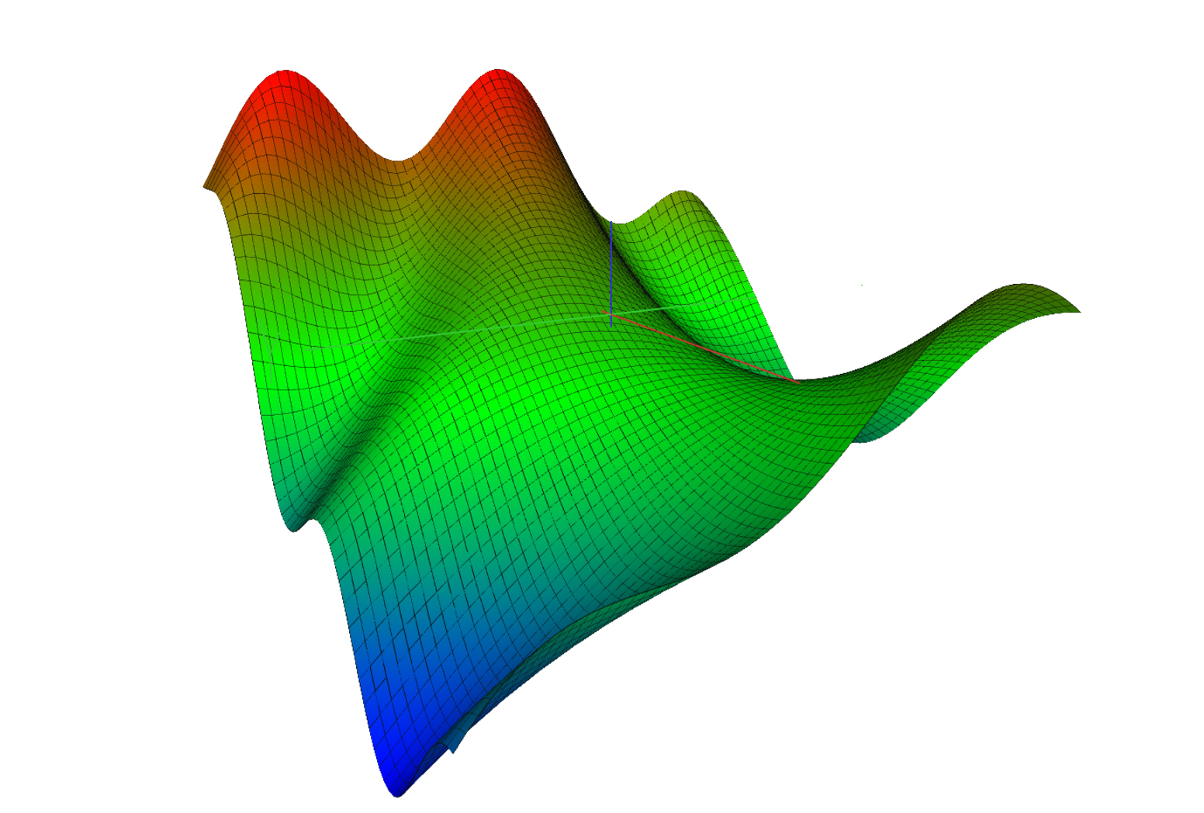
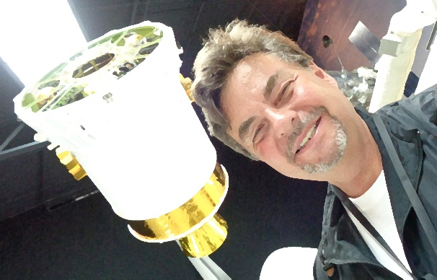


SSAFR 2019 Song: Methods in Math
Lyrics: Peter Lohmander
Melody: Dire Straits, Brothers in Arms
Inconsistent solutions
We know them by now,
But our background is science,
Where math is key,
Some day you'll return to
Derivations so pure,
You'll no longer risk
To be guessing and wrong
Through these fields of confusion,
Incompleteness and lies,
I've witnessed your suffering,
As the errors grow wild,
And though they did hurt us so bad
With solutions quite wrong,
You did not desert me
My methods in math
There's so many different plans
So many different trends
And there is just one solution,
Which is the optimal one
Now our science goes quite well
Our solutions ride high
Now we all know very well
Every lie has to die
But it's written in the starlight
And every line in your palm
Only fools can make war
On our methods in math
The Andes
http://www.lohmander.com/
Forests
of Chile
SSAFR 2019
in Puerto Varas
March 3-7
Pacific Ocean
Principle of Chile:
Yoni Schlesinger | Brothers in Arms (Dire Straits)
solo fingerstyle | B&G Little Sister
https://www.youtube.com/watch?v=7QEeQhMr33E

Slide 121
SSAFR song
by Peter Lohmander 2017-08-29
(Melody: Sancta Lucia)
Systems analysis,
in forest resources,
thats what our planet needs,
lets gather our forces,
to optimize management,
consider logistics,
do not forget the many animals,
climate and fires.

Slide 122
Faustmann song
by Peter Lohmander 1984-12-13
(Melody: Sancta Lucia)
Economic society,
deep in the forest,
we are all gathered here,
in the honor of Faustmann,
the whole world we represent,
and the gold that is green,
which we then transform to money,
in the optimal way.

