Slide 1
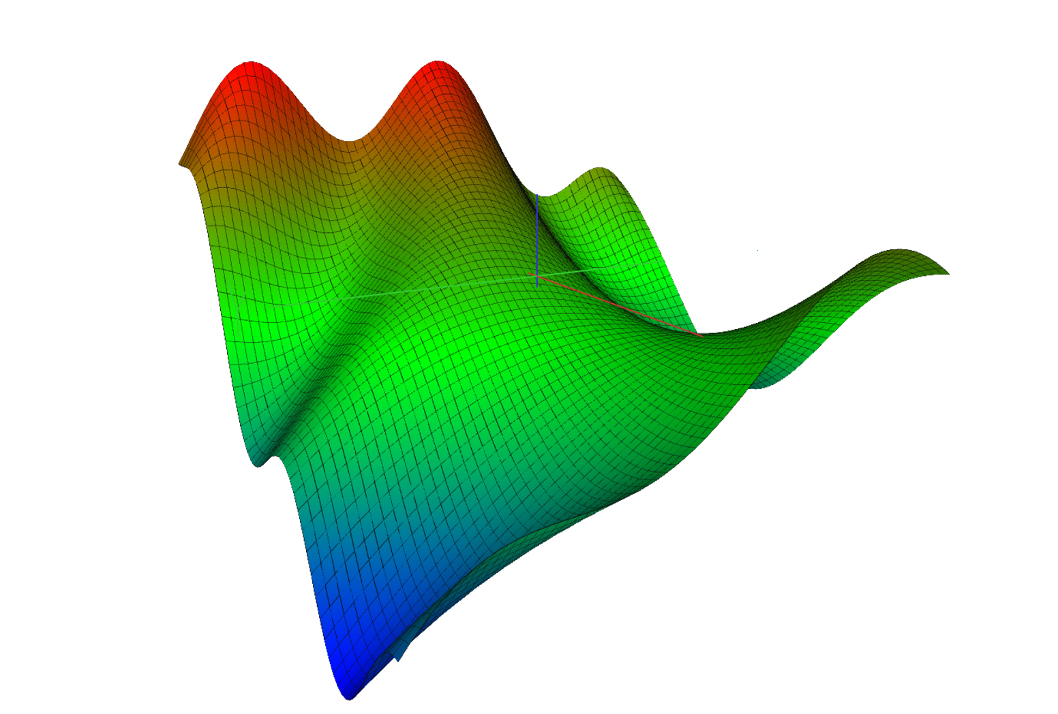
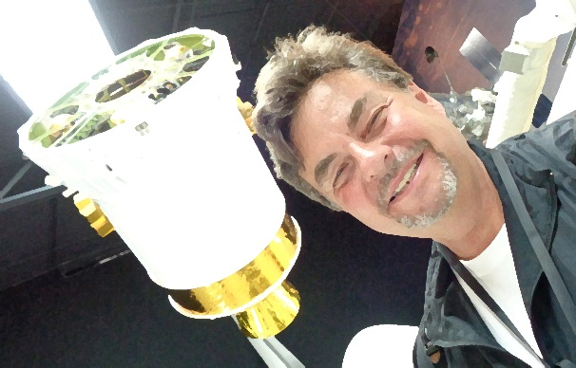


SSAFR 2019 Song: Methods in Math
Lyrics: Peter Lohmander
Melody: Dire Straits, Brothers in Arms
Inconsistent solutions
We know them by now,
But our background is science,
Where math is key,
Some day you'll return to
Derivations so pure,
You'll no longer risk
To be guessing and wrong
Through these fields of confusion,
Incompleteness and lies,
I've witnessed your suffering,
As the errors grow wild,
And though they did hurt us so bad
With solutions quite wrong,
You did not desert me
My methods in math
There's so many different plans
So many different trends
And there is just one solution,
Which is the optimal one
Now our science goes quite well
Our solutions ride high
Now we all know very well
Every lie has to die
But it's written in the starlight
And every line in your palm
Only fools can make war
On our methods in math
The Andes
http://www.lohmander.com/
Forests
of Chile
SSAFR 2019
in Puerto Varas
March 3-7
Pacific Ocean
Principle of Chile:
Yoni Schlesinger | Brothers in Arms (Dire Straits)
solo fingerstyle | B&G Little Sister
https://www.youtube.com/watch?v=7QEeQhMr33E

